Slide 1
Video conference Italy - france
29 th March 2019

Slide 2
Video Conference , Italy-france
Some days before we prepared the videoconference
with the French school.

Slide 3
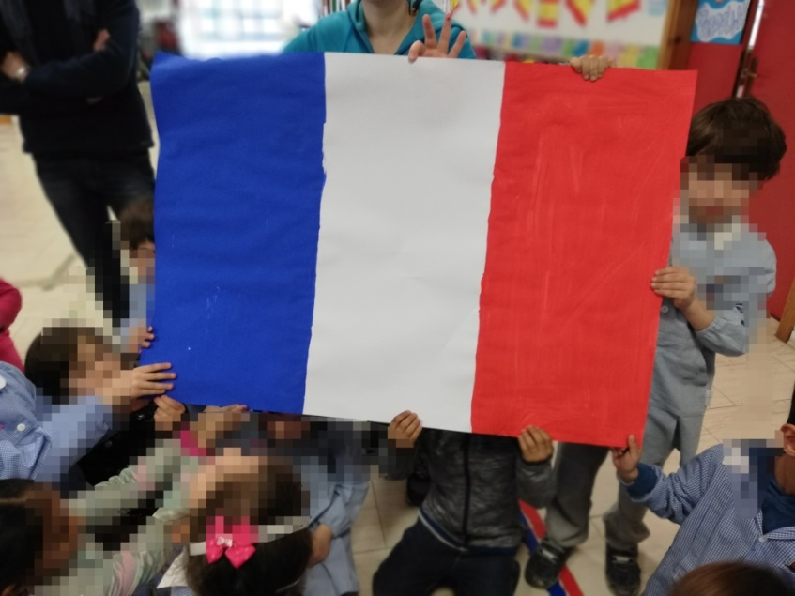
Video Conference , Italy-france
The French flag

Slide 4
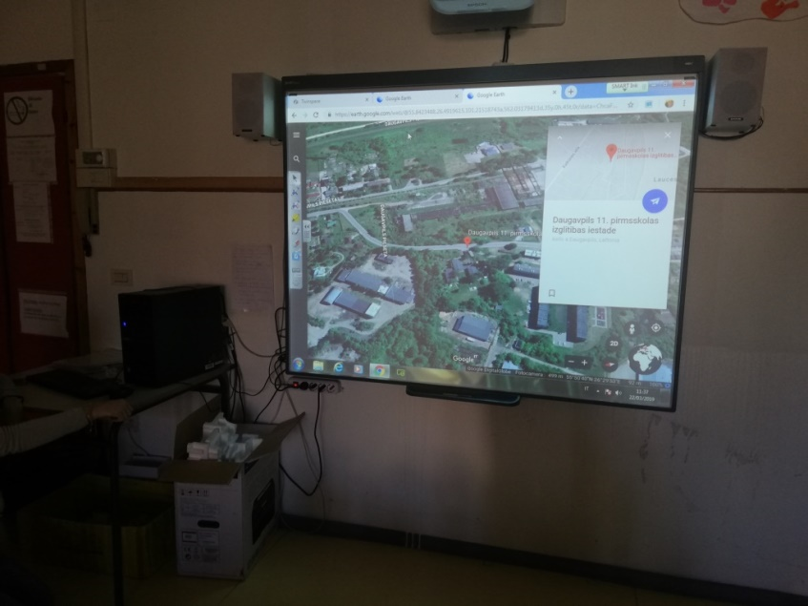
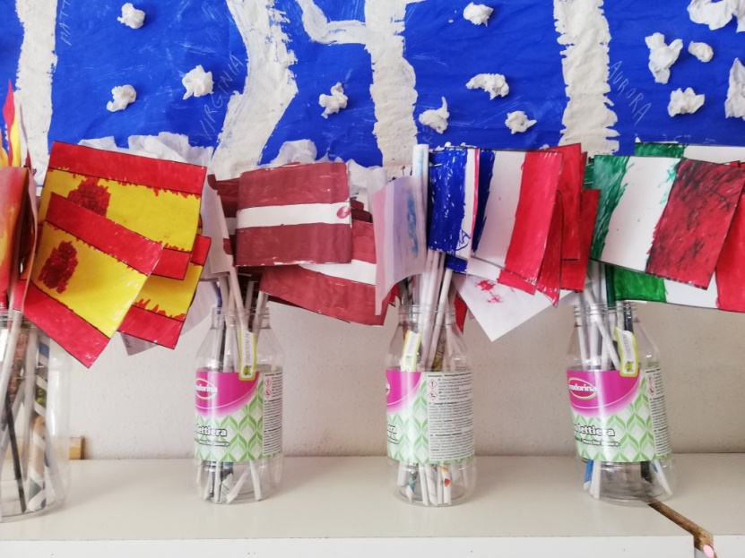
Video Conference , Italy-france
With Google Earth we gave a look to the school and the area

Slide 5
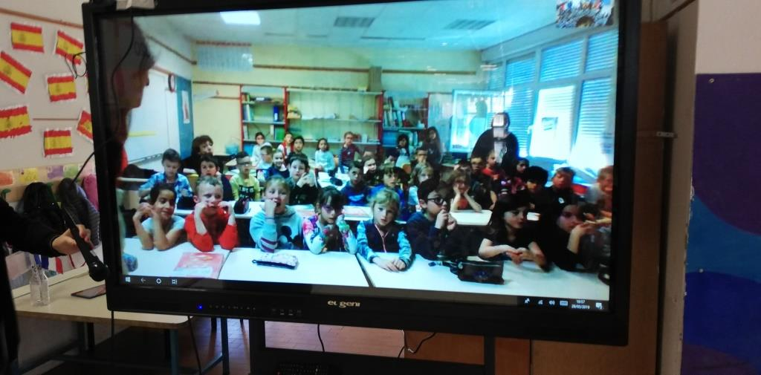
Video Conference , Italy-france
The day has arrived!
Some technical troubles…as usual… but then… here they are!
Our French friends!

Slide 6
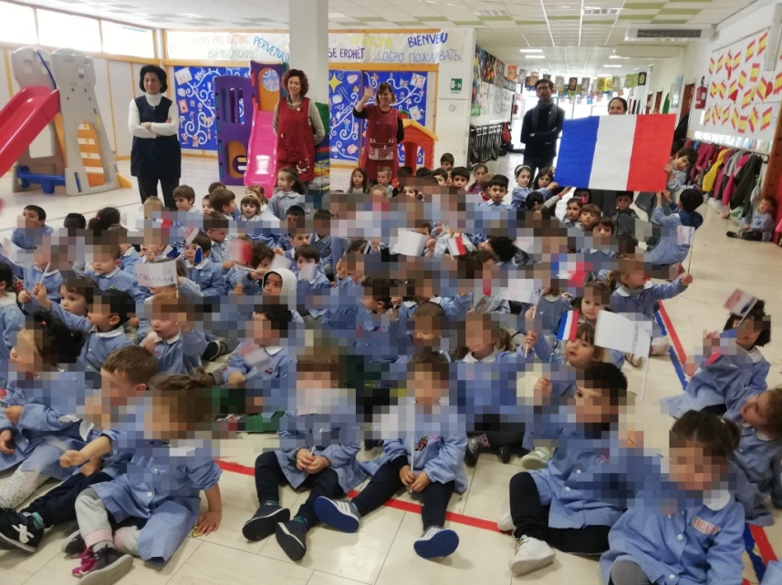
Video Conference , Italy-france
We watched our friend on the screen and we sang a song in French together! We are not very good but we are going to learn it soon!

Slide 7
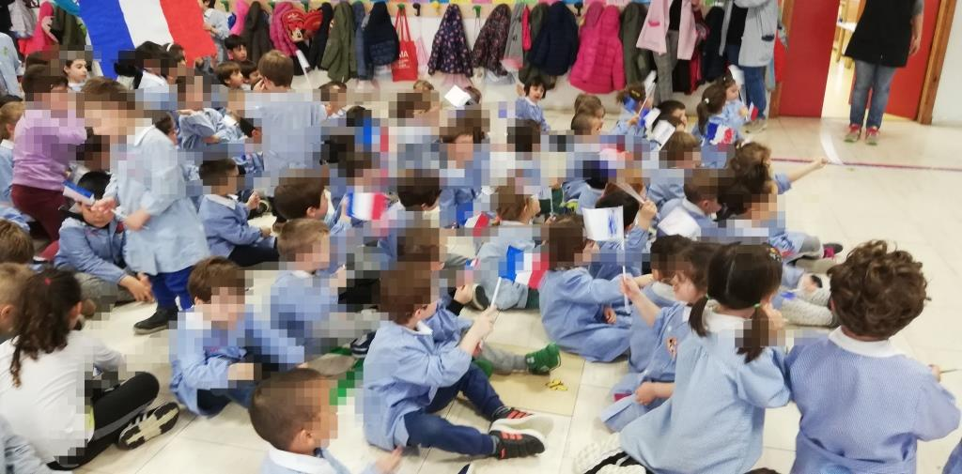
Video Conference , Italy-france
We hope to meet our French friends as soon as we can sing the French song!
https://www.youtube.com/watch?v=BRxYipJOl1A&feature=youtu.be

