Slide 1
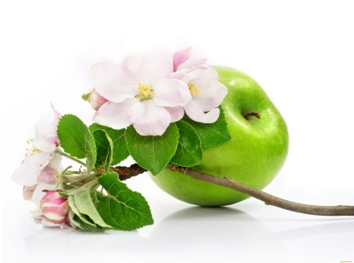
Preschool activities using Persona Doll methodology.
Prepared by: Daugavpils City Preschool Educational Institution No. 11 “Ābelīte” teachers
Ludmila Atrahimoviča
Gaļina Košlača

Slide 2
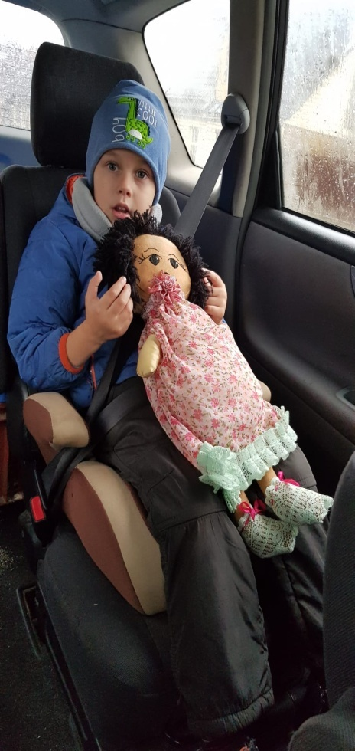
Meeting a new friend
EMMA
JĀNIS
LĪGA

Slide 3
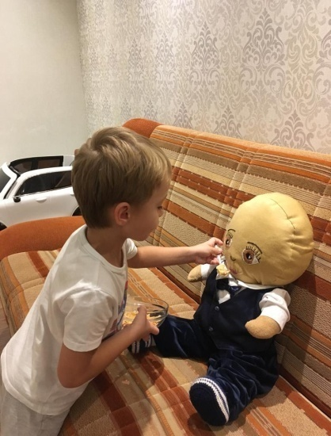
Being a good friend as part of everyday family life

Slide 4
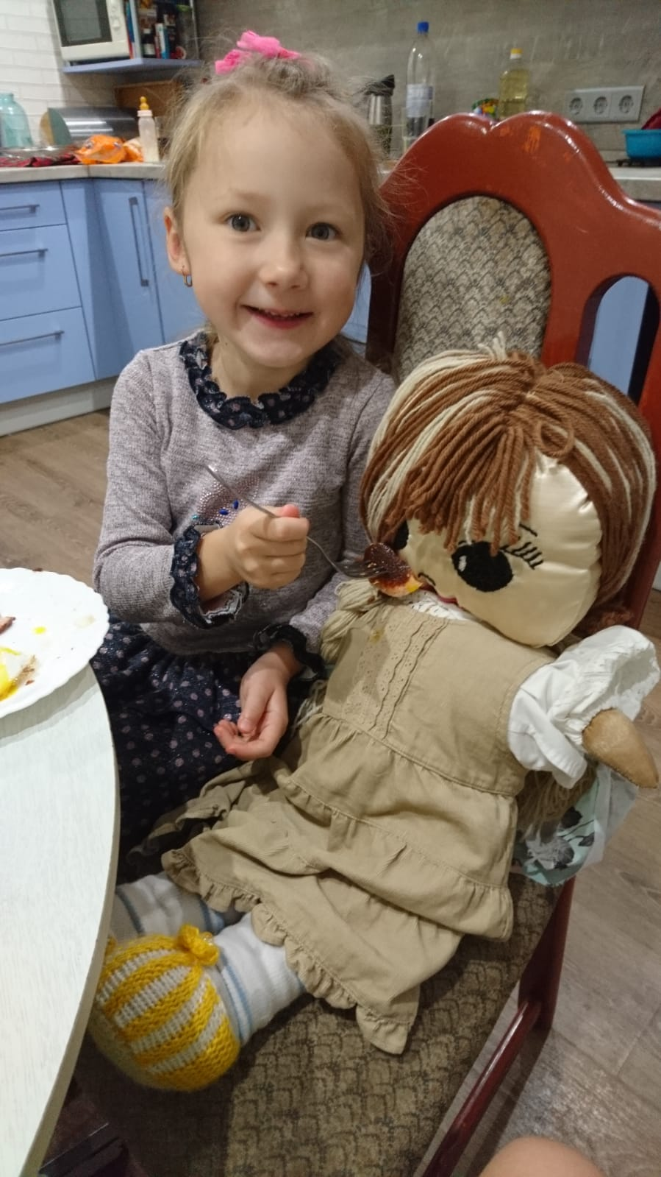
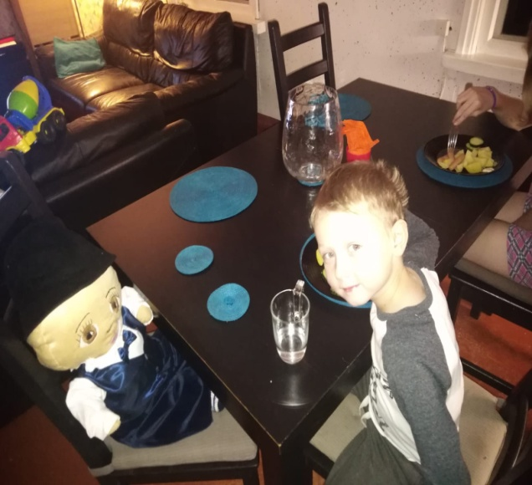
Being a good friend as part of everyday family life

Slide 5
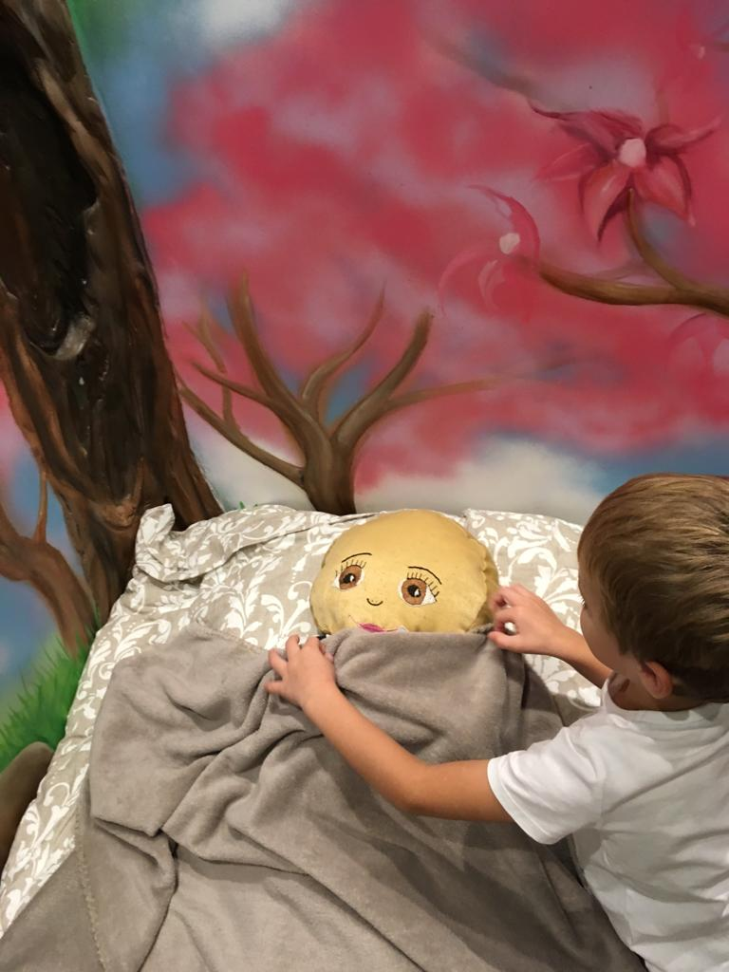
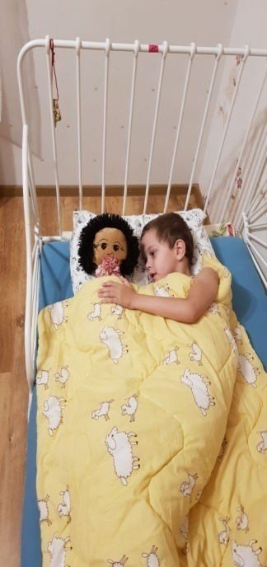
Being a good friend as part of everyday family life

Slide 6
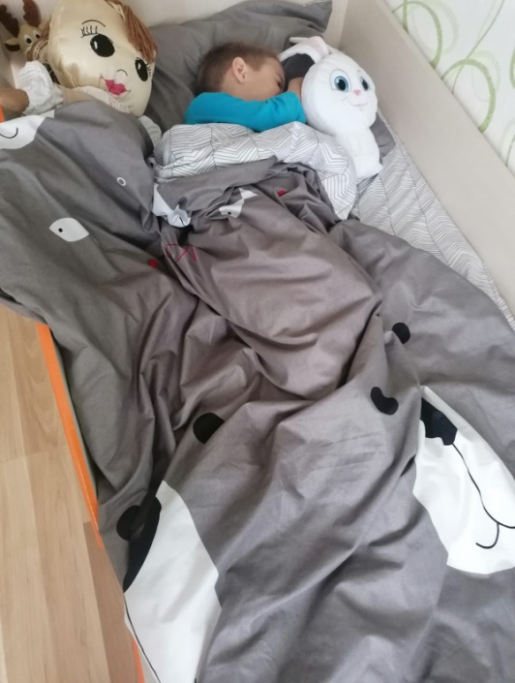
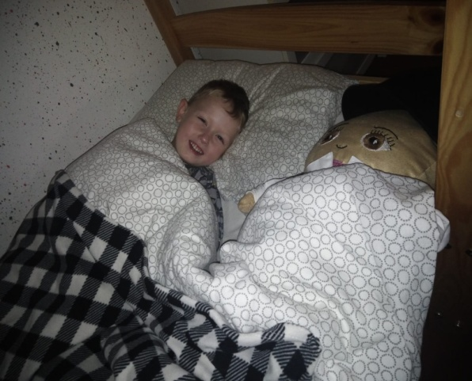
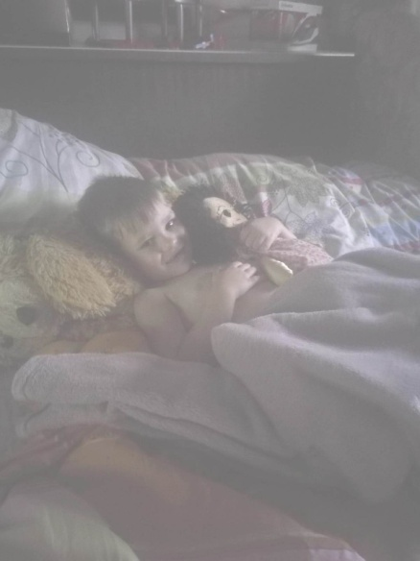
Being a good friend as part of everyday family life

Slide 7
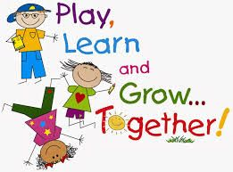
Learning together is fun!

Slide 8
Learning together is fun!

Slide 9
Learning together is fun!

Slide 10
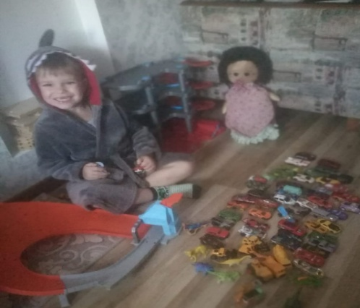
Playing together

Slide 11
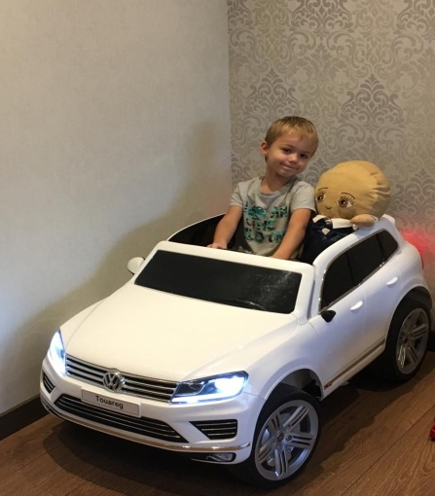
Playing together

Slide 12
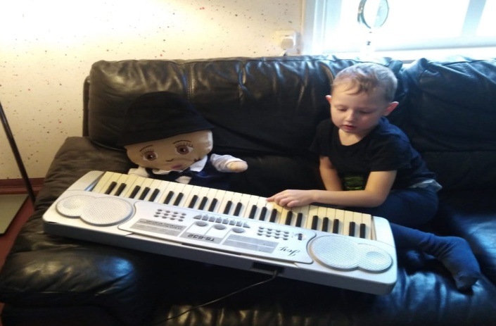
Playing together

Slide 13
Playing together

Slide 14
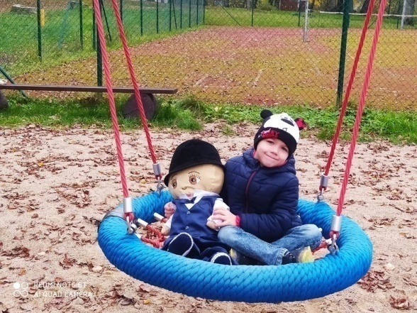
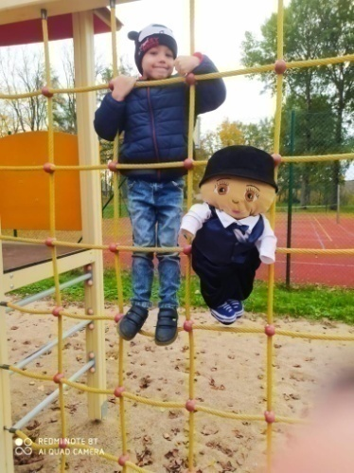
Going outside

Slide 15
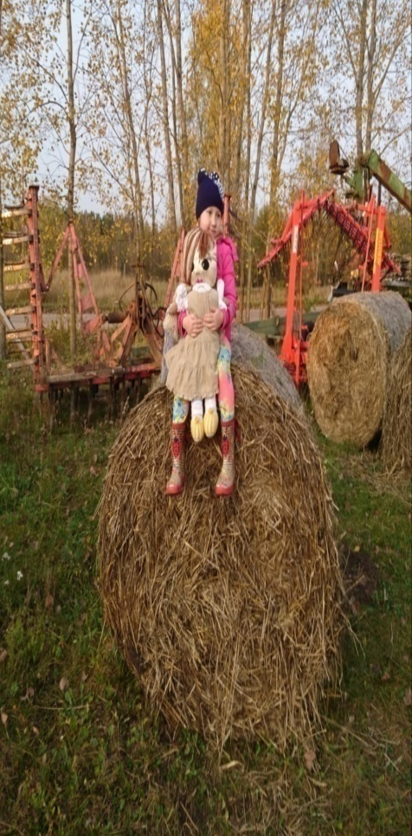
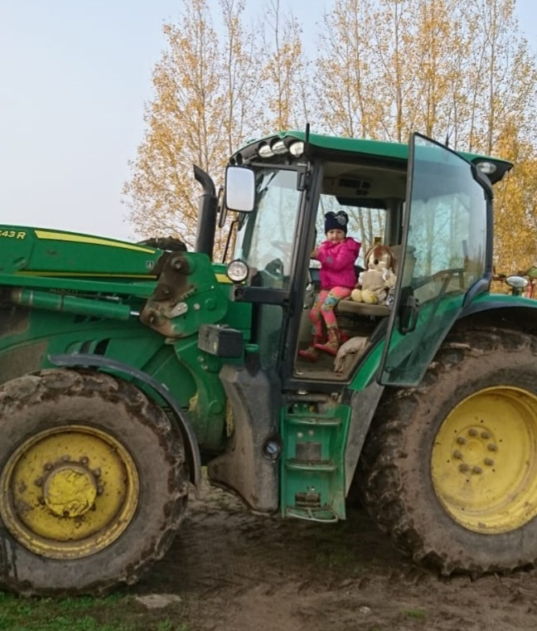
Going outside

Slide 16
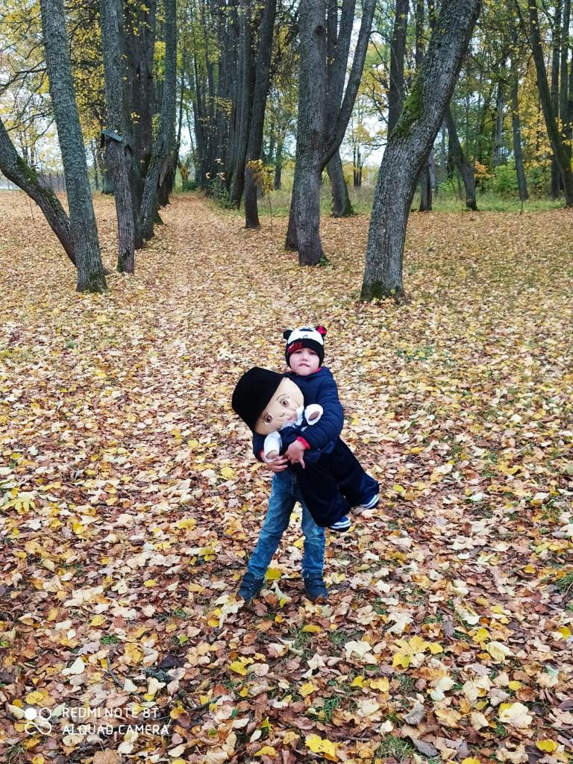
Going outside

Slide 17
Going outside

Slide 18
Going outside

Slide 19
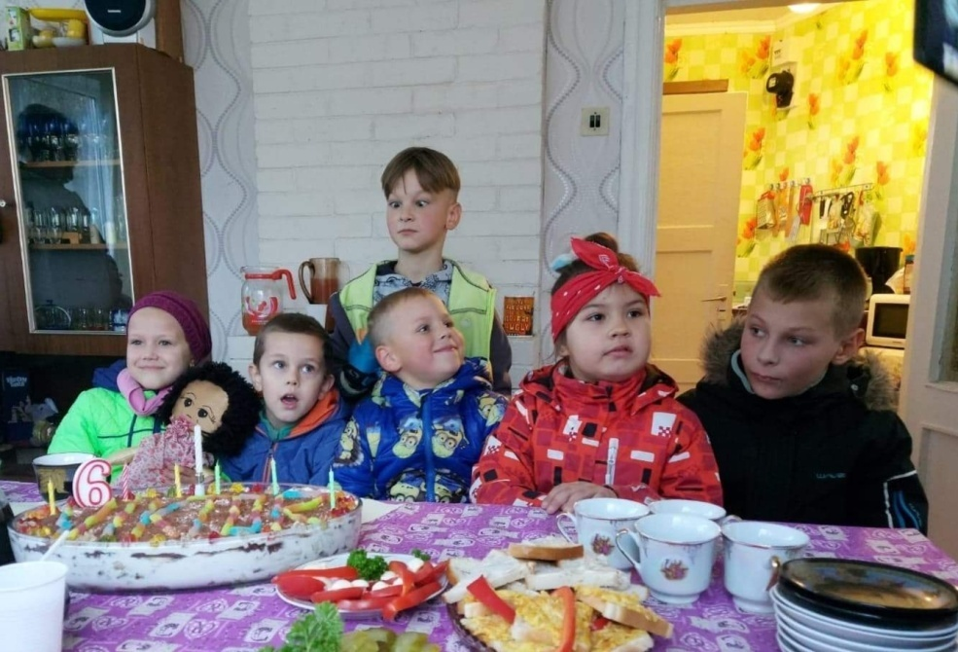
Visiting Friends

Slide 20
There here is always room in the heart for one more friend!

Slide 21
There here is always room in the heart for one more friend!

Slide 22
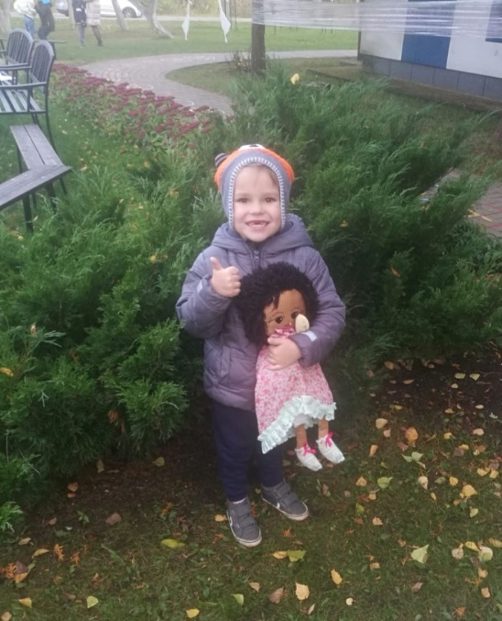
There here is always room in the heart for one more friend!

Slide 23
Thank You for Your attention!

