Slide 1
SECOND TRAINING EVENT LATVIA, 17th-21th June 2019
Our activities during our first year with
Persona Doll Methodology
I’m special, exploring my body and my mind
Italy

Slide 2
FRATS I’m special, exploring my body and my mind
In this first activity, all the children of our school made a great job.
They spoke a lot about this subject and in the following pages you can have a look….

Slide 3
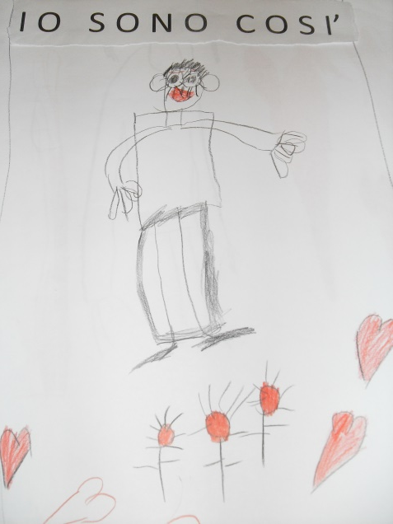
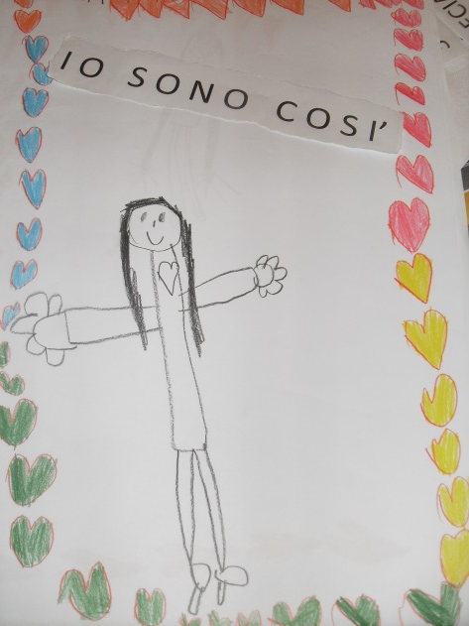
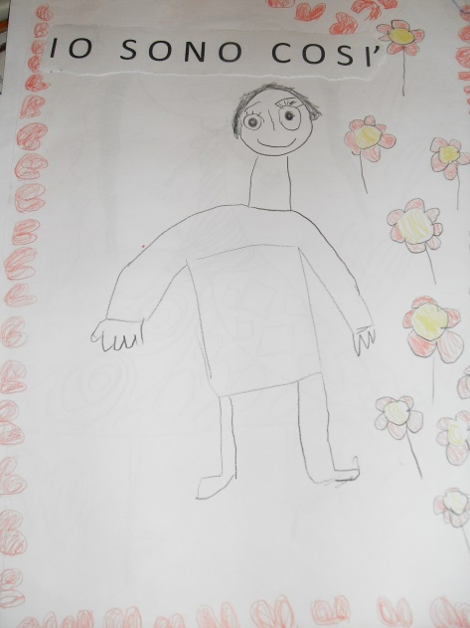
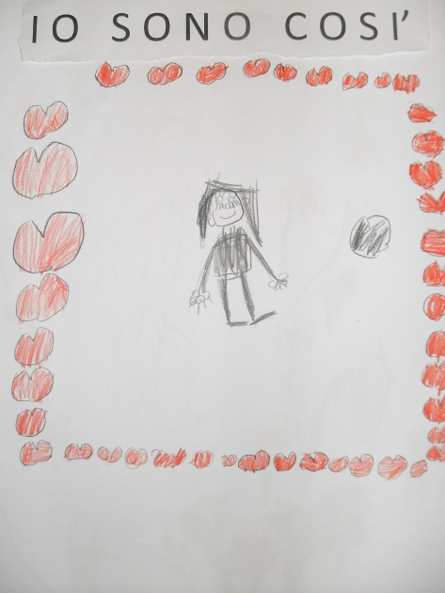
FRATS I’m special, exploring my body and my mind
I am like this! Here I am!

Slide 4
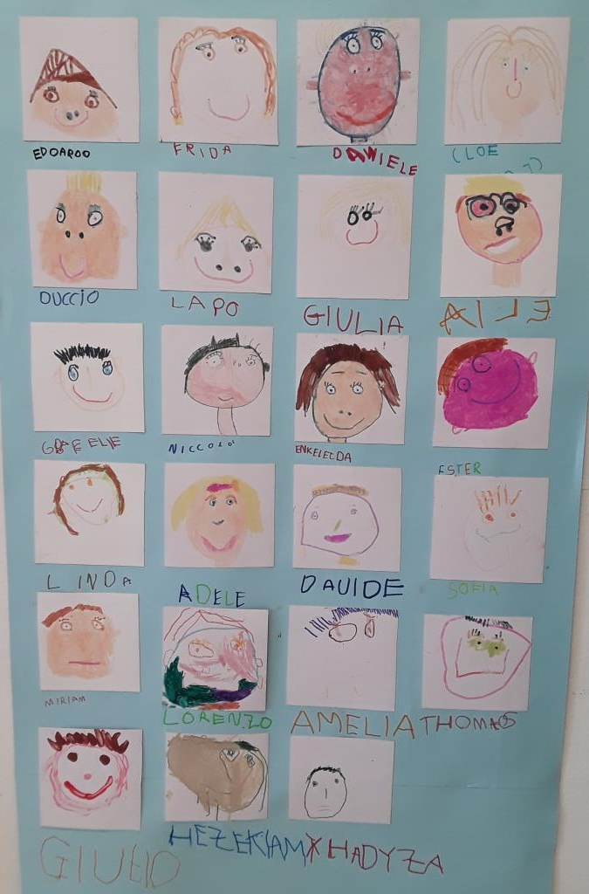
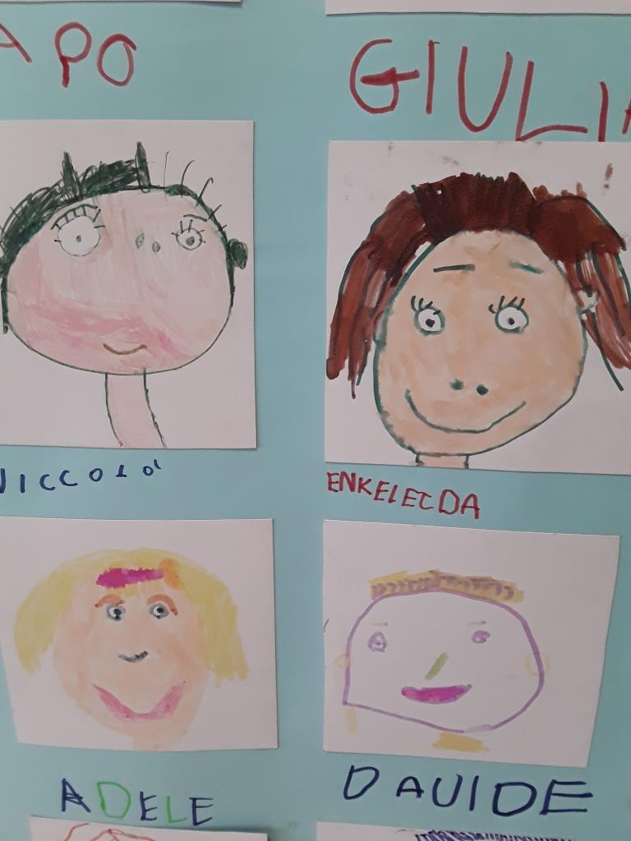
FRATS I’m special, exploring my body and my mind

Slide 5
FRATS I’m special, exploring my body and my mind
Each of us is good in something!
Everyone is special!
Niccolò: «To be special means to be able to do many things»

Slide 6
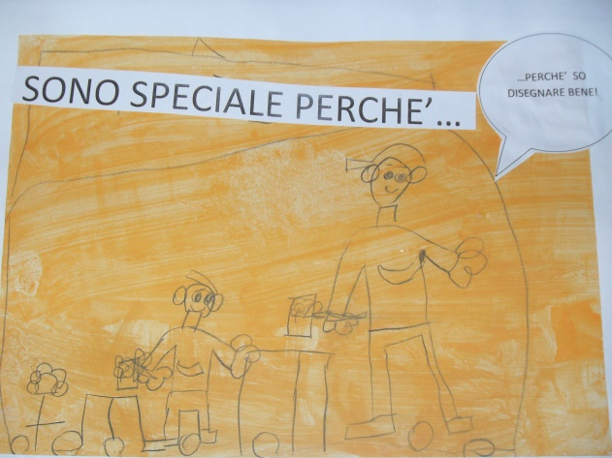
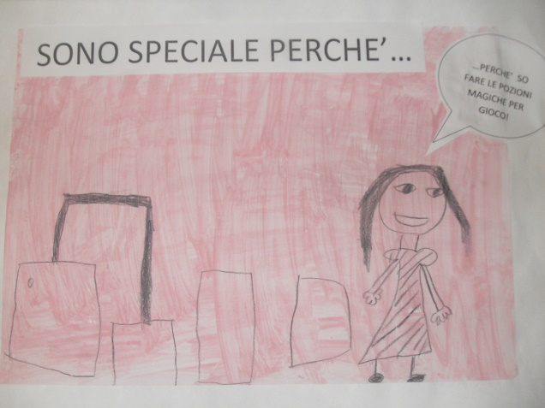
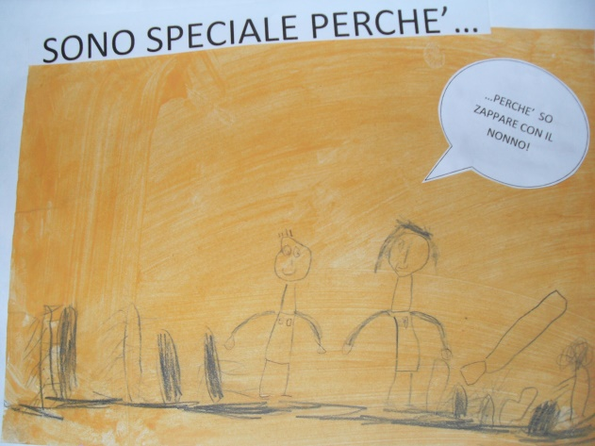
FRATS I’m special, exploring my body and my mind
I’m special because I can…
…play in the kitchen with my little sister.
… sing with my mother
… draw very well
…keep silent while I’m watching ninja Turtles
…pretend to make magic potions
… make cakes with my dad
…hoe with my grandad

Slide 7
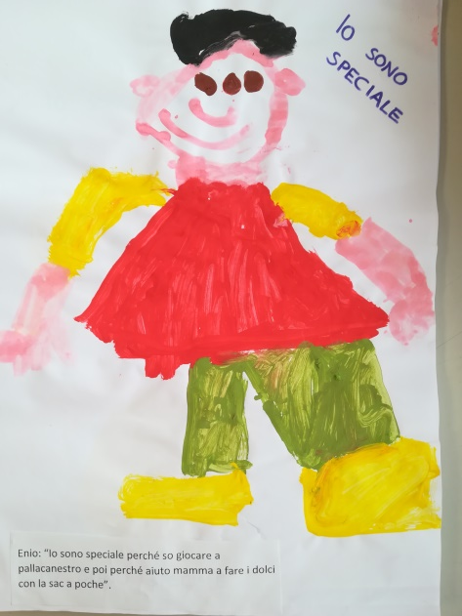
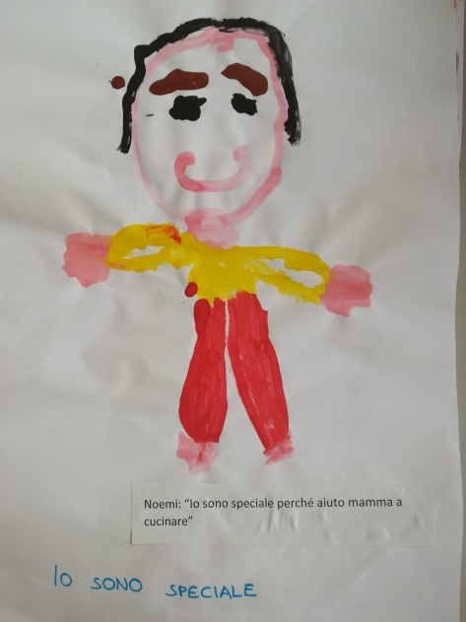
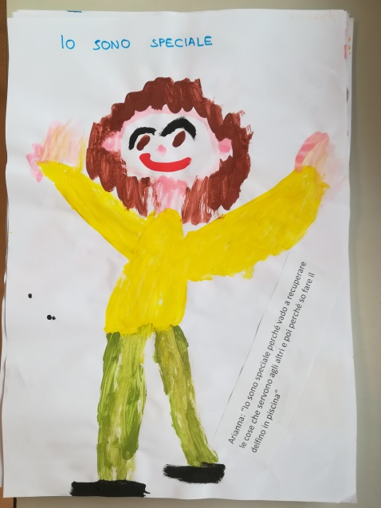
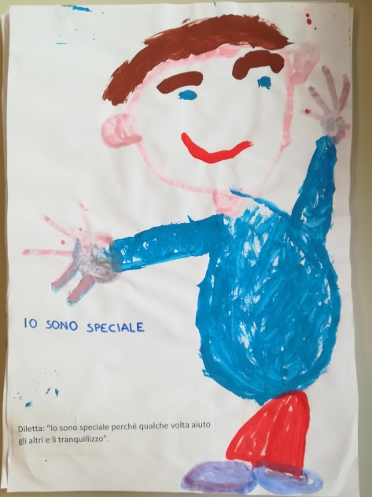
FRATS I’m special, exploring my body and my mind
I’m special because I can play baskeball and then I help my mother to make cakes with a sac-à-poche.
I’m special because I help my mother to cook.
I’m special because I go and take things for the others and I can swim as a dolphin in the swimming pool
I’m special because sometimes I help the others and I try to keep them quite.

Slide 8
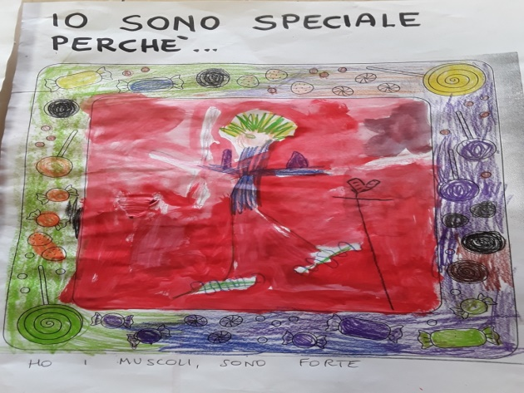
FRATS I’m special, exploring my body and my mind
I’m special because…
I’ve got muscles and I’m powerful!

Slide 9
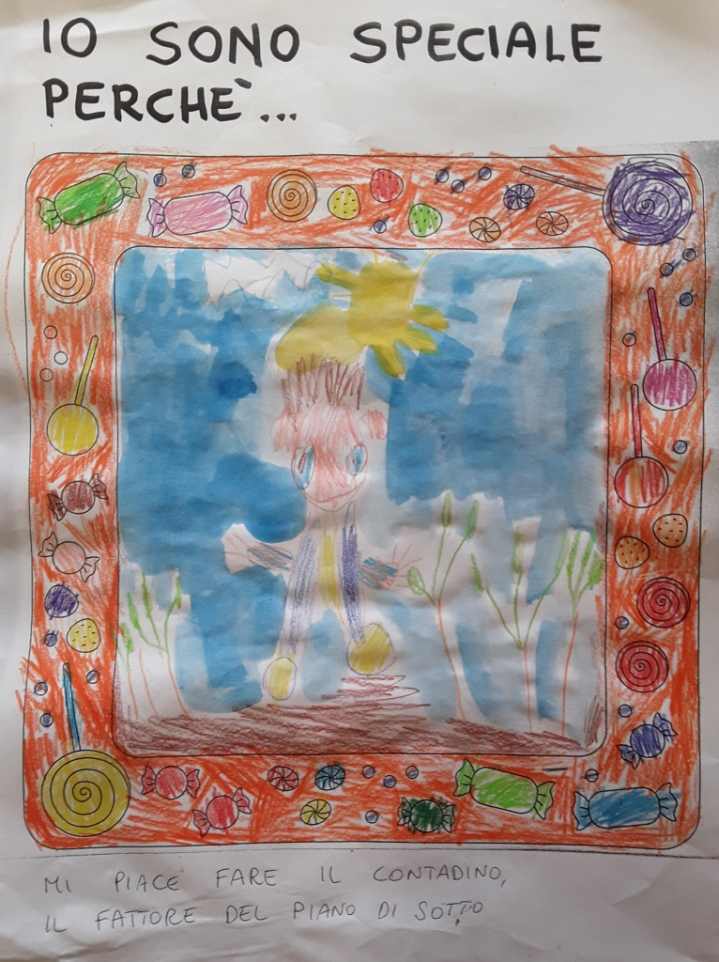
FRATS I’m special, exploring my body and my mind
I’m special because…
I like to be a peasant like my neighbour.

Slide 10
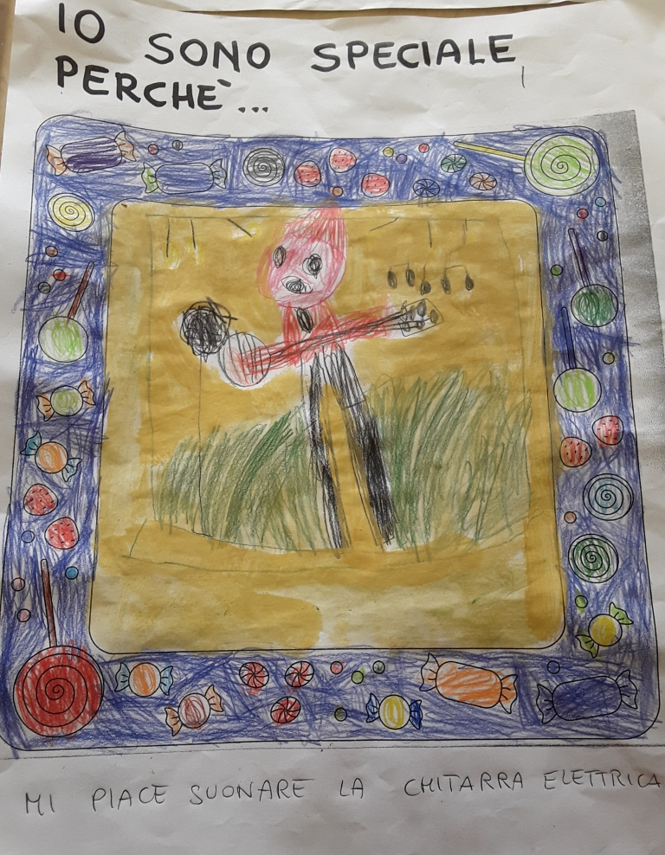
FRATS I’m special, exploring my body and my mind
I’m special because…
I like playing the electric guitar.

Slide 11
FRATS I’m special, exploring my body and my mind
Exploring our body and our mind we are talking about how we feel
how can I recognize my emotions?
When I feel happy, sad, angry, surprised,etc.
Then I draw faces with different expressions

Slide 12
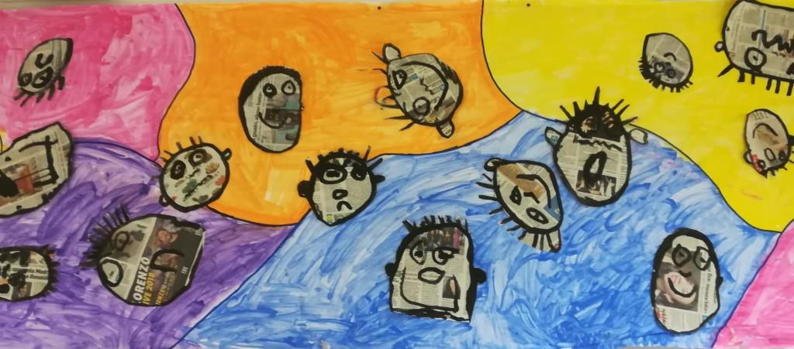
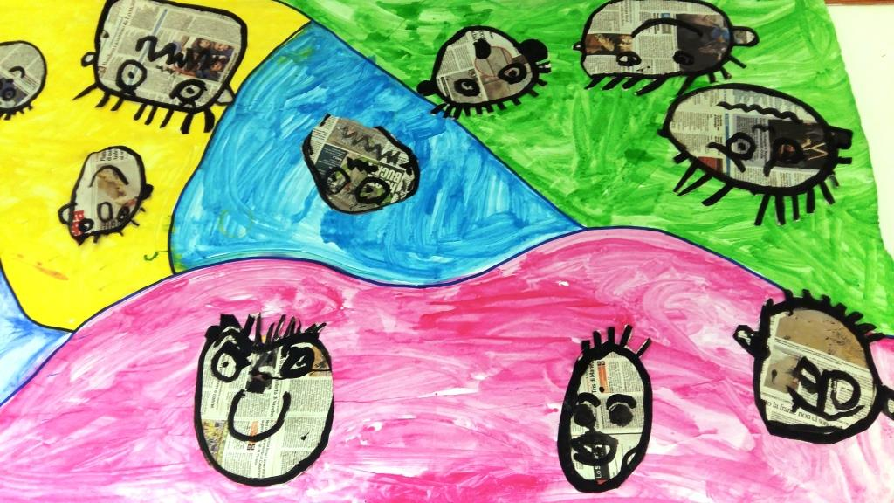
FRATS I’m special, exploring my body and my mind
How do you feel today?

Slide 13
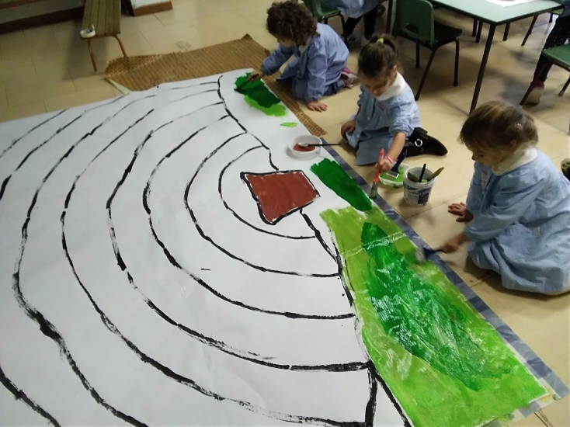
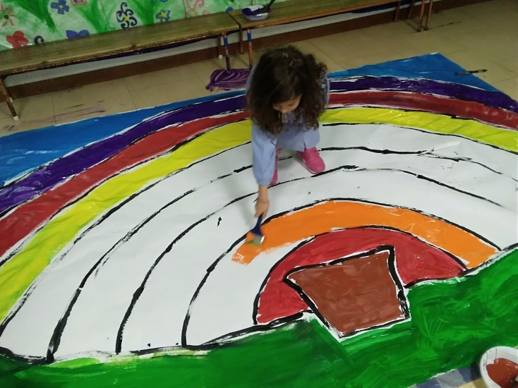
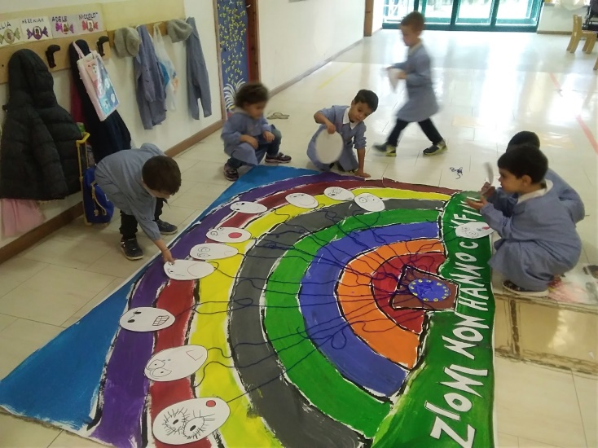
FRATS I’m special, exploring my body and my mind
Preparing a poster

Slide 14
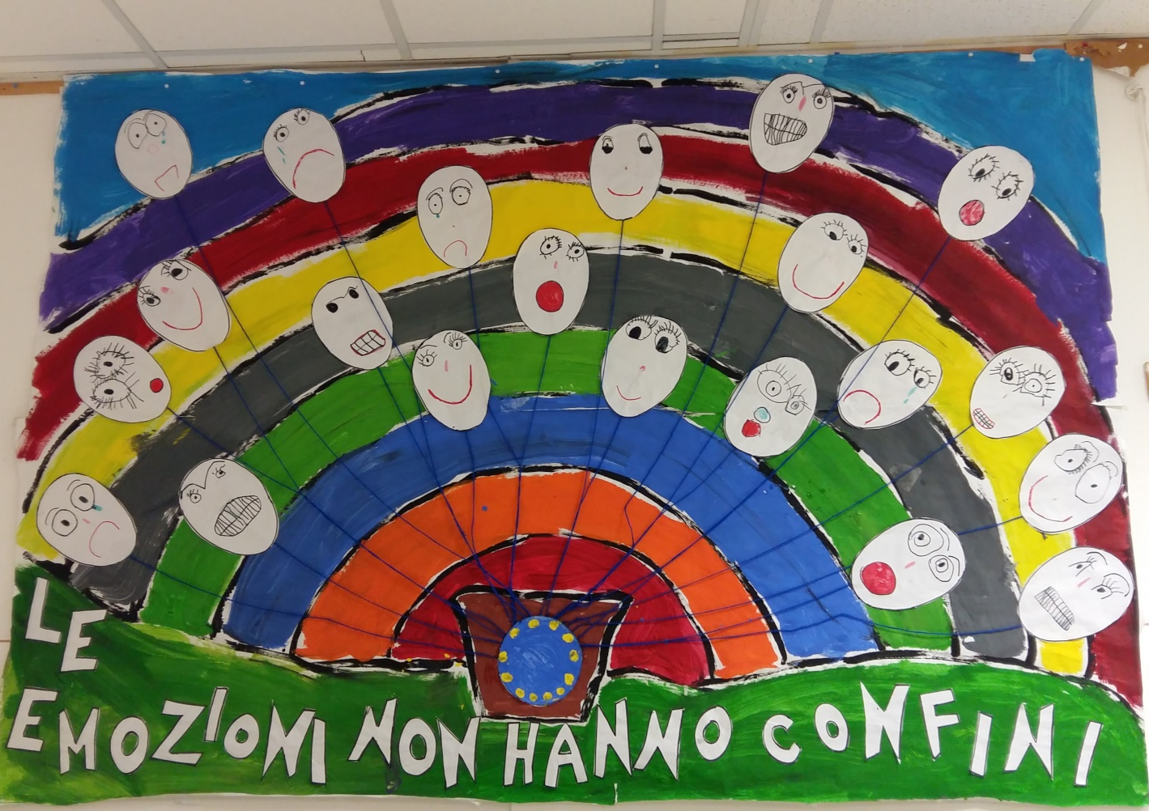
FRATS I’m special, exploring my body and my mind
Emotions don’t have any border

Slide 15
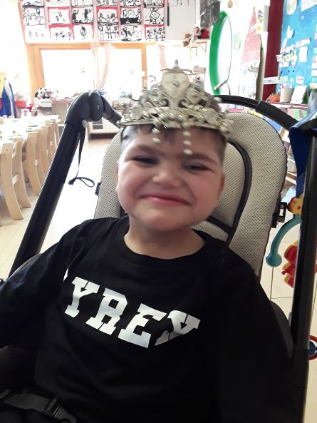
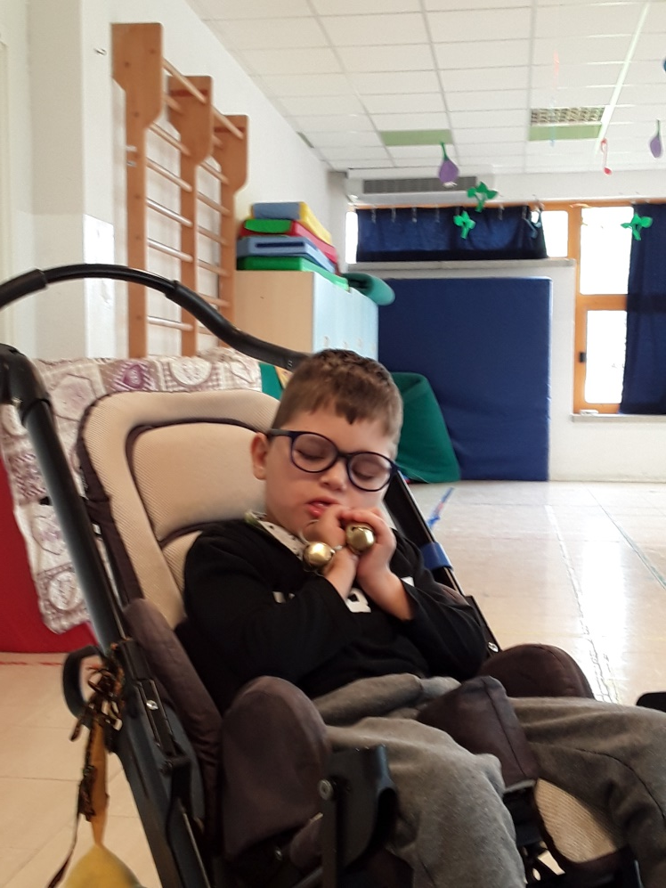
FRATS I’m special, exploring my body and my mind
I’m special because I like music!

Slide 16
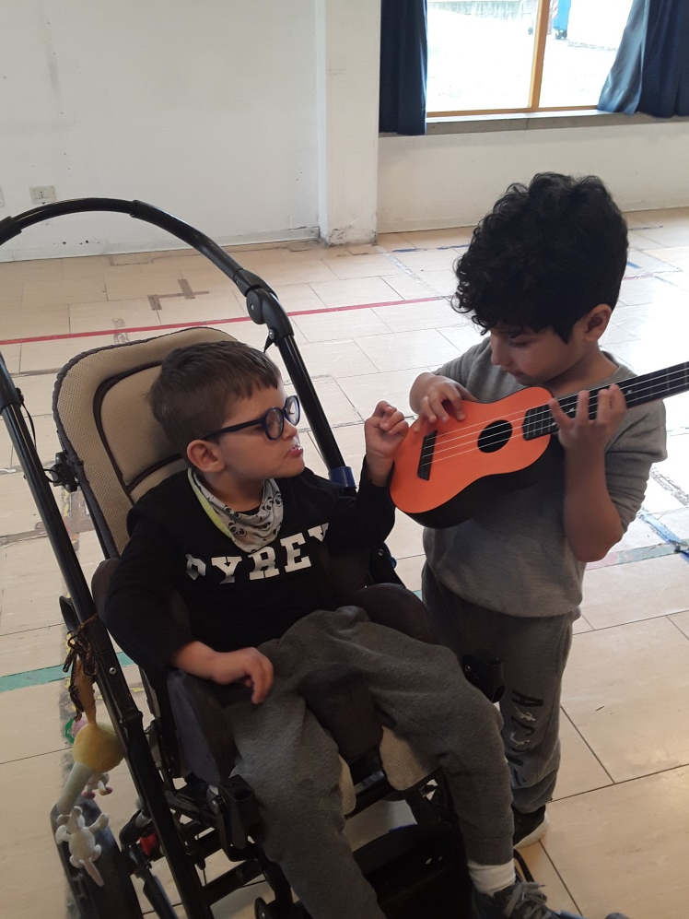
FRATS I’m special, exploring my body and my mind
I’m special and I play for you

Slide 17
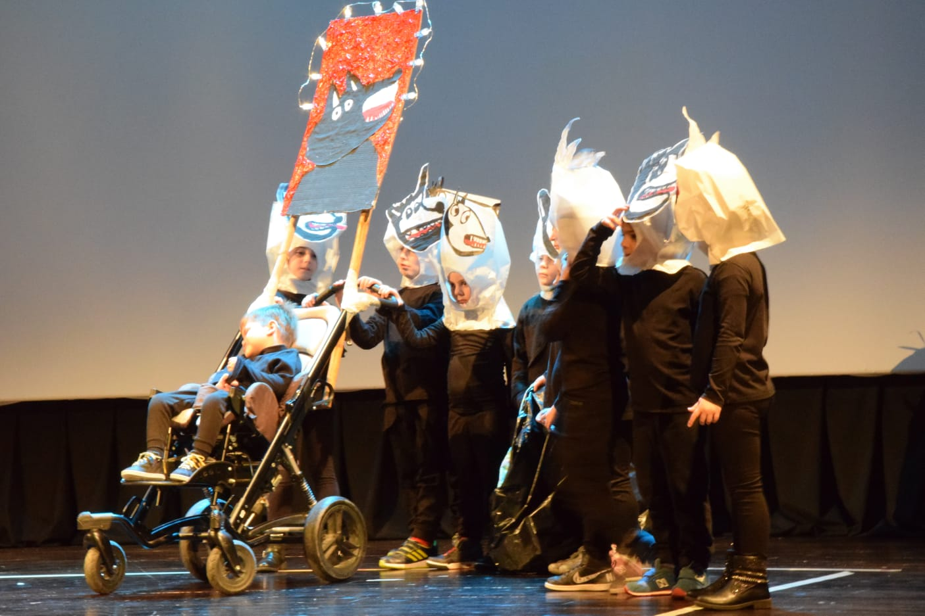
FRATS I’m special, exploring my body and my mind
Emotions on the stage!
Everybody has to control his own emotion to cope with the public in front of him.

Slide 18
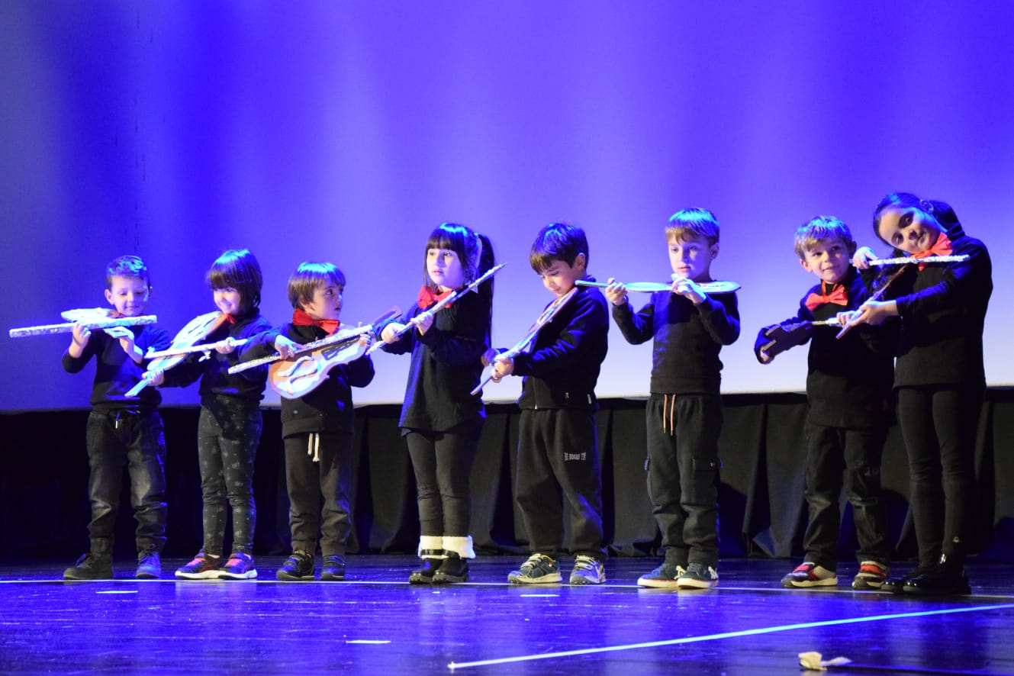
FRATS I’m special, exploring my body and my mind
Emotions on the stage!

Slide 19
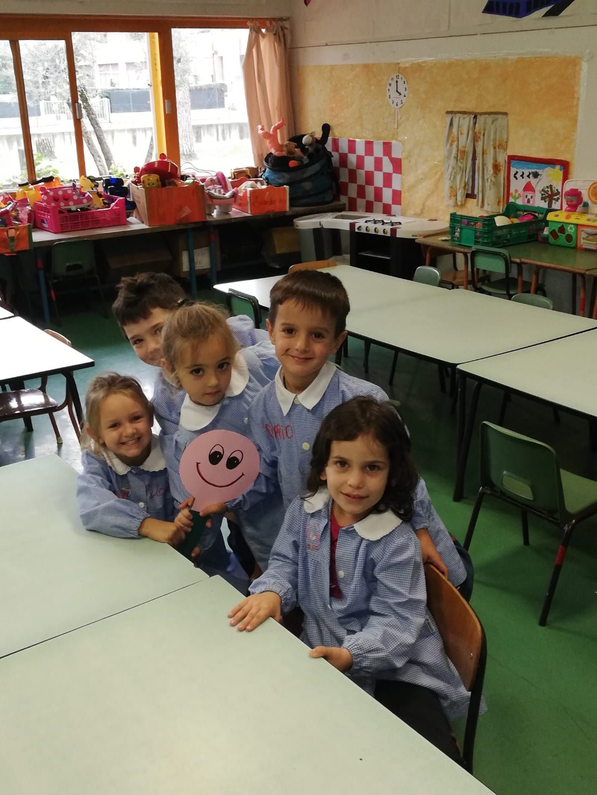
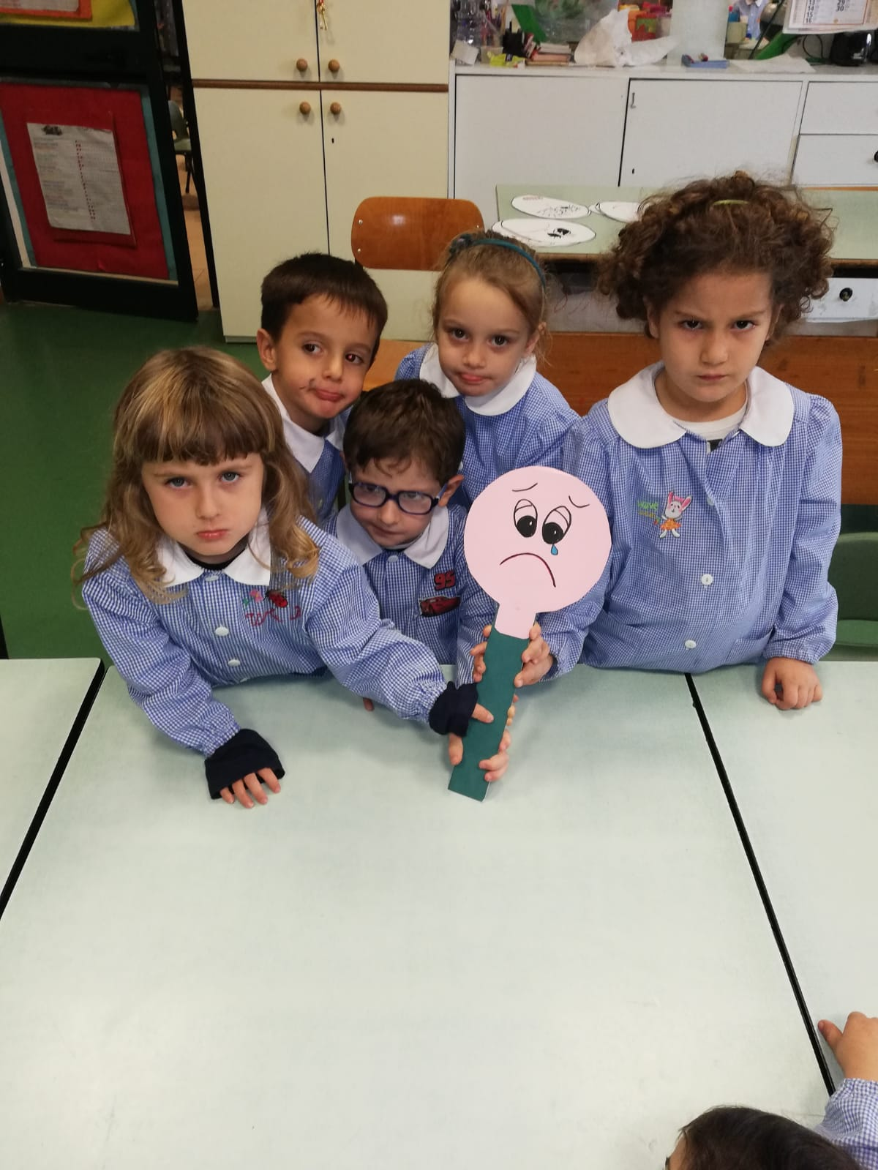
FRATS I’m special, exploring my body and my mind
The palette!

Slide 20
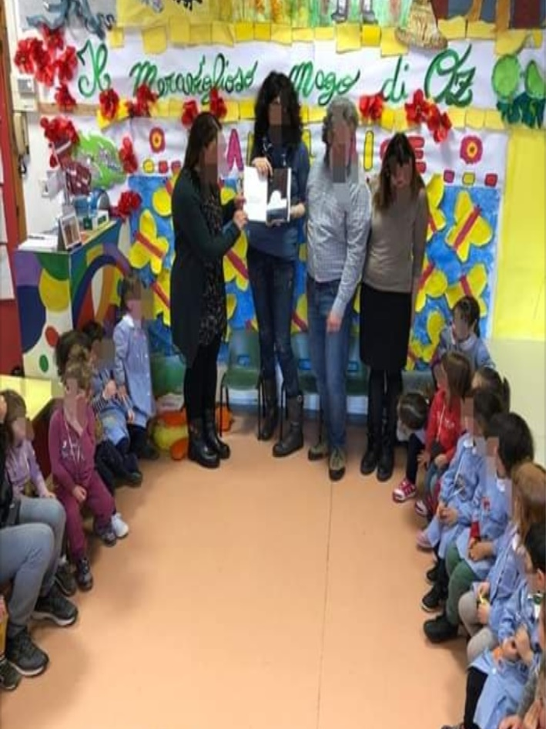
FRATS I’m special, exploring my body and my mind
With our parents!

Slide 21
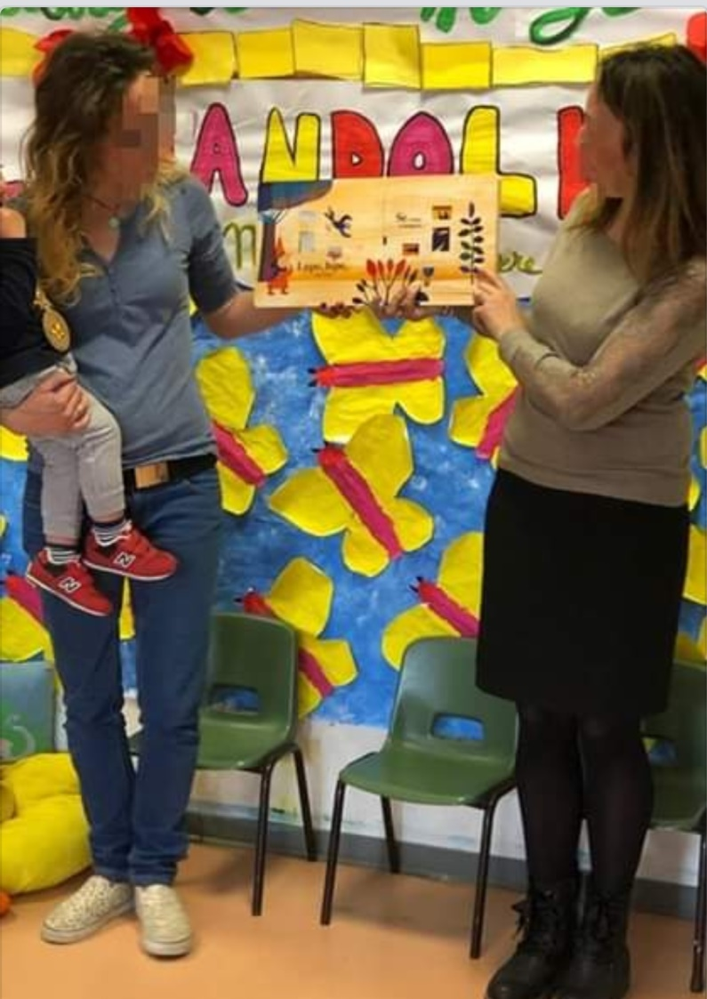
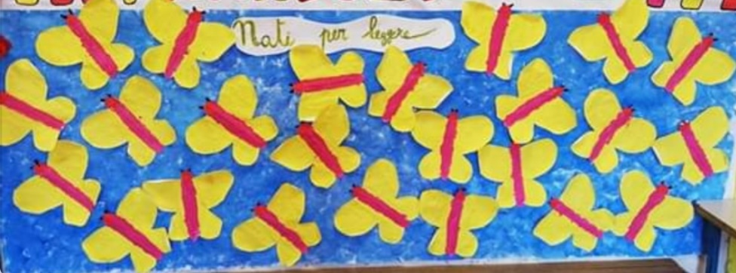
FRATS I’m special, exploring my body and my mind
With our parents!

Slide 22
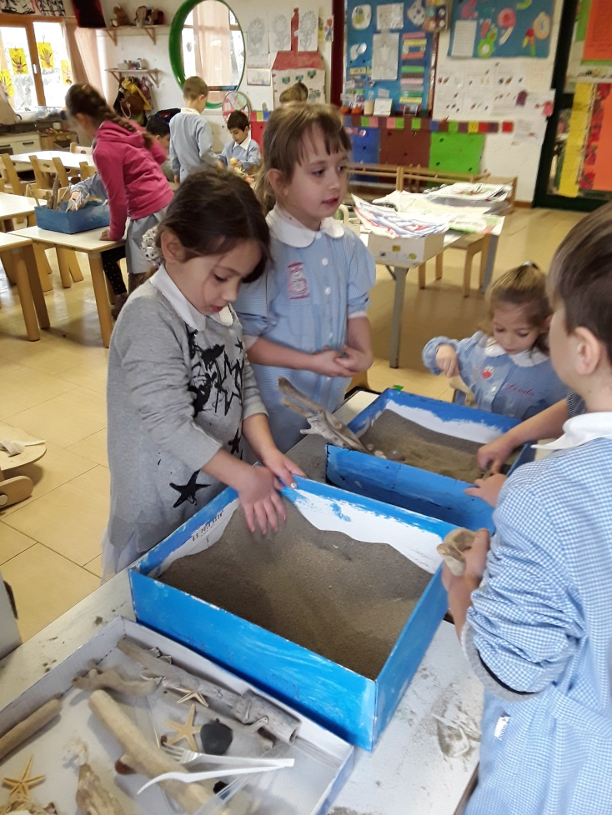
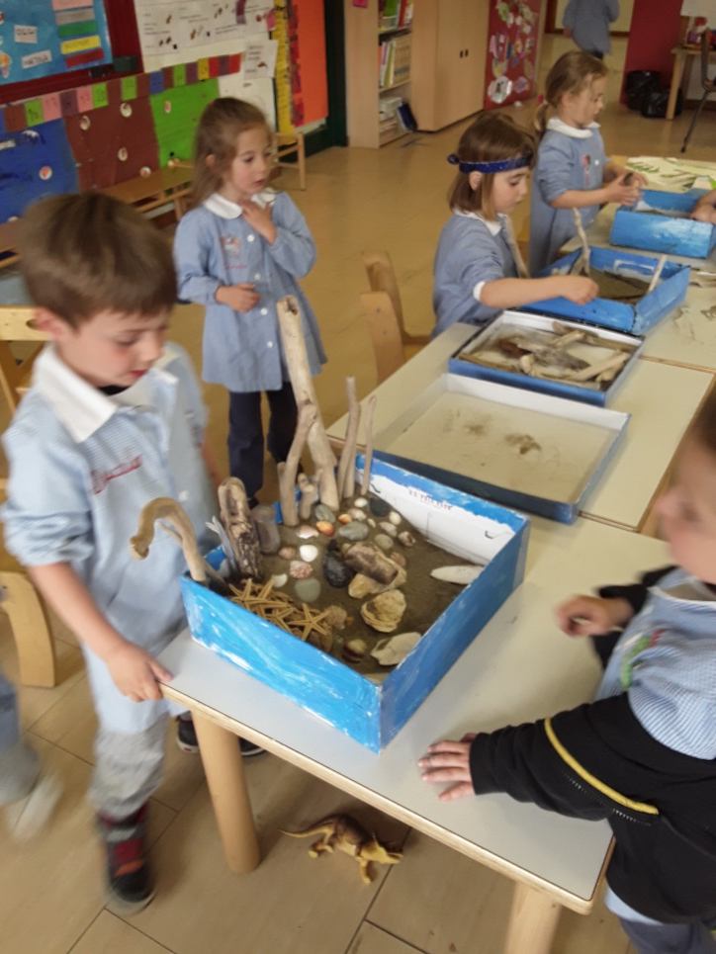
FRATS I’m special, exploring my body and my mind
Relaxing with the Zen Garden

Slide 23
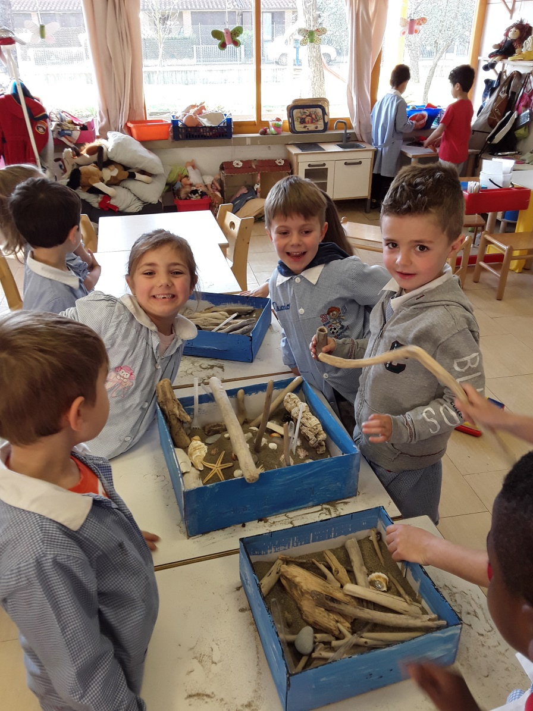
FRATS I’m special, exploring my body and my mind

Slide 24
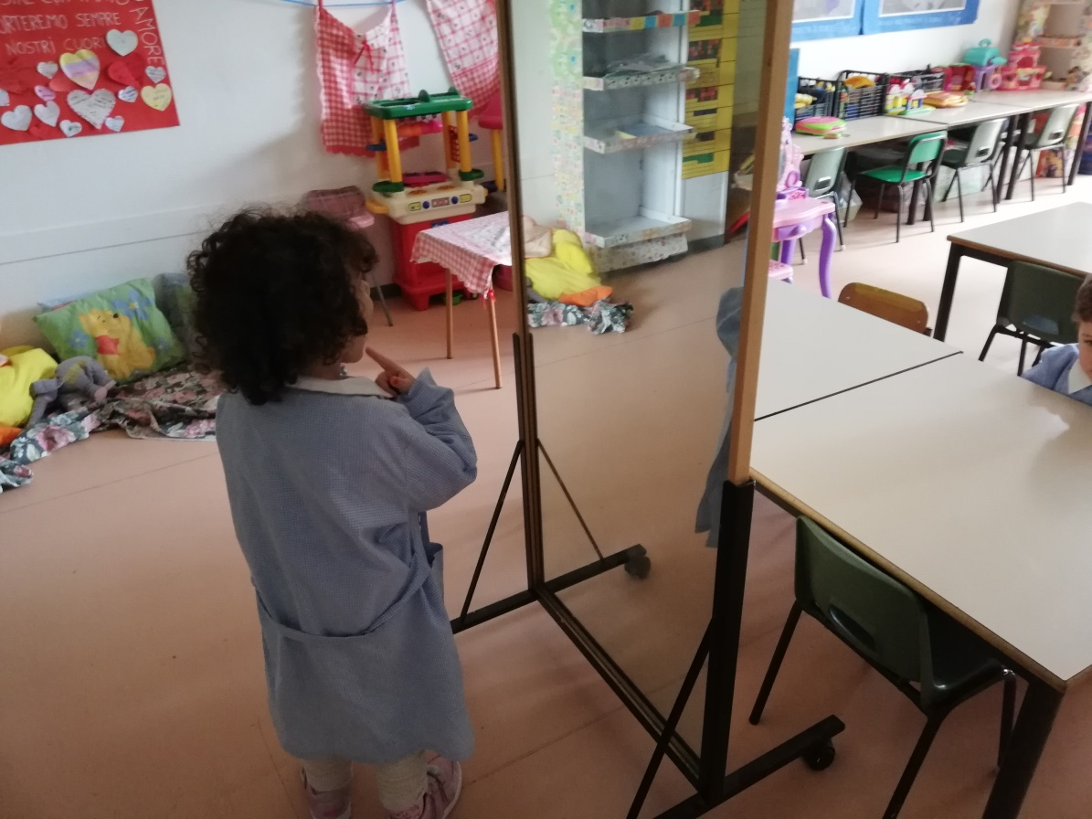
FRATS I’m special, exploring my body and my mind

Slide 25
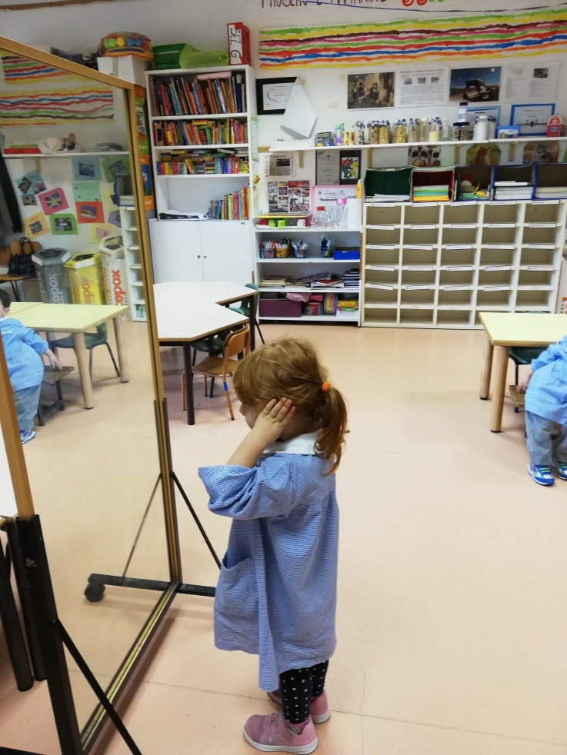
FRATS I’m special, exploring my body and my mind

Slide 26
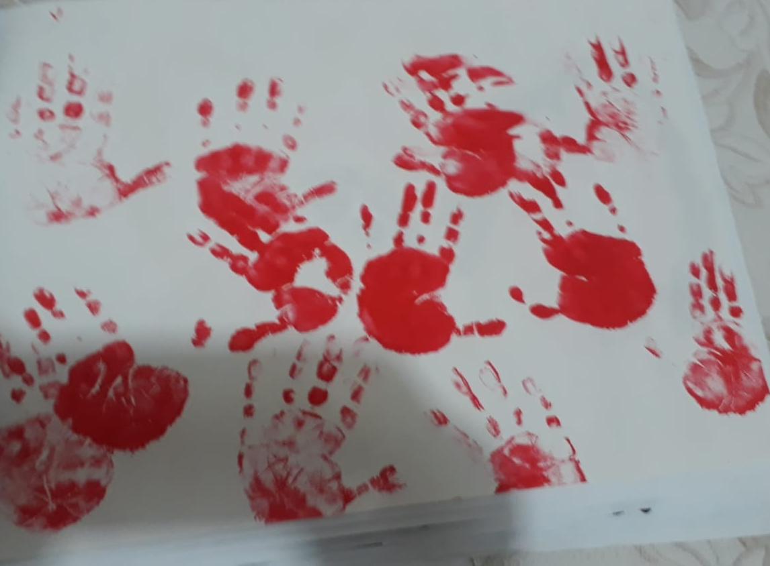
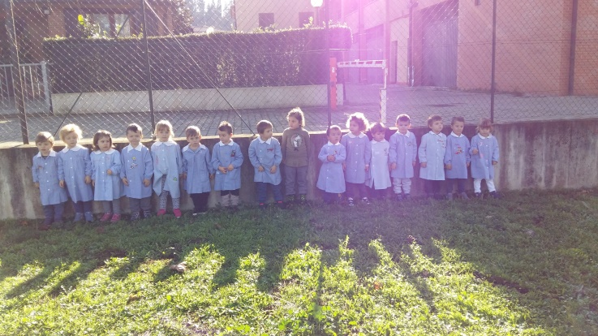
FRATS I’m special, exploring my body and my mind

Slide 27
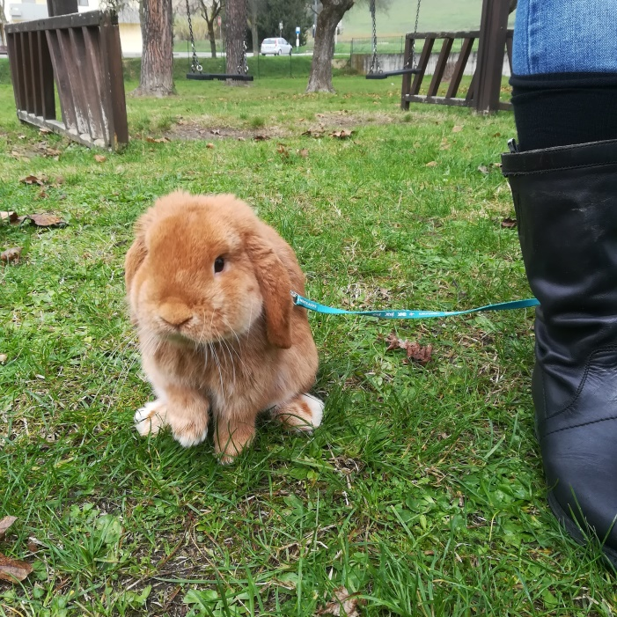
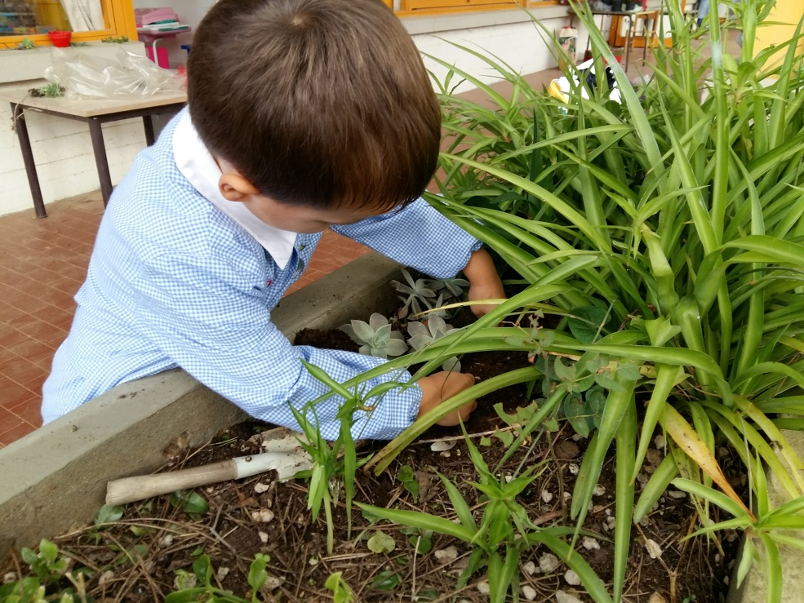
FRATS I’m special, exploring my body and my mind
Respect of diversity: animals and plants

