Slide 1
Our Lithuanian week!
Erasmus+ FRATS
Istituto Comprensivo Certaldo
Scuola dell’infanzia Sturiale

Slide 2
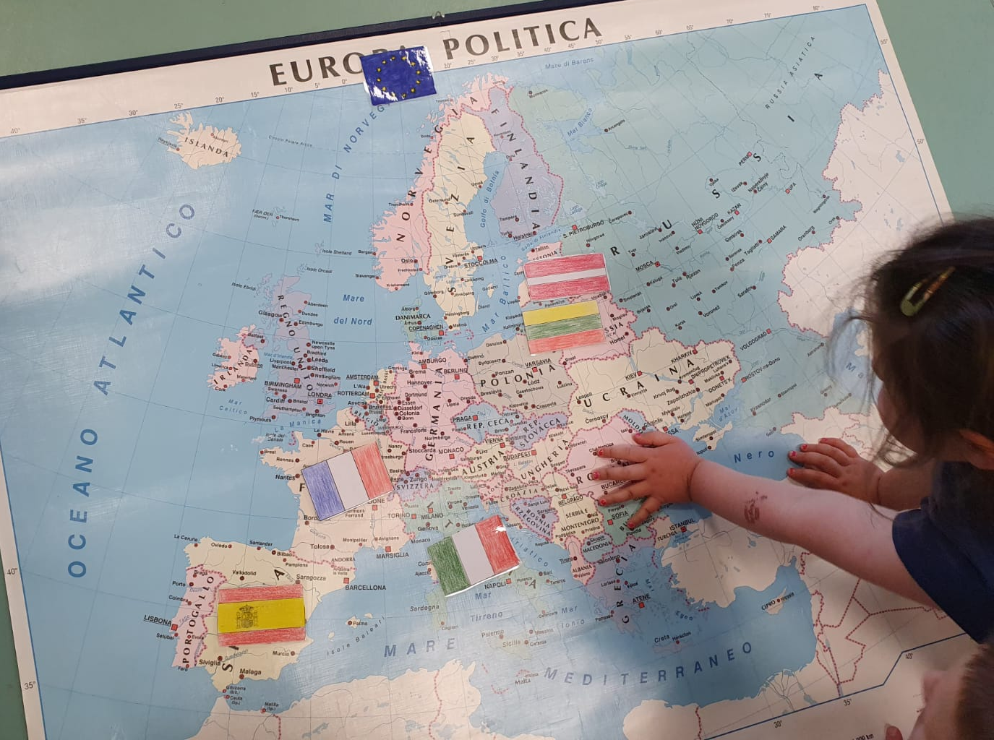
Our Lithuanian week!
We know the flag but we don’t know where the Lithuania is…

Slide 3
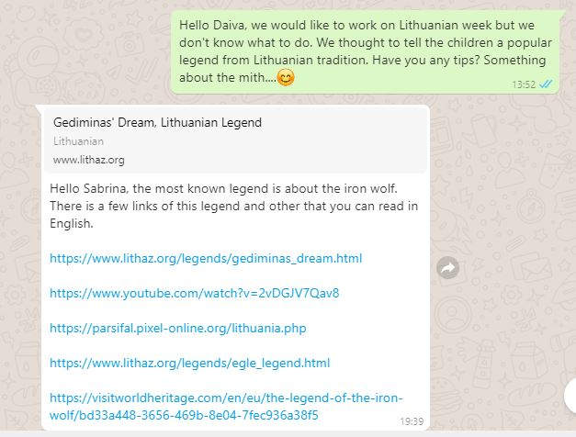
Our Lithuanian week!
We read on internet that Lithuania is famous for wild nature and popular legend, so we asked our Lithuanian partner to send us a special legend

Slide 4
Our Lithuanian week!
So we read the Iron wolf legend.
It speaks about an important sovereign who dreamt of an iron wolf on a hill that was ululated at the moon. That was the place where he founded the town of Vilnius.

Slide 5
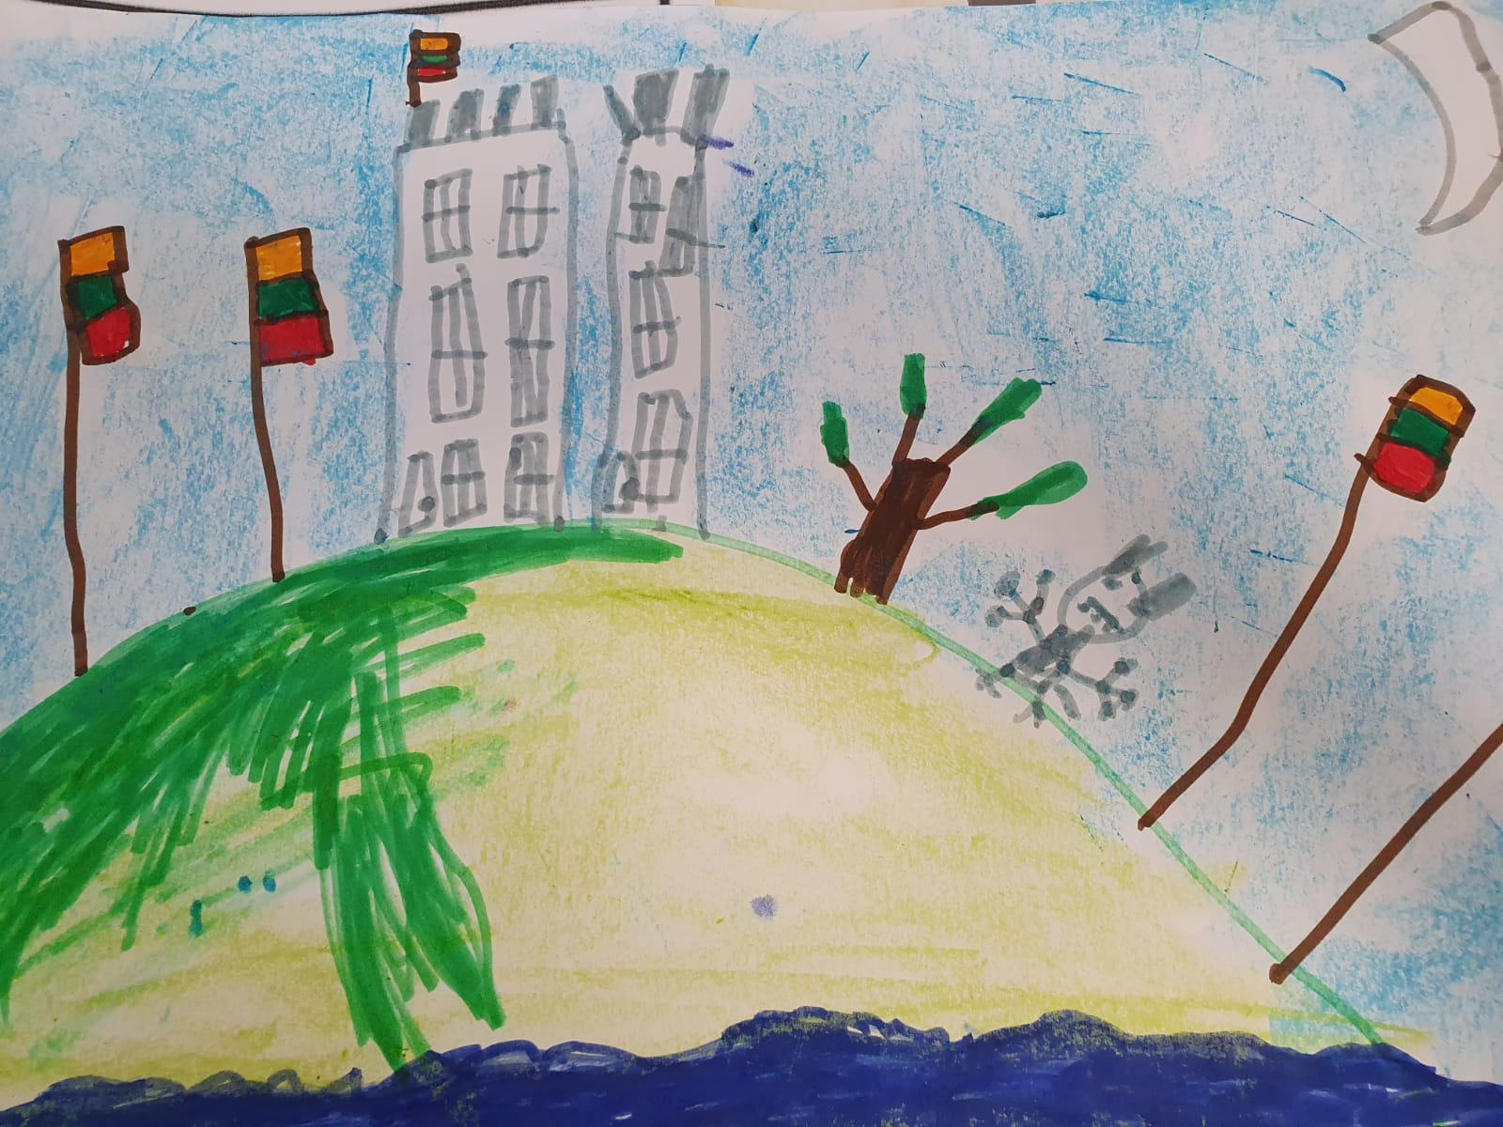
Our Lithuanian week!

Slide 6
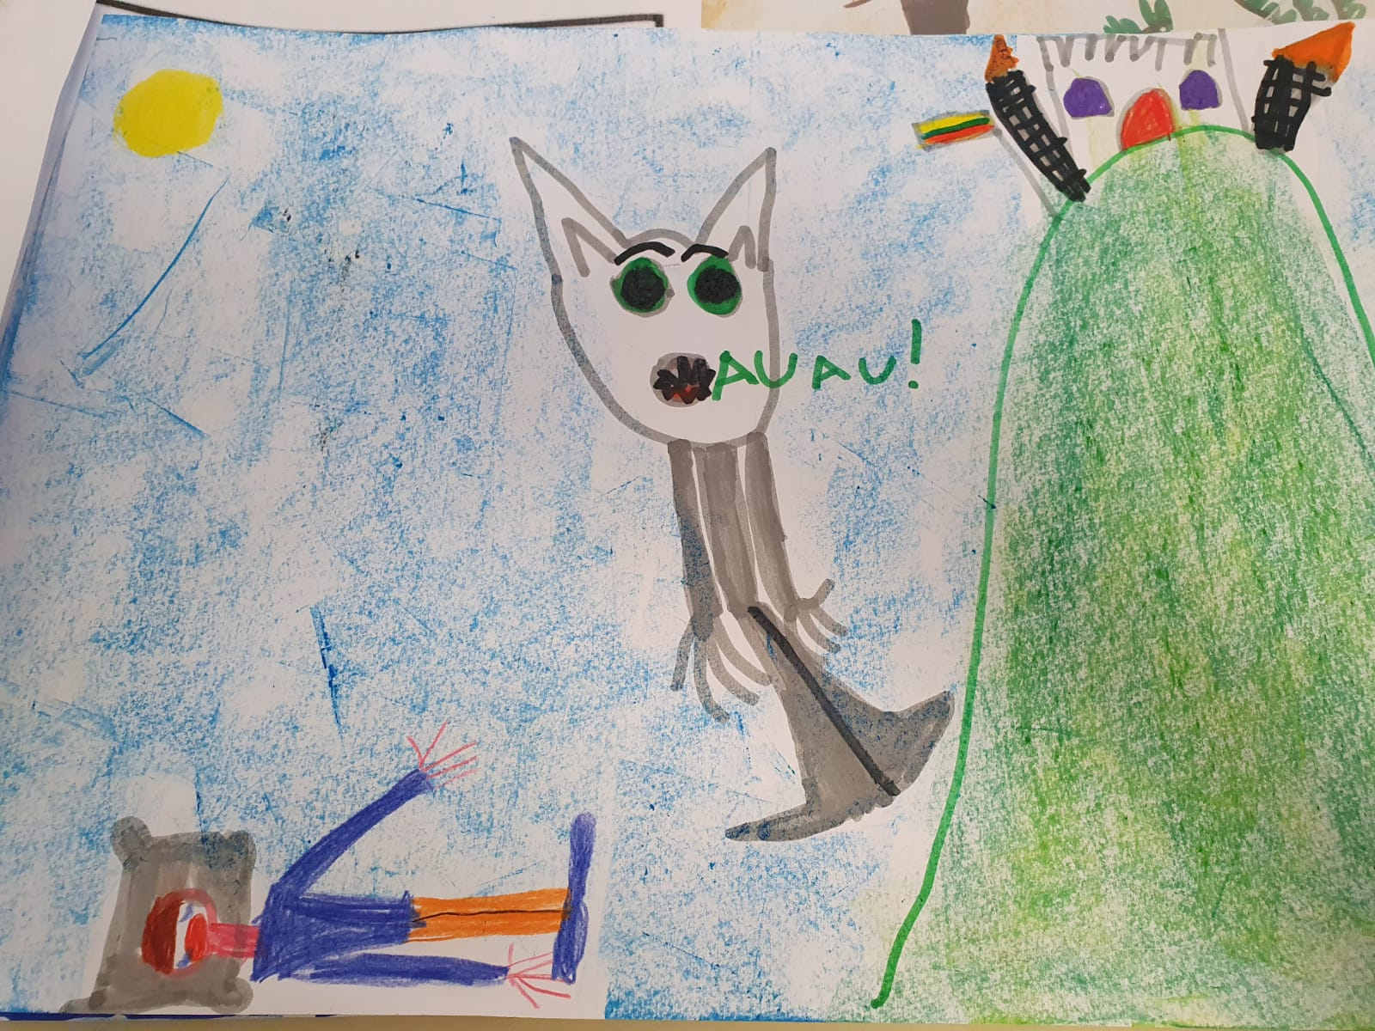
Our Lithuanian week!

Slide 7
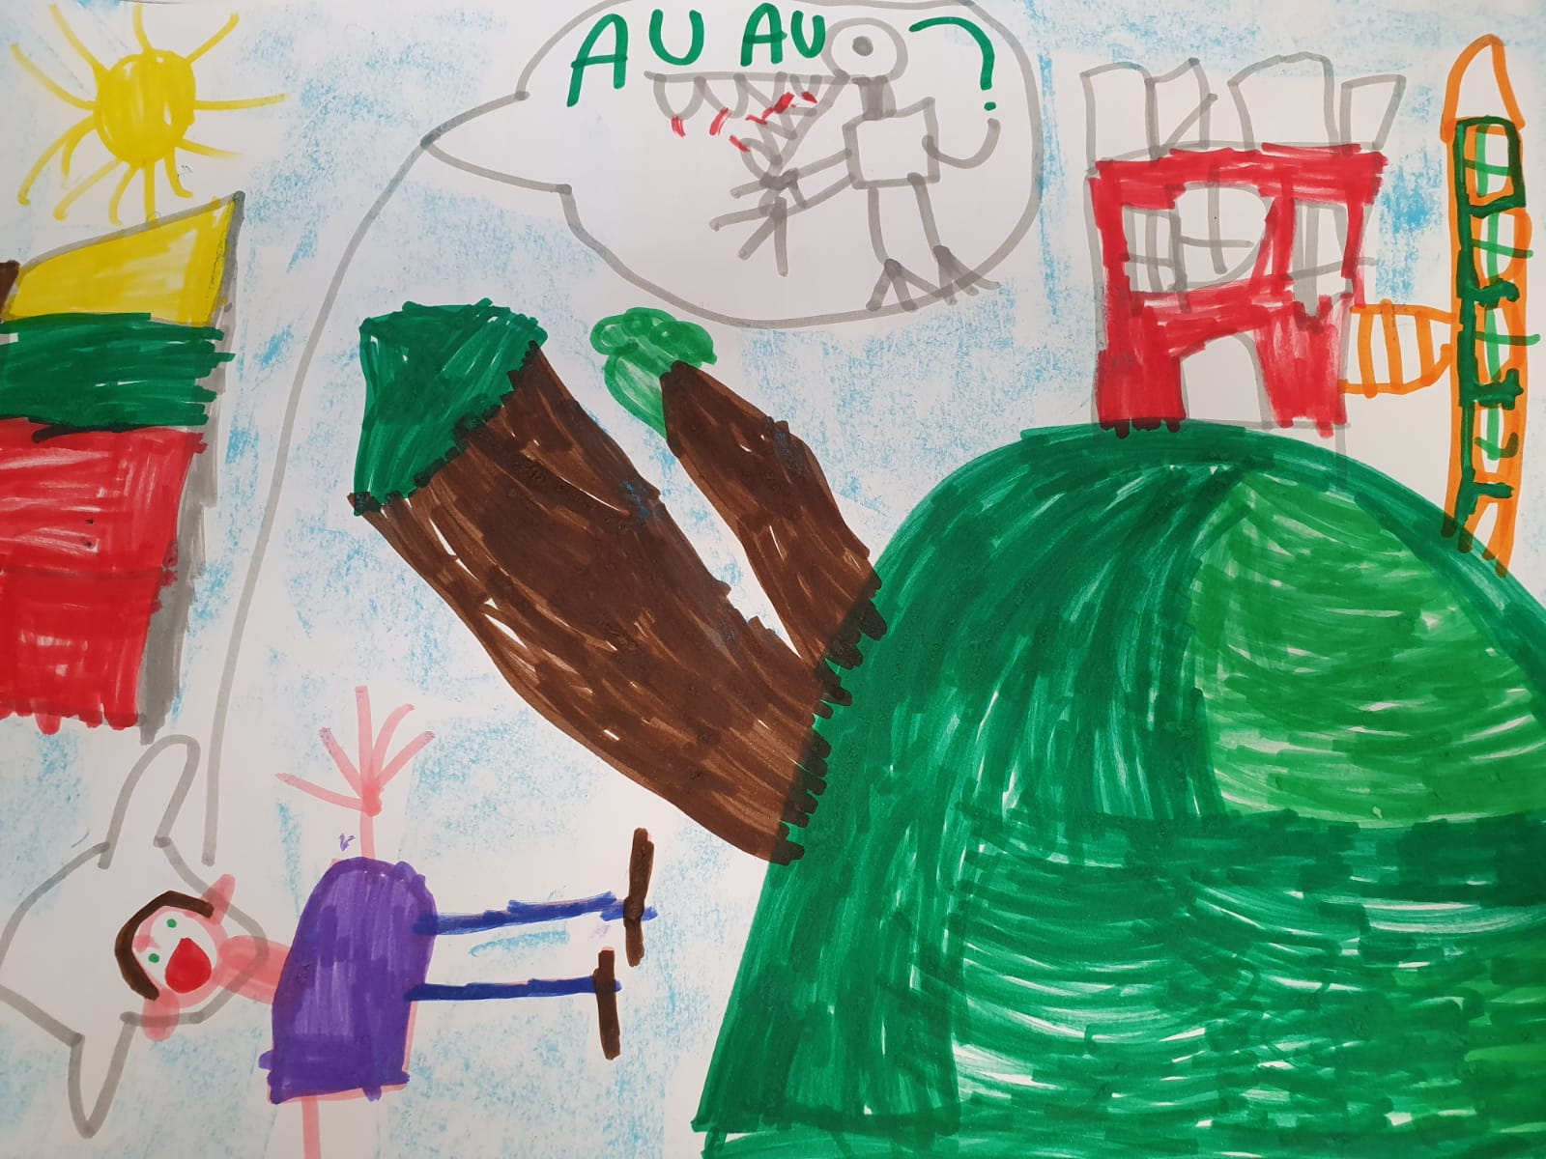
Our Lithuanian week!

Slide 8
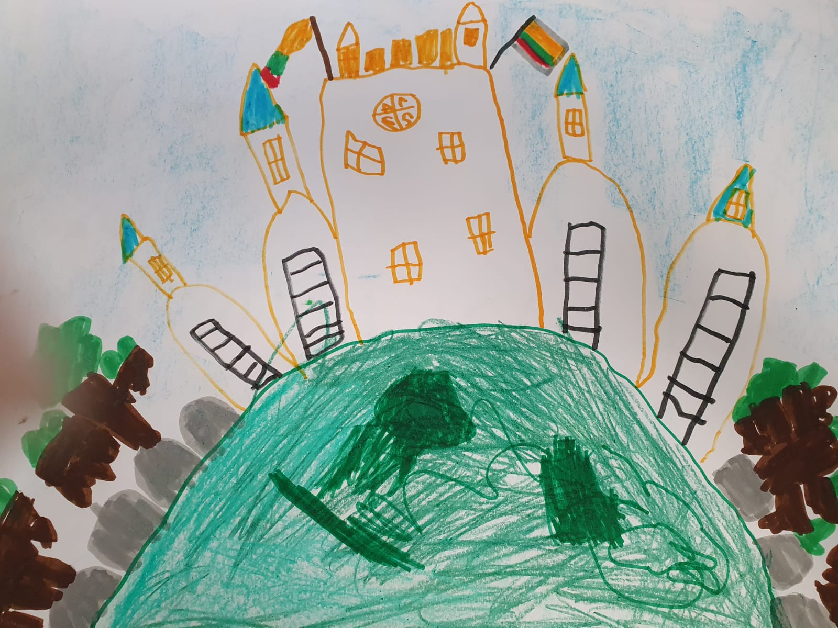
Our Lithuanian week!

Slide 9
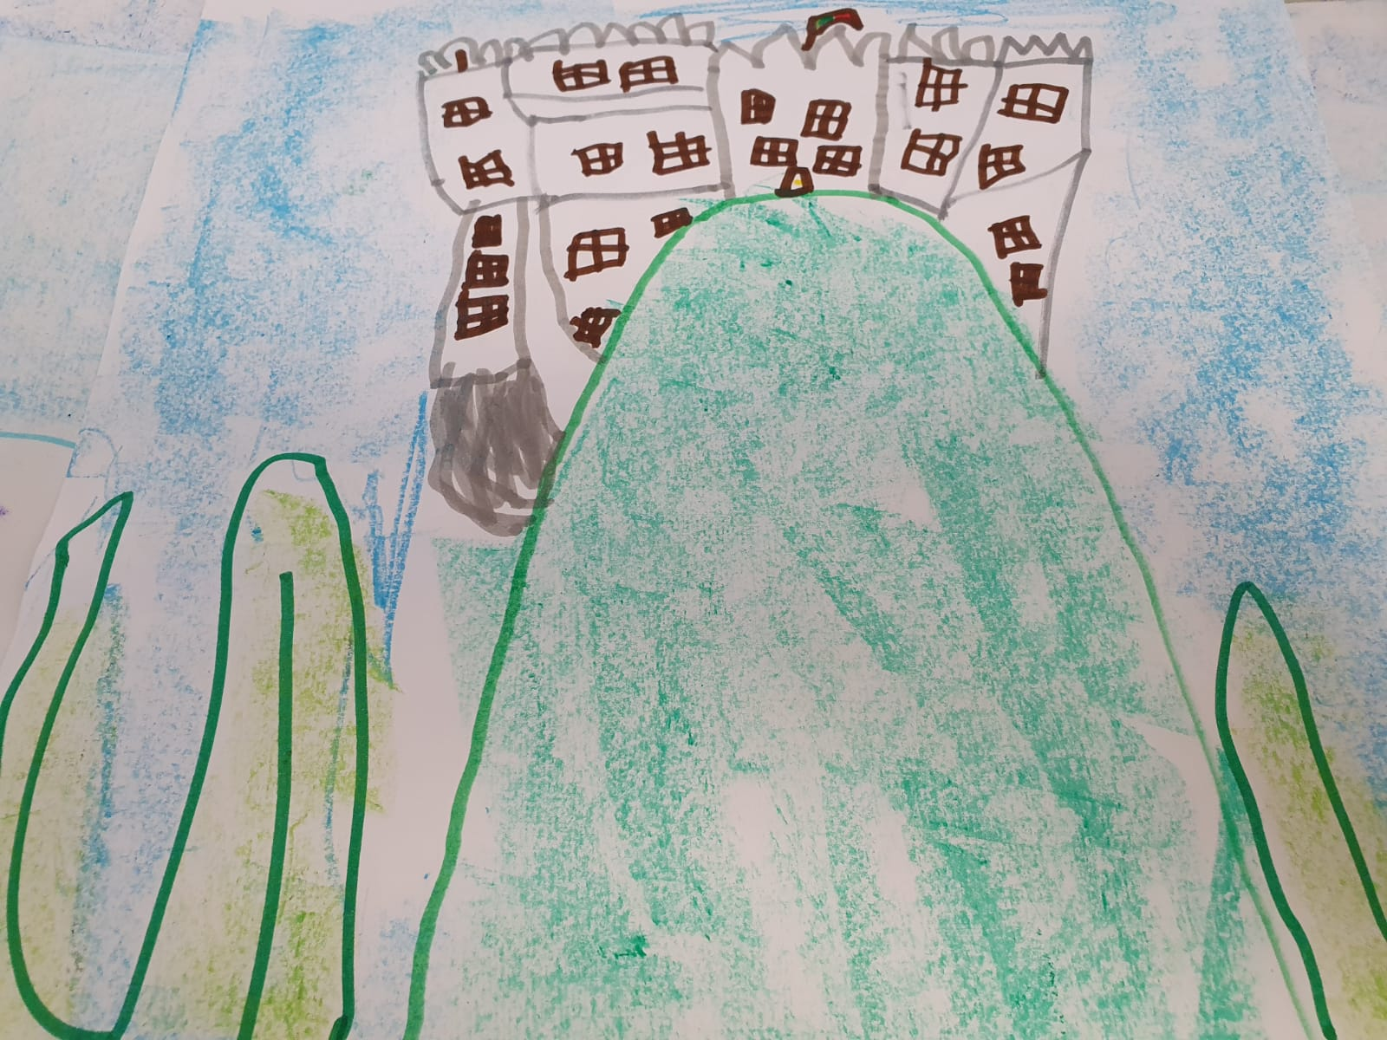
Our Lithuanian week!

Slide 10
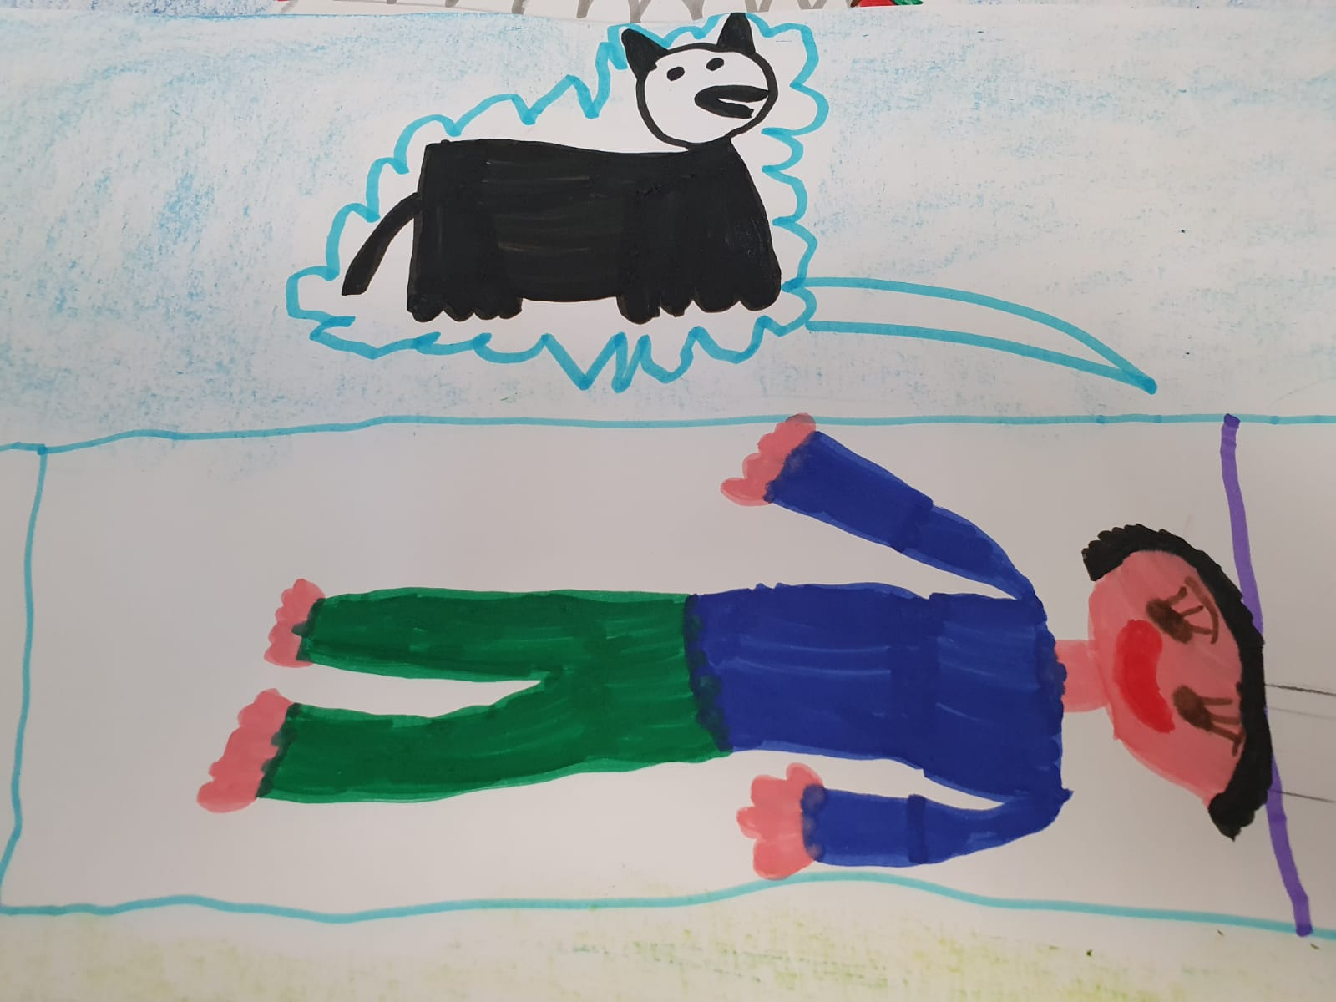
Our Lithuanian week!

Slide 11
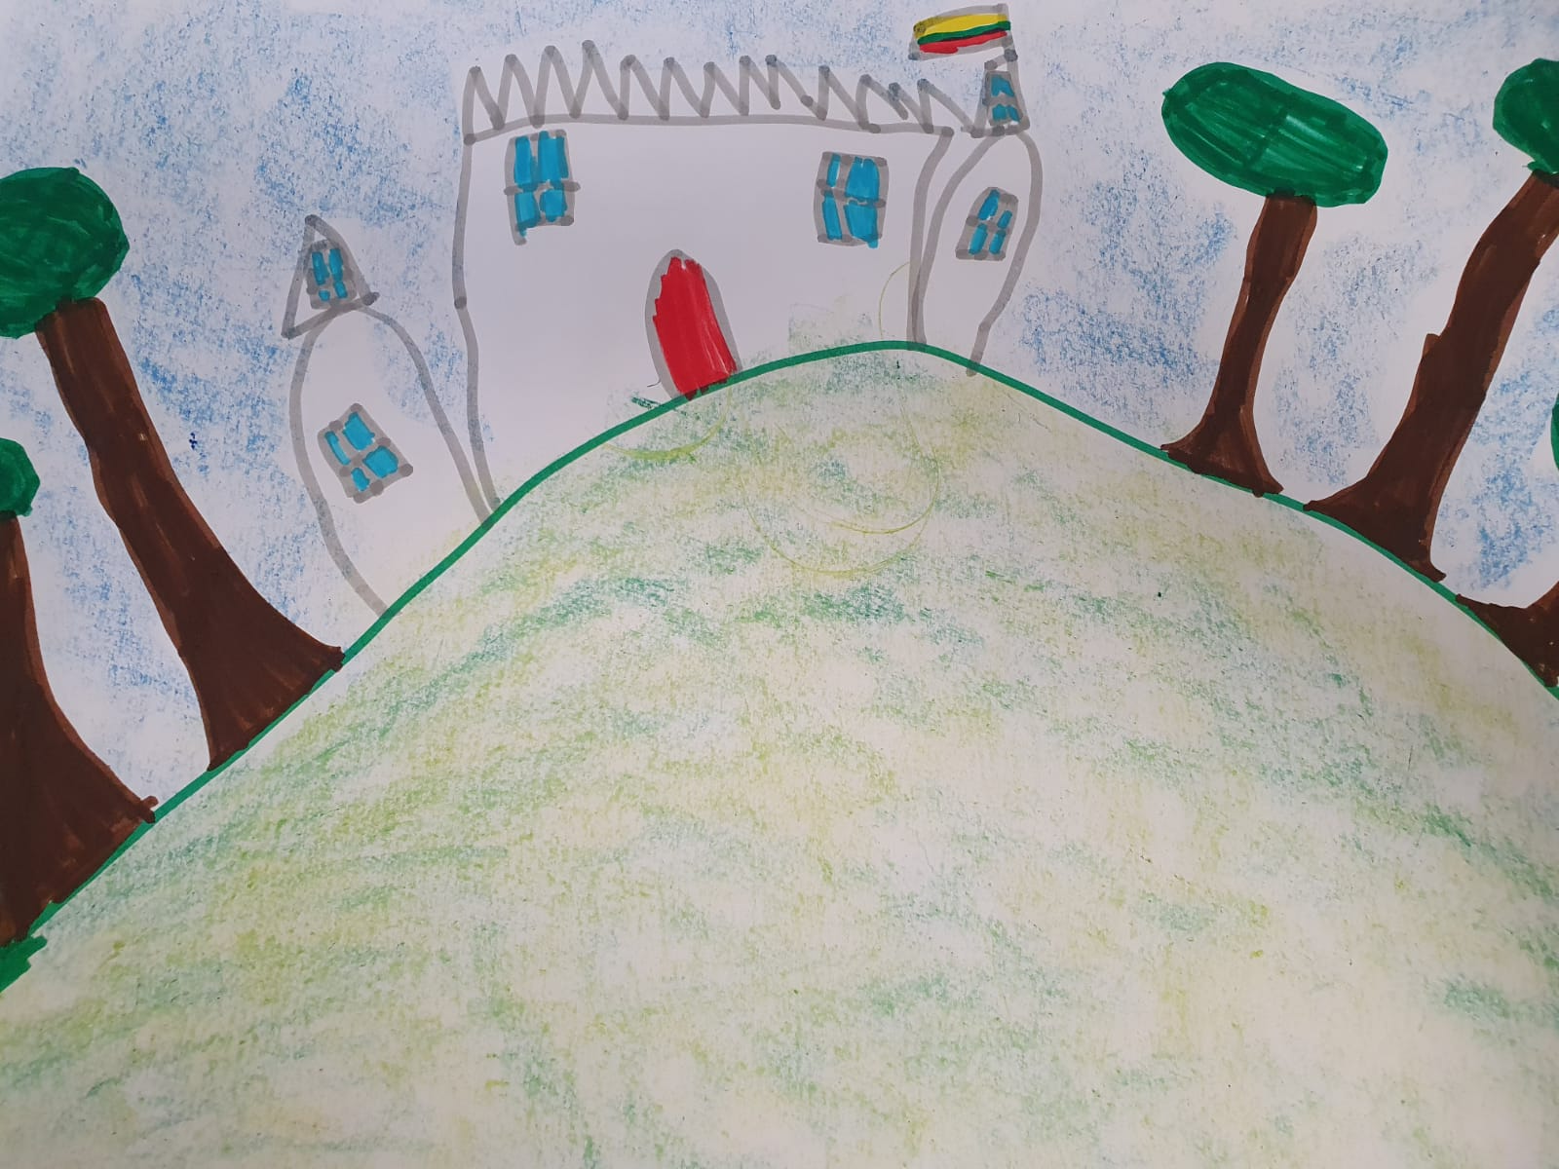
Our Lithuanian week!

Slide 12
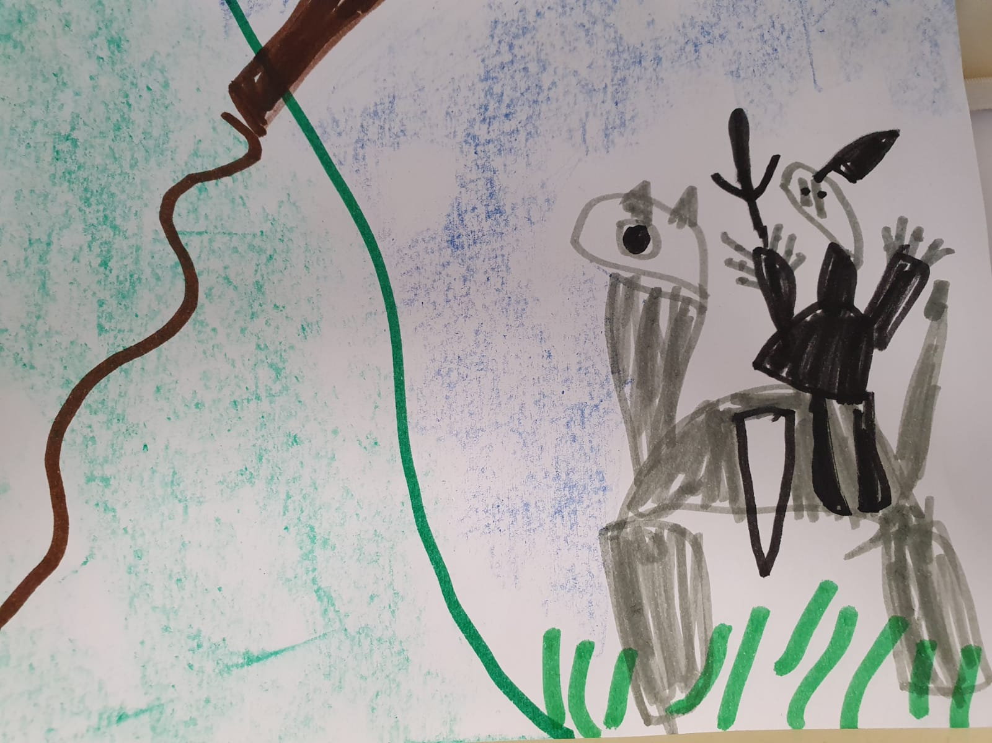
Our Lithuanian week!

Slide 13
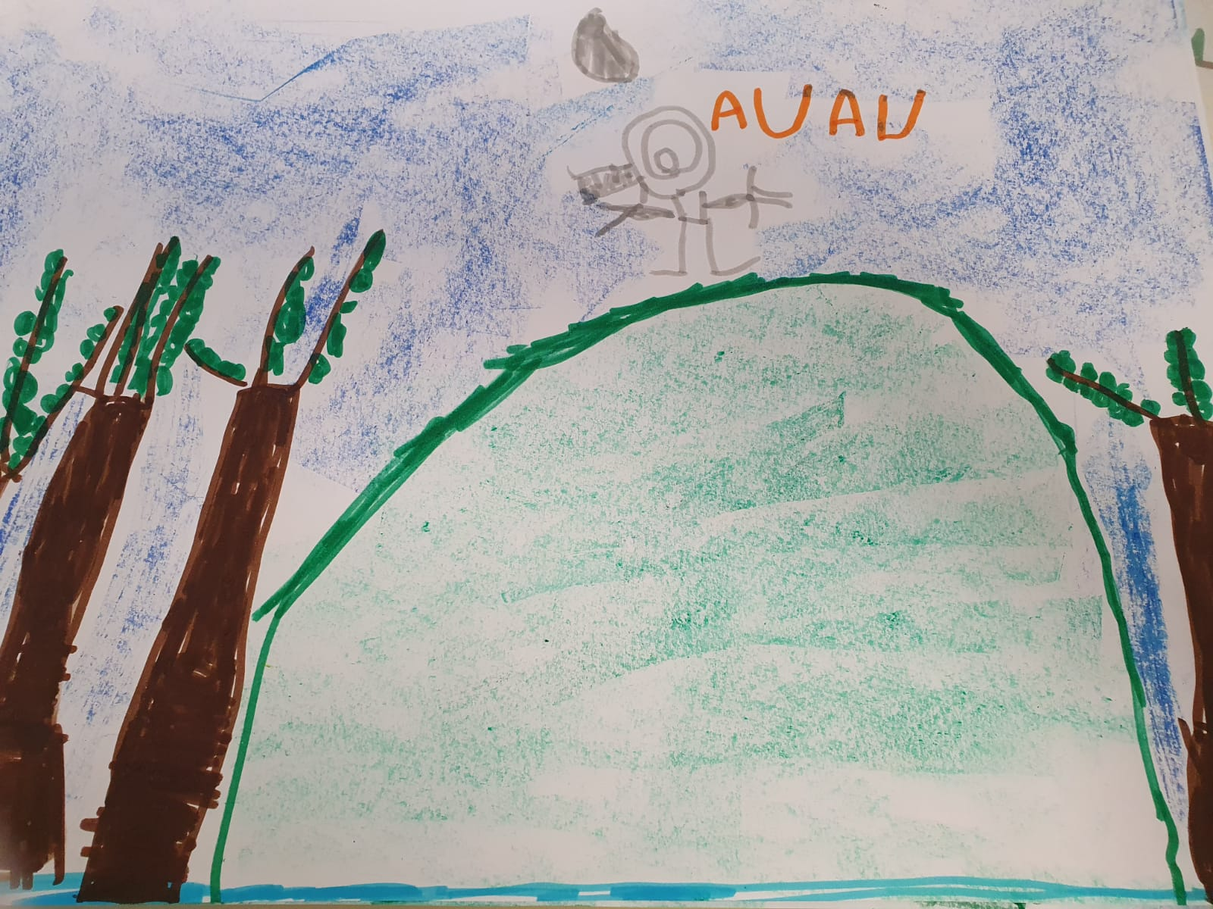
Our Lithuanian week!

Slide 14
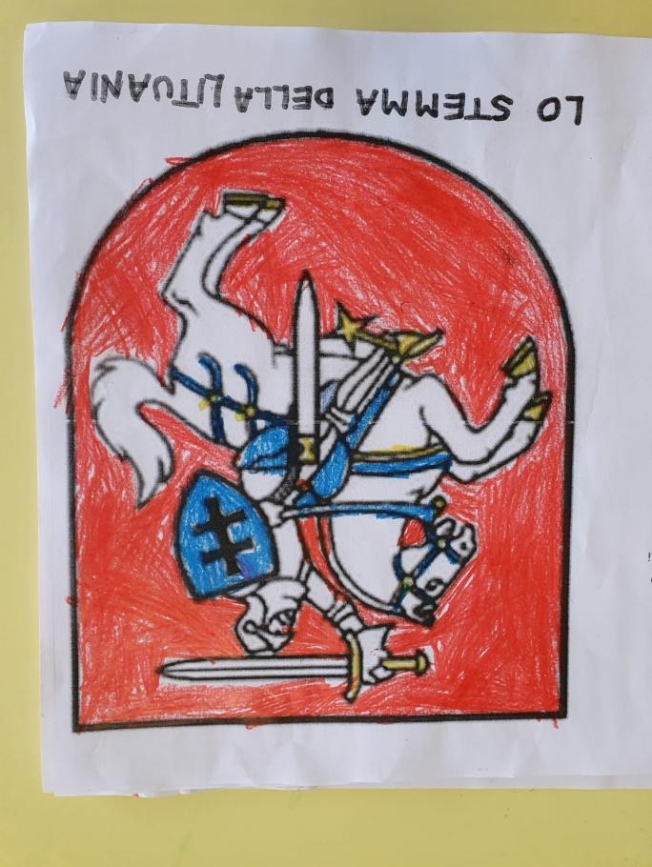
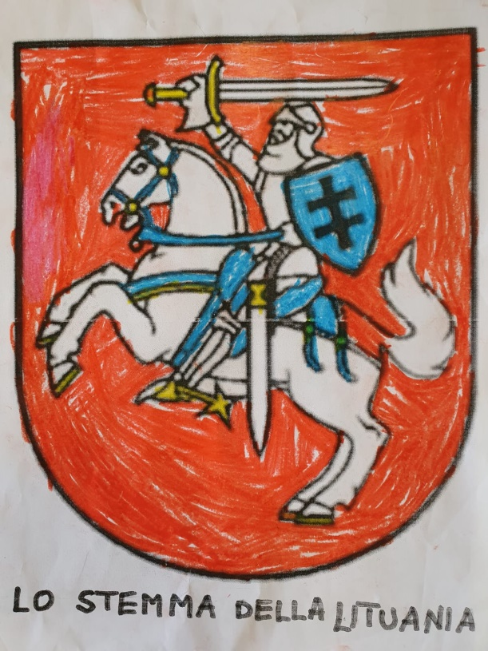
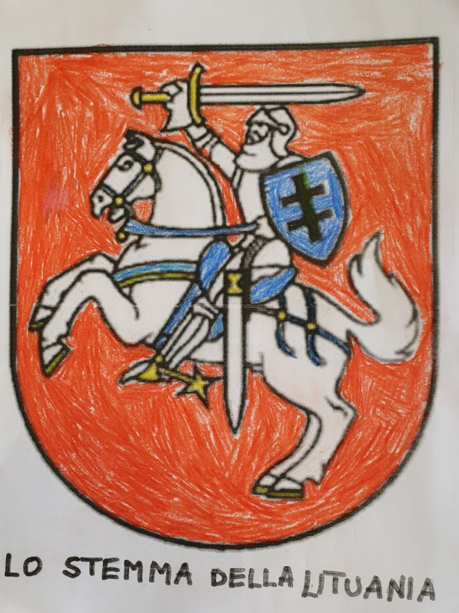
Our Lithuanian week!
Then we coloured the coat of arm of Vilnious

Slide 15
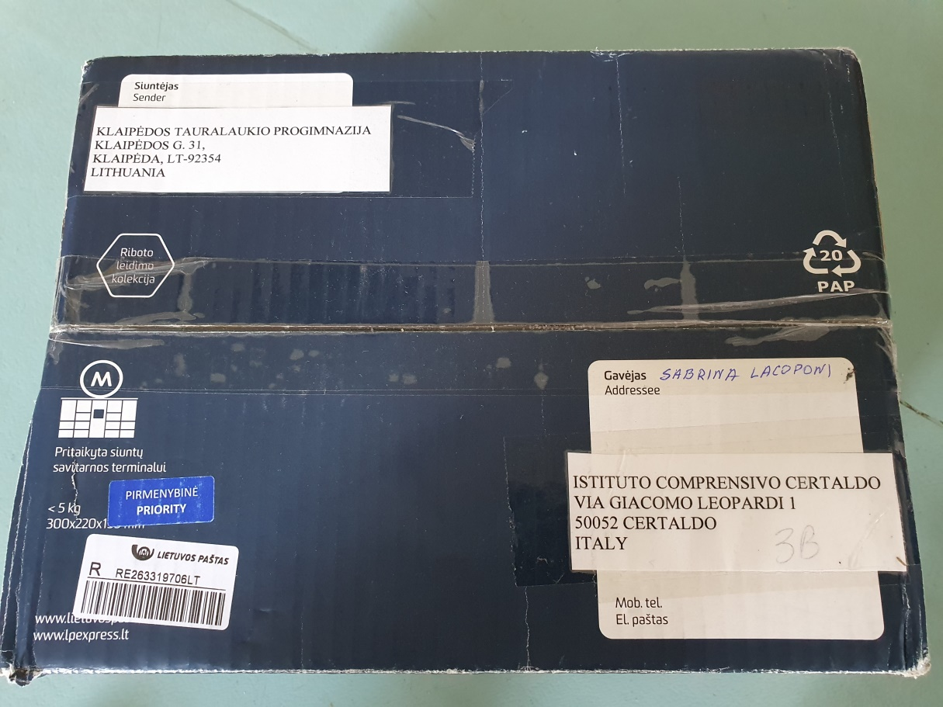
Our Lithuanian week!
Then our Lithuanian friends sent us a very nice present. A package with some presents for us: a letter and some maps, some buiscuits, tea, pencils and some flower seeds. What a surprise!!!

Slide 16
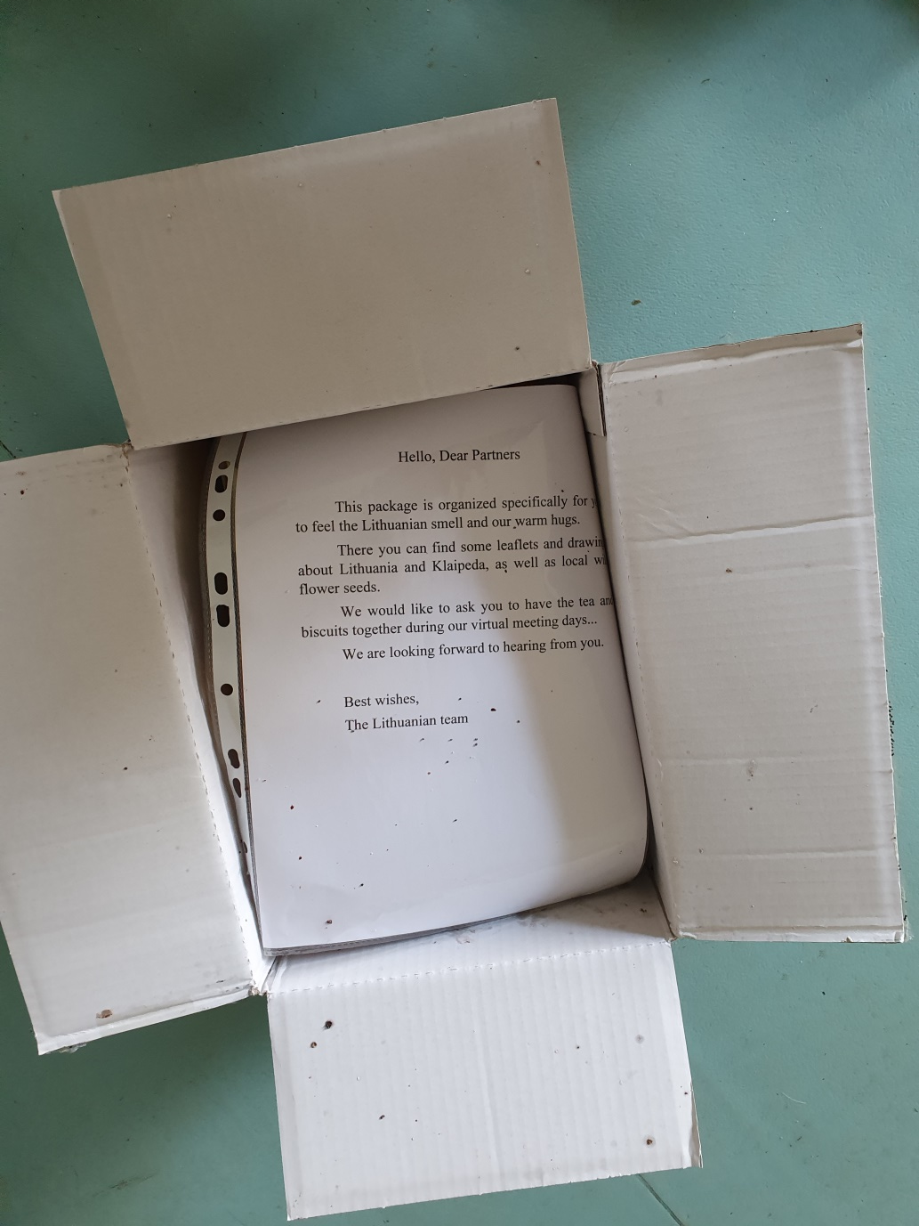
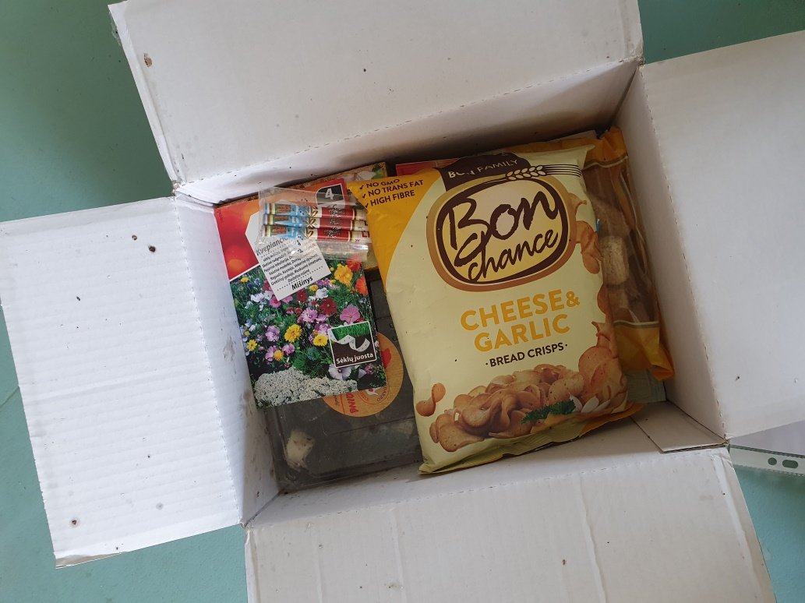
Our Lithuanian week!

Slide 17
Our Lithuanian week!
Ačiū
Thank you
Grazie

