Slide 1
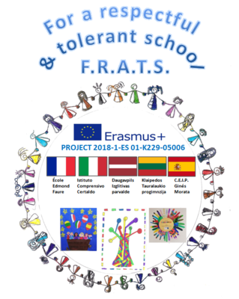
Activities
„I AM SPECIAL“
„AŠ - YPATINGAS"

Slide 2
During the Erasmus+ project “For respectful and tolerant school”, we talked with kids about differences and that no two people are the same. Every child examined themselves and their friend, how they are similar and how different they are, noticing the differences between them and their friends.nnnnnnnnnnnnnnnnnnnnnnnnnnnnnnnnnnnnnnnnnnnnnnn

Slide 3
With kids we created books “I am special – Aš ypatingas”, where kids drew themselves, wrote about themselves, their hobbies and height, put their fingerprints in, then they compared everything. After creating the books, kid happily read and showed them to their friends, told about themselves to each other.

Slide 6
I am special… no two people have the same fingerprints

Slide 7
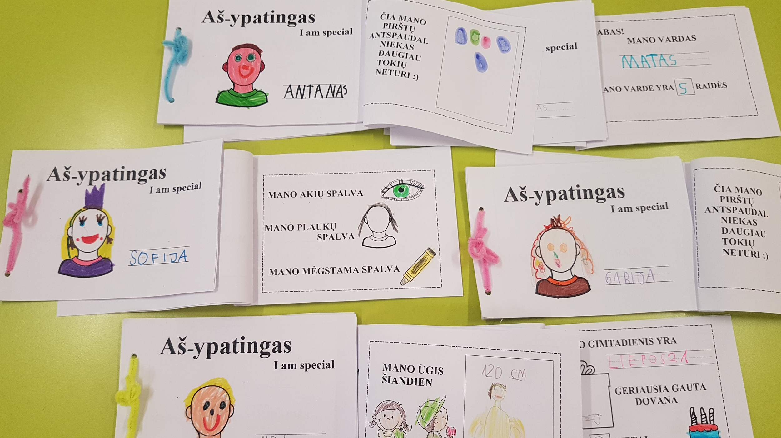

Slide 8
During the “I am special” activities a best friend was a mirror, who helped kids get to know their selves better, because of that we helped the kids to create mirrors, where they portrayed themselves. These mirrors tell the kids that everyone is important.

Slide 9
My eyes, lips, nose are unique…

Slide 11
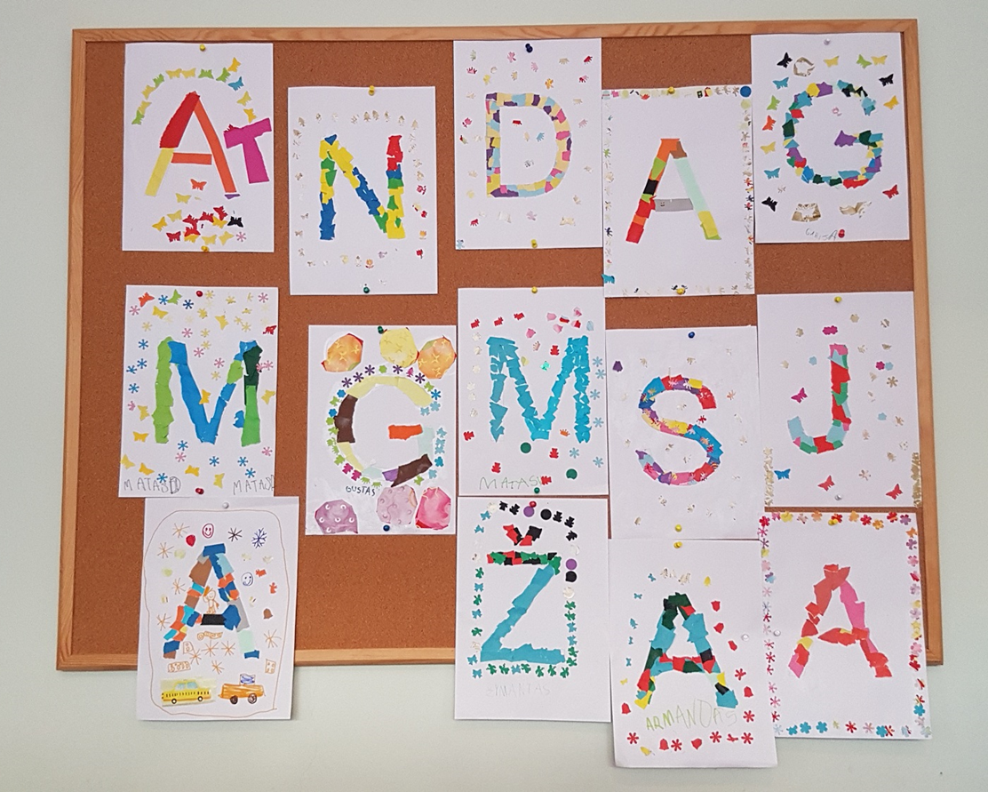
We talked about everybody having a name and that it is special. Kids stylized the first letters of their names. Children really liked this activity.

Slide 12
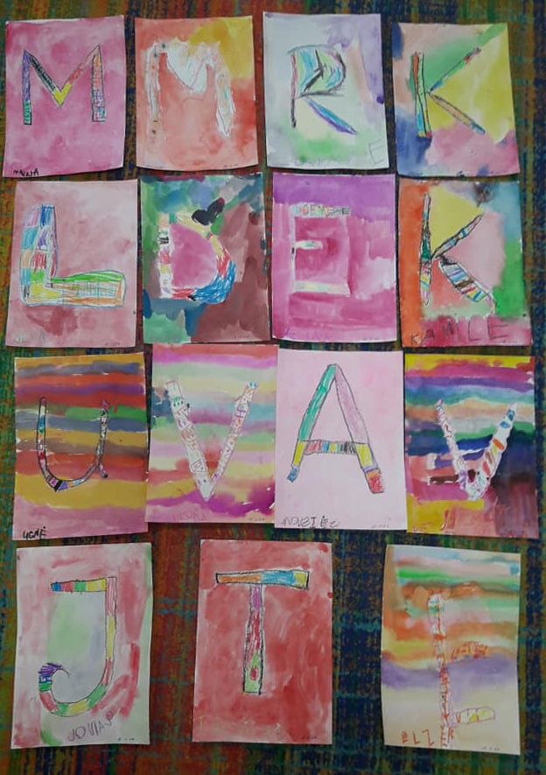
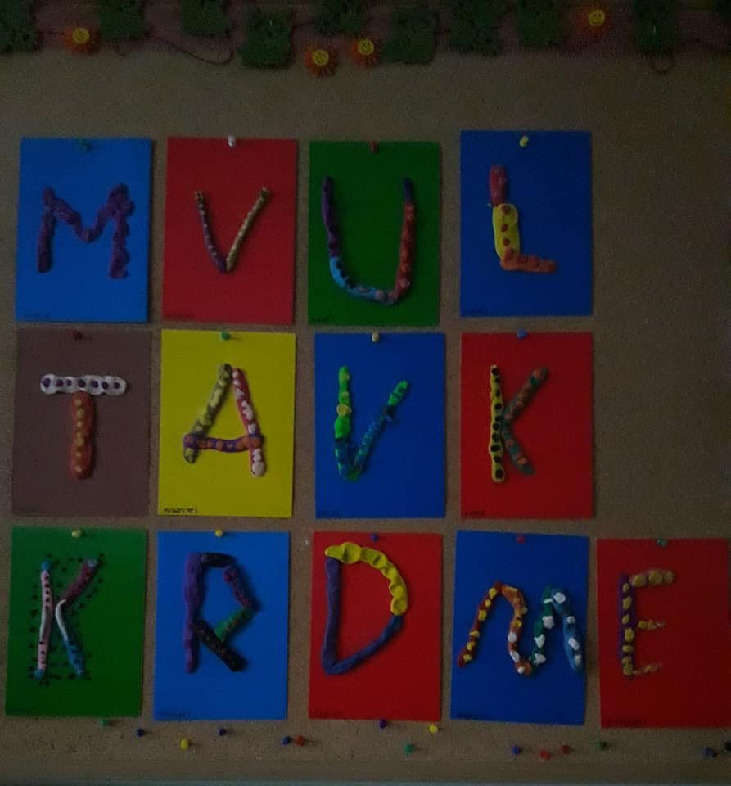

Slide 13
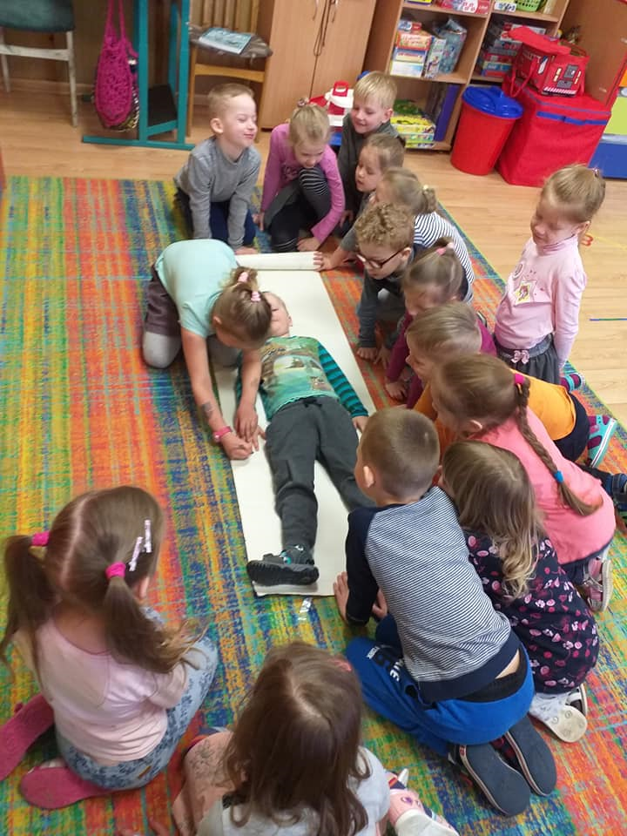
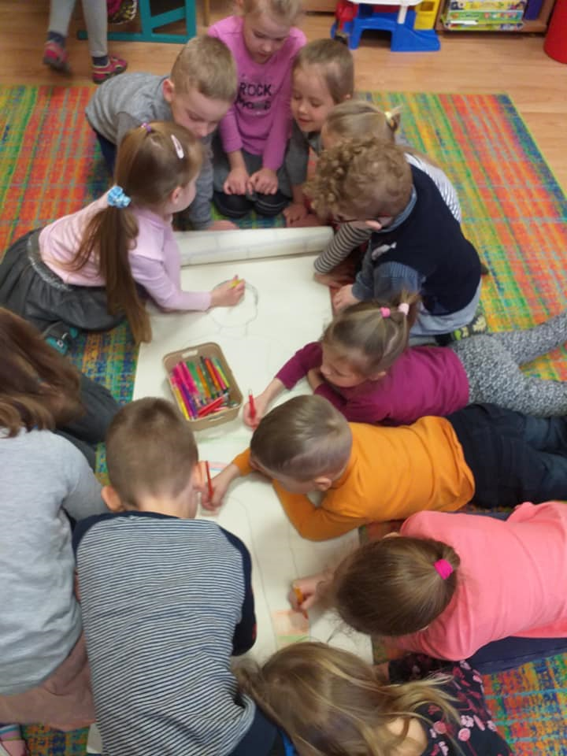
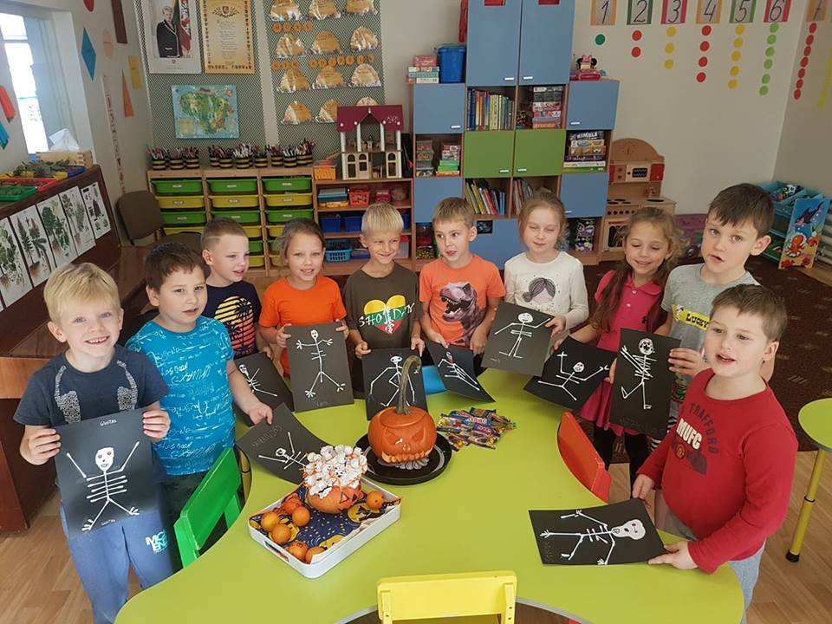
The kids studied the human body. They traced the silhouette of a friend on paper. We cut it out and kept it until the next fall to see how much the friend has grown. We made a human skeleton out of sticks, talked about the number of bones in a body.

Slide 14
During the “I am special” activities kids had a good time, got to know themselves and their friend

