Slide 1
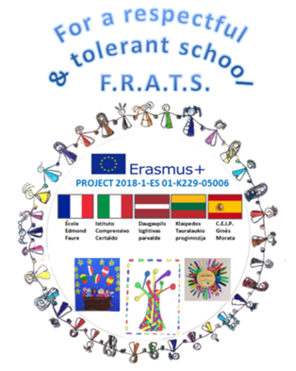
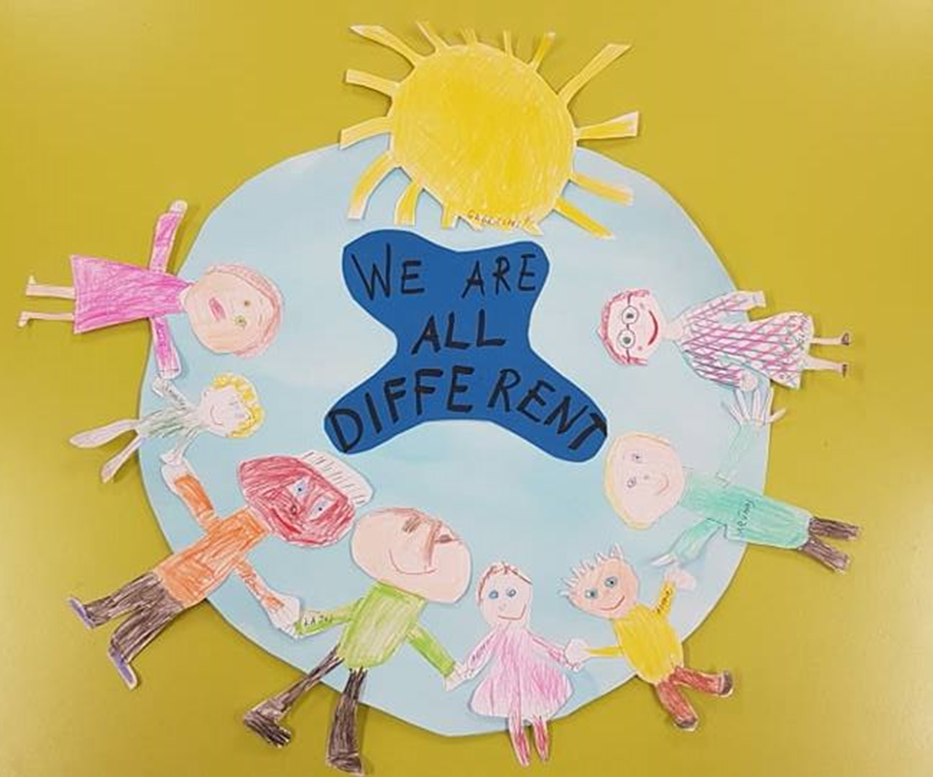

Slide 2
Activities for teaching differences

Slide 3
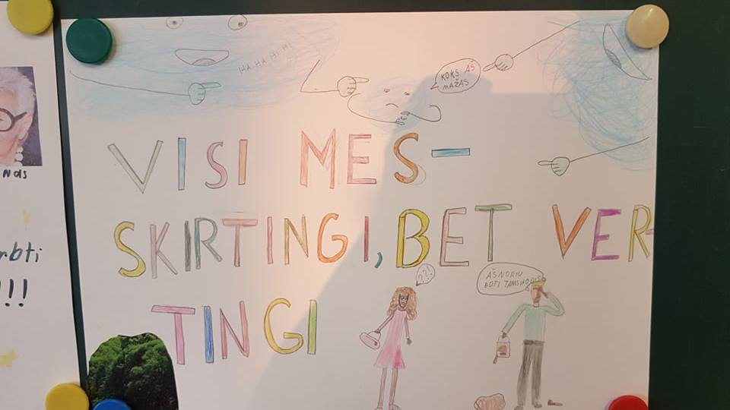
Developing the Erasmus+ project “For respectful and tolerant school” we talked with kids about being special and different. After “I am special” activities, children noticed that they differ in height, eye color, body build, skin color. We discussed about our differences making us special.

Slide 4
Differences wall

Slide 5
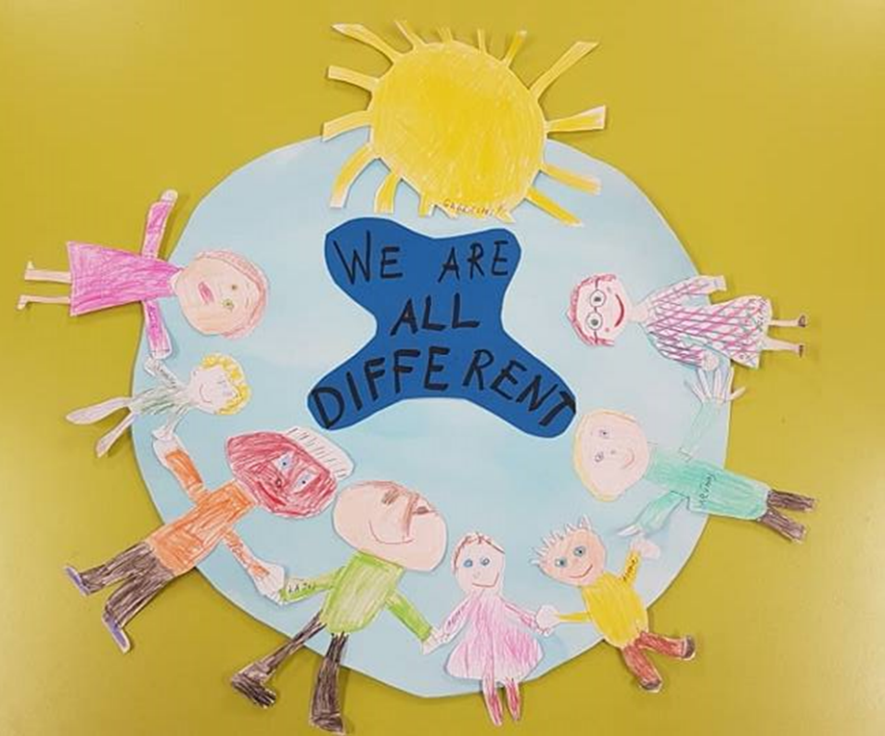
We talked with kids about skin color, that there are a lot of different cultures, different skin colors and various other physical attributes. We drew people, glued them onto a drawn earth, by that we accentuated that everyone is important and needed.

Slide 6
We watched a story about crayons who were all different and everyone thought of themselves as the most pretty. They all argued until they realized that they are all special and needed to create a drawing. This story taught us that working together and accepting other’s differences can help us achieve a lot.
https://vimeo.com/23111919

Slide 7
Activities „A box of crayons“

Slide 8
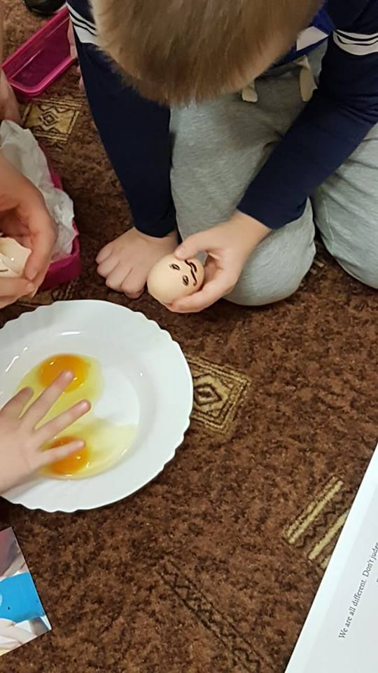
We did experiments with eggs. All of them differed in their color, size, but after cracking them, we found the same egg whites and yolk. We discussed that you should not judge people on their appearance, and that you should not reject somebody based on their looks. You need to take the people for what they are and get to know them better. „Our skin is just our covering, like wrapping paper. And, you can‘t tell what someone is like from the color of their skin“

Slide 9
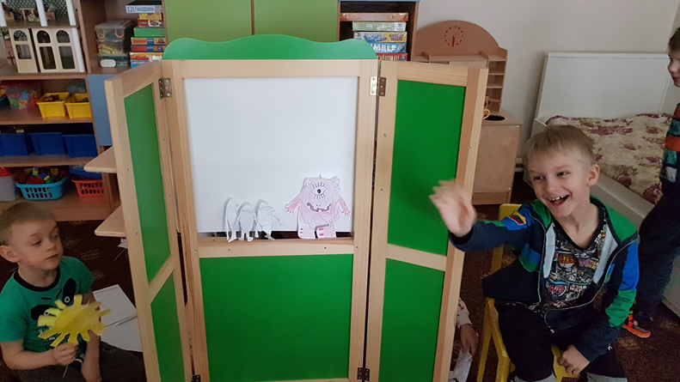
We also read and discussed a story called “The pink monster”. Rosa was very sad. She lived in a white city, where everyone looked similar and she was different. So she traveled to find a place where she could be happy. She did find it – a place where everyone was different, happy, lived and played together. Kids drew characters from the story, who came to life in their play of the same name as the story. https://www.youtube.com/watch?v=qujO8Vt_6WY&feature=youtu.be

Slide 10
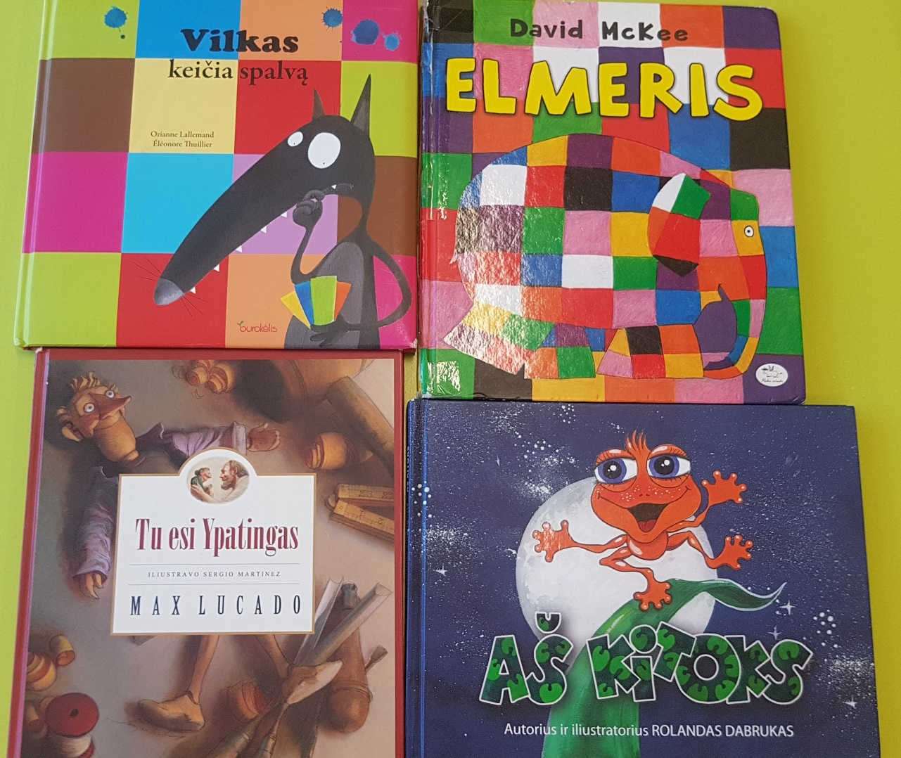
Together with children we read books which taught the kids and strengthened their knowledge that everyone is different yet important for the world to be even more beautiful.

