Slide 1
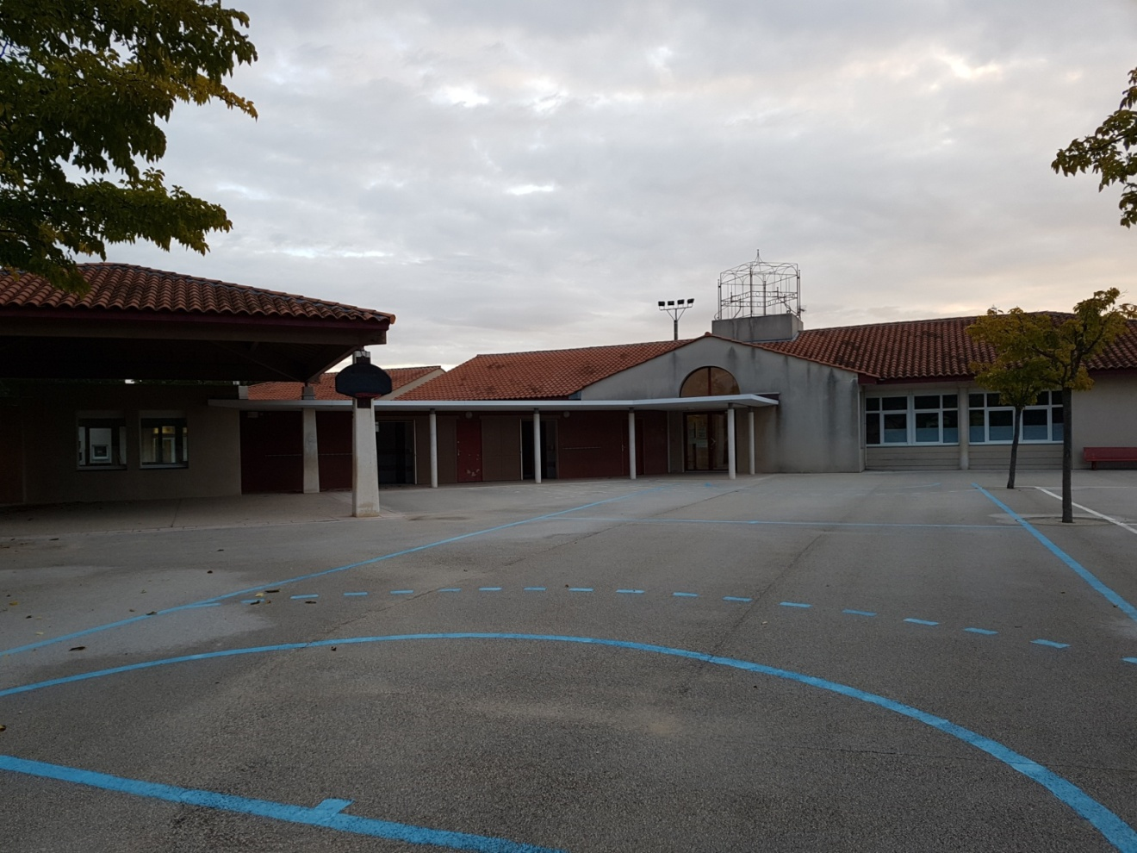
Elementary school Edmond Faure

Slide 2
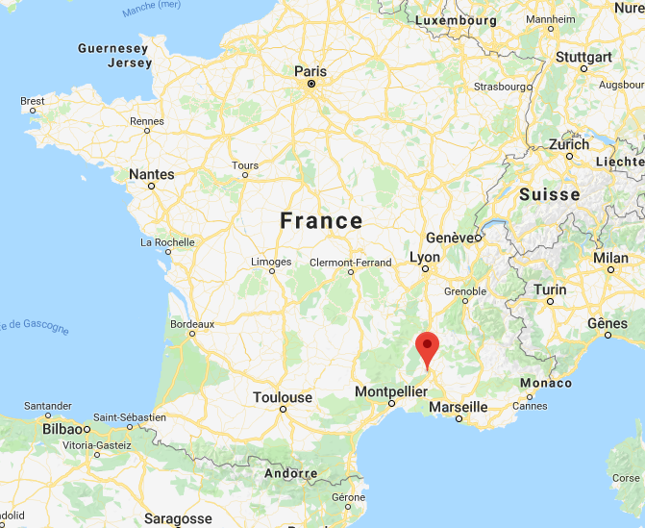
The school is located in the South of France, in a small village (about 1500 habitants) named Saint Geniès-de Comolas, not far from Avignon and Nîmes.

Slide 3
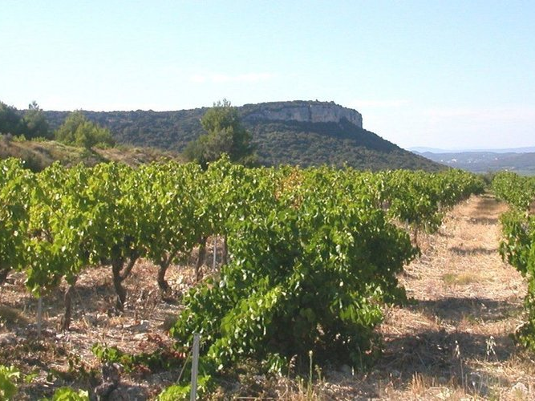
Around us, there are vineyards, beautiful landscapes. ….

Slide 4
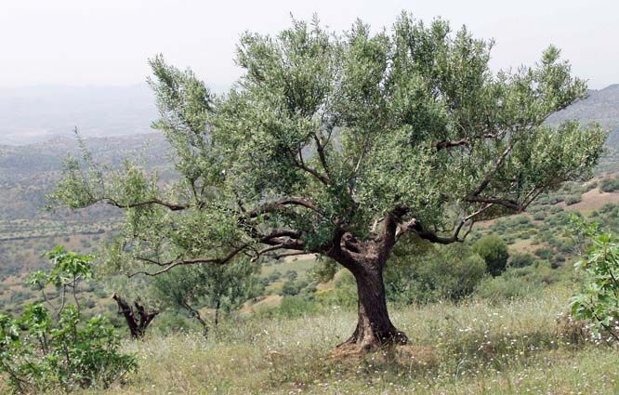
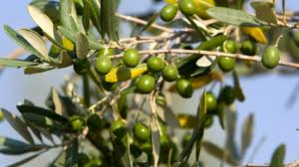
And a lots of olive trees!

Slide 5
Education system
- Nursery school: from 3 to 5
- Primary school from 6 to 10
- College from 11 to 14
- High school from 15 to 17
- Secondary studies : from 18
In France, school is obligatory from 6 to 16 years old.

Slide 6
The elementary school Edmond Faure is a public school from 6 to 11 years old. From 3 to 6, pupils go to the nursery school near to our school.
We work on Monday, Tuesday, Thursday and Friday in front of the children. The school begins the morning at 8.30 to 12. And the afternoon from 2.00 pm to 4.30.
Teachers work 24 hours in classes and 3 hours per week to help pupils with difficulties and meetings. We have to prepare class on our personnal time.

Slide 7
Morning and afternoon break lasts 15 minutes.
During the lunch, the children can eat at the canteen ( the parents pay the meal) or go home.
There is also a nursery the morning from 7.15 to 8.20 and the evening from 4.30 to 6.30.

Slide 8
The school staff is formed by 6 teachers and so there are 6 classes:
- CP: where pupils are 6 years old. The class of Pauline
CP-CE1: 6- 7 years old
CE1- CE2: 7-8 years old . The class of Gisèle
CE2- CM1: 8- 9 years old
2 CM1- CM2 : 9-10 years old . Céline’s class.
There are about 140 pupils in school, 23 per classe
A specialist teacher in psychology comes on request.
There is also a bahamian conversation assistant who comes every Tuesday .

Slide 9
In our school, we work all the competences needed in french curriculum.
French Mathematics Sciences
Geography History Art
Music Physical sport English
We teach English to pupils from the smaller to higher class.
We have also tablets, computers ans white interactive boards.

Slide 10
The most project in this moment is an action each last Tuesday before the holidays. During this afternoon, we mix all classes . We involve parents at this time to help us to supervise activities ( sport, manual activities, sign language, theater..) It creates a special relationship with parents and develops a positive understanding and cooperation.
There is a parents association who earn money with differents activities ( bake sale, manual activities.. ) and give money to us . We use the money for pay the bus, visits ..

Slide 11
The city hall buy all we need at school: pencils, paper,…
We have about 350 per classe to go out in bus (it’s correspond to only one outing)
School doesn’t have money so we have a school association: we collect money when we can.

Slide 12
We want to participate at this project to develop new abilities and learn new methodologies. It’s enriching to share new practices with colleagues from all over the Europe.

Slide 13
We are really enjoy to join us!
Thanks for your attention!

