Slide 1
Organization of teaching process

Slide 2
The ministry of education and sport approves the main documents:
Education programs (the goal, process, objects)
The study plan (duration, time, holiday dates )
School must follow the education programs and the study plan.

Slide 3
Duration of education process
School year stars on the 1st of September
Preprimary education is compulsory.
Primary education continues 175 days in a year, for 4 years.
School year consists of 3 terms or 2 half years.
In 1st form lessons are 35 min. 2-12 forms - 45 min.

Slide 4
The main parts of a lesson:
Introduction
Learning activities
Conclusion

Slide 5
Planning of education activities in pre-school groups: • Plan for a year • Plan for a week

Slide 6
Timetable
• Gathering, preparations – 7.30-8.30
• Breakfast – 8.30-9.00
• Morning circle – 9.00-9.30
• Educational activities – 9.30-10.30
• Outside games, in groups – 10.30-12.00
• Lunch – 12.00-12.30
• Sleep, calm games – 12.30-15.00
• Evening circle – 15.00-15.30
• Dinner, preparations – 15.30-16.00
• Games and other activities in groups or outside – 16.00-18.00

Slide 7
Education activities are planned and executed according to the topic of the week:
SOCIAL COMPETENCE:
Core skills
Can say their name, surname.
Can say how old they are.
Know their birthday date.
Can name their interests, hobbies.
Can state their opinion confidently.
Stick to the rules and agreements.
Are able to show emotions, intentions, have pity over the ill or the troubled.
Have rudiments of responsibility, self-control and self-regulation.
Tidy up their playgrounds, take care of toys and objects.
Play freely, coordinate actions, discuss about the rules.
Take note of other’s opinions.
Resolve conflicts peacefully.
Are interested in their surroundings, activities.

Slide 8
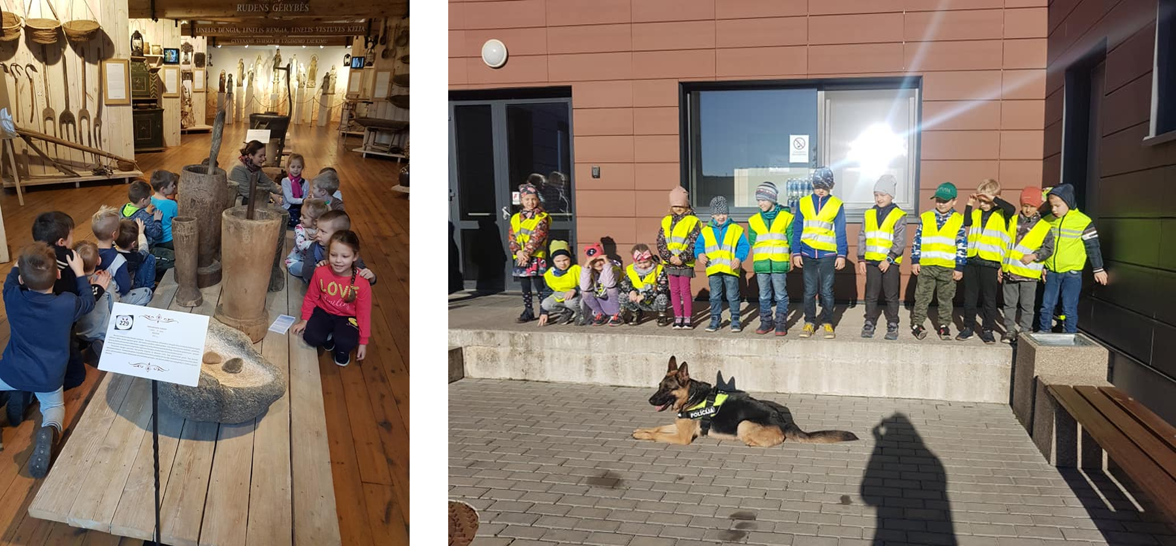

Slide 9
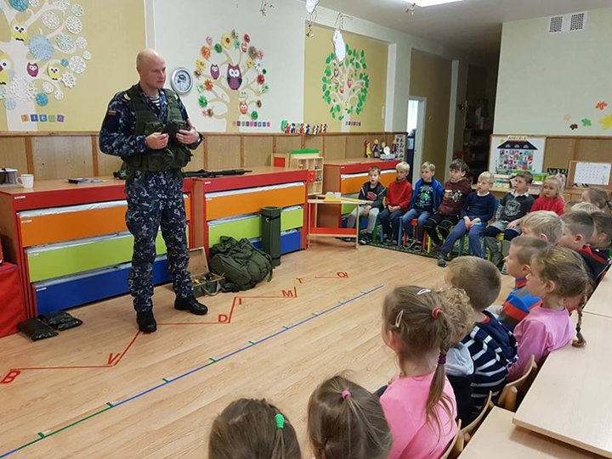

Slide 11
COGNITION COMPETENCE:
Core skills
Actively ask questions about things that interest them.
Observe, explore, experiment.
Willingly model, construct, play tabletop games.
Count, measure, compare, group.
Comprehend size and position of objects.
Group, compare objects while changing the basis of comparing
Depict features of known objects with touch and feel.
Can name the features of seasons, weeks and parts of the day.
Comprehend human, plant and animal circle of life.
Experiences in nature depict in drawings.
Observe the weather, its changes.
Can say how animals and plants are beneficial to humans.
Know that you shouldn’t litter and that you should save the natural resources.

Slide 12
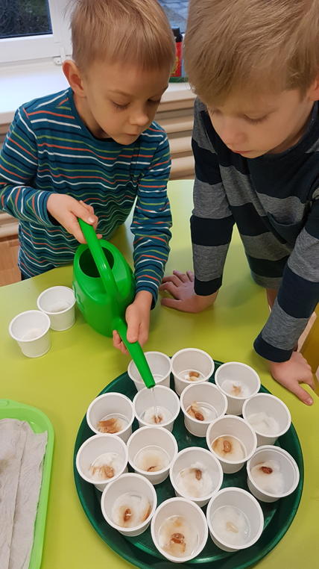
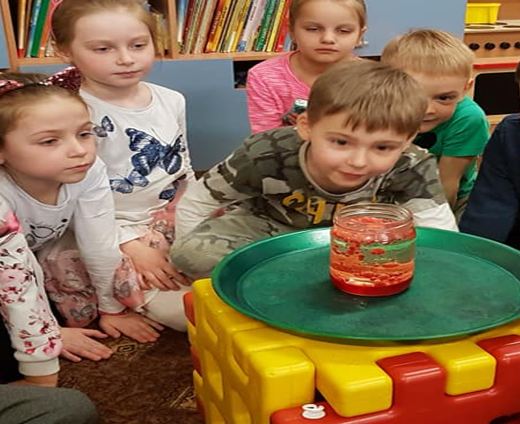

Slide 13
COMMUNICATIONAL COMPETENCE
Core skills
Speak according to a situation (place, time context).
Say their thoughts comprehensively.
Concentrate and state their opinion.
Willingly listen to texts being read, stories being told.
Create a short beginning and end to a story.
Recite poems, tell stories.
Take interest and interest in books.
Notice differences and similarities between images, signs and sounds.
Recognize some of the letters.
Copy, draw, and try to write some letters, words.
Notice and recognize some words.
Correctly hold the pencil, marker.
Redraw lines, figures, patterns.
Read their own name or other words important to them.

Slide 14
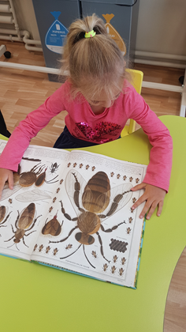

Slide 15
ART COMPETENCE Core skils
Creatively utilize various art expression tools and materials.
Precisely color shapes, drawings.
Carefully do pieces of work, various tasks.
Get ready and tidy up the work space on their own.
Willingly play theatre: create storylines, take roles and play them.
Willingly act, improvise
Willingly tell stories, share experiences about plays seen in groups, kindergarten.
Are able to dance: smoothly, expressively, alone, in a pair or a group.
Play instruments: are able to make sounds with various toys, objects and instruments.
Differentiate short and long, high and low pitched musical and non-musical sounds.
Sing willingly.

Slide 16
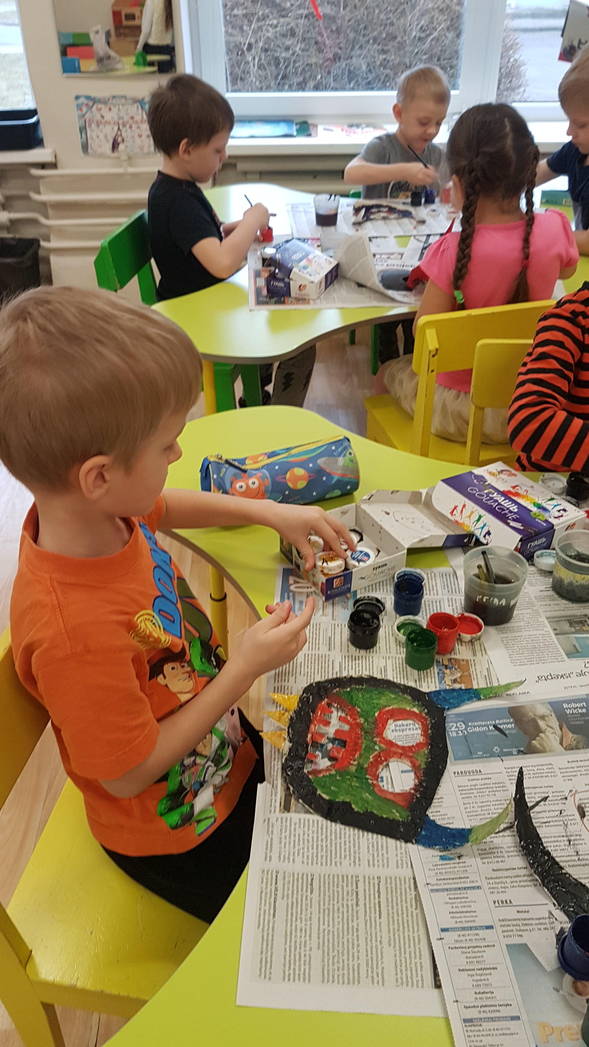
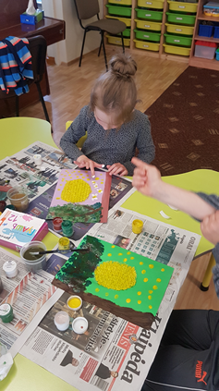
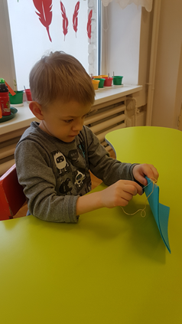

Slide 17
HEALTHCARE COMPETENCE Core skills
Take care of their and other’s safety and health according to available options.
Are able to relax, calm down.
Say why you shouldn’t take matches, sharp objects and medicine.
Are able to explain how to act safely on a road.
State why a person is sick, what helps to grow up healthy.
Are able to take care of personal hygiene independently.
Are able to name and show main parts of the body.
Independently make and tidy up the table, playgrounds.
Independently tie and loosen shoe laces.
Dress up on their own.
Know their home address.
Know the numbers of emergency services.
Sit, stand correctly.

Slide 18
