Slide 1
LATVIA WEEK‘s moments

Slide 2
The Gifts from erasmus + project partners

Slide 5
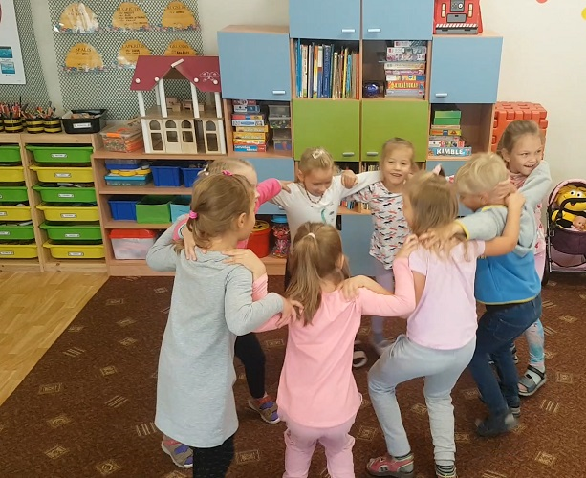
LATVIA DANCE

Slide 6
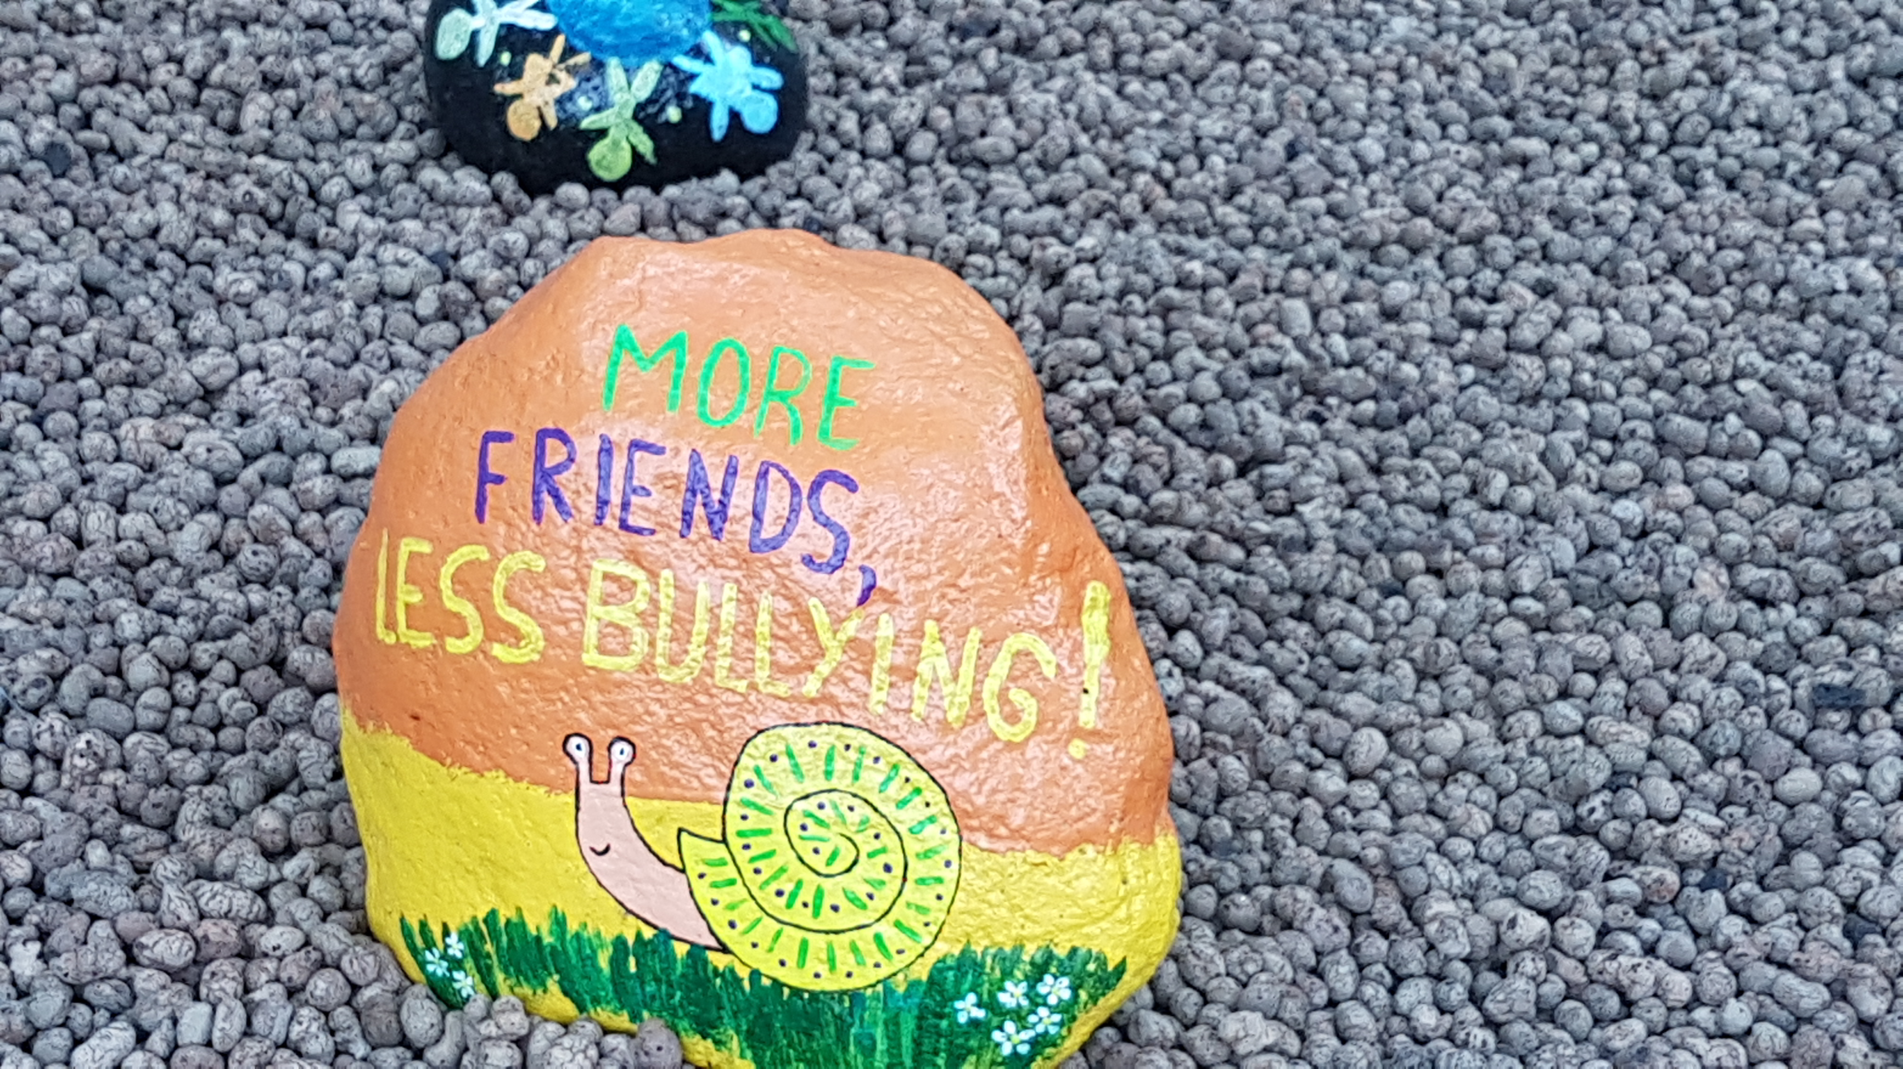
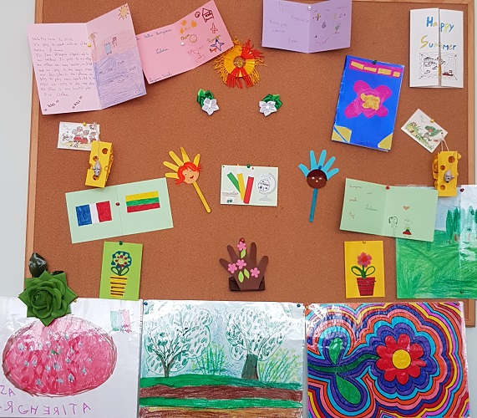
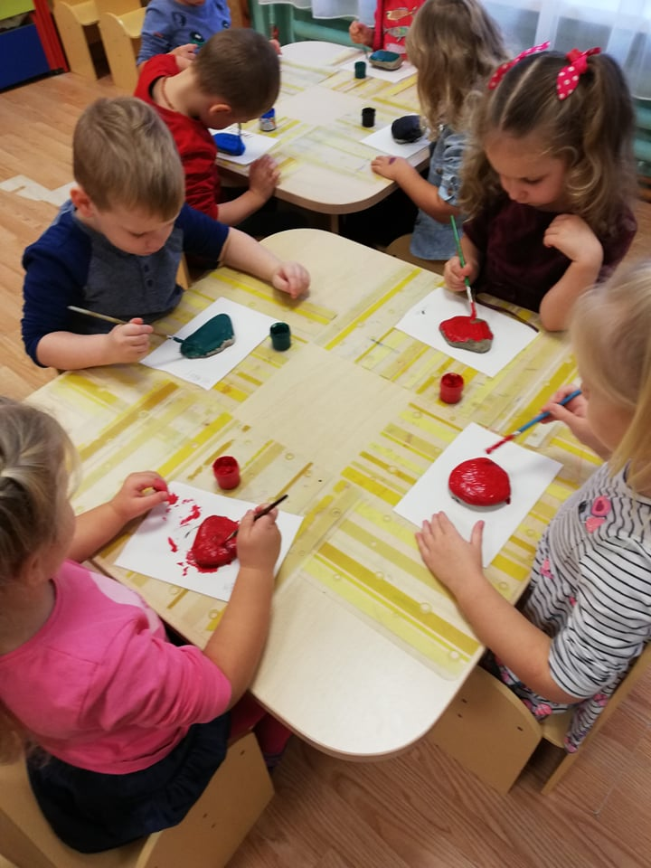

Slide 8
