Slide 1
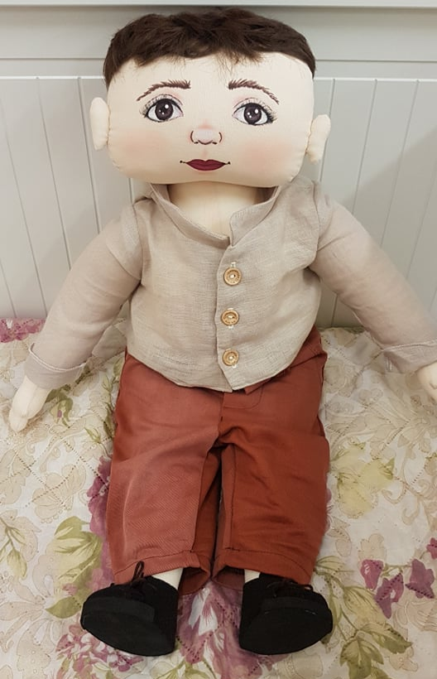
Doll etan

Slide 2
Family: lives with his father and his mother. Has an older brother.
Nationality: Eric was born in Lithuania. His parents are Lithuanians. They speak Lithuanian between themselves.
Likes/ differences: likes being with friends, playing active games, running, helping grownups. Likes to eat a lot. Doesn’t like being laughed at. Doesn’t like tabletop games, educational activities done on or by the table.
Favorite food: likes dishes from meat, sweets. Doesn’t like – curd, pasta.

Slide 3
Fears: afraid of insects, being alone.
Physical individuality: now he’s 5 years old, dark hair, brown eyes. He is of heavy build.
History: Etan really likes running, but often when running he trips over his friends or objects and falls over. Etan really wants to make friends, but sometimes he shows his emotions too strongly and hurts his friends, sometimes – without intention. Friends avoid Etan because they fear that he will hurt them and they also laugh at him because of his obesity. Then Etan feels bad because he is clumsy due to his obesity.

Slide 4
ETAN STORY
One Wednesday Etan came to the kindergarten happy, in a good mood, talked to friends. During the morning circle listened to teacher's stories, actively participated in activities. After the activities, kids were getting ready to go outside. Etan was happy, that he‘d get to go outside, from the joy he hugs his friend too strongly and makes him fall over. The friend gets angry, because it wasn‘t fun for him, that Etan hugged him without a warning and the other kids got frightened when they fell over. Etan always tries to be nice, so apologizes to his friend nicely and promises to try not to do this again.
Etan being in a hurry trips over other kids. The kids get angry that he‘s fat and always trips over things. Firstly, Etan tries to apologize to everybody, but the kids start laughing at him, calling him names. The boy asks his friends to stop doing that, but they don‘t listen to him and keep laughing. Etan starts to cry. His friend’s words hurt him. One boy comes closer to Etan, pushes him, says that Etan is fat, and always blocks the way. Etan gets angry and starts pummeling his friend. He gets angry because he always tries to be good, to apologize after hitting his friends accidentally, but his friends make fun of him because of his obesity, laugh at him and push him. The teacher splits them apart and, after going outside, gets everyone to sit in a circle and talk.
How does Etan feel?
Why did Etan do this?
Why do other kids make fun of him?

Slide 5
The story of a doll Ethan thought us nice behavior with kids, who are different. We laid out cards and created stories, talked about helping a friend, not laughing at him/her.
We tried to feel what the other person experiences while being laughed at, what we could change in our behavior to make Ethan feel better.
We watched an animated movie, which reminded us that everyone is important, we should help each other and never give up.
https://www.facebook.com/psichologijosnamai/videos/2144138198996477/?t=8
Activities with dolls help us to develop children's social skills, make speak who are too shy to say about their feelings. While helping the dolls, children learn to communicate and to work together, find answers to their questions.

Slide 6
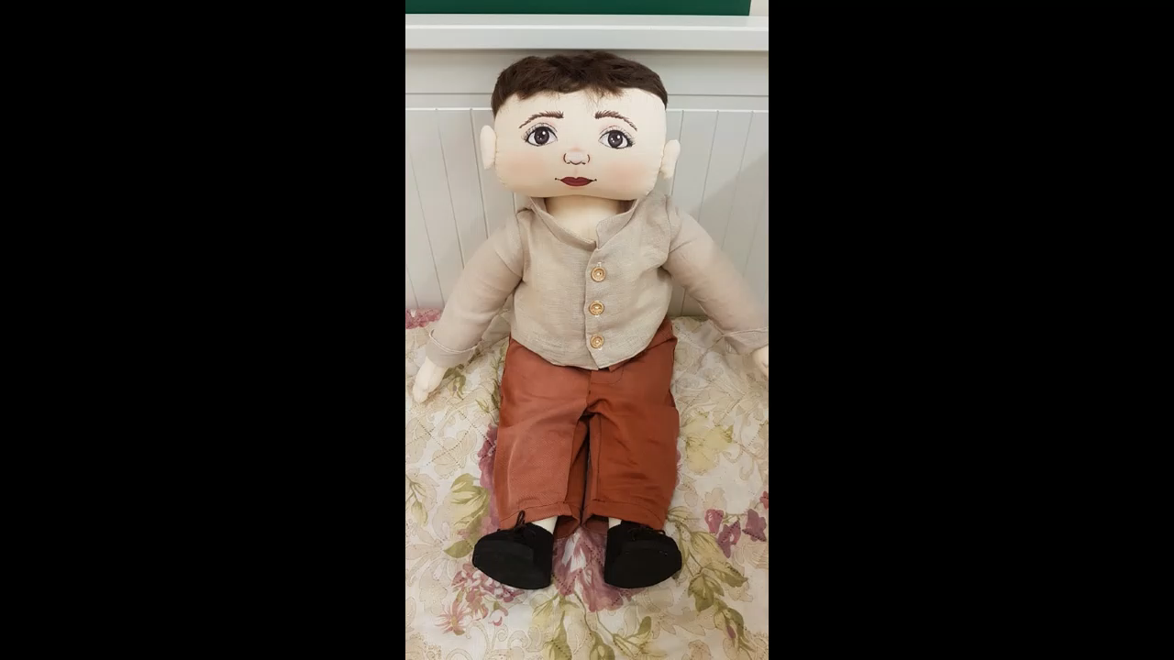
ACTIVITIES WITH DOLLs

