Slide 1
Lead a Persona Dolls activity based on children with special needs.
7th – 10th June
2021

Slide 2
Lead a Persona Dolls activity based on children with special needs. The Dolls and their stories are great to address disability and special needs issues, and build self-esteem and confidence.
The Dolls can help to support children with special needs as some Dolls use wheelchairs, some wear glasses etc. The dolls build empathy between children of different levels of ability/disability. Dolls can help children ‘unlearn’ prejudice they may have picked up towards children who are ‘different’ to themselves, or those with different special needs. Persona Dolls also assist with integration in mainstream facilities as well as dealing with prejudice from non-disabled children

Slide 3
The day of persons with dissabilities 3rd December

Slide 5
Each one of us makes this puzzle complete

Slide 7
I am special. Activities and discusions about people wearing glasses

Slide 9
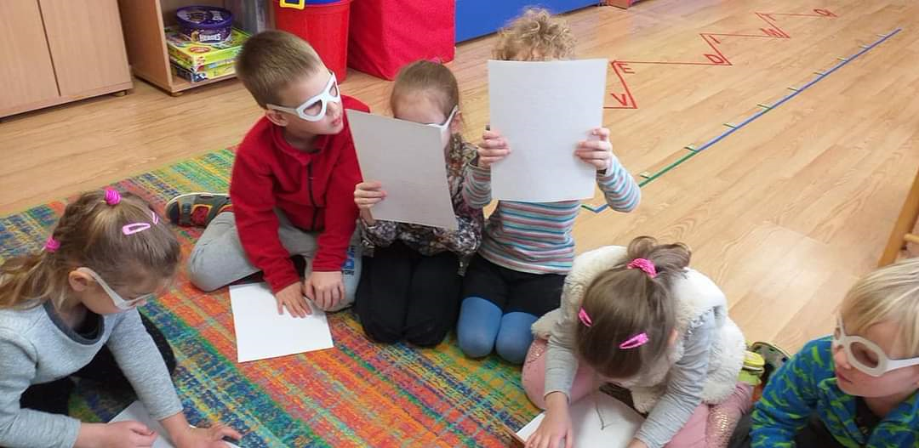
Trying to read Braille

Slide 10
I am wearing glasses

Slide 11
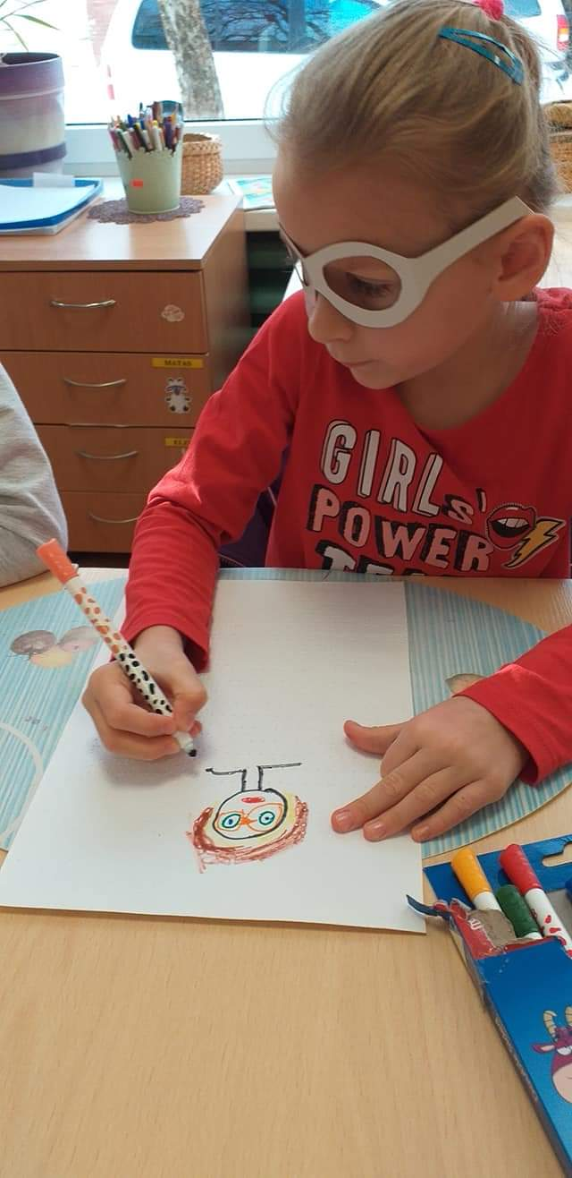
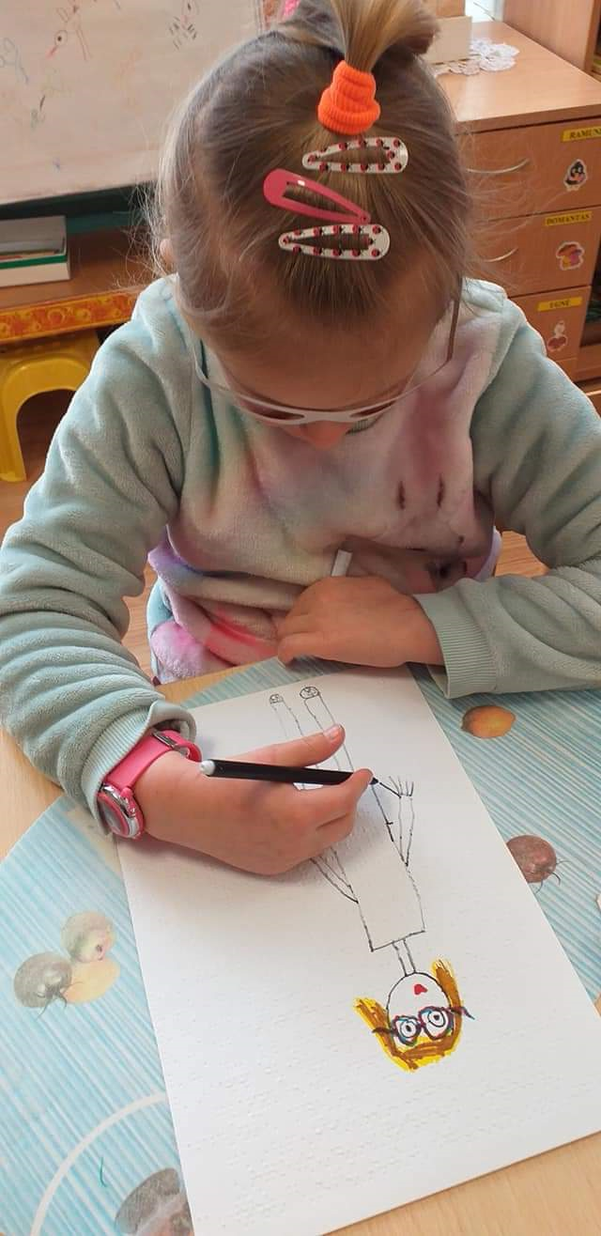

Slide 12
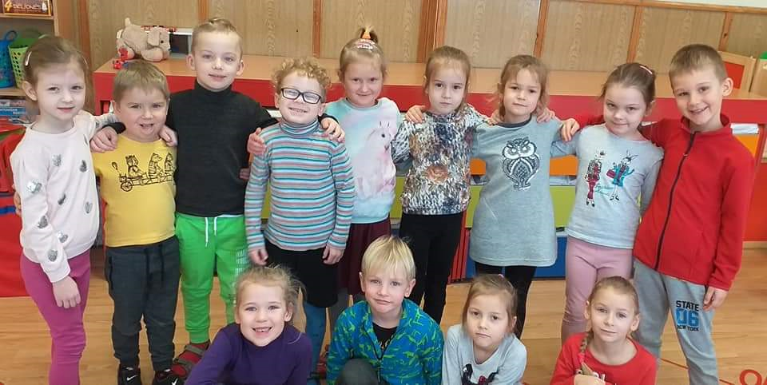
We are wery happy

