Slide 1
PDM
Persona
Doll
Methodolgy
M.Mar Jurado

Slide 2
TRAINING: PERSONA DOLL METHODOLGOGY

Slide 3
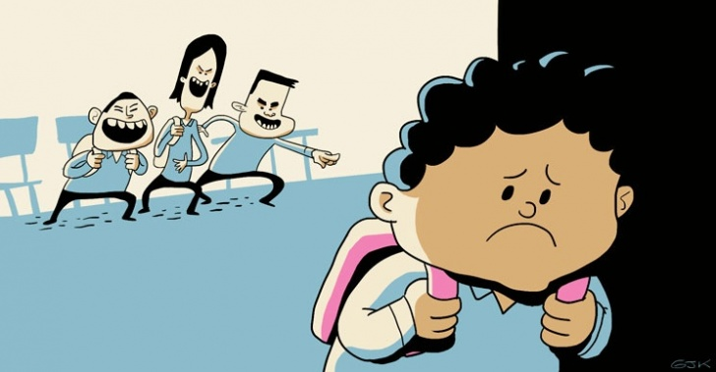
1st LESSON-INTRODUCTION
*Meeting organization.
Application form review. Steering groups, tasks.
Evaluation of the project quality. Spanish NA report.
Timeline. *Selfevaluation : Montly reports.
*Discussion:
1-Children aggressive behaviour
and bullying. Notice, Act, Prevention.
2-What are the main problems you see every day between young children?
Notes:
*1- Changes??? Children who will help them at school, classes that every team should visit, exchange of presents/cards, control certificates and bill (are them ok)
*2-Self evaluation- contact- control- Google calendar, every moth I will write tasks, 2-
*3-WORKSHEET 1Discussion: Everyschool 5 minutes to agree/ 15 minutes to discuss with others.-
-Results
What is bullying?
KIVA define acoso como 3 actuaciones repetidas contra la misma víctima por los mismos acosadores en 2 semanas.-
When is the right time to handle bullying?
Always--
Who can easyly be bullyied?
What can we do to prevent it? What is more efficient – punishment or analyzing the problem and finding solution with children.?
Valueing children individuality.
Increasing children self-esteem.
Positive role model from grown ups.
Careing about sensitive children.
Engouraging children.
PDM can help us to do all those things

Slide 4
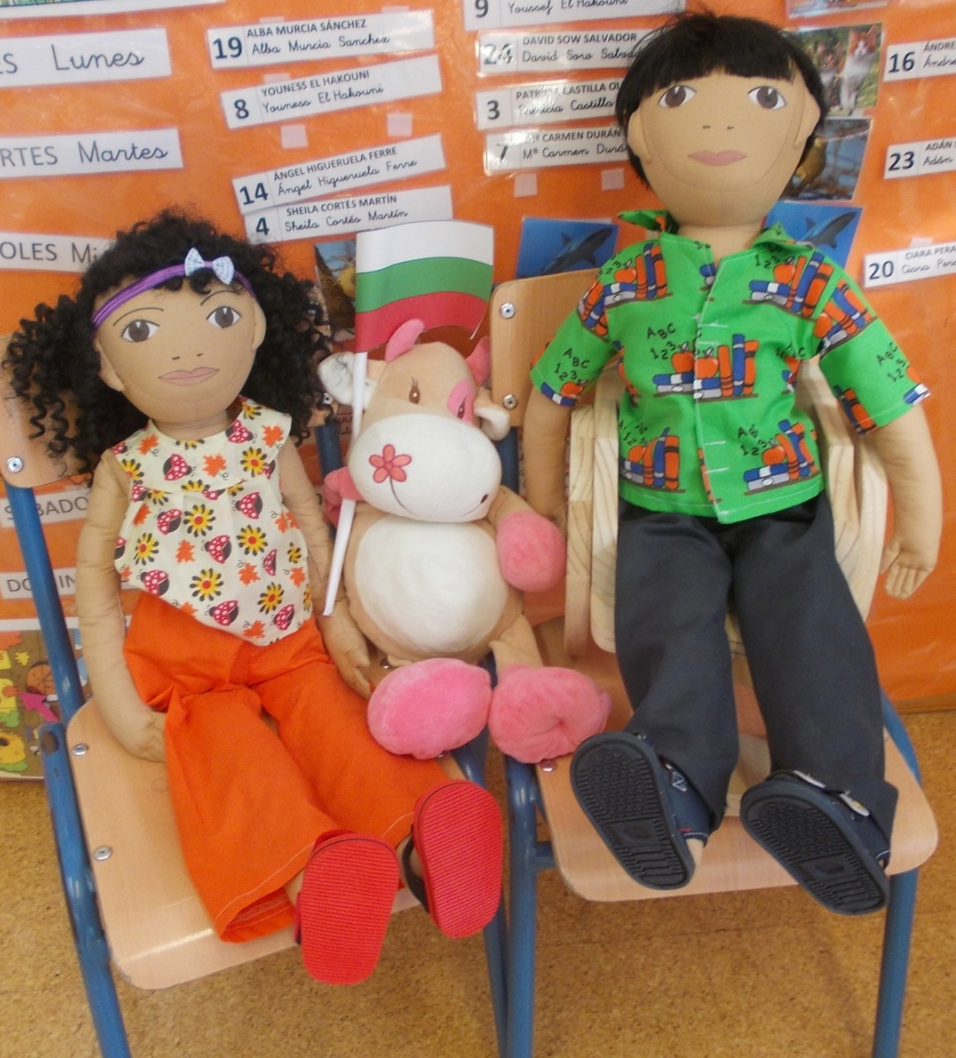
2nd LESSON-PDM
Persona Doll methodology :
*HISTORY
Created in USA, 1950
Through doll activities
we deal with these topics:
teaching values
practicing social skills
developing tolerance
Notes:
*1- HISTORY:
Persona Dolls were first used in the United States. At that time, the 1950s, very few resources were available that reflected the ethnic diversity of children. Two teachers Kay Taus and her colleague Ruth moaned and groaned about this unfair and unacceptable situation. One day they took action.
They created dolls out of card and matched their skin colours and physical features as accurately as they could to the children in their nursery school. Personas were developed for each doll and stories based on children's experiences, were woven around the Dolls. The children quickly identified and bonded with them.

Slide 5
DOLLS
They are not just ordinary toys.
Every doll has its personality.
They come to classroom only for their activities or special situations.
Their size should be hugable.
They reflect children differences and individuality
During doll activities children point out differences and similarities with dolls.

Slide 6
PRINCIPLES
PDM is unique, can be adapted
Uses an emotional language.
Proposes playful activities.
Develops children sense of empathy.
Encourages children to stand out
for themselves and others.
Analyzes and solves everyday
problems.
Practices with children how to
face individually problem situations.
Notes:
*1- dolls can be developed and topics can be chosen according to the need of every school.

Slide 7
*Mainly focus on introducing differences and increasing tolerance.
*very practical and useful tool to:
*develop children self esteem;
*develop empathy and respect to diversity in children;
*handle prejudices and repulsion
*Solve problems
Notes:
*1-Differences: cultures, languages, physical,
*2-These “down-to-earth” dolls, their ”true like” experience they share through doll stories and the discussion included
*3-Individuality and self - esteem: developing and expressing self knowledge, group feeling, confidence.
empathy and diversity: feeling comfortable about diversity, to understand differences, caring about differences.
prejudices: describing unjustice and understanding pain.
problem solveing: developing activity in children, impact and skills to act in unfair situation.

Slide 8
PROFILE & PERSONALITY
Doll personalities are created with the cooperation of teachers' team taking into account specific problems or situations which the team consider that they should work about .

Slide 9
Some data can not change after the profil/personality has been create but other can be changed during time
All profiles are written to the doll book, where doll stories will be also included.

Slide 10
Workshop:
Ordering dolls
Introduction of Spanish dolls. Analysing documents: books, dolls, handbooks, stories, videos, webpages...
Persona Doll España
Every child is special- English
Every child is special- Spanish
Ceip Ginés Morata

Slide 11
3rd LESSON-PROFILE INFORMATION
How old is the doll?
Is it a boy or a girl?
What is the doll’s name?
What languages do the doll speak?
What makes the doll happy, sad and moody?
Is doll afraid about something?
Where does the doll live?
Who does the doll live with?
Does the doll share room with someone?

Slide 12
Do doll’s parents work? Where?
What does the doll like to do at home?
What is the doll good at, what is difficult for he/she?
Is there something that the doll can not do?
What is dolls favourite food and what food does not the doll like?
Has something happened in doll life or something will happen soon?
Is there a special day in dolls life? How is it celebrated?
Other interesting aspects you consider useful

Slide 13
WHEN WRITING PROFILE KEEP IN MIND
Dolls reflect children in your school
Dolls should have many differences in order to be able to handle as many topics as possible.
When creating personality to a doll from another culture look for information about the culture and nationality peculiarities.
When you give to a doll a certain peculiarity, try to avoid direct similiarity to a certain child

Slide 14
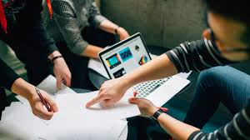
3rd LESSON- TEAM WORK
*Differences that you deal in your schools.
What are the main aspects that make your pupils differents?
How do you work about that?
Notes:
15 minutes WORKSHEET 2 ( keep your answers for agreement on next session).
Hoja anexa fotocopiada para trabajo

Slide 15
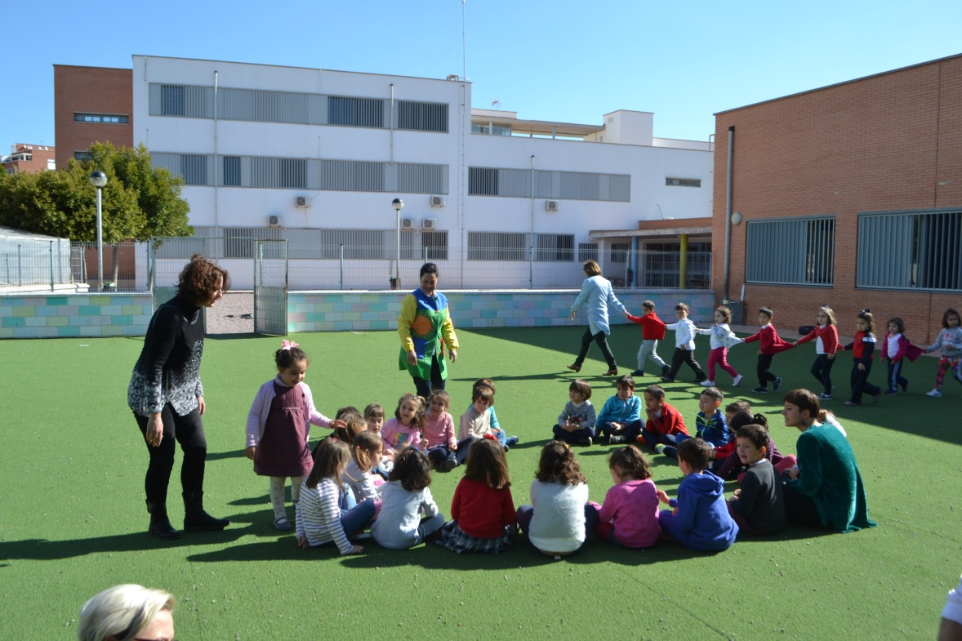
3rd LESSON- HOST INSTITUTION
Our country - SPAIN
Our city –ALMERIA
Our school- CEIP GINES MORATA
Introduction Spanish educational system.

Slide 16
4th LESSON- PARTNERS
Introduction to every school/city/ country participant
Comparing 5 different Educational systems in Europe
Notes:
10-15 MINUTES EVERY TEAM

Slide 17
5th LESSON- DIFFERENCES
*Cultural differences
Other nationalities, languages, skin colour, religion
*Overweight
Different physical abilities, eating habits, disease,etc…
*Language and comunication problems
Different ways of communication
Notes:
RECORDAR TRABAJO WORKSHEET LESSON 3-
*1-CULTURAL Very important is the behavior example of adults.
PD methodology is a very good opportunity to introduce other nationality and culture in a positive way.
When children are aware about cultures and nationalities differences they act more tolerant to children from other cultures.
Preventive work – skincolor differences!
Encourage children to create friendship with children from another culture.
*2- Overweight High risk to be bullyied and to become bullyies.
Social exclusion can deepen the overweight problem.
PD methodology is a good oportunity to explain the reasons of being overweight: unhealthy eating habits, insufficient physical activity, disease, genetic.
Prioritizing healthy lifestyle.
People different physical ability.
Focus on what children are able and can do, not to what children can not do.
Recognize children individual achievements.
*3- Adaption problems due to understanding language.
Social problems due to understanding language.
Self – expression and communication difficulties.
Repulsion from games due to understanding language.
Through Persona Dolls methodology activities children understand how difficult it is to understand and express yourself in different language.

Slide 18
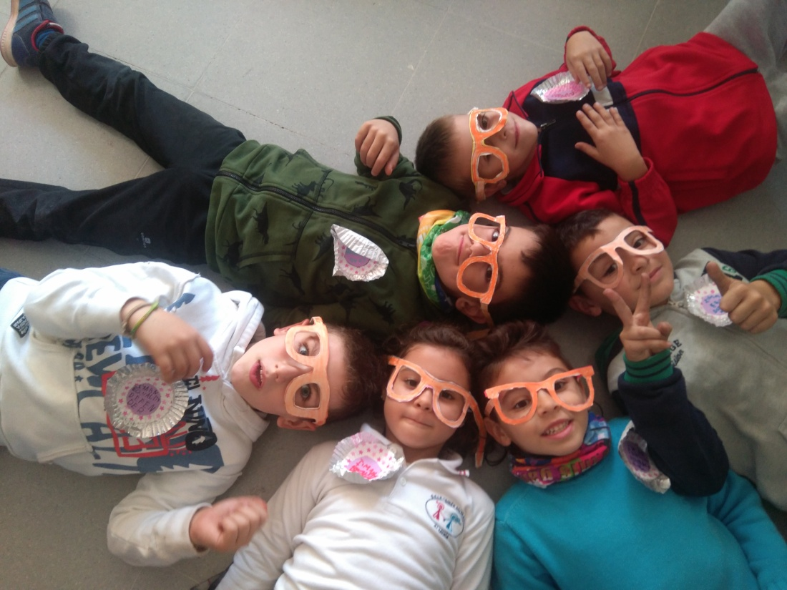
*Social unequality
Prejudices and negative acttitude
Medical diagnosis & Special needs
Autism, hyperactivity, allergy, asthma, diabetes, physical disability, mental disability, hearing loss
Wearing glasses
Fealing Unconfortable and fearful
Notes:
*4-Sensitive and difficult topic but very necessary to be handled.
Children with unwashed and dirty clothes.
Difference and unequality of toys.
Difference and unequality of clothes.
Grown ups will example a good standart as for example for children.
NB! Prejudices and negative attitude – IT IS NOT CHILDREN FAULT!
Staying away from activities (christmas party, thetre, museum).
Helpfulness and careing.
*5- Autism, hyperactivity, allergy, asthma, diabetes, physical disability, mental disability, hearing loss.
PD methodology helps children to understand special needs and also empathy and tolerance increases.
PD methodology is a good oportunity to shape tolernace preventevly - children are often reluctant to the topics that are unknown to them.
Through doll activities children will be aware that special needed children can participate in a lot of everyday activities.
As the result of activities special needed children confidence and courage will increase.
*6- Fear of wearing glasses.
Feeling uncomfortable and forgetting.
Through PD activities children understand why some people have to wear glasses.
Children empathy grows towards wearing glasses.
Good oportunity to handle teasing and concrete situations

Slide 19
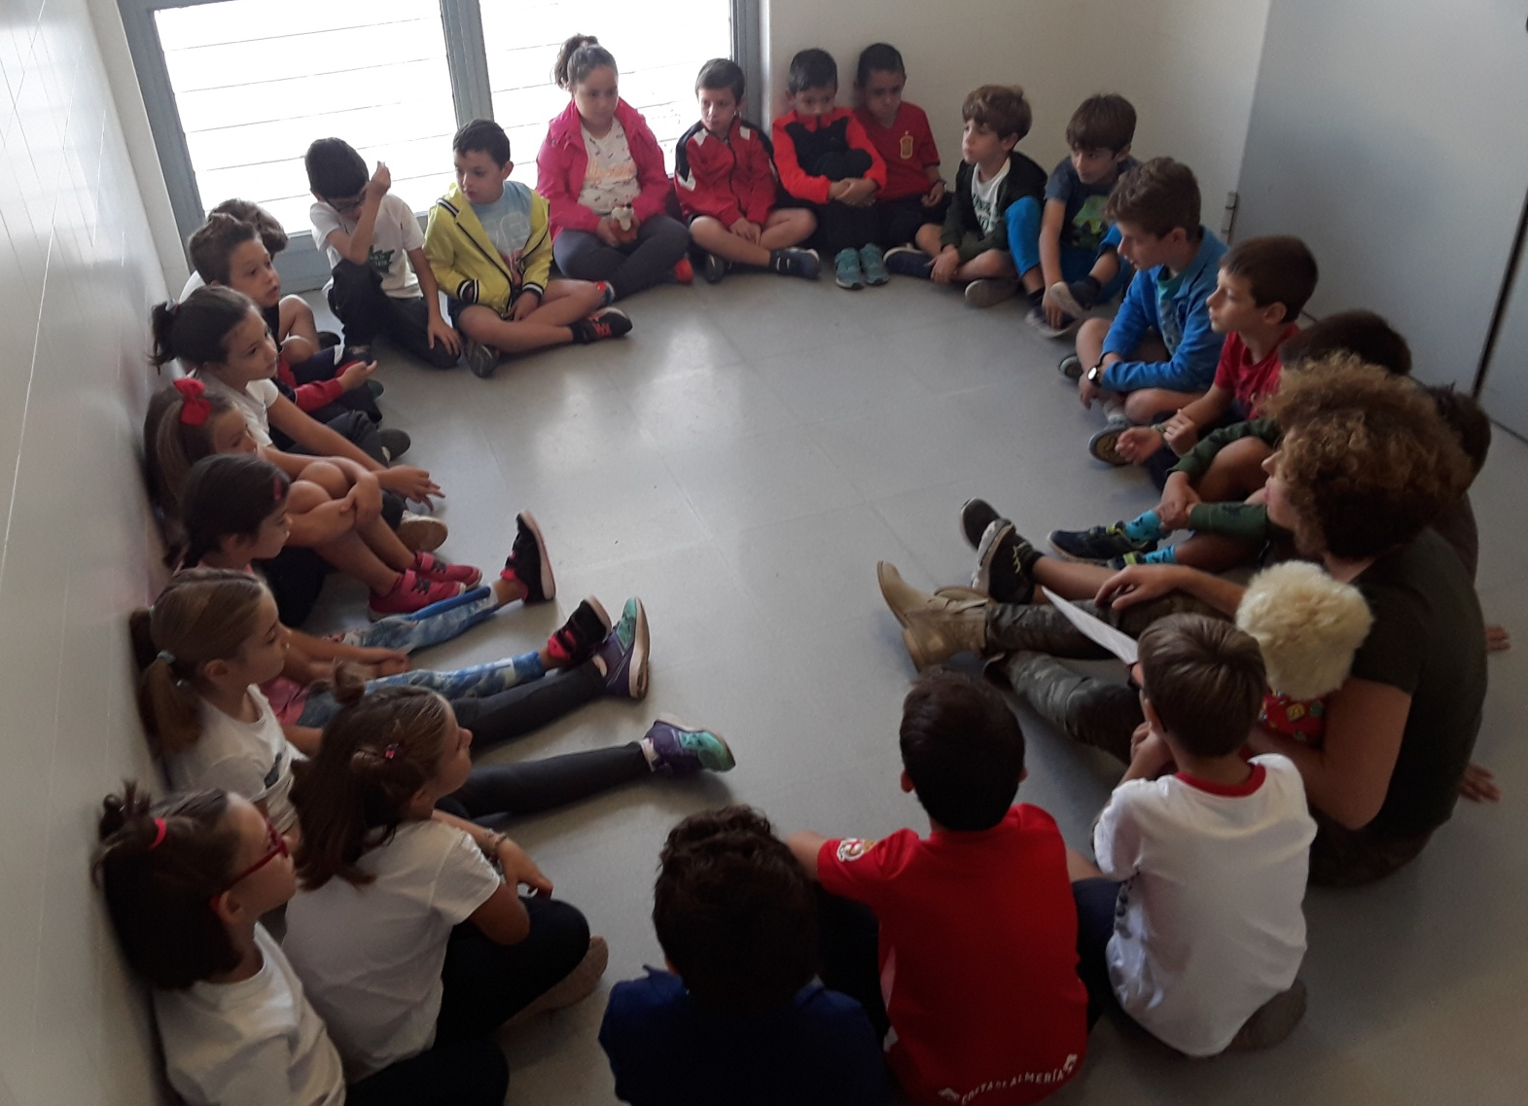
5th LESSON- WORKSHOP
Workshop: Creating a doll profile that suits your school.
Notes:
WORKSHEET 3

Slide 20
5th LESSON- FAMILIARIZATION
FIRST MEETING WITH DOLLS
Teacher would create an ambiance of mistery and motivation for a new friend who is coming
Teacher tell about doll personality and profile
The doll greets the class and hugs or touches every child who want to.

Slide 21
*Children get to know the doll.
*Children point out similarities and differences with the doll.
Interesting and fun extra activities.
Doll sits in the lap of teacher and speaks through teacher by whispering.
Try to avoid handleing a problem during dolls first meeting with children.
During doll sessions all children and adults sit on the same level.
Notes:
*1-Explain children honestly that this is a doll – it is a game.

Slide 22
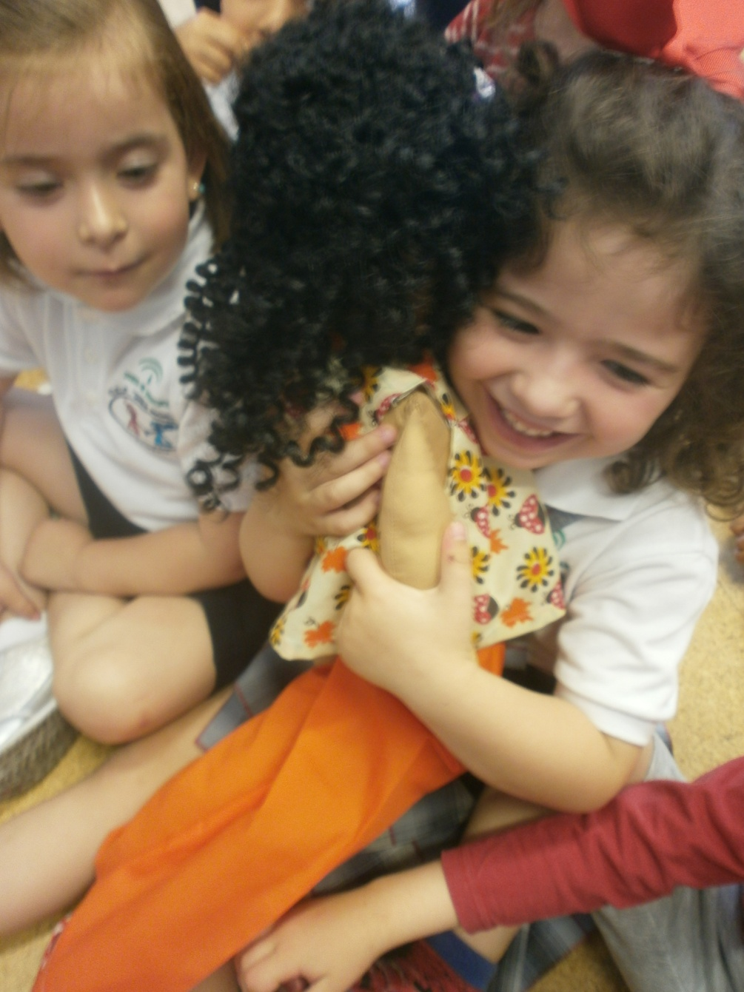
We talk about both happy and sad events in connection with dolls
Dolls visit classroom only during the doll session.

Slide 23
Visit to class 4 years A First meeting with dolls How did the children feel and behave during doll session?
Notes:
Questions after this, what do you think about children feelings during the activitiy?

Slide 24
6th LESSON- AFTER DOLL SESSION
CHILDREN FEELINGS AND BEHAVIOR
Were they excited ?
Did they identify with the doll?
Did they communicate actively ?
Was the athmosphere of the activity calm,?
Did children take actively part of the activity?
Did children wish for physical contact with the doll – touching and hugging?
Did Children reflect empathy, compassion and careing?
Notes:
CHILDREN REACTION TO DOLLS MEETING
Children are excited abot the dolls visit;
Children identify with the dolls;
Children communicate actively during doll sessions;
The athmosphere of the activity is calm, more children take actively part of the activity;
Children wish for physical contact with the doll – touching and hugging;
Children reflect empathy, compassion and careing

Slide 25
6th LESSON- STORIES
OBJECTIVES(DOLL STORIES&DISCUSSIONS)
To shape children self-esteem;
To shape emotional language and emotional maturity;
To listening “children voice”;
To develop empathy in children;
To accept differences;
To increase a sense of cohesion, nobody feels ALONE;
Handleing differences;
Active problem solveing;
To shape supporting attitude towards the “victim”.

Slide 26
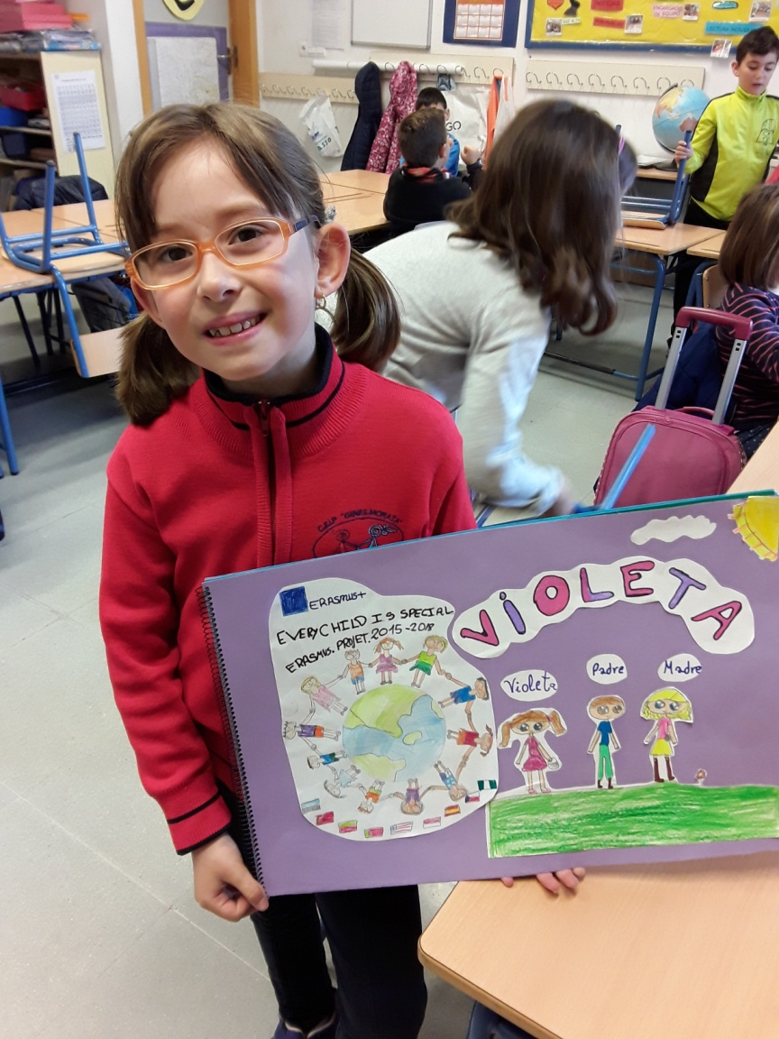
TIPS BEFORE CREATING STORIES
Doll stories should be useful to help children to accept those who are different from the rest and to appreciate those many things and features we have in common.
Talking about both happy and sad events related to dolls.

Slide 27
Every topic happened in the group/school can be handled
All doll stories should be documented and added to dollbook.
If you solve with children a current problem, try to change concrete situation or on doll pecularities that point out a certain child.
Doll stories shouldn’t concentrate and handle only situations about the dolls physical peculiarities.

Slide 28
TELLYING DOLL STORIES-
During a tellyingstory lesson, doll tells children a story which children will analyze in order to proposs possible solutions.
LESSON STRUCTURE
*Motivation/ Greeting / Hugging
Remind what we remember about the doll.
* Story/ children Identifying with the doll.
*Doll tells teacher what has happened
*Discussion: how the doll feels?
Notes:
*1- HUGGING Through hugging children embrace the dolls easier.
*2- IDENTIFICATION Through identifying with the dolls develops children ability to see the injustice described in the stories. Empathy towards dolls engourages children to stand out from themselves and others if they see unfairness.
*3- SPEAKING- Doll sits in teachers lap and speaks through teacher as whispering. Teacher, doll and children sit on the same level.
*4-DISCUSSION Teacher and children discuss about what has happened to the doll and how the doll feels.

Slide 30
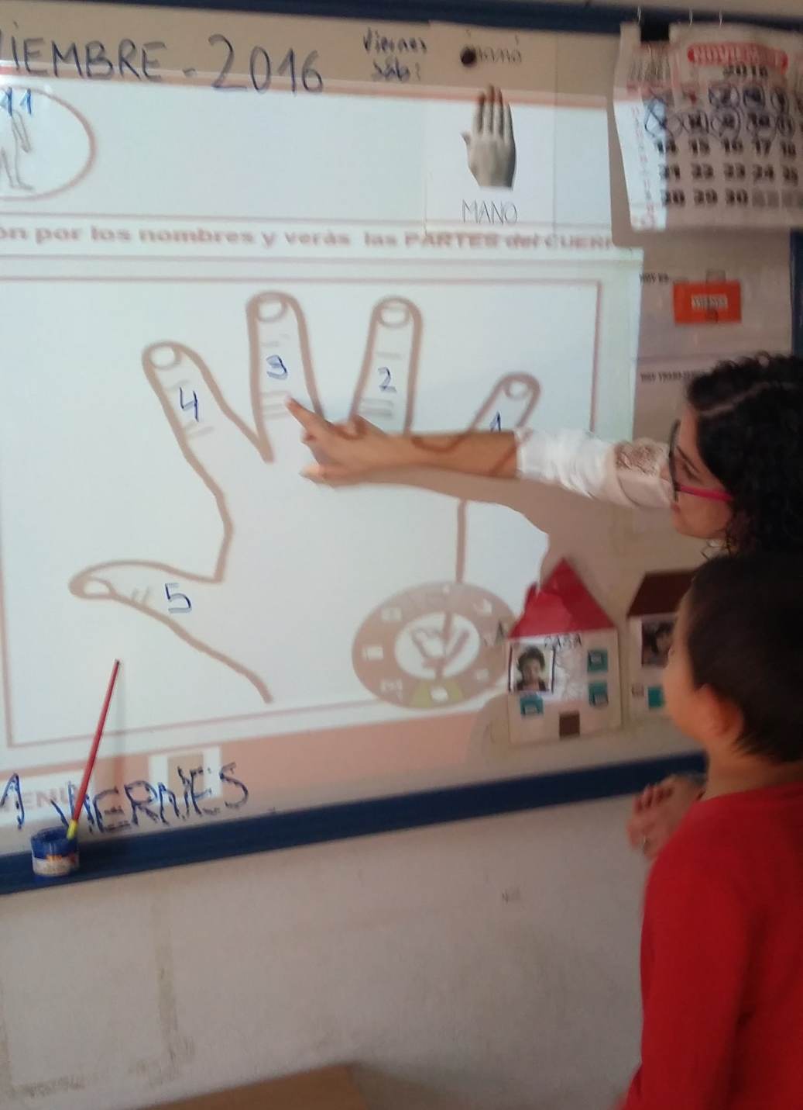
*Additional information about the problem.
*Doll and children communicate.
*Problem solving – teacher inquiring questions.
Teacher praises children for their attentiveness and problem solveing.
*Doll gives children feedback.
Notes:
*1- MORE INFORMATION- We can introduce more information about the problem the doll describe. We can use videos/games/ pictures… to make children conscious about the topic. (For example if the doll tell a story about a boy who need to use a hearing aid, we can show children pictures with the object, people using it….)
*2-DOLL COMUNICATION- Teacher engourages children to ask questions TO the doll.
*3- PROBLEM SOLVING-During problem solveing session there has to be a judgemental and accusation free environment.
Try to guide children to discuss how could we solve the problem in a different way. Children analyze what has happened and point out how they can help the doll with the problem. Teachers and children talk about if someone has behaved unfair towards someone, why?
In this kind of process children will become desiders and problem solvers. Teacher remains only observer – who guides children to wright answers.
Teacher directs children to find right answers/ solutions. We don’t tell children that this is right and this is wrong. There are not any wrong answers. Every childs opinion is important.
*4- DOLL FEEDBACK-
In a later session doll can explain children if their suggestion were useful and thanks them

Slide 31
All doll stories including what children have pointed out will be documented and added to dollbook.
It’s really important you keep
evidences of every activity with
children (pictures, photos or
written reports)

Slide 32
DOLL STORIES ARE USEFUL
To discuss with children about very difficult topics;
To increase children trust towards grown ups;
To increases openess and spontaneousness in children.
To create an open tolerant athmosphere – there are no wrong/right answers; just different versions.
To help children feel more comfortable and open minded in the company of grown ups.
*To increase the sense of empathy
Notes:
*1- They are also useful to
Children are able to make a difference between good and bad behaviour.
We can handle the same problems that take place with our children.
To prevent future prejudices and problems.
We can make prevention work about differences which are not familiar to children or they will be soon.
Children communication and selfexpression skills improve.
Children dare to stand out for themselves and others.
Children know how to solve problems in everyday life and dare to ask for help.

Slide 33
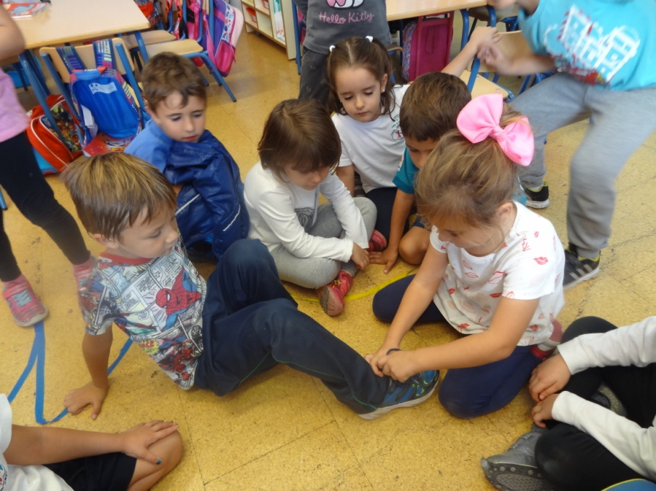
To improve the ability to listen and to pay attention.
To make children be more concentrated.
To allow them to express their feeling.
To increase their self-steem and make them more self –confident
To make them conscious about respecting their mates and care about helping others.
Notes:
*1DOLL STORIES MAKE CHANGES IN CHILDREN BEHAVIOUR
The sense of empathy increases;
Improves the ability to listen, concentration and attention;
Children express their feelings and they have more confidence;
Children respect their mates more and care about helping.

Slide 34
6th LESSON- CREATING STORIES
Work in teams –
Creating a doll story
Problem to be solve
Additional information
Questions to children
Evidences

Slide 35
7th LESSON- ABOUT TRAINING
Organizing and preparing training sessions for other teachers in every partner institutions.
Discussion- how, when and how many teachers?
Dissemination- To extend the PDM network in your city/country

Slide 36
7th LESSON- INITIAL EVALUATION
QUESTIONNAIRES
3-6 years old
7-11 years old
*RESULTS
Notes:
*1-RESULTS- INITIAL EVALUATION RESUTLS
A sample of 4/5 students of the classes of 4 years, 5 years and 1 level in primary education (6 years) have takenthe test.
To the first question the differences that are mentioned have been: language, race, physical differences (color of hair, eyes, height, strength) character (nervous, playful), special needs, their ideas (minds, thoughts) and names. There are 4 students who mention that there are no differences and 1 who does not know or does not answer.
Regarding the second question, the vast majority are familiar with the wheel chair and the glasses and know what their use is. it is noteworthy that the biggest confusions or negative responses have occurred in relation to the hearing aid.About the blind cane, all of them agree that is a stick but they don't know its real use.
75% of students say they know people from their environment with special needs, not only at school, but also friends and family. The ways to help them have generally been difficult to explain and they give answers like being their friend, playing with them, holding their hands, telling stories, keeping them company ....
As for if you can play with partners with speciall needs, there are 50% that indicate yes and another 50% that indicate no. Different types of games are mentioned according to the needs with enough accuracy that denotes that some of the older students have worked on these aspects (for example they mention wheelchair basketball, and balls with bells).All the children said that being different is positive, although 3 of them don't know or don't want to say

Slide 37
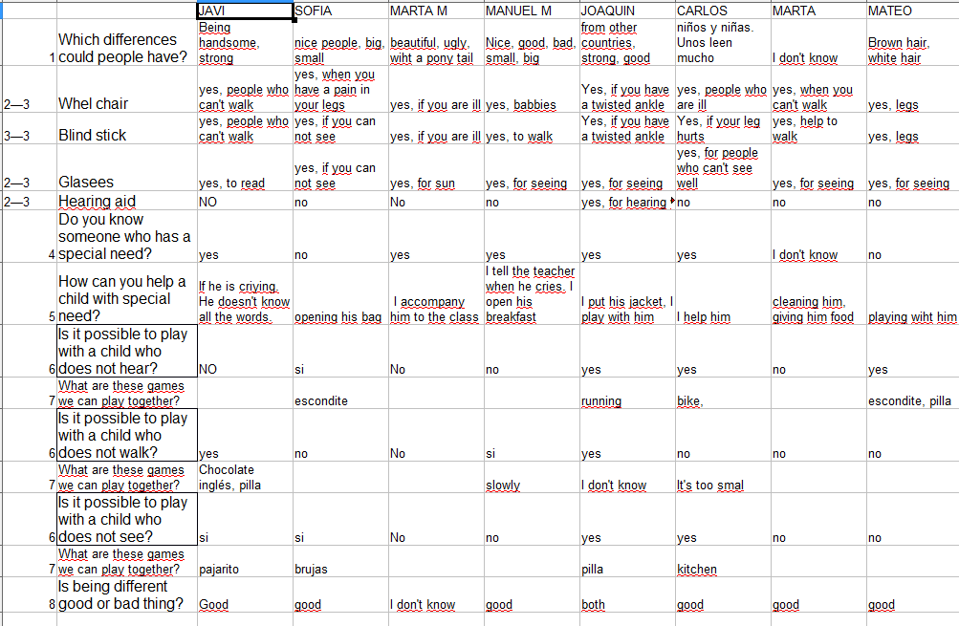

Slide 38
7th LESSON- DISSEMINATION PLAN
Notes:
* PREPARE ALSO ACTIVITIES FOR DISSEMINATION OF PDM (not always the same)

Slide 39
7th LESSON- WEBPAGES
WEB PAGES
etwinning
mobility tool
your own website

Slide 40
8th LESSON
Evaluation of the first meeting. Creating questionnaires.
Preparing activities to be implemented during the first years.
Solving doubts and problems.

