Slide 1
DEVELOPPING CHILDREN SOCIAL SKILLS

Slide 2
Social skills are capabilities of a person to behave in a way that allows them to build relationships with other people, groups, to communicate and to cooperate. Social skills allow you make social connections, effectively solve various everyday problems, help understand psychological problems, analyze instances of inappropriate behavior. Because of that it is very important to develop them.

Slide 3
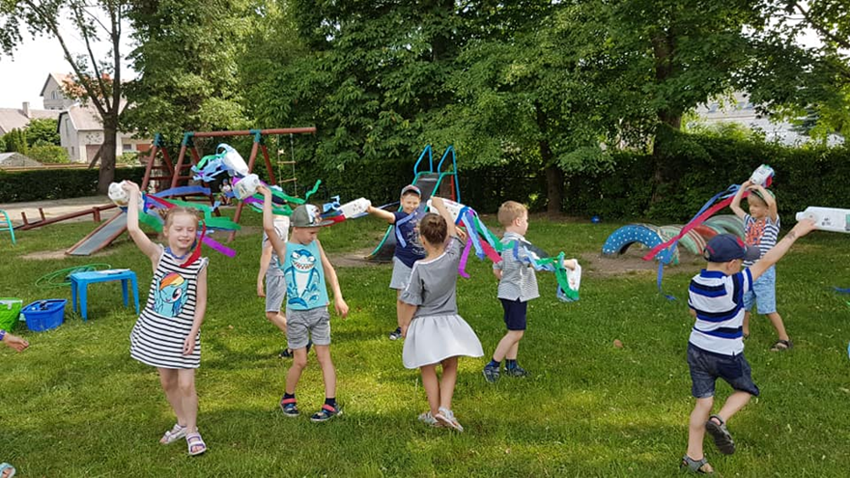
In pre-school a child receives the most important behavior, communication and activity variants and even chooses their main roles for their whole life. Social skills are acquired while observing, repeating the behavior of surrounding people and by getting the feedback of the consequences of their behavior. While playing kids gain new abilities, skills, social experience, values. While playing role-playing games, kids take in acceptable behavior norms and morality rules.

Slide 4
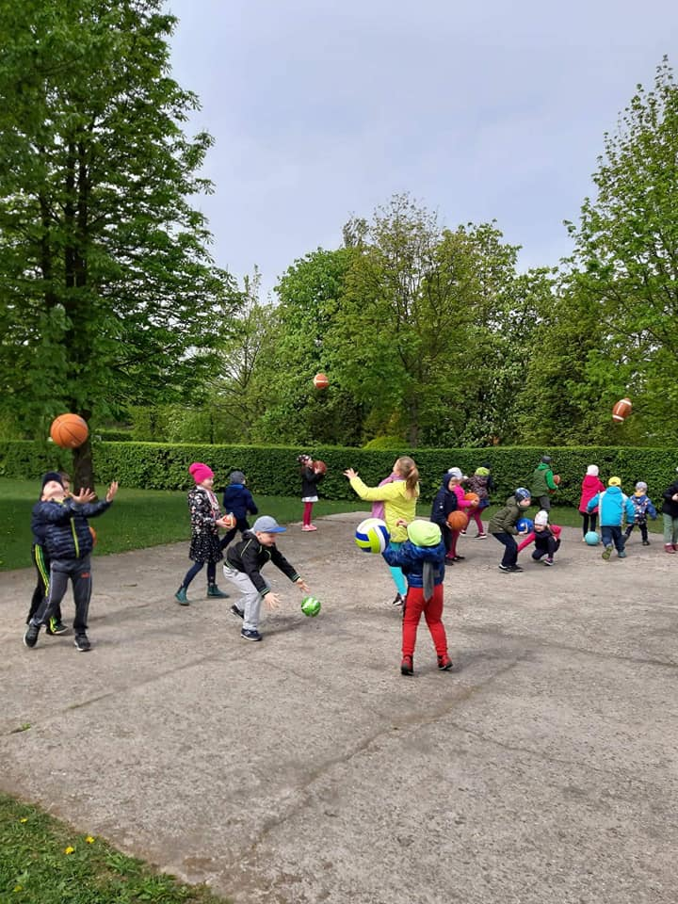
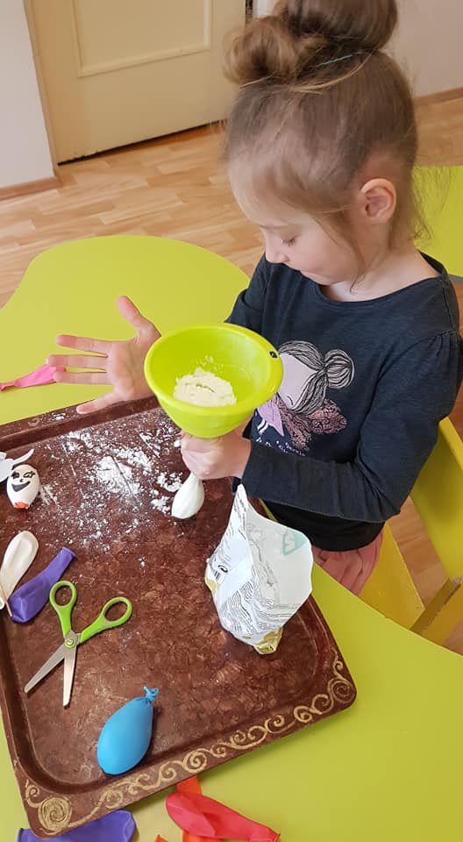
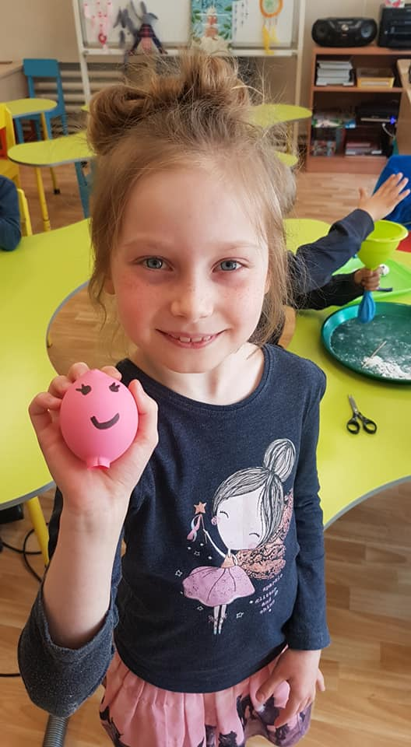
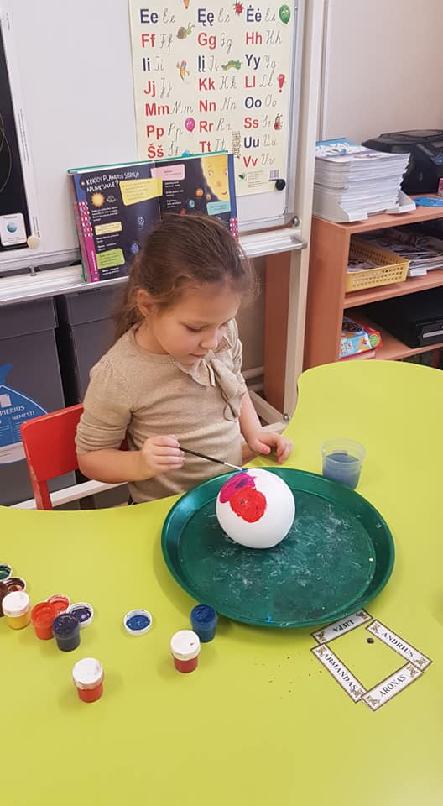
Most important social skills’ exercises consist of: • Roleplaying games, drawing, telling stories, analysis; • Learning of a specific skill; • Completion of homework, showing and discussion.

Slide 5
Important factors of improving social skills: • Special grown up attention to situations that a child is experiencing for the first time. When wanting to consolidate a social skill, it is important to make sure, that the action is being made correctly, to get all obstacles out of the way, to control the consolidation of the skill. • Precise organization of a child’s (and grown-up’s) system of actions.

Slide 6
• Example of people (grown-ups) leading the process. If you want to form a good habit, you need to make a good example and show the meaning of the actions and their sequence. • Skill consolidation. Every social skill is developed in steps: it is shown; it is tried out in various situations – by acting, while playing; other members of the group and leaders share their impressions about the kids’ progress – they compliment, encourage (feedback); during the last step various methods are used to try and make kids use the new skill in a real life situations.

Slide 7
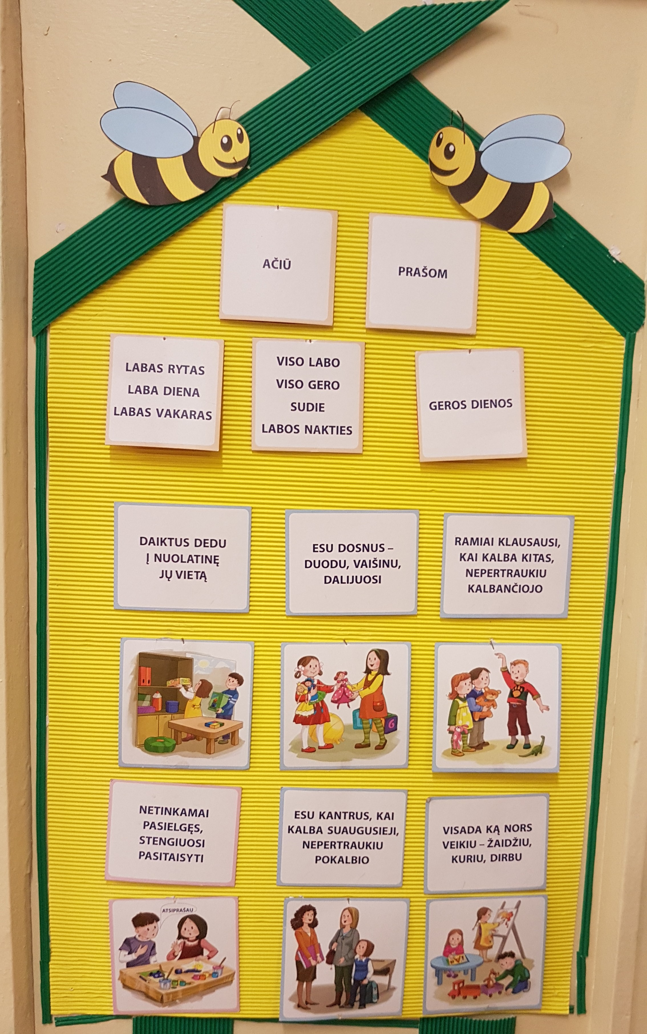
• Group work rules are needed in the development of social skills. They need to be created together with the children, so they gain more responsibility in case they don‘t listen to them. While making the rules it is important to take into account the children’s age, individual development and other factors. Rules have to be clear, consistent and helping the child’s socialization.

Slide 8
Improving social skills in groups: • Imitation: watching the positive interactions between children; imitation of behavior and communication, which help maintain friendship.

Slide 9
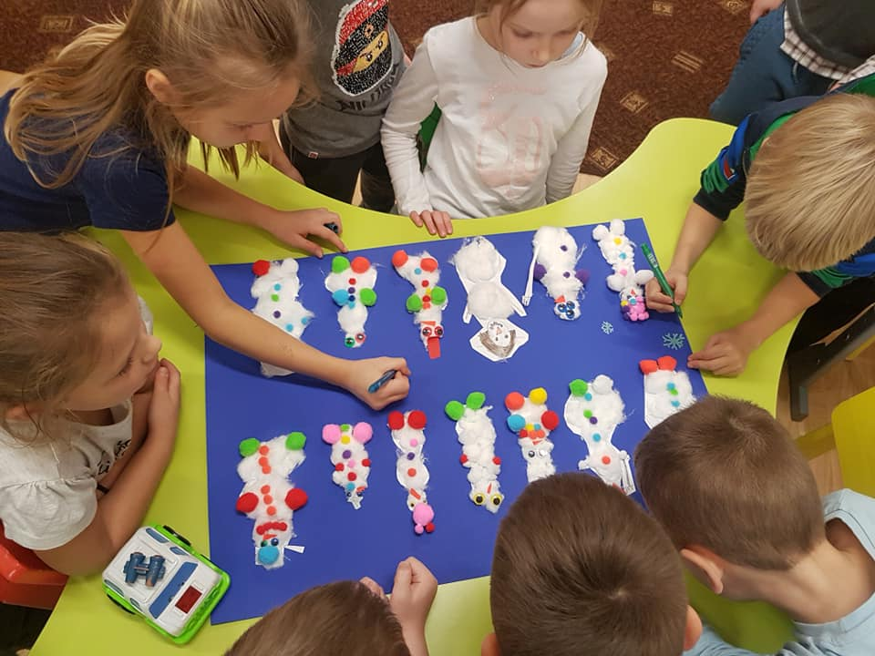
• Participation: work with others; initiating activities, games; being interested in activities; helping a younger kid.

Slide 10
• Cooperation: keeping in order; sharing toys and supplies; giving solutions; if rules cause a disagreement, find a compromise.

Slide 11
• Communication: talking; speaking about activities and yourself; giving questions about activities; giving questions about others; listening to what others are saying; watching others do something.

Slide 12
• Confirmation and support: take interest in others; saying something nice, when others succeed; smiling; being happy when needed to offer help or an advice

