Slide 1
Video conference Italy - Latvia
27th March 2019

Slide 2
Video Conference , Italy-latvia
Some days before we prepared the videoconference
with the Latvian school.

Slide 3
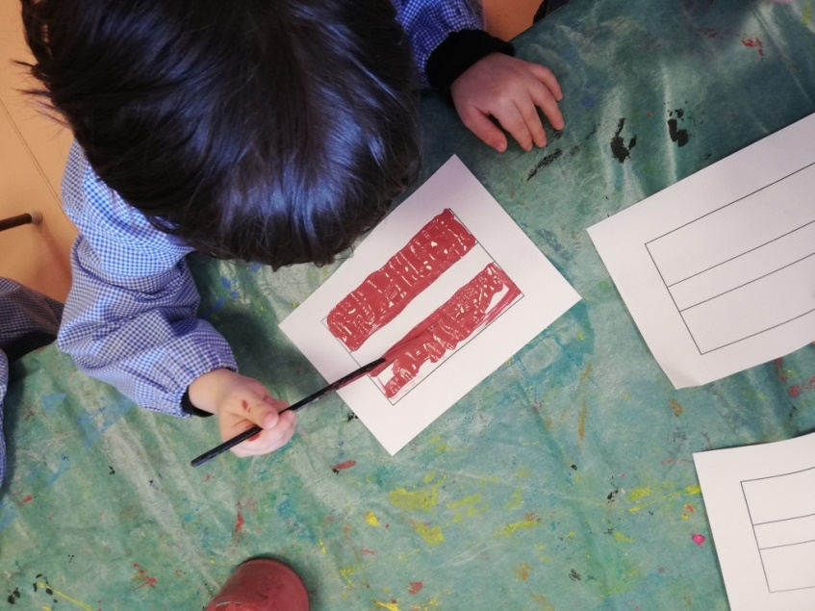
Video Conference , Italy-latvia
The Latvian flag

Slide 4
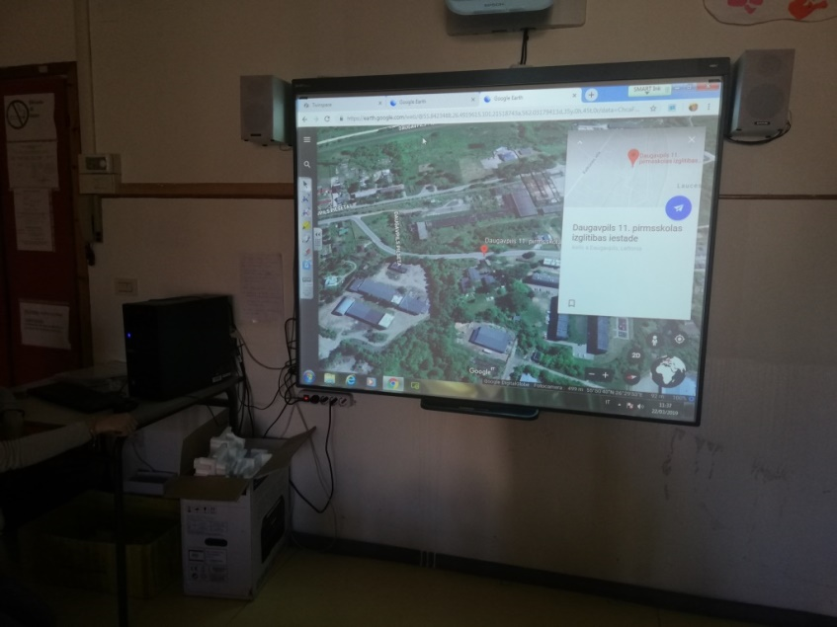
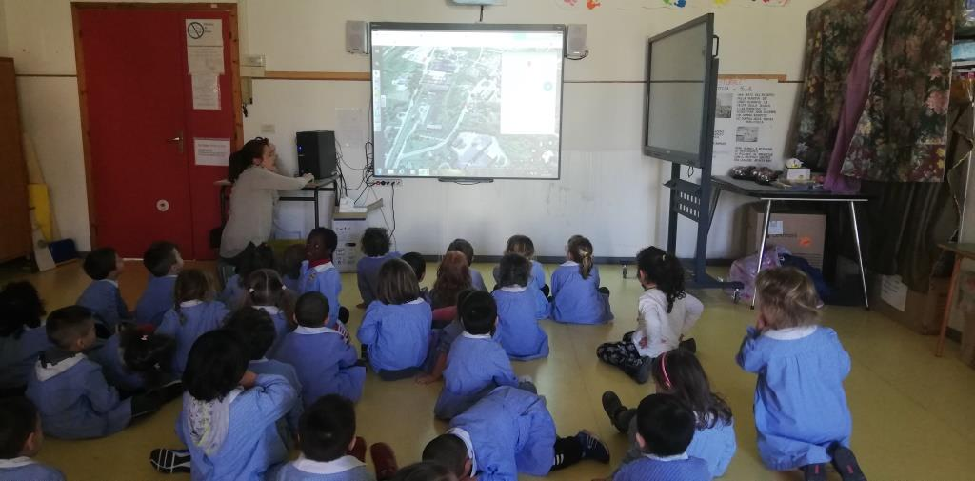
Video Conference , Italy-latvia
With Google Earth we gave a look to the school and the area

Slide 5
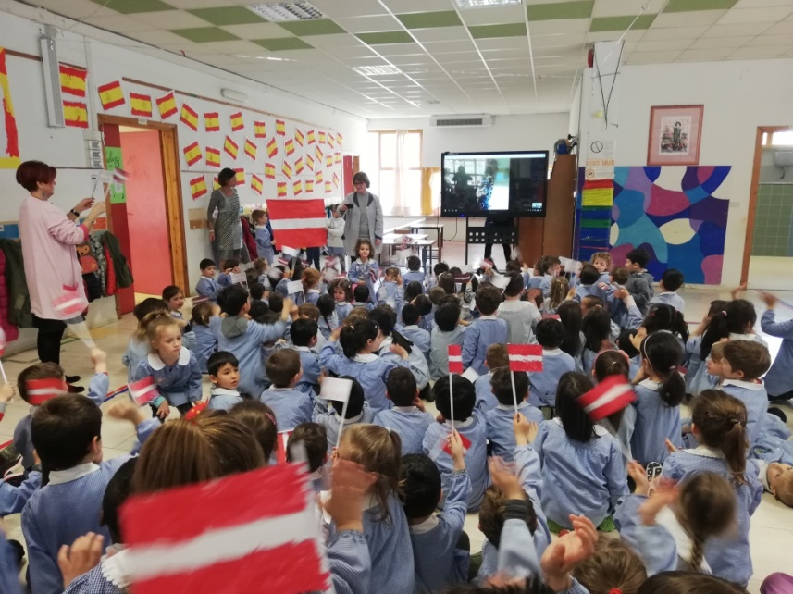
Video Conference , Italy-latvia
The day has arrived!
Some technical troubles…as usual… but then… here we are!!!

Slide 6
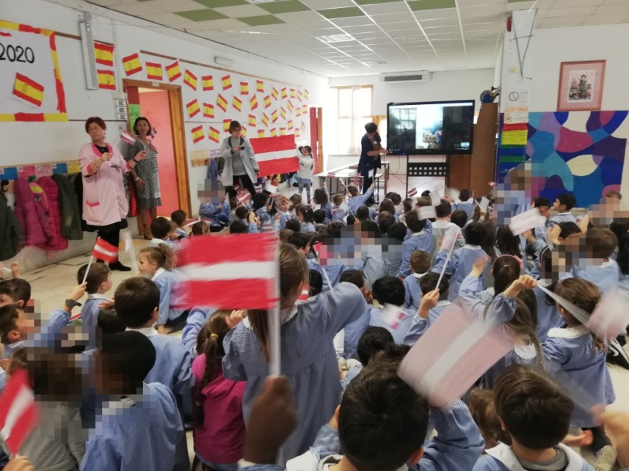
Video Conference , Italy-latvia
We watched our friend on the screen and we sang a song!

Slide 7
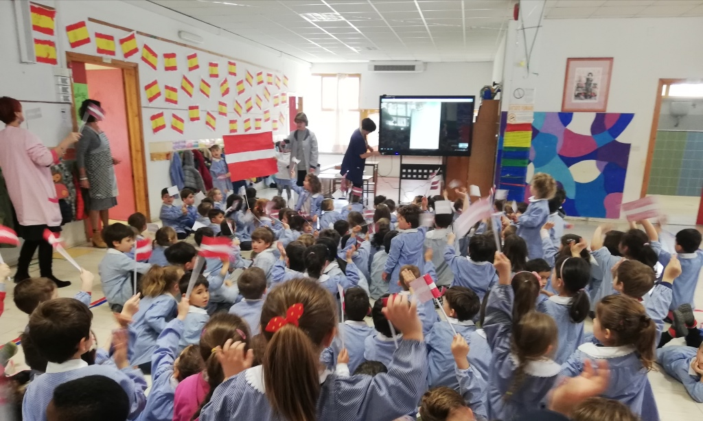
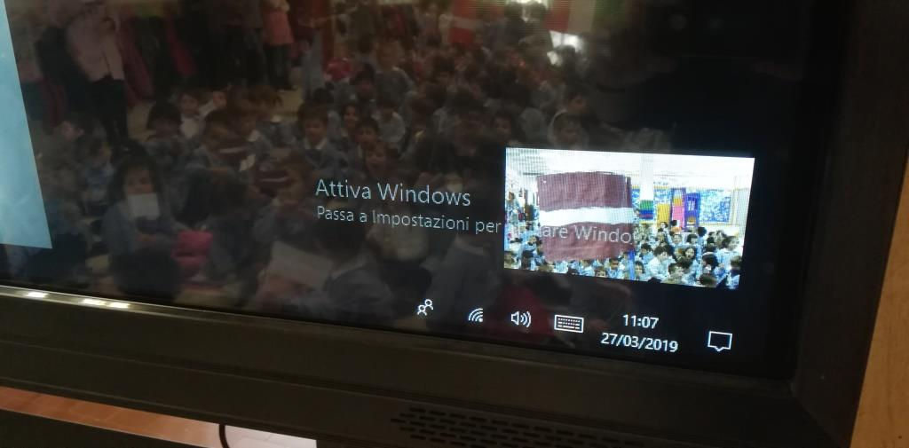
Video Conference , Italy-latvia
What an emotion!

