Slide 1
Activities in France about I’m special and differences.
All humans
All differents
All equal

Slide 2
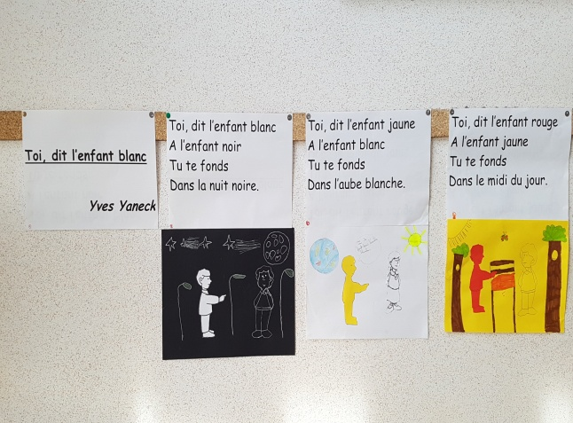
In litterature ( theatre, poem) , art, with the sign language, in EMC ..

Slide 3
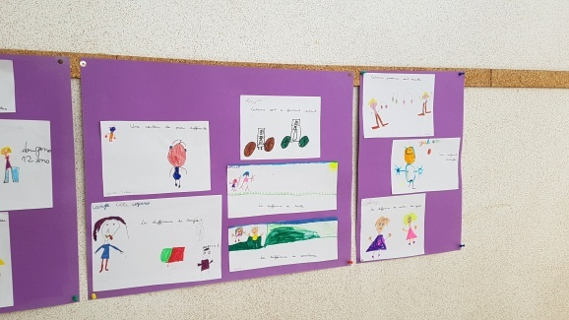
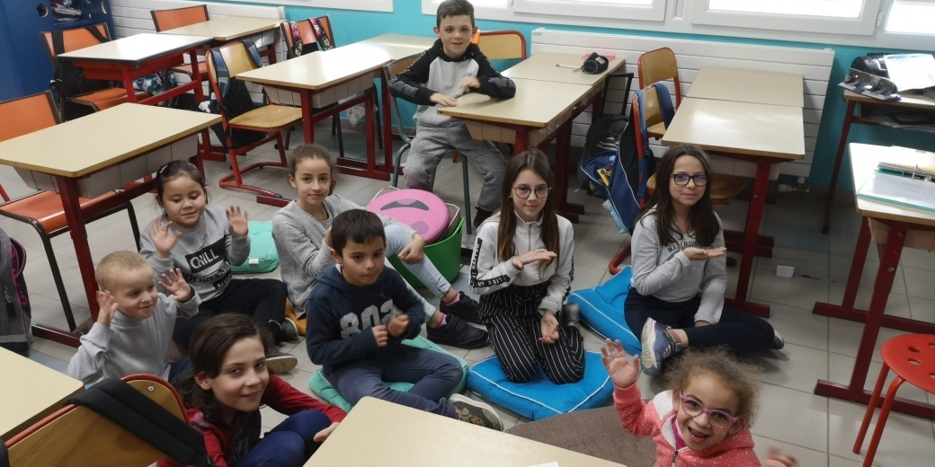
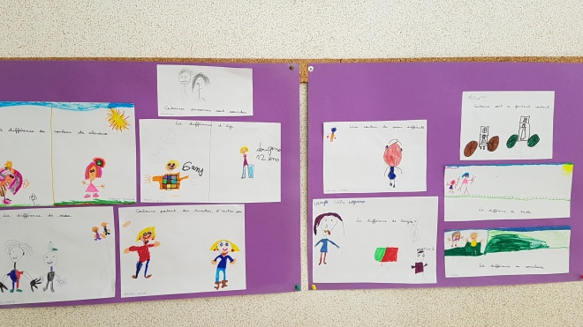
Wall of differences
Sign language

Slide 4
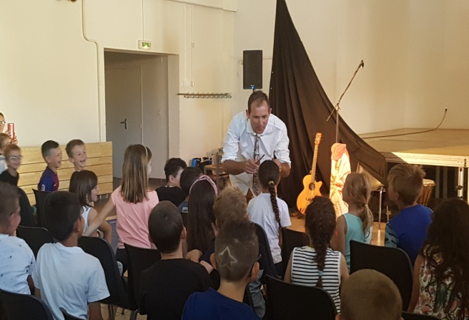
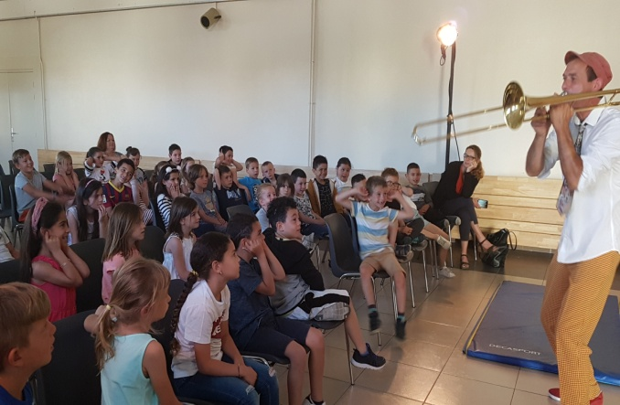
Monday the 3rd of June, we saw a beautiful show about differences…
What is the best sound? the prettiest? Every sound thinks it’s him!
But eventually they will realize that everyone is unique and different and that they are all beautiful.Together the work and the sounds accomplished are much more harmonious. It is the difference that creates this beauty!

