Slide 1
Supporting children individuality

Slide 2
At school, help by teachers
Special needs’ groups = APC in french
On Monday, tuesday and thursdsay, each teacher choose pupils who have dificulties in french or mathematics and help them during 40 minutes from 12h10 to 12h40. The group is about 4 or 5 pupils.
PPRE = personalized plan for school success
Pupils with a lot of learning difficulties has a individual plan to permit him to progress at his own pace

Slide 3
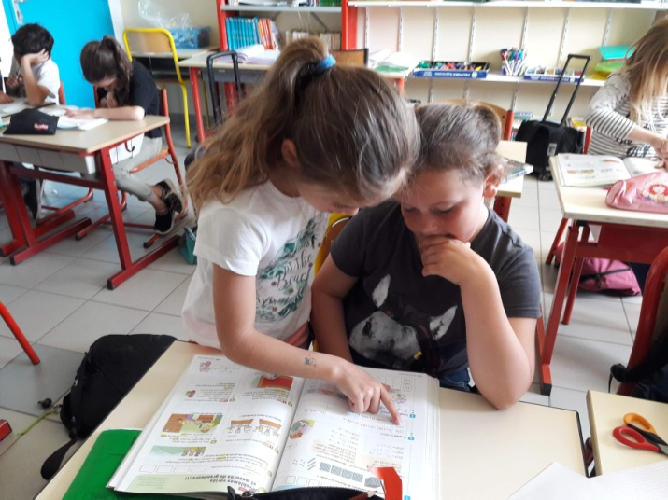
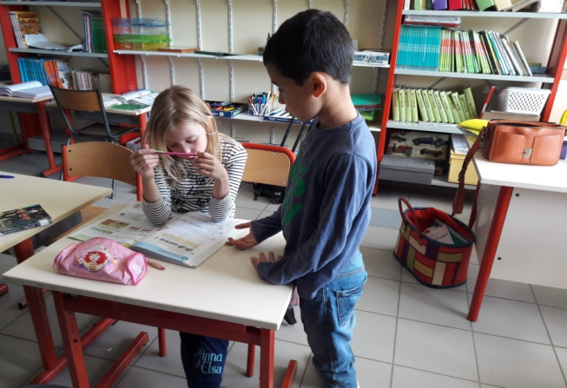
Personalized work such as text hole, photocopies,…
Help at the desk of the teacher
Reformulate the instructions
Tutoring in class

Slide 4
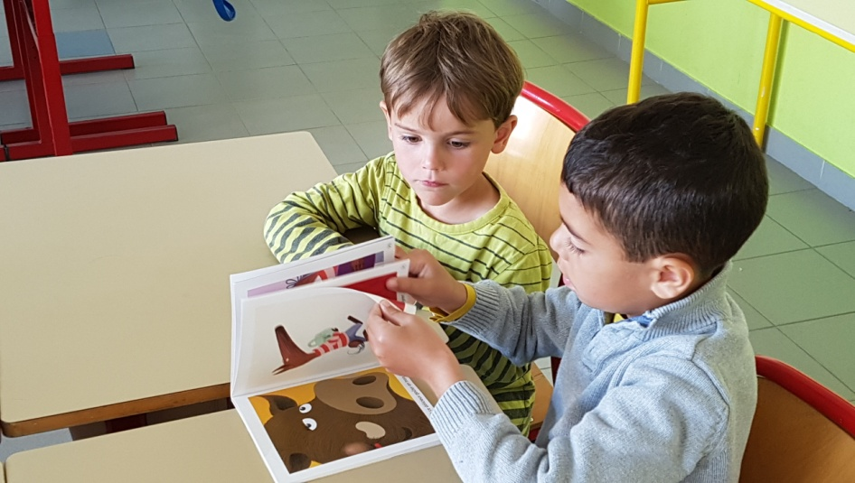

Slide 5
Personalized program for handicaped pupils= PPS in french
Personalized program for pupils with a dvs trouble ( dyslexic, dysgraphia, …)
Decompartmentalization: pupil with huge difficulties goes to learn the skills he doesn’t have in an other class, usually the below class
Meeting of the educational team: in case of huge and long-lasting dificulties, we meet all the members involved with the pupil to search solutions

Slide 6
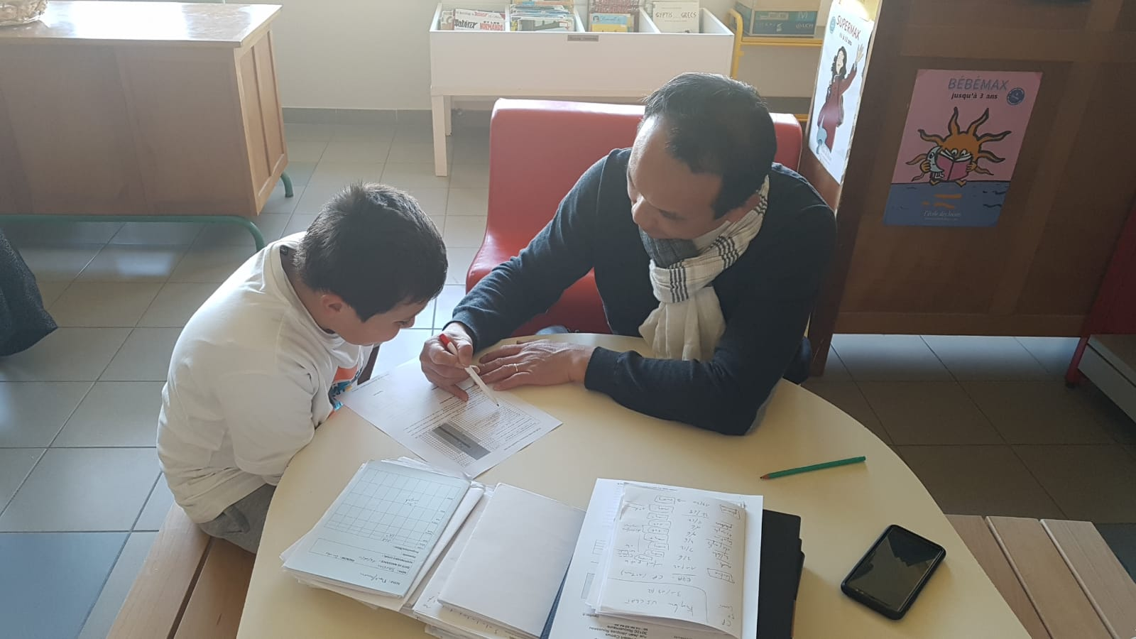
Call to the psychologist of the school
If we need, we can ask him to see our pupils and tell us what we have to do or what help we have to ask to the family

Slide 7
AVS = school carer
She helps pupils who have difficulties (learning, desease, mental or physical handicap)
She explains all activities and does it with the pupil she is in charge
She follows the pupil during all his schooling

Slide 8
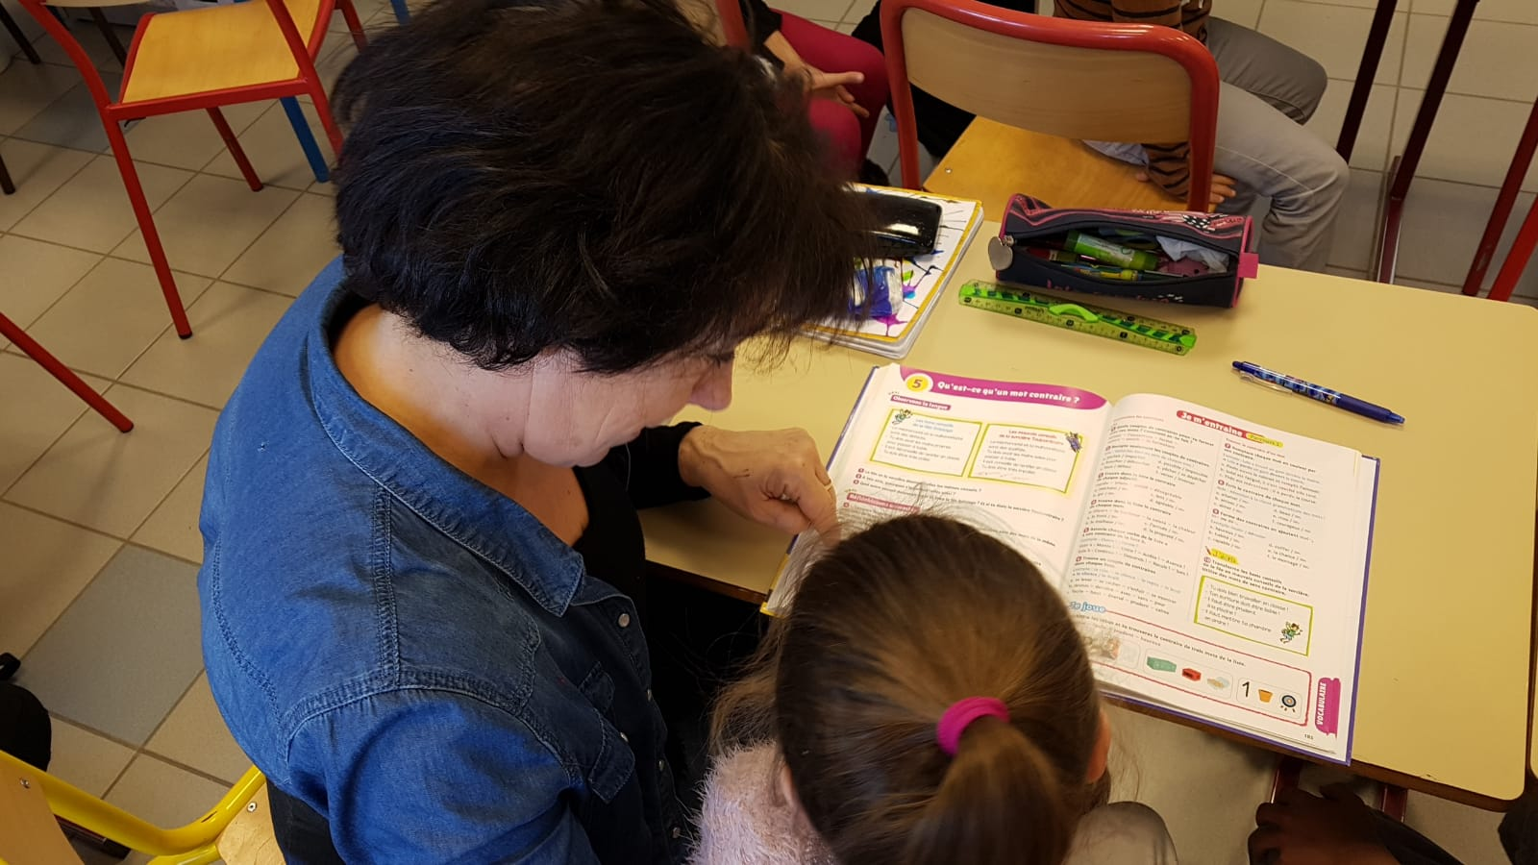
AVS

Slide 9
External helps
Psychologist
Speech therapist
Orthoptist
Psychomotor
Hospital checkup

Slide 10
CMPP: medical center for psychology and pedagogy
We can ask for helps but it’s very long (about 4 or 6 months waiting).
A team take in charge all dificulties of the child and help in outside the scholl
CMPEA: psychological medical center for children and teenagers
The same as the CMPP

