Slide 1
Developping social skills in France

Slide 2
The School is the place where students acquire the skills that will be indispensable to them throughout their life, beyond their schooling, to continue their training, to build their personal and professional future, to succeed in society and to exercise their citizenship freely: autonomy, responsibility, openness to others, respect for oneself and others, exercise of the critical spirit. They learn to live together in a democratic and republican society

Slide 3
Learning to live together is considered one of the primary school’s priority learnings. This objective is pursued in secondary education by reference to official texts, in particular the common basis of knowledge, skills and culture [1] developed in 2015. Today, in France, the National Diploma of the Patent endorses the acquisition of the skills described in the base, including the social skills mentioned in Area 3, which aim to train the person and the citizen: “Students express their feelings and emotions using specific vocabulary. He exploits his intellectual and physical faculties with confidence in his ability to succeed and progress.
The student learns to resolve conflicts without aggression, to avoid the use of violence through his or her mastery of the means of expression, communication and argumentation. It respects the opinions and freedom of others, identifies and rejects any form of intimidation or control. Learning to distance prejudices and stereotypes, he is able to appreciate and live with people who are different from him. He is also capable of empathy and caring.”

Slide 4
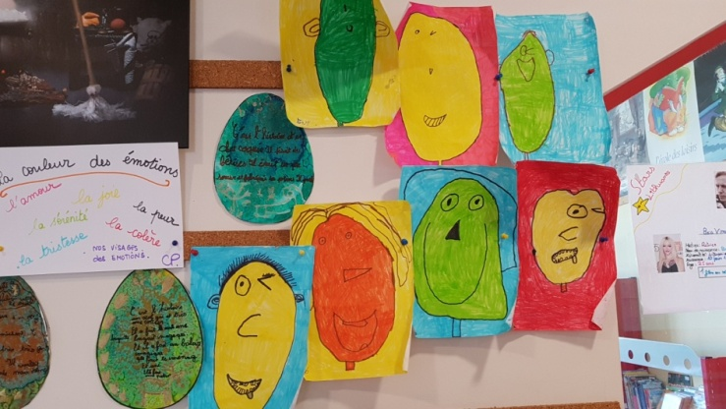
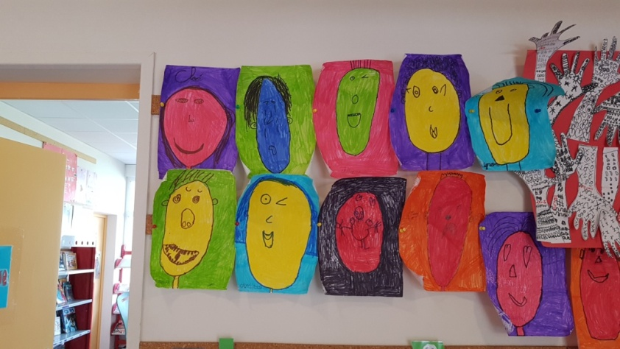
At school, we try to respect the programs to the best of our ability.
In art: we work on the emotions.

Slide 5
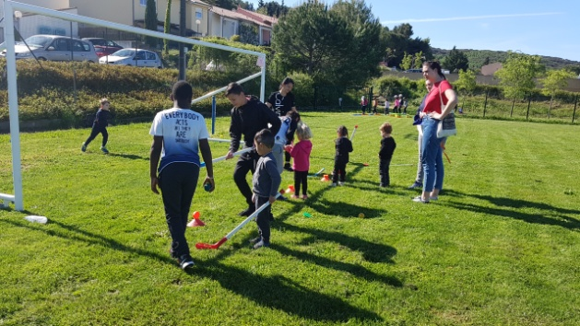
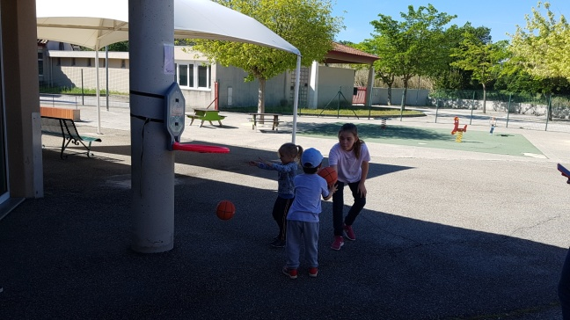
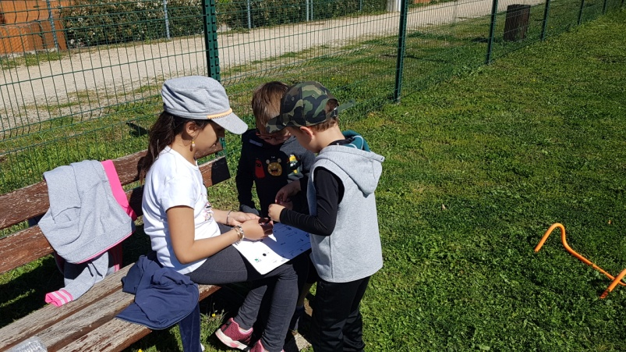
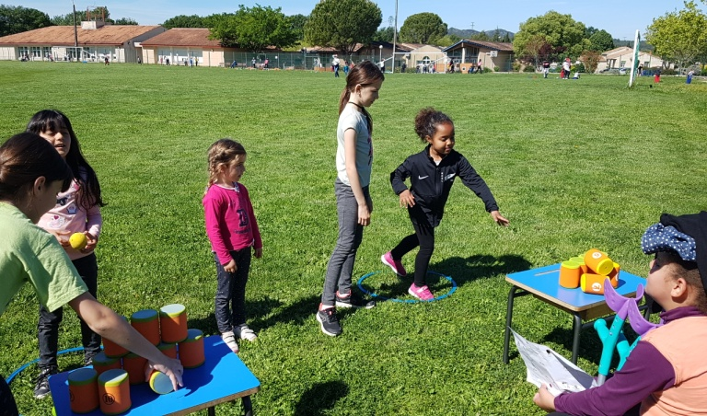
In sport, we usually organize olympiads with kindergarten students as well as college students. The older love to take care off the youngest. It is always a good moment together.

Slide 6
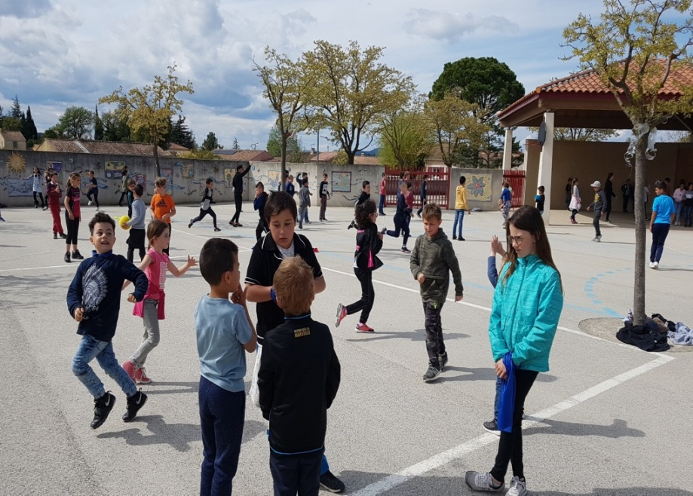
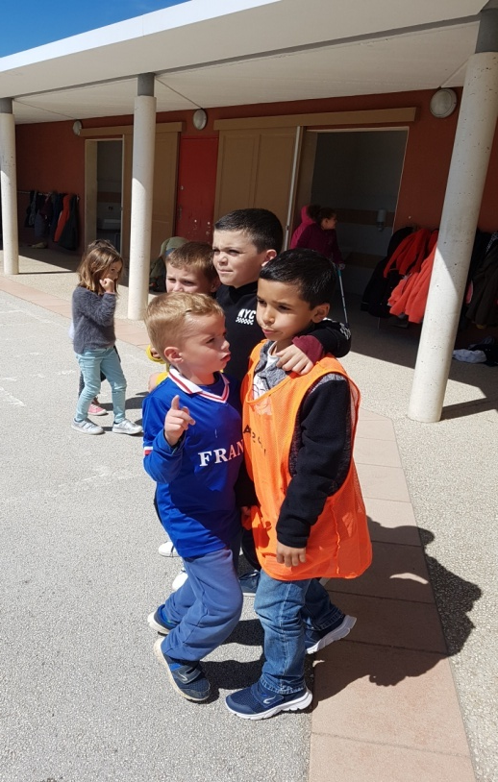
In civic and moral education
Mediators of schoolyards: some students are in the yard and as soon as they hear or see a problem, they go to the children and try to solve it. If they can’t do it, or if the concern is too great, an adult takes over.

Slide 7
Clears messages: When they have a problem, a conflict, the children first try to talk to each other. One explains what he cares about with his words, his emotions. It can be difficult to express one’s emotions and listen to the other. When they have finished the conflict must be resolved and if not they will tell an adult.
.

Slide 8
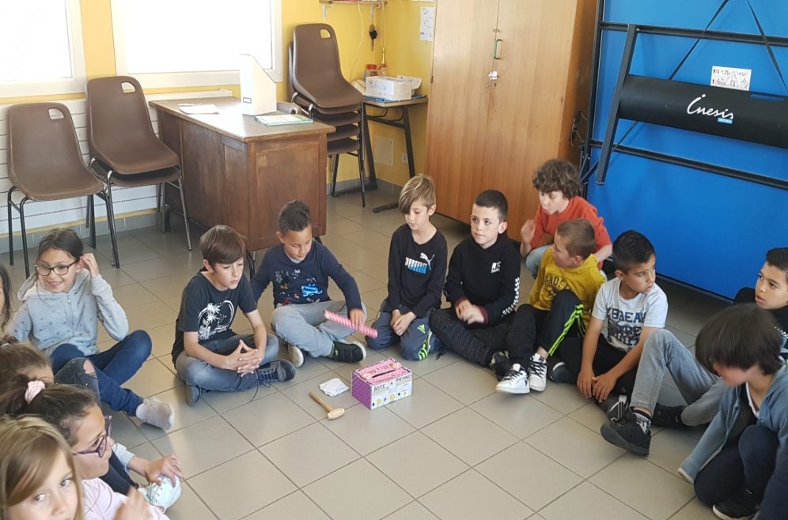
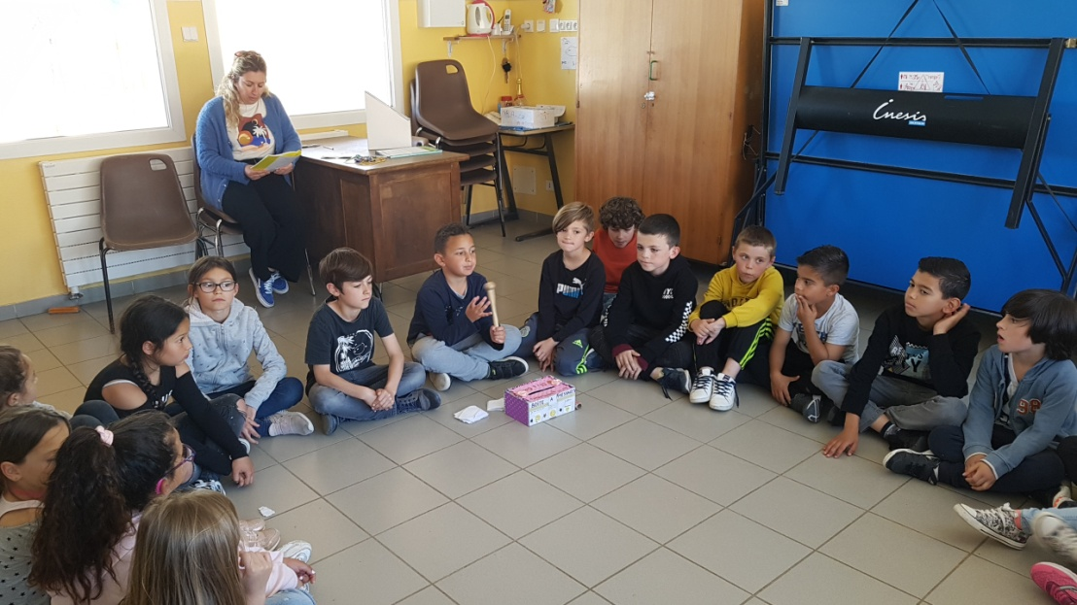
Class council: a class meets once a week. They take stock of the week and list the positives and things that could be improved, changed. They find solutions together by talking and listening to each other.

Slide 9
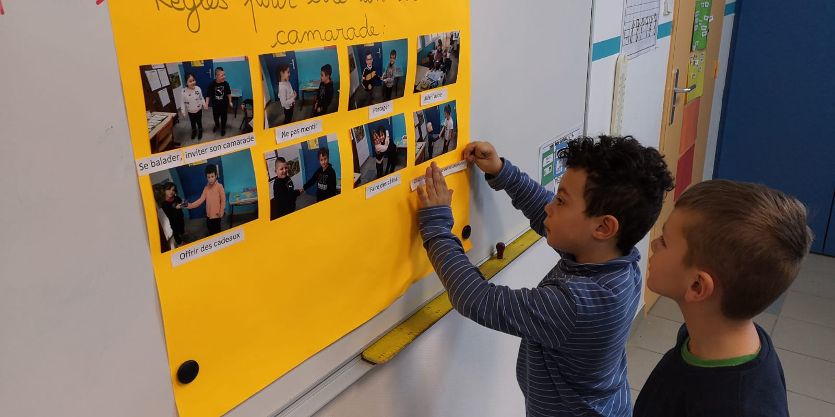
Try to respect for the rules of collective life, whether it concerns the functioning of the class or the rules of procedure of the establishment. The children together establish the rules of the class.

Slide 10
