Slide 1
Teaching values in France

Slide 2
In addition to the transmission of knowledge, the Nation sets as its primary mission at the school to share with students the values of the Republic. The right to education is guaranteed to everyone in order to enable him [...] to exercise his citizenship” (Law of orientation and programme for the future of the School of 23 April 2005 - art.2).
The School transmits the values of the Republic: freedom, equality, fraternity; secularism; rejection of all discrimination. Students study the major texts that form their basis. It is up to all adults who work with students in the exercise of their duties to share these values.

Slide 3
The School must transmit to the pupils all the republican values through its teachings, school life and all the educational activities it carries:
The School is laic.
Equality of girls and boys
Human rights education and the fight against discriminatory practices
In our school, we try to do the best to make our pupils better to transmit the essentials values.

Slide 4
Cooperation and camaraderie
« Mardi de la convivialité » it’s an action, that we do each Tuesday, before holidays. During an afternoon, we mix all classes . We involve parents at this time to help us to supervise activities ( sport, manual activities, sign language, theater..) It creates a special relationship with parents and develops a positive understanding and cooperation between children .

Slide 5
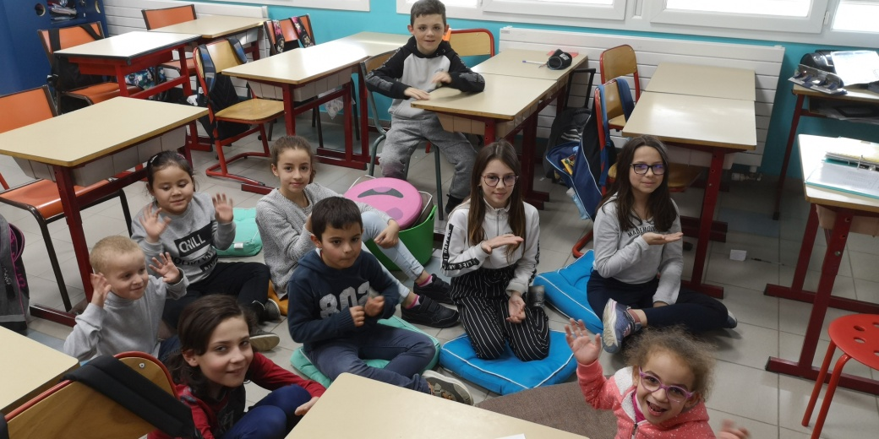
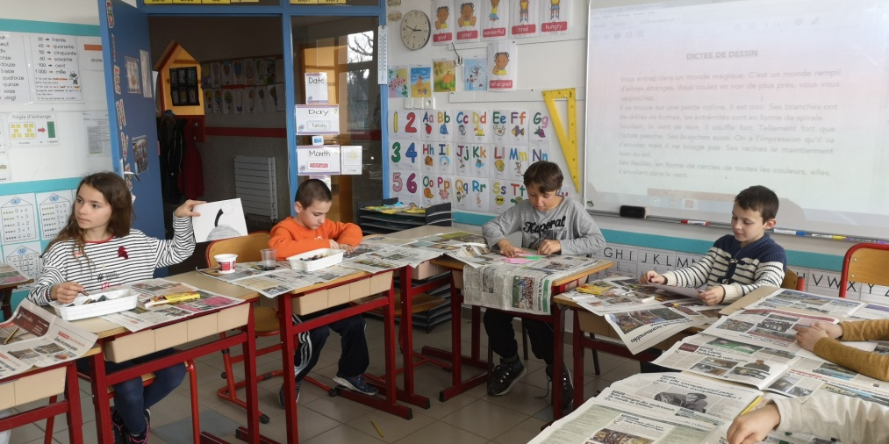
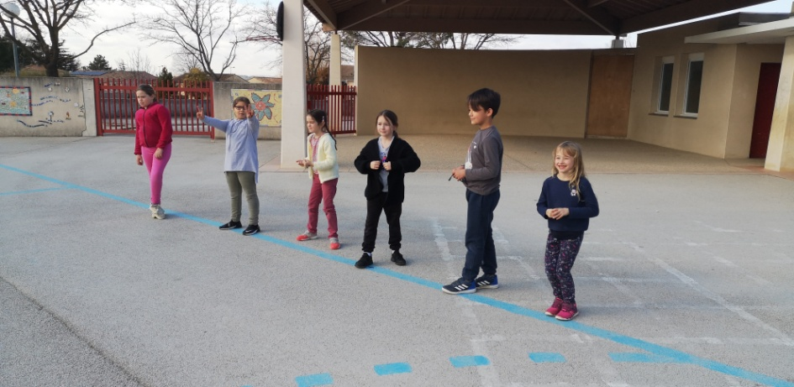

Slide 6
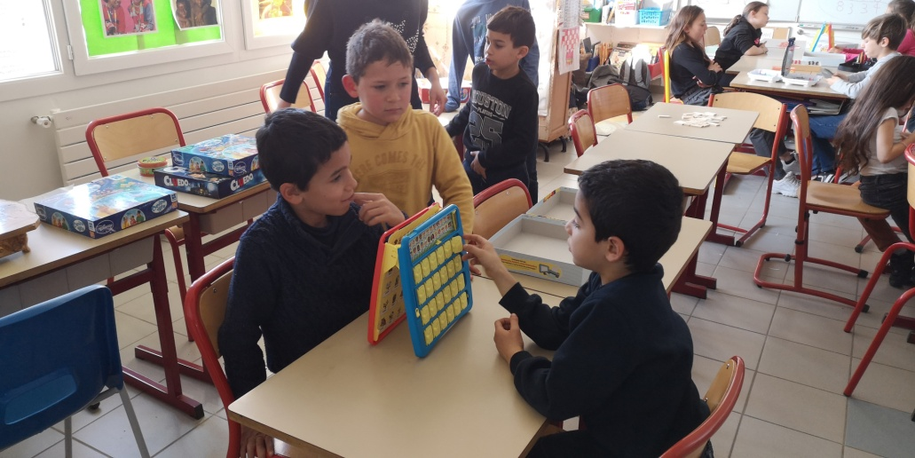
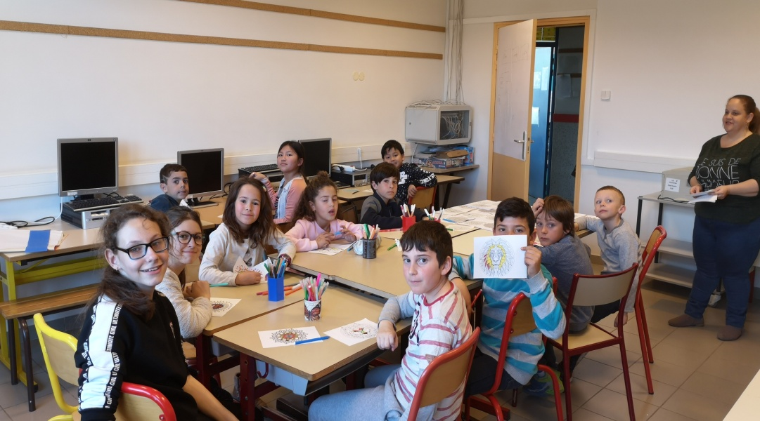

Slide 7
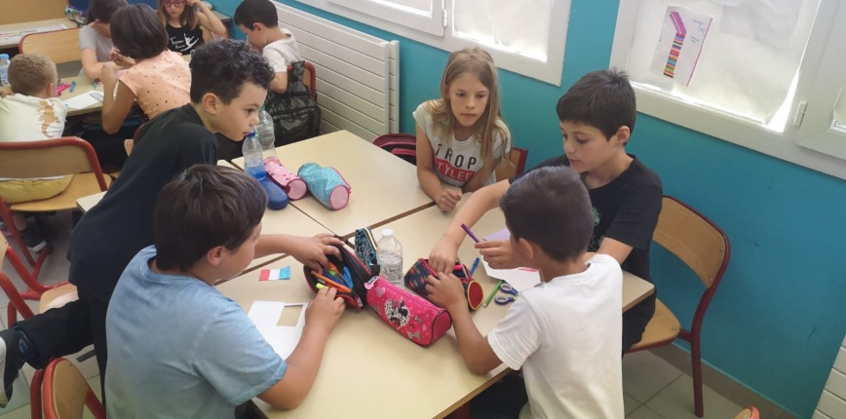
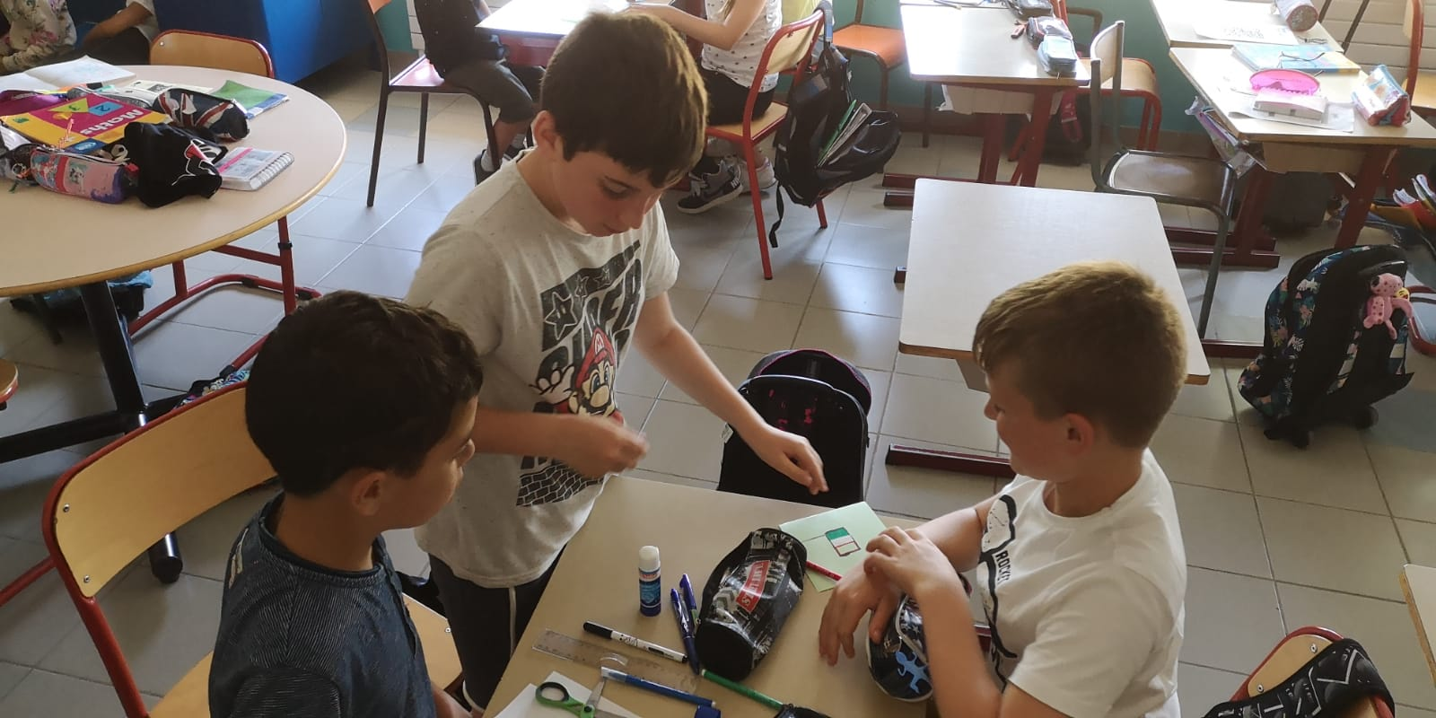
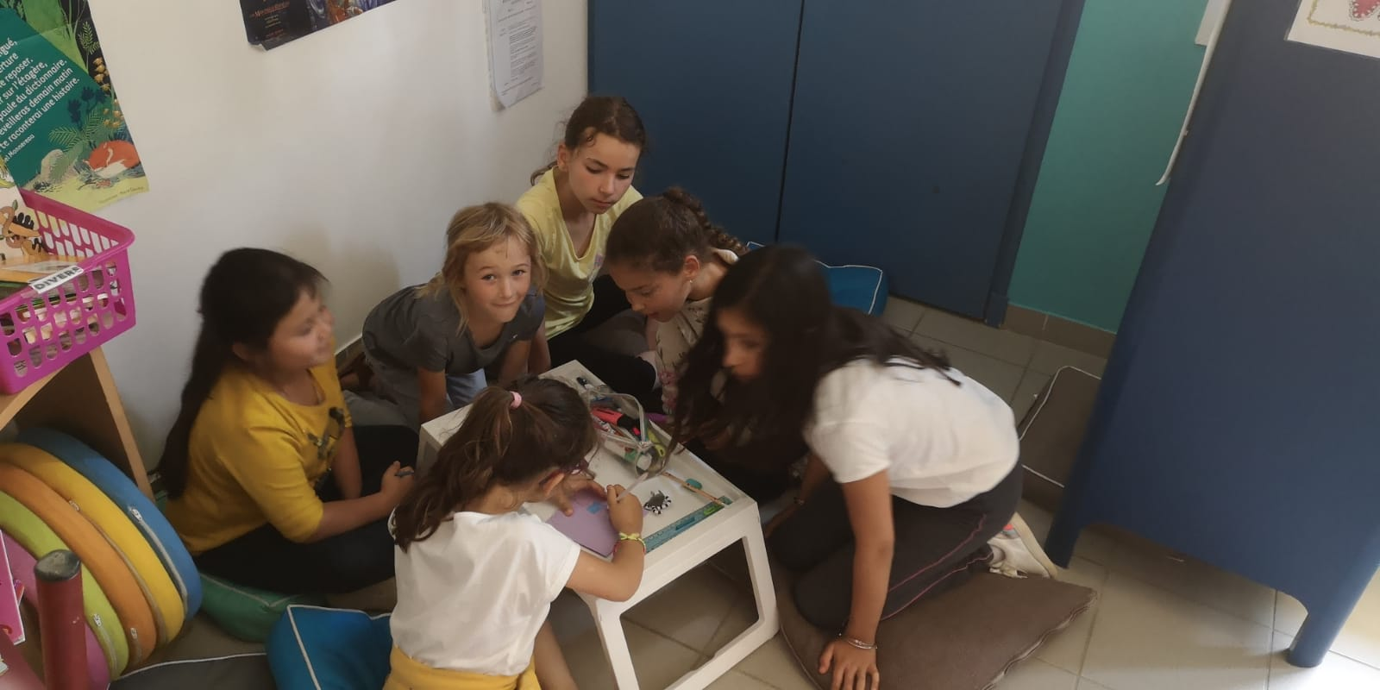
When we prepared the gifts for our europeans friends, we mixed the children . They enjoyed this moment.

Slide 8
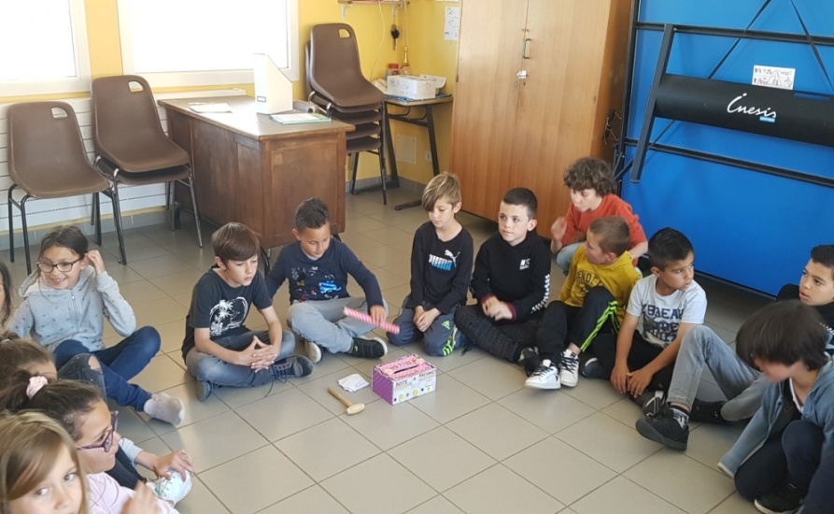
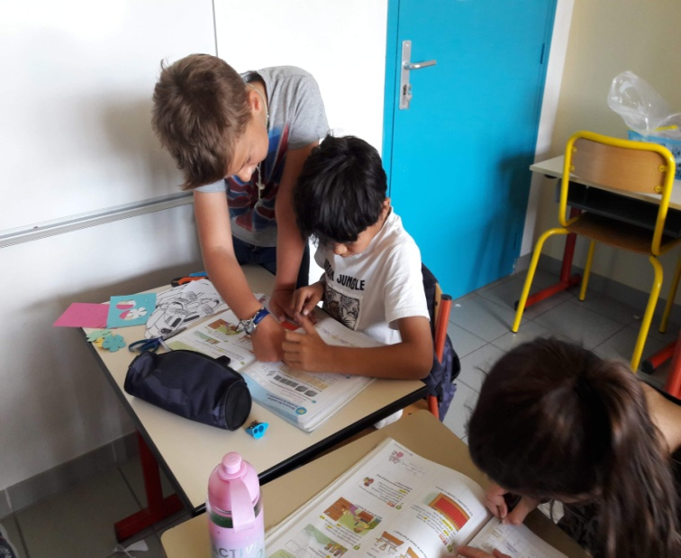
Cooperative council
Tutoring and coaching: a child with facilities helps an other with difficulties.

Slide 9
Equality
Same rights and duties
Help from teachers; Differentiation; Personalized work such as text hole, photocopies,…
AVS: She helps pupils who have difficulties (learning, desease, mental or physical handicap)
She explains all activities and does it with the pupil she is in charge

Slide 10
Integration
Work on open-minded: no judgement

Slide 11
Secularity
The principle of secularism has been the foundation of the French educational system since the end of the 19th century
No proselyte, no religious symbols at school
All of this is written in the school rules .

Slide 12
This is The Charter of Secularism
It is a text which summarises the important points of the laicity to be respected in the school.
It is displayed in each class.

