Slide 1
Christmas Time!
F.R.A.T.S.2018-2020
Scuola infanzia A.Sturiale
Certaldo,
Italy
December 2018

Slide 2
F.R.A.T.S.2018-2020
Many different activities…
Decorations for our school
Small presents to take home
Decorations for our classes
Readings on Christmas
Singing some songs

Slide 3
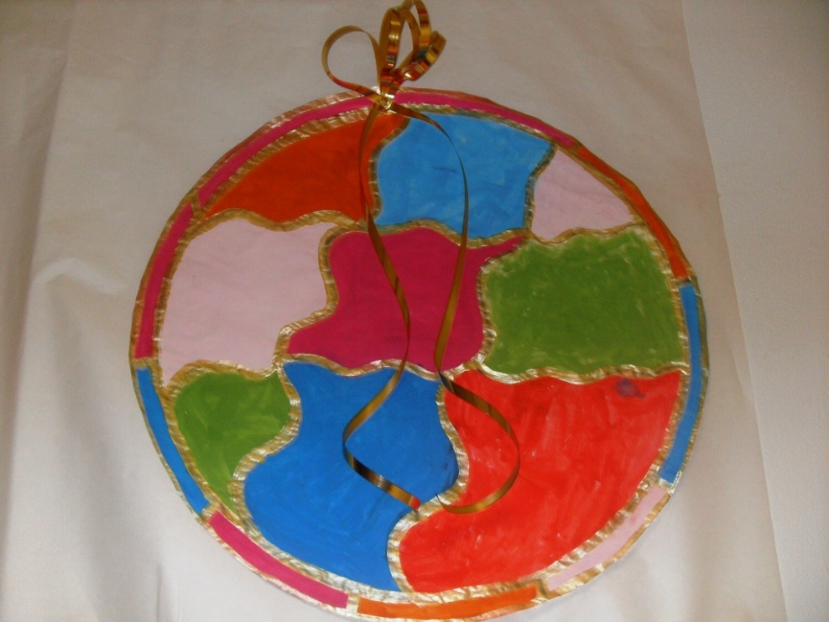
F.R.A.T.S.2018-2020
DECORATIONS

Slide 4
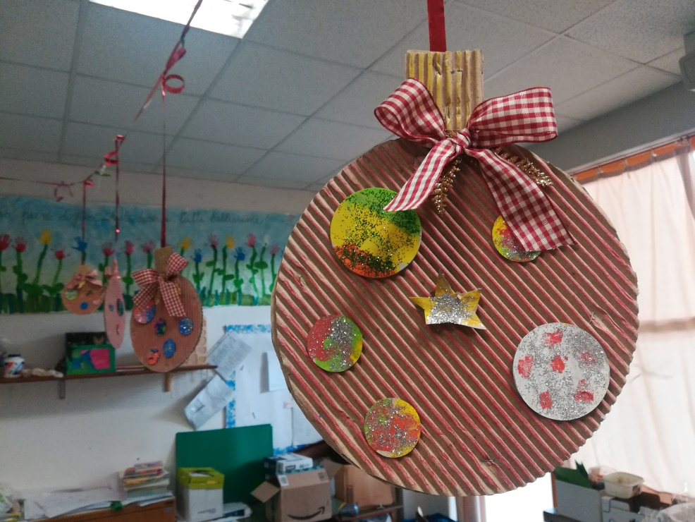
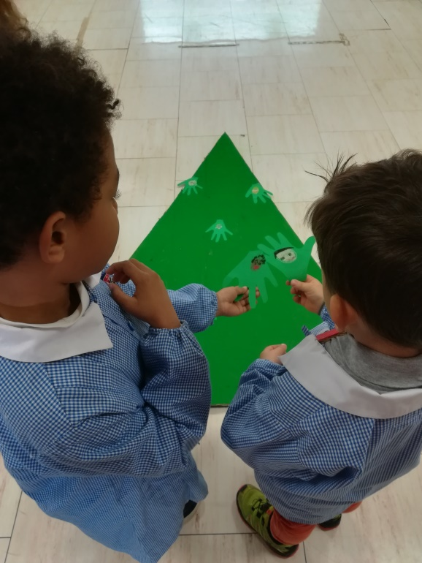
F.R.A.T.S.2018-2020
DECORATIONS

Slide 5
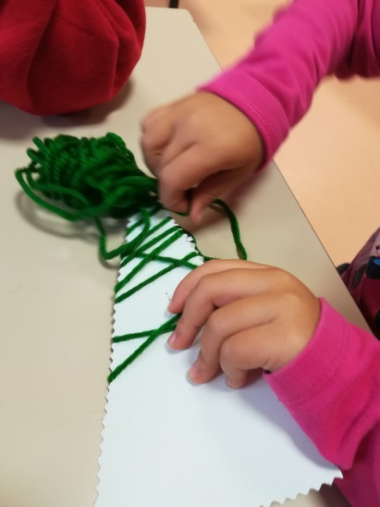
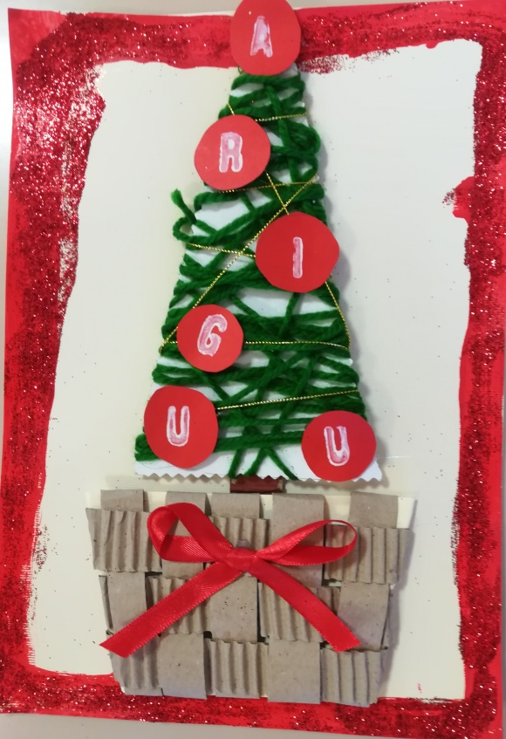
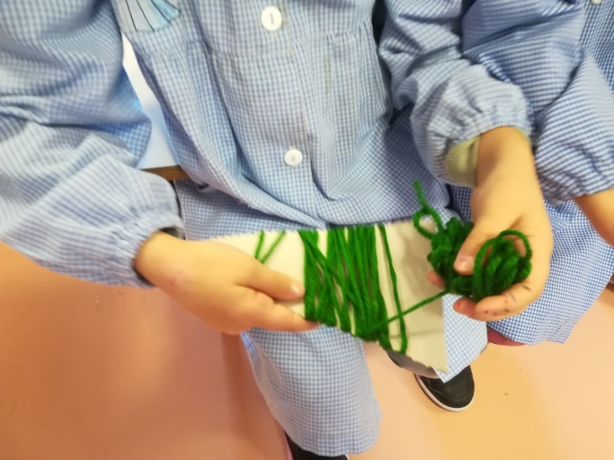
F.R.A.T.S.2018-2020
Cards

Slide 6
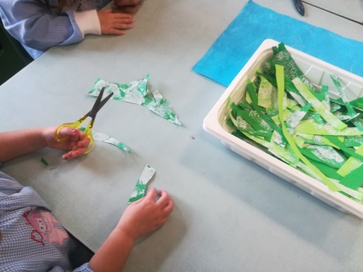
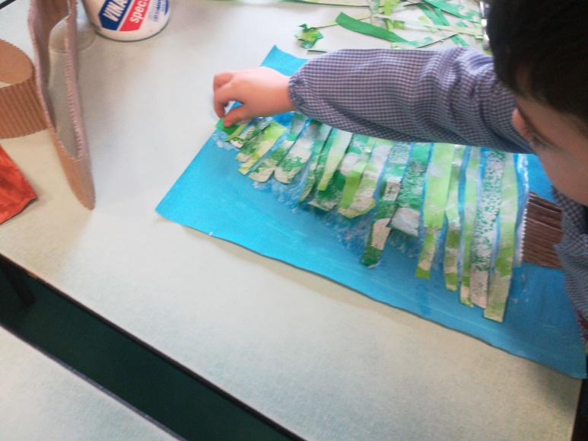
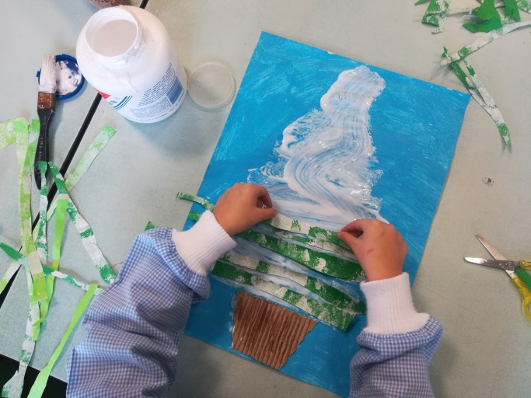
F.R.A.T.S.2018-2020
Drawings

Slide 7
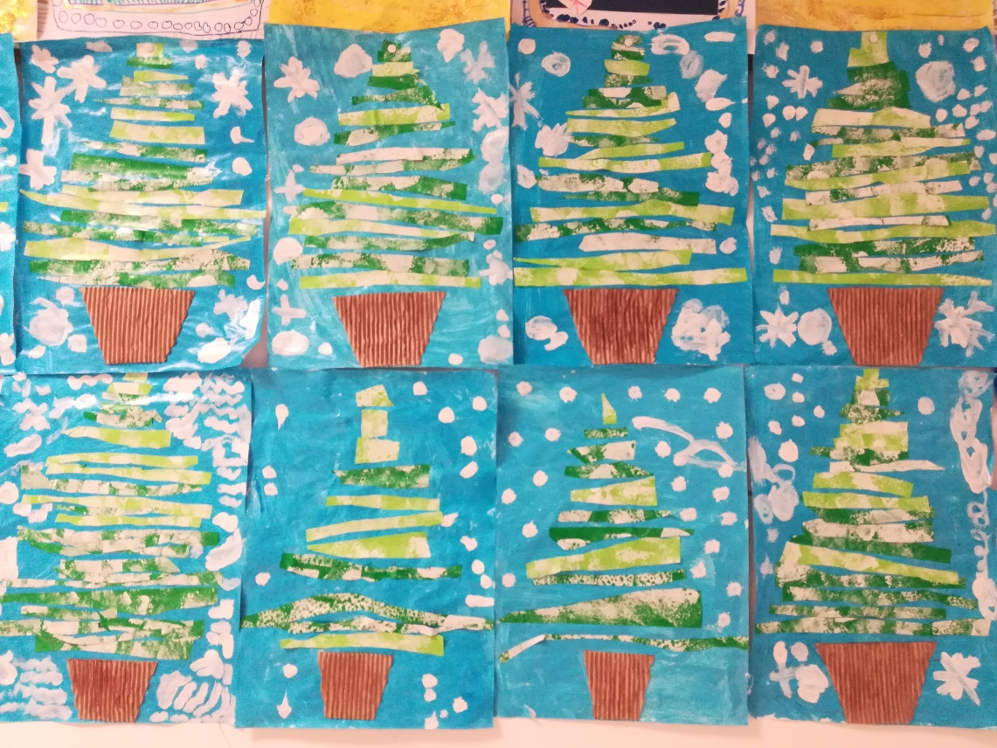
F.R.A.T.S.2018-2020
Drawings

Slide 8
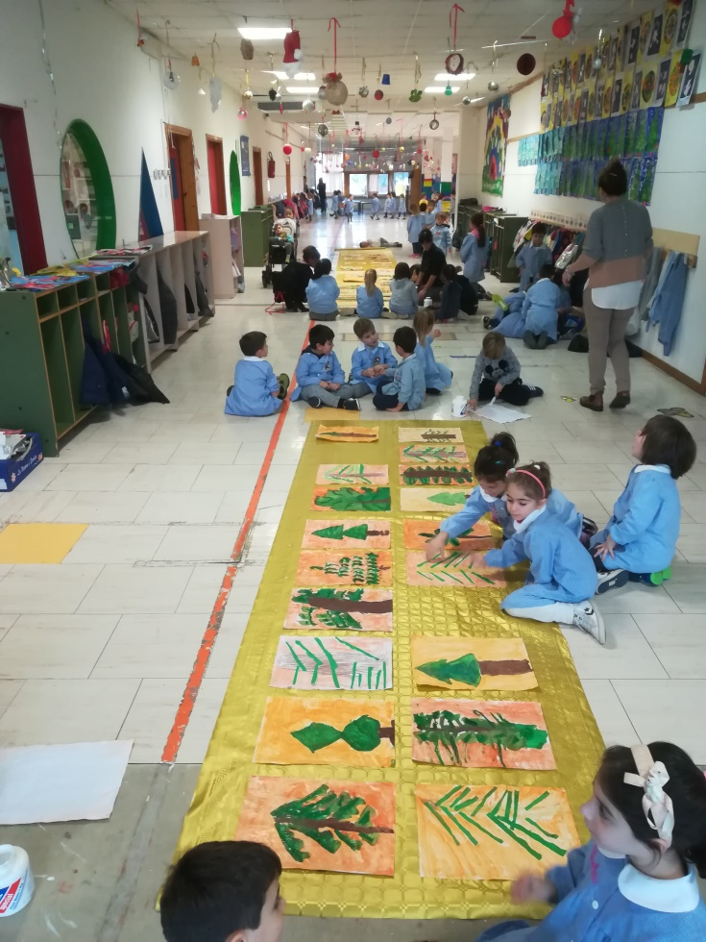
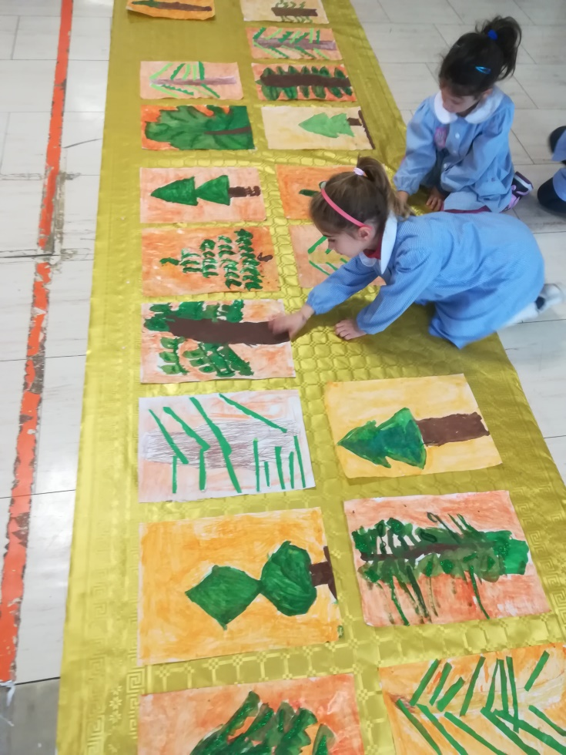
F.R.A.T.S.2018-2020
POSTERS

Slide 9
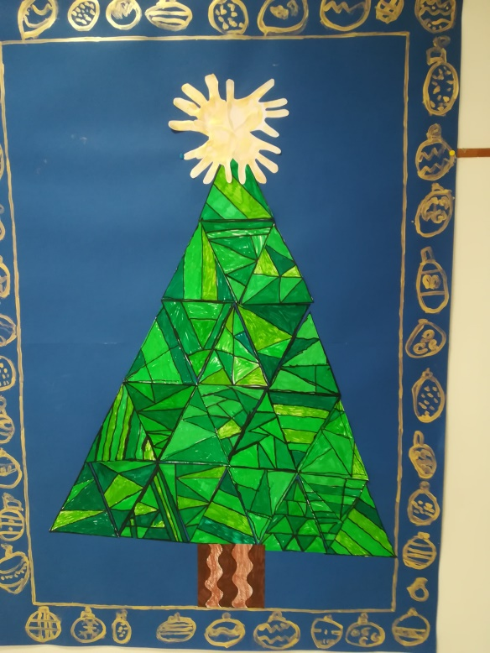
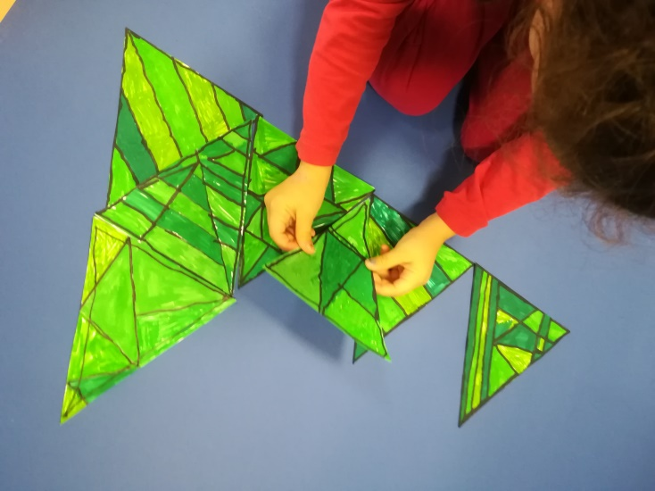
F.R.A.T.S.2018-2020
COLLAGE

Slide 10
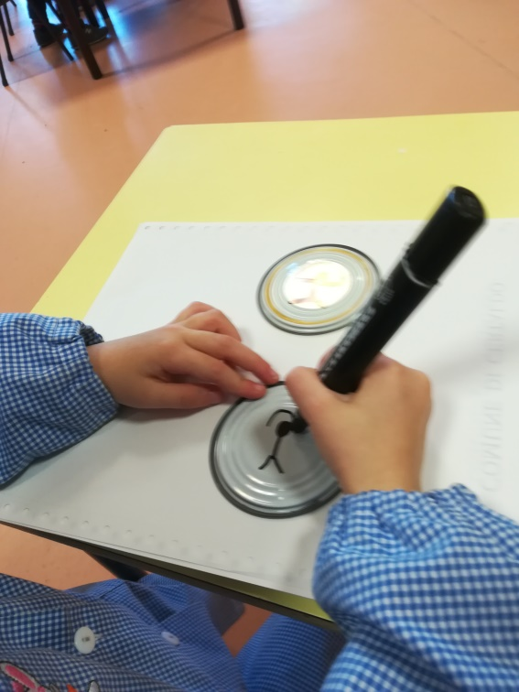
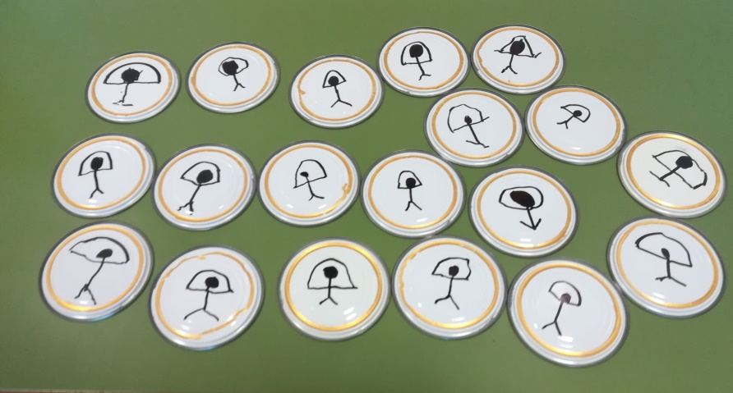
F.R.A.T.S.2018-2020
INDALO

Slide 11
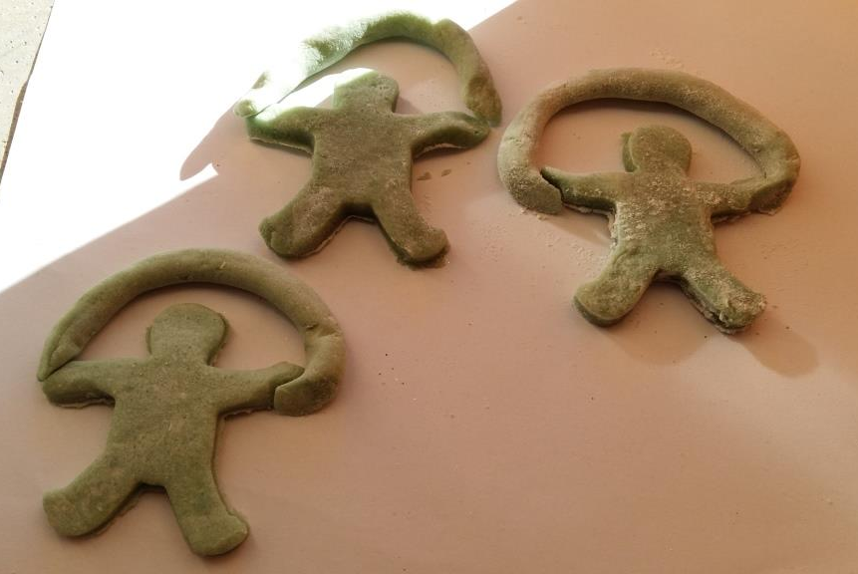
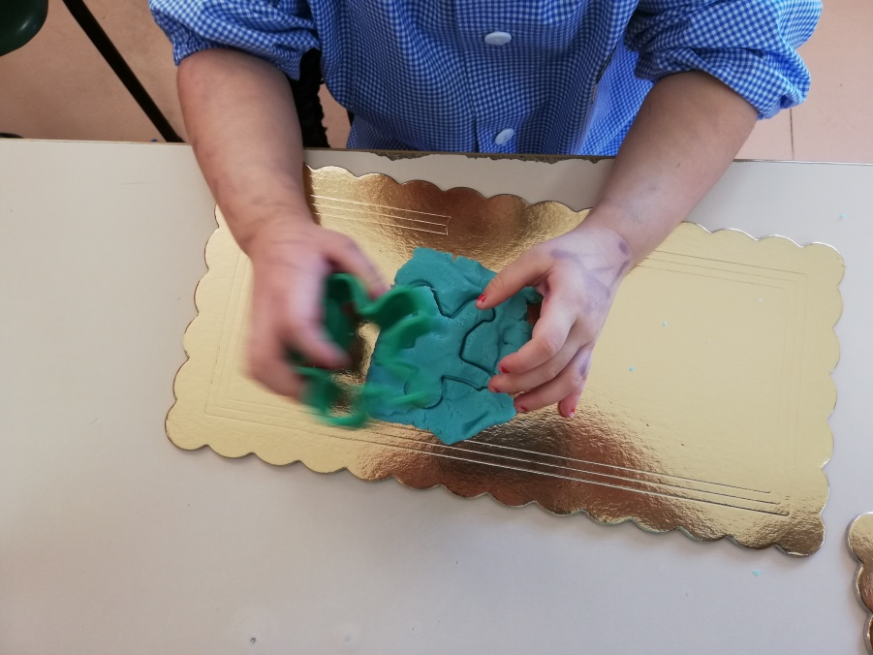
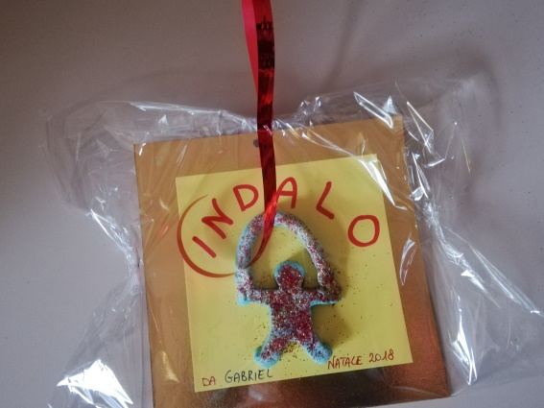
F.R.A.T.S.2018-2020
INDALO

Slide 12
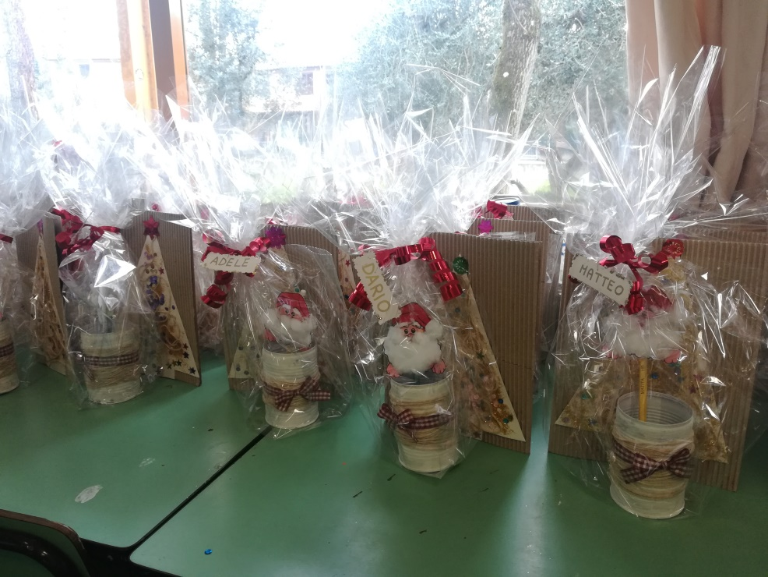
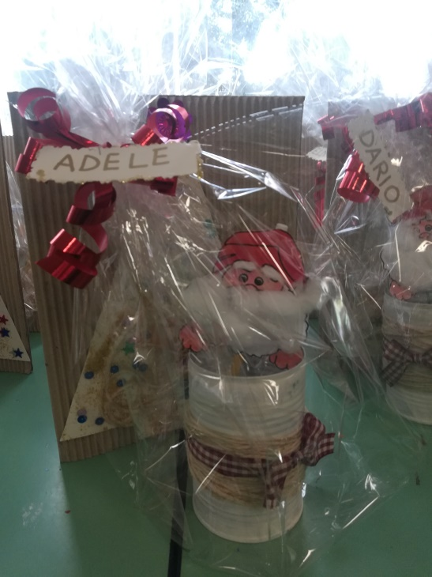
F.R.A.T.S.2018-2020
SOME PRESENTS TO TAKE HOME

Slide 13
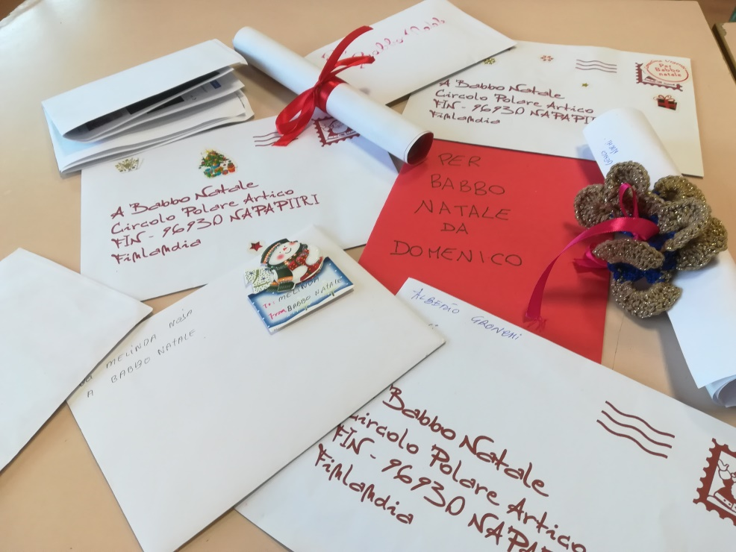
F.R.A.T.S.2018-2020
WAITING FOR FATHER CHRISTMAS
We prepared some letters forFather Christmas… What would you like to receive?

Slide 14
F.R.A.T.S.2018-2020
A SPECIAL CAKE
We read a traditional story about the origin of the Panettone, an Italian traditional cake we usually eat for Christmas and we worked on this.
Some children played a simple drama.
The story says that in the Renassaince a rich and popular lord, Federico Il Moro, who lived near Milan, was preparing an important party with many guests.
His cooker was working hard and he left his young helper taking after the oven. Inside, there was the cake.
Unfortunatelly, the young boy, called Tony, was very tired and got asleep so the cake got burned. Tony decided to make a new special bread using eggs, flour, sugar, raisins and candied fruit. The result was a success! The cake took the name from the boy: Pan di Tony (Tony’s bread) = Panettone.

Slide 15
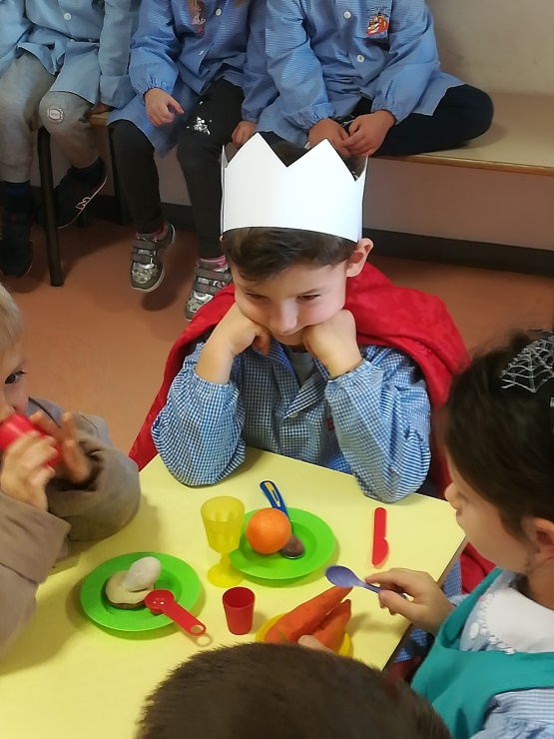
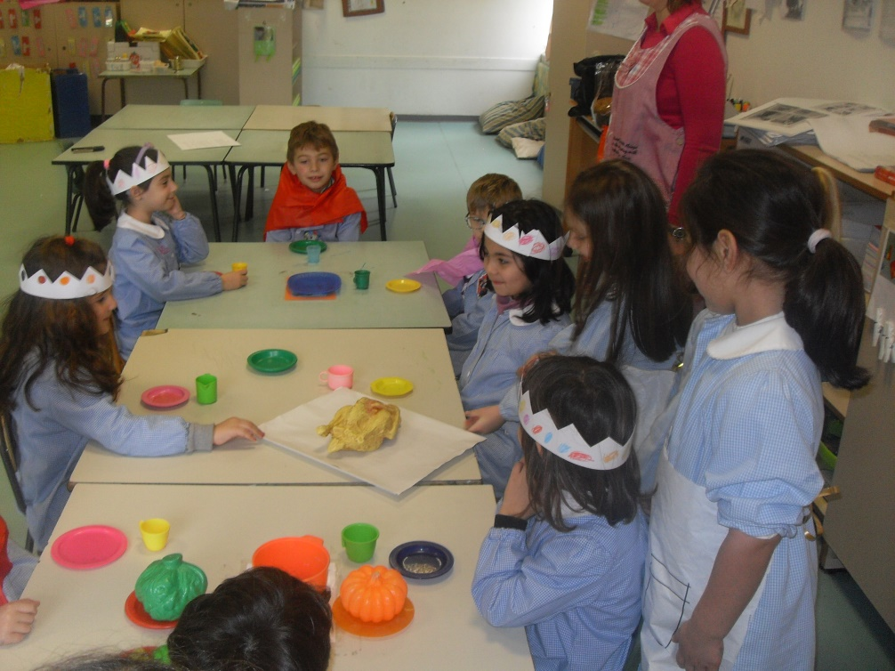
F.R.A.T.S.2018-2020
DRAMA
The Lord and his guests are waiting…

Slide 16
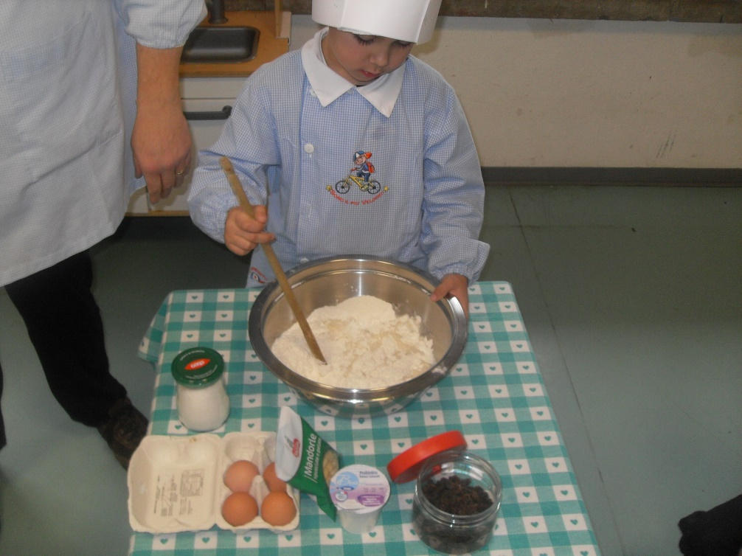
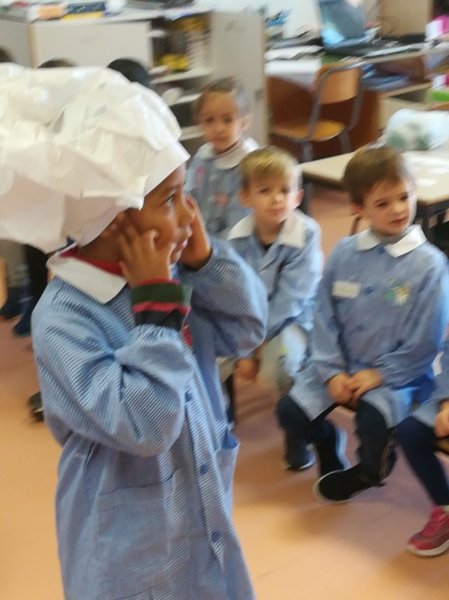
F.R.A.T.S.2018-2020
What
happened?
How can I do?!@
DRAMA
I’ll do a special bread, don’t worry

Slide 17
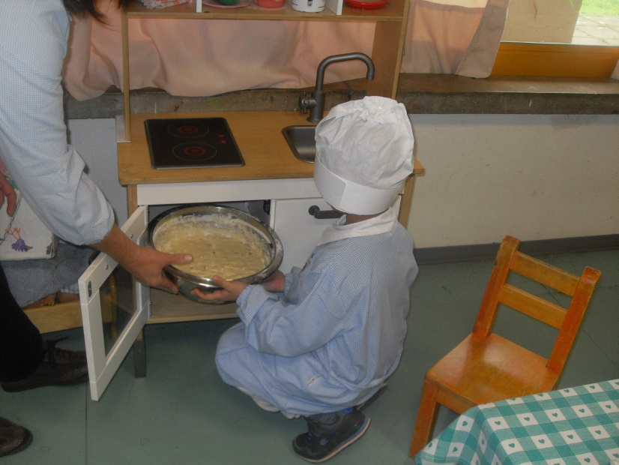
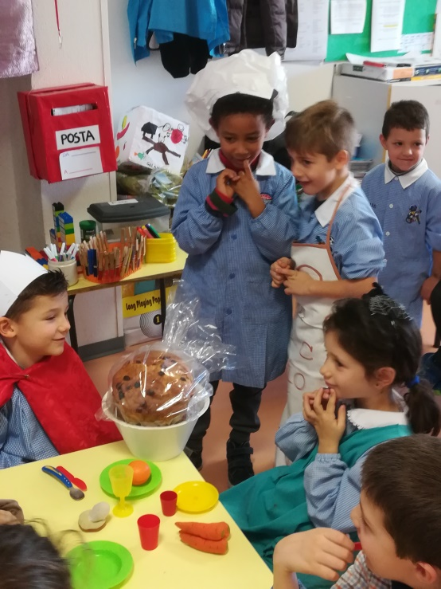
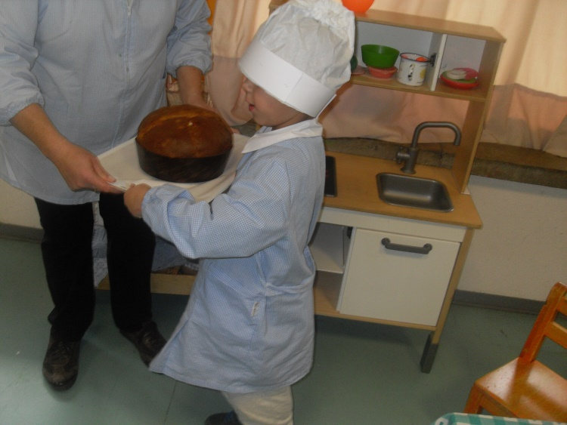
F.R.A.T.S.2018-2020
DRAMA
Into the oven….
What a success!!!!!

Slide 18
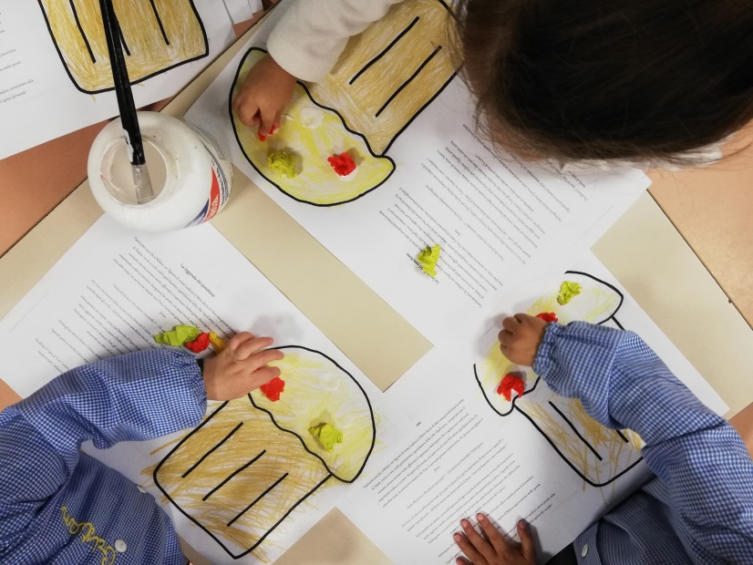
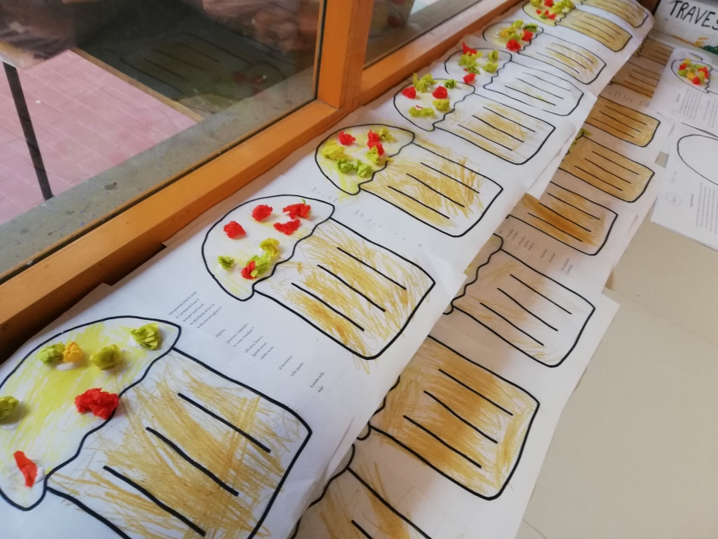
F.R.A.T.S.2018-2020
After the Story
PANETTONE is here!

Slide 19
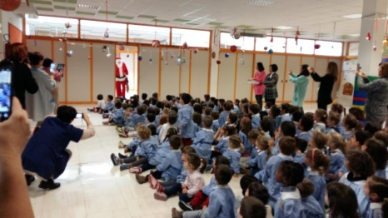
F.R.A.T.S.2018-2020
FATHER CHRISTMAS is coming..

Slide 20
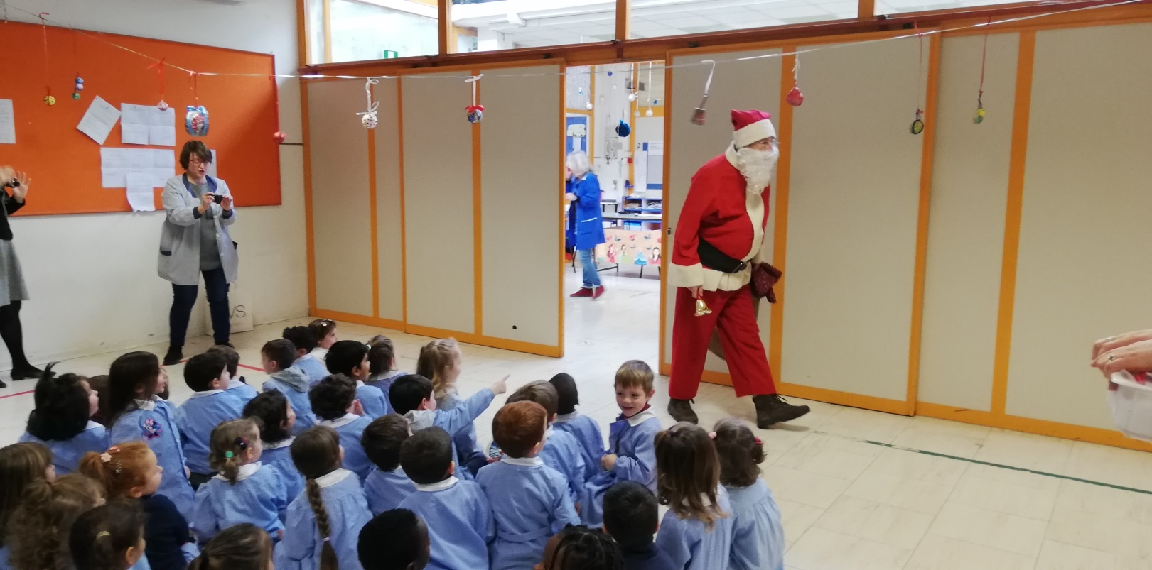
F.R.A.T.S.2018-2020
FATHER CHRISTMAS is here but
where is he going?

Slide 21
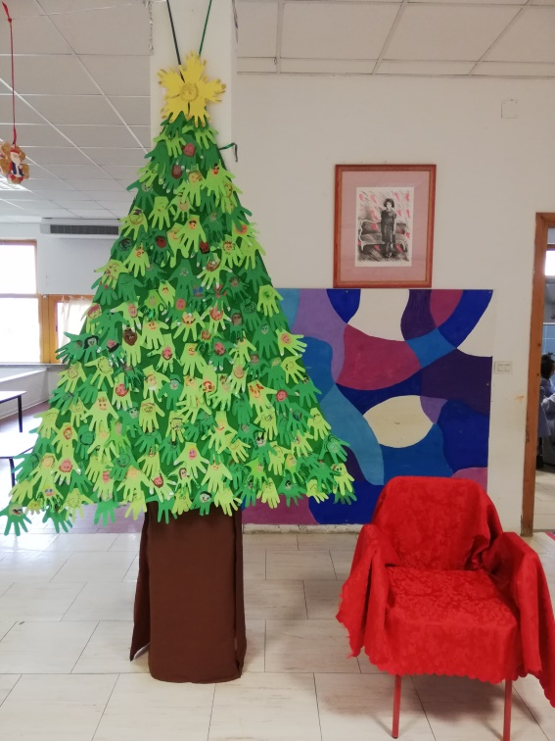
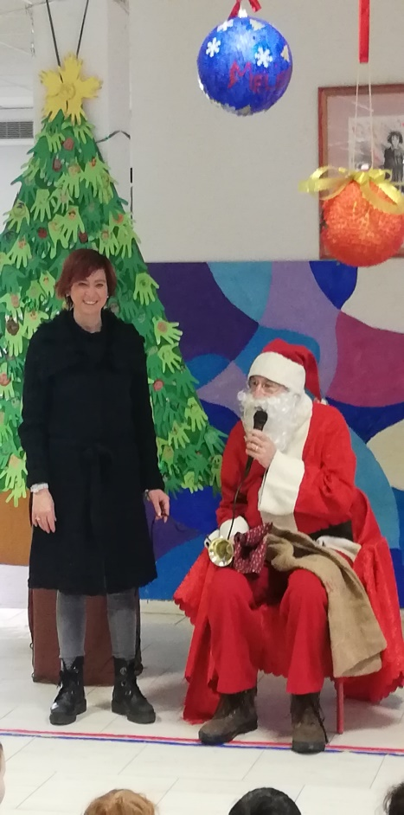
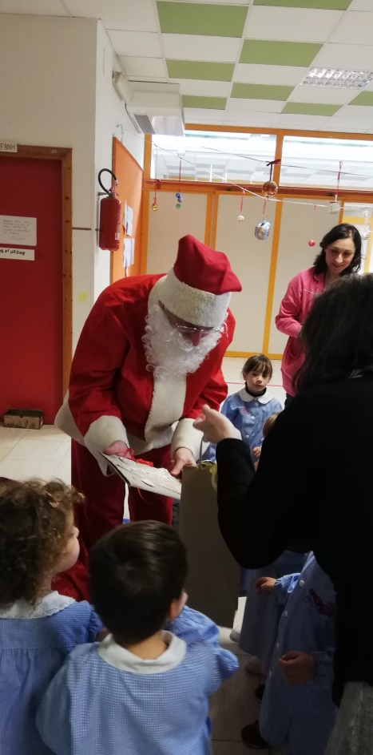
F.R.A.T.S.2018-2020
FATHER CHRISTMAS

Slide 22
F.R.A.T.S.2018-2020
And you
What have you done for
CHRISTMAS?

