Slide 1
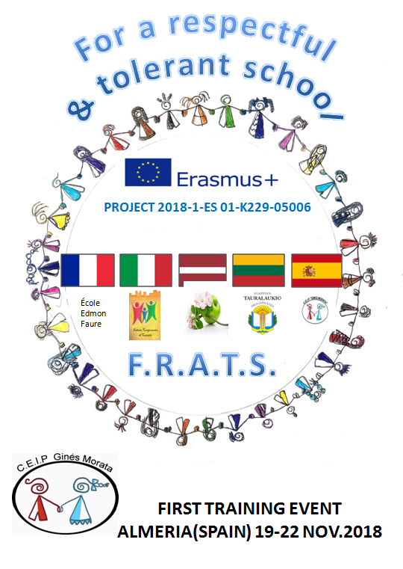
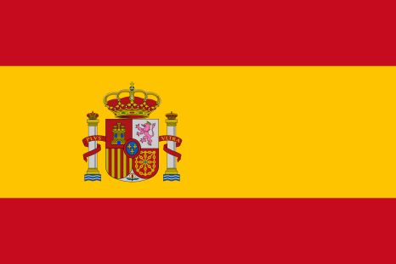
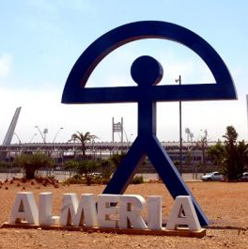
OUR COUNTRY OUR CITY OUR SCHOOL

Slide 2
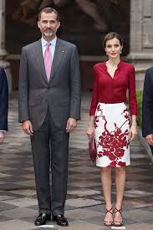
SPAIN
Year of EU entry: 1986
Political system: Parliamentary Monarchy, our King is Felipe VI, and our Queen Letizia.
Capital city: MADRID
Total area: 504.645 km2
Population: 47 million
Currency: euro
Notes:
MAP: Spain is located in southwestern Europe on the Iberian Peninsula, The people of Spain often refer to their country as the "Bull Skin" (Piel de Toro) because of the shape of its territory. The Spanish mainland is bordered to the south and east almost entirely by the Mediterranean Sea (except for a small land boundary with Gibraltar); to the north by France, Andorra and the Bay of Biscay; and to the west by the Atlantic Ocean and Portugal and. Spanish territory also includes the Balearic and Canary Islands and the cities of Ceuta and Melilla in North Africa.

Slide 3
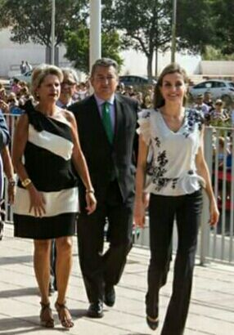
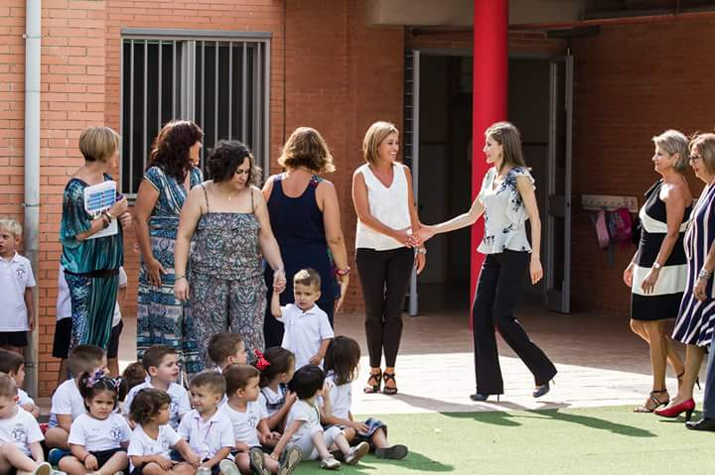

Slide 4
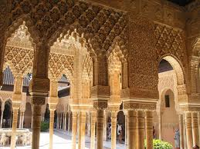
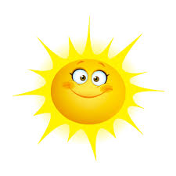
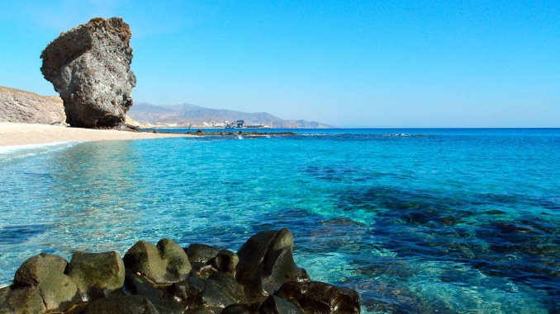
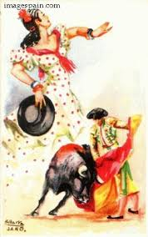
We are Known
- Monuments. Alhambra
-Tourism. Canary Islands
-Weather.
-Football. El clásico
-Music and dance. Flamenco
-Bullfight
-Literature. Don Quixote
-Language. Spanish
Gastronomy
Siesta and Fiesta
Notes:
Spain is known for its culturally diverse heritage, having been influenced by many nations and peoples throughout its history. Spanish culture has its origins in the Iberian, Celtiberian, Latin, Visigothic, Roman Catholic and Islamic cultures.

Slide 5
ALMERIA
Our city
Notes:
5

Slide 6
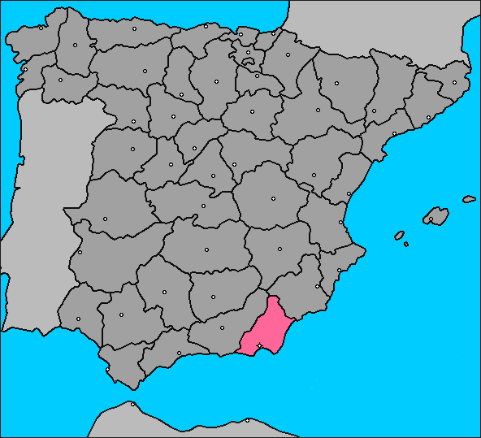
ALMERIA
Almería is in Andalucia (South Spain). By the Mediterranean Sea.
Notes:
6
6

Slide 7
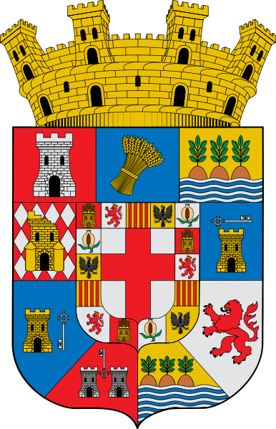
ALMERIA SYMBOLS
The Indalo is a man holding a rainbow.
It brings good luck.
Notes:
7

Slide 8
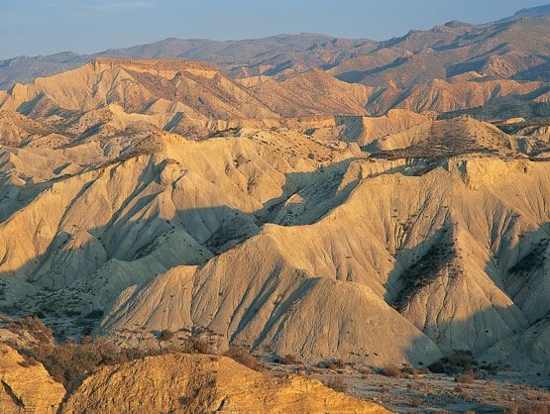
Driest and hottest place in Europe:
Cabo de Gata-Níjar Natural Park and the Desert of Tabernas.
Notes:
8
8

Slide 9
Almeria is a natural film set.
Lots of films were shot here

Slide 10
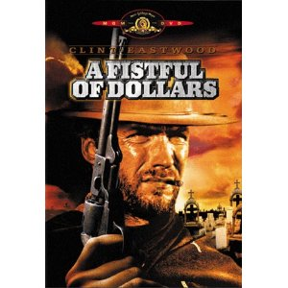
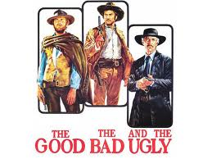
Notes:
10
10

Slide 11
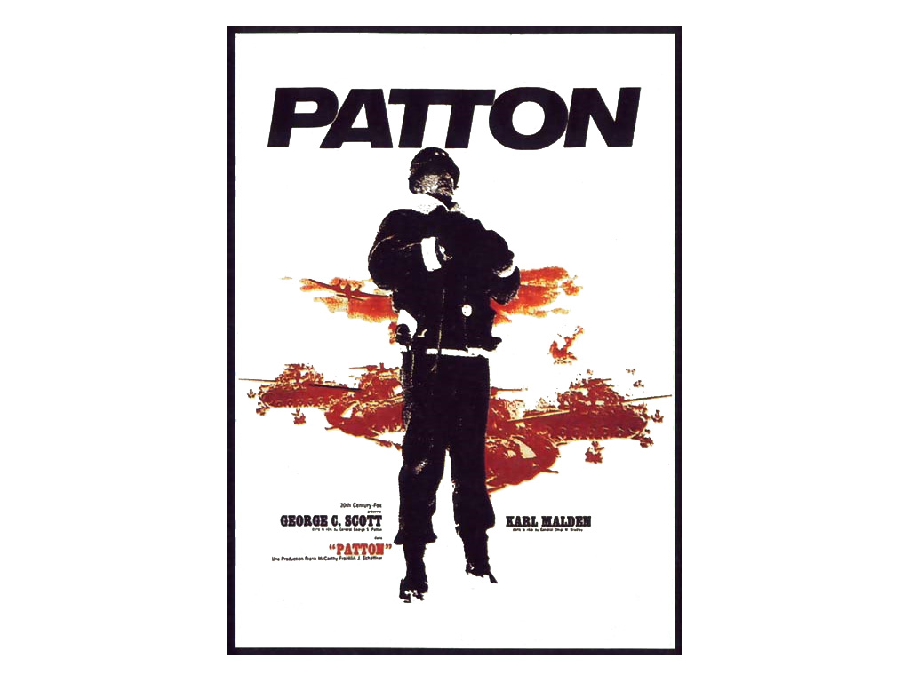
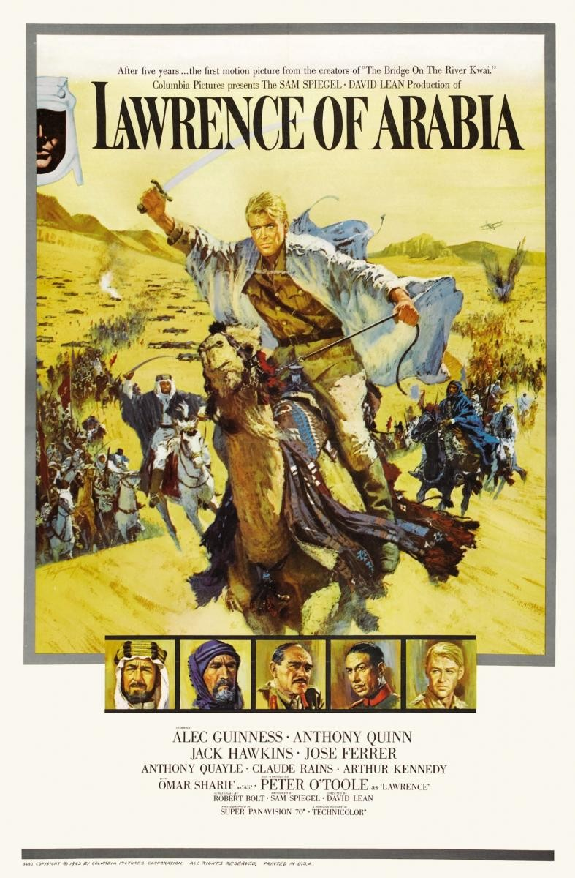
Notes:
11
11

Slide 12
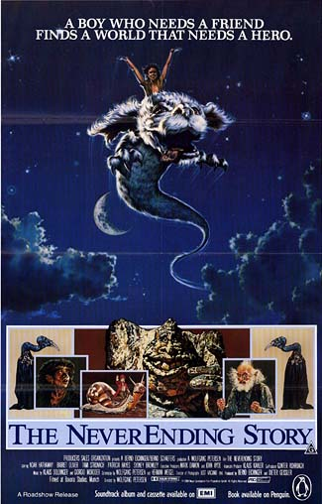
Notes:
12
12

Slide 13
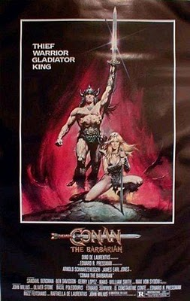
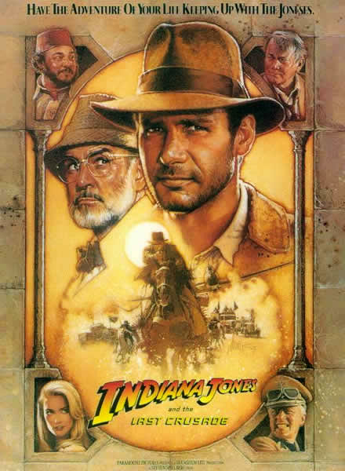

Slide 14
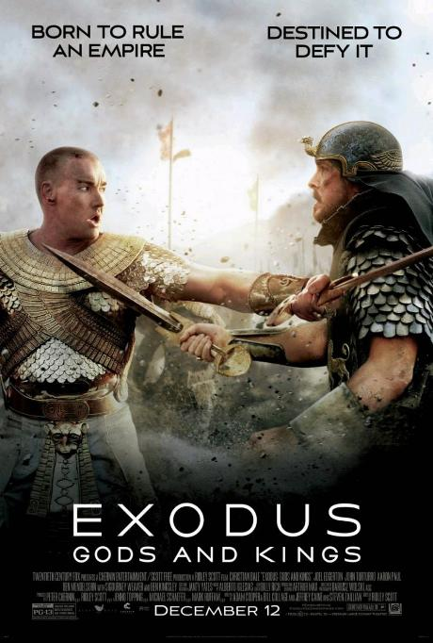
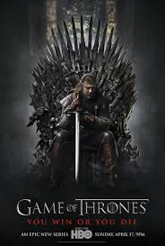

Slide 15
Europe pantry- The plastic sea Greenhouse farming
Notes:
15

Slide 16
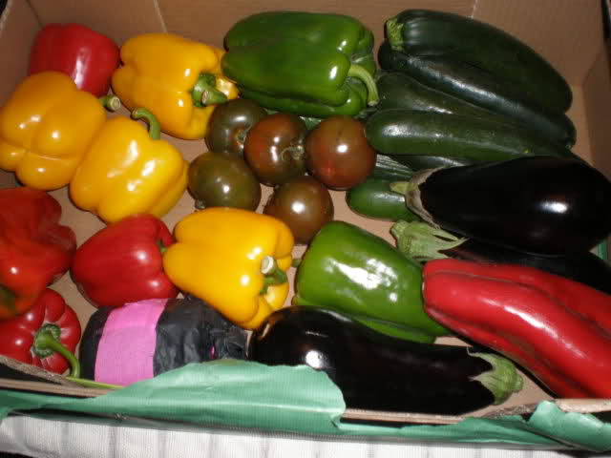
Tons of vegetables are exported to other European countries

Slide 17
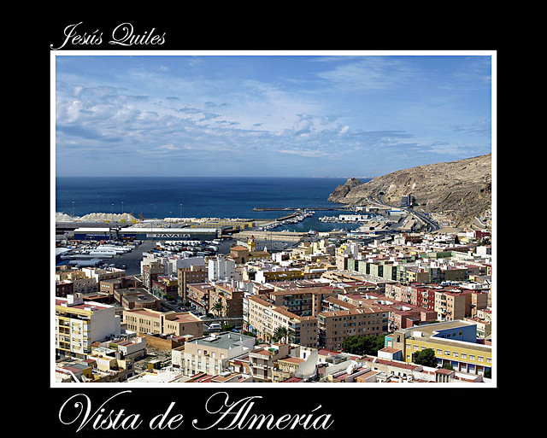
THE CITY
The city of Almería: 190,000 inhabitants
Notes:
17
17

Slide 18
The Alcazaba, a moorish castle.
Notes:
18
18

Slide 19
UNSPOILT BEACHES
Notes:
19

Slide 20
Cabo de Gata lighthouse
Notes:
20

Slide 21
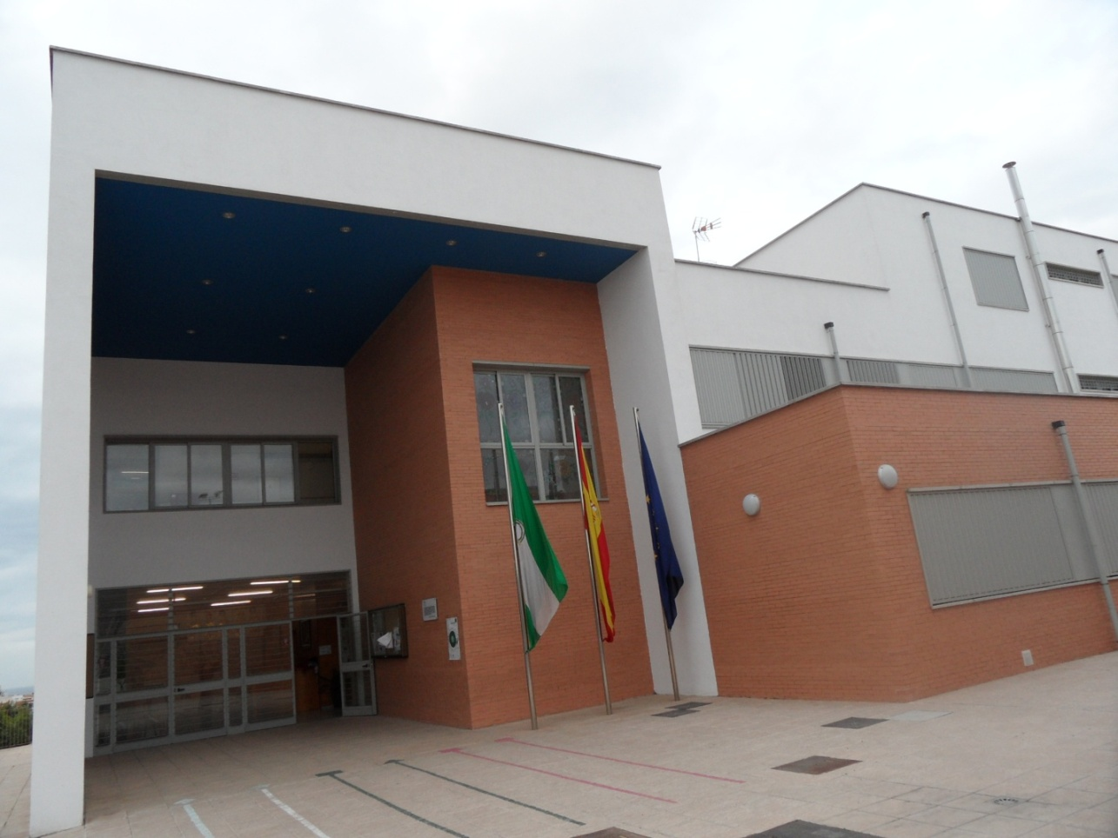
WE ARE 30 TEACHERS
500 PUPILS ( from 3 to 12 years old)

Slide 22
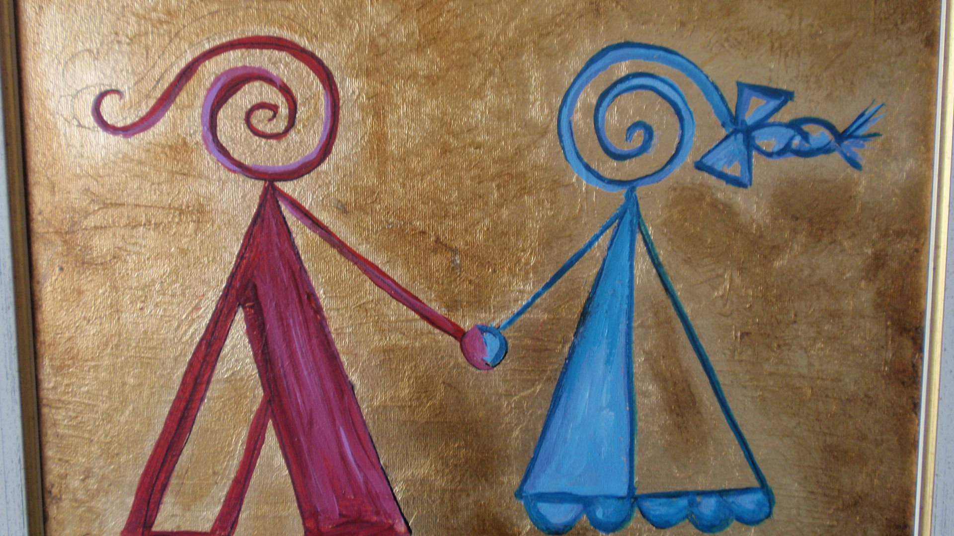
OUR SCHOOL LOGO

Slide 23
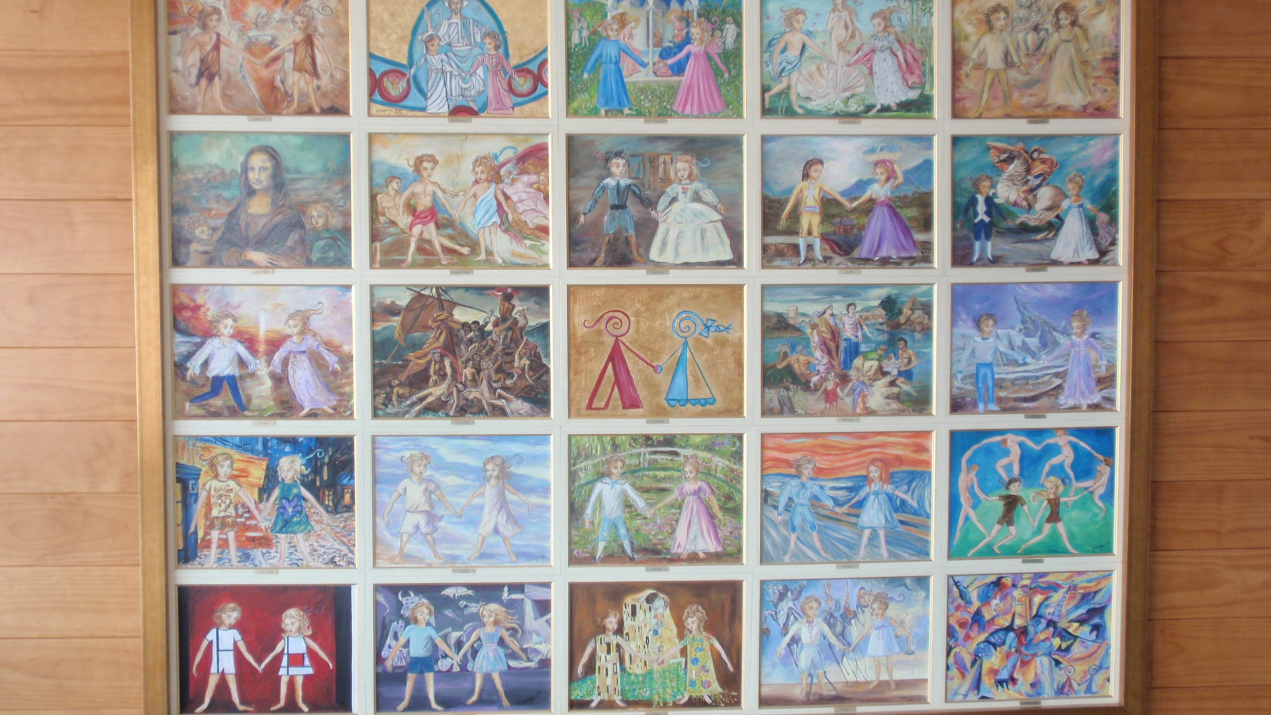
Our logo in painting history

Slide 24
Spanish educative system
Kindergarten
Infant education -not compulsory
First cycle (0-2)
Second cycle (3-5)
Primary School
Primary education (6-11)
High school
Secondary education(12-16)
Upper secondary (16-18) -not compulsory

Slide 25
i
METHODOLOGY
Key competences
Project based learning
INFANT
Task based learning
PRIMARY

Slide 26
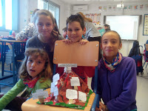
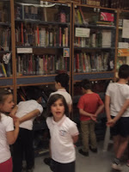
Library
Plurilinguism

Slide 27
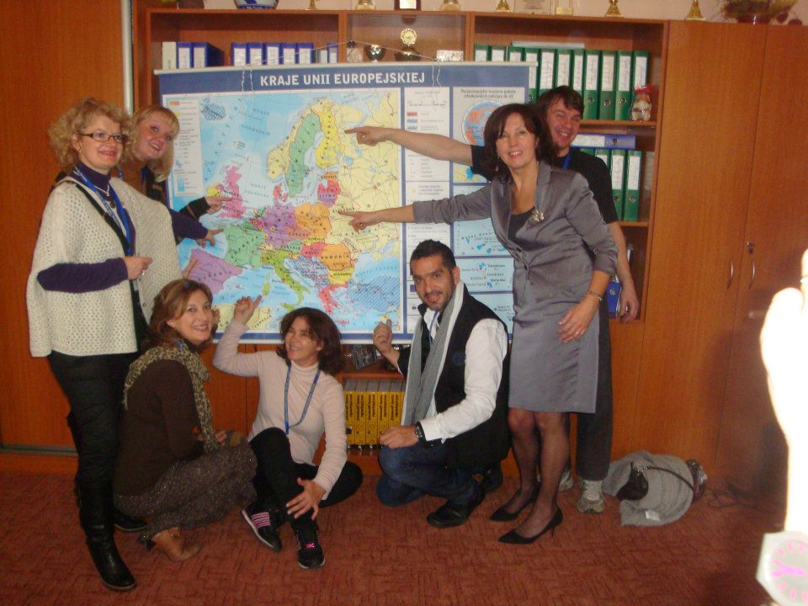
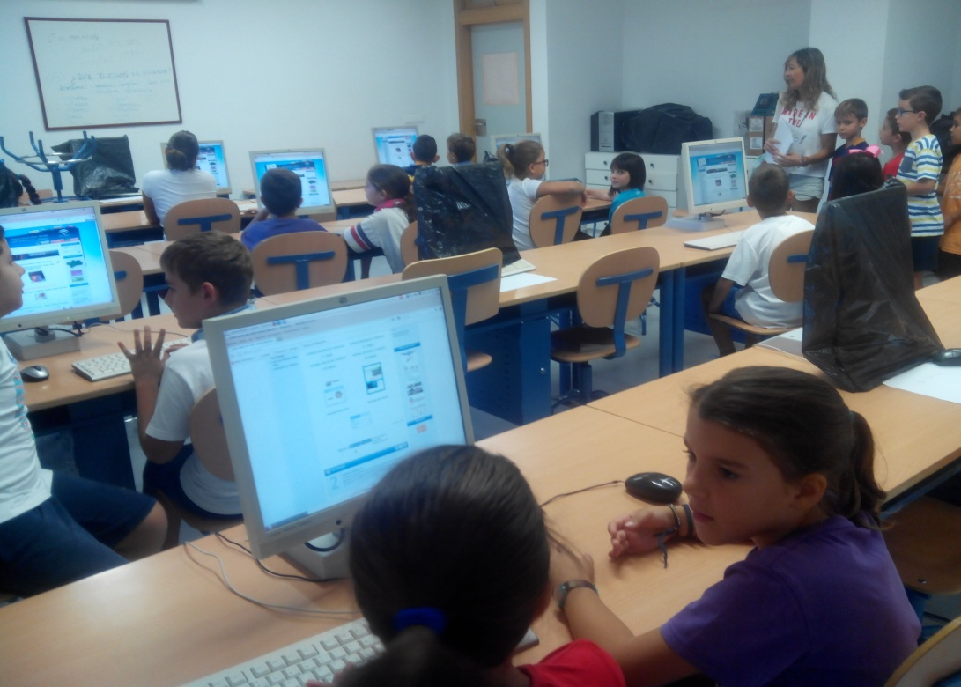
ICT
Erasmus and international projects

Slide 28
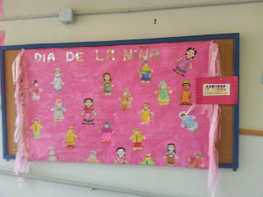
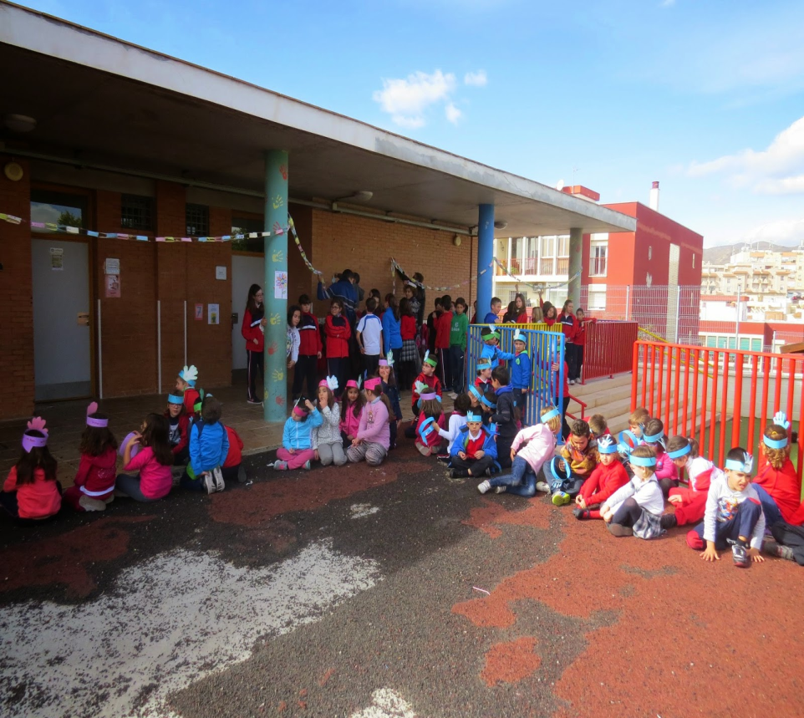
OUR PROJECTS
Peaceful school
Erasmus
Coeducation

