Slide 1
ERASMUS + FRATS
VIRTUAL MEETING EVENT 7th-10th June 2021
Lead a Persona doll activity
based on children with special needs

Slide 2
Lead a Persona doll activity based on children with special needs

Slide 3
Lead a Persona doll activity based on children with special needs

Slide 4
Lead a Persona doll activity based on children with special needs
Why doesn’t she speak?
Maybe she is little…
Maybe she’s shy
She is on a wheelchair… perhaps she has broken her legs
She can’t walk because her legs hurt
Maybe she’s sick
Maybe she’s got her legs in a cast…. No that’s not the truth, her feet are soft!
We can show her how to walk, we can teach her how to do.
She can watch how we do…..

Slide 5
Lead a Persona doll activity based on children with special needs
A jar of wonderful things
What would you like to give Ulla?
What could make her happy?
A rainbow!

Slide 6
Lead a Persona doll activity based on children with special needs
What children suggested to do with and for Ulla
We help her to walk
I can help her to sing a song
I can teach you to play with the sand
I would like to teach her to ride a bike
Can we do Yoga exercises with Ulla?
I would like to play with her
I love her
I would like to offer her a tree, so she will be happy

Slide 7
Lead a Persona doll activity based on children with special needs

Slide 8
Lead a Persona doll activity based on children with special needs

Slide 9
Lead a Persona doll activity based on children with special needs

Slide 10
Lead a Persona doll activity based on children with special needs

Slide 11
Lead a Persona doll activity based on children with special needs

Slide 12
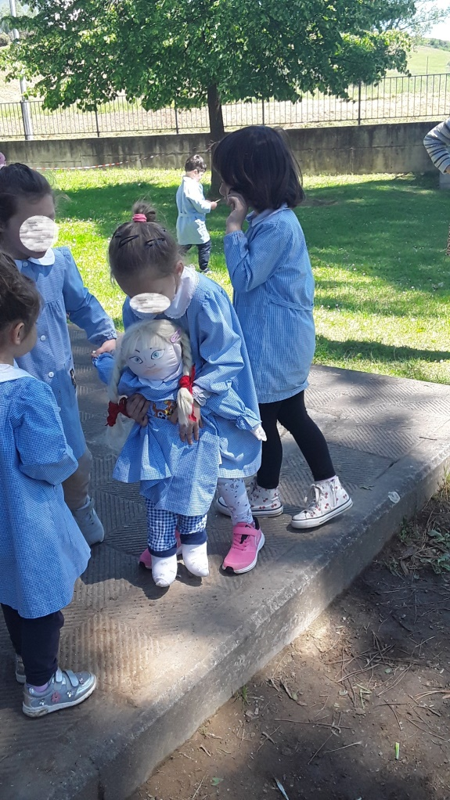
Lead a Persona doll activity based on children with special needs

