Slide 1
ITALIAN WEEK

Slide 2
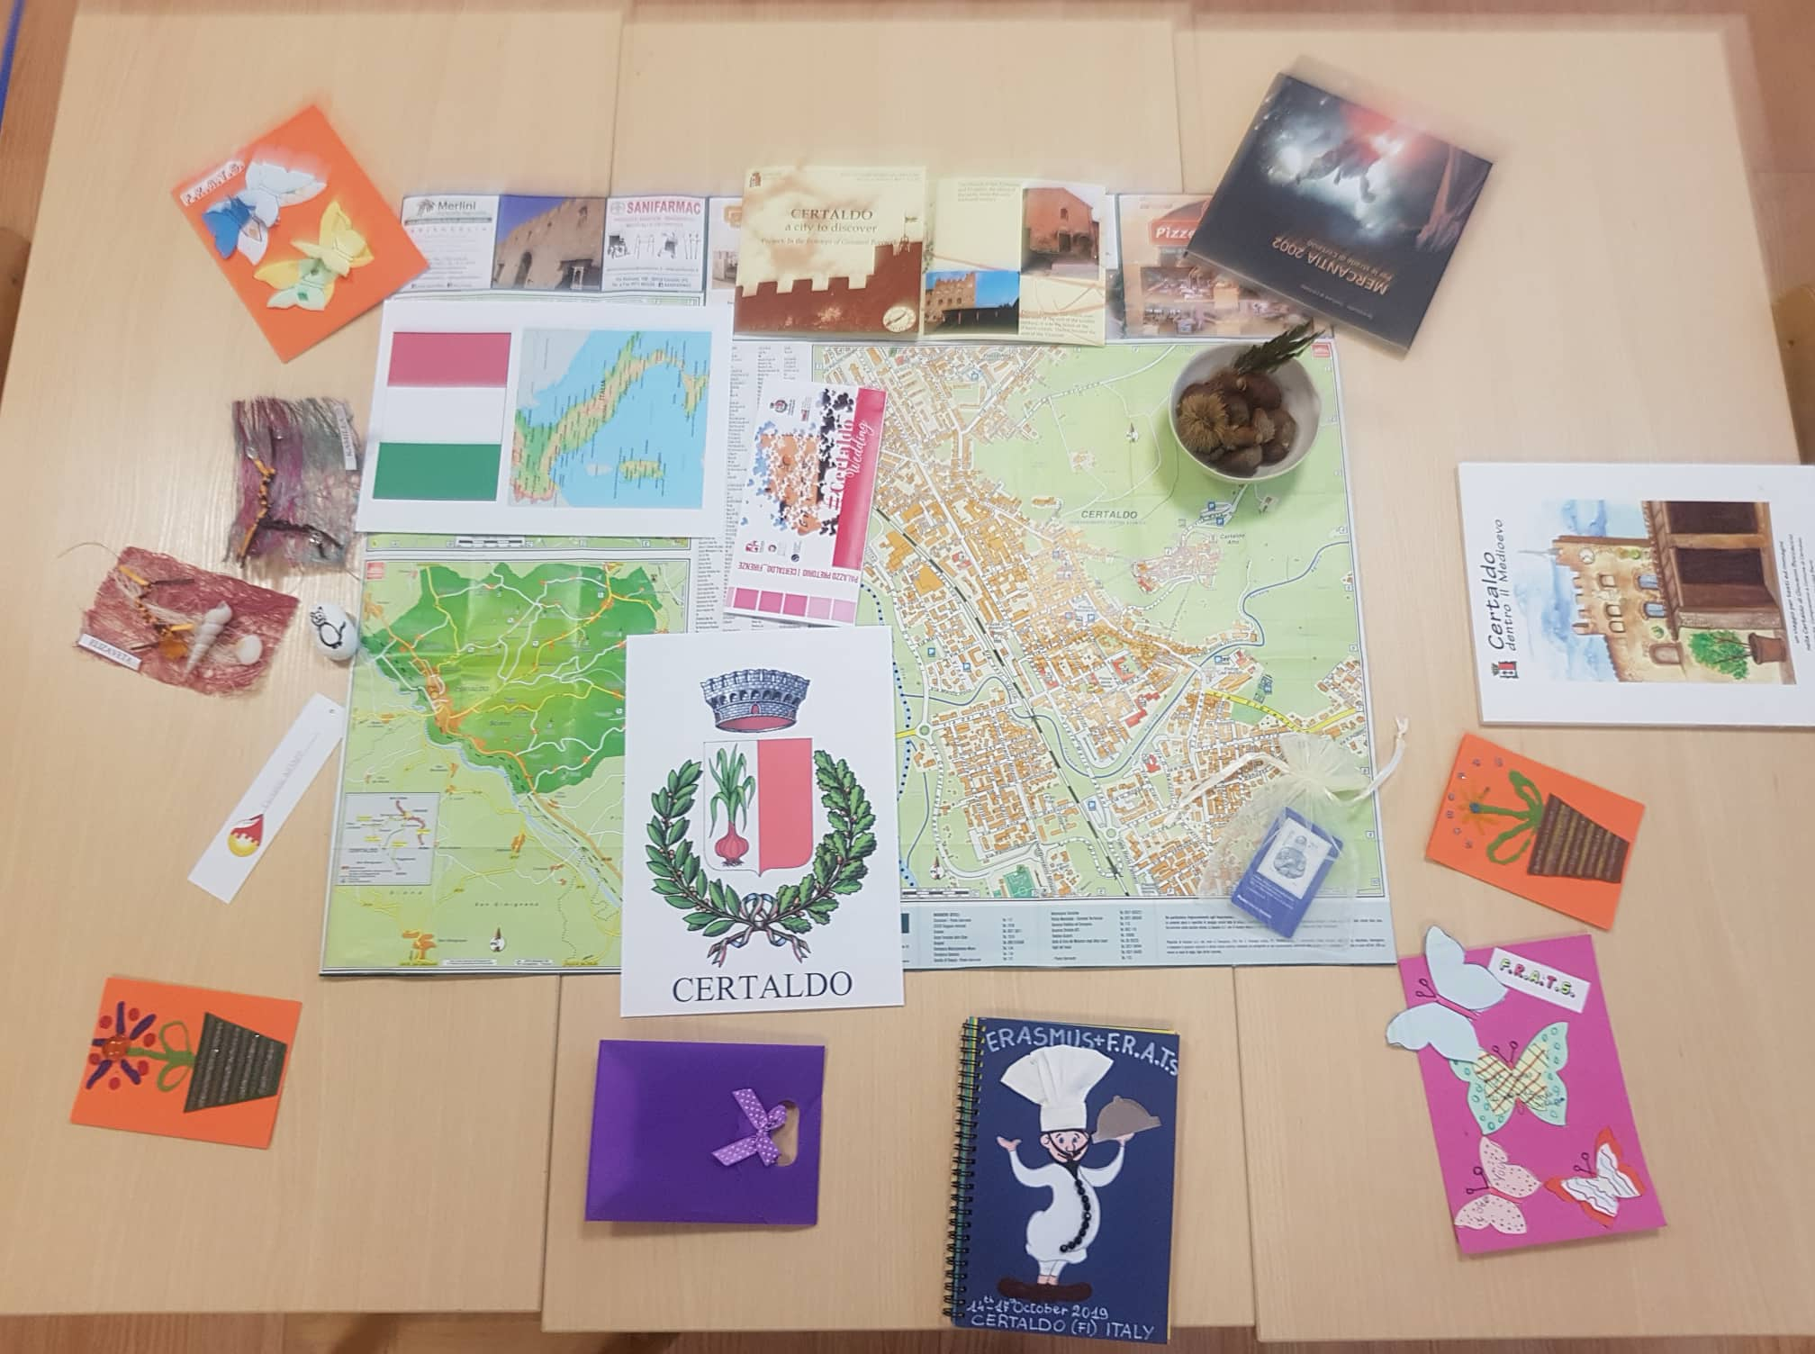

Slide 3
Where is Italy, CERTALDO...?

Slide 4
Italian flag, capture...

Slide 5
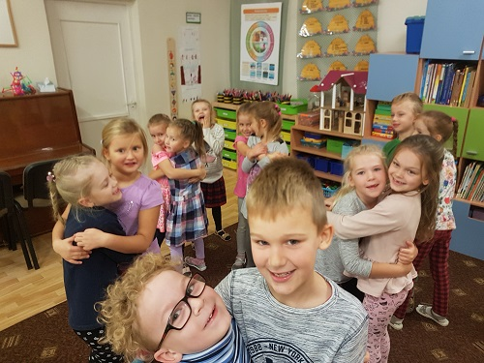
Playing italian game: find a pair when the music stop

Slide 6
The Children drew: Certaldo blazon

Slide 7
And Certaldo alto

