Slide 1
Our Spanish week
Scuola Infanzia Sturiale, Italy
February 2019

Slide 2
Our Spanish week Scuola Infanzia Sturiale, Italy
Fast the belts… we are going to take off!

Slide 3
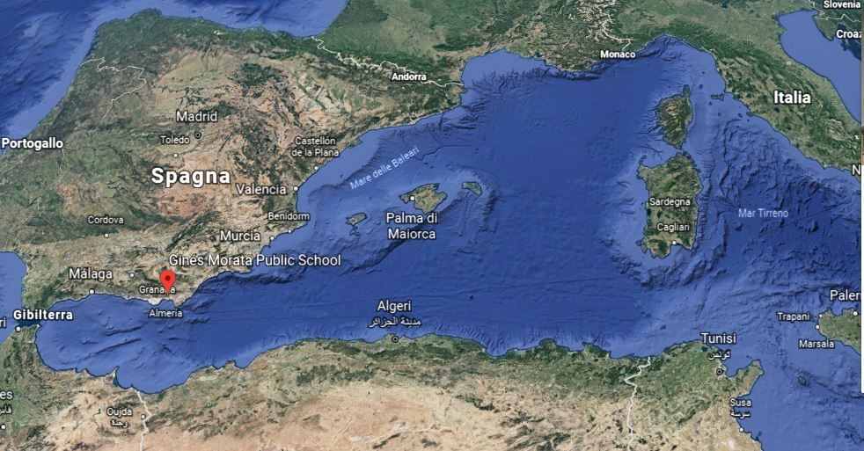
Our Spanish week Scuola Infanzia Sturiale, Italy

Slide 4
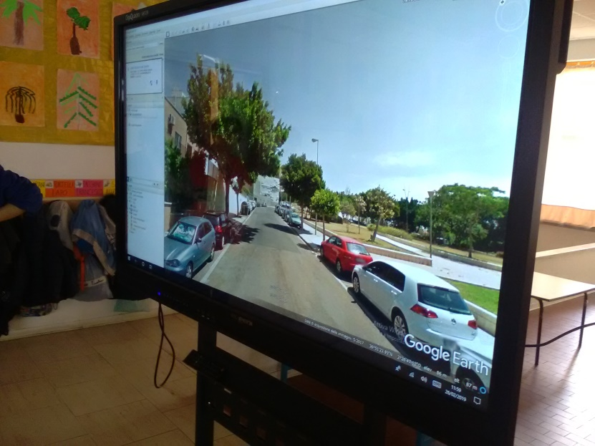
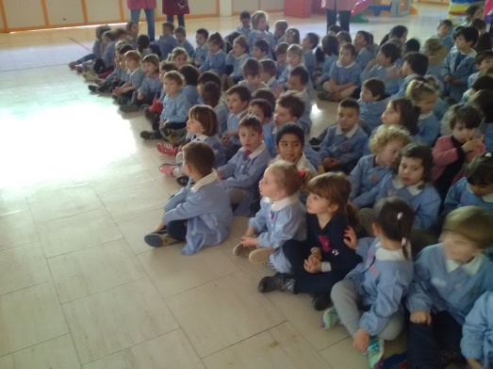
Our Spanish week Scuola Infanzia Sturiale, Italy
Landed at
the Gines Morata School in Almerìa!

Slide 5
Our Spanish week Scuola Infanzia Sturiale, Italy

Slide 6
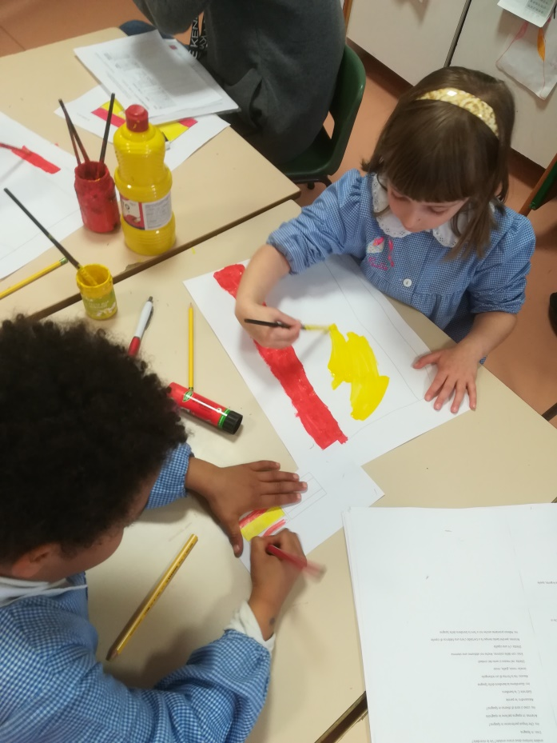
Our Spanish week Scuola Infanzia Sturiale, Italy
Preparing the flags

Slide 7
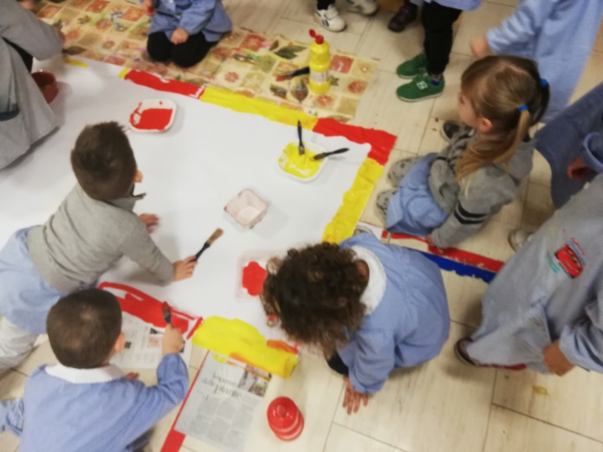
Our Spanish week Scuola Infanzia Sturiale, Italy
Preparing the flags

Slide 8
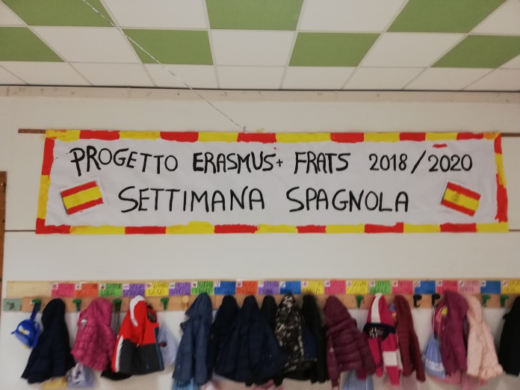
Our Spanish week Scuola Infanzia Sturiale, Italy

Slide 9
Our Spanish week Scuola Infanzia Sturiale, Italy
Our Spanish partners suggested to watch a story in Spanish…

Slide 10
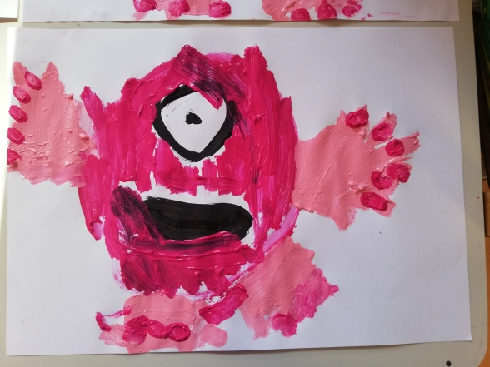
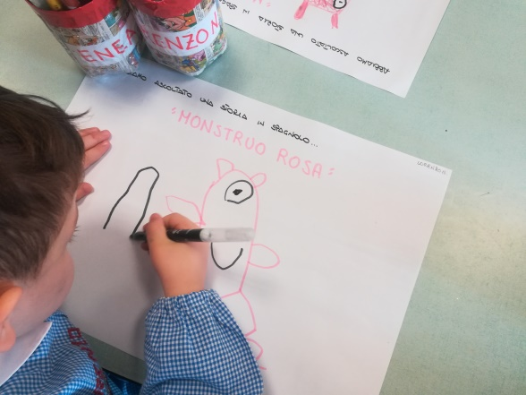
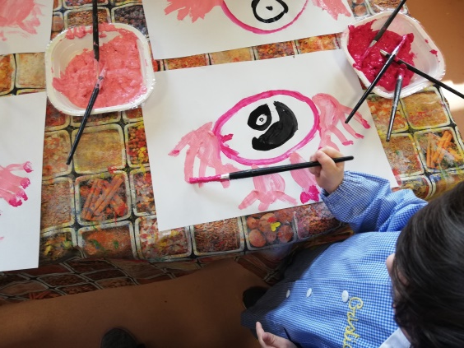
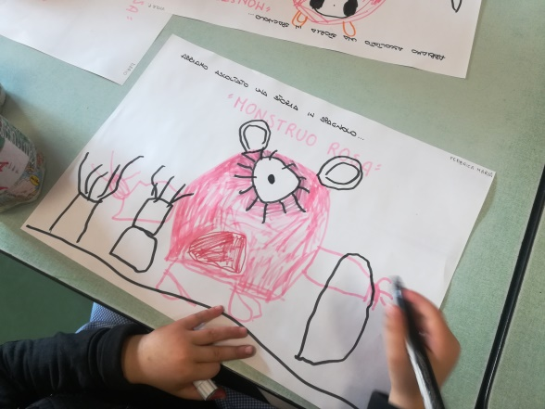
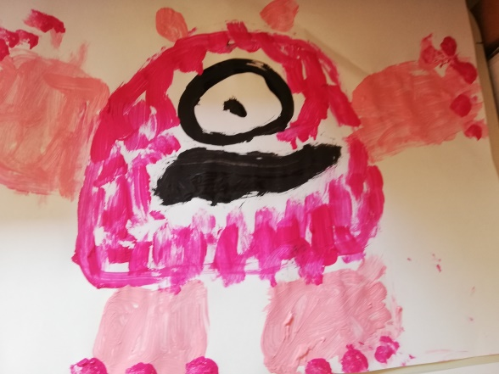
Our Spanish week Scuola Infanzia Sturiale, Italy
…and we made also the drawing!

Slide 11
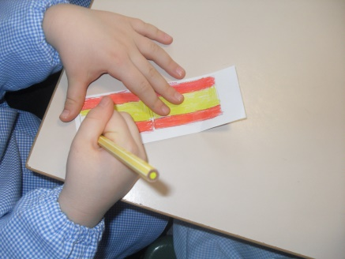
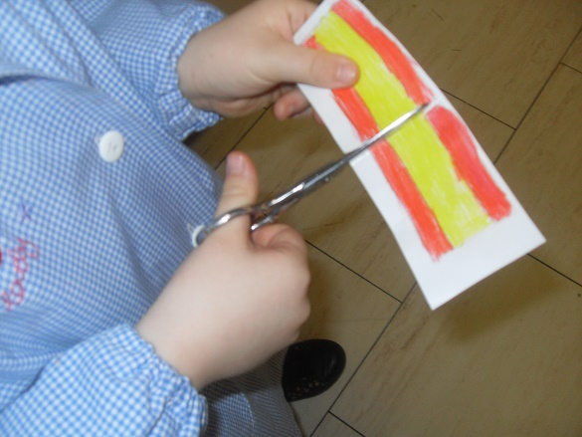
Our Spanish week Scuola Infanzia Sturiale, Italy
Our castanets!

Slide 12
Our Spanish week Scuola Infanzia Sturiale, Italy
Our castanets!

Slide 13
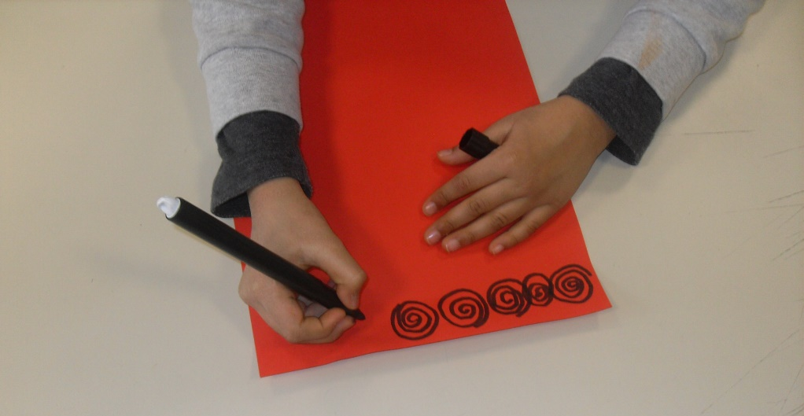
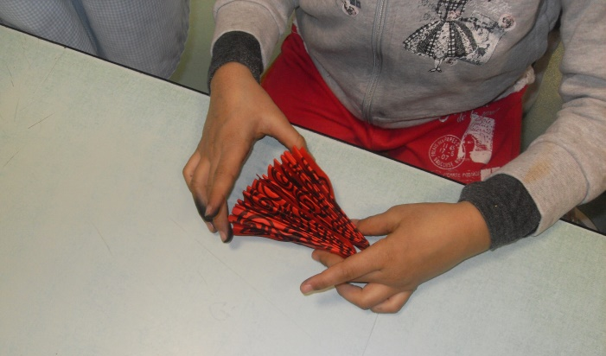
Our Spanish week Scuola Infanzia Sturiale, Italy
Making folding fans!

Slide 14
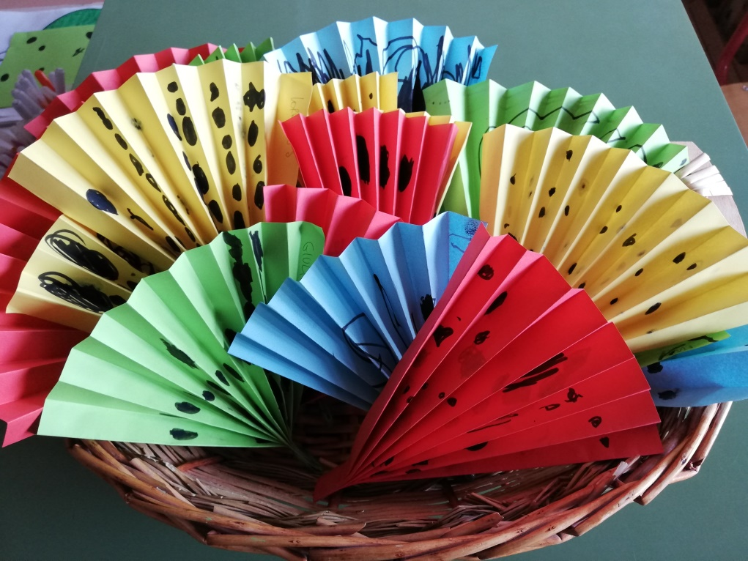
Our Spanish week Scuola Infanzia Sturiale, Italy
Different types of folding fans!

Slide 15
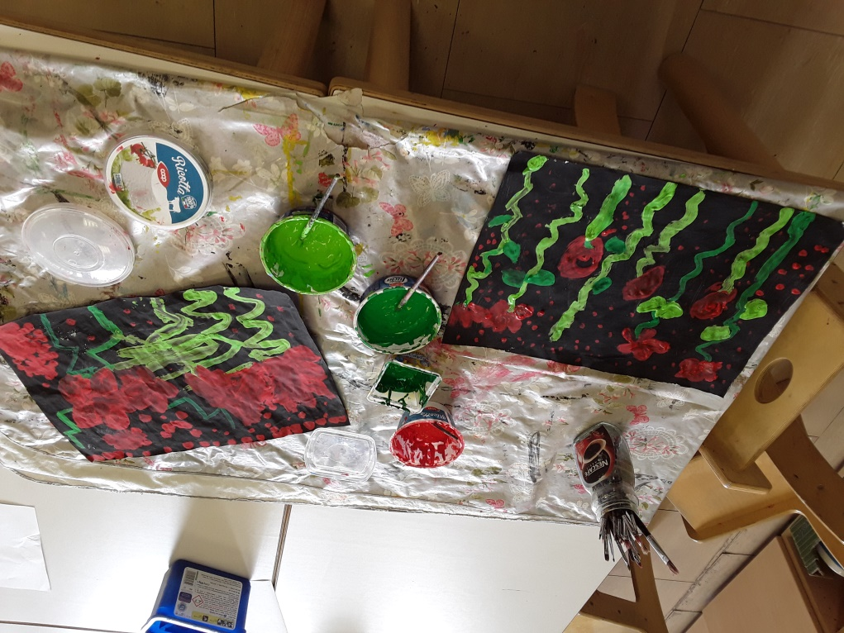
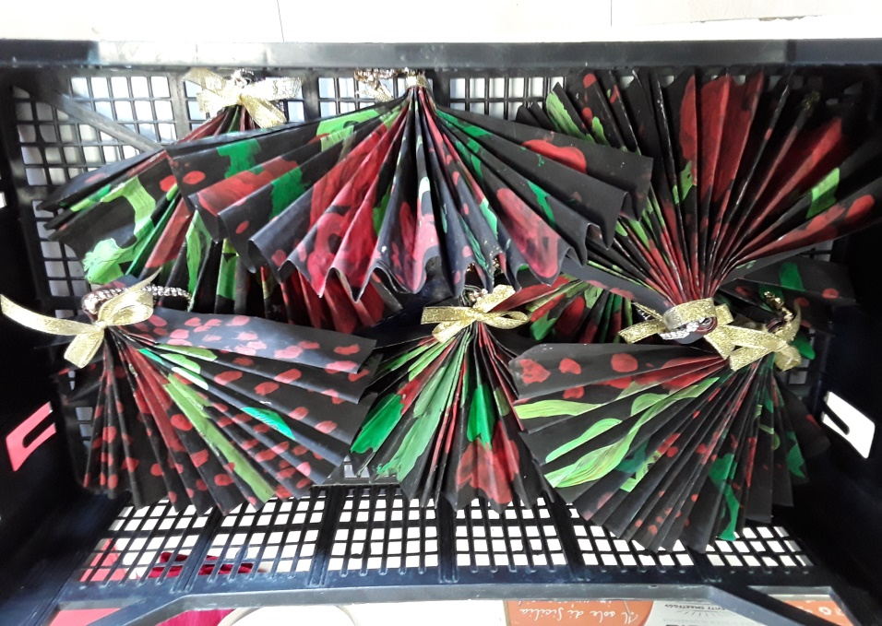
Our Spanish week Scuola Infanzia Sturiale, Italy
Different types of folding fans!

Slide 16
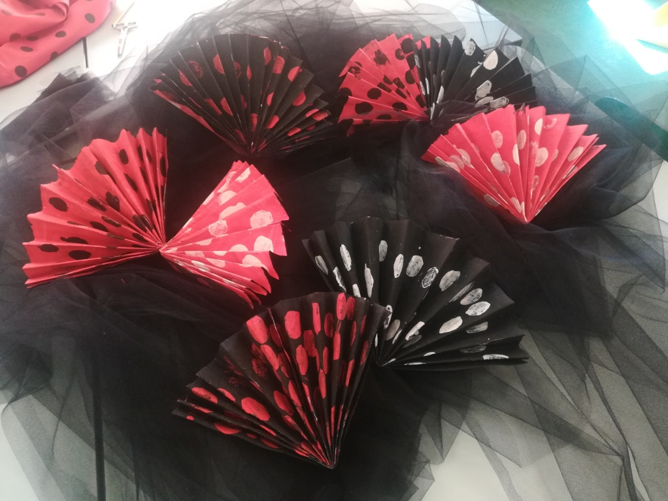
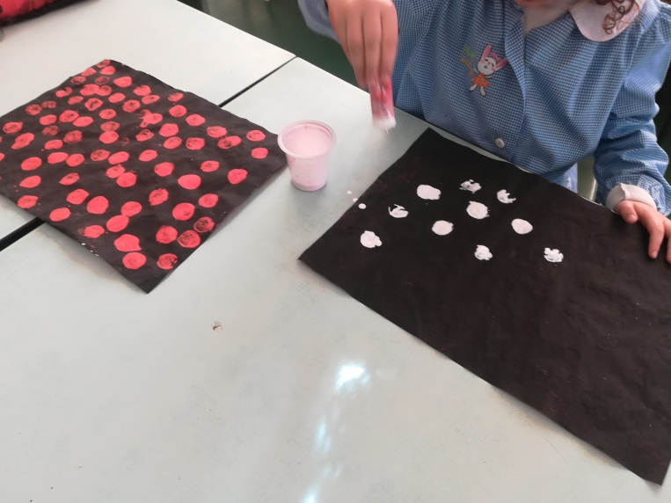
Our Spanish week Scuola Infanzia Sturiale, Italy
Different types of folding fans!

Slide 17
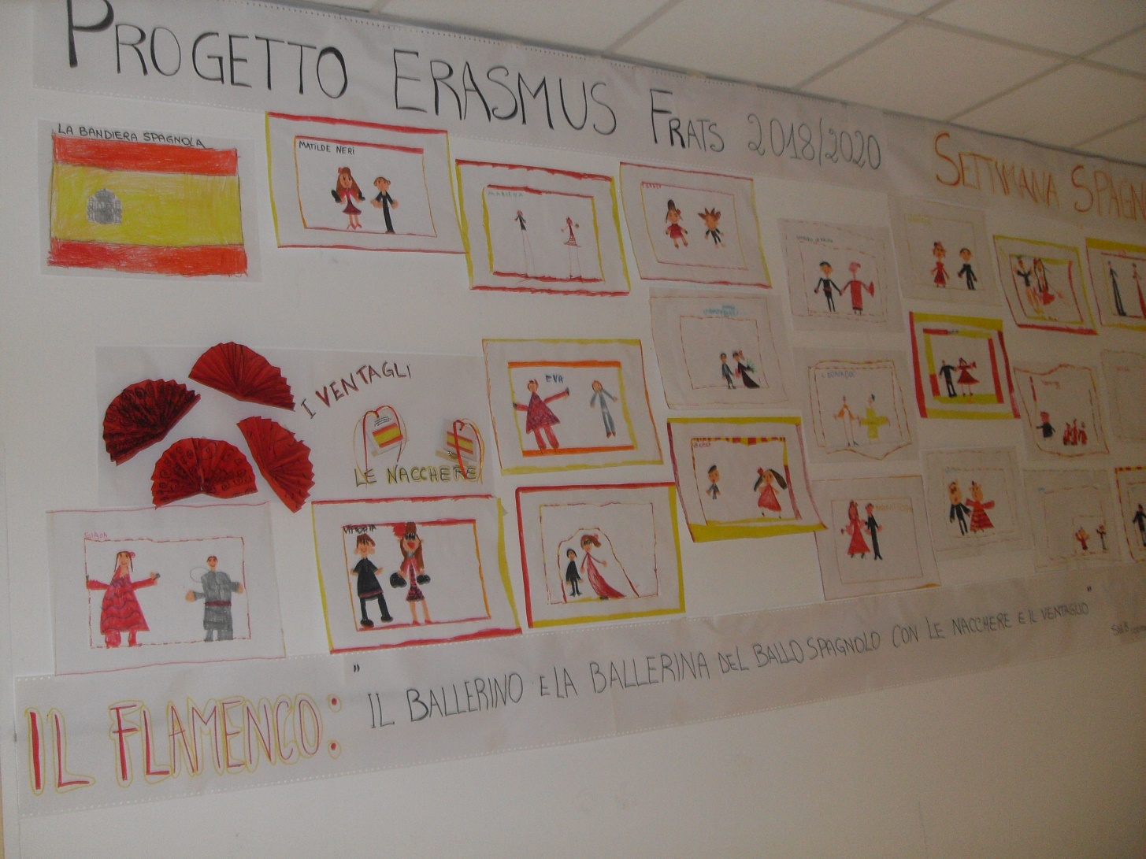
Our Spanish week Scuola Infanzia Sturiale, Italy

Slide 18
Our Spanish week Scuola Infanzia Sturiale, Italy
What a wonderful dance!

Slide 19
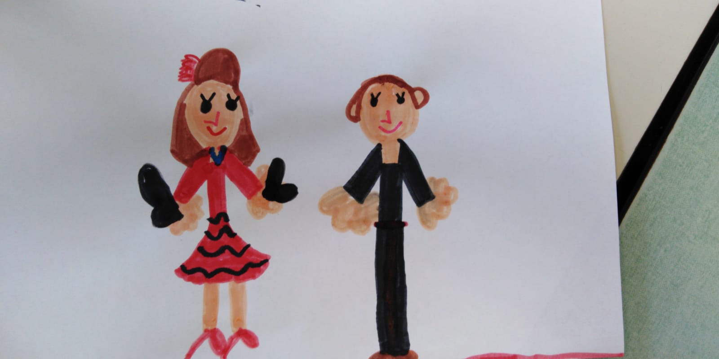
Our Spanish week Scuola Infanzia Sturiale, Italy
Olé!

Slide 20
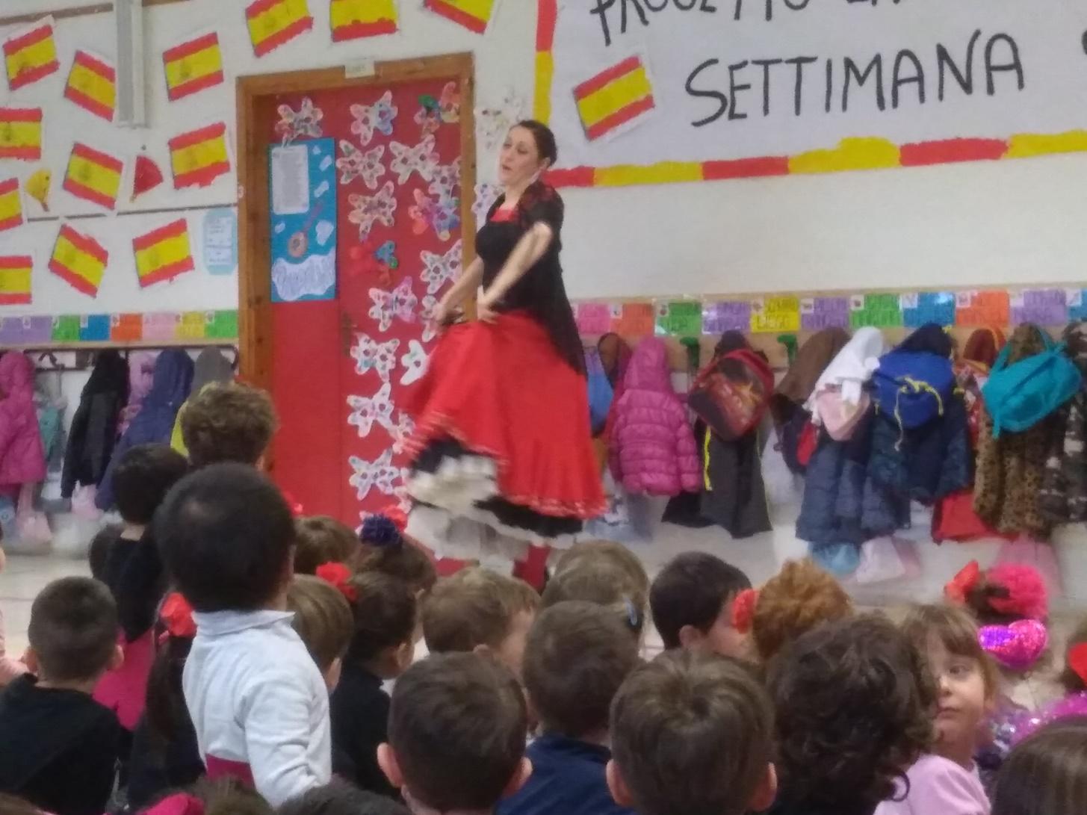
Our Spanish week Scuola Infanzia Sturiale, Italy
Our dancer of flamenco!

Slide 21
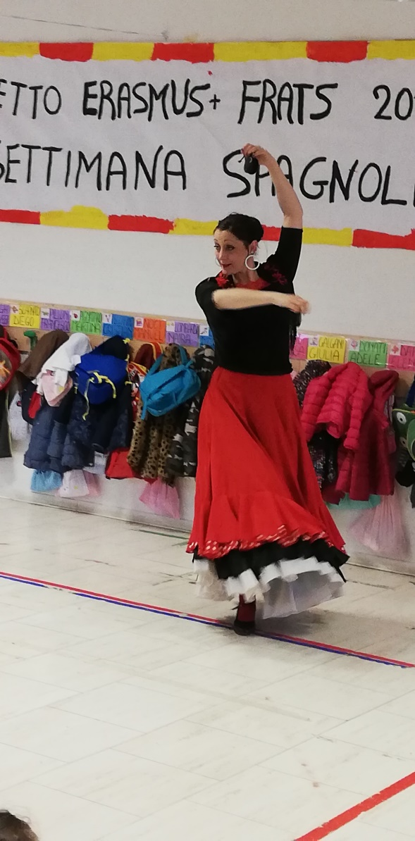
Our Spanish week Scuola Infanzia Sturiale, Italy
Wonderful!

Slide 22
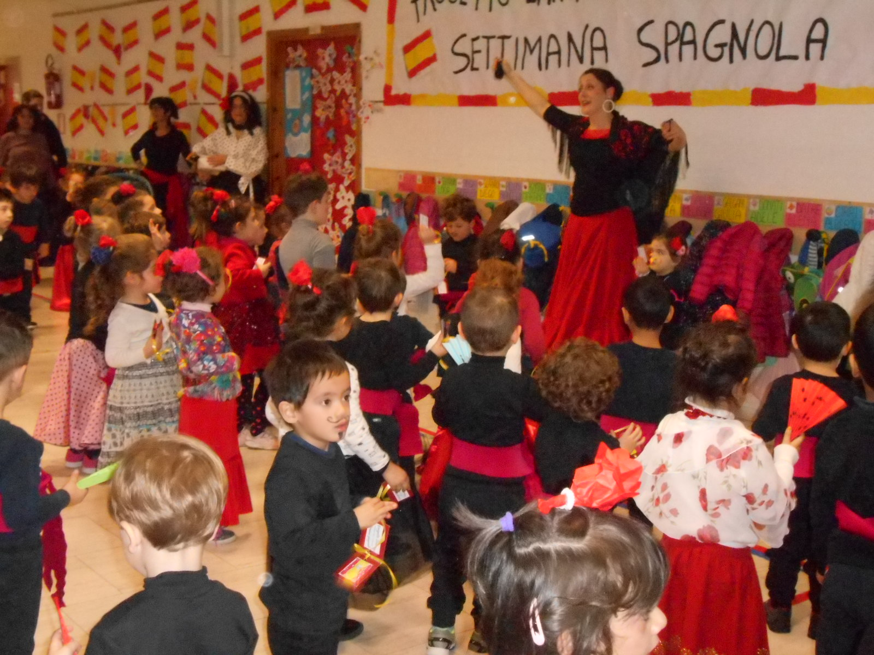
Our Spanish week Scuola Infanzia Sturiale, Italy

Slide 23
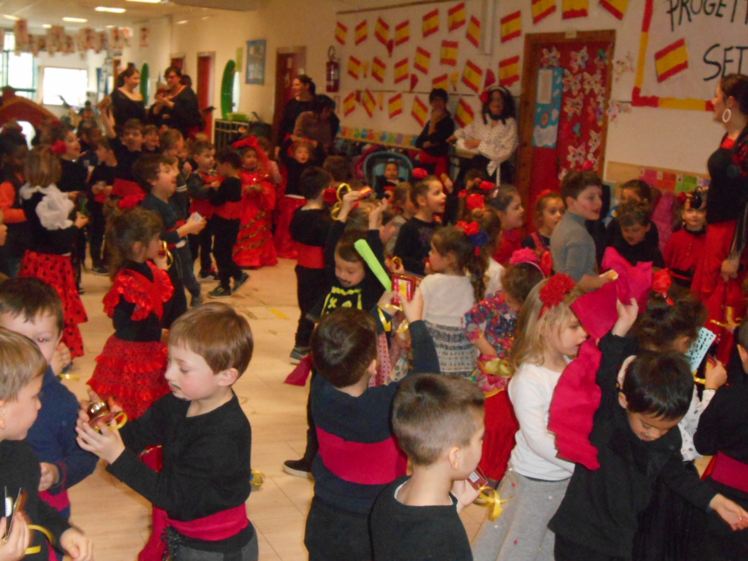
Our Spanish week Scuola Infanzia Sturiale, Italy

Slide 24
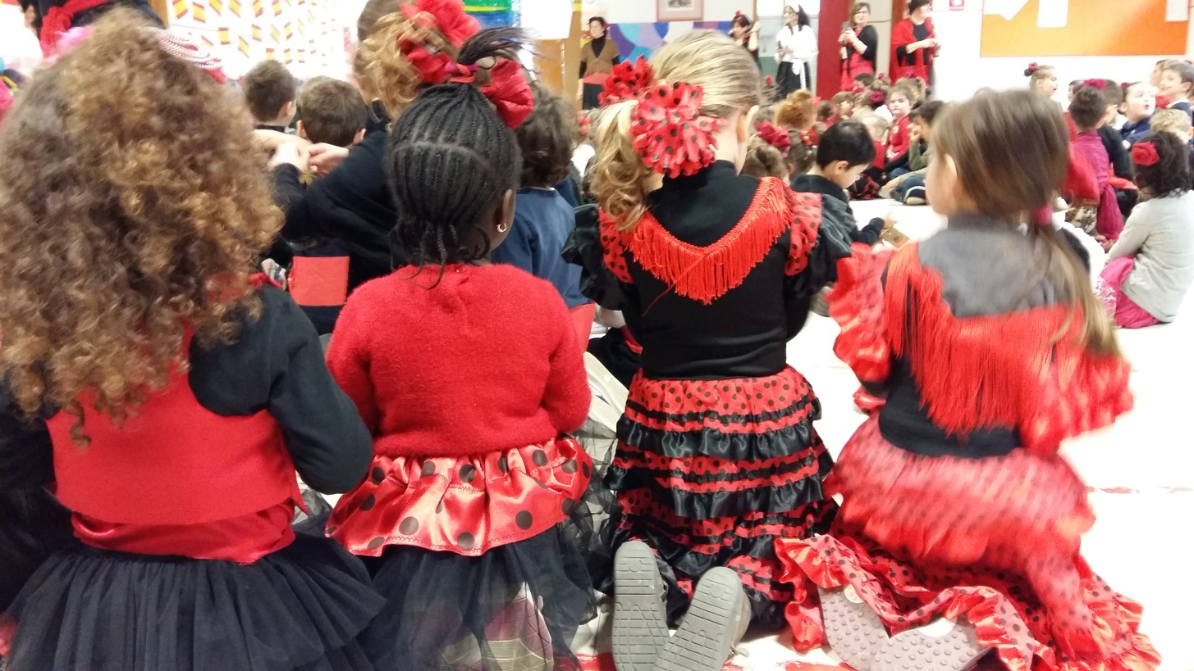
Our Spanish week Scuola Infanzia Sturiale, Italy

Slide 25
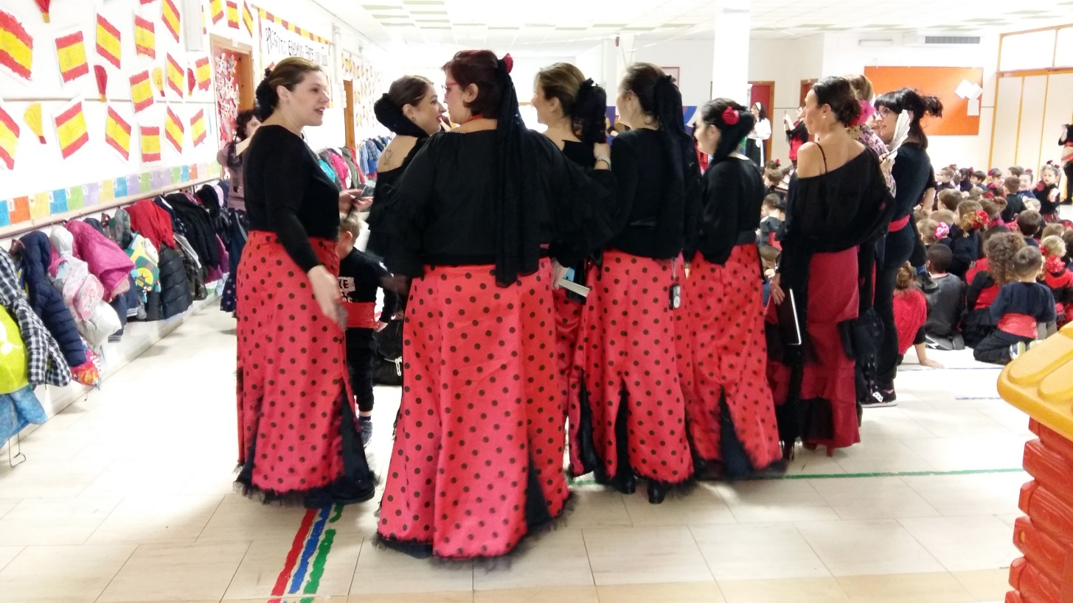
Our Spanish week Scuola Infanzia Sturiale, Italy

Slide 26
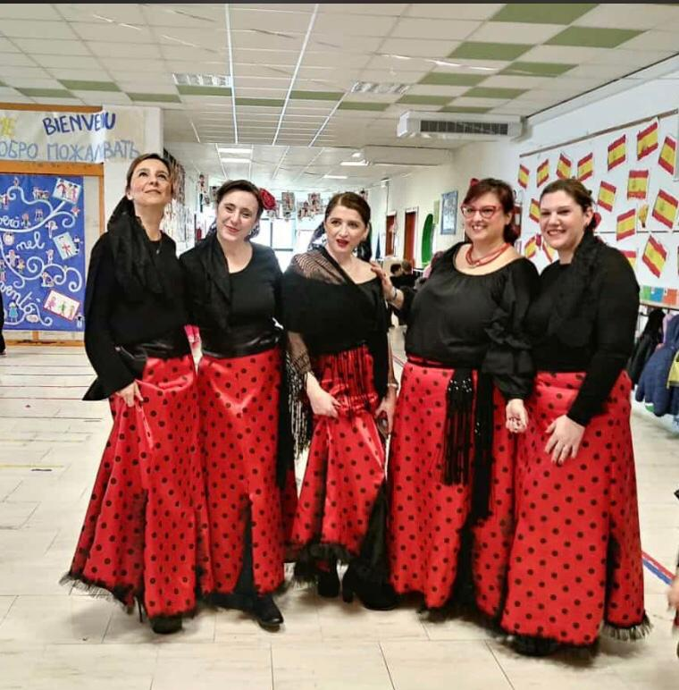
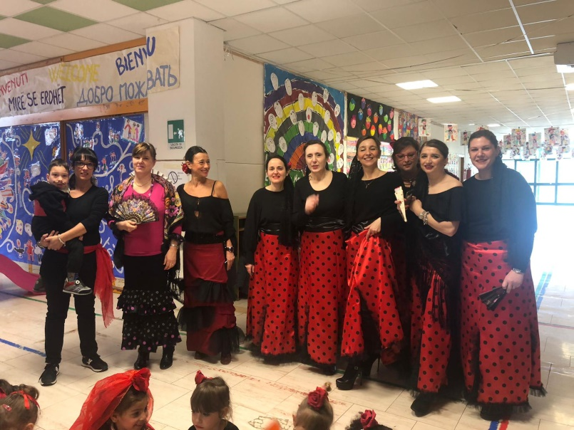
Our Spanish week Scuola Infanzia Sturiale, Italy

Slide 27
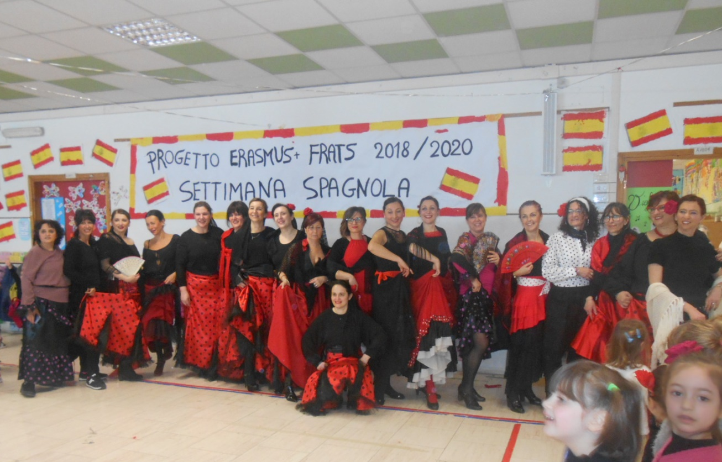
Our Spanish week Scuola Infanzia Sturiale, Italy

Slide 28
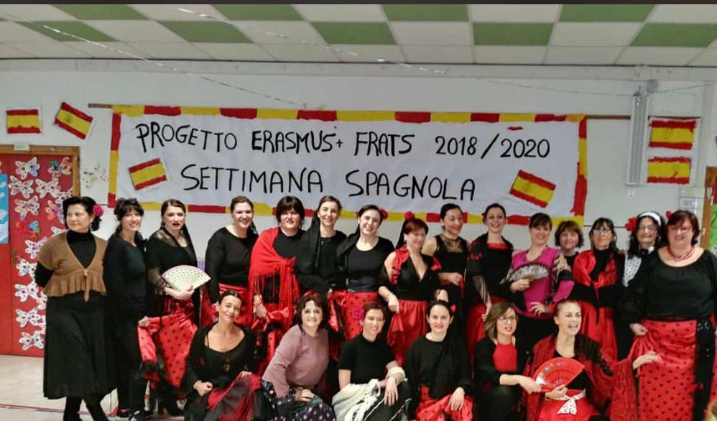
Our Spanish week Scuola Infanzia Sturiale, Italy
Our teachers!

