Slide 1
When the sun rises

Slide 4
Difficult wake up

Slide 6
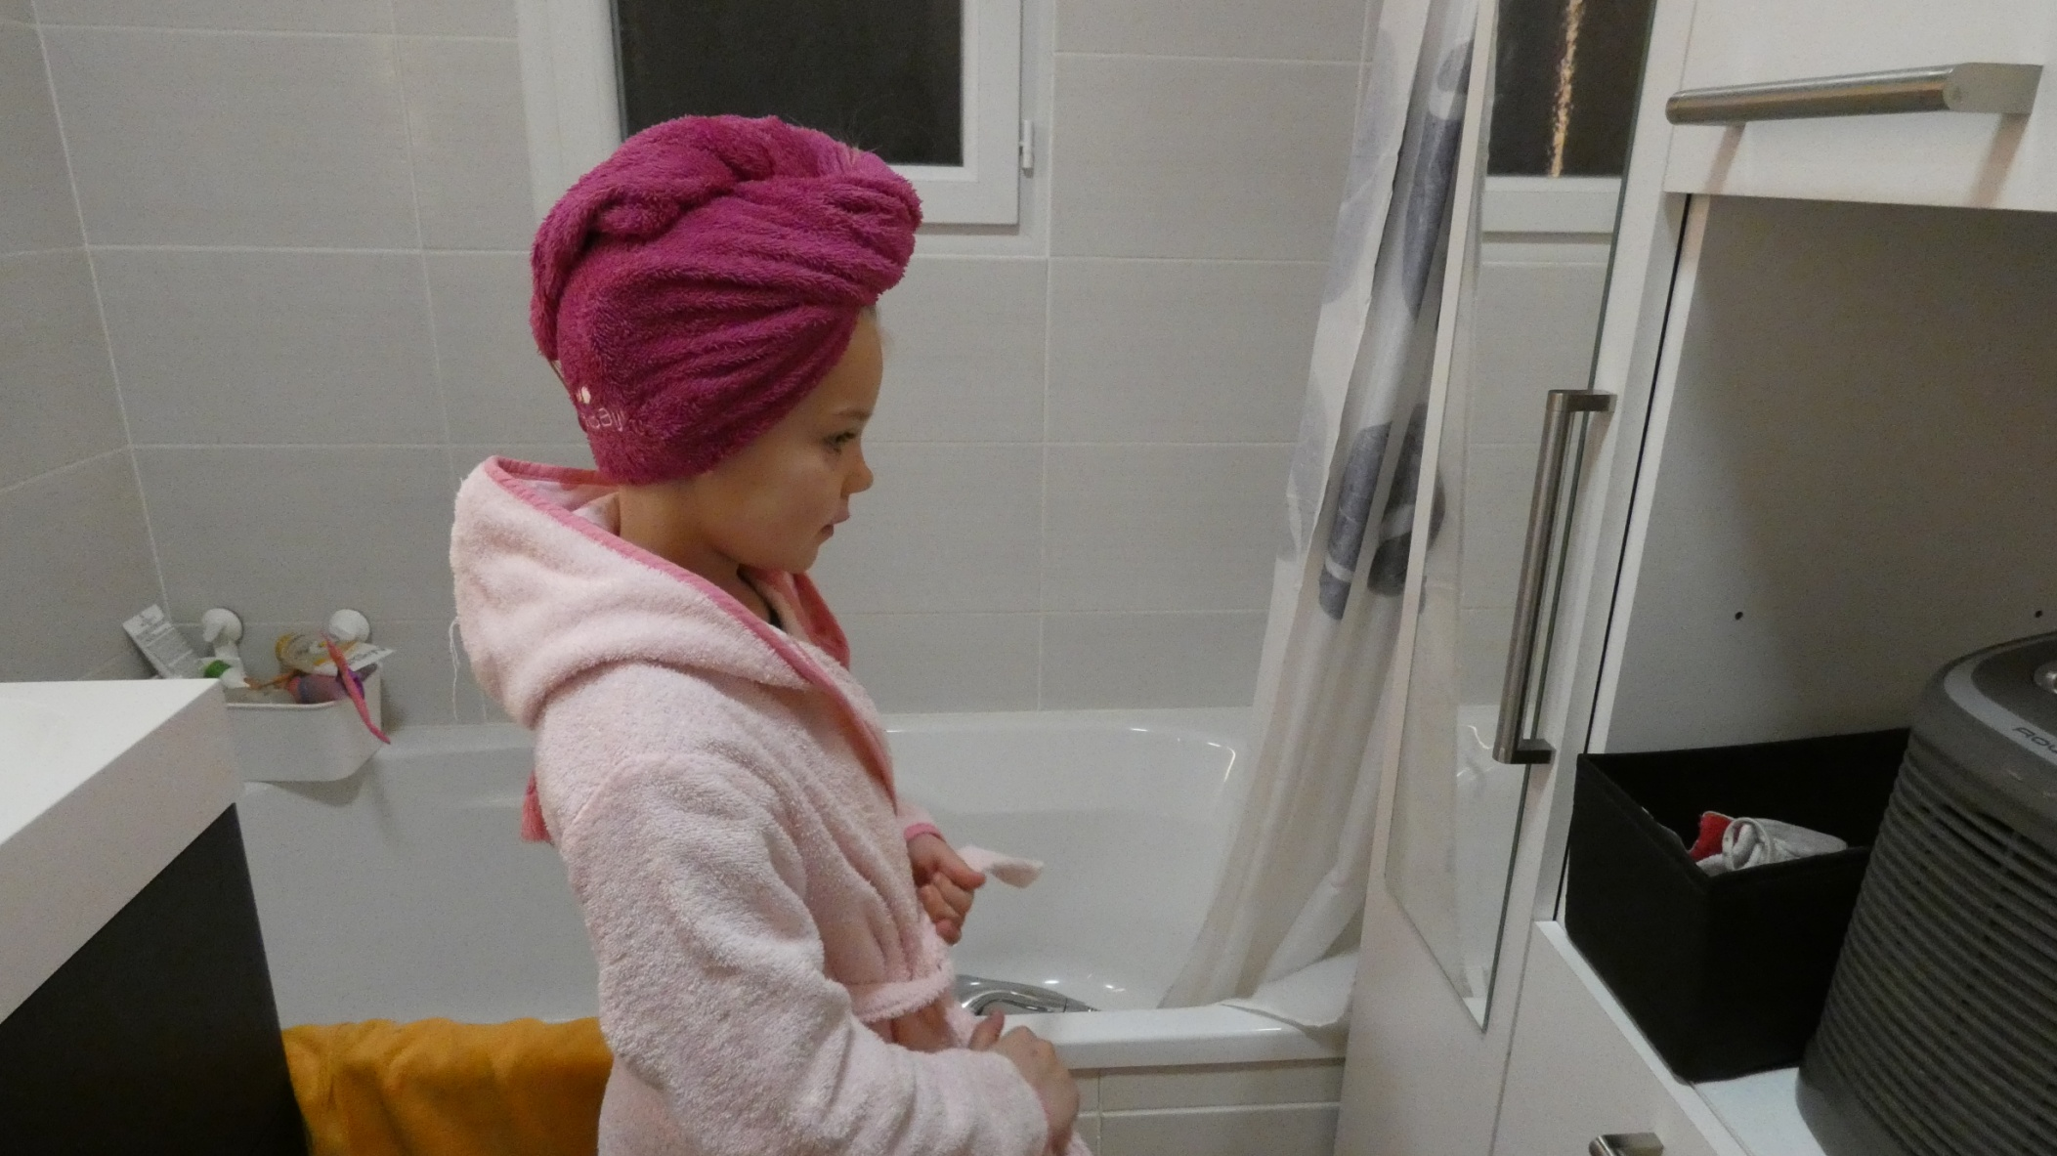

Slide 11
When the sun is at its zenith …
…At noon

Slide 13
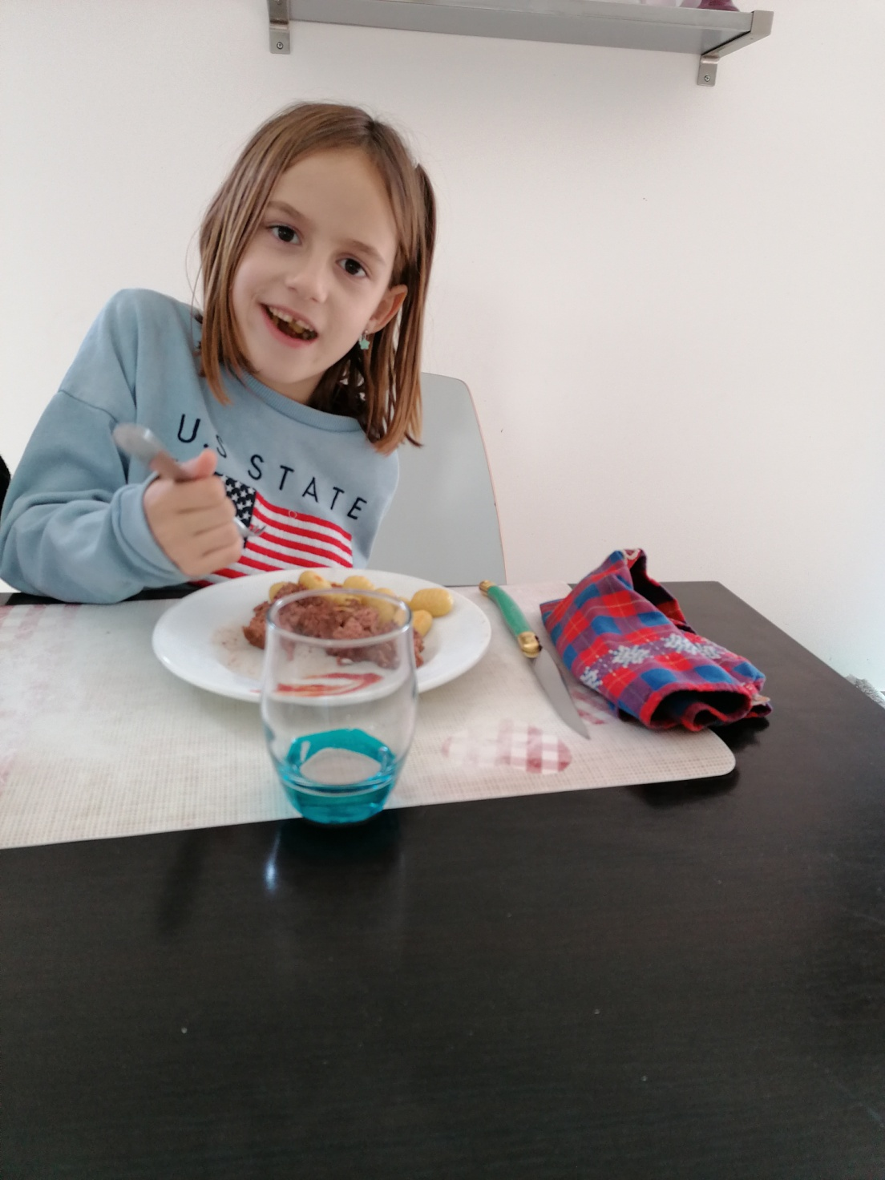

Slide 15
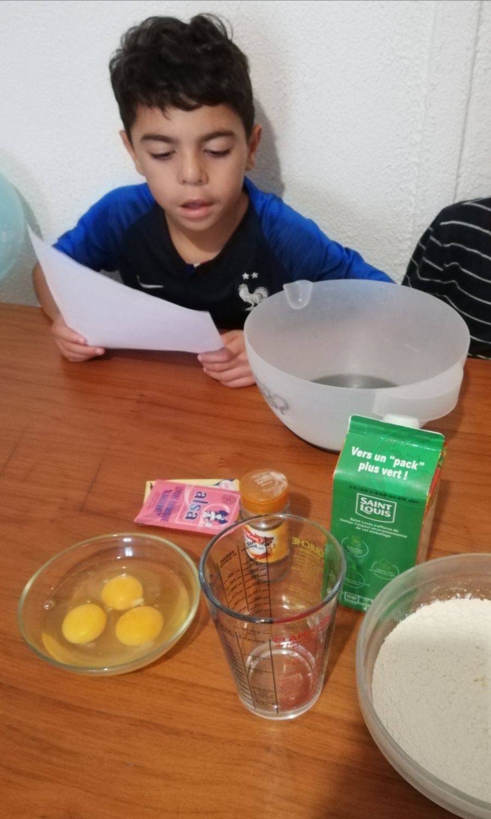

Slide 16
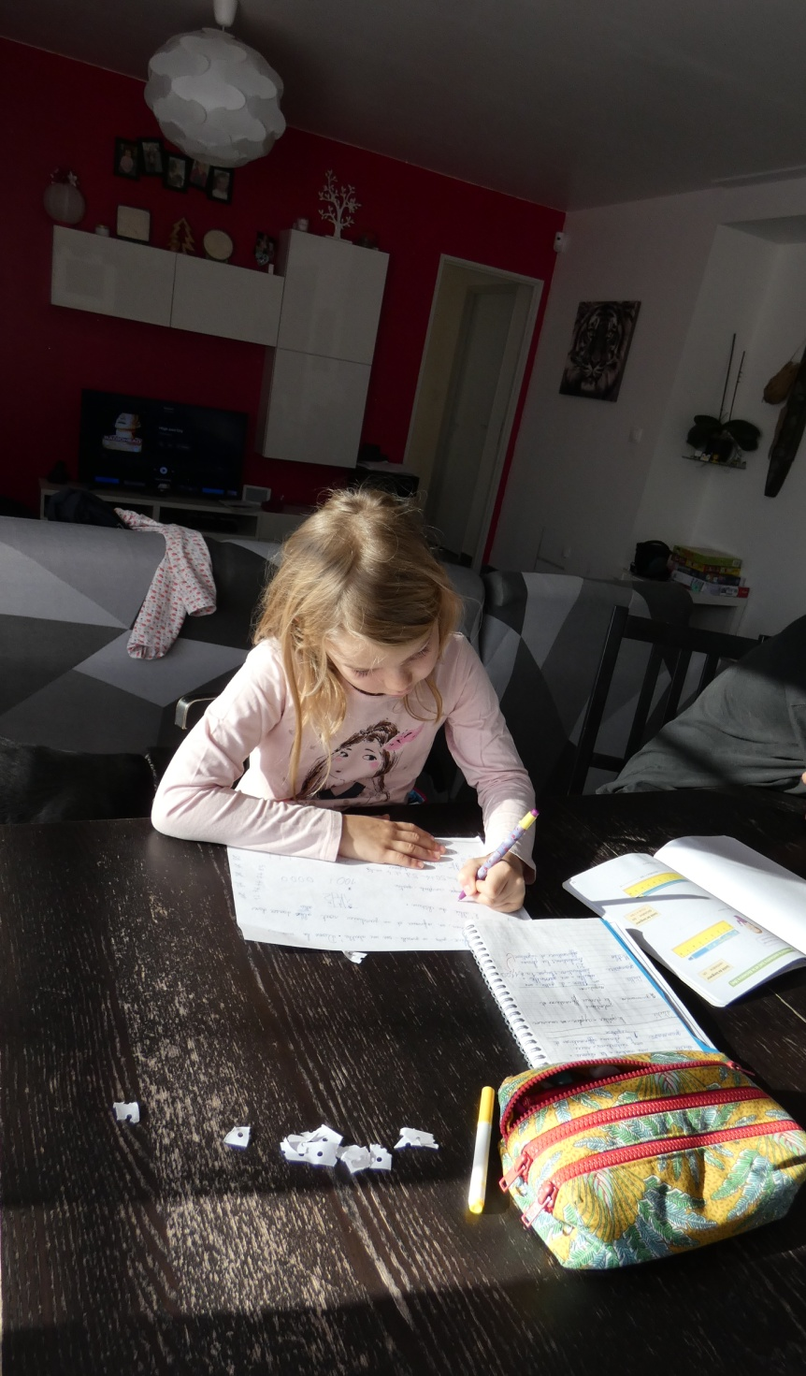

Slide 17
When sun sets…
...At dusk

Slide 21
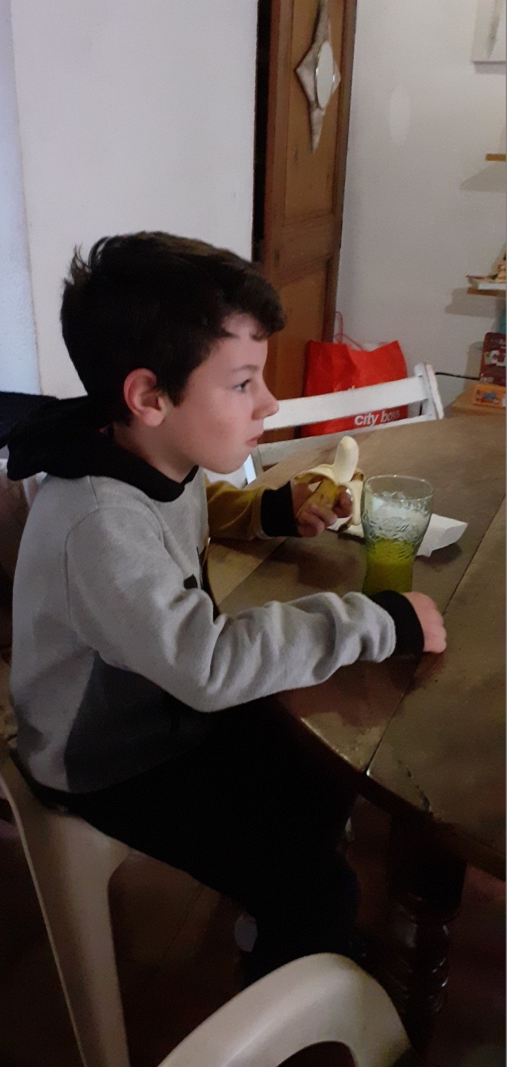

Slide 22
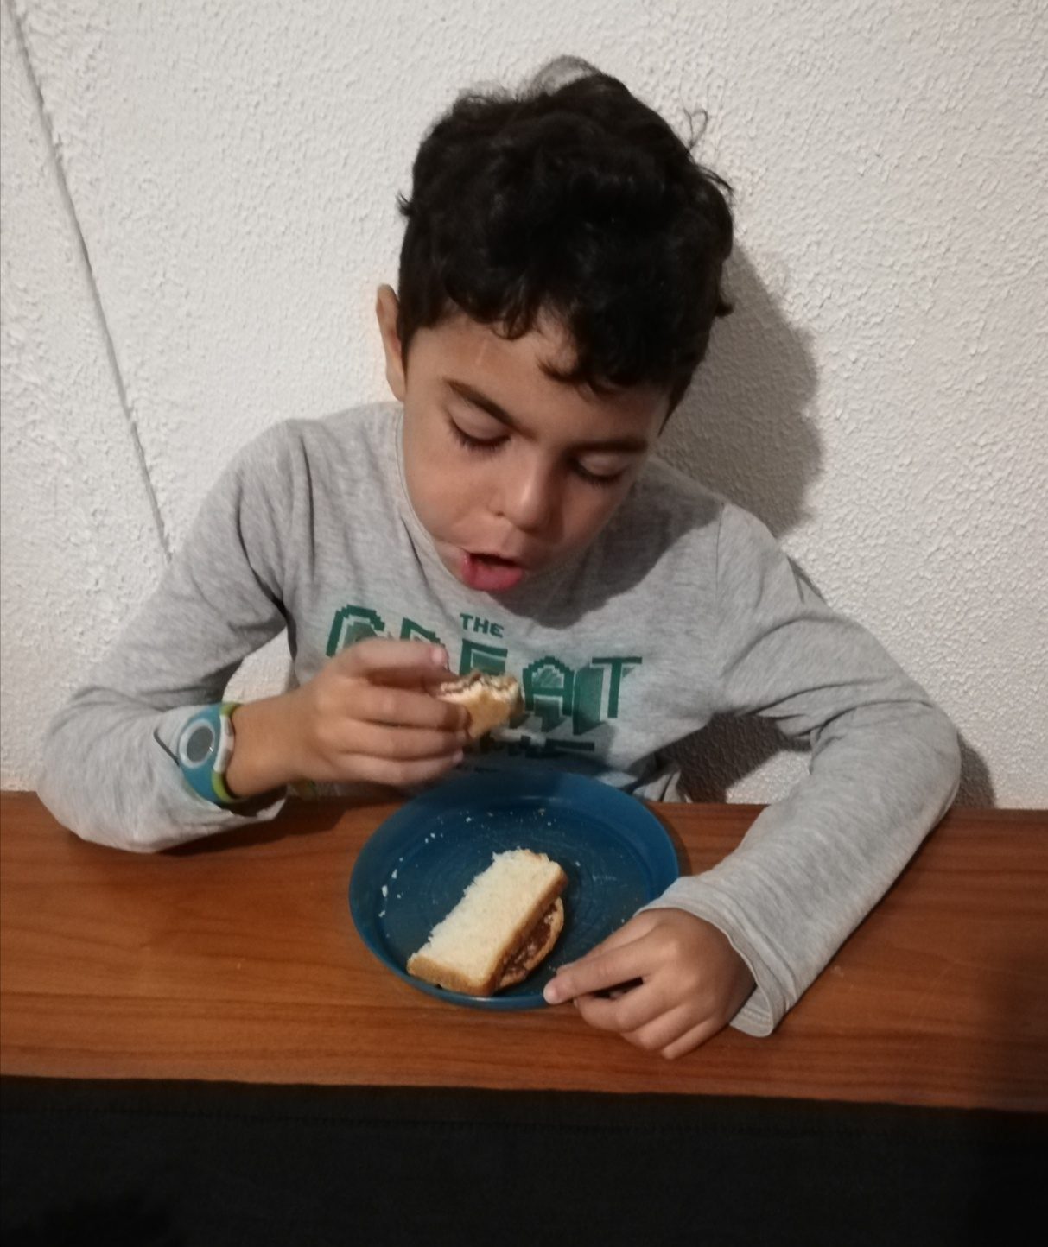

Slide 25
