Slide 1
KA219 Srategic School Partnerships Project
2015-2018
Following the Footprints of the Emperors
LTT Meeting
in Bitola/MACEDONIA
6th-11th November, 2017
Tarsus Borsa İstanbul Şehit Umut Sami Şensoy Anadolu Lisesi
Tarsus/Mersin
TÜRKİYE

Slide 2
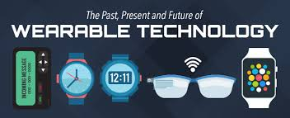
WHY WEARABLE TECHNOLOGY?
Common technology devices that intend to be worn mustn’t only meet our functional requirements but also our social, emotional, and aesthetic needs. The wearable ones are more personified because it reflects our tastes and mood, personalities, cultural beliefs and values. The wearable technology has a history which goes back a lot further.

Slide 3
The earliest known form of wearable technology could be The Abacus made of silver and placed within a ring.

Slide 4
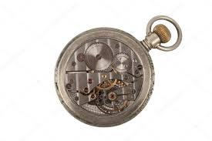
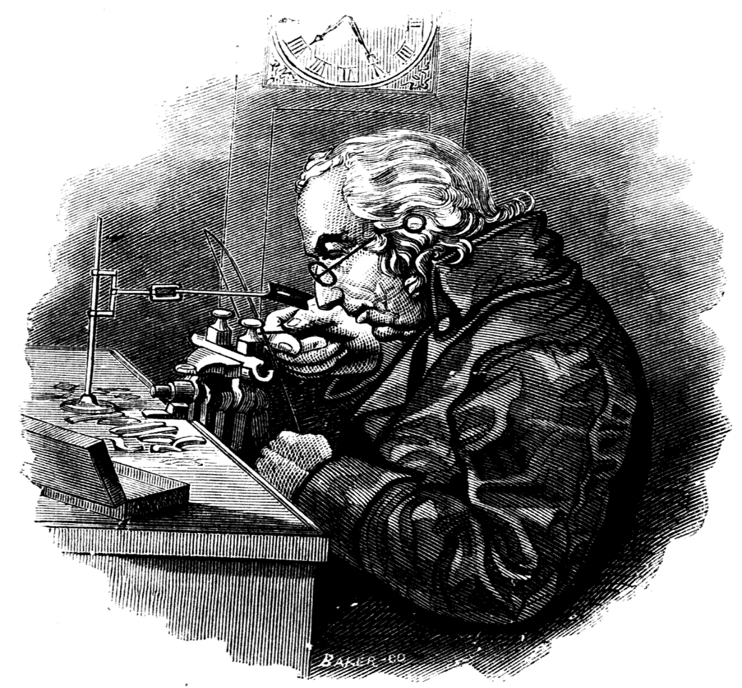
‘Pedometer watch ’ was the idea of Leonardo Da Vinci for counting steps but Abraham-Lois Perrelet modified his self-winding watch mechanism to measure steps and the distance travelled when walking.

Slide 5
Today we use body mounted cameras,wristbands,glasses,rings and smart watches. We decided to improve theseproducts because we have security problems in all societies

Slide 9
REASON OF OUR PRODUCT IDEA
Most women around the world are becoming victims of street robbers. Our product aims to help these victims. We developed a special bag.

Slide 10
SecBag
There is an electric shock circuit just under the zipper part. There is a stun gas mechanism under the bag. So street robber will become unconscious. These mechanisms will be hidden so the bag will still be beautiful. The location of the bag can be determined with the help of GPS inside.

Slide 11
OUTSIDE VIEW OF THE BAG

Slide 12
INNER APPEARANCE OF THE BAG

Slide 13
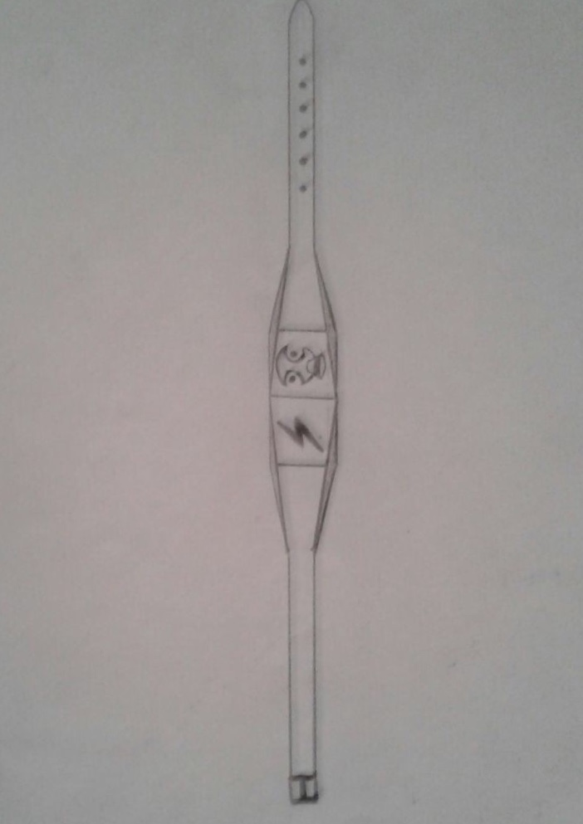
SecBand
It is designed to give electrical shock to the Street robbers when they get away with the bag. There are two buttons on it. If you press the first button, it gives electric shock, if you press the second it lets out stun gas. With the help of this wristband, you can knock Street robbers form a safe distance.

Slide 14
SecBag & SecBand
Idea:Ahmet Kızıl
Draft:Yasin Yeşilyurt
Presentation:Seymen Köksal

