Slide 1
KA219 Srategic School Partnerships Project
2015-2018
4th LTT Meeting
in SPAIN/BURGOS
25 Sept.-1 Oct. 2016
İMKB Şehit Umut Sami Şensoy Anadolu Lisesi
Tarsus/Mersin
TÜRKİYE

Slide 2
«Following the footprints of the emperors»
https://ffoeeu.wordpress.com

Slide 3
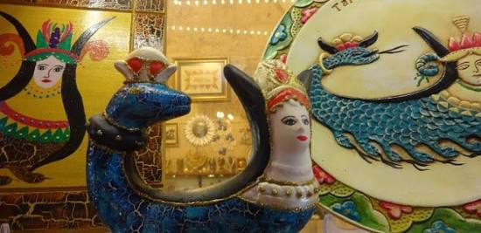
SHAHMARAN

Slide 4
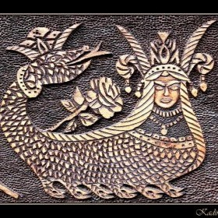
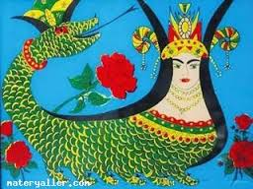
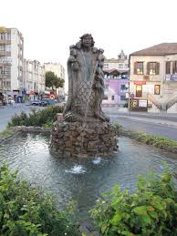
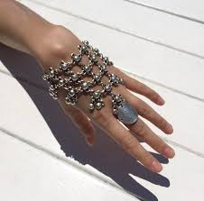
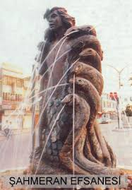
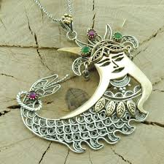
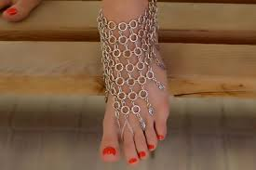

Slide 5
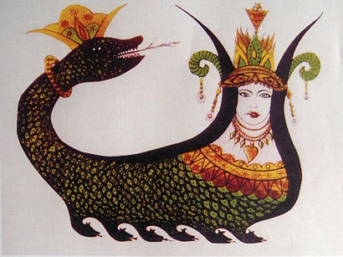
A mythical creature
’’Shah’’ means ’’king’’ and ’’Mar’’ means ’’snake’’
A wise,intelligent woman & the queen of the snakes
When dies, her spirit will pass to her daughter.
Lives in a cave

Slide 7
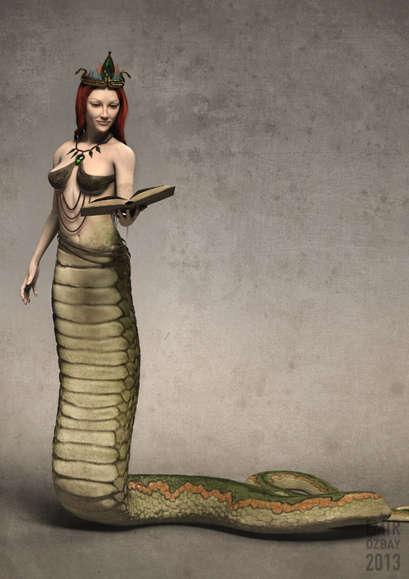
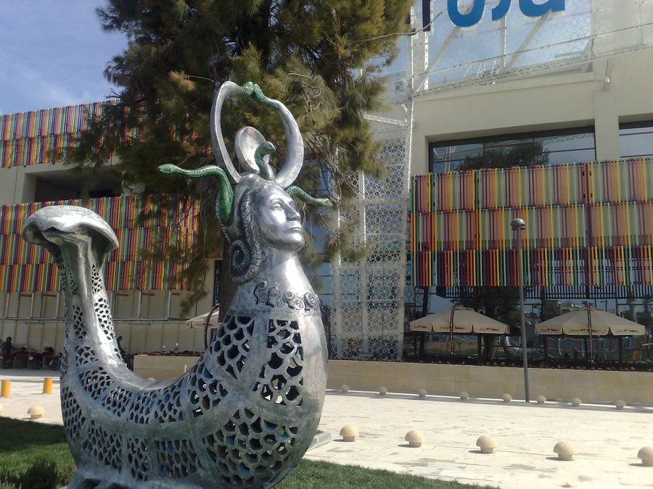
Highlights
Falls in love with a traveler named Tasmasp
Tasmasp listened to her stories, when she had no stories, he returned to his land.
King becomes ill,
The only way to recover is to eat Shahmaran
Tasmasp takes king’s men to her cave
Notes:
named

Slide 8
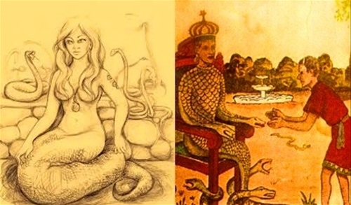

Slide 9
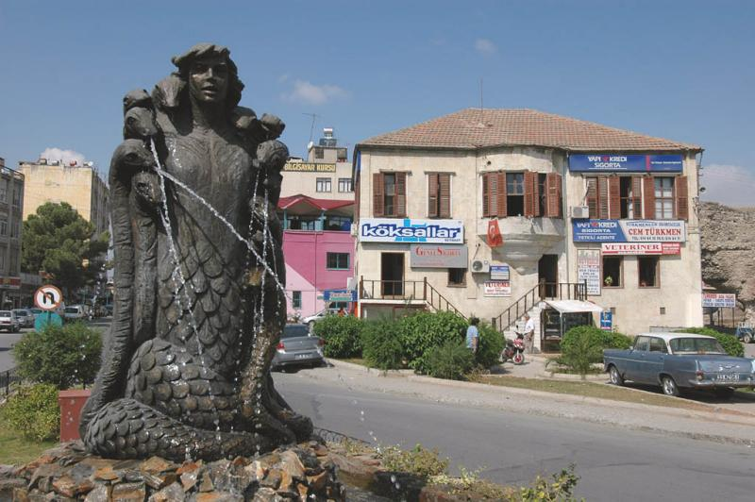
Kills Shahmaran and boils her meat, king eats her meat and gets recovered but Vezier drinks the water and dies immediately.
Tasmasp eats her head and he was not affected at all and becomes Vezier.
It is believed that the snakes aren’t aware of their king’s death and if they learn,they will occupy Tarsus.

Slide 10
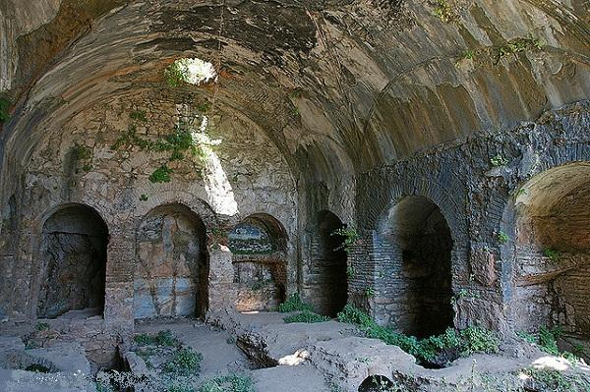
THE SEVEN SLEEPERS (Ashab-ı Kehf)

Slide 11
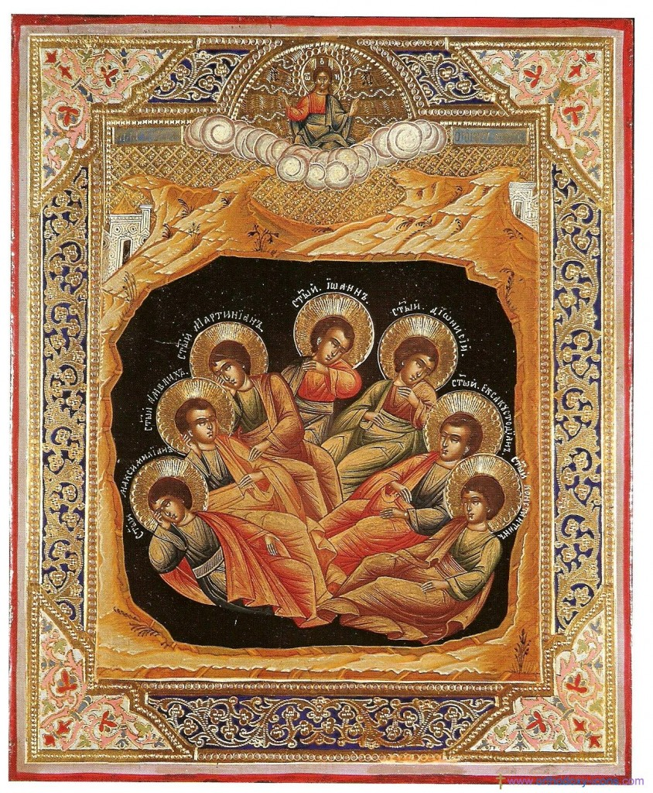

Slide 12
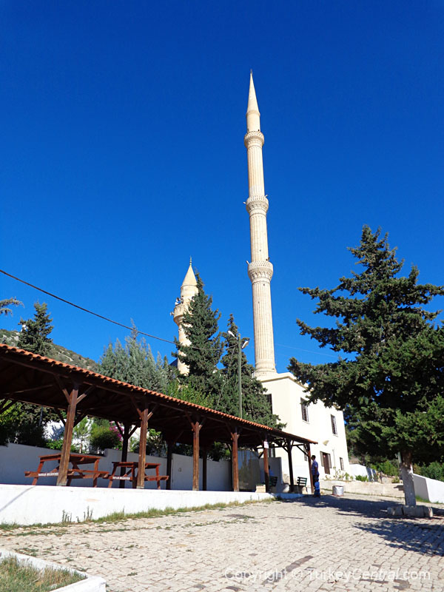
In Arabic, it is called ’’Eshab-ı Kehf’’and depicted in ’’Kehf’’ section of the Koran and ’’Kehf’’ means cave, and ’’Eshab’ means people in Arabic
Sacred for both Muslims and Christians
There are several caves which are claimed to be real cave.

Slide 13
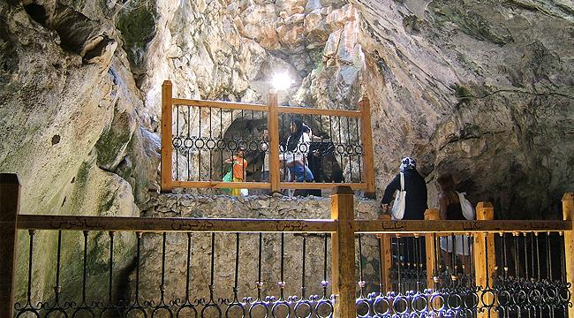
The Legend
It is believed to have taken placed during Roman Emperor, Decius
Refers to a group of seven youths
Yemliha, Mekseline, Mislina, Mernuş, Sazenuş, Tebernuş and Kefeştetayuş and their dog; Kıtmir
To be tortured since they believed in one god

Slide 14
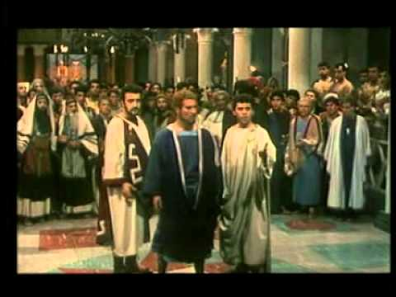

Slide 15
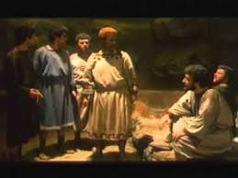

Slide 16
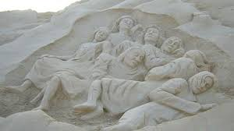
Escaped from king and hid inside a cave and fell into a deep sleep
Awoke and thought they slept only one day
the city completely changed and understood that they slept for 309 years
The Seven Sleepers finally fell in to an eternal sleep.

Slide 17
Seven sleepers’ cave in Tarsus

Slide 20
PREPARED BY
Dilara Çemrek
Fatih Deniz Mete
Nil Yaren Kaygusuz
İMKB ŞEHİT UMUT SAMİ ŞENSOY
ANADOLU LİSESİ
Tarsus-Mersin/TÜRKİYE

