Slide 1
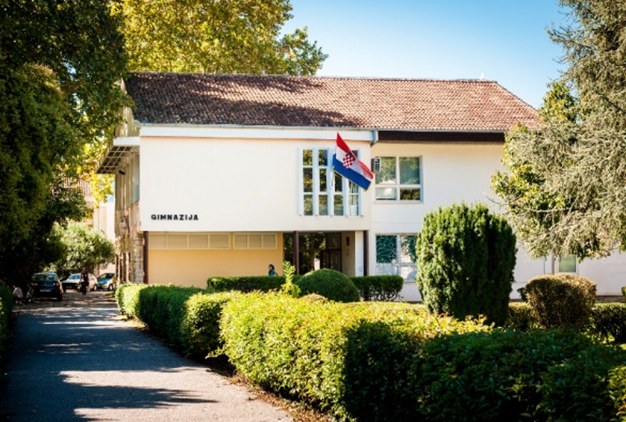
Gimnazija Metković
Erasmus plus KA2 projects dissemination

Slide 2
- Application
Application process in spring 2015,
partner search through Etwinning forum
(3 projects applied, 2 approved)
from 1 September 2015, 2 KA2 projects approved
by the Agency for Mobility and EU Programmes:
„Following the Footprints of Emperors” (3 years)
„Can you tell me the way to...?” (2 years)

Slide 3
FOLLOWING THE FOOTPRINTS OF EMPERORS
Turkey – coordinator (IMKB Sehit Umut Sami Sensoy Anadolu Lisesi)
3 years; approved EU grant for Gimnazija Metković: €36,000
Project aims: improved knowledge of own culture and EU partner countries, improved 21st century skills, ICT skills, knowledge of history and foreign languages, youth employability, teacher training
Project tasks: studying Ancient Roman history in 9 partner countries (Turkey, Croatia, Italy, Spain, Portugal, Germany, Bulgaria, Romania, Macedonia) through mobilities and in-school tasks
Project products: videos on topics of teaching, history and technology, souvenirs, 3D Roman city, model roman city
Methodology: regular meetings with project team of students and teachers once a week to work on project tasks

Slide 4
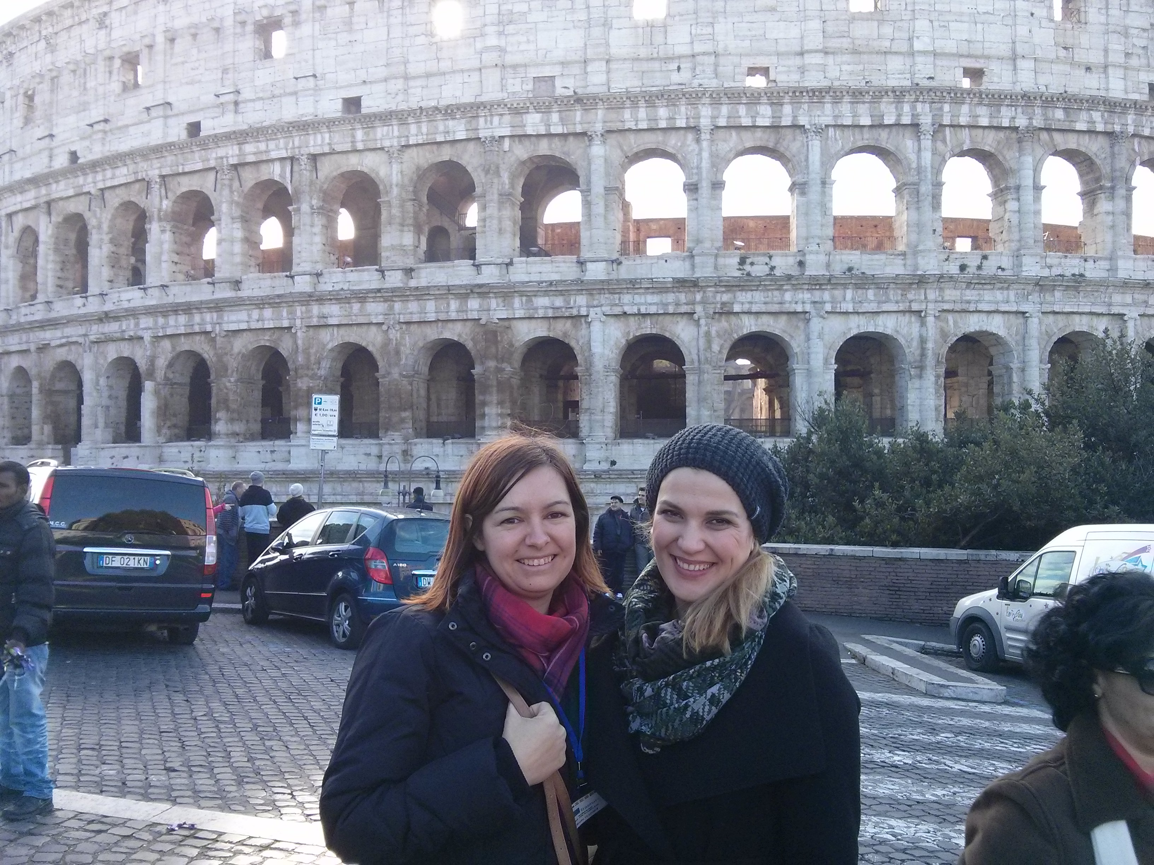
Italy, November 2015
Transnational project meeting
(teachers only) in Rome and Carovilli
Presentation of each school,
distribution of upcoming tasks
Presentation of results of
Questionnaires applied to teachers and
students in each partner school
(Knowledge of EU,
Knowledge of Roman relics,
Attitudes to teaching/learning,
ICT skills and use by teachers,
Foreign language skills by teachers
and students)
Choosing the project mascot

Slide 5
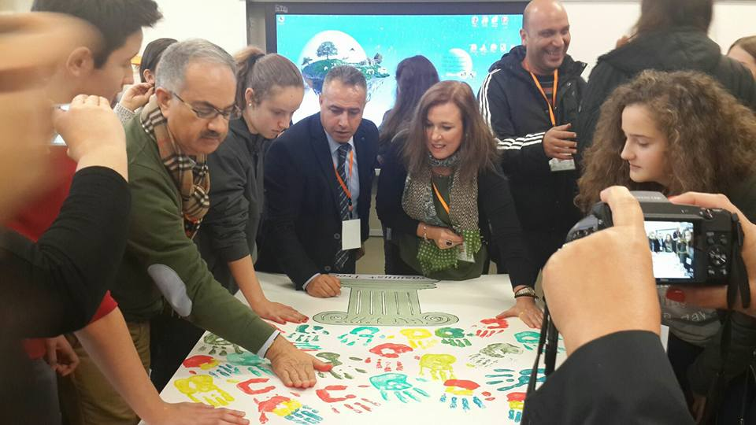
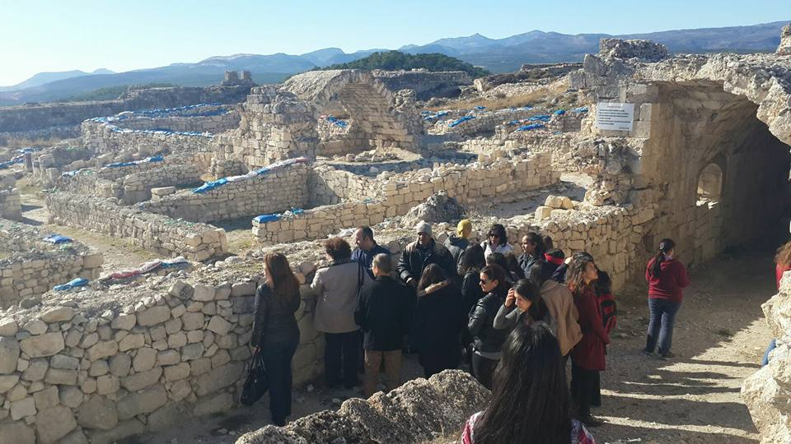
Tarsus, Turkey – January 2015 (LTTT Activity)
Gimnazija Metkovic did not participate for security reasons
Students prepared and sent a presentation about the history of our town in Roman era
Students prepared and sent a model of a Roman relic (Diocletian’s palace) to be displayed at the Turkish coordinator school

Slide 6
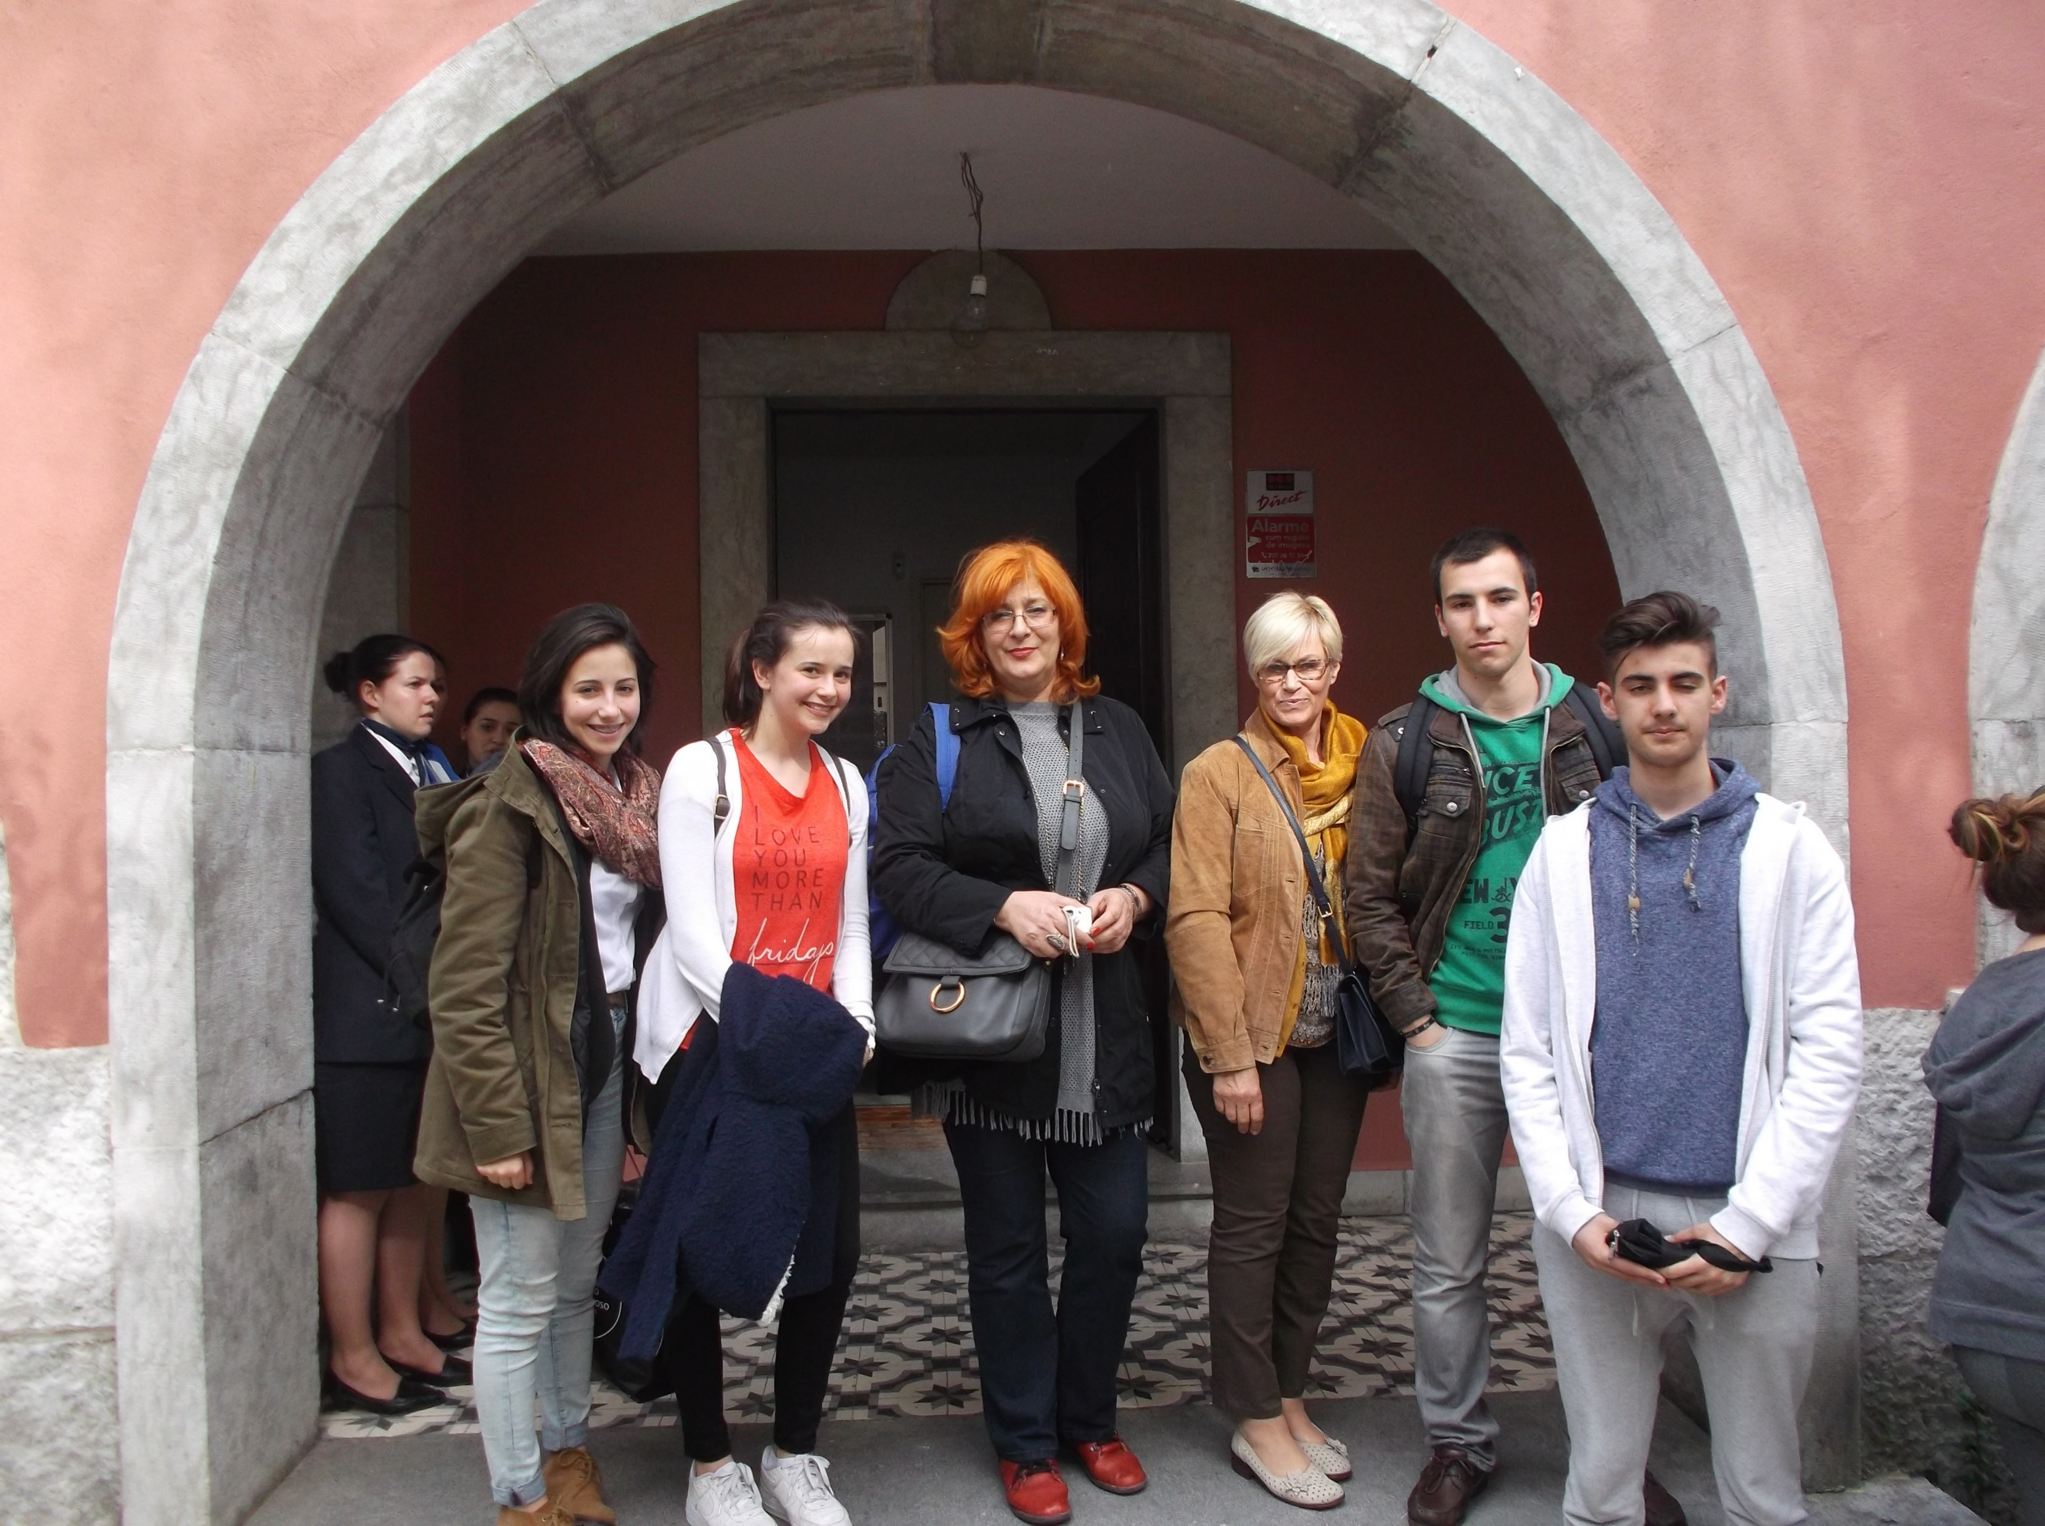
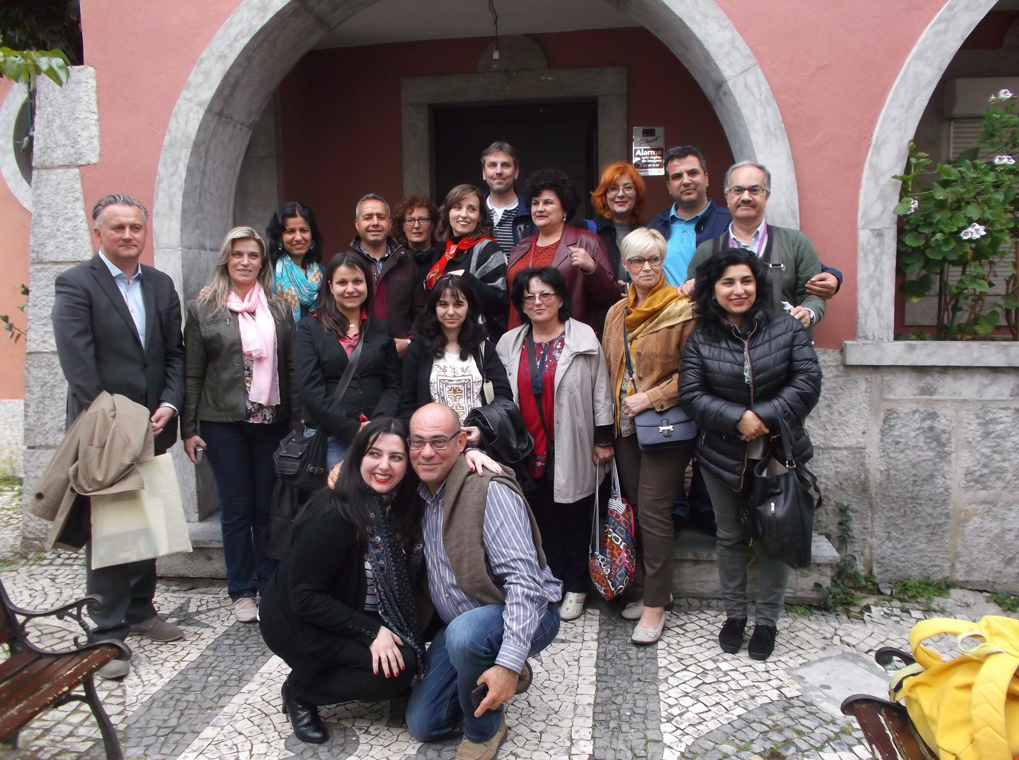
Lisbon, Portugal – April 2016 (LTTT Activity)
presentation of our school’s activities incorporating the „21st century skills”, focusing on the 4C’s: creativity, communication, cooperation, critical thinking
communication: a video and vlog
cooperation and creativity: hand made souvenirs as gifts for Portugal mobility
critical thinking: presentation about Croatian school system reform

Slide 7
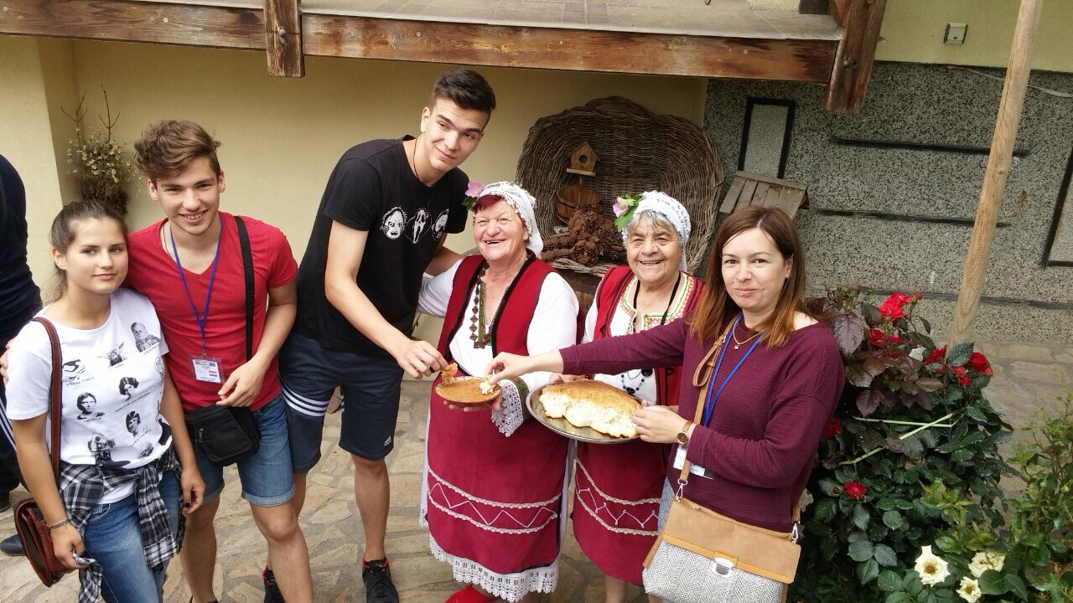
Bulgaria, June 2016 (LTTT Activity)
presentation about what students have learned about Roman religion in our area (Ancient Roman cults in Narona)
visit to archaeological site in Sofia, Bulgaria
visit to Museum of history in Sofia, Bulgaria
visit to Plovdiv Roman arena

Slide 8
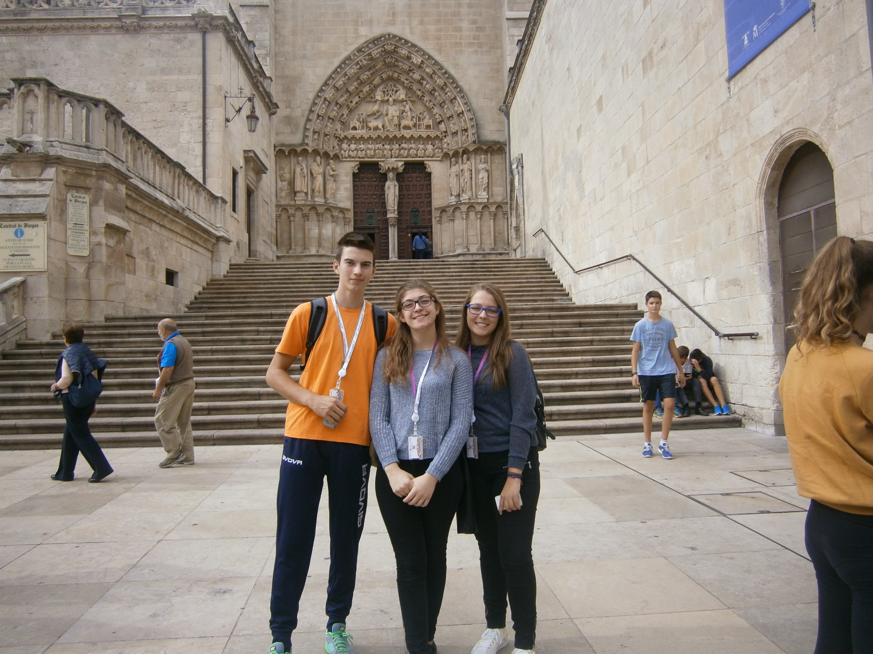
Spain- Burgos, Madrid – September 2016 (LTTT Activity)
preparation and performance of Antigone Ancient tragedy in the Roman theater in Clunia, Spain
(students playing parts in English)
- presentation of ancient myths from our area to produce a common book on myths

Slide 9
Lisbon, Portugal – November 2016
second Transnational project meeting in Lisbon, Portugal
discussing previous and upcoming project tasks
preparing Interim report(s)
presentation of 3D Roman city prepared by Portuguese team

Slide 10
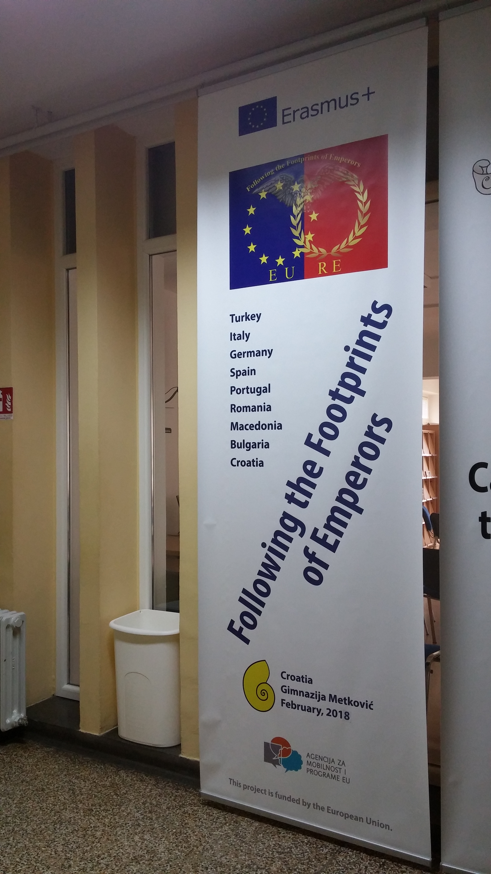
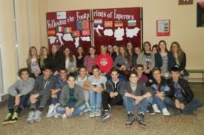
Activities in school
Project team: second year students
+
teachers of English, history and Latin
Weekly project meetings

Slide 11
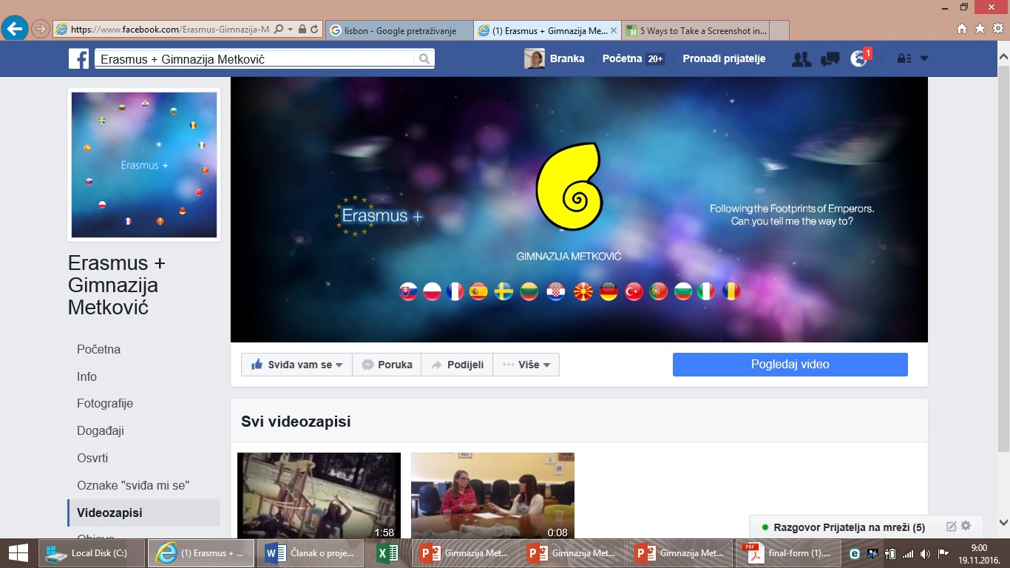
Activities in school
4 C’s (21st century skills):
Creativity,
collaboration,
communication,
critical thinking
Weekly updates: https://www.youtube.com/watch?v=WkGG88f2brY
Support videos: https://www.youtube.com/watch?v=GWQMl7vpaUE
Project task videos: https://www.youtube.com/watch?v=28QWL-GDXu0

