Slide 1
GOOD EDUCATION PRACTISES IN TURKEY

Slide 2
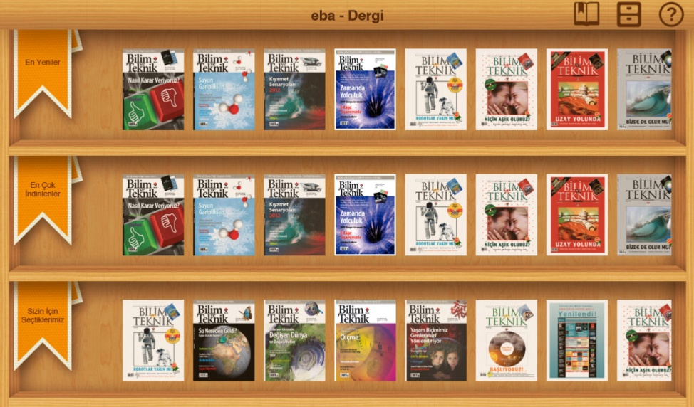
EBA (Electronic Information Net)
It is a document sharing site. Every teacher from any school can upload any material he/she prepared so you can find any kind of documents for all subjects.
E-magazines
Materials for all school subjects

Slide 3
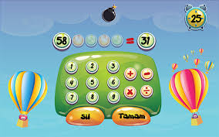
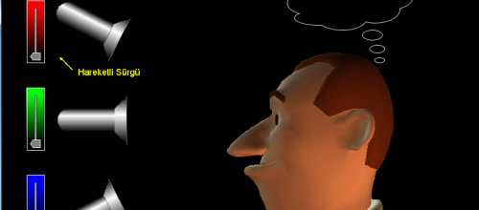
EBA
A math game for younger students
A video about Would Rather
A material about colours for physics

Slide 4
Teacher from village schools

Slide 5
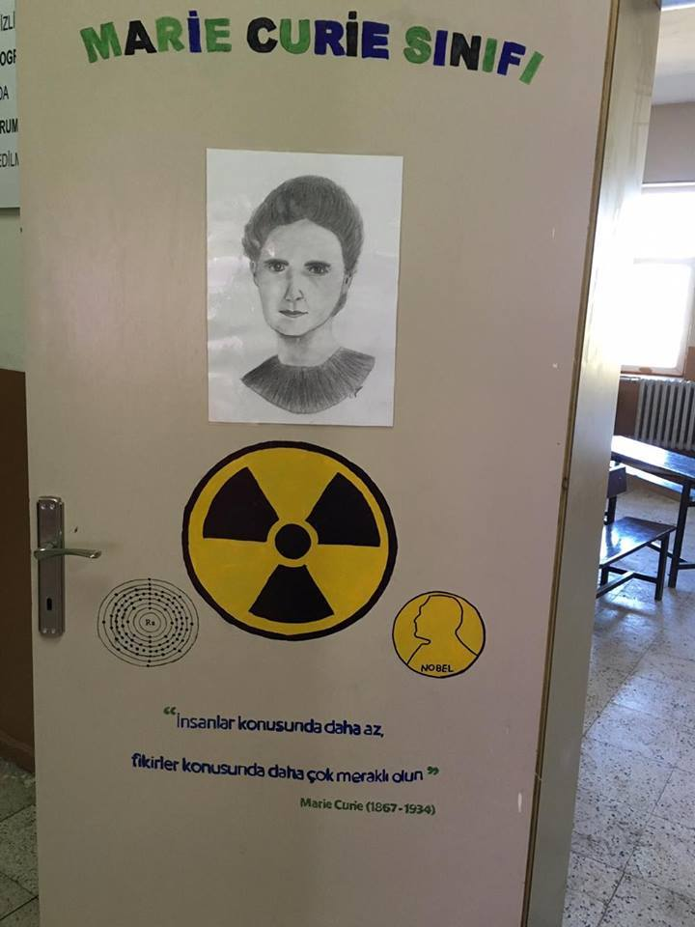
Teacher from village schools
Classroom Doors

Slide 6
Teacher from village schools
AFTER
BEFORE

Slide 7
An simple way to learn for teaching multiplying

Slide 8
A grafiti for teaching difference between left and right parts of brain

Slide 9
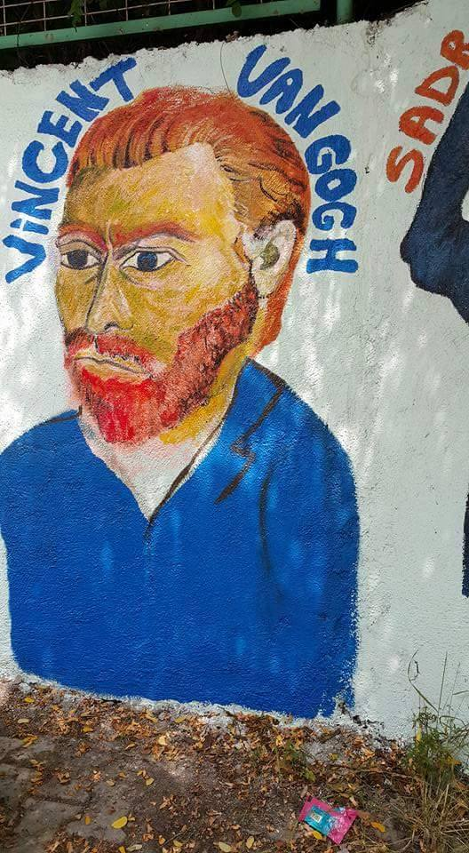
Wall painting

Slide 11
An English room at village school

Slide 12
Different usage of desks

Slide 13
Literature street at a school corridor

Slide 14
I haven’t graded exam papers yet

Slide 15
Turkish Teachers at Break time
TEA

