Slide 1
CROATIA- MARCH-2018

Slide 2
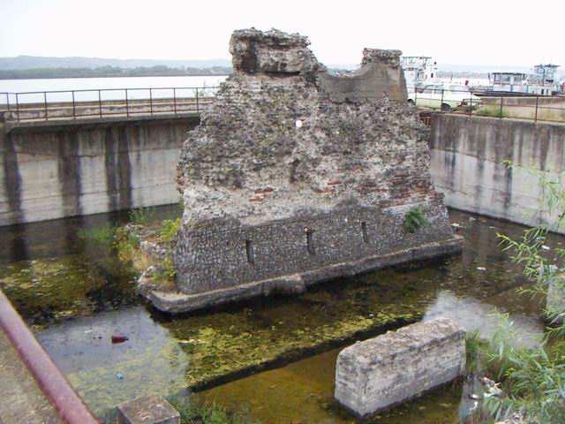
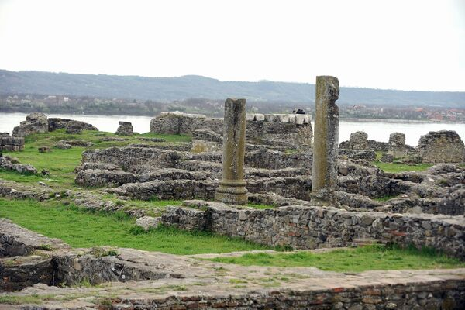
Roman amphitheaters on the territory of Romania
Apolodor's Bridge
This story is related with....
The Roman Fort from Drobeta
Trajan's Column

Slide 3
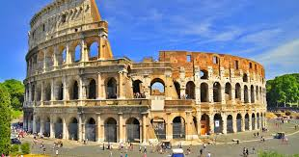
The first amphitheaters were built of wood and were dismantled after the performances ended. More than 200 amphitheatres have been identified throughout the Roman world.
The largest and most representative amphitheater remains the Colosseum.

Slide 4
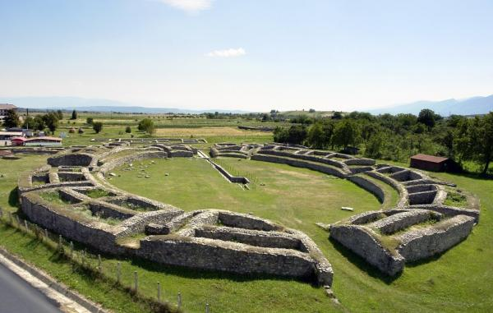
In Romania's territory, Roman amphitheaters were discovered at Ulpia Traiana Sarmizegetusa, Porolissum, Micia and Veţel Mureş, but none of them were identified as represented in any of the 2,500 scenes on Trajan's Column in Rome

Slide 5
At the end of the 19th century historians and archaeologists began to search in the archaeological sites open along the Danube the Roman military amphitheater that appears in a bas-relief on the Column of Trajan, a monument dedicated to the triumph of this emperor on the Dacians, built by the architect Apolodor of Damascus in 113 AD.

Slide 6
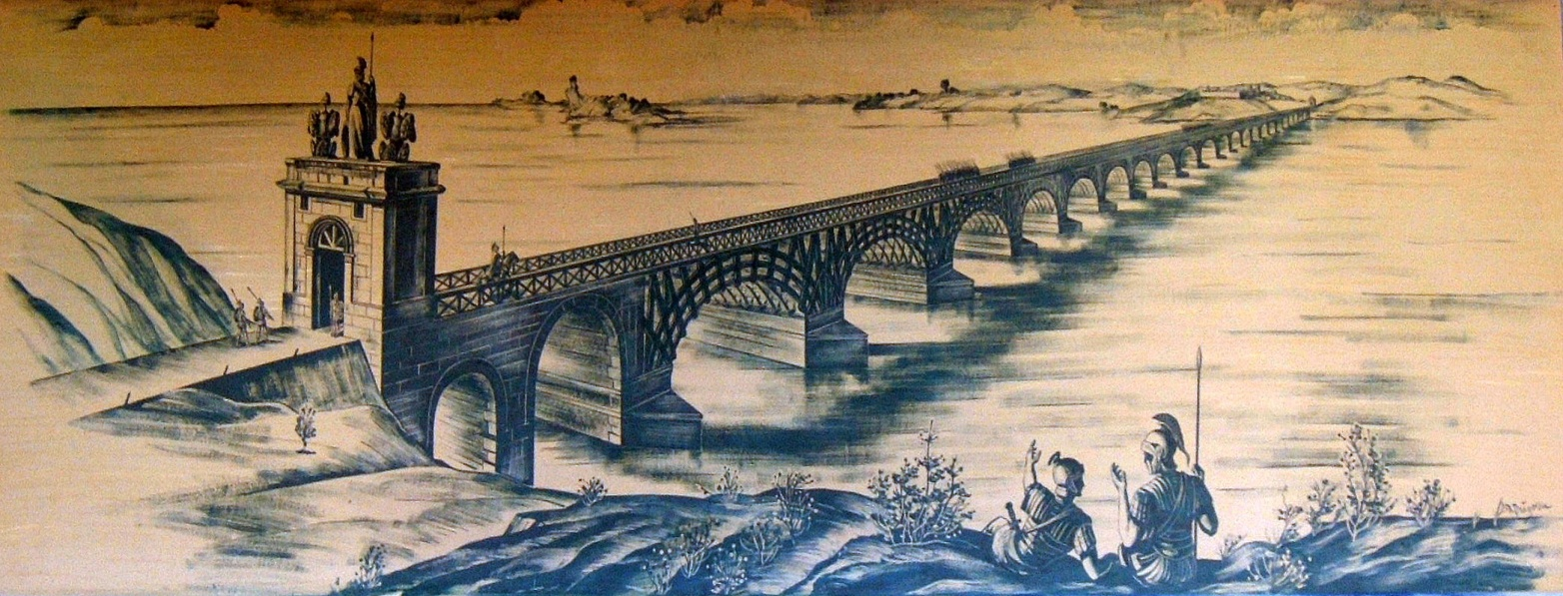
After so many searches, in November 2010, it came to light after excavations made even in the courtyard of the “Iron Gate” Region Museum. The discovery is of particular importance for the tourism in the area, because a few steps away from the ruins is the roman castrum Drobeta and foot of the Trajan's Bridge, two other important historical objectives.

Slide 7
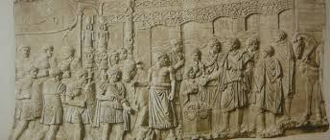
The researches started in 2012 by the archeologists from the Institute of Archeology "Vasile Pârvan" in Bucharest confirmed that the amphitheater observed on Traian's Column at the Colosseum, located on Via dei Fori Imperiali, was built at Drobeta at the beginning of Roman rule in Dacia around the years 106-107 “. The specialists was looking for it for over 100 years.

Slide 8
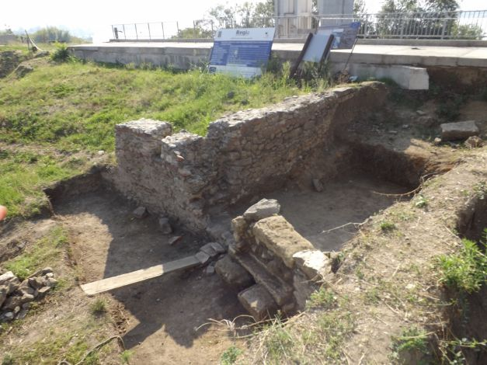
The Amphitheater was a circular building with much smaller dimensions than the 36x36 square meter , serving the garrison stationed in the Drobeta Castles, with a capacity of approximately 1,500 people.

Slide 9
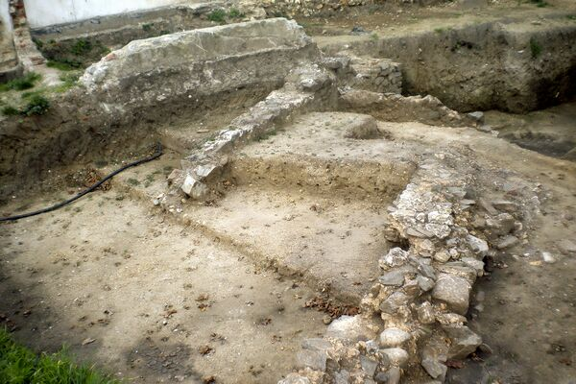
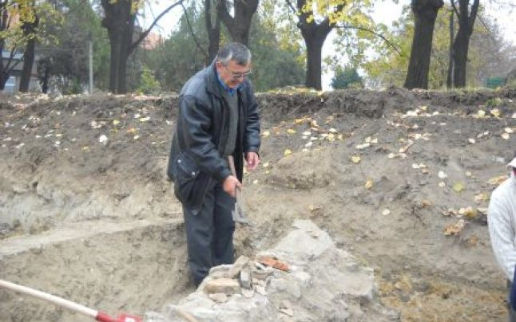
Situated near the Roman Castrum , this amphitheater was a gathering of soldiers and games of gladiators were held at the various celebrations ,celebrating the imperial cult, but it was probably used at times and for a field of exercise even for soldiers.

Slide 10
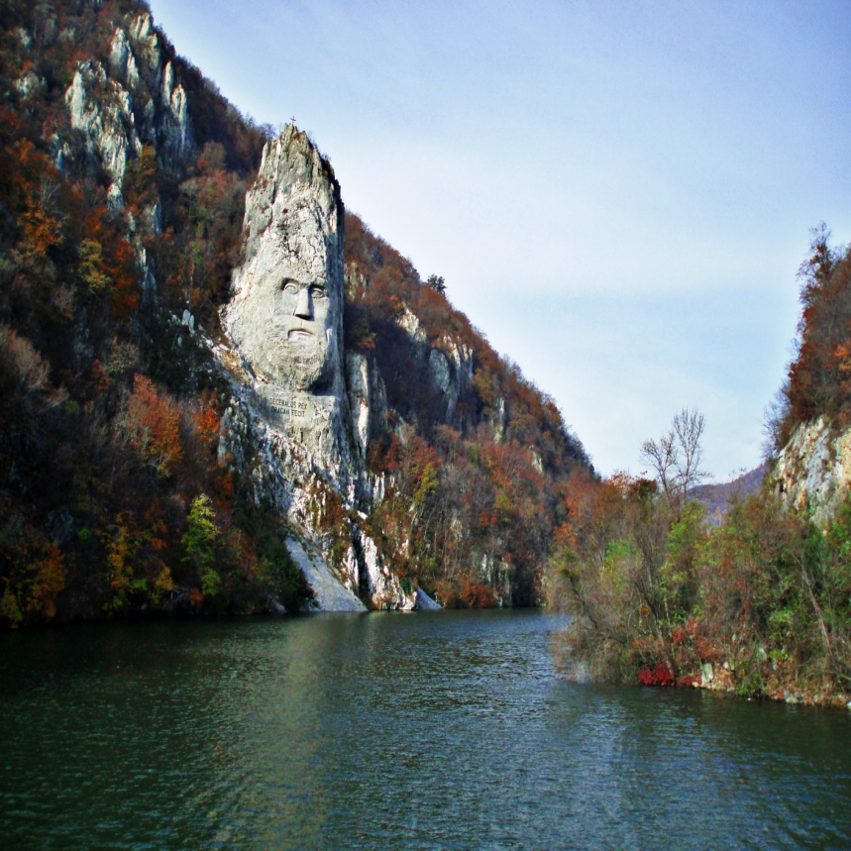
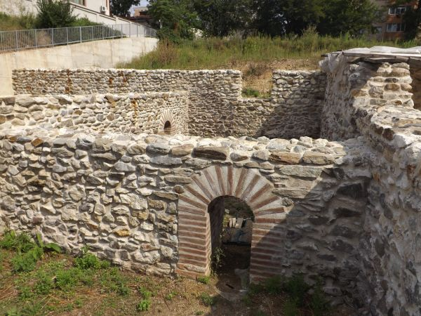
The amphitheater lasted until the sixth to seven decades of the third century, when it was burned, probably following the great Gothic invasion. At that time, the Roman camp was also destroyed.
DECEBAL –DACIAN’S KING

Slide 11
“The Danube’s boilers” - Drobeta Turnu Severin - Romania

Slide 12
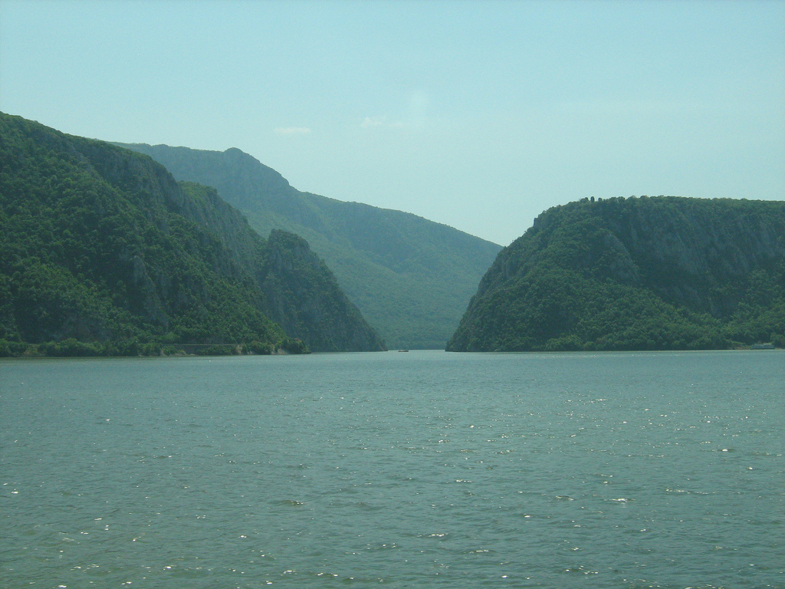
ROMANIA TEAM....
IULIA
ELENA
MIOARA
LUCIANA
THANK YOU!

