Slide 1

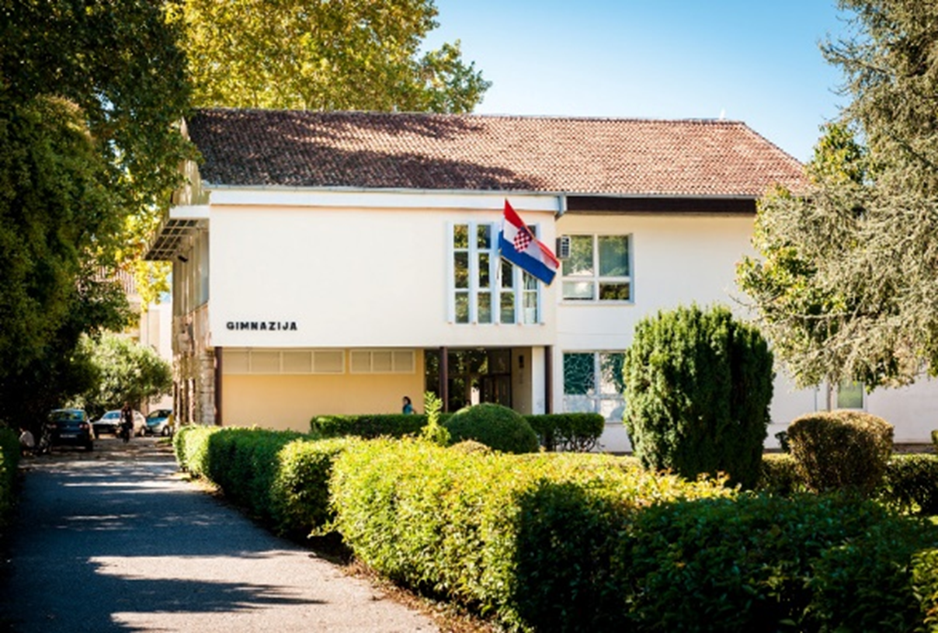


Gimnazija Metkovic, Croatia
Examples of good practice
In the classroom and extracurricular activities
FOLLOWING THE FOOTPRINTS OF EMPERORS
Transnational project meeeting
Lisbon, 22 – 24 November 2016

Slide 2

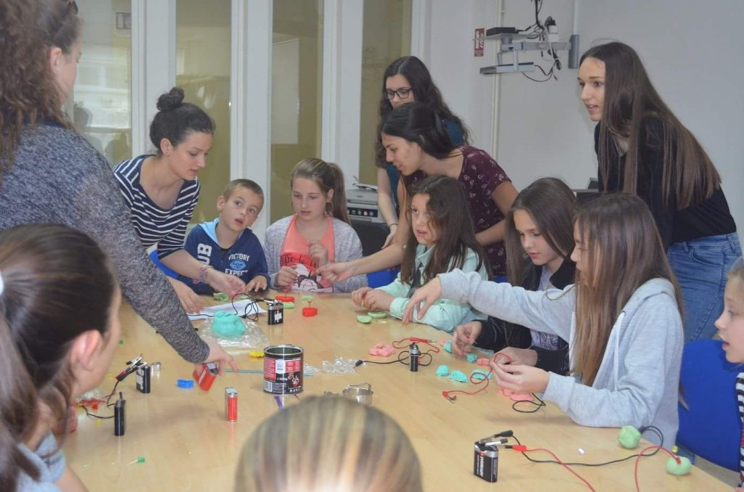
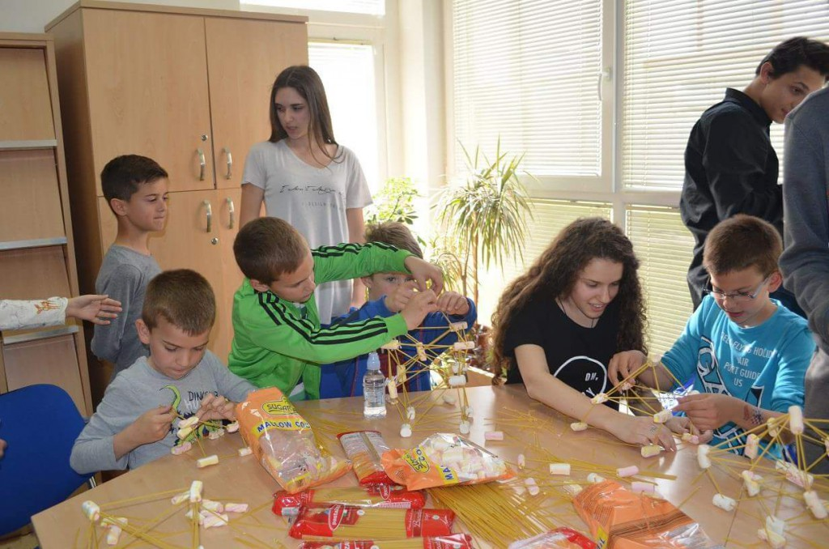
SCIENCES
- An Evening of Math – annual event hosted by math teachers and our students for primary school pupils (some activities: string art – geometry for Christmas cards, abacus building...)
- use of edmodo platform for math homework and test practising
- An Evening of physics – annual event hosted by physics teachers and our students for primary school pupils - experiments

Slide 3

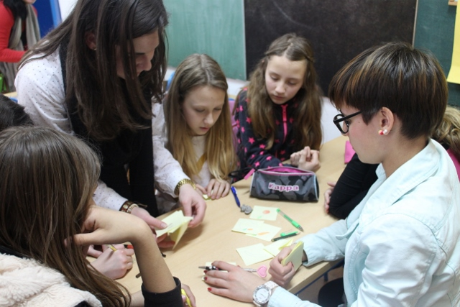
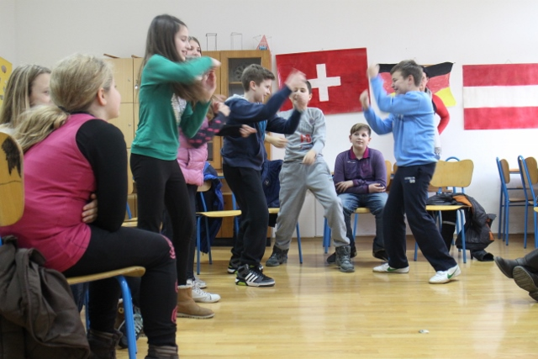
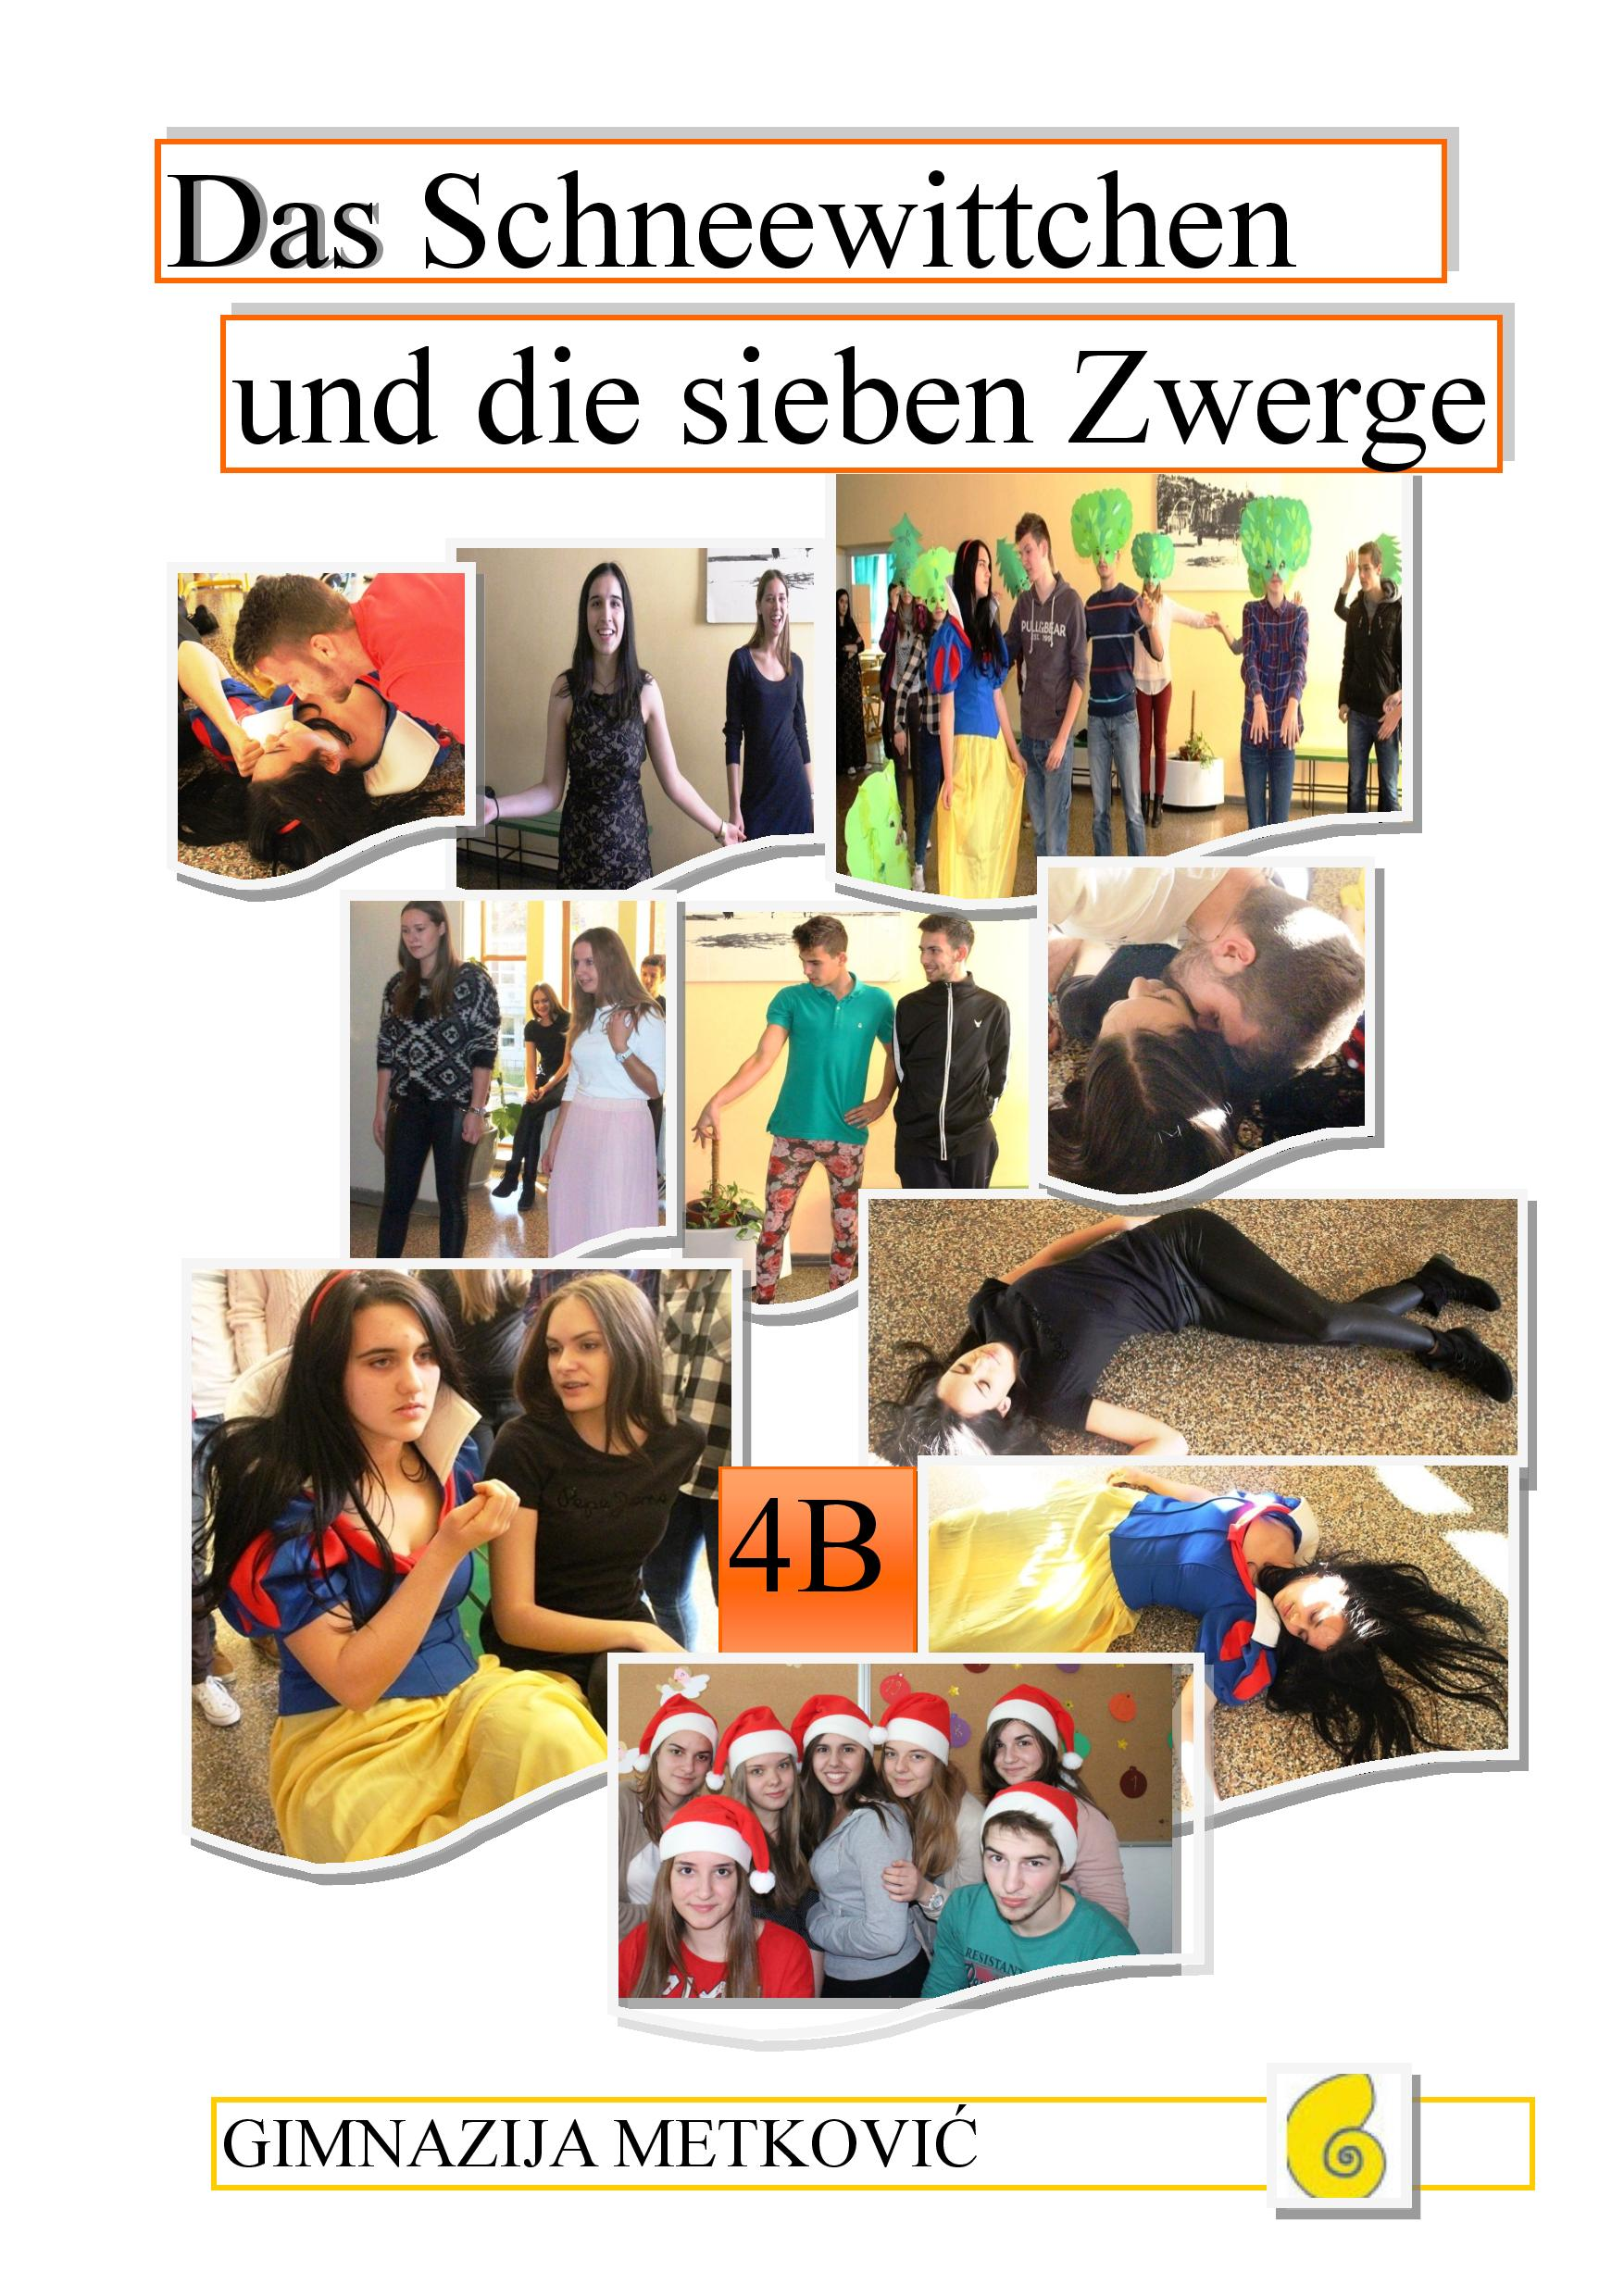
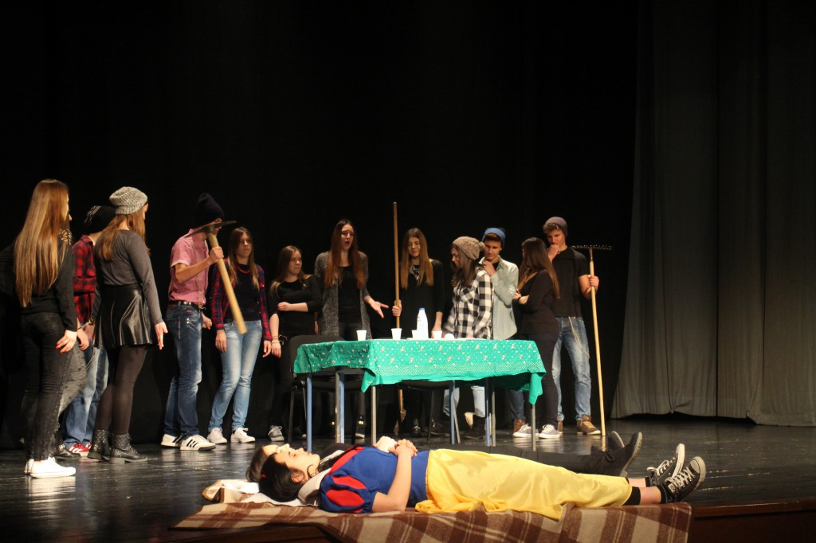
GERMAN LANGUAGE TEACHING
- PASCH – programme in cooperation with the Goethe Institute (workshops in drama, art etc.; creating a magazine)
- GERMAN CINEMATOGRAPHY MONTH
- SPRACHANIMATION – workshops by
our students for primary school pupils
- MÄRCHEN – fairy tale performances

Slide 4
ENGLISH LANGUAGE TEACHING
- European Language day celebrations (performances, posters, quizzes)
- speaking activities and role-play ideas from funny talk shows
(the Ellen show, Jimmy Kimmel Live ...)
- Valentine’s day / Poetry day
- mini – presentations as warm-up or follow-up activities
- students prepare questions for quizzes and oral examination
- videos / performances of short stories read in class („The Gift of the Magi” by O. Henry)

Slide 5
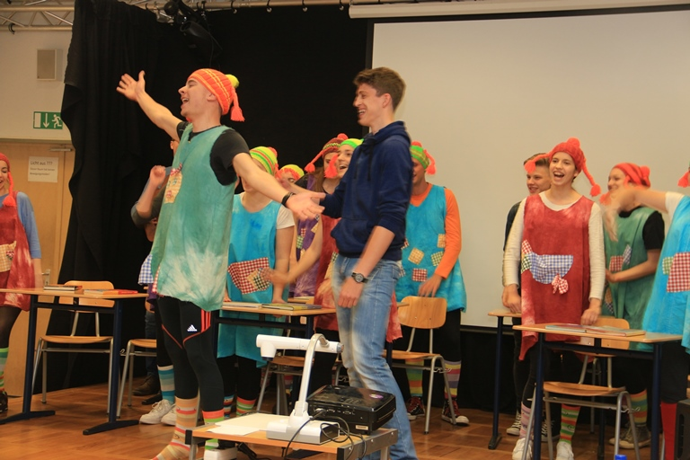
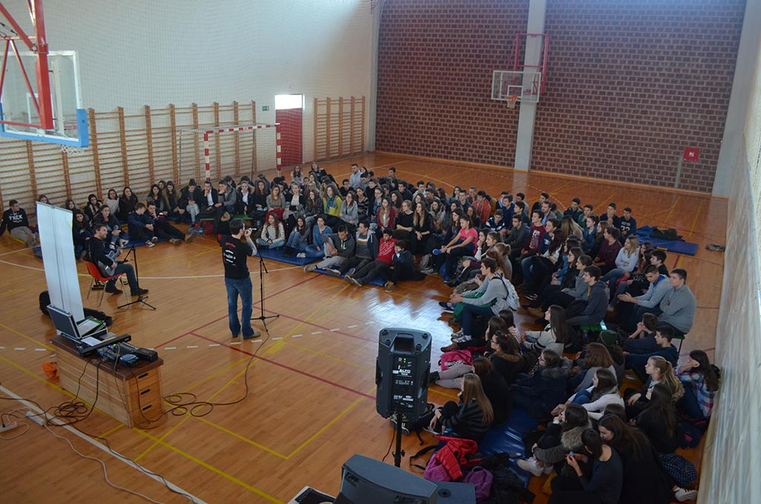
SCHOOL LIBRARY
WORLD BOOK DAY ACTIVITIES
- performances of famous literary works,
poetry readings
- literature and trivia quiz with literary prizes
LITERATURE THROUGH VIDEOS
- videos featuring scenes from major literary works
A BACKPACK FULL OF CULTURE
- project in cooperation with the Ministry of Culture;
workshops on music, book binding and book digitalization,
creative writing

Slide 6
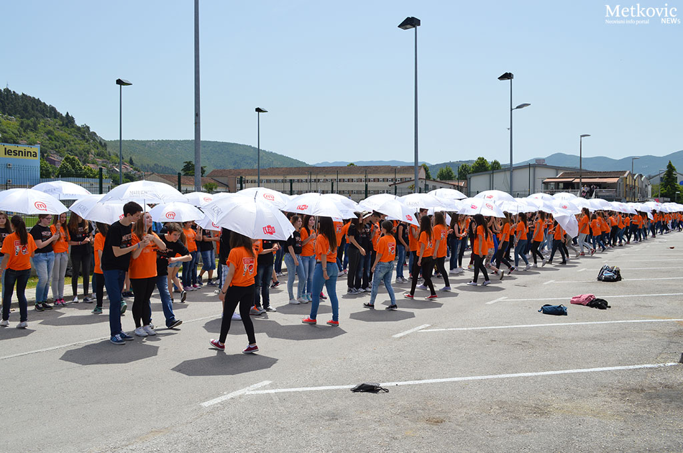
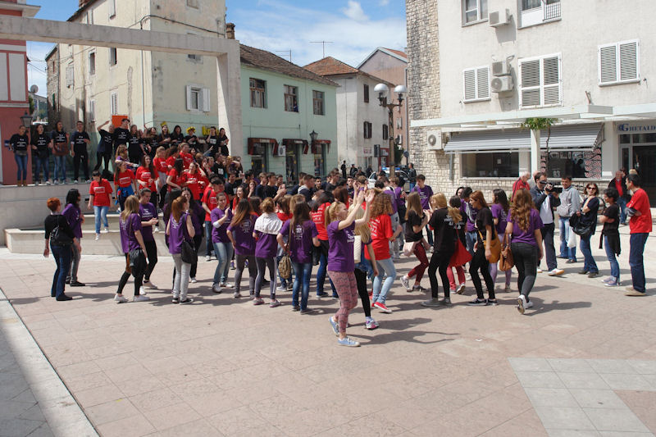
WELFARE OF STUDENTS
- last day of school for 4th year students – singing and dancing the Quadrilla dance
- teacher meetings: regular meetings of teachers of a single class minimum twice a year to discuss individual students’ progress
- study groups in the afternoon (with teachers or students only)

Slide 7

THANK YOU FOR YOUR ATTENTION
Author: Branka Vladimir, Gimnazija Metkovic
Looking forward to other ideas from our respected partners!!!

