Slide 1
Air pollution
Oliwia Wiśniewska

Slide 2
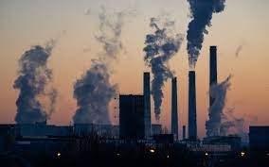
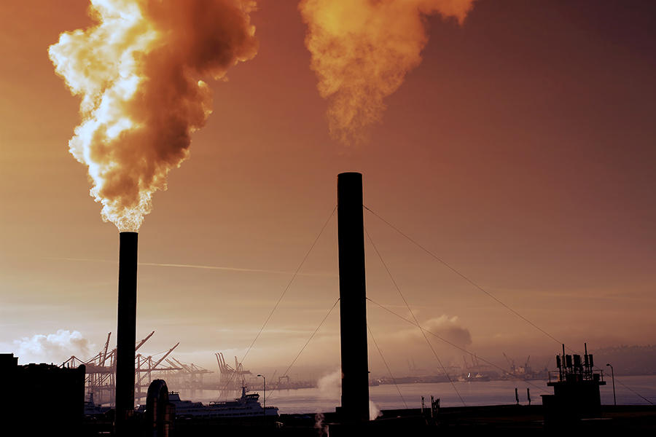
What is the definition of pollution?
Pollution occurs when an amount of any substance or any form of energy is put into the environment at a rate faster than it can be dispersed or safely stored. The term “pollution” can refer to both artificial and natural materials that are created, consumed, and discarded in an unsustainable manner.

Slide 3
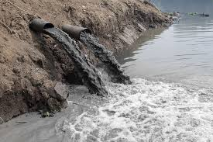
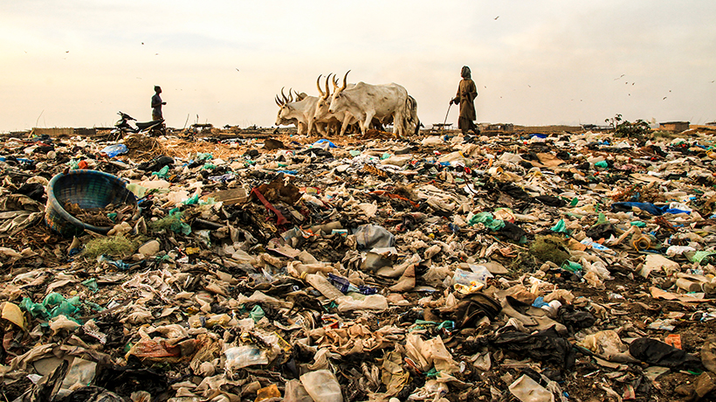
Major types of pollution
air pollution,
light pollution,
litter pollution
noise pollution,
plastic pollution,
soil contamination,
radioactive contamination,
thermal pollution,
visual pollution,
water pollution.

Slide 4
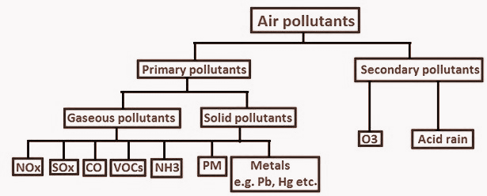
Types of air pollutants
Primary Pollutants
Primary pollutants enter the atmosphere directly and are caused by either natural causes or human activity.
For example, greenhouse gases, coals, fossil fuels and volatile organic compounds are all pollutants that go up into the air directly.
Secondary Pollutants
Secondary pollutants are created by chemical
reactions that take place in the atmosphere.
Photochemical smog forms when sunlight reacts
dangerously with car exhaust in the atmosphere.
One of the major secondary pollutants is ozone.
It is created when nitrogen dioxide in the
atmosphere reacts with sunlight:
NO2 + hν → NO + O
O + O2 → O3

Slide 5
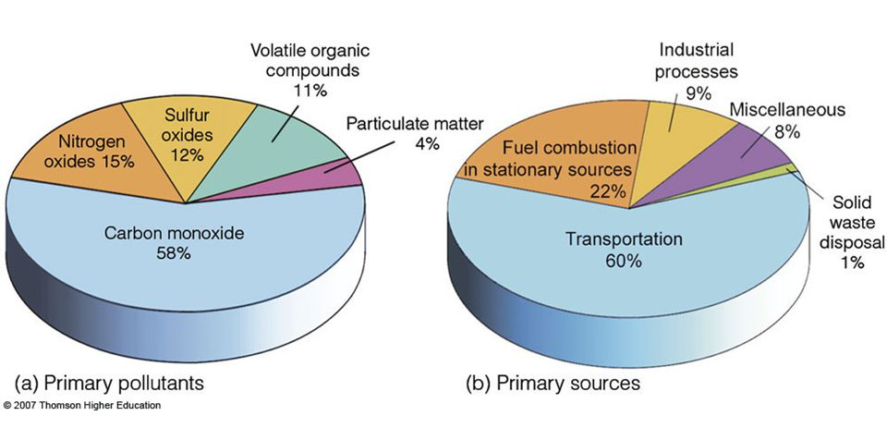
Major primary air pollutants and their sources

Slide 6
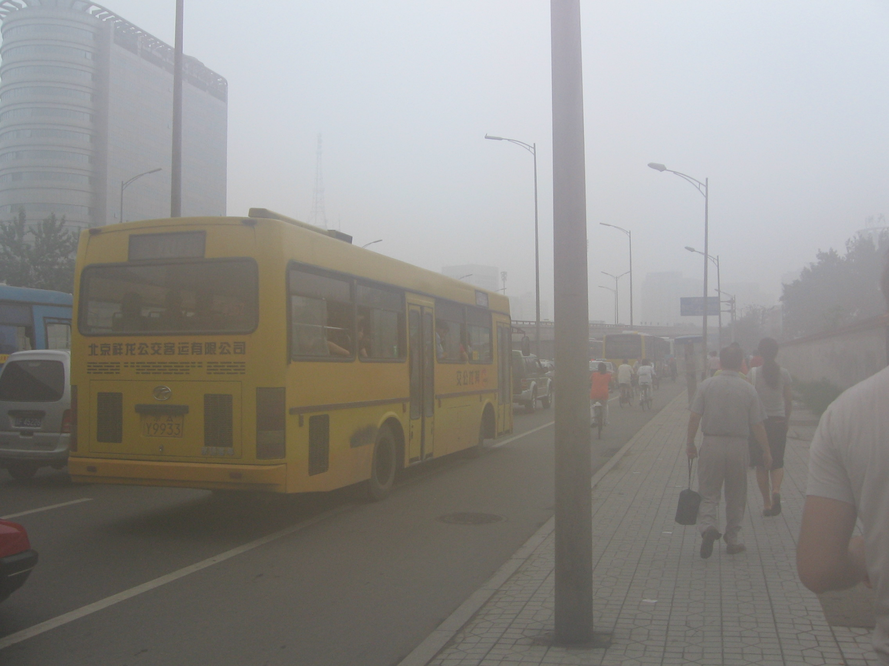
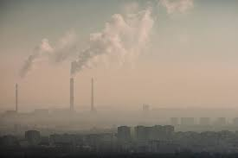
PM - Particulate Matter
Particulate Matter is a term used for particles found in the air - dust, soot, dirt, smoke, and liquid droplets.
PM2.5 particles are given the 2.5 annotation to describe the size as being 2.5 micrometers or less. PM10 are less than 10 micrometers in diameter.
Due to PM’s small size, it has the ability to both remain suspended in the air for long periods of time, and be absorbed deep into the bloodstream upon inhalation.
PM is either emitted directly from various sources or created by other pollutants reacting in the atmosphere.
Sources of PM’s include industrial processes and chemical reactions occuring between gases such as sulfur dioxide, nitrogen oxides and volatile organic compounds.

Slide 7
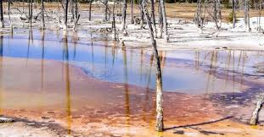
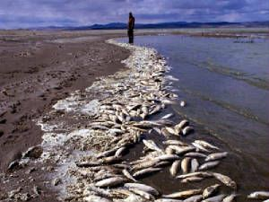
SO2 - sulfur dioxide
It is a colourless gas with an irritating odour. It is produced by burning fossil fuels and by the smelting of mineral ores that contain sulfur. Erupting volcanoes also can be a source of sulfur dioxide.
Sulfur dioxide, combined with water and air, forms sulfuric acid, which is the main component of acid rain, which can cause deforestation, determinate aquatic life and corrode building materials and paints.
In Europe the potential for forming acid rain from sulfur dioxide emissions is high.
Sulfur dioxide affects the respiratory system, irritates the eyes and increases the risk of tract infections. It causes coughing, mucus secretion and aggravates conditions such as asthma and chronic bronchitis.

Slide 8
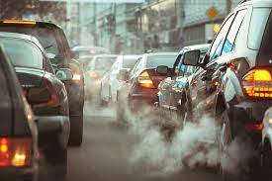
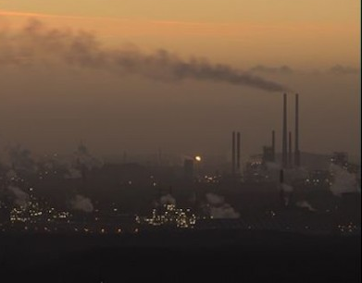
NOx - nitrogen oxides
This term refers to the mixture of NO (nitric oxide) and NO2 (nitrogen dioxide), which are gases produced from fuel burning processes.
Nitric oxide is colourless and is oxidised in the atmosphere to form nitrogen dioxide, which has an odour and is an acidic, highly corrosive gas that can affect our health and environment.
Nitrogen oxides are critical components of photochemical smog.
Elevated levels of nitrogen dioxide affect respiratory tract. Long-term exposure to high levels of nitrogen dioxide can cause chronic lung disease. It may also affect the senses.
Nitrogen dioxide also can fade and discolour furnishings and fabrics, reduce visibility, and react with surfaces.

Slide 9
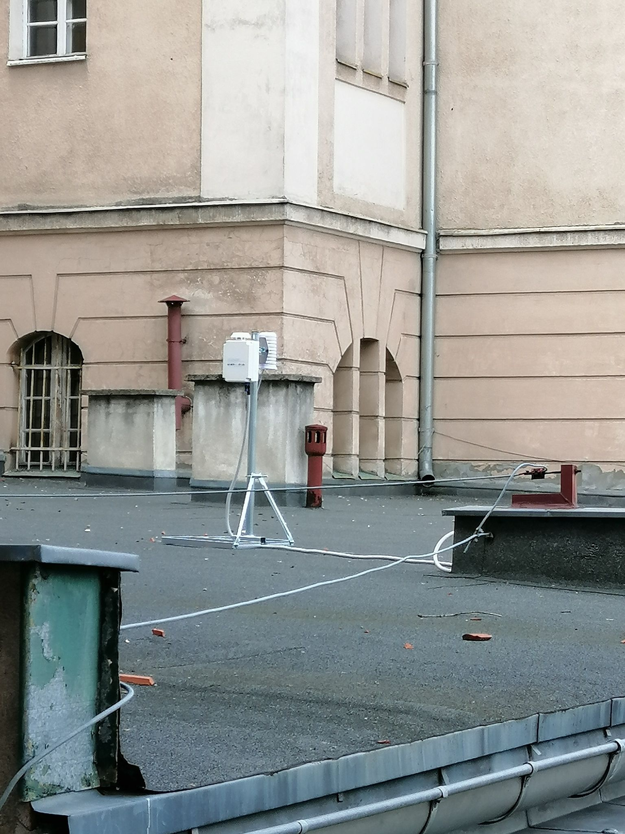
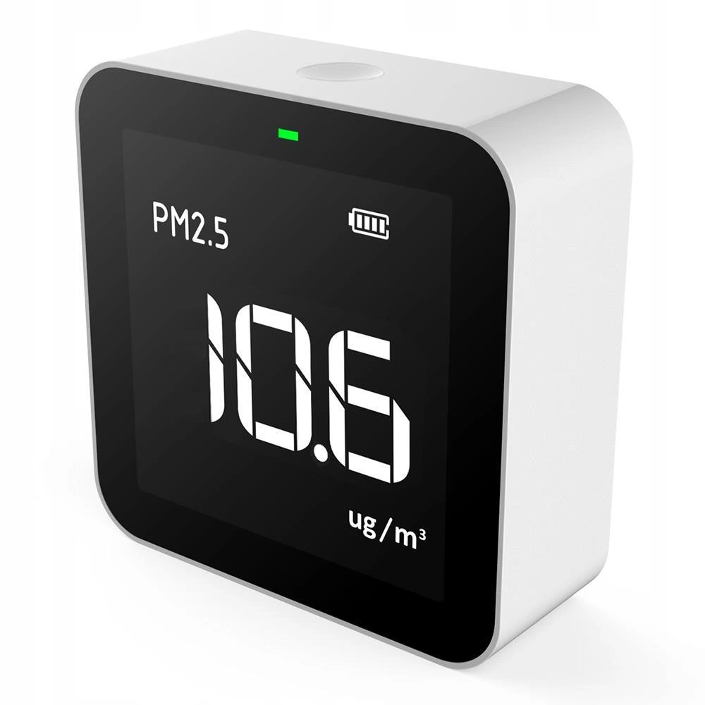
What do dust meters look like?

Slide 10
Air pollution influence on the environment and human health
Global Warming
Climate Change
Deterioration of fields
Extinction of animal species
Deterioration in building materials
Respiratory health problems (emphysema, asthma, chronic obstructive pulmonary disease - COPD)
Chronic bronchitis
Alzheimer's and Parkinson's diseases
Psychological complications
Air pollution is estimated to kill over 7 million people every year!

Slide 11
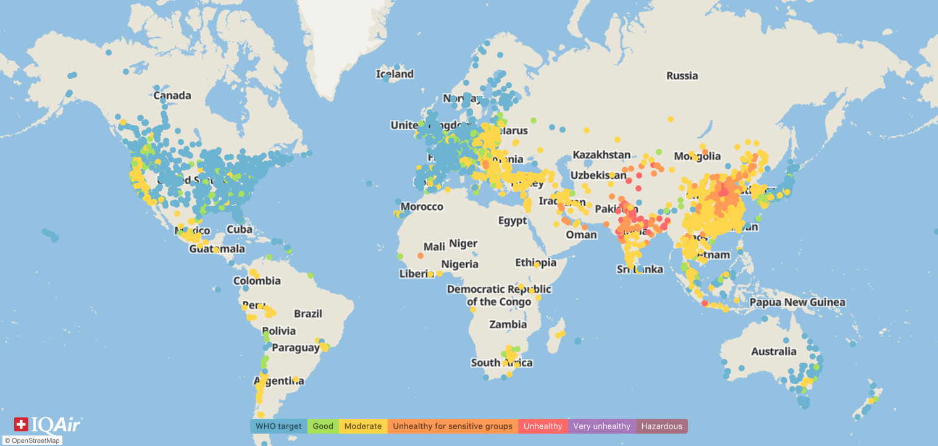

Slide 12
Articles worth reading
How does air pollution affect our health? https://www.medicalnewstoday.com/articles/327447?c=265556322996#summary
3 ways we can solve the air pollution crisis https://www.greenpeace.org/international/story/28533/3-ways-we-can-solve-the-air-pollution-crisis/
Reducing Air Pollution https://www.sdapcd.org/content/sdc/apcd/en/reducing-air-pollution.html
Try to spread awareness of air pollution impact on human health and environment and how to solve this problem, please!

Slide 13
Bibliography
pollution | Definition, History, Types, & Facts
Pollution Facts & Types of Pollution
Types of Air Pollution Study Guide
Air pollution and health video series
Effects of air pollution on human health and practical measures for prevention in Iran
https://www.iqair.com/blog/air-quality/pm2-5
https://www.qld.gov.au/environment/pollution/monitoring/air/air-pollution/pollutants/sulfur-dioxide
https://www.qld.gov.au/environment/pollution/monitoring/air/air-pollution/pollutants/nitrogen-oxides
https://www.iqair.com/world-air-quality-report

