Slide 1
Good practice ideas and examples which ICT tools and Social media channels teachers use for better communication with parents
Erasmus+Project:
"High quality feedback – the key to successful
cooperation between teachers and parents in
preschools"
(No:2020-1-LT01-KA229-077868)

Slide 2
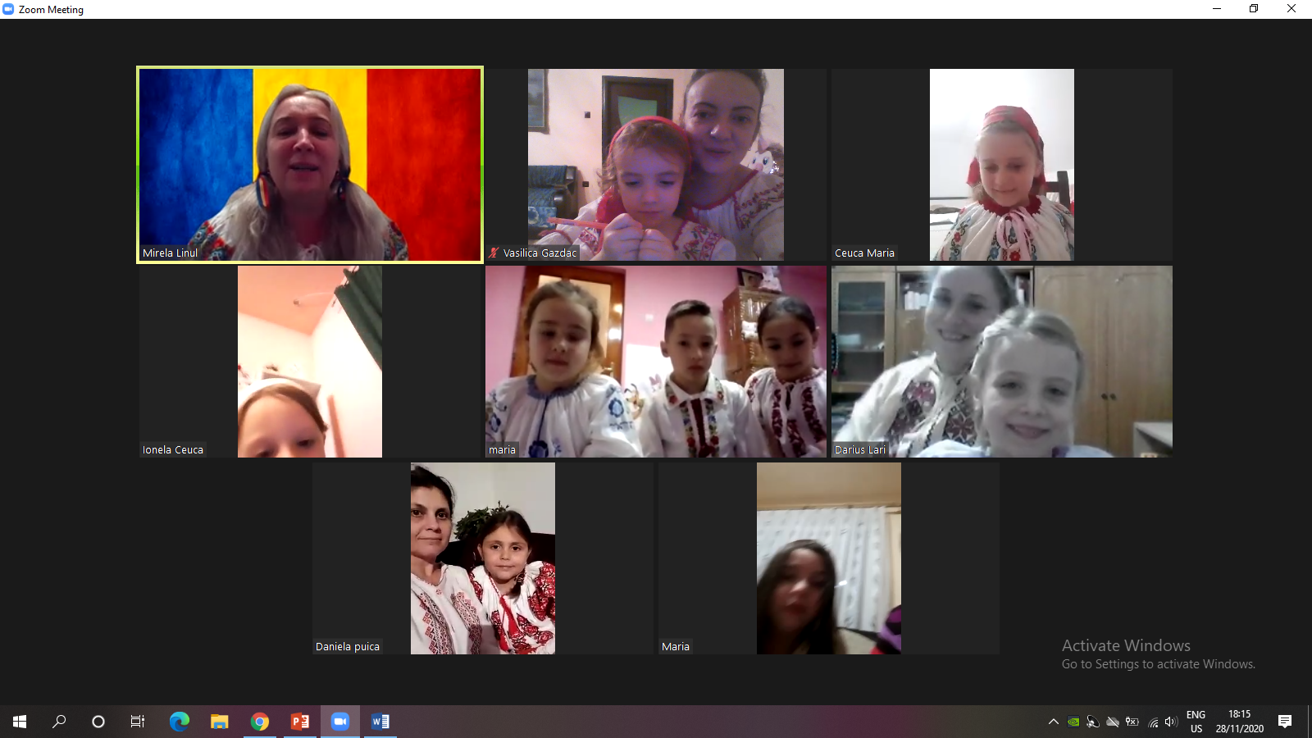
Good practice Erasmus+
Synchronous communication -Google Meet, Zoom
-we use it in direct meetings with children and parents;
-during meetings only with parents/grandparents;
-in parental counseling activities in which we invite various specialists such as psychologists, pediatricians, librarians;
-the duration of the meetings is according to the age of students.

Slide 3
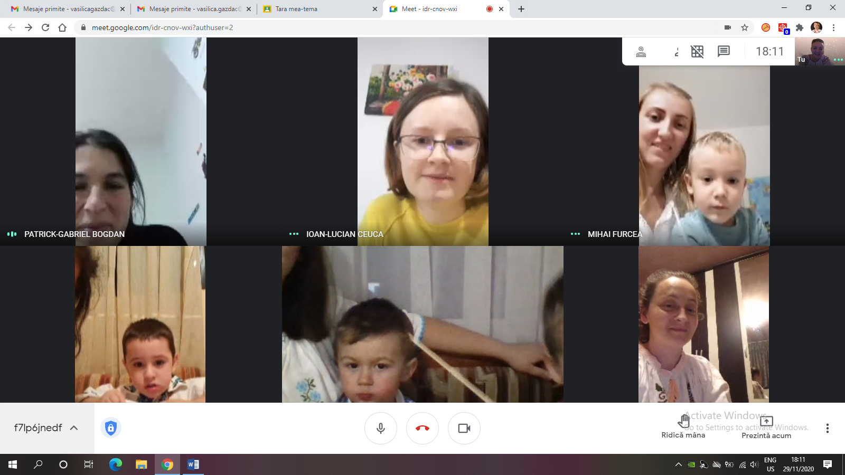
Good practice Erasmus+

Slide 4
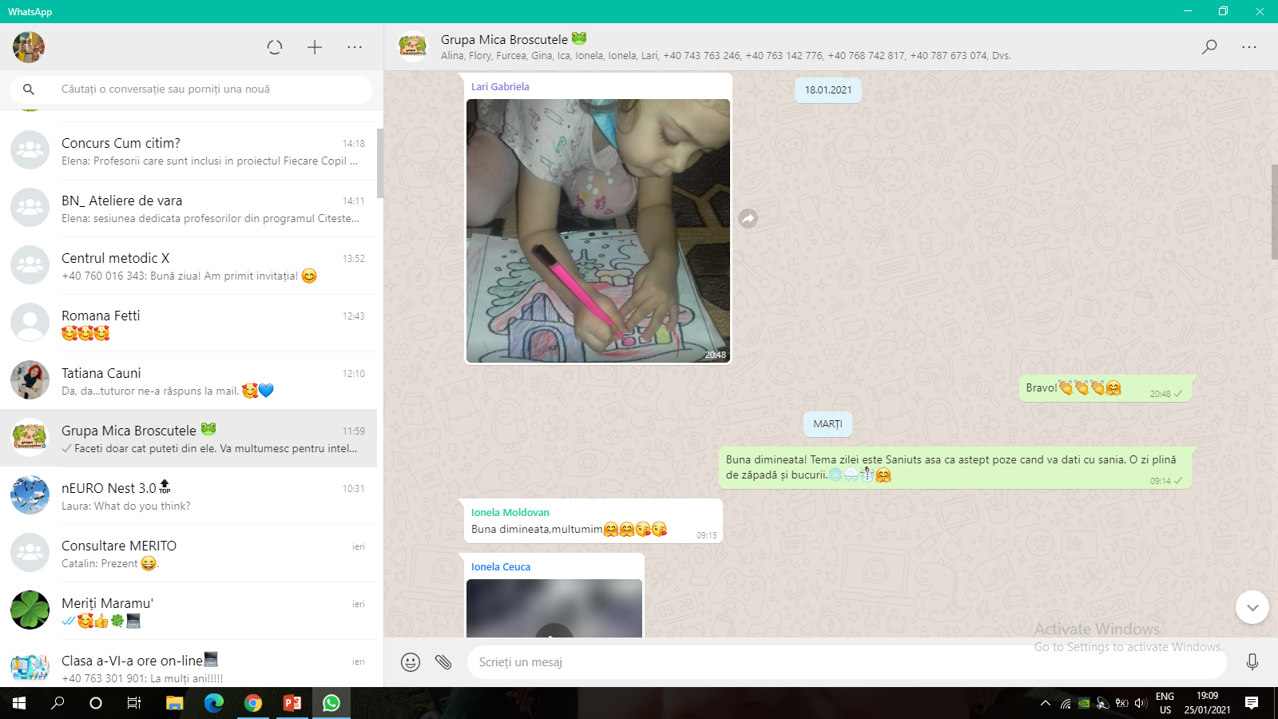
Good practice Erasmus+
Asynchronous communication - Whatsapp group, messages of kindergarten class and Facebook school page.
And through digital applications which we transfer knowledge content and playful tools.
We used with success Wordwall, Learning apps, Jinsawpuzzle and Padlet.

Slide 5
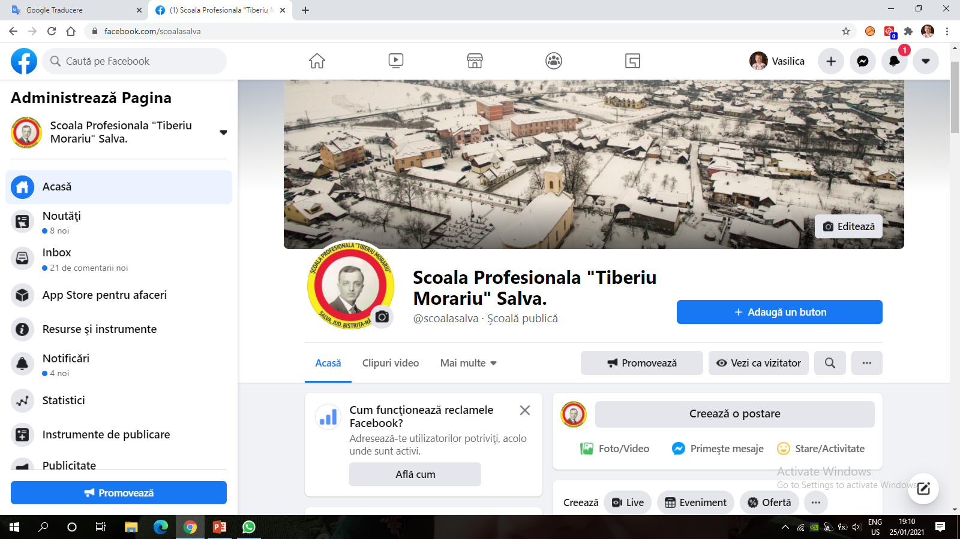
Good practice Erasmus+
Description of the sub contents

Slide 6
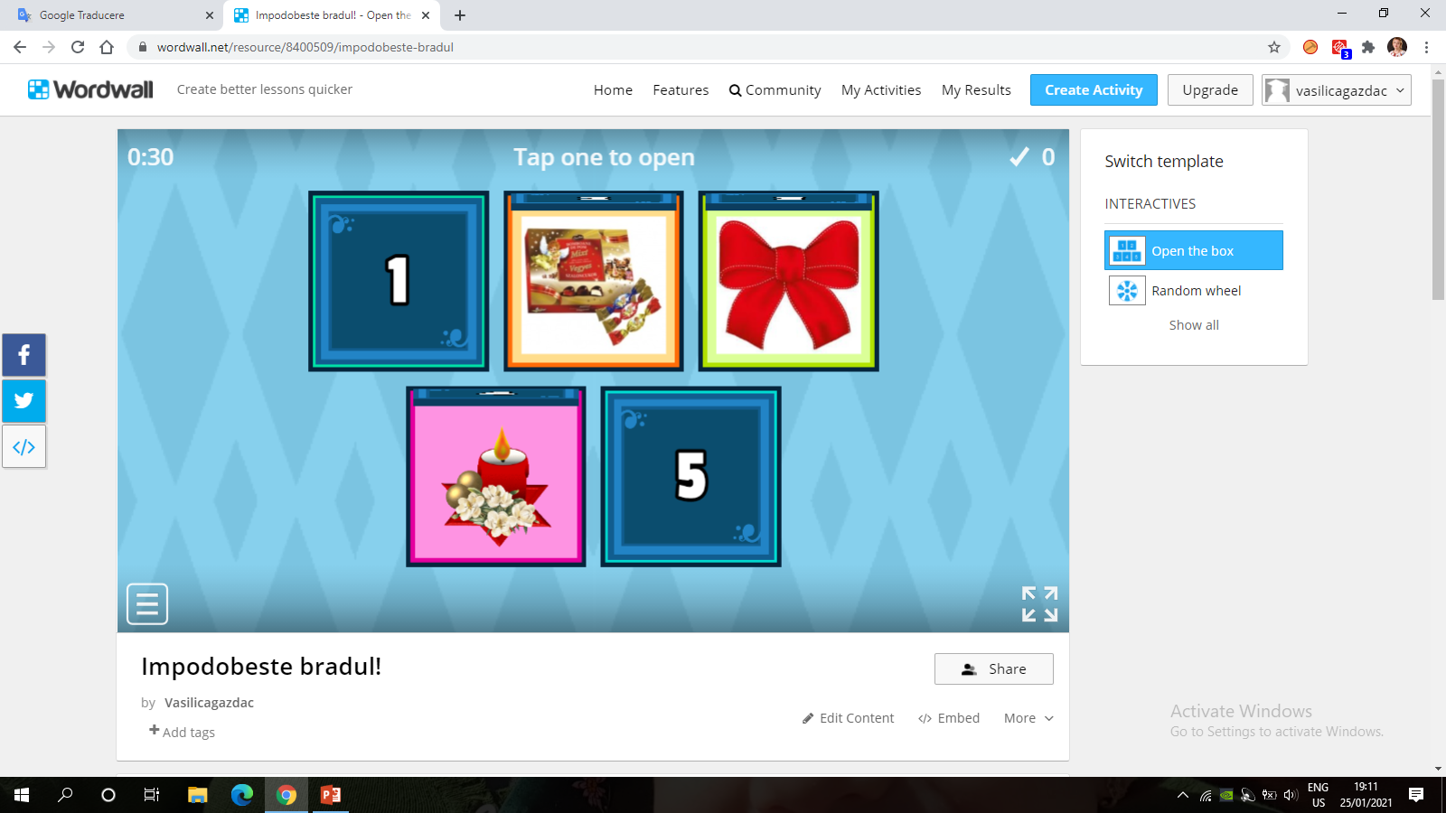
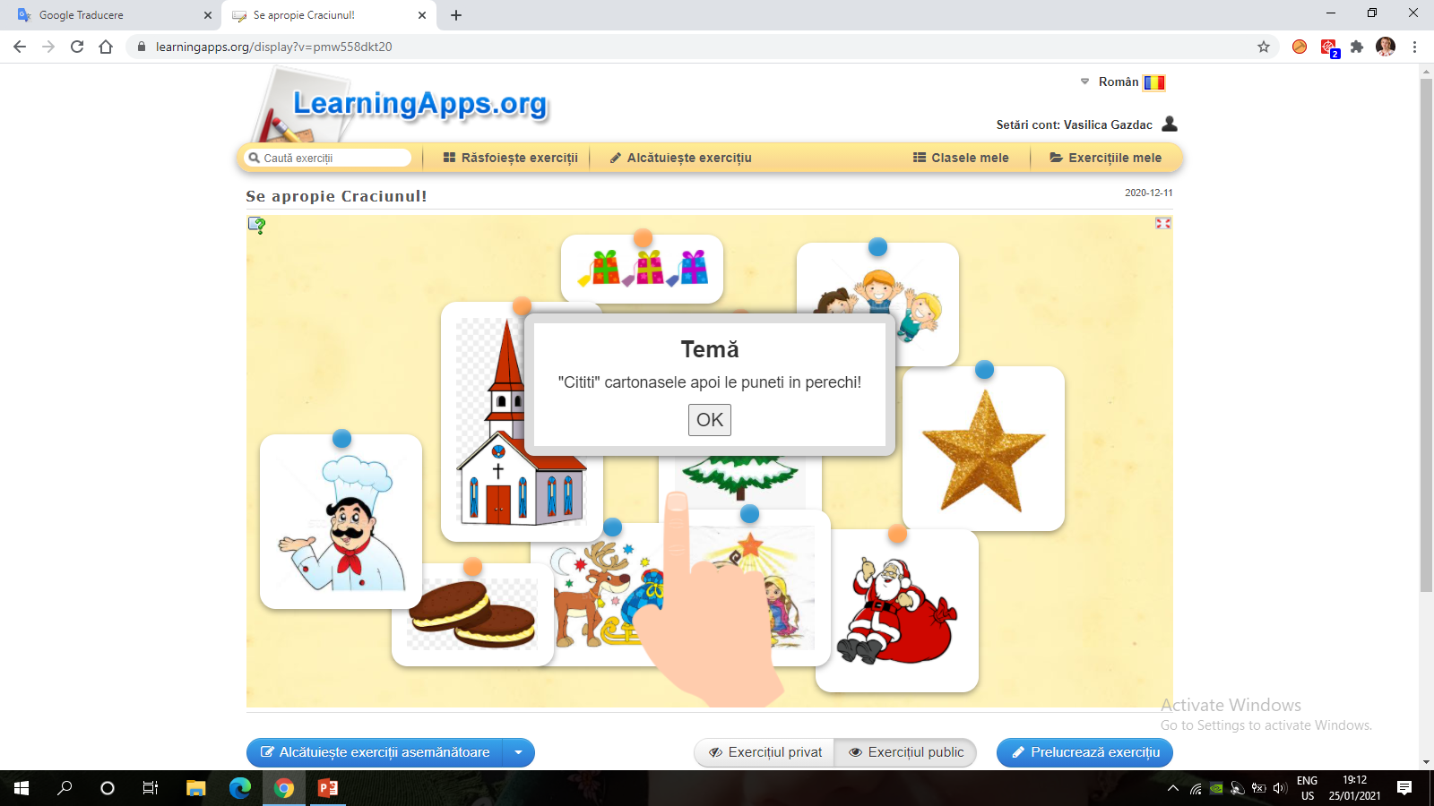
Good practice Erasmus+
Description of the sub contents

Slide 7
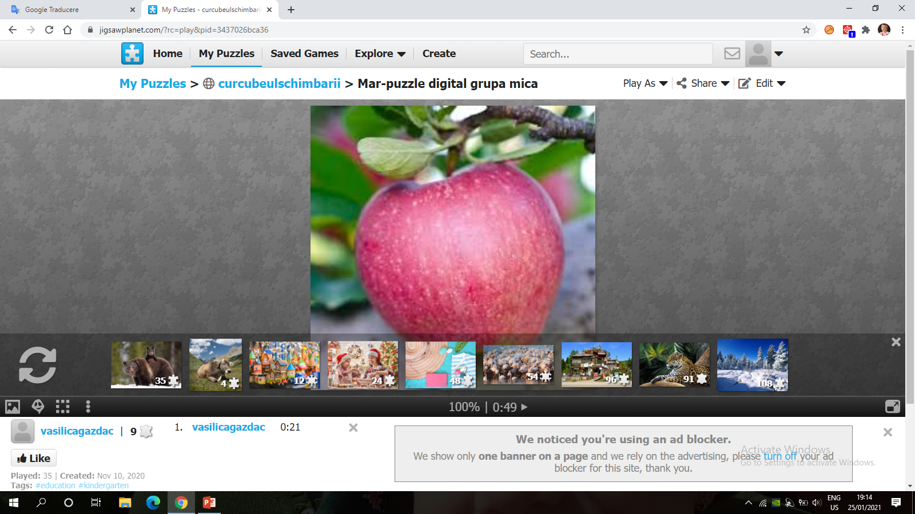
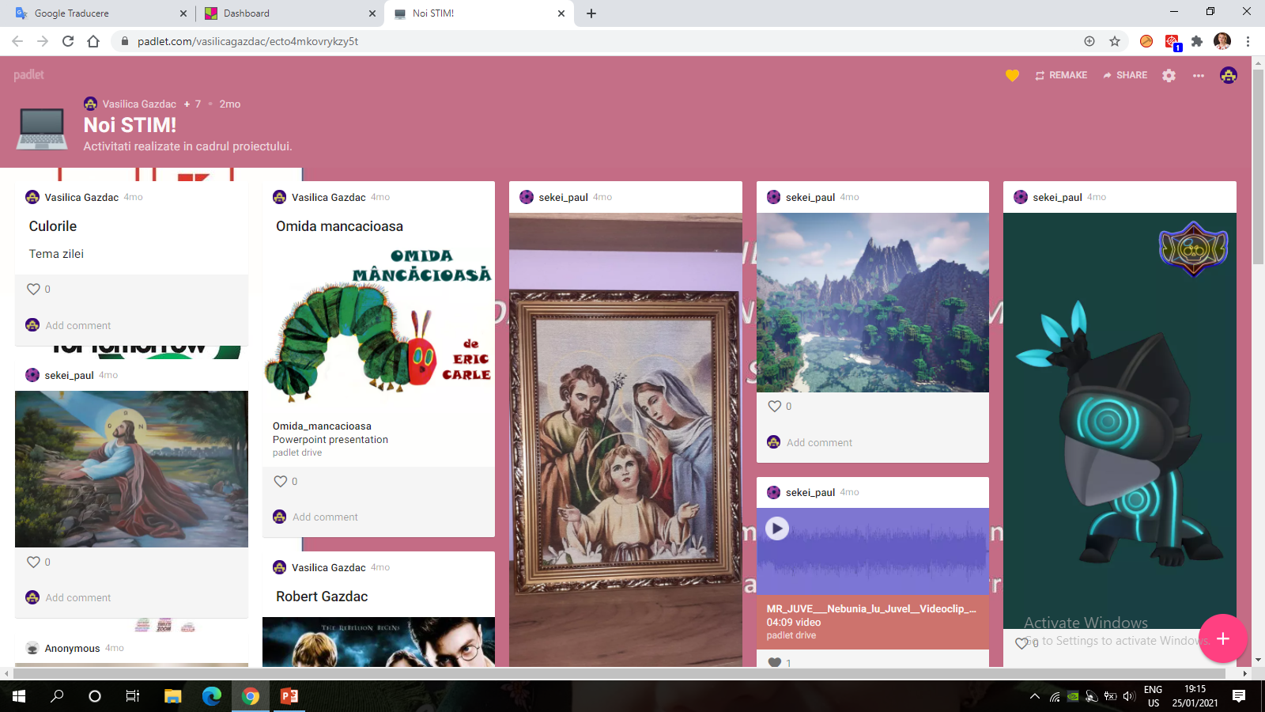
Good practice Erasmus+
Description of the sub contents

Slide 8
Good practice Erasmus+
“The European Commission support for the production of
this publication does not constitute an endorsement of the
contents which reflects the views only of the authors,
and the National Agency and Commission cannot be held responsible
for any use which may be made of the information contained therein”.
Made by Romania Team ( Vasilica Gazdac and Crina Linul)
Thank you for your attention!

