Slide 1

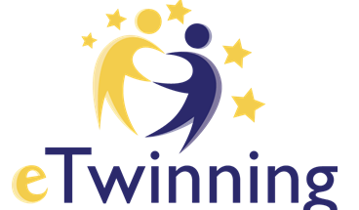

Project
• Teachers' high quality feedback to parents – key to a successful child’s development •
Detska gradina ●ARABELLA●
www.arabella-kindergarten.com
Vidin, Bulgaria
ICT tools and social media channels for better communication with parents
The European Commission support for the production of this publication does not constitute an endorsement of the contents which reflects the views only of the authors, and the Commission cannot be held responsible for any use which may be made of the information contained therein.

Slide 2

Effective communication and cooperation between teachers and parents are very important. This builds for family involvement in children's development and education. Teachers and parents inform and consult each other about requirements, questions concerning learning, practices, and children's behavior.

Slide 3

THE PARTNERSHIP BETWEEN TEACHERS AND PARENTS
• builds family involvement in children's development and education
• helps children learn better
• creates a harmonic environment where children, teachers, and parents felt friendly
• creates various activities, which engage parents, supporting their responsibility
• involves parents in learning activities at home
• helps foster supportive, understanding parents
• builds parent trust

Slide 4
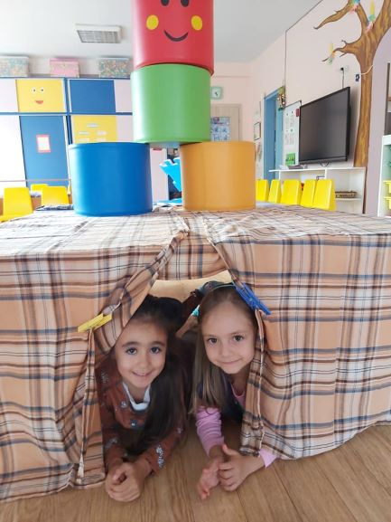
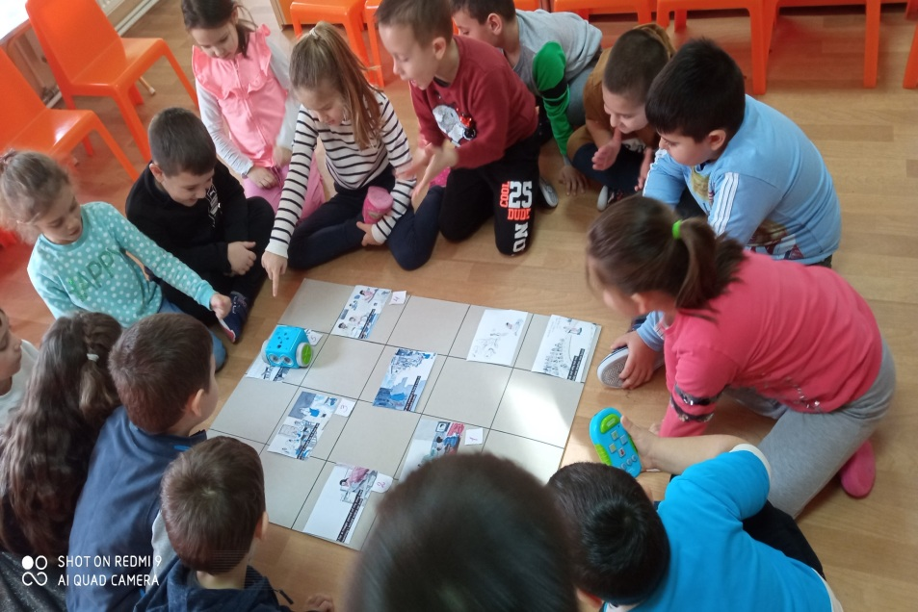
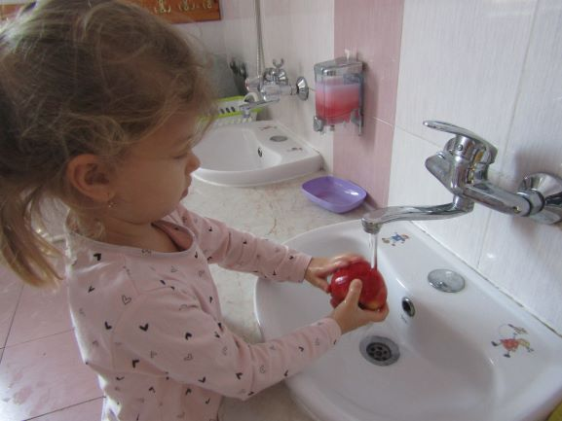
ICT tools and social media cannels can keep parents up to speed on their kids' progress and support constructive dialogue
We use ICT tools for distance learning, individual and group counseling
sharing holidays, daily learning activities, presenting child’s production.

Slide 5
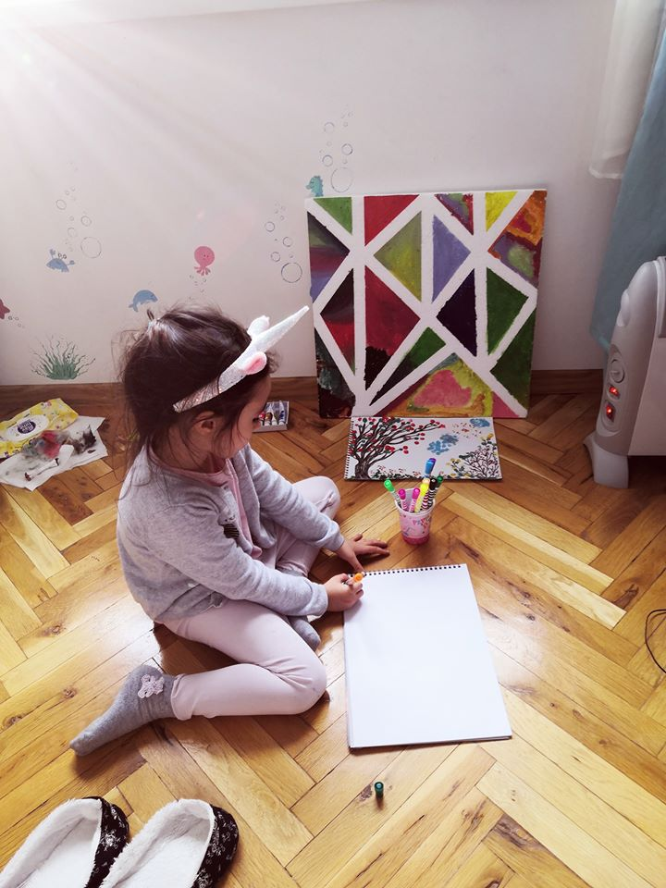
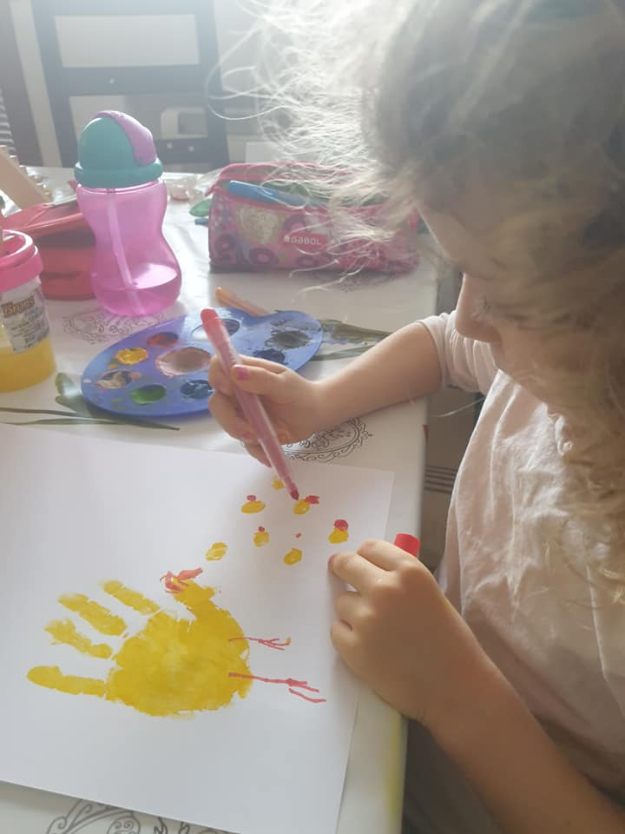
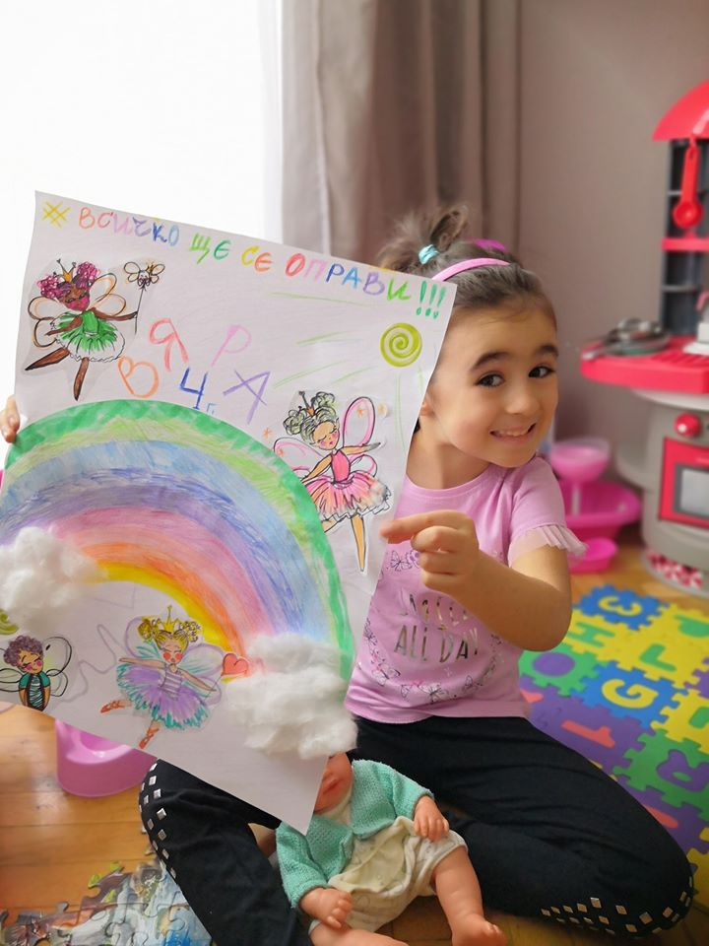
What ICT tools and social media channels we used to improve parents– teachers communication?
Emails To optimize email communication with parents, we create initial relationships with families in-person, we develop, share, and enforce an email policy, we create a plan for managing email: we decide how much time we devote to email.
Conversations on the phone
Different apps and platforms make it easy to communicate with parents via text, videos, teaching resources. Most tools give us the ability to send a message to an individual parent, or a group of parents. (WhatsApp, Messenger)

Slide 6
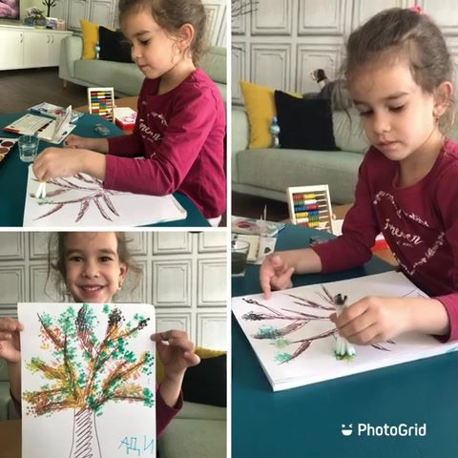
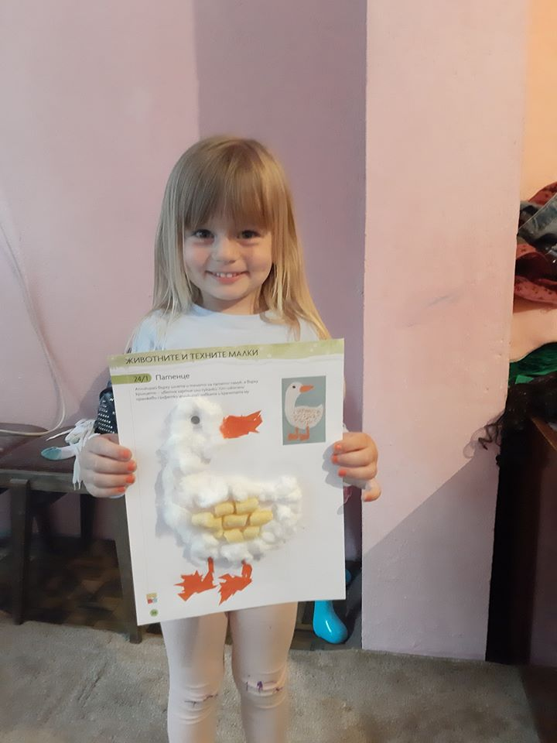
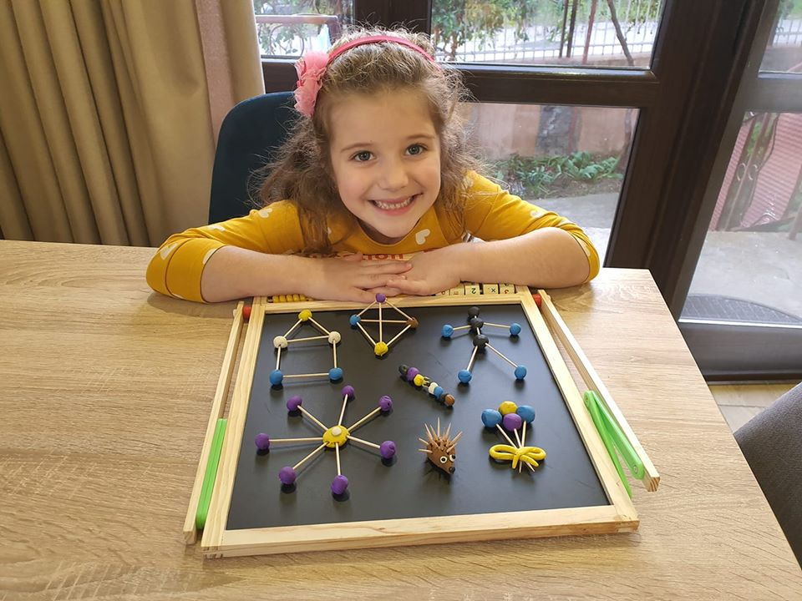
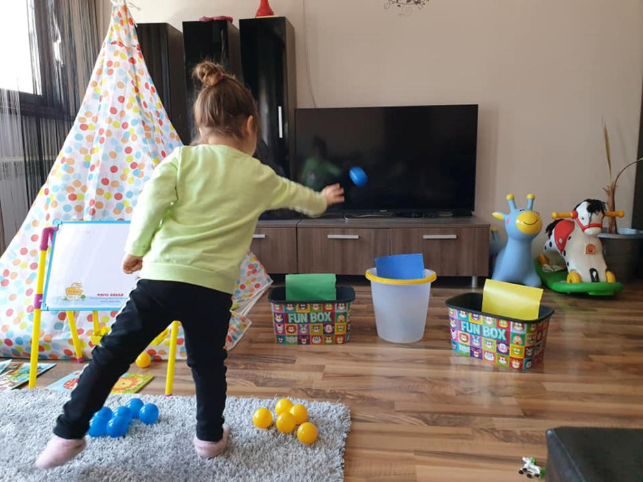
We have created closed Facebook groups in which only parents of children in one class are members.
Communication between parents on the web takes place in many ways, including sending personal messages, invitations to participate in events, sharing photos, text, hyperlinks, videos, feedback, stories, music, songs, participation in various games. Teachers share educational resources that they create.

Slide 7
Teachers used various online educational tools to help children and teaching them in distance platforms for teaching and learning. We have created our own educational resources.
https://www.youtube.com/watch?v=d53A_1QCJMU&feature=youtu.be&ab_channel=RaiaNedelkova
https://www.youtube.com/watch?v=9aY6RLYuHuw&feature=youtu.be&ab_channel=RaiaNedelkova
https://www.youtube.com/watch?v=fYdljKob0kw&feature=youtu.be&ab_channel=RaiaNedelkova
https://www.youtube.com/watch?v=D8Im6qb9R70&feature=youtu.be&ab_channel=RaiaNedelkova
https://www.youtube.com/watch?v=IDObe2MO_WI&feature=youtu.be&ab_channel=RaiaNedelkova
https://www.youtube.com/watch?v=Uv-J-FPyst4&feature=youtu.be&ab_channel=RaiaNedelkova
https://www.jigsawplanet.com/?rc=play&pid=2bc5aae090cf
https://www.jigsawplanet.com/?rc=play&pid=0b595fdbea6b
https://www.youtube.com/watch?fbclid=IwAR0X_PyNs0n8t5ZQgBJHex5xfDdyWHFoH-Rt_CEKS0sYvnO6D0jlWyJNfAc&v=5Uo4KZDUcBQ&feature=youtu.be
https://learningapps.org/display?v=pwoe0o4jc20&fbclid=IwAR2yN90ZxVMMLCXi4PLPxe_Et8rMrCEcbXZm9j-ocWieMFGtuOoaZjBMwfA
https://www.youtube.com/watch?fbclid=IwAR0cU7oa2j1taZyof8htA0sLvlx6N3mIxcL5Ptr9zA0RlCcQkPkX8kVwfPA&v=EK8UGHWtyqY&feature=youtu.be
https://bookcreator.com/resources-for-teachers/kindergarten/
https://www.jigsawplanet.com/?rc=play&pid=2e87282670bf&fbclid=IwAR1Kbmp5-uIdqEKBdYZfqO-mahq1w6Vv3ccRaCgoiCvuhjA8DuNxfjawpoM
http://krokotak.com/2018/03/koledna-dekoratsiya/?fbclid=IwAR3_s1M53QokrGUDEgXMkuuAm4YUAd6HVdteXqVstcwCfhZLGof9Ps2_qcA
https://www.easypeasyandfun.com/paper-ball-garland/?fbclid=IwAR3e1KFel7_kJWf180VFalb0rqa3gcoTqTX1Lf8TV160W-Pyl2P2OrfZmXg
http://roditel.bg/
http://purvite7.bg/7-idei-za-letni-zanimaniya-stimulirashhi-razvitieto-na-detsata/

Slide 8
Here are some practices – ICT tools for distance learning
Educational resources created by the teacher
https://www.youtube.com/watch?v=p4K0YFQOFrc&feature=youtu.be&ab_channel=RaiaNedelkova
https://www.youtube.com/watch?v=4dwGqwykwJE&fbclid=IwAR18rOw3VVfIo1ieKOIzR6sCo3zOMN5LLpjqcoeZ4Cii872c4NkX0OJkv7E
https://www.facebook.com/1969m/videos/2938360279721046
specialized educational platforms
https://www.dechica.com/
https://ucha.se/?gclid=CjwKCAiAxp-ABhALEiwAXm6IydkRz87ioz_EpGrgScXEMXZe0w3sNCKBpq00V6MEbBj0DNjCXSCQ0RoC_80QAvD_BwE
Learning Apps
games
https://www.jigsawplanet.com/?rc=play&pid=2e87282670bf&fbclid=IwAR1Kbmp5-uIdqEKBdYZfqO-mahq1w6Vv3ccRaCgoiCvuhjA8DuNxfjawpoM
https://learningapps.org/display?v=pwoe0o4jc20&fbclid=IwAR2yN90ZxVMMLCXi4PLPxe_Et8rMrCEcbXZm9j-ocWieMFGtuOoaZjBMwfA
Video story presented by the teacher
https://www.facebook.com/lora.stefanova.7/videos/4843666152342762

Slide 9
Here are websites with teaching resources that we used for distance education
ttps://www.naeyc.org/resources/pubs/yc
http://roditel.bg/
http://purvite7.bg/7-idei-za-letni-zanimaniya-stimulirashhi-razvitieto-na-detsata
http://teacher.scholastic.com/products/ect/index.html
https://bookcreator.com/resources-for-teachers/kindergarten/
https://www.jigsawplanet.com/?rc=play&pid=2e87282670bf&fbclid=IwAR1Kbmp5-uIdqEKBdYZfqO-mahq1w6Vv3ccRaCgoiCvuhjA8DuNxfjawpoM
https://learningapps.org/display?v=pwoe0o4jc20&fbclid=IwAR2yN90ZxVMMLCXi4PLPxe_Et8rMrCEcbXZm9j-ocWieMFGtuOoaZjBMwfA

Slide 10
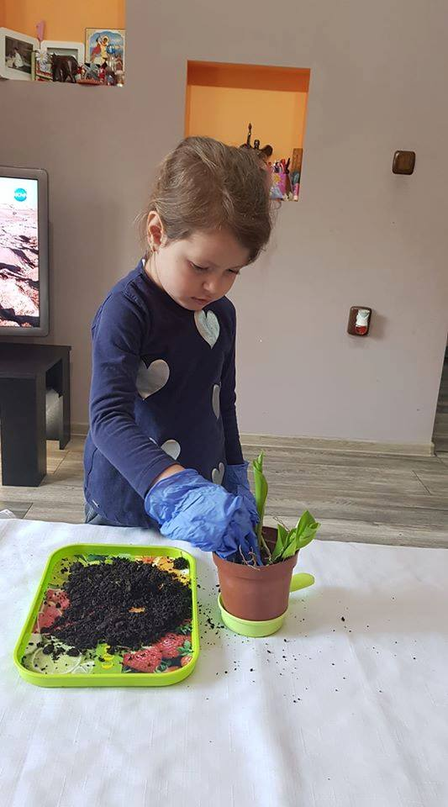
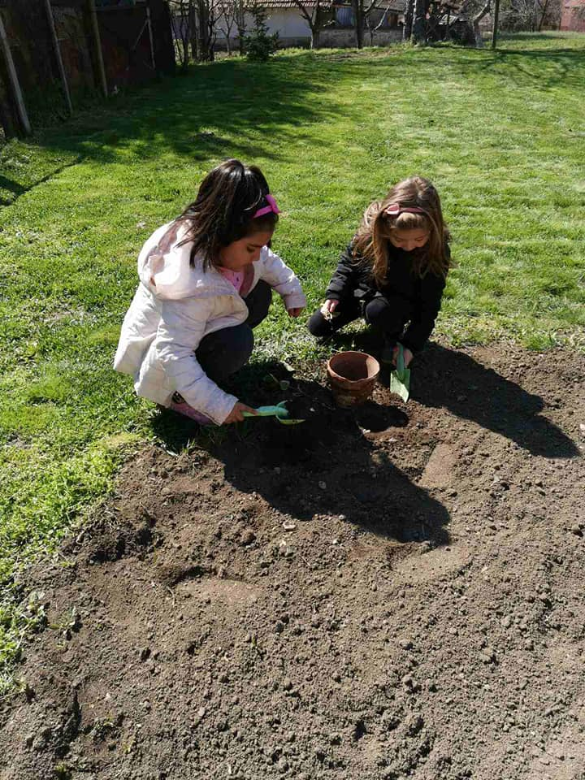
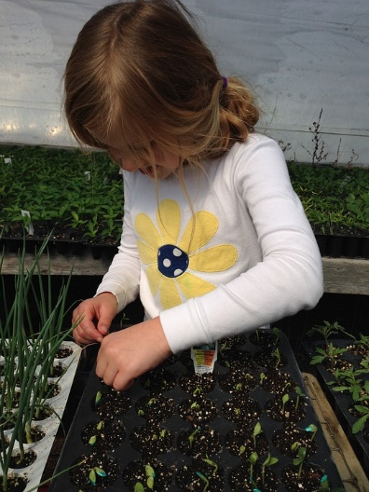
We share resources for environmental campaigns and empathy for community issues
https://www.facebook.com/thepetcollective/videos/691385285083589
https://gorata.bg/
https://bspb.org/
https://plushenomeche.org/

Slide 11
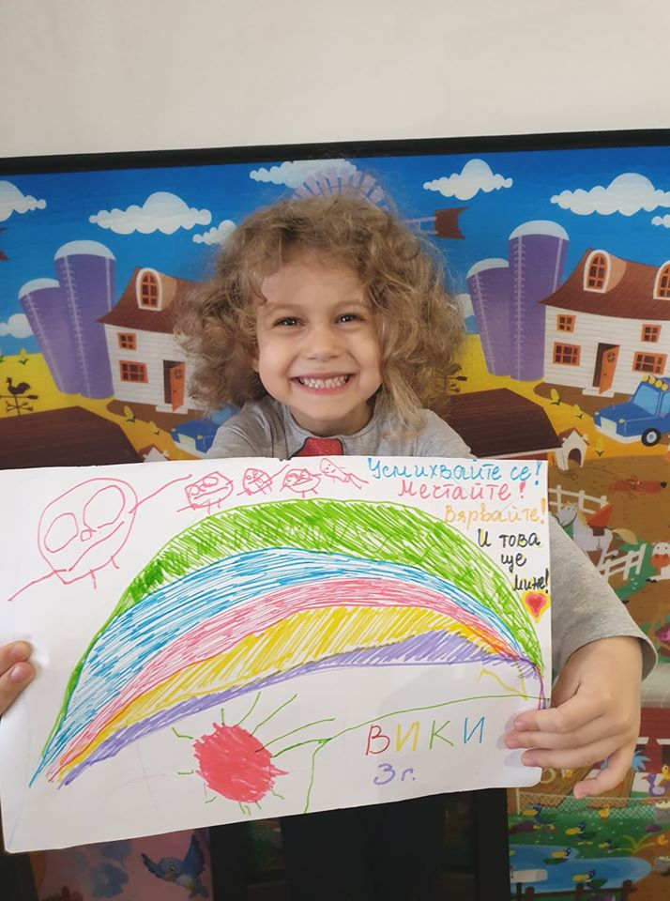
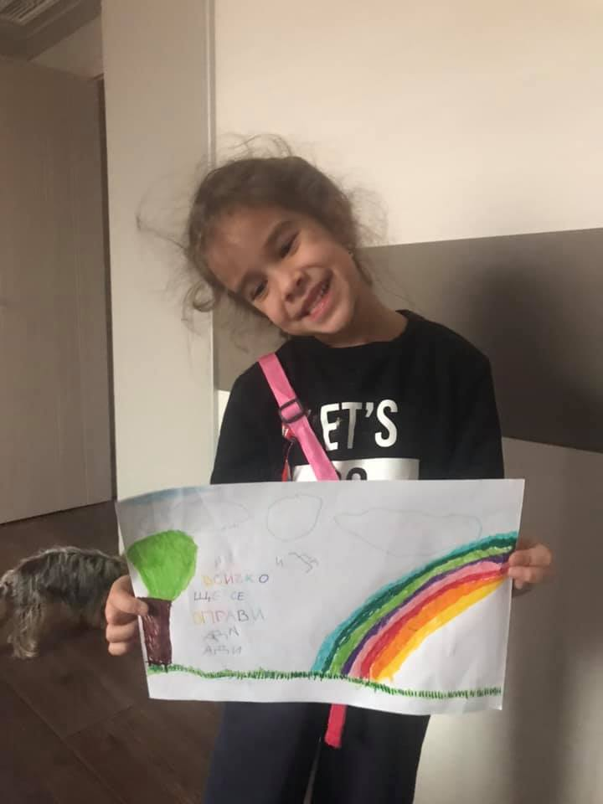
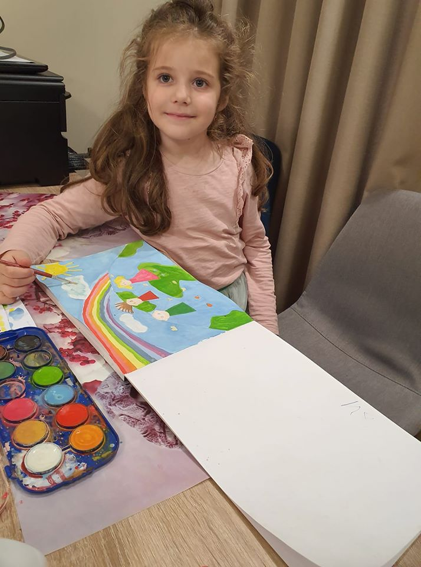
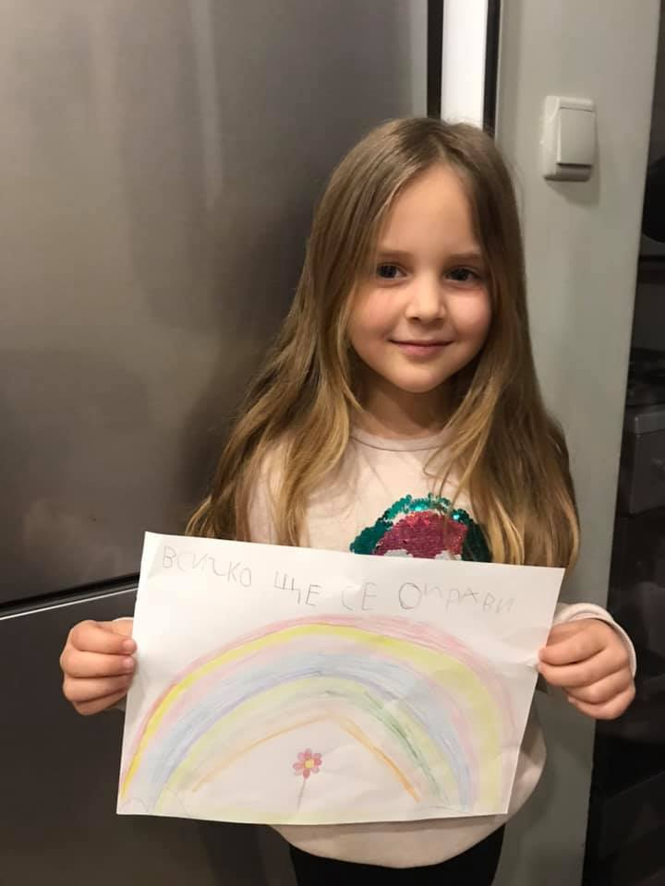
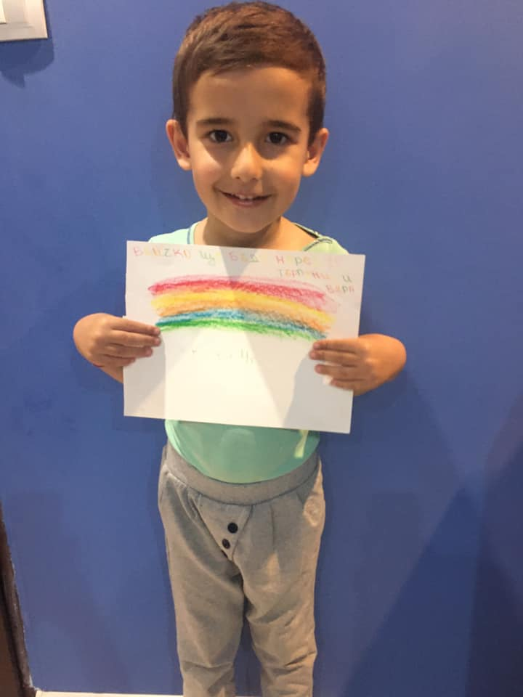
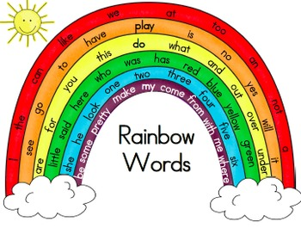
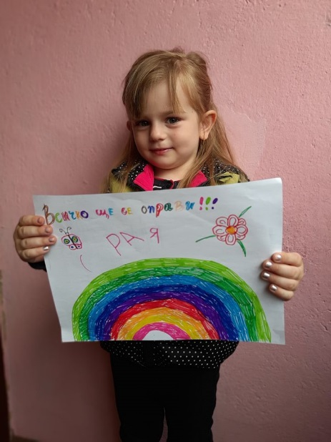
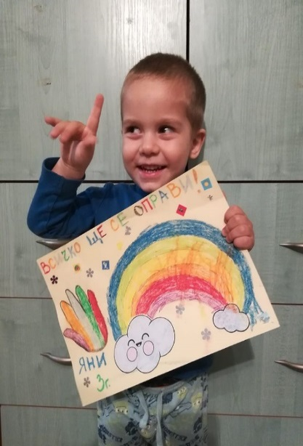
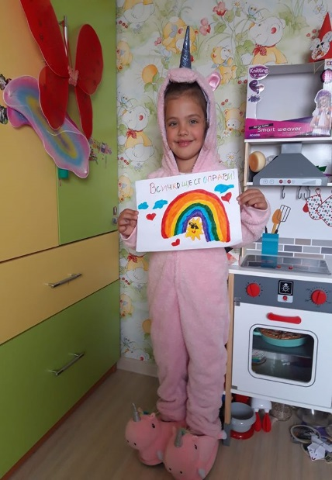
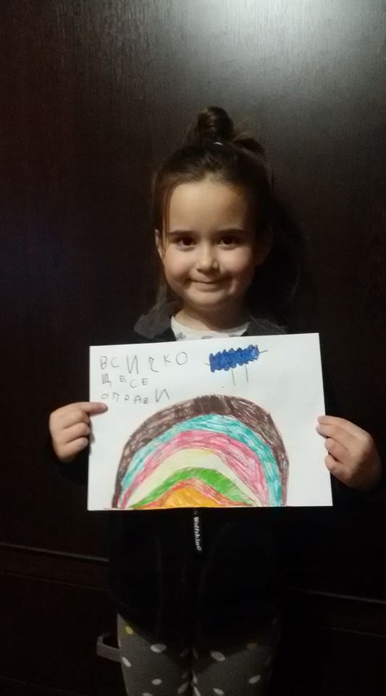
The children spread hope and kindness by continuing the initiative "Everything will be fine“.

Slide 12
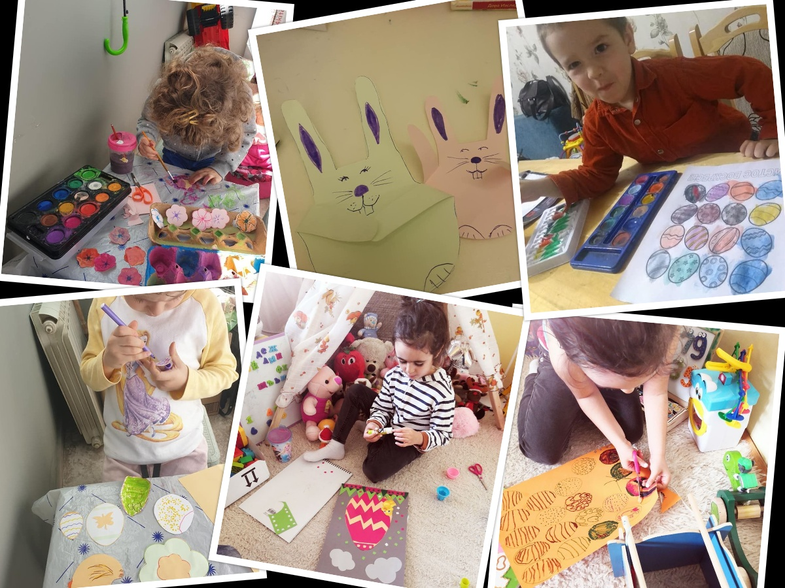
We would like to use the ZOOM and Google Meet for parent meetings and special events!
We give parents the transparency they deserve.
We found that it paid to be proactive!

