Slide 1
Teachers’ high quality feedback to parents - key to a successful child's development.

Slide 2
Kindergarten of Elateia.
Greece.
ICT tools .

Slide 3
SCH.MAIL ,is the number one tool for teachers in Greece to communicate to each other and with parents.
It ‘s provided from the Greek Ministry of education and ensures that everything is safe as it is about children and the school.

Slide 4
E-ME, and E-CLASS are platforms provided also from the Ministry of education where every teacher can create his or her classroom environment and you need to log-in to be part of it.

Slide 5
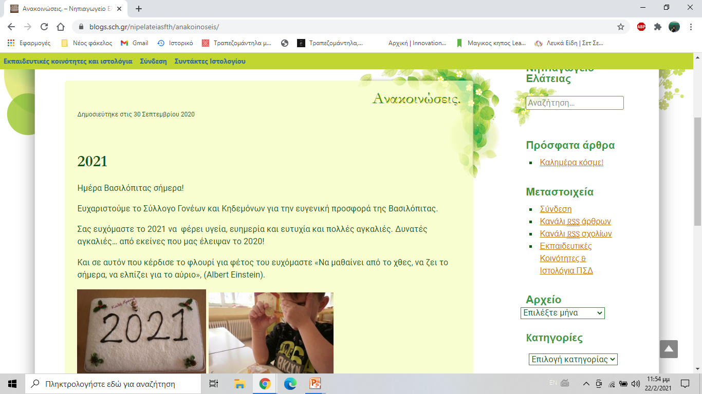
The Ministry also provides, every school and teacher, with the opportunity to create a blog or a personal webpage and this our blog for the school.

Slide 6
Our video conferences during the pandemic were carried out only through “webex” platform for all the public schools.
(The Greek Ministry of Education provides all the necessary tools for the teachers and the students, to ensure that they are safe , as there are very strict laws for the personal data especially for the students.)

Slide 7
We also use :
Google mail, Google Forms,
Google docs, Google calendar.
Padlet,
Wordwall,
Jigsaw puzzle,
Kahoot,
Artsteps,
Canvas,
Microsoft,
You Tube.

Slide 8
Kindergarten of Elateia.

