Slide 1
March 2021-Activities School Profesionala Tiberiu Morariu Salva
Erasmus+Project:
"High quality feedback – the key to successful cooperation between teachers and parents in preschools" (No:2020-1-LT01-KA229-077868)

Slide 2
March Activities
1
#8 March-Mother Day
2
# 100 books
3
# Dissemination activities

Slide 3
#8 March-Mother Day

Slide 4
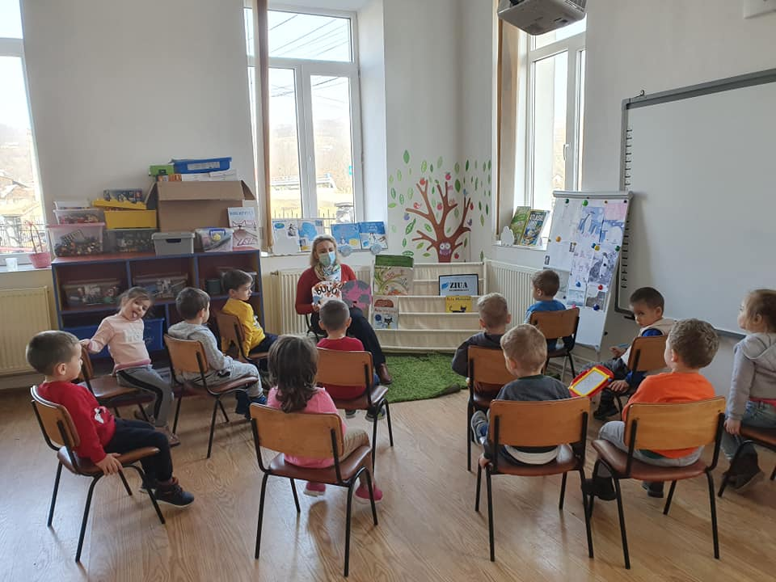
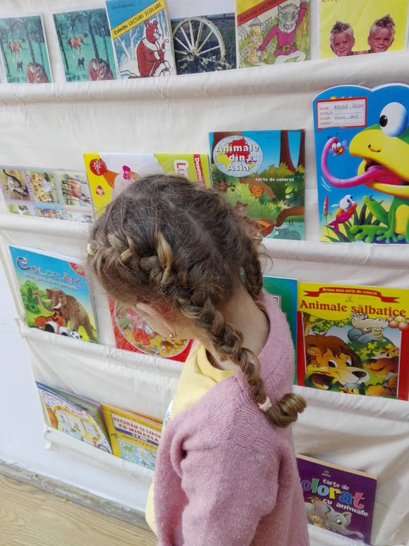
# 100 books

Slide 5
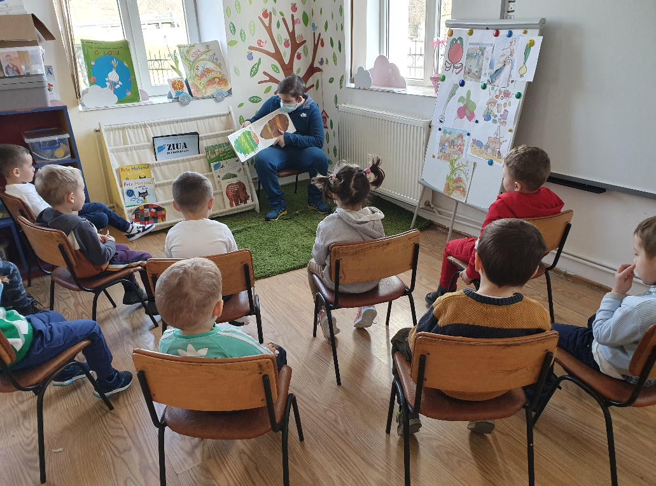
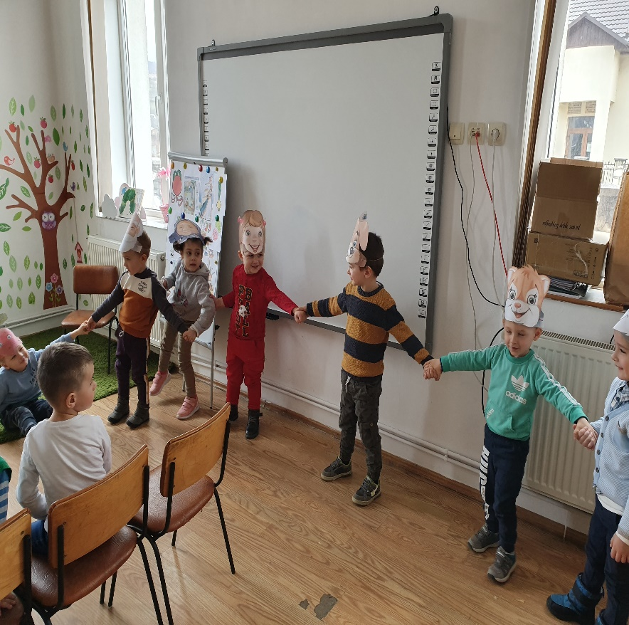
# 100 books

Slide 6
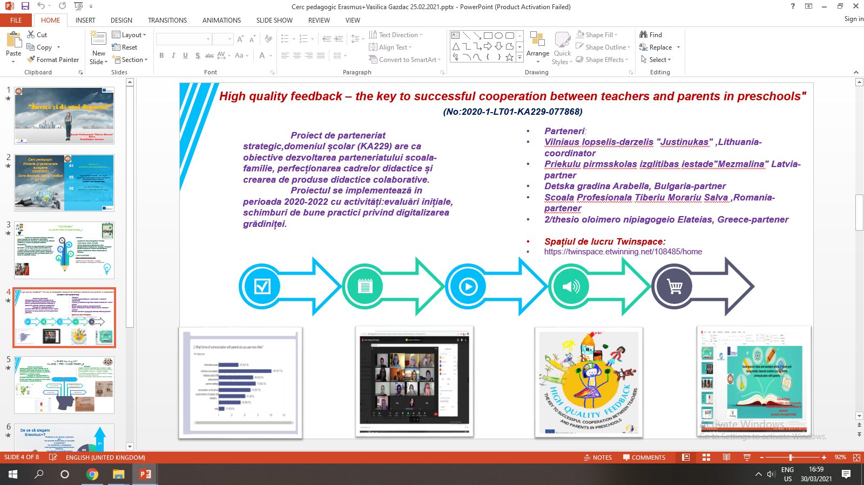
# Dissemination activities

Slide 7
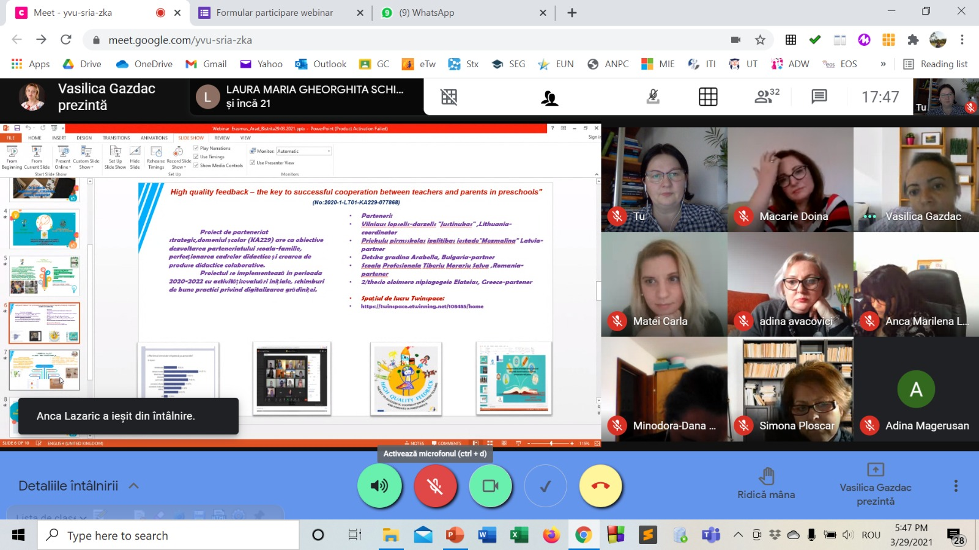
# Dissemination activities

Slide 8
School Profesionala Tiberiu Morariu Salva
“The European Commission support for the production of
this publication does not constitute an endorsement of the
contents which reflects the views only of the authors,
and the National Agency and Commission cannot be held responsible for any use which may be made of the information contained therein”.
Made by Romania Team ( Vasilica Gazdac and Crina Linul)
Thank you for your attention!

