Slide 1
Kindergarten Mežmaliņa, Priekuļi, Latvia
ICT tool usage amongst teachers

Slide 2
Do you use ICT tools?
Yes, but rare (28,6%)
Always (28,6%)
Sometimes (42,9%)

Slide 3
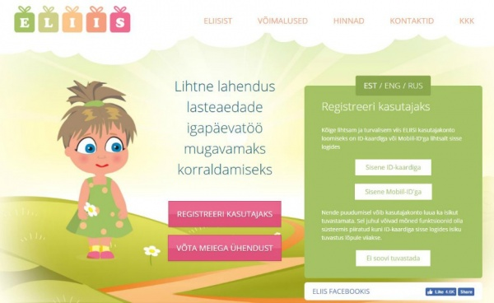
Which ICT tools do you use?
School electronic diary (ELIIS)
Google (gmail, documents, calendar, photo)
Padlet
Microsoft ( Word, Excel, Team, Powerpoint)
ZOOM

Slide 4
In what purpose do you use ICT tools?
Feedback from parents – 7,1%
Feedback for parents – 7,1%
Information exchange – 35.7%
All earlier given answers – 50%

Slide 5
Which are most popular ICT tools you use for feedback to parents?
School electronic diary– 7,7%
WhatsApp– 76, 9%
Facebook– 7,7%
E-mail – 7,7 %

Slide 6
How do you describe your skills with ICT tools/social networks by providing feedback?
Very high – 1 (7.1%)
High – 3 (21.4%)
Weak – 2 (14.3%)
Average – 8 (57.1%)

Slide 7
What help would be needed to improve professional qualifications for working with ICT tools and social networks?
Improve Excel 5%
ICT courses about how to use the latest ICT programs, tools, ectr. 5%
Practical seminar (no knowledge of ICT tools or social networks use) 15%
Professional workshop (has knowledge of use, but wants to learn at profesional level) 60%

