Slide 1
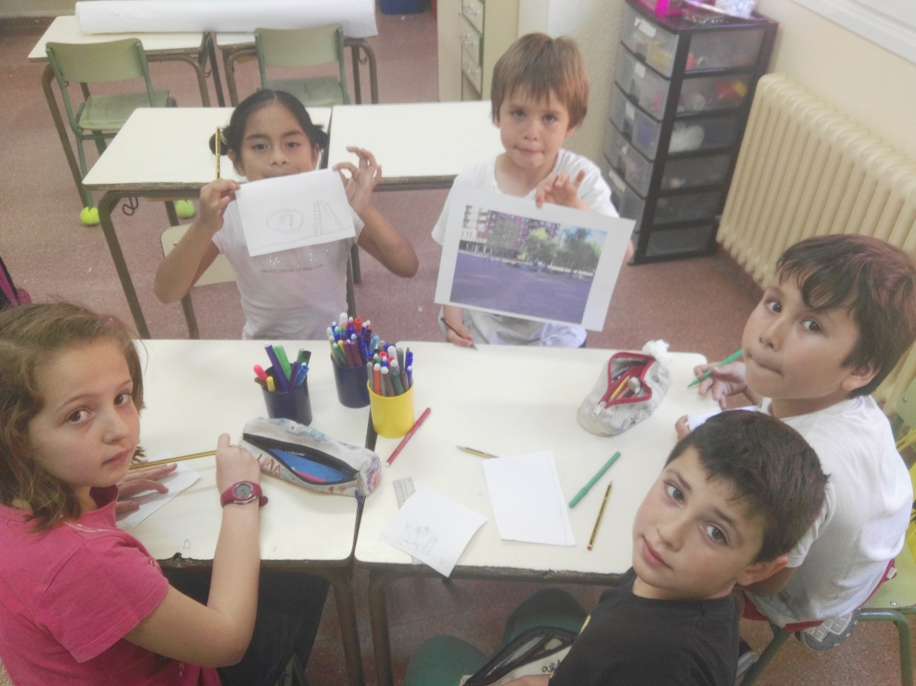
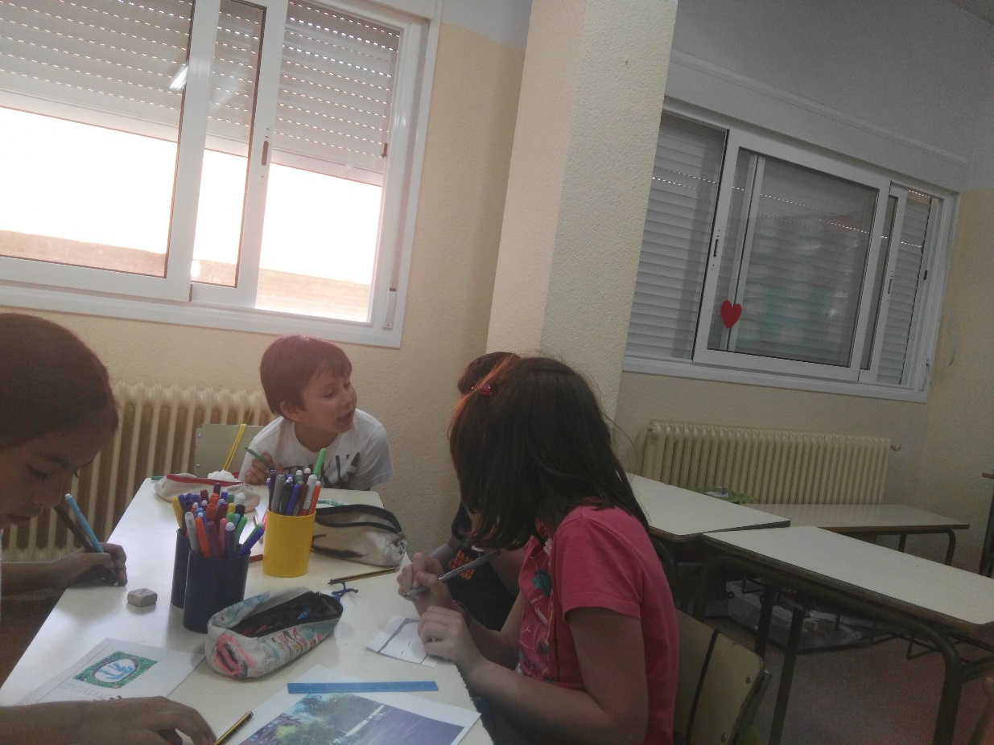
TRES CANTOS IN THE FUTURE WORKSHOP

Slide 2
TRES CANTOS TODAY

Slide 3
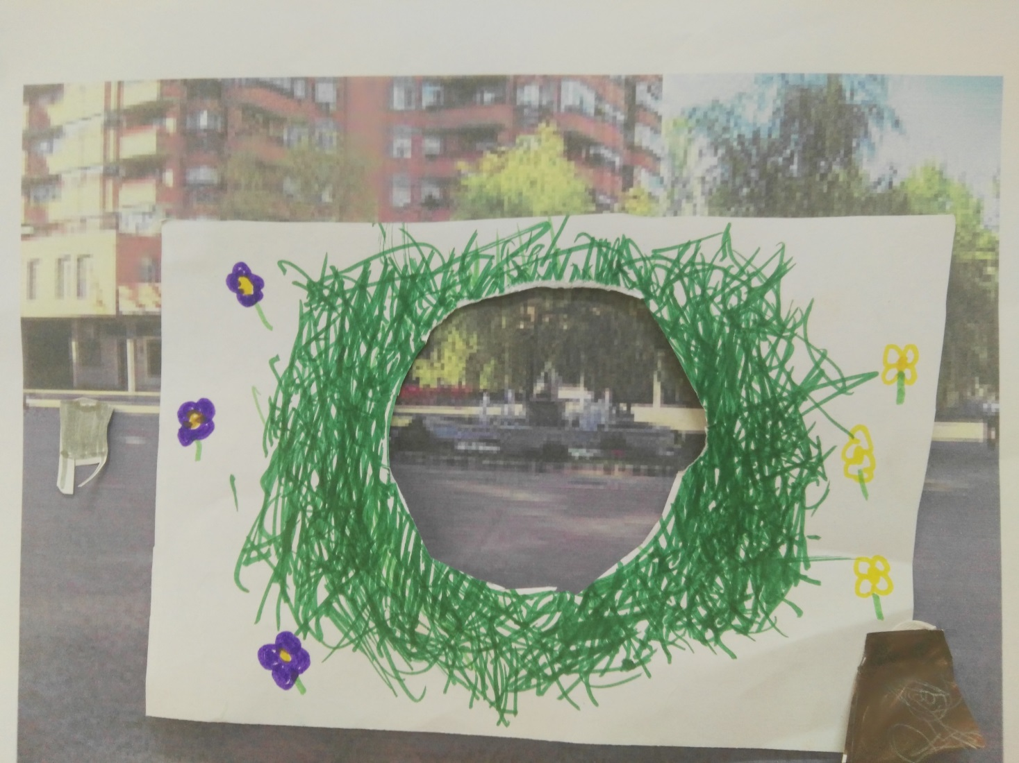
RUBBISH BINS SQUARES: PLANTS AND FLOWERS

Slide 4
PARKS, FOUNTAINS, …

Slide 5
WE HAD A LOT OF FUN

