Slide 1
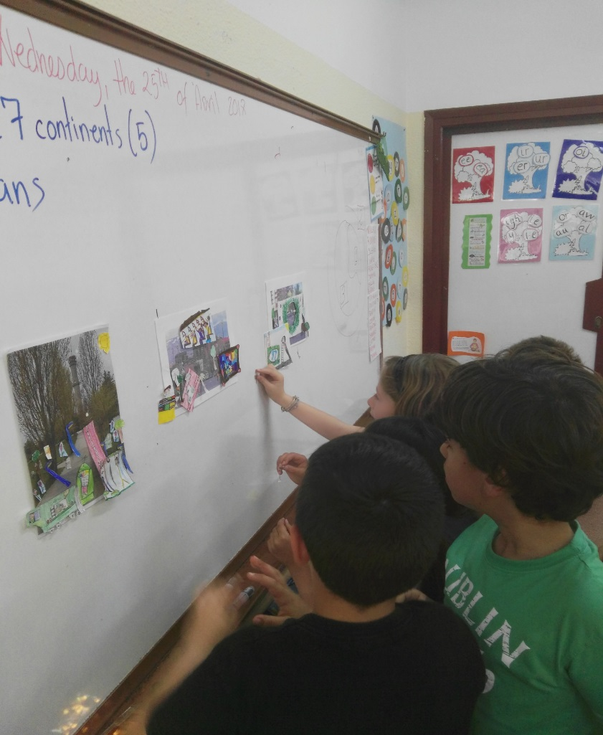
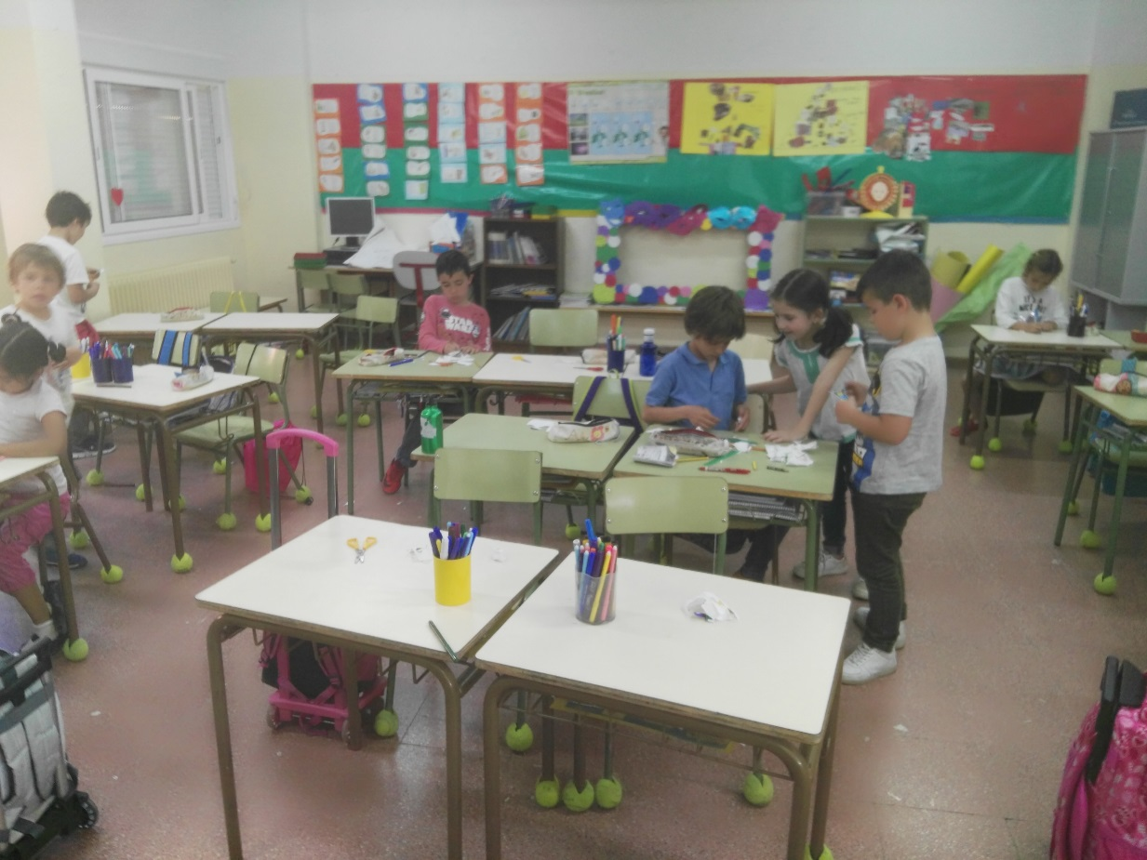
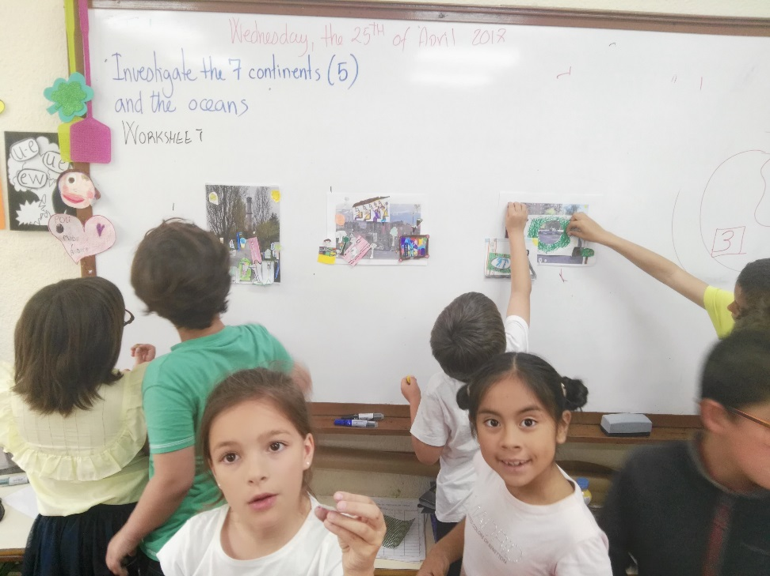
TRES CANTOS IN THE FUTURE WORKSHOP

Slide 2
TRES CANTOS TODAY

Slide 3
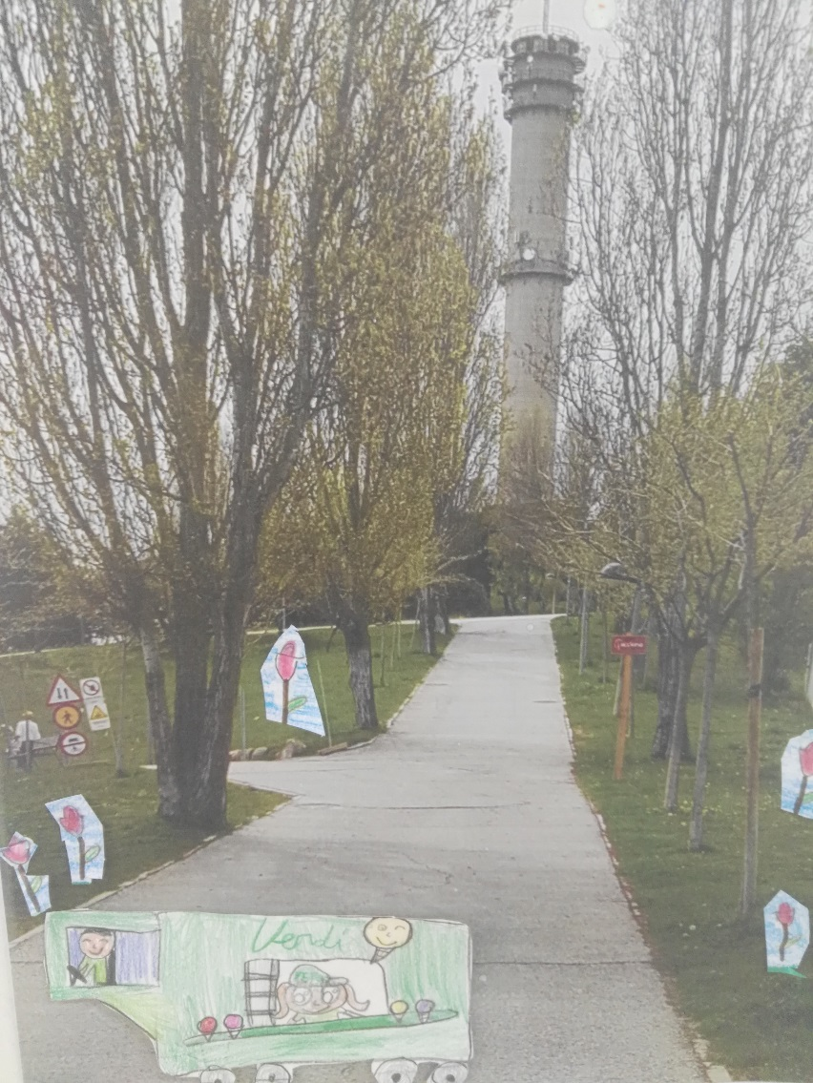
WE WANT MORE PLANTS IN OUR CITY AND ALSO A KIOSK TO BUY CANDY, ICE-CREAMS, WATER,….

Slide 4
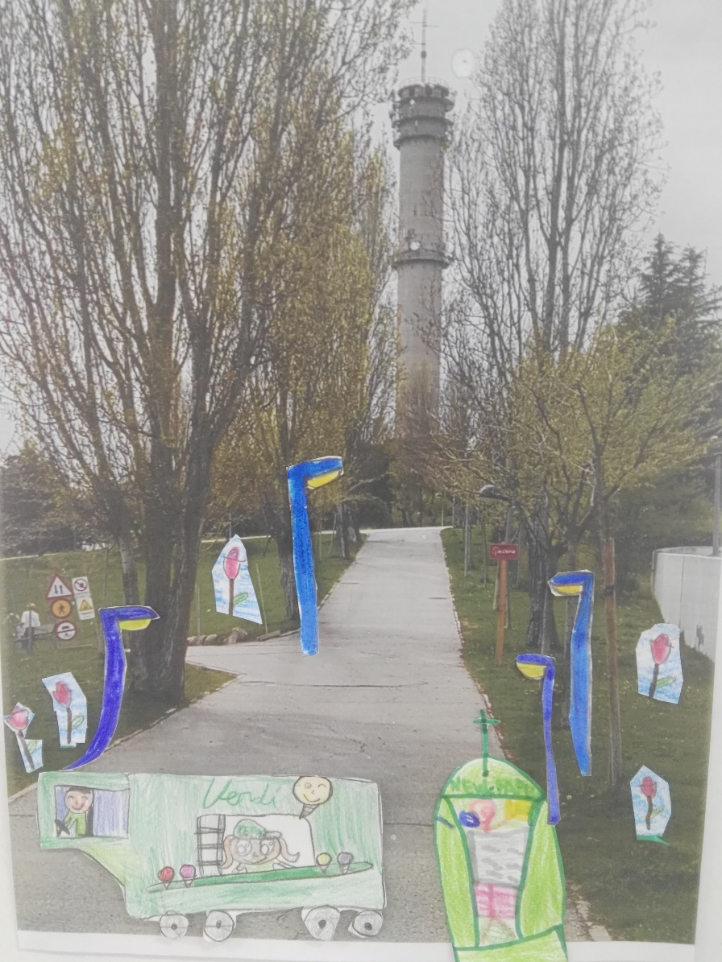
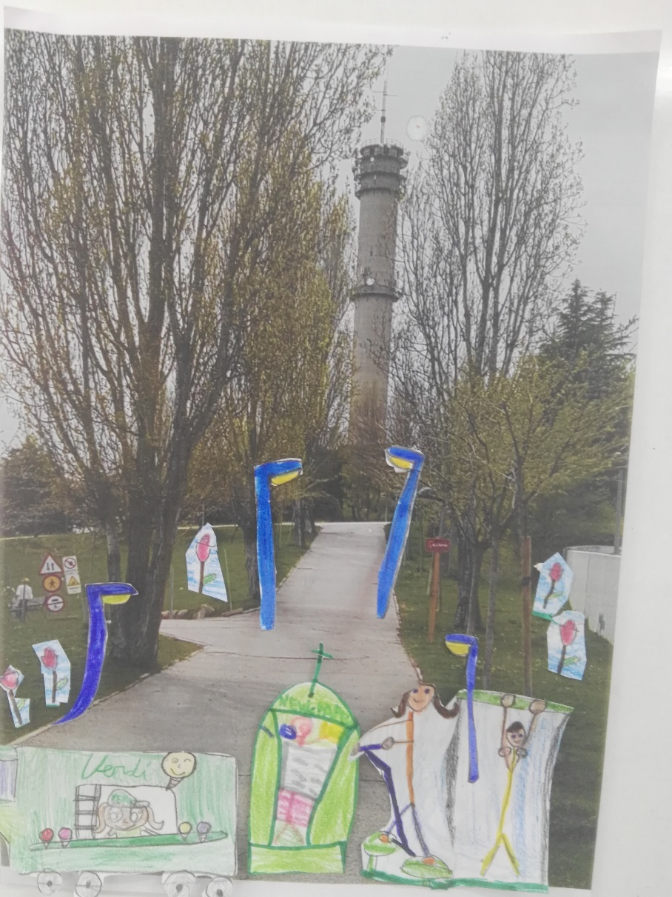
WE WILL ADD: STREET LIGHT RUBBISH VINS OUTDOOR GYM

Slide 5
