Slide 1
Pictures with families
And how we turned them into photos.

Slide 2
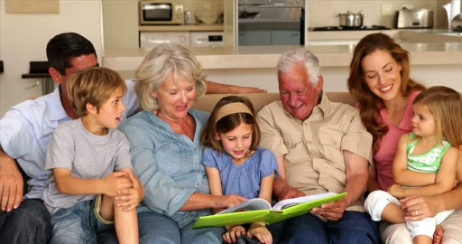
Grandparents and parents watching a photo album with their children.

Slide 3
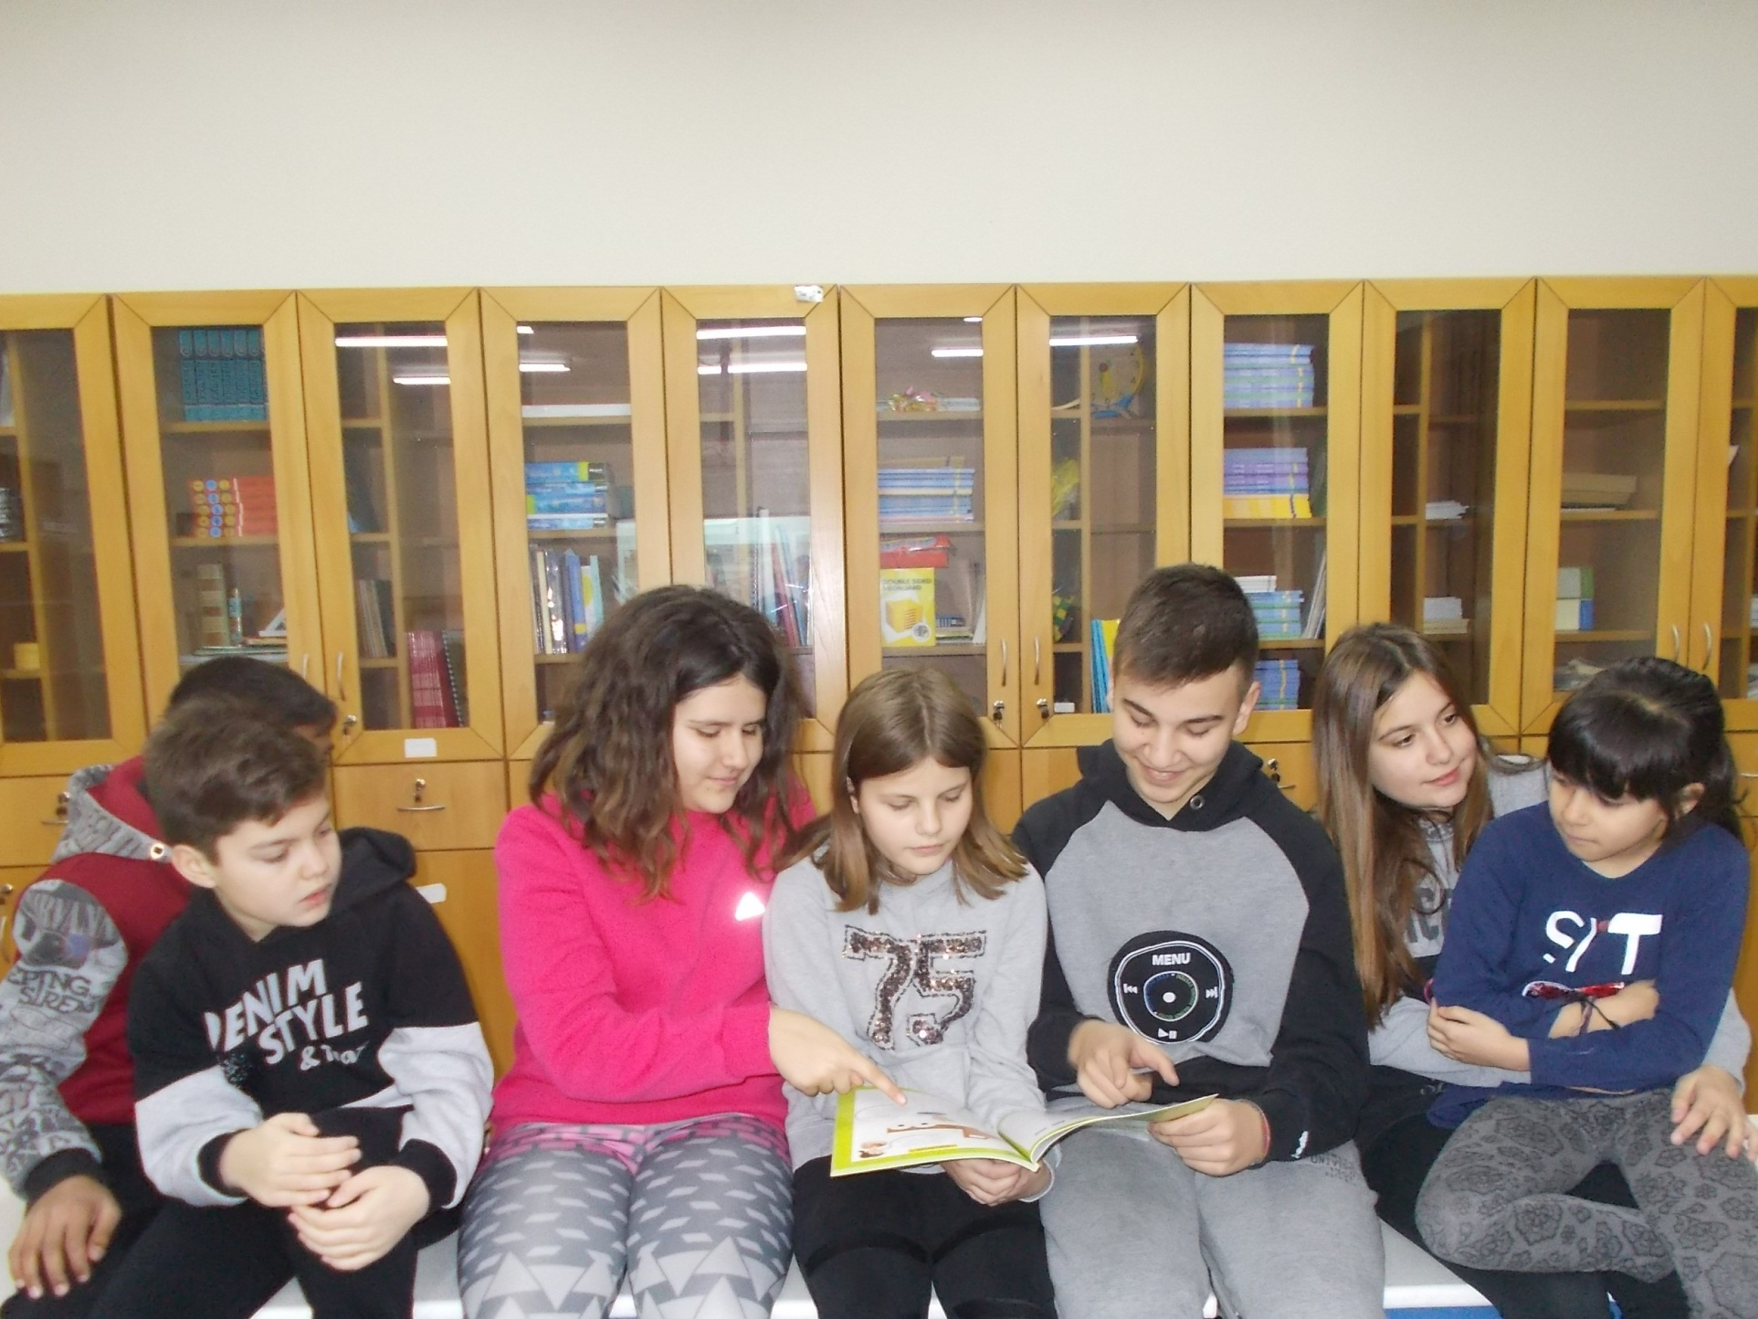

Slide 4
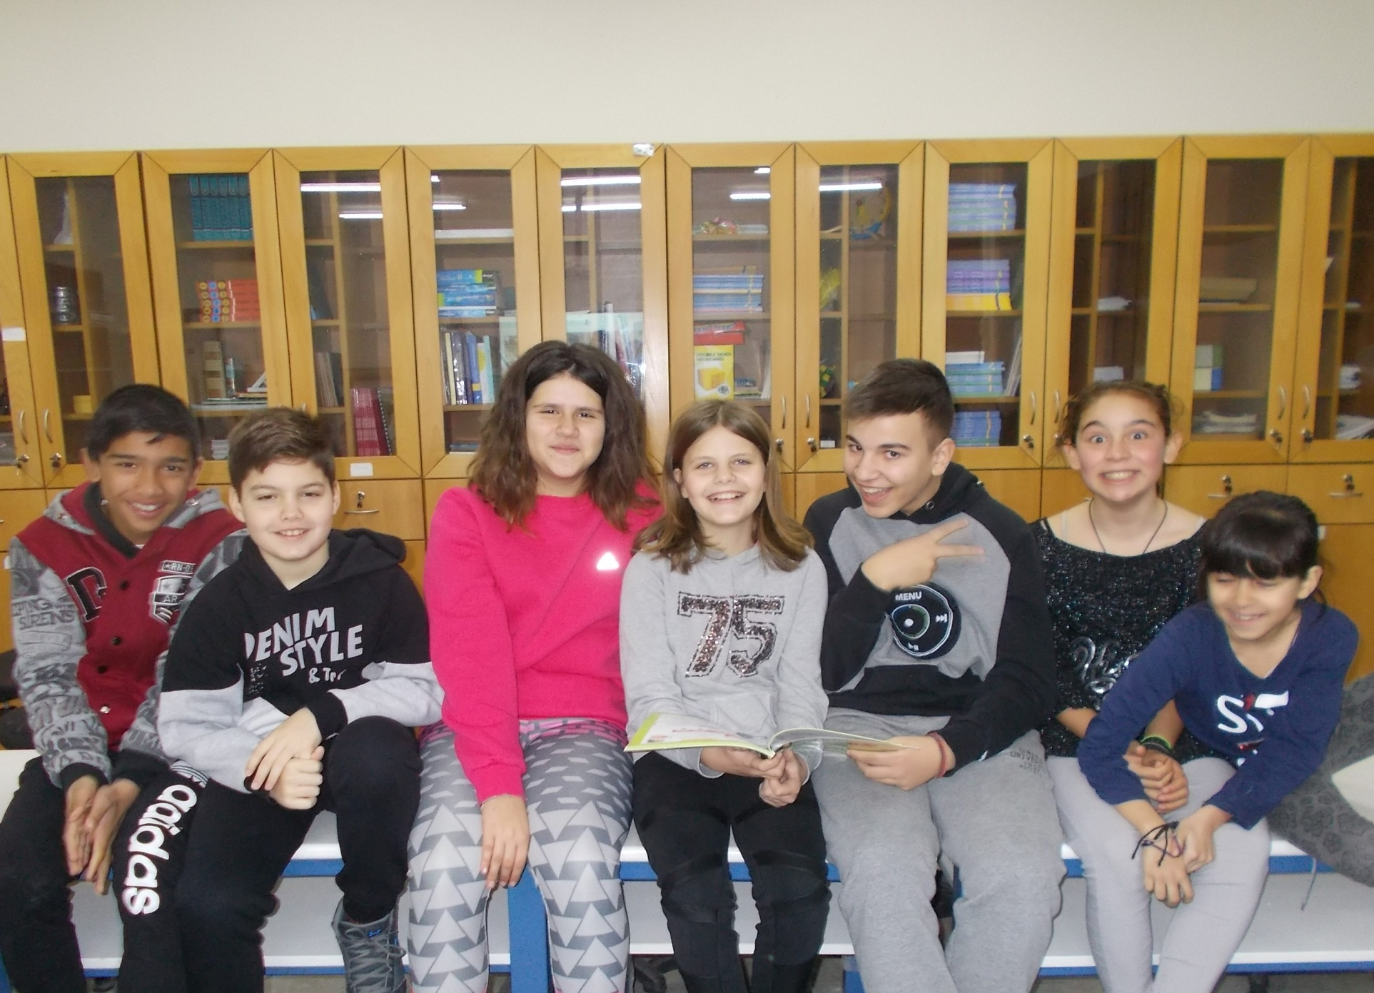
Now the father can be seen. Different mother.

Slide 5
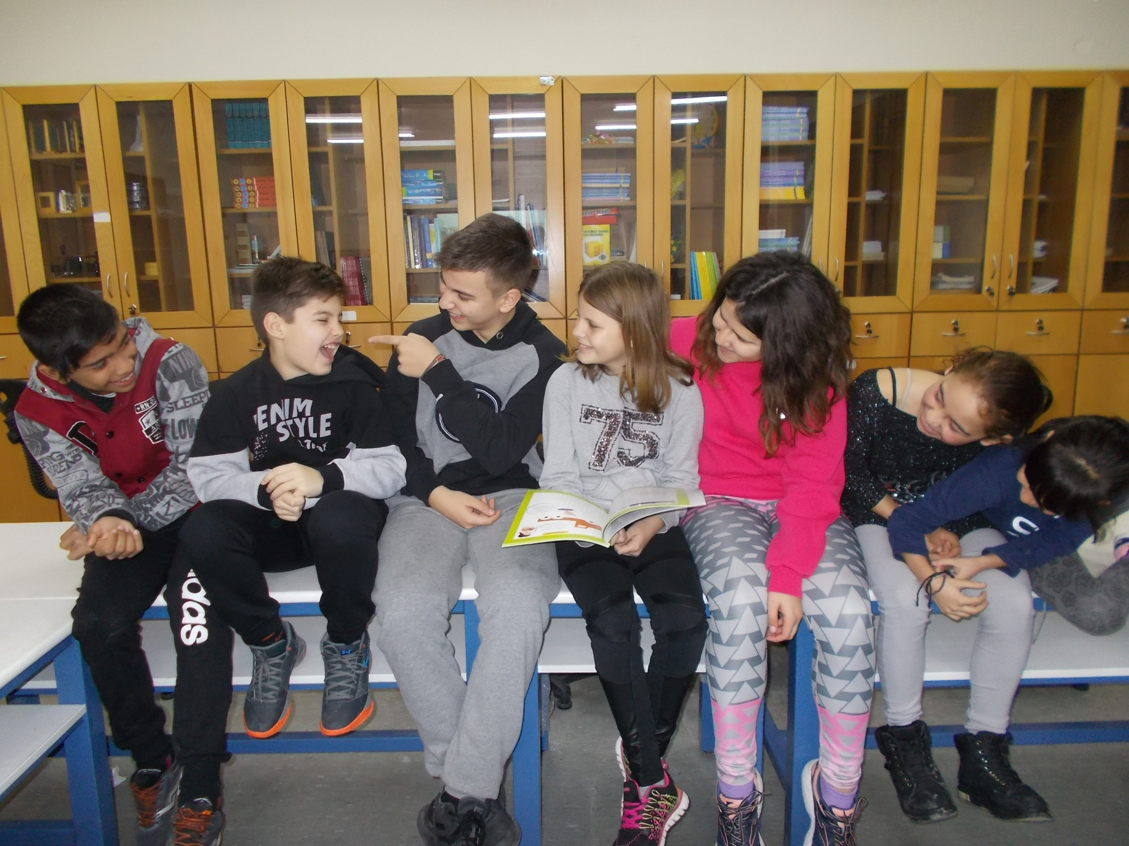
They are all laughing at what the boy said.

Slide 6
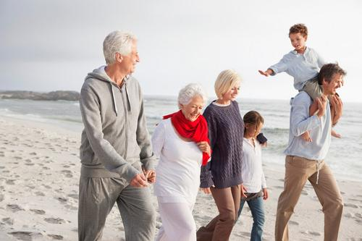
Grandparents, parents and children walking on the beach.

Slide 7
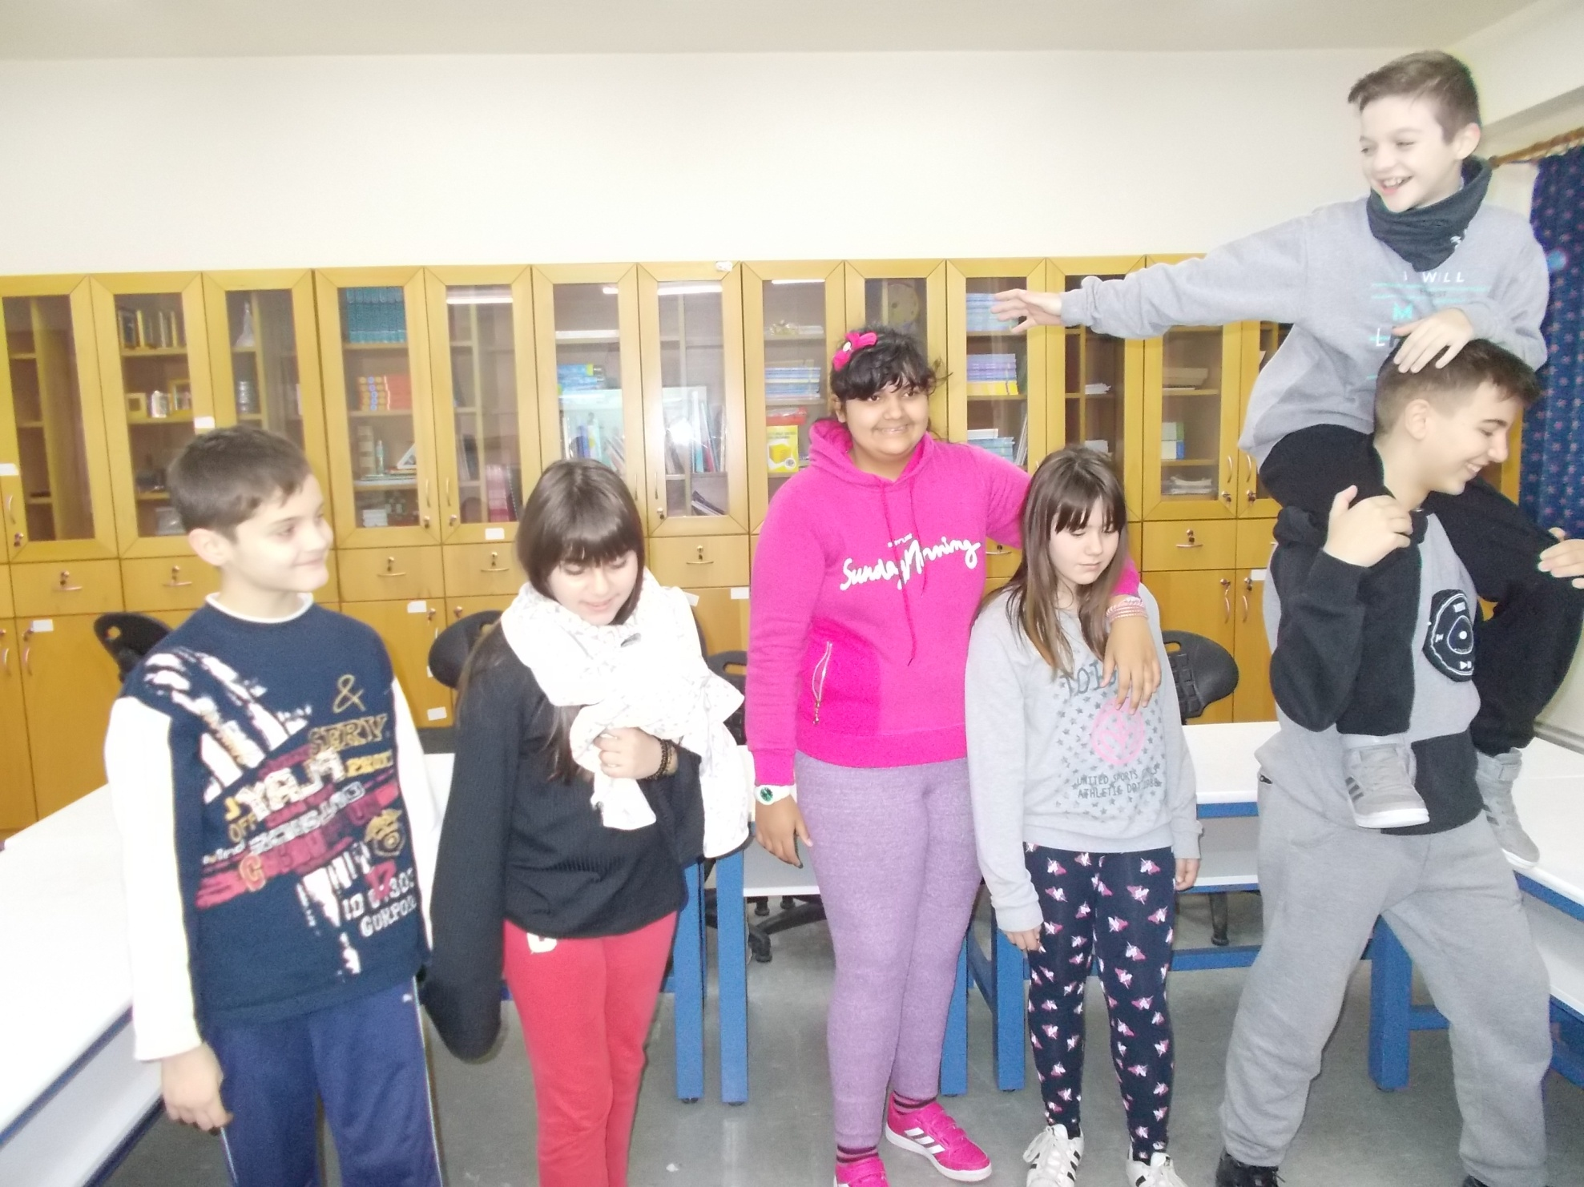

Slide 8
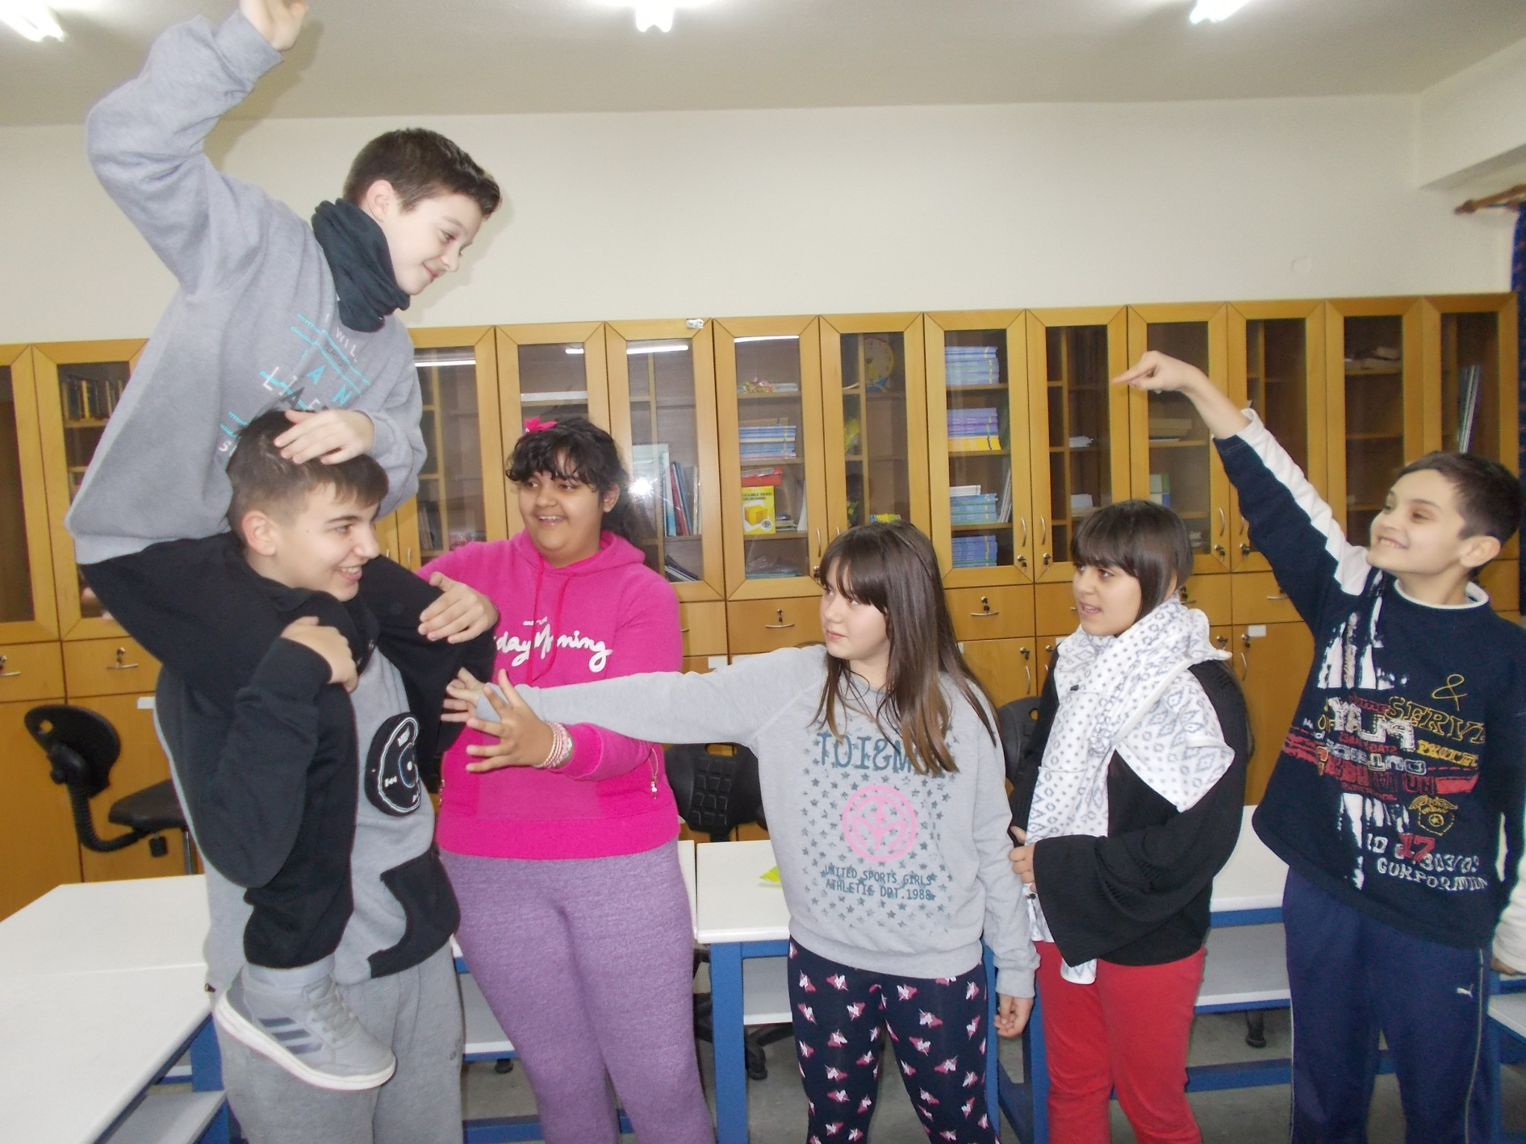
Now the girl wants to get on father’s back.

Slide 9
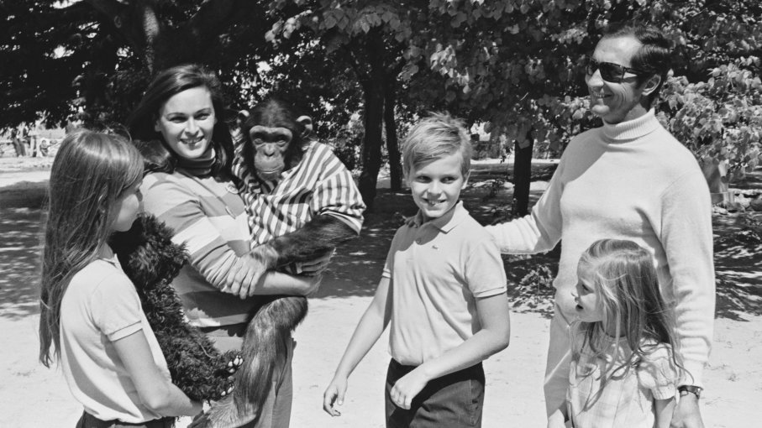
A family that loves animals.

Slide 10
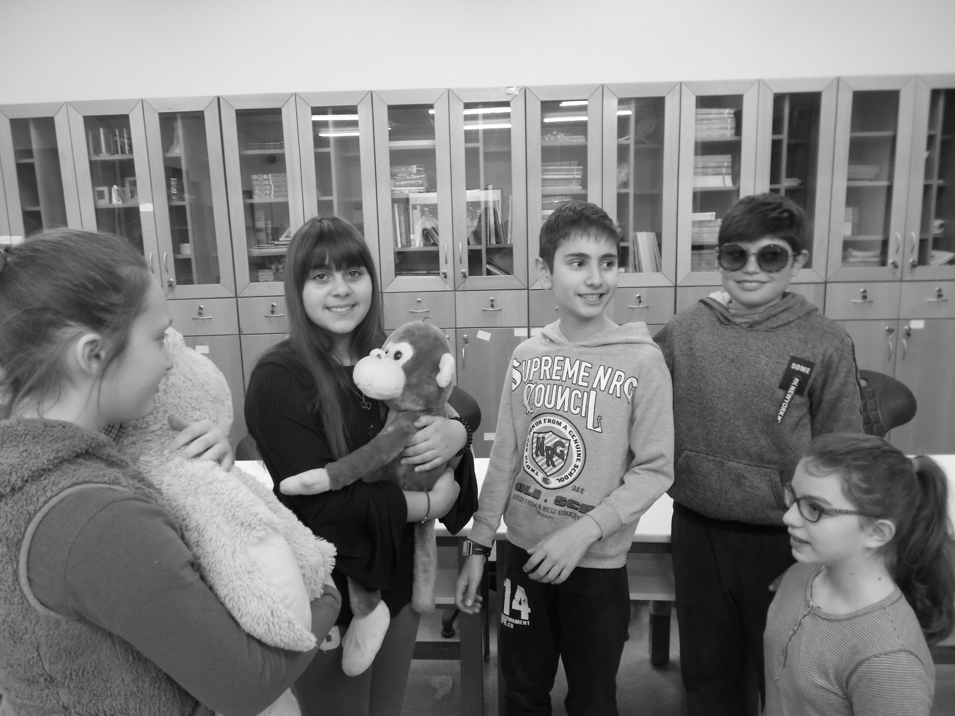

Slide 11
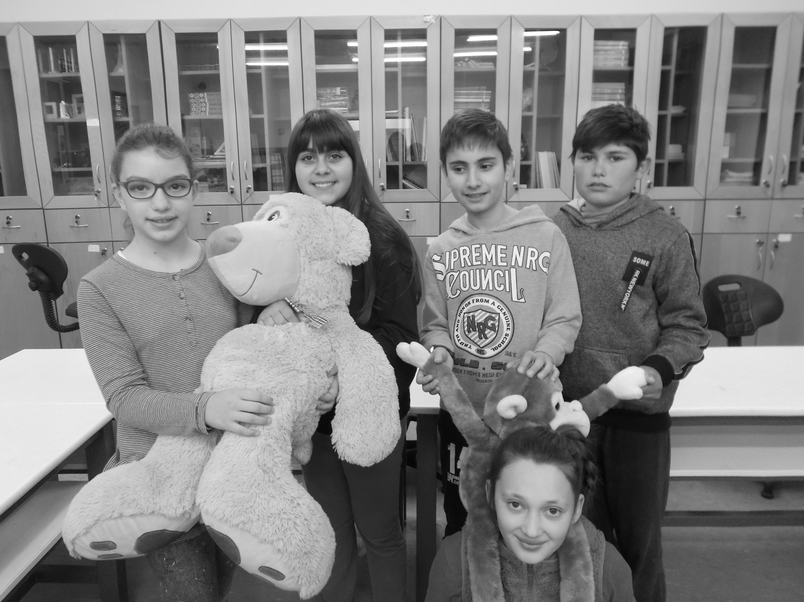

Slide 12
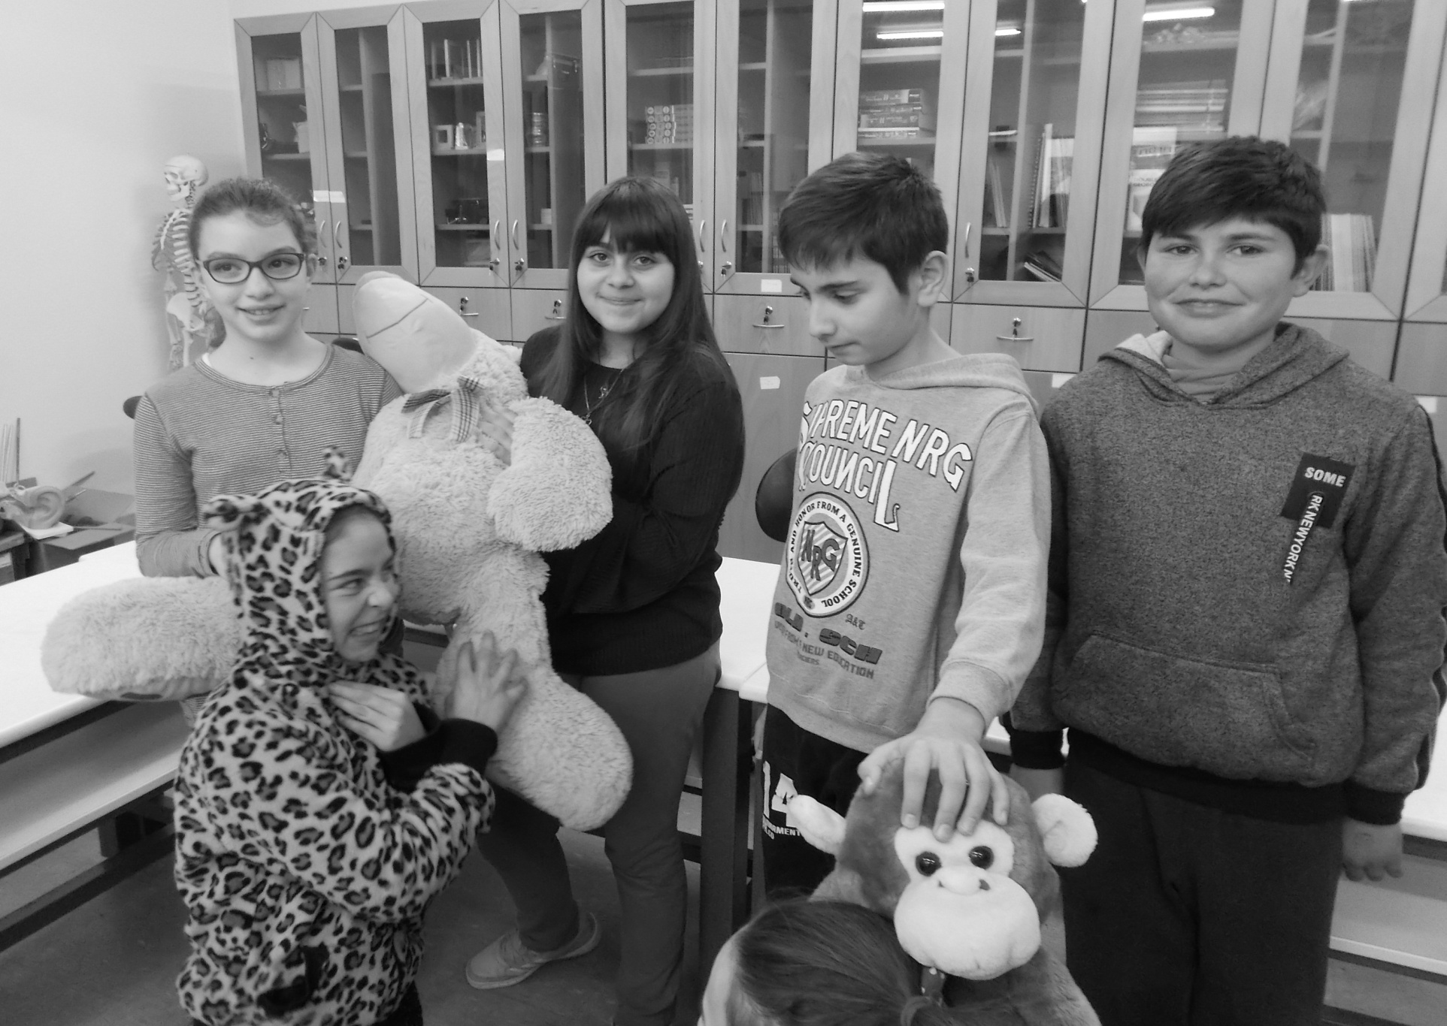
A new little “cat” enters the family.

Slide 13
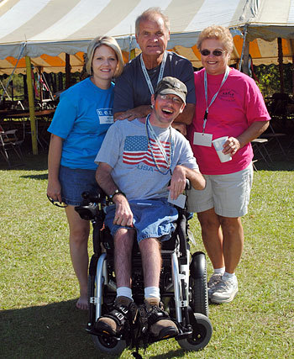
A family with a member with special needs.

Slide 14
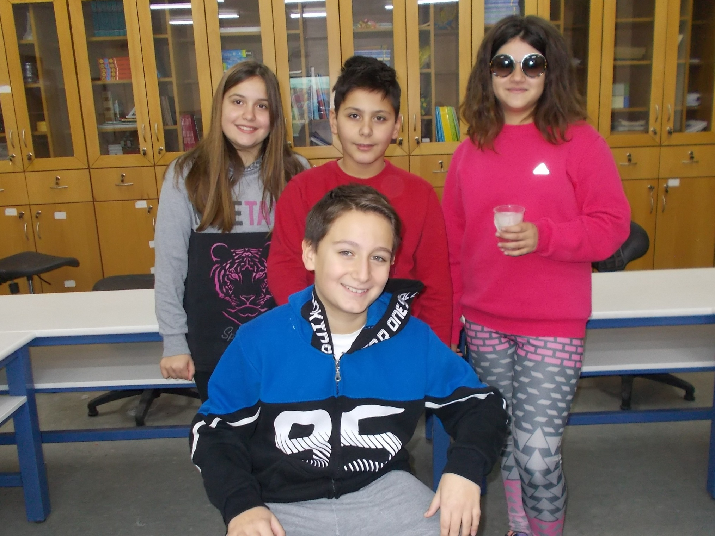

Slide 15
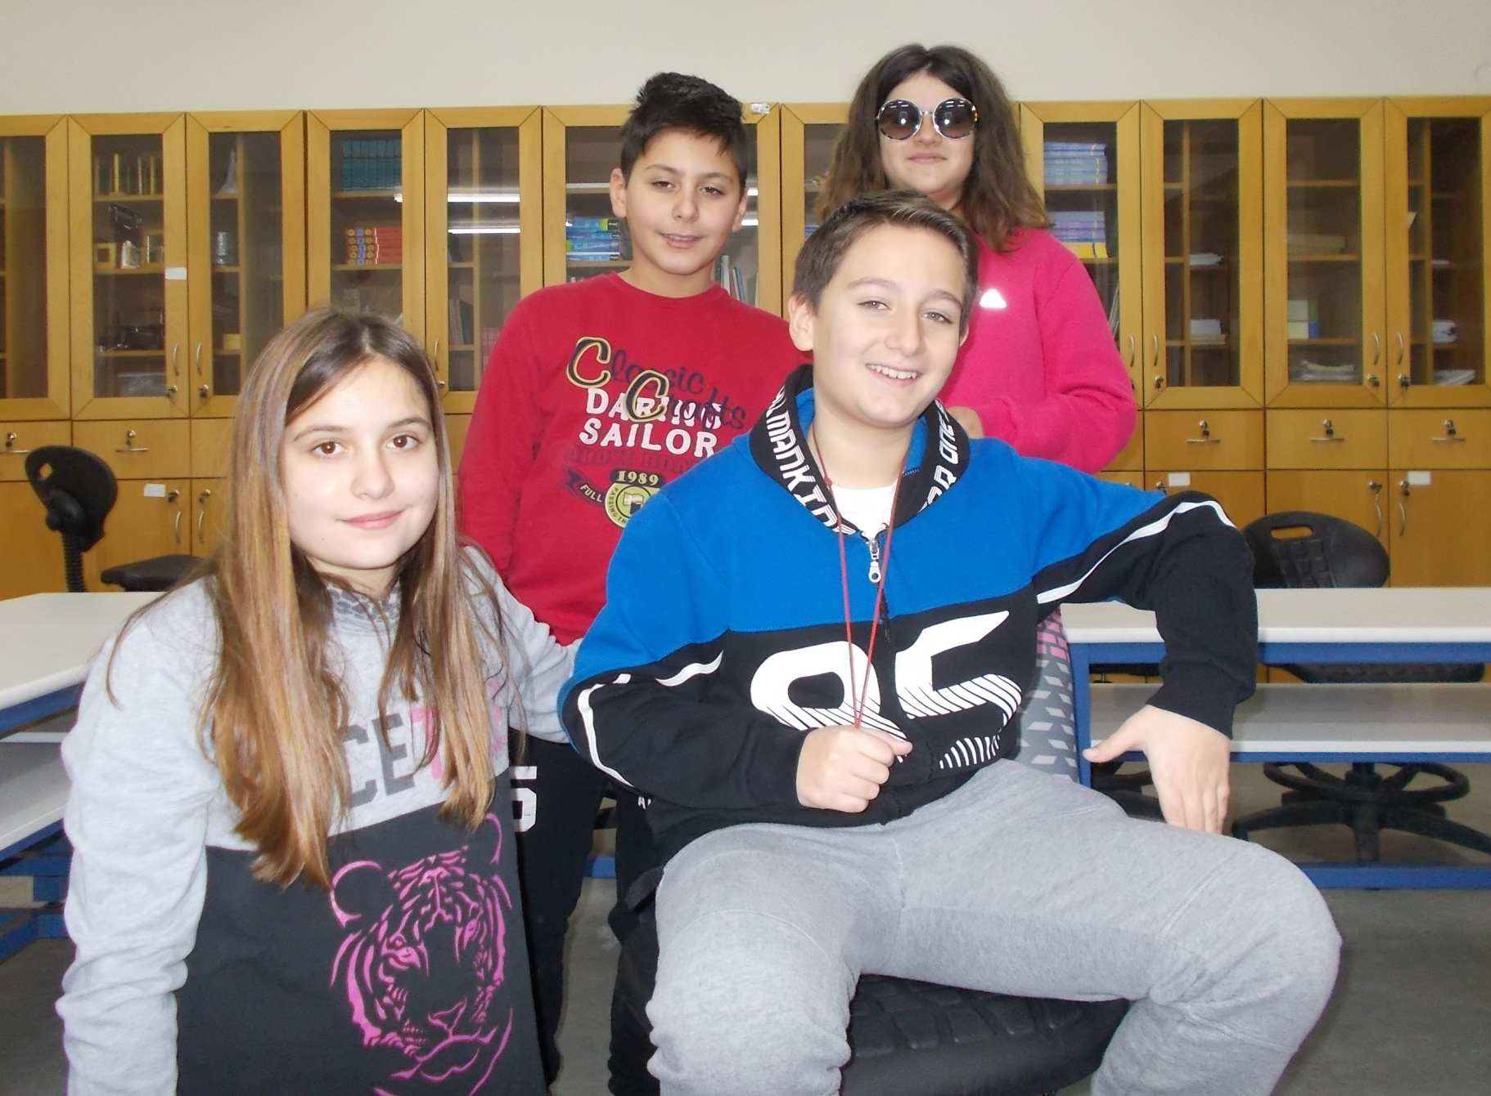
The sister loves her brother and hags him.

Slide 16
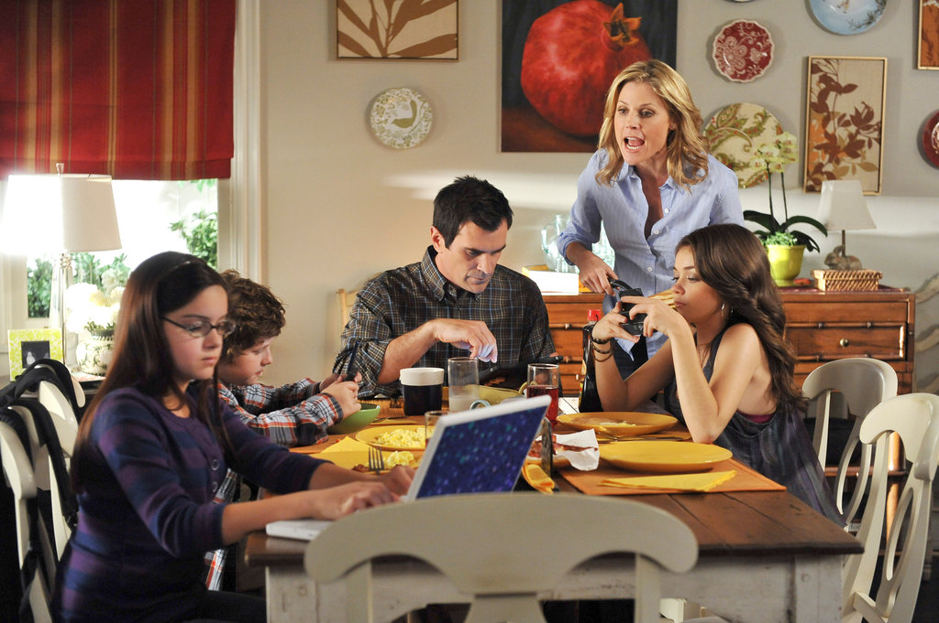
Noone is paying attention to what mother is saying due to cell phones.

Slide 17
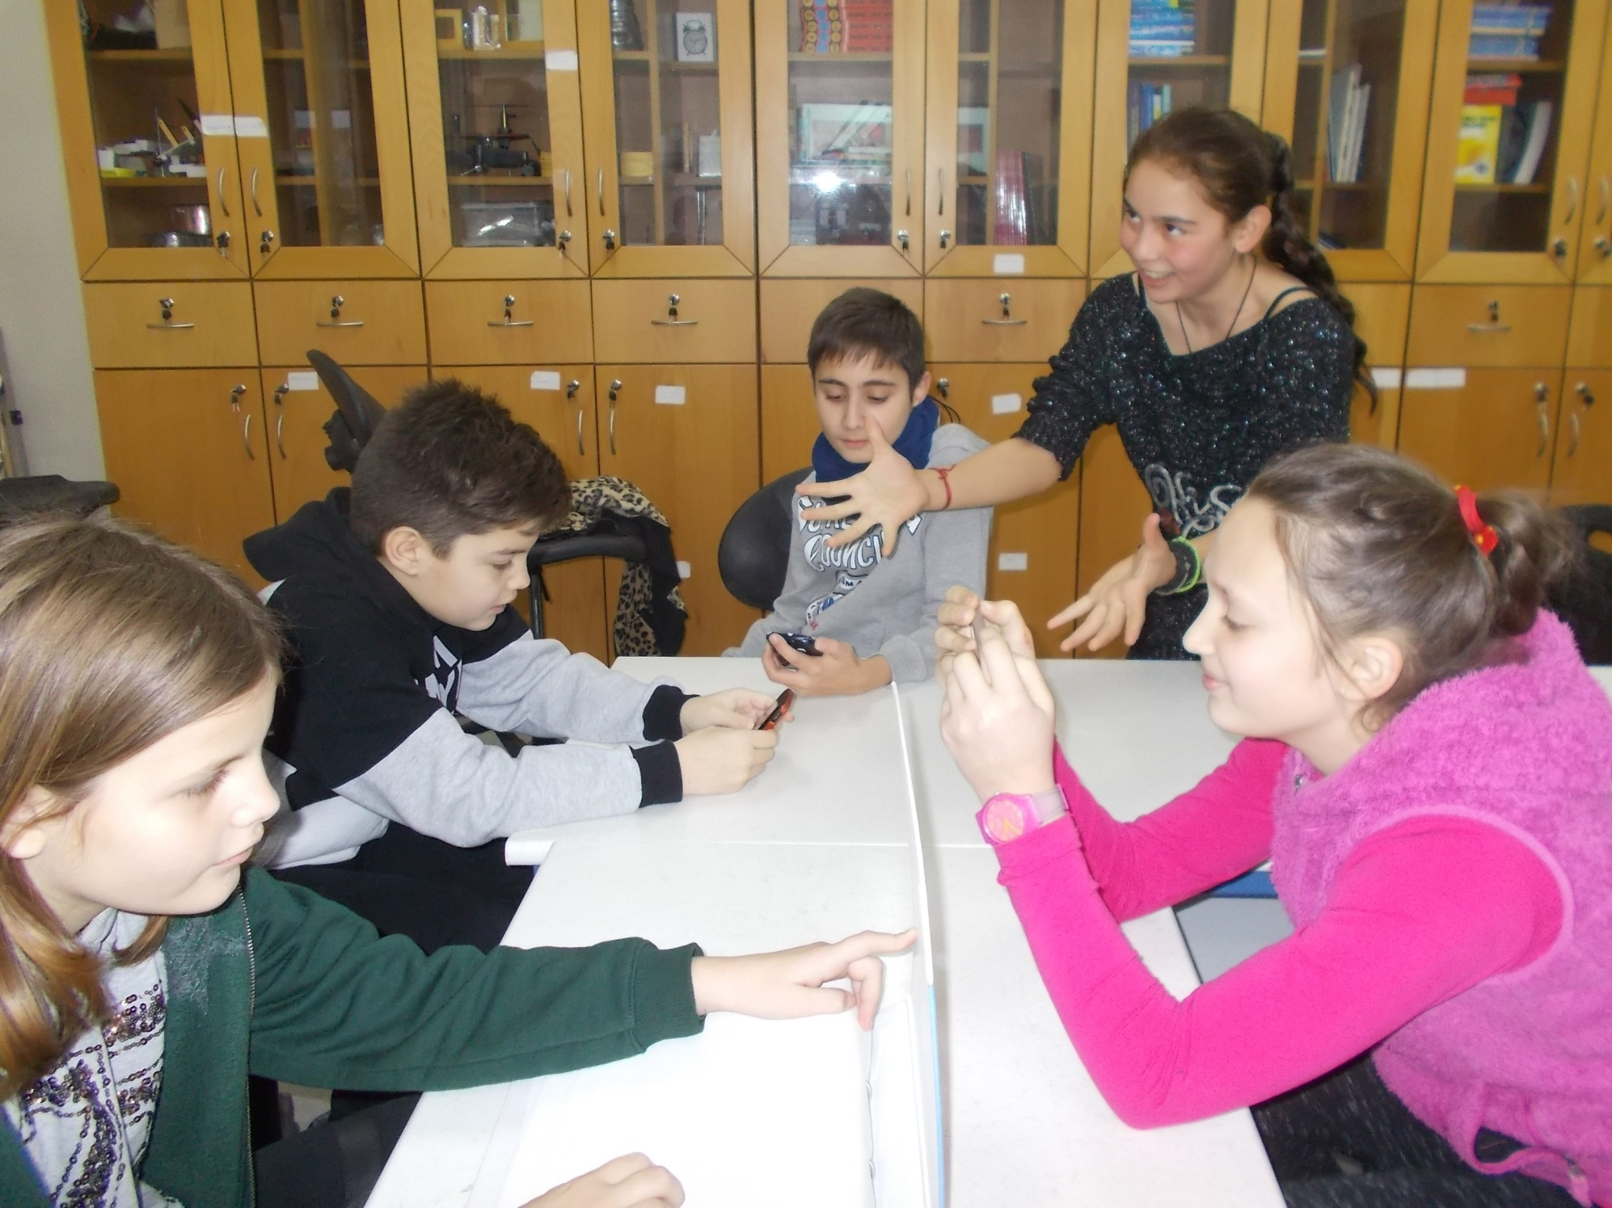

Slide 18
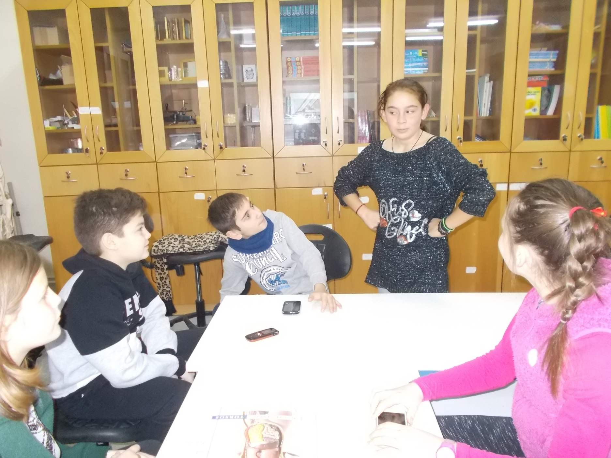
Now they are all paying attention to what mother says.

