Slide 1
We all learn, we all count in Europe
Our school, our town

Slide 2
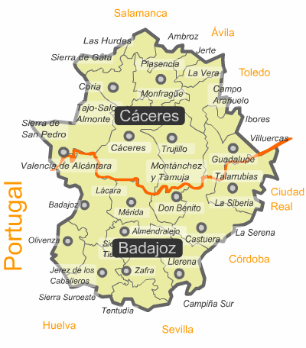
1.- TOWN
Almendralejo, Badajoz.
International city of wine.
''Romantic City''
José de Espronceda.
Carolina Coronado.

Slide 3
1.1.- POPULATION.
1842-6.000
2015-35.000
Seven times more.

Slide 4
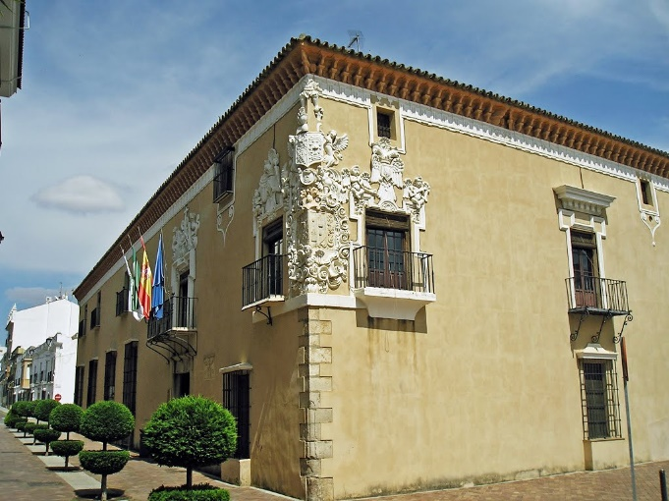
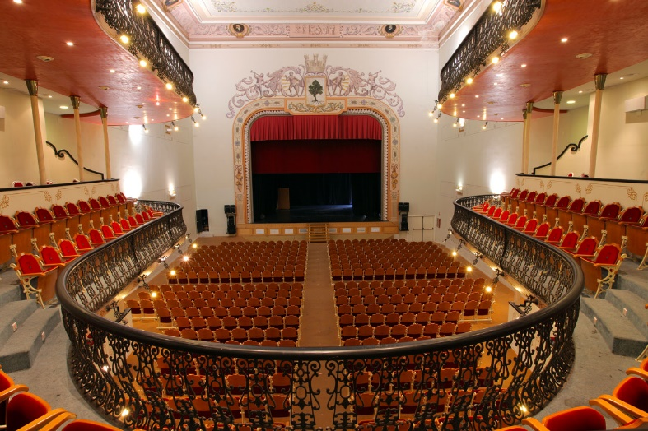
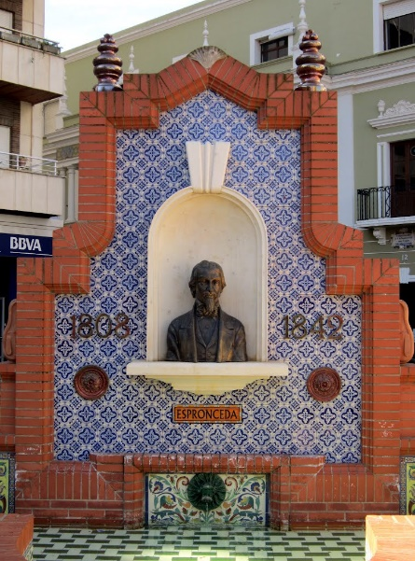
1.2.- PLACES
Wineries.
Carolina Coronado Theatre
Town Hall.
Bullring.
Municipal Library.

Slide 5
1.3.- LOCAL CELEBRATIONS
Bonfire Night (1st-2nd February)
La Piedad Festival (15th August)
"San Marcos" day. (25th April)

Slide 6
2.- SANTIAGO APOSTOL
Opened 1950.
First 10 years:
323 students. Only boys.
+ 900 students today.

Slide 7
2.1.-AN ORDINARY DAY AT SCHOOL
8:15
50 minutes.
30 minute break time.
14:05.
Bilingual Programme 15:00

Slide 8
2.2.-Courses and programmes offered
Lower Secondary = E.S.O.
Upper Secondary = Bachillerato
Vocational Training
Higher Education
Bilingual Programme
Remedial Classes:
REMA
IMPULSA

Slide 9
2.3.-Programmes and international projects
Erasmus Charter for Higher Education. KA103 (2014-2020)
Student exchange withMarc Bloch High School. (2014-2016)
Comenius Skills for life, Skills for future. (2012-2014)
Y.E.S. for future. KA2 (2014-2017)
Todos aprendemos, todos contamos en Europa.KA101 (2016-2018)

Slide 10
2.4.- OUR SCHOOL IN FIGURES

