Slide 1
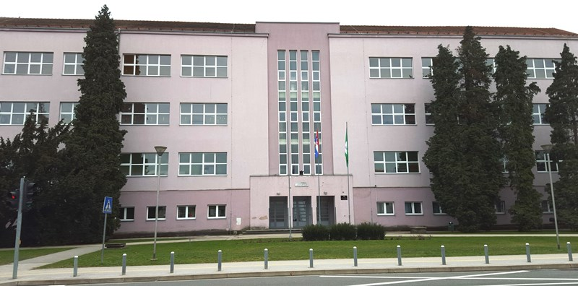
MY SCHOOL – THE FIRST PRIMARY SCHOOL VARAŽDIN
It is located in the centre of Varaždin, Croatia
The school was built in 20th century
There are 60 employees and 479 pupils in our school
The school is the pride of our town and its culture

Slide 2
EDUCATION IN CROATIA
NURSERY SCHOOL – children betwen 6 months and 6 years
PRIMARY EDUCATION – it starts from the age of 6 and lasts for 8 years - 1st to 8th grade
SECONDARY SCHOOL – lasts for 3 or 4 years, can be divided into high schools (grammar schools), art schools and vocational schools, is not obligatory
UNIVERSITES and POSTGRADUATES STUDIES – European system

Slide 3
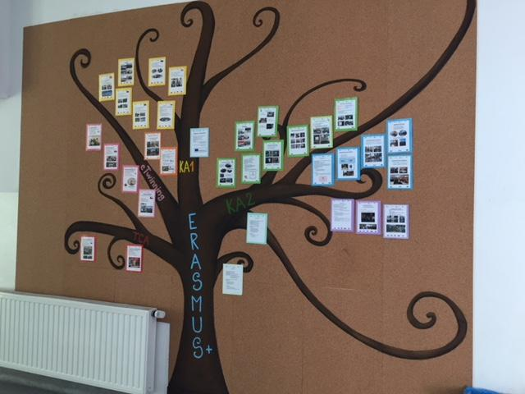
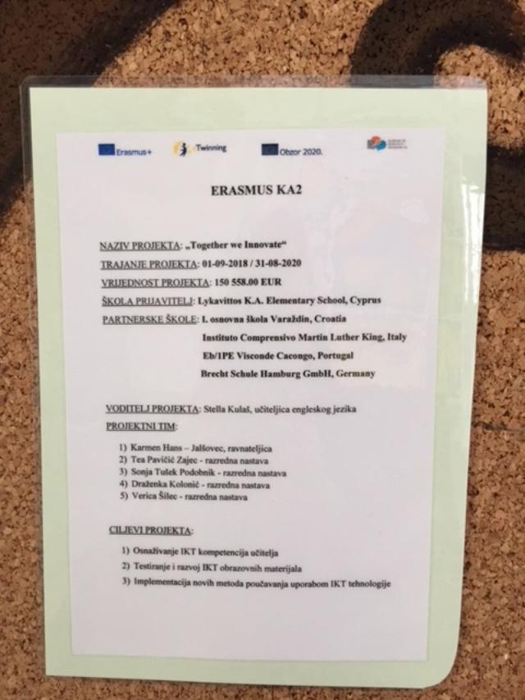
Our school integrates into a lot of Erasmus+ projects so we have an Erasmus+ school corner where all our activities are placed and visible to all the students, teachers and parents
Our newsletter is here too

Slide 4
Present major projects at school
Since August 2016, the school started with Erasmus+ KA1 project dealing with the “Modernization and improvement of the teaching process” within the school
In cooperation with the Slovenian school “Bistrica ob Sutli”, in September 2016, we started a three year long Erasmus KA2 project ”Competences of the 21st century”
Projects of our Robotic’s group- "Human science technology art engineering mathematics laboratory" with Italy and Sweden
“Connected with the environment” Erasmus+ KA2 project with Poland, Slovenia, Greece and Austria – EKO group
“Teach me how to play” KA2 project with Spain and Slovenia
Our project – Innovative Schools Together

Slide 5
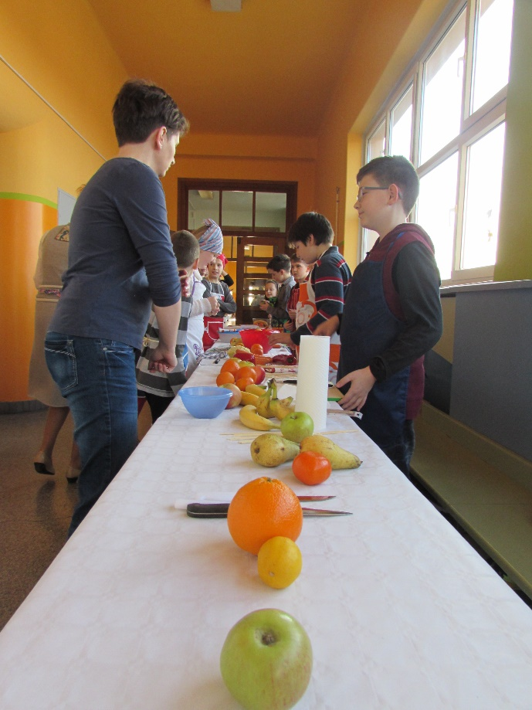
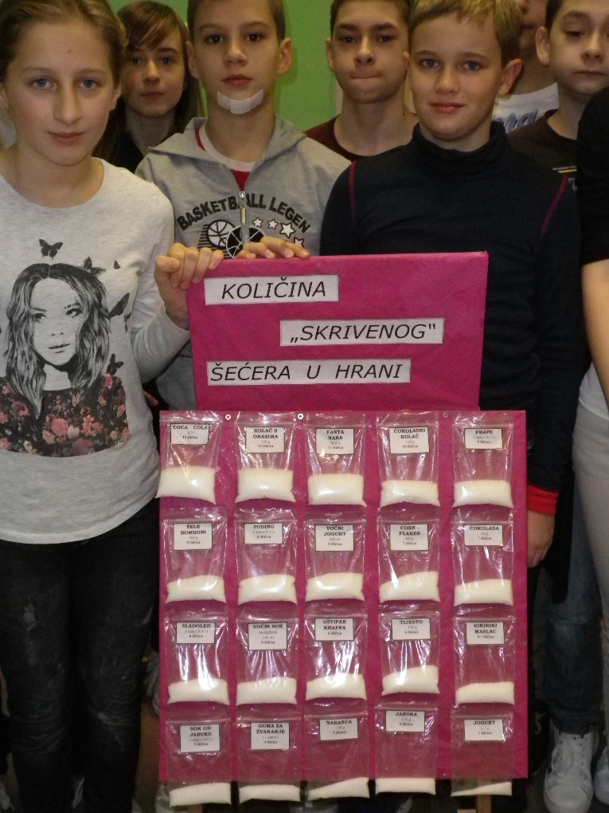
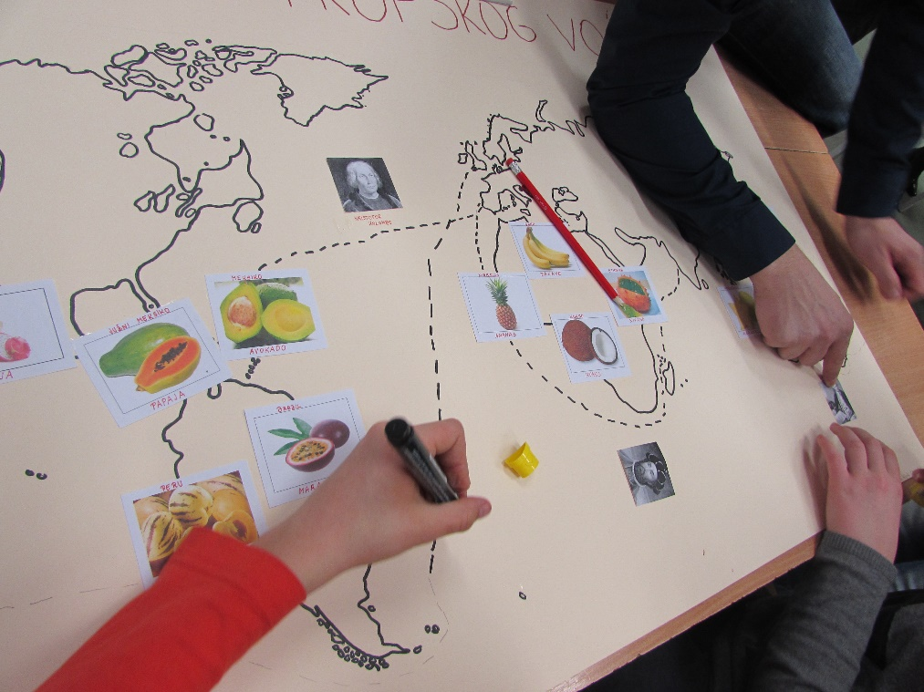
In our school we also “Eat responsibly” – one of our
school projects

Slide 6
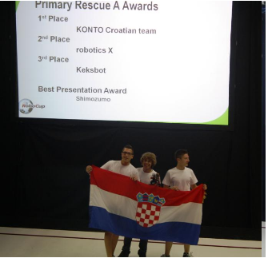
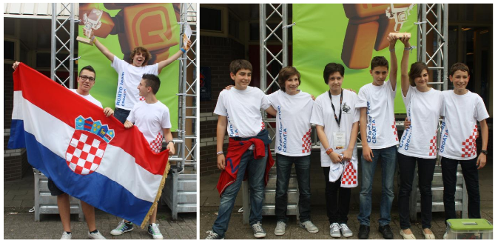
Other famous project from our school is:
ROBOTICS - we have won 1st places in the International and World competitions –
in Mexico, Netherlands, Austria, Germany, China…

Slide 7
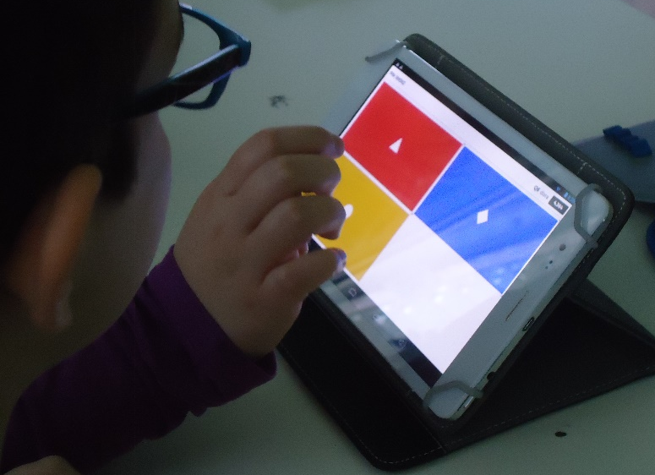
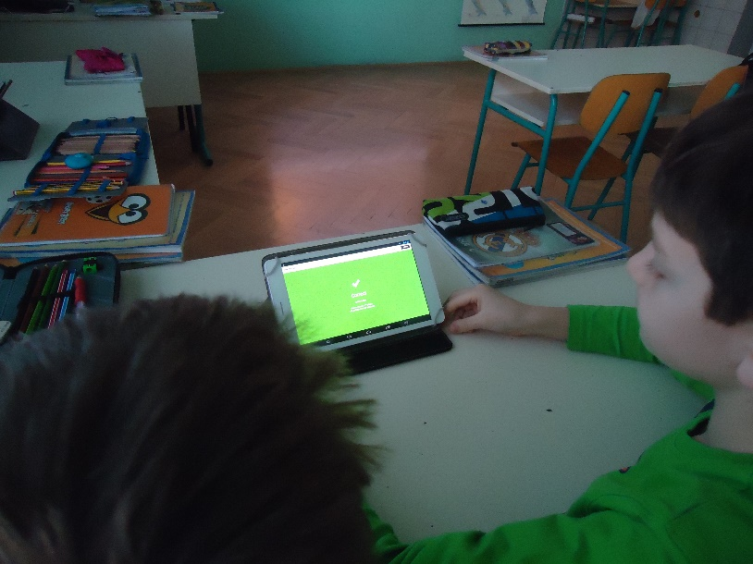
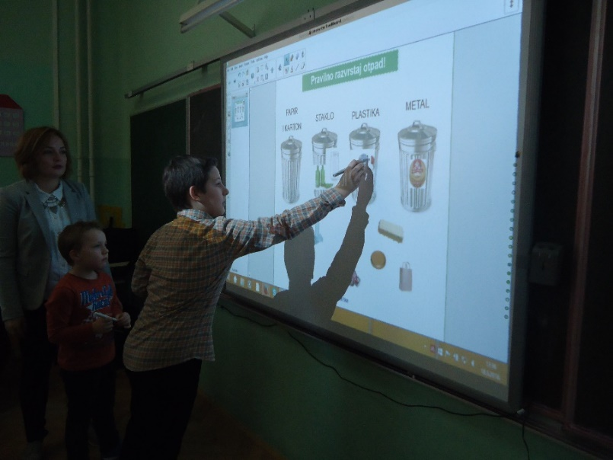
We learn foreign languages: English, German, French and now we’re
starting with Chinese
In recent years we introduced new technologies such as smart boards and tablets

Slide 8
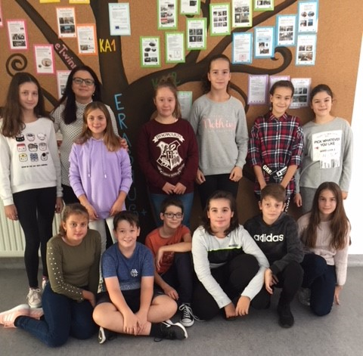
THIS IS US! Project Team of our project! Hello everyone!
Tea
Tara
Zana
Nikola
Hedi
Tia Maria
Anja
Vanessa
Teacher Stella
Petar
Jan
Vito
Tia

Slide 9
Thank you!!! Stella Kulaš I.PRIMARY SCHOOL VARAŽDIN CROATIA

