Slide 1
BLUE
ZONES
OUR
PLANS

Slide 2
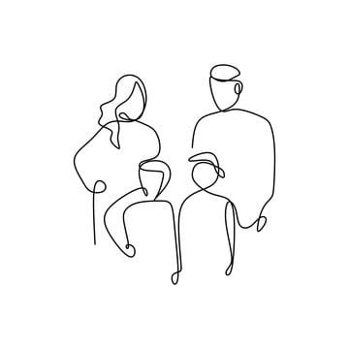
INDEX
FAMILY PLANS
SCHOOL PLANS
TOWN PLANS

Slide 3
ABOUT OUR FAMILIES
FAMILY PLANS

Slide 4
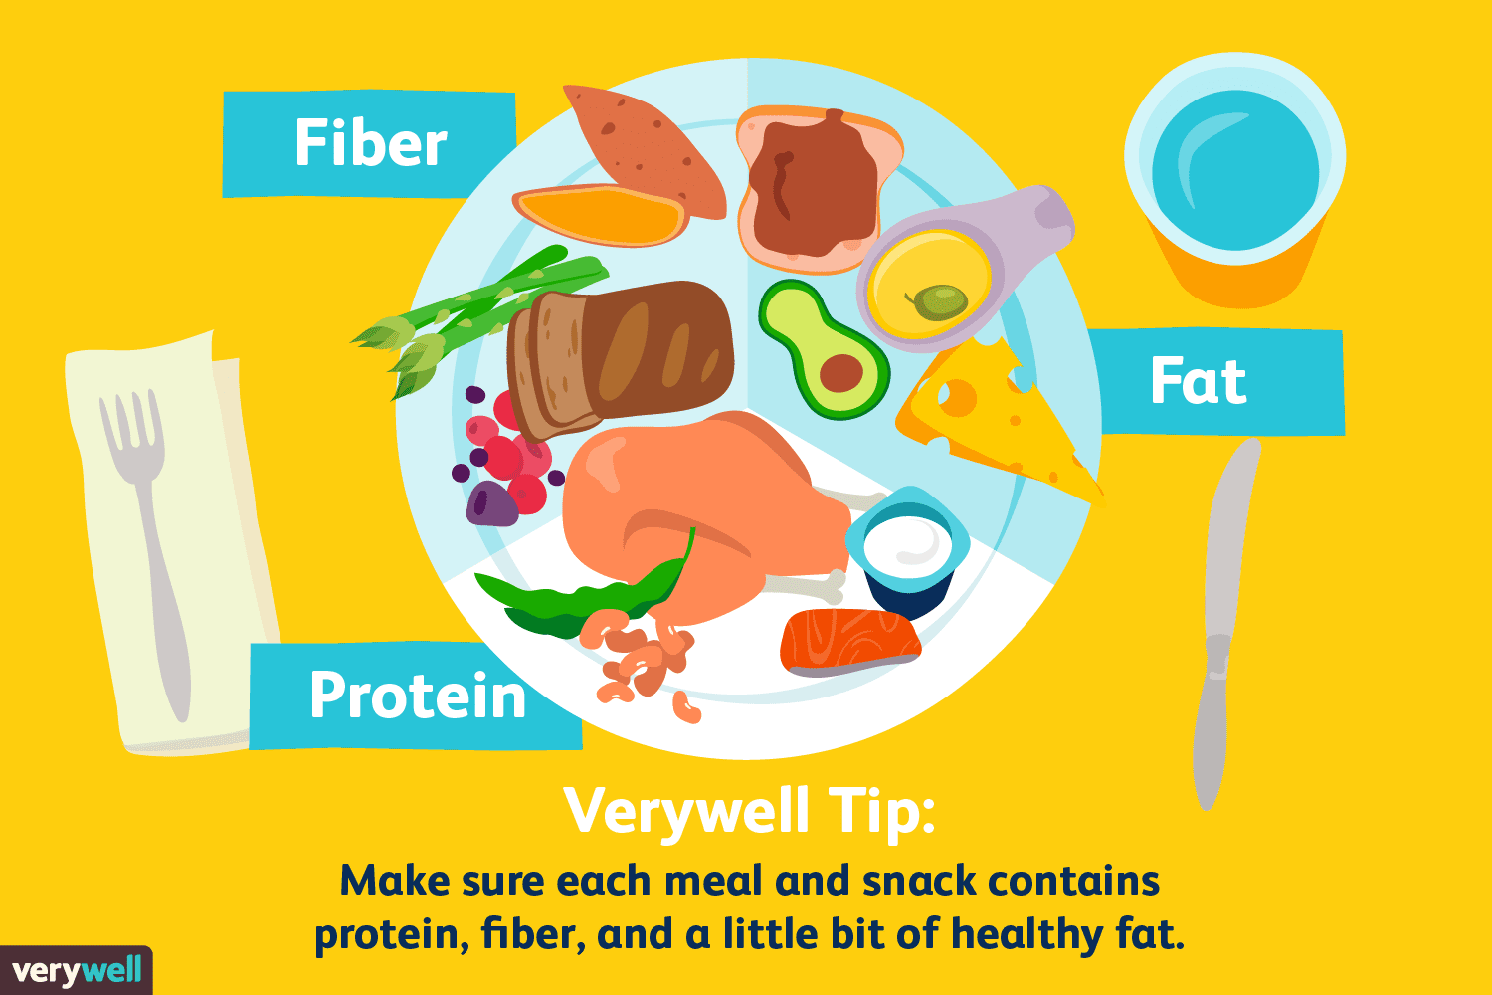
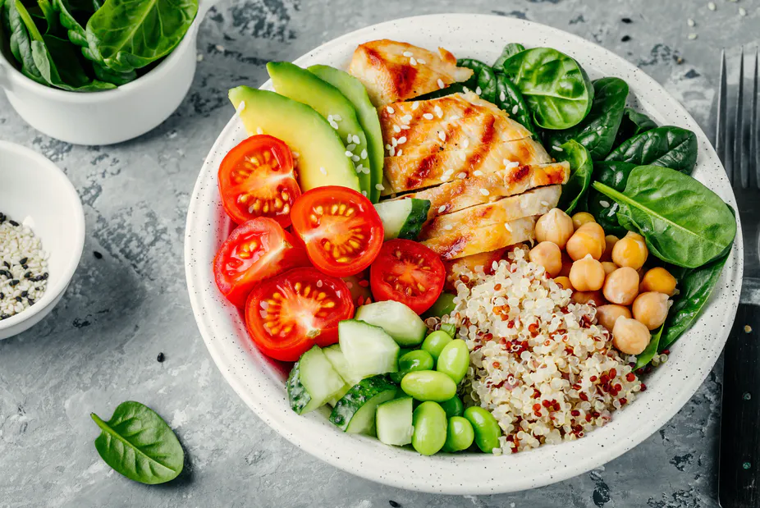
Follow the 80% rule
Have healthy and varied diet as well as following the 80% rule to keep us healthy.

Slide 5
PURPOSE
Tener unos objetivos y sueños comunes y compartirlos con la familia. Haciendo esto un par de minutos al día puede unir más a la familia y fortalecer su vínculo.

Slide 6
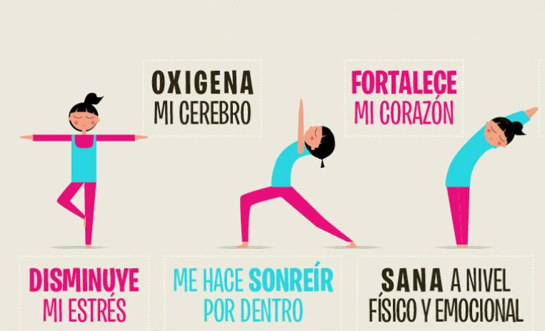
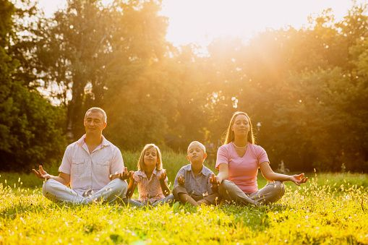
RELAX TOGETHER
Release stress with our family once a week doing yoga or spending time watching tv.

Slide 7
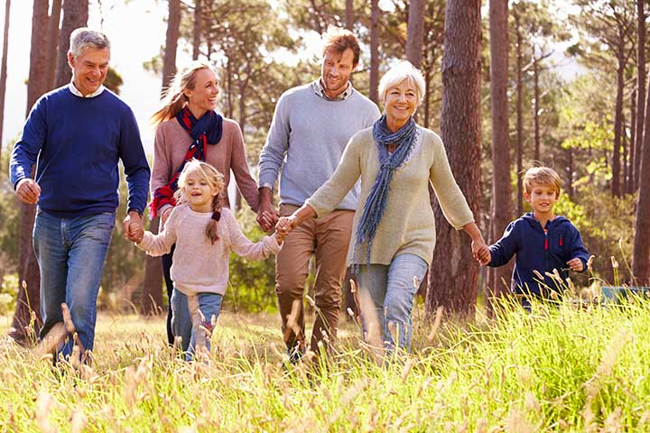
PASAR MÁS TIEMPO JUNTOS AL AIRE LIBRE
Go for a walk or in bicycle every weekend together and have fun outdoors. In this way, we would exercise and enjoy nature.

Slide 8
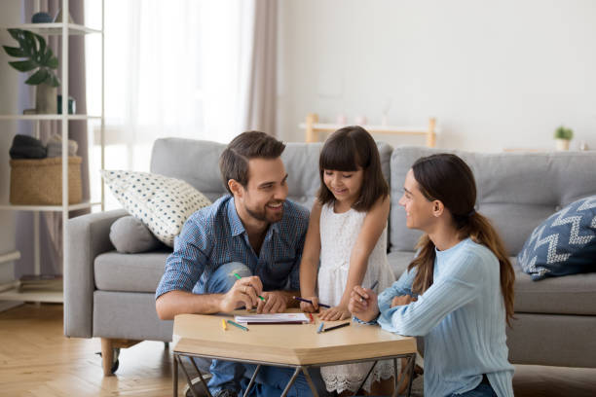
REDUCE TIME WITH DIGITAL DEVICES
Probably, this proposition must strictly adhere to us. If we are sensible enough, we should replace our wasted time with mobiles with spending time with our loved ones. After all, they are our best support.

Slide 9
ABOUT THE SCHOOL
SCHOOL PLAN

Slide 10
HAVE TIME TO CHILL OUT
Have a stress relief class twice a week to forget about school work and make the weak more bearable.

Slide 11
ENSEÑAR HÁBITOS ALIMENTICIOS MÁS SALUDABLES
HAVE HEALTHIER FOOD IN THE CAFETERIA INSTEAD OF SWEETS AND GREASY FOOD.

Slide 12
INTEGRAR MÁS MOVIMIENTO A LA ENSEÑANZA
CONTRIBUIR A PLANTAR UN HUERTO ESCOLAR O INCREMENTAR 1 HORA MÁS DE EDUCACIÓN FÍSICA A LA SEMANA, SON ALGUNAS DE LAS INFINITAS ACTIVIDADES QUE MEJORARÍAN LA SALUD DEL ALUMNADO.

Slide 13
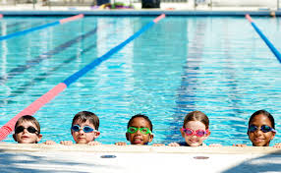
SUPPORT SOCIAL CLUBS
BY SUPPORTING AND ENCOURAGING TEENAGERS TO TAKE PART IN SOCIAL CLUBS, TEAM WORK WOULD BE PROMOTED. IT WOULD BE A GREAT OPPORTUNITY FOR STUDENTS TO SOCIALIZE.

Slide 14
LESS HOMEWORK AND EXAMS
THE REASON WHY TEENAGERS ARE STRESSED IS BECAUSE OF THE HUGE AMOUNT OF WORK WE HAVE TO DO, SO REDUCING IT WOULD HELP. THERE ARE MORE ENJOYABLE WAYS TO TEACH.

Slide 15
ABOUT OUR TOWN
TOWN PLAN

Slide 16
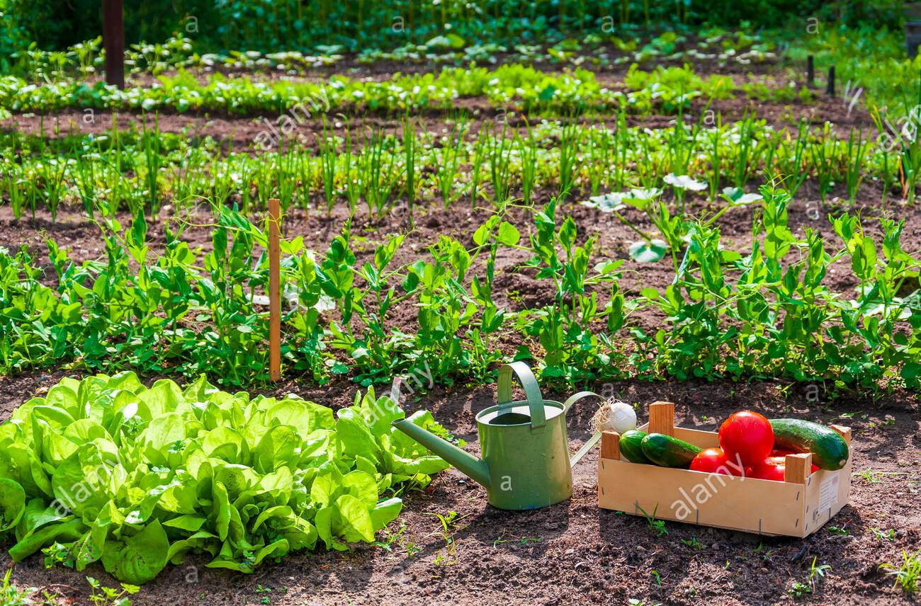
SELL AND PROVIDE MORE LOCAL MEDITERRANEAN FOOD
BY DOING THIS, WE SUPPORT LOCAL PEOPLE BY PURCHASING THEIR PRODUCTS AND A VARIED DIET WOULD BE IMPLEMENTED AMONG CITIZENS.

Slide 17
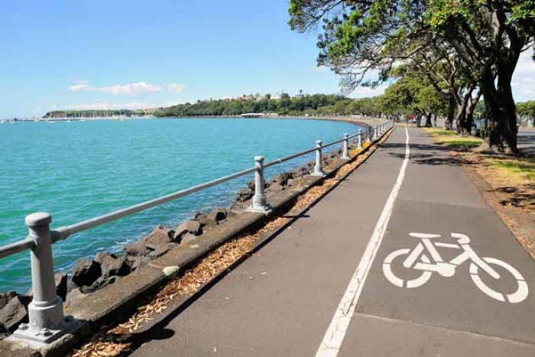
CONSTRUIR MÁS CARRIL BICIS Y ACERAS
DEBIDO A QUE HAY POCOS CARRILES PARA BICICLETAS Y ACERAS EN MALAS CONDICIONES EN NUESTROS PUEBLOS, NUESTRO PRÓXIMO PLAN ES IMPLEMENTAR MÁS. CREEMOS QUE ESTE ES UN MÉTODO EFECTIVO PARA MOTIVAR A LA GENTE A MONTAR MÁS EN BICICLETAS Y NO UTILIZAR COCHES.

Slide 18
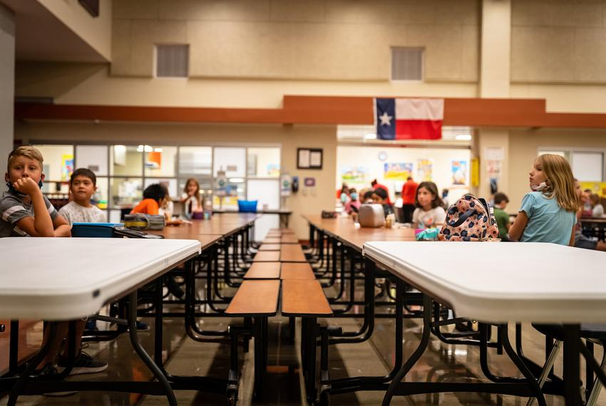
SOCIAL LUNCHROOM
OUR SECOND PROPOSAL IS TO ORGANIZE A SOCIAL LUNCHROOM FOR ANYONE WHO WANTS OR NEEDS TO GO. NO NEED TO HIGHLIGHT THAT ALL MEALS WILL BE BASED ON A PLANT DIET.

Slide 19
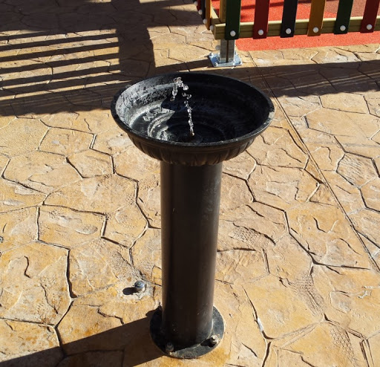
COLOCAR MÁS FUENTES DE AGUA POTABLE PARA HIDRATARSE
AL IGUAL QUE MANTENER UNA BUENA DIETA, MANTENERSE HIDRATADO ES IGUAL DE IMPORTANTE. AL REALIZAR ESTA ACCIÓN LAS CALLES ESTARÍAN LIMPIAS Y SIN BOTELLAS DE PLÁSTICO POR LAS ACERAS.

Slide 20
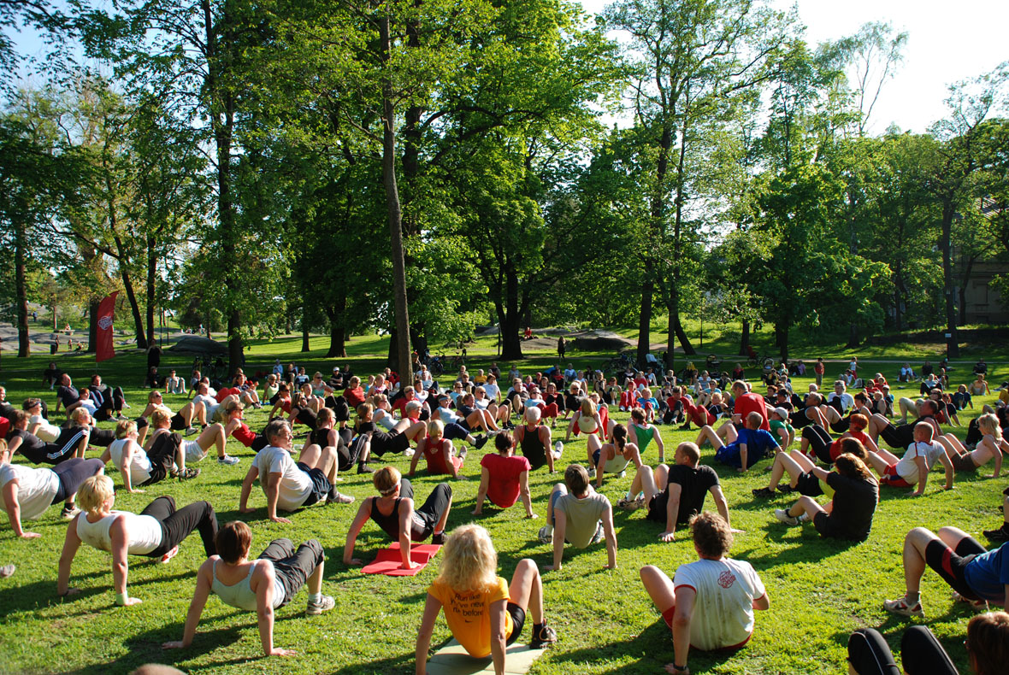
ENCOURAGE PEOPLE TO PARTICIPATE ON LOCAL ACTIVITIES
ENCOURAGING PEOPLE TO PARTICIPATE ON LOCAL ACTIVITIES CAN HELP YOU DEVELOP SKILLS AND CAN GIVE YOU A WAY TO HELP OTHERS. BESIDES, YOU CAN MEET YOUR NEIGHBORS AND MAKE NEW FRIENDS.
YOGA, SOCCER, BASKETBALL AND GAMES LIKE THE SCARF WOULD BE SOME OF THE ACTIVITIES.

Slide 21
THANK
YOU

