Slide 1
Sound experement
telephone

Slide 2
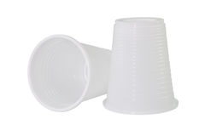
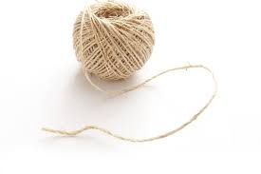
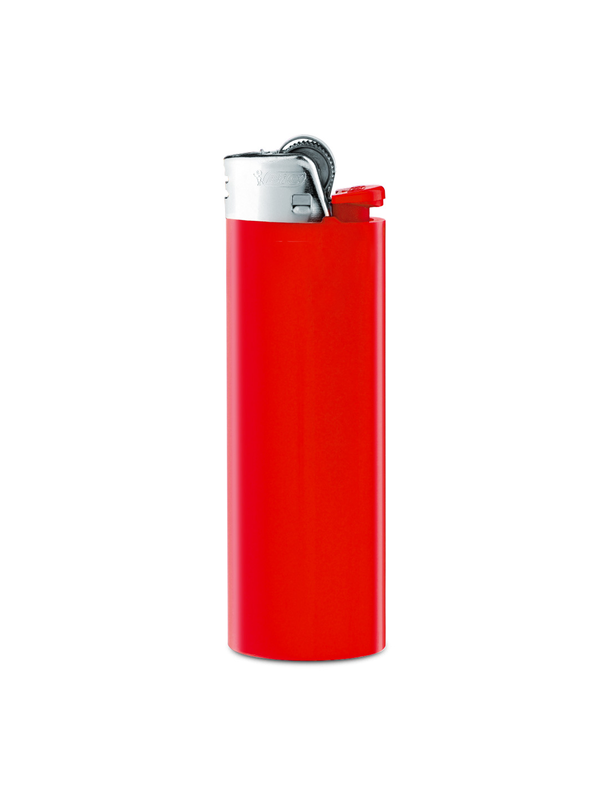
We will need:
Two plastic cups
A long string
Lighter or SCISSORS

Slide 3
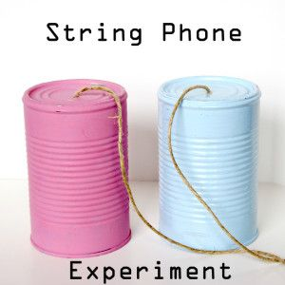
procedure
We have to make two small holes on the bottom of the cups.
Then we take a piece of string and put it trough the holes.
Then we tie it so it‘s secure.

Slide 4
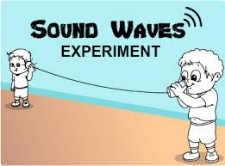
Play time
One kid will speak into the cup and the second kid will hold the other cup to his ear.
The string has to be straight and tight.
Can you hear what the other kid just said?

Slide 5
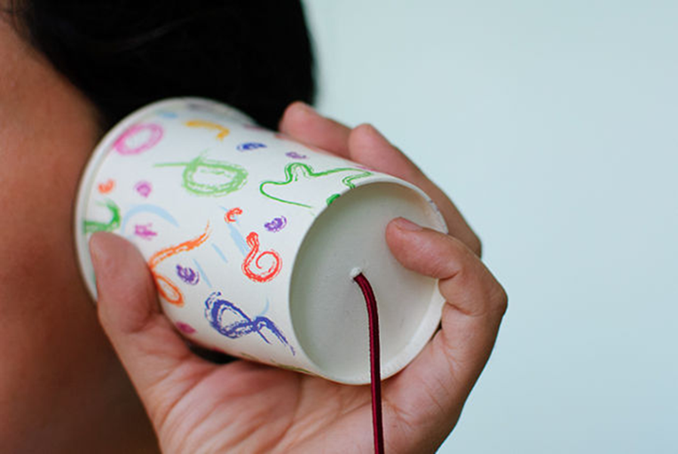
WHY Did THis HAPPENd?
This is beacuse when one person talks into his or her cup, the bottom of the cup vibrates or moves back and forth.
When any object moves, it causes movement in the air particles also.

