Slide 1
How to use “Canva“?
by Giedre

Slide 2
How to find

Slide 3
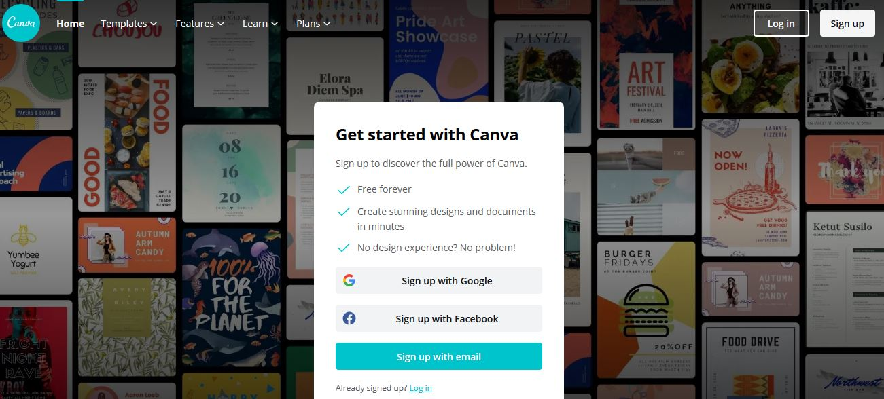
Registration
www.canva.com

Slide 4
Create an account
Registration
Write name
Create e-mail
repeat e-mail
Write password
Tick (to identify if you aren‘t a robbot)
Press registration

Slide 5
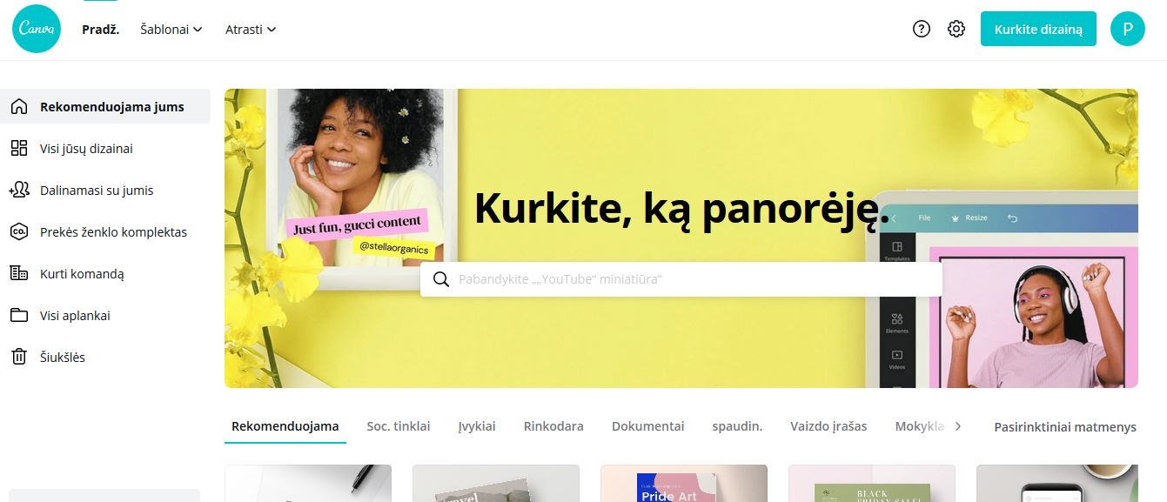
Now you are in
There are all your created designs
Let‘s create your logo
enter

Slide 6
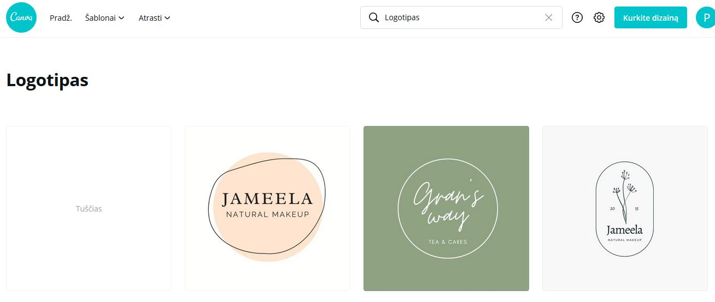
How create a logo
Enter
Choose empty or template
Empty

Slide 7
How create a Logo
Templates
Download photo from your devise
Photos
Elements
Text
Insert video
Background

Slide 8
To save on your computer
download

