Slide 1
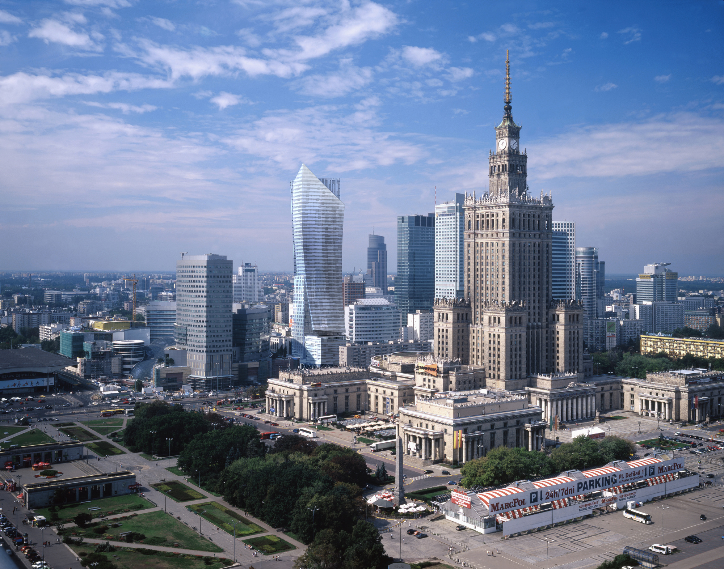
`
My favourite places in Warsaw

Slide 2
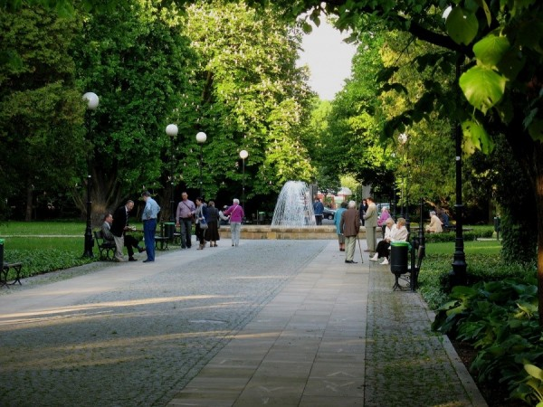
park
My favourite park in Warsaw is Park Dreszera.
It’s not very far from where I live, in the district called Mokotów.

Slide 3
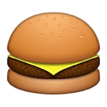
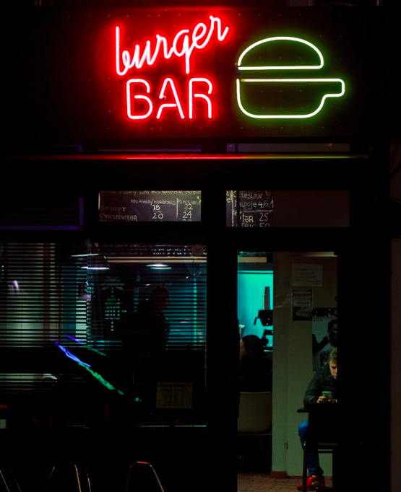
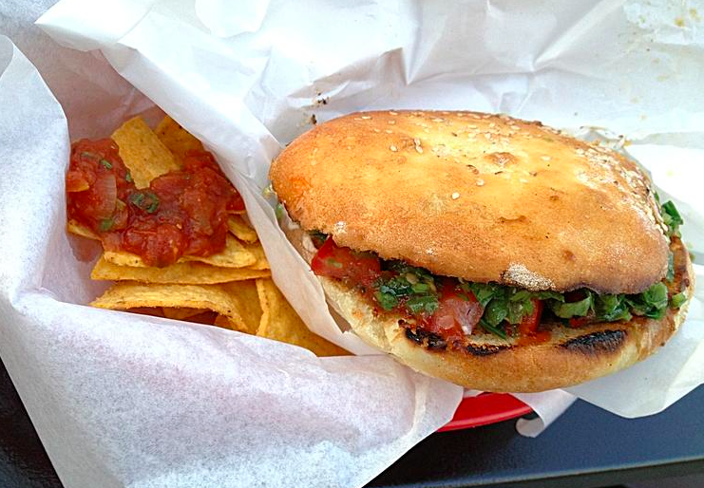
restaurant
My favourite restaurant is Burger Bar. They serve delicious hamburgers which they make on the site, as well as the buns. My favourite burger is the Green Chili.

Slide 4
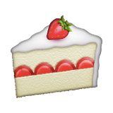
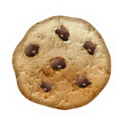
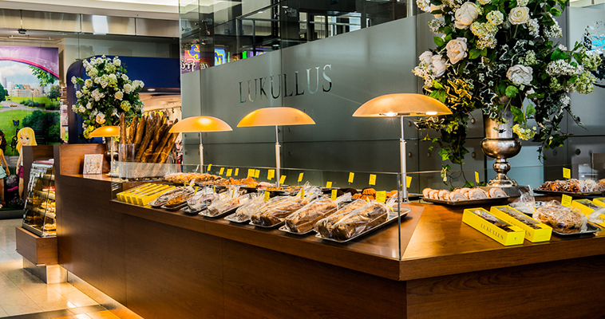
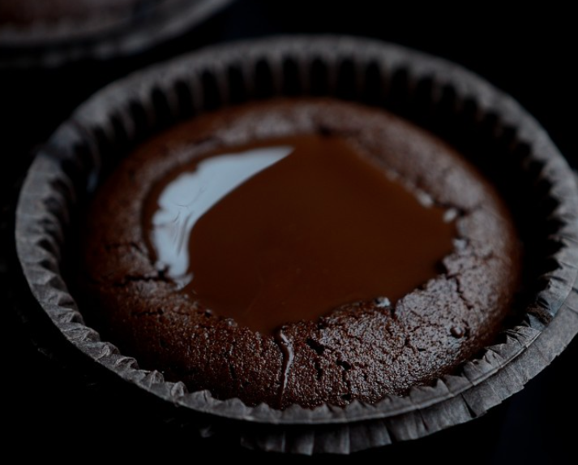
bakery
My favourite bakeri is Lukullus. It is located in couple different places in Warsaw. My favourite thing from there is Armani’s Lava Cake.

Slide 5
the end
Thank you for your attention.
Julian

