Slide 1
Famous Polish People
Kamila Żmijewska & Weronika Suchenek

Slide 2
Maria Skłodowska-Curie
She was born on 7 of the November in 1867. was a Polish and naturalized-French physicist and chemist who conducted pioneering research on radioactivity. She was the first woman to win a Nobel Prize, the first person and only woman to win twice, the only person to win twice in multiple sciences, and was part of the Curie family legacy of five Nobel Prizes. She was also the first woman to become a professor at the University of Paris, and in 1995 became the first woman to be entombed on her own merits in the Panthéon in Paris. She died in Passy on 4 of the July in 1934.

Slide 3
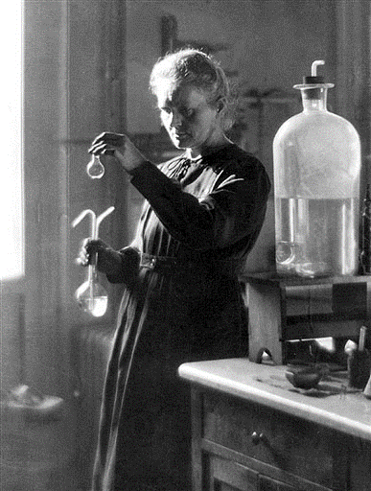
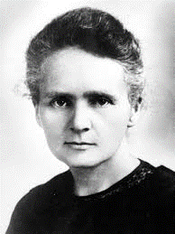

Slide 4
Lech Wałęsa
He was born 29 September 1943. He is a Polish politician, trade-union organizer, philanthropist and human-rights activist. A charismatic leader, he co-founded Solidarity (Solidarność), the Soviet bloc's first independent trade union. Wałęsa was an electrician by trade. Soon after beginning work at the Lenin Shipyard (now Gdańsk Shipyard), he became a dissident trade-union activist. For this he was persecuted by the Communist authorities, placed under surveillance, fired in 1976, and arrested several times won the Nobel Peace Prize in 1983, and served as President of Poland from 1990 to 1995. In the Polish election of 1990, he successfully ran for the newly re-established office of President of Poland.

Slide 5
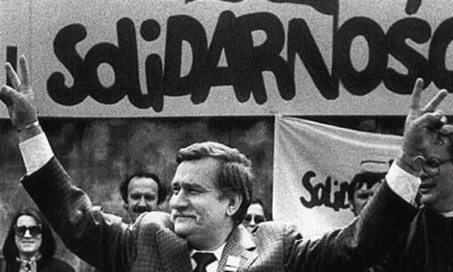
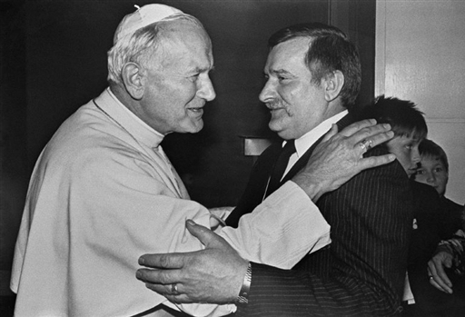

Slide 6
Justyna Kowalczyk
She was born on 19th of the January in 1983. She is a Polish cross country skier who has been competing since 2000. Kowalczyk is a double Olympic Champion and a double World Champion. She is also the only skier who won the Tour de Ski four times in a row and one of two female skiers, who won the FIS Cross-Country World Cup three times in a row (the other one being Finn Marjo Matikainen). Kowalczyk holds the all-time record for the most wins in Tour de Ski with 14 competitions won and 29 podiums in total. She also won the Vasaloppet ladies' class in 2015.
She is a member of cross country ski department of AZS AWF Katowice and is coached by Aleksander Wierietielny.

Slide 7
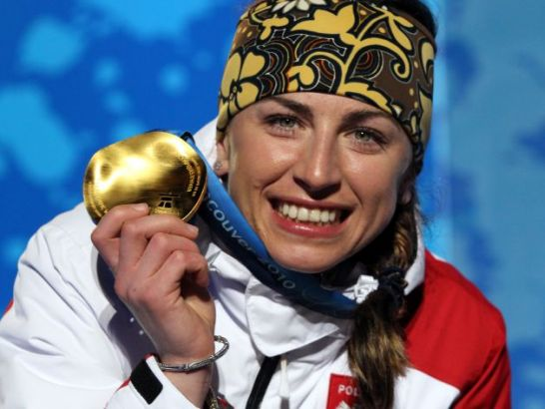
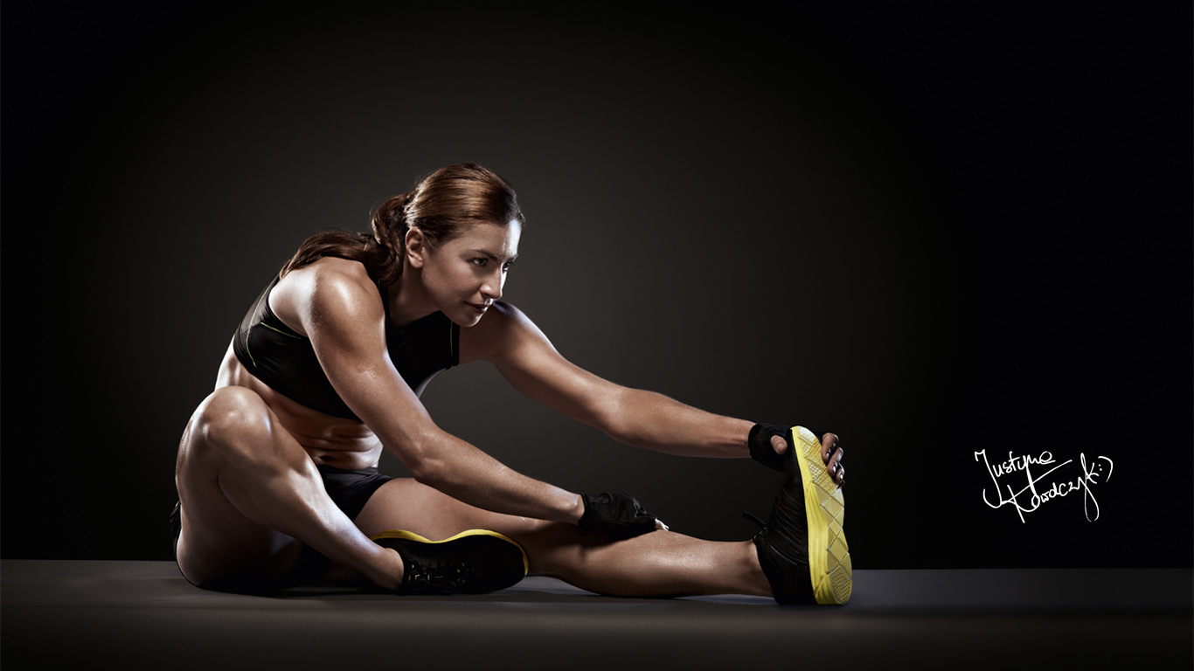

Slide 8
Pope John Paul II
Actual name: Karol Józef Wojtyła. He was born on 18th of the May in 1920. He was a Roman Catholic priest, bishop, and Cardinal who eventually rose to become Pope. He was elected by the second Papal conclave of 1978, which was called after Pope John Paul I, who was elected in August after the death of Pope Paul VI, died after thirty-three days. Then-Cardinal Wojtyla was elected on the third day of the conclave and adopted his predecessor's name out of tribute to the deceased former pontiff. In the years since his death, John Paul II has since been made a saint by the Church. He is referred to as Pope Saint John Paul II or Saint John Paul the Great, for example as a name for institutions. He was the second longest-serving pope in modern history after Pope Pius IX, who served for nearly 32 years from 1846 to 1878. John Paul II was the first non-Italian pope since the Dutch Pope Adrian VI, who served from 1522 to 1523. He was one of the most travelled world leaders in history, visiting 129 countries during his pontificate. He died on 2nd of the April in 2005.

Slide 9
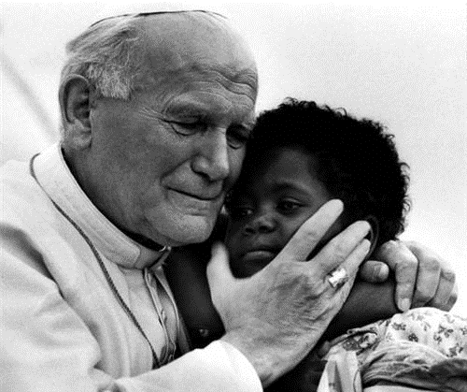
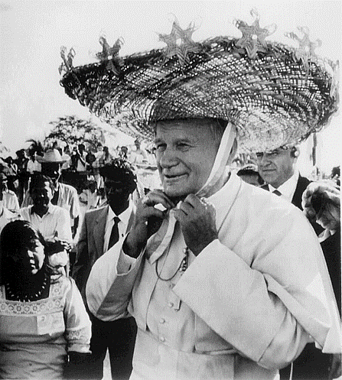

Slide 10
Thank you for attention ☺

