Slide 1
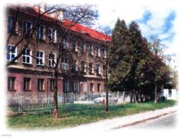
My school
Kamila Żmijewska

Slide 2
School rules
Obligations:
We should Listen to teachers
We must be prepared for class
We have to do our homework on time
We should arrive on time
We must bring materials
We should raise a hand befor speaking
We must listen to instructions

Slide 3
School rules
Prohibitions:
We can’t take other students materials without permission
We mustn’t make a noise
We shouldn’t use mobile phones during lesson
We mustn’t write or crave on our desks
We can’t eat or drink in computer class
We shouldn’t come to class late
we can’t crticize anybody’s opinions or ideas

Slide 4
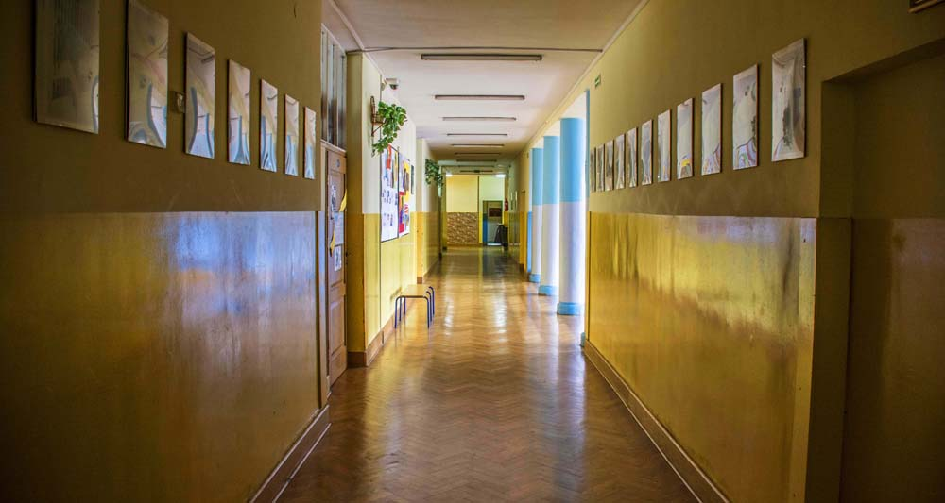
How we adress teachers?
We call our teachers: Professor, teacher etc. But It’s more polite to use : Mrs, Mr etc.

Slide 5
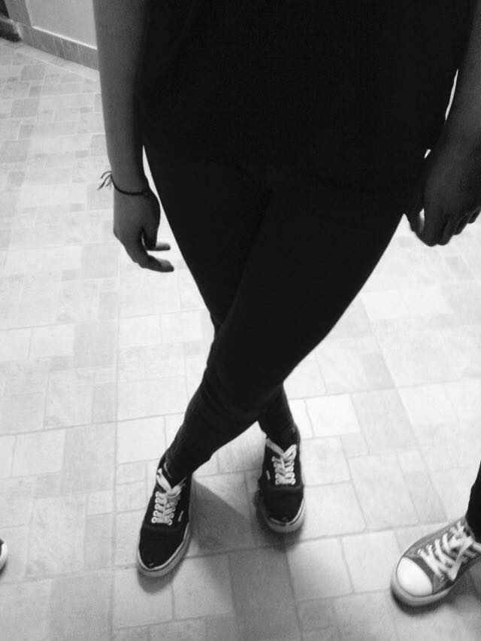
What can we wear?
Luckily we don’t have to wear uniforms.
In fact we can wear what we want to, but our apparel has to be modest. We are allowed to wear petit jewellery and delicate make-up. We shouldn’t dye our hair.

Slide 6
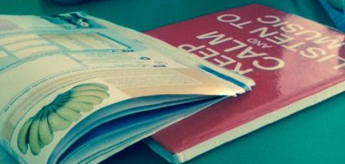
Homework and exams
Unfortunately we usually have a lot of homework and exams.
Recently we had to write about 2-3 exams per week, so we had to study a lot.

Slide 7
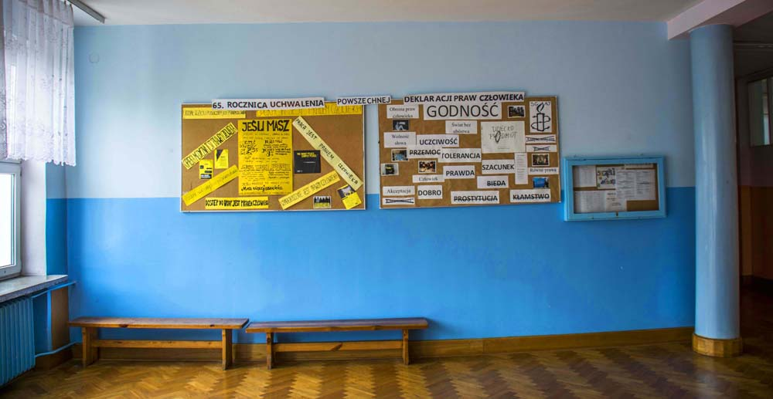
Activities after school
After school we have some extra lessons of the physics, spanish, drama club etc.
At the end of the second class in Our school we Have to do at least one project. There are many of them. I chose "The Musical".

Slide 8
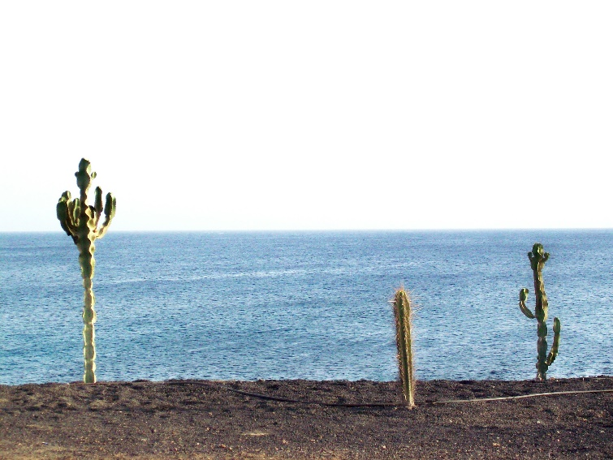
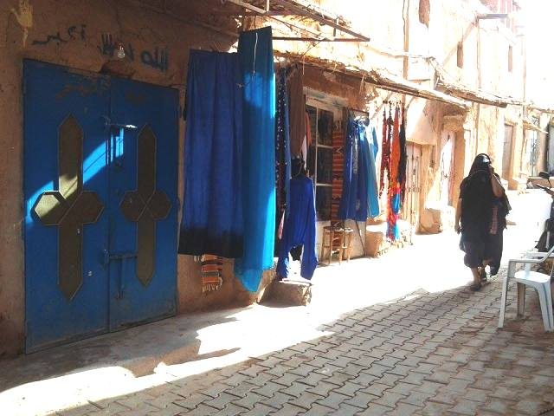
School holidays
In comparison with other countries we don’t have a lot of school holidays. (In Sweden they have a sport break, spring break, etc. ; in france Wednesday is a free day and omitting that they have some holidays too.)
Of course we have some days off school (for example: Independence day). Additionally we have summer and winter holidays.

Slide 9
My opinion
In my opinion school has positives and negatives sides.
I can meet new people there and make friends, learn about different topics, things that might be useful in the future.
Negative points of school are some boring lessons and a lot of work. Because of that sometimes we arrive tired at home.
One way or another i like my school

Slide 10
Thanks for your attention ☺

