Slide 1
Erasmus +
My school my life

Slide 2
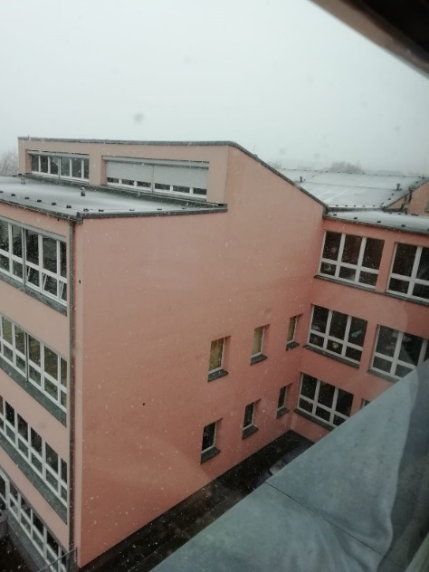
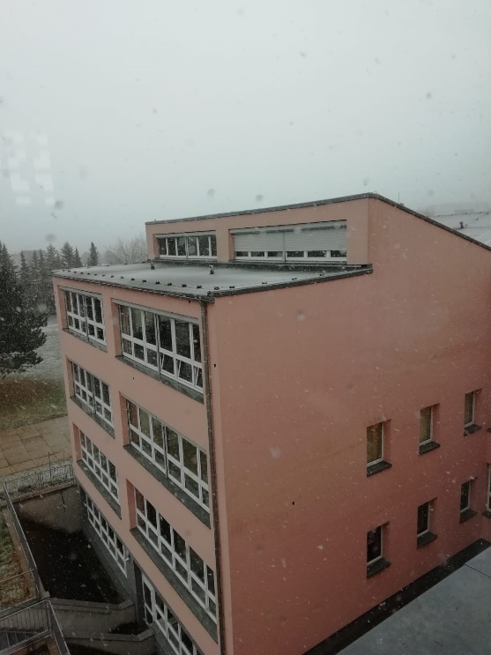
Wanted poster of our school
Our school: Friedrich Ludwig Jahn Secondary School
Residential area: Freyburg
Student number: 264
Teachers number: 22
Subjects: German
Maths
English
Biology
Geogaphy
Clubs: Sport
Bees
Erasmus +
Graffiti
There are about 264 students, 22 teachers, a school social worker and a school counselor in our school. There is also a caretaker at our school.
The school was built in 1980.
The subjects German, Math, English, History, Music, Economics, Technology, Physics, Biology, Russian, Chemistry etc. are taught here. In addition to teaching, working groups are offered, for example Bee club, Erasmus club, Graffiti club. The school starts at 7.40 and the regular class ends at 13.05.

Slide 3
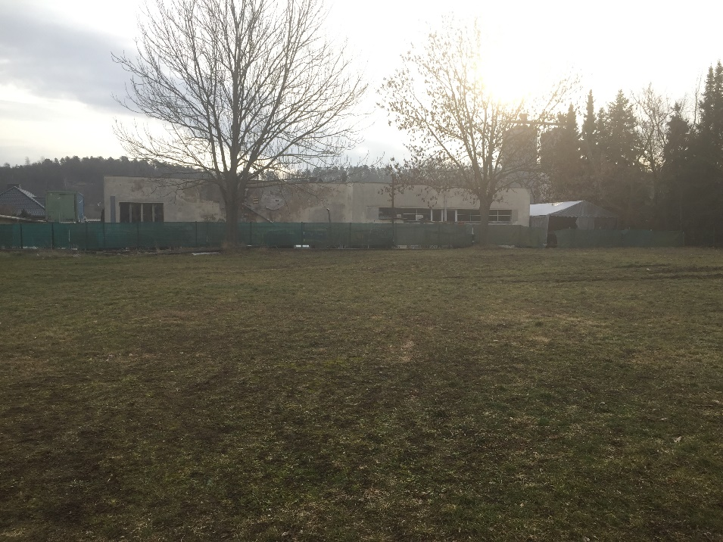
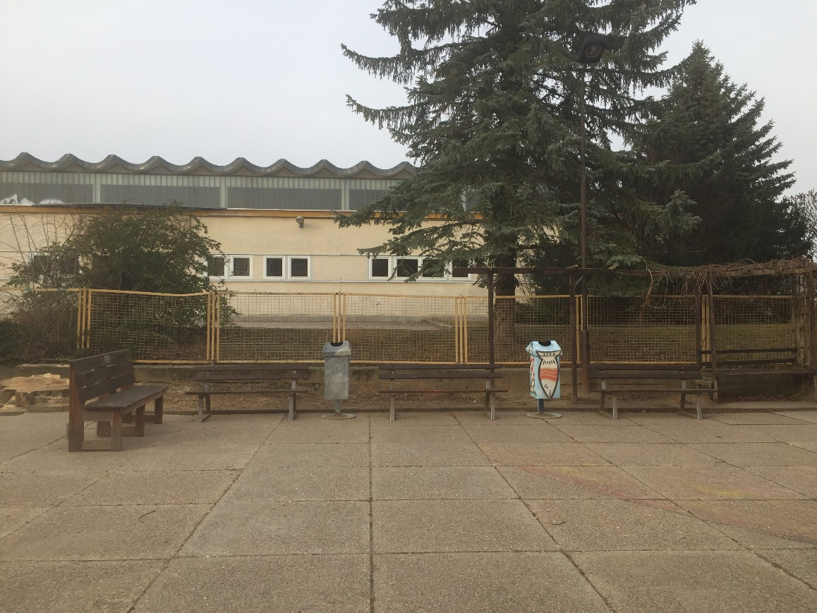
Schoolyard
These are the places for our graffiti wall.

Slide 4
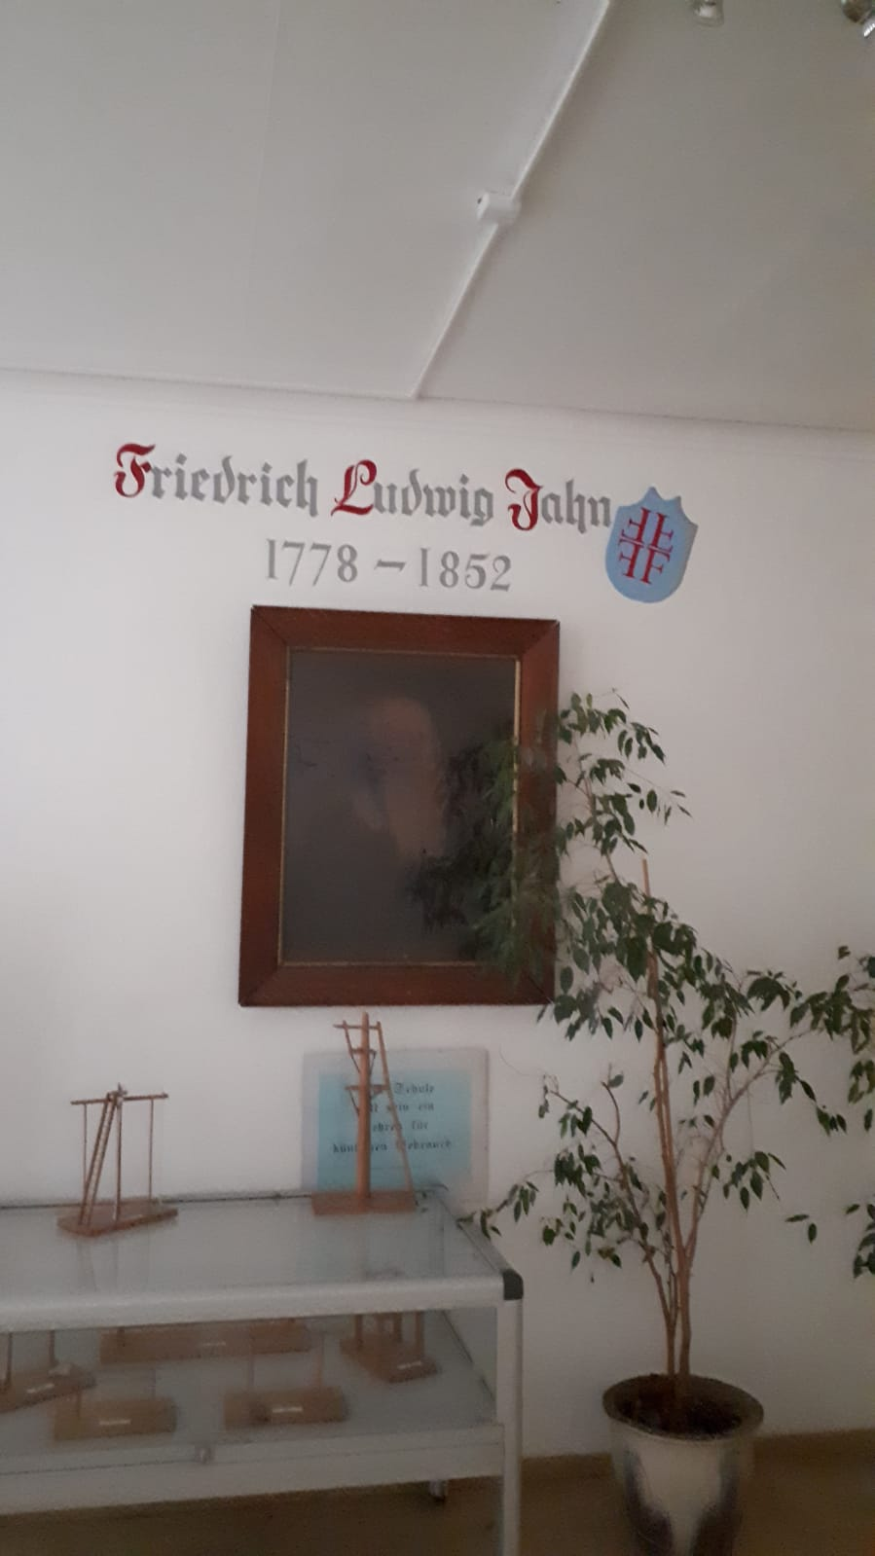
Founder
Johann Friedrich Ludwig Christoph Jahn, known as a gymnast, was a German teacher of numerous gymnastic equipment such as the bars and the bar. In addition, Jahn was a member of the Frankfurt National Assembly. He was born on August 11, 1778 in Lanz and died on October 15, 1852 in Freyburg (Unstrut).

Slide 5
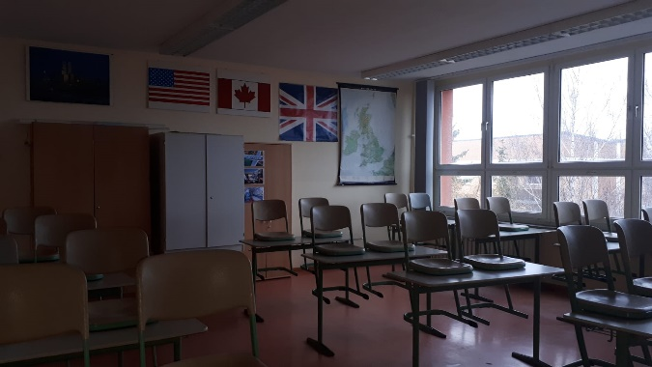
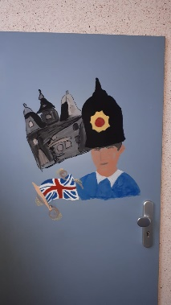
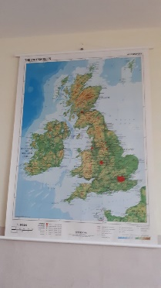
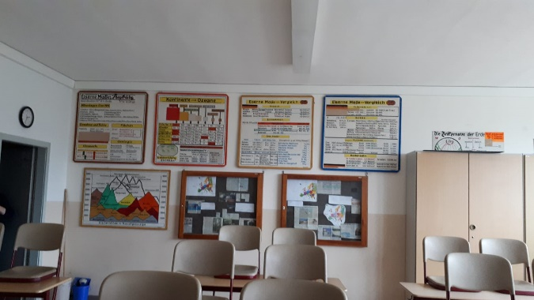
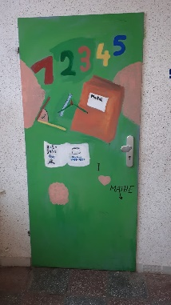
Classrooms
We have many decorated room, corridors and floors.
For example the English room door and
the Maths room door.

Slide 6
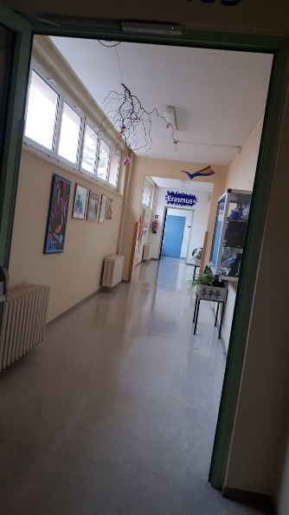
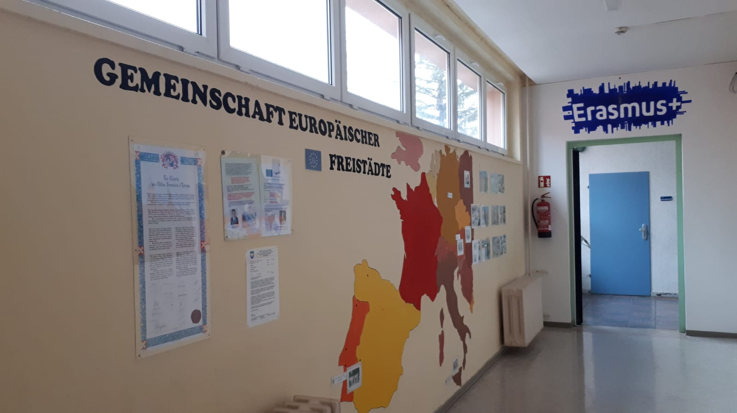
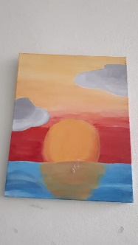
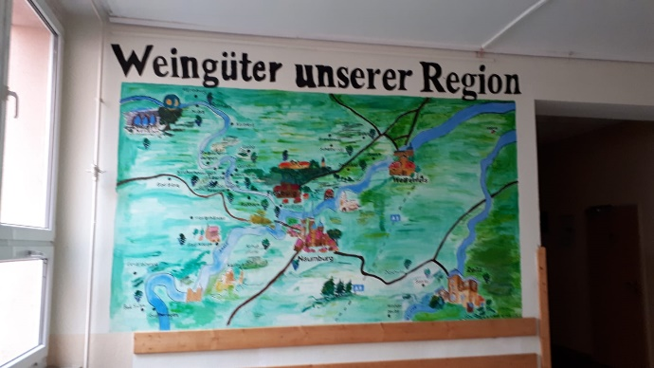
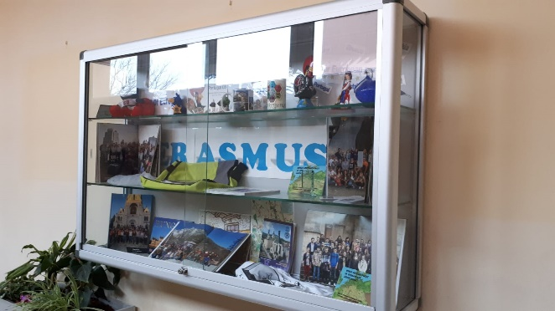
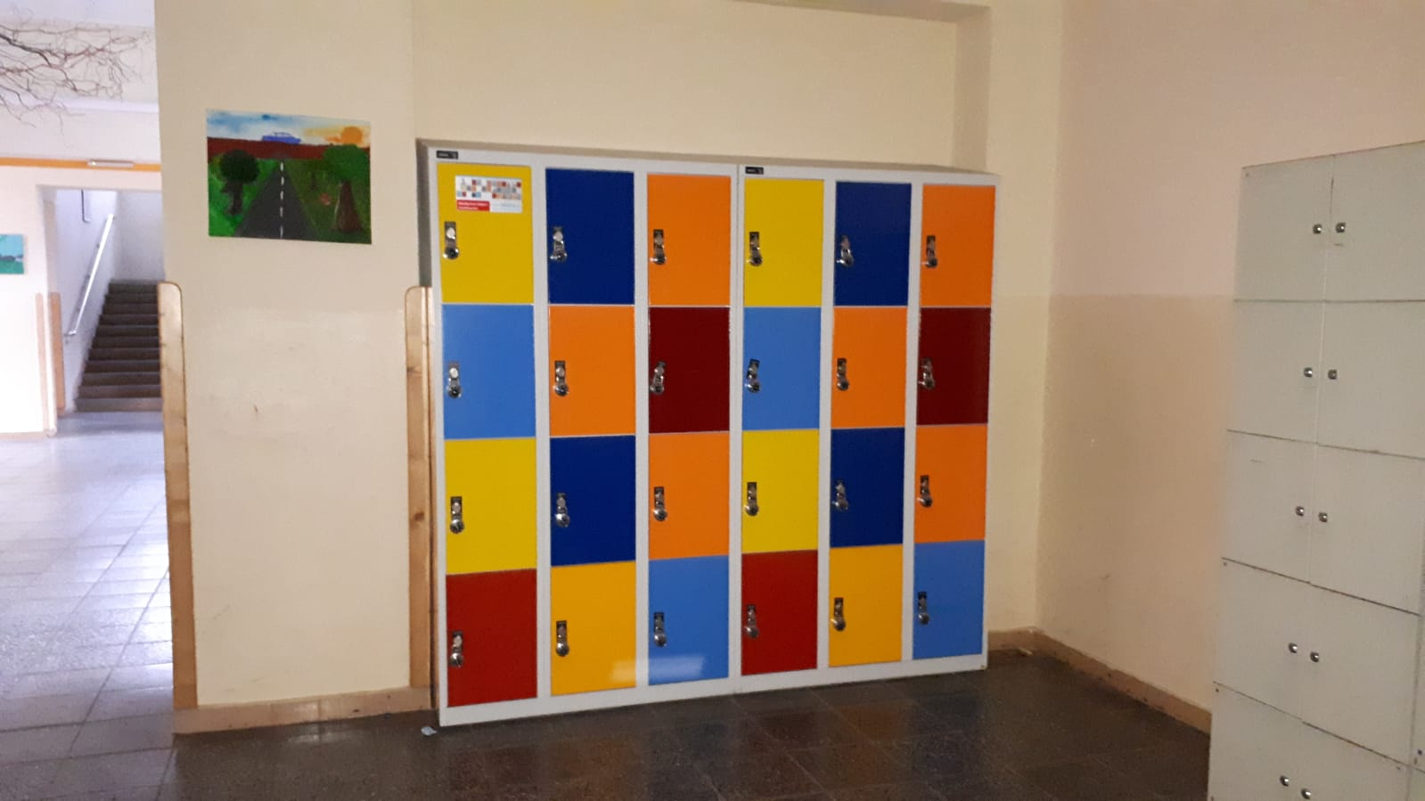
School corridor
This is our Erasmus+ floor.
And this is our foyer with lockers.
Wineries of our region

Slide 7
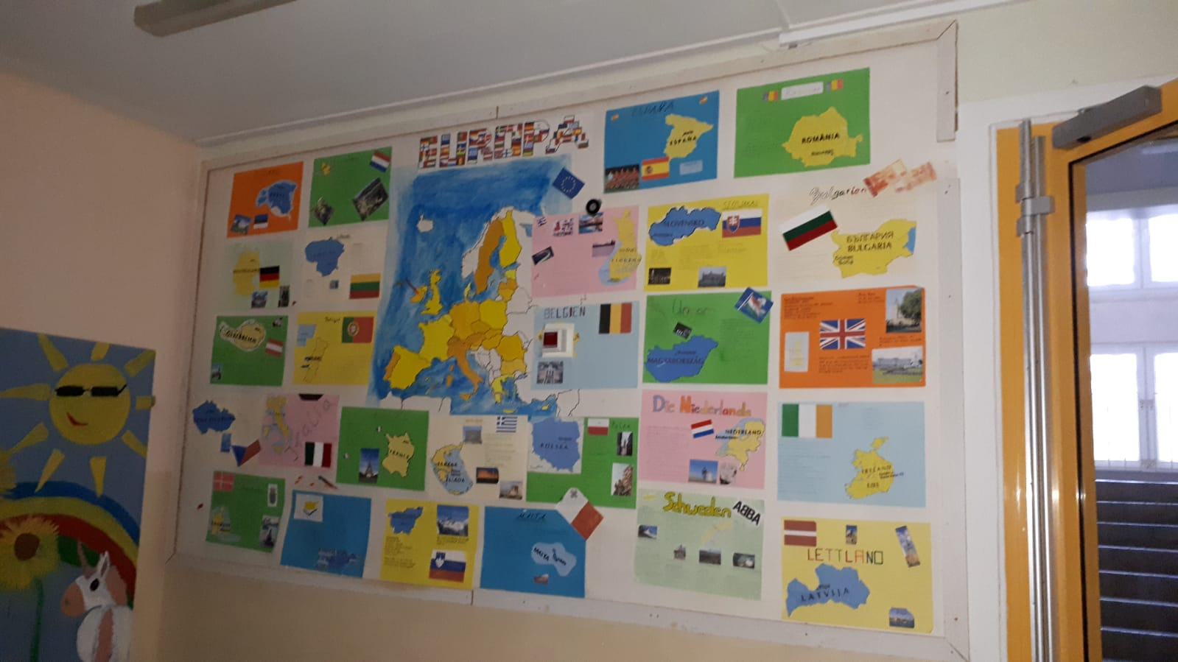
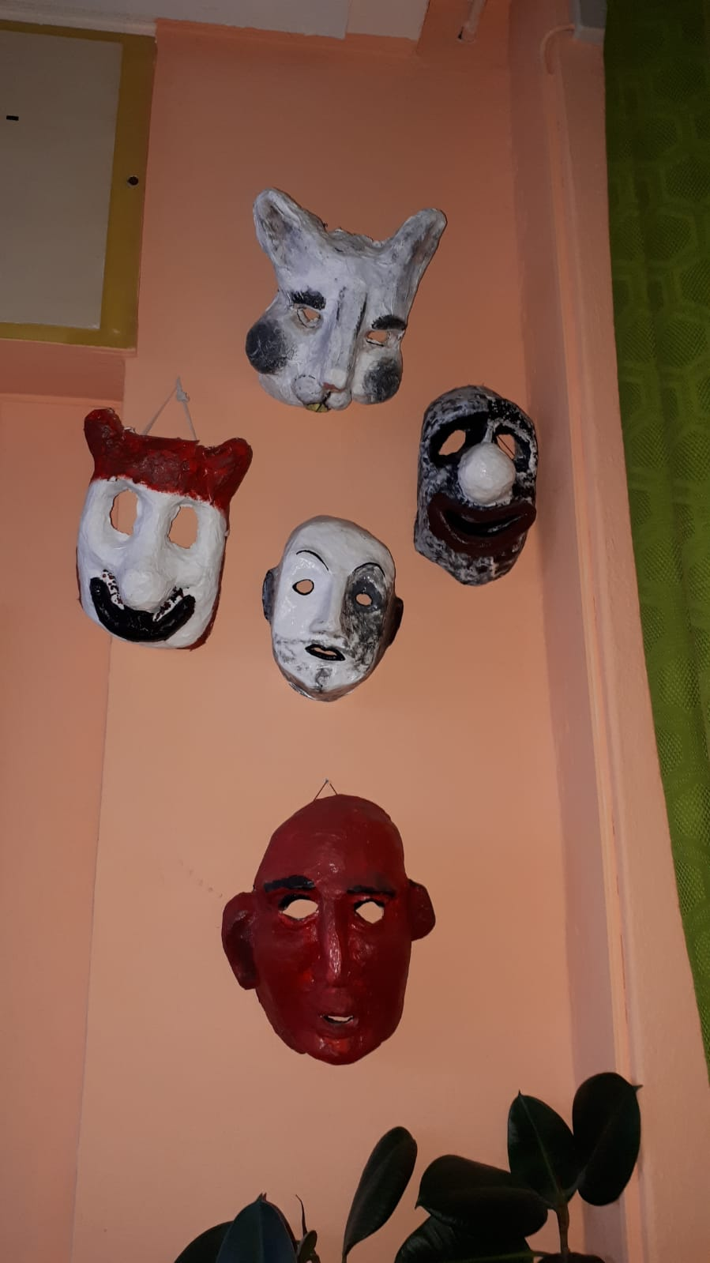
Art

Slide 8
We are looking forward to your visit.

