Slide 1
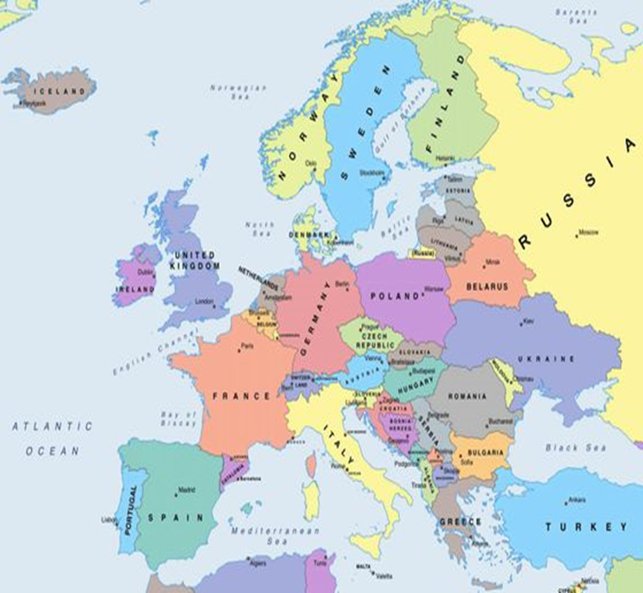
This is Germany, the country where we live.
Germany has
82,79 million inhabitants and an area of
357.386 square kilometres.

Slide 2
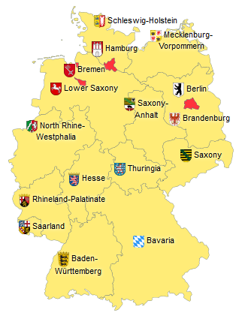
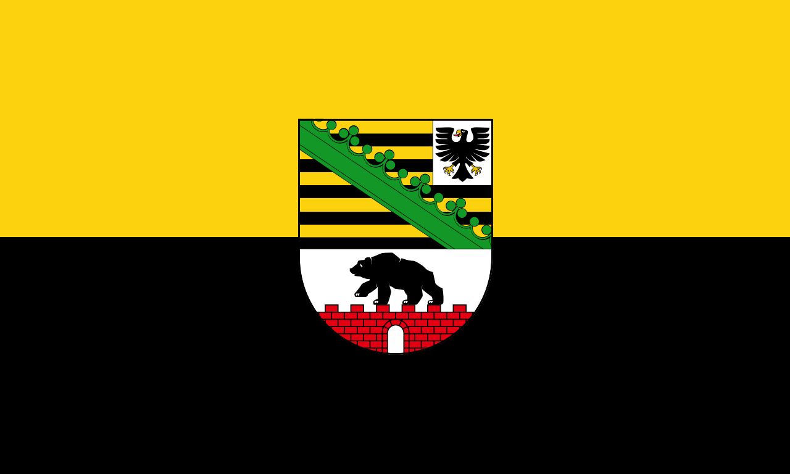
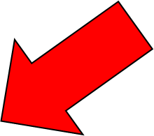
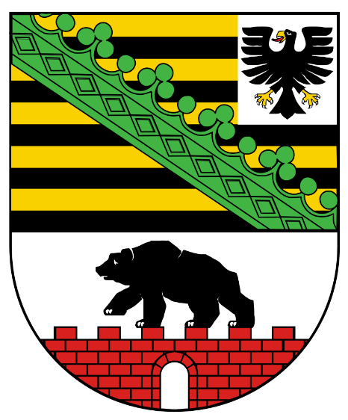
Saxony-Anhalt
This is Saxony-Anhalt, our federal state.
There live about 2,23 million people and it has an area of 20.451,58 square kilometres.

Slide 3
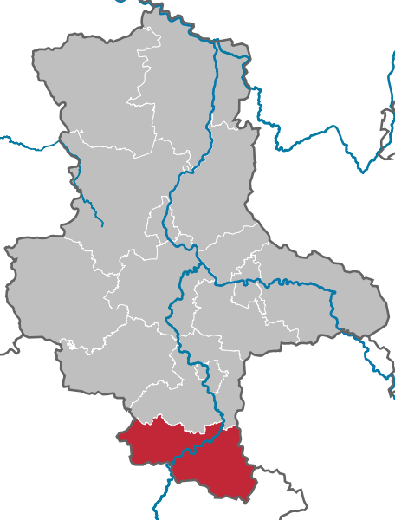
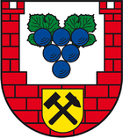
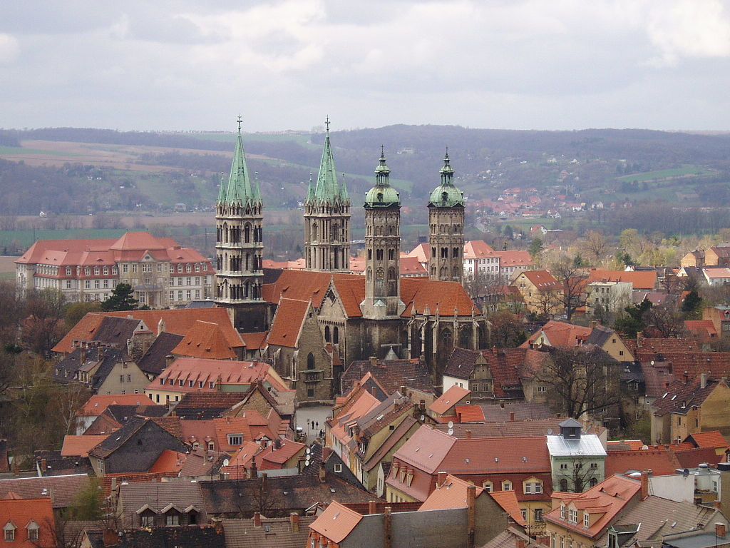
In the south of Saxony-Anhalt you can find our district: the Burgenlandkreis – in English: Castle District.
Here live 181.968 people in an area of 1.413,67 square kilometres.
There are 33 communities in our district, towns and villages.
Our administrative town is Naumburg.

Slide 4
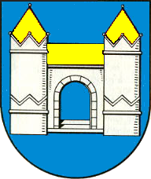
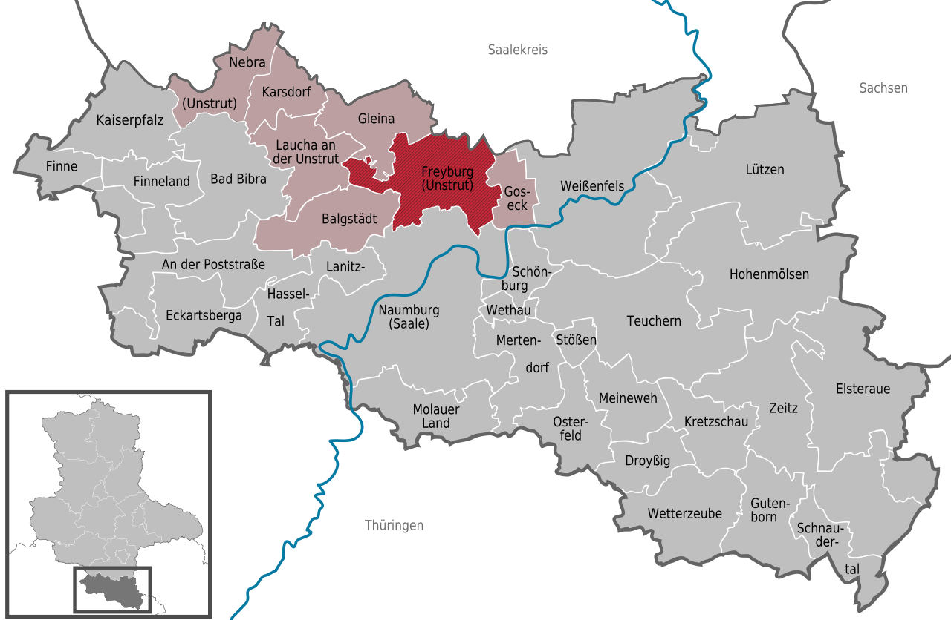
Freyburg has got 4706 inhabitants in the town and its 7 villages around.

Slide 5
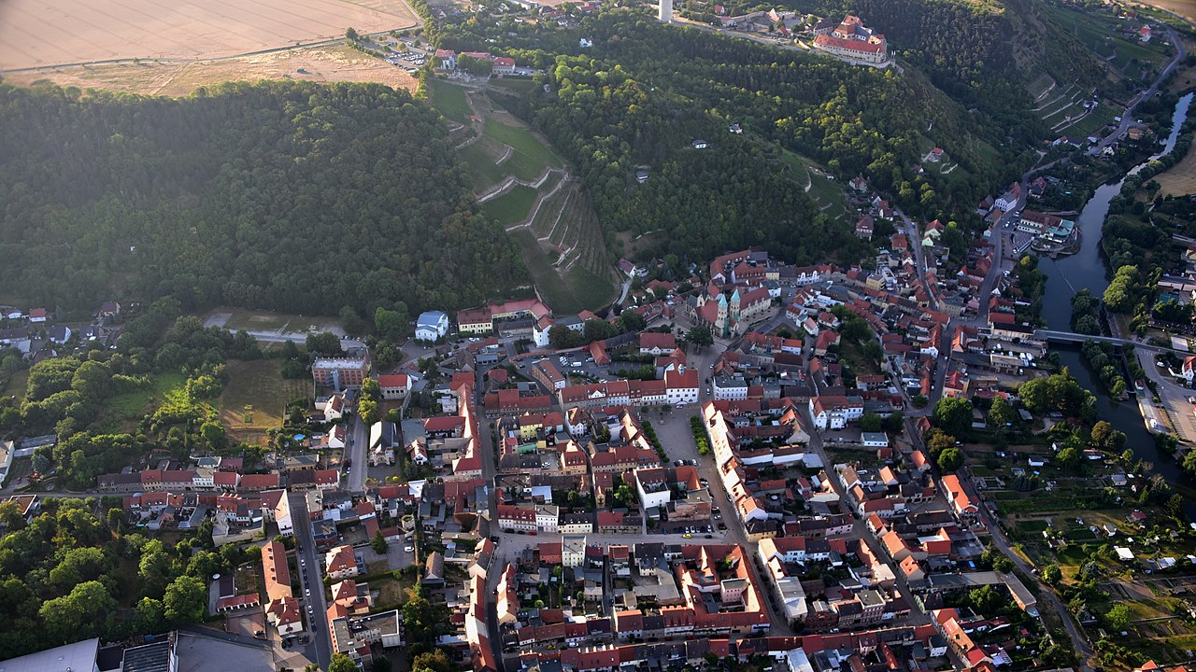
Freyburg is located on a bend of the Unstrut, which forms a deeply cut valley at this point. Since the Unstrut runs from west to east, the southern slopes in combination with the soils offer ideal wine-growing conditions.

Slide 6
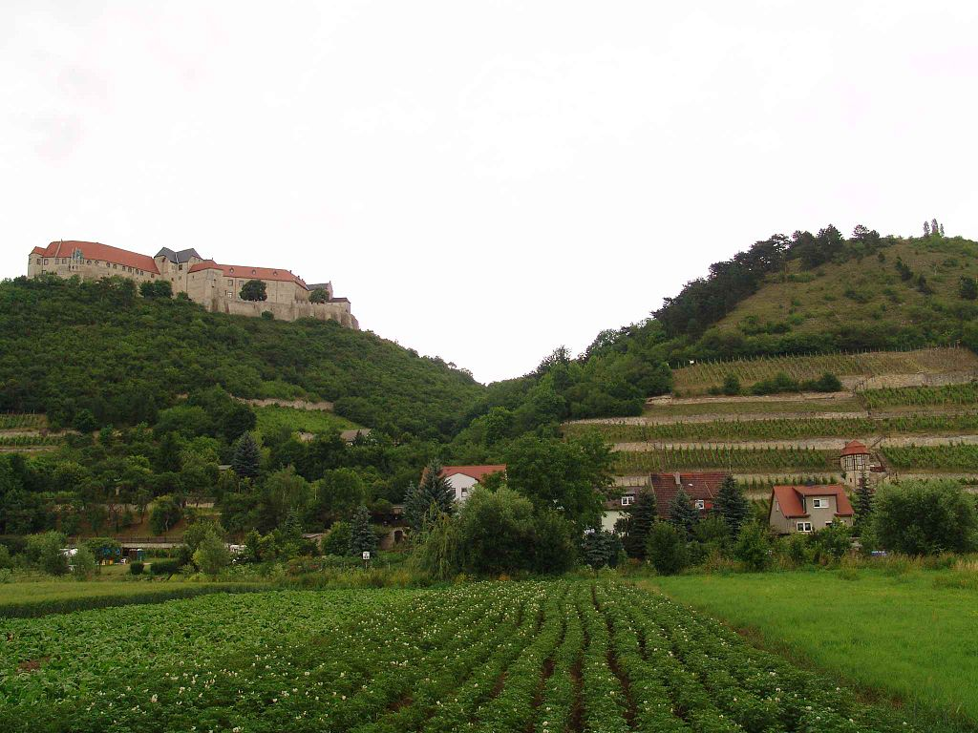
The history of Freyburg begins with around 1090 when the Neuenburg Castle was built on a mountain east of the present town.
The place Freyburg belonged to the territory of the landgraves in Thuringia, was first mentioned in 1203 and got town law in 1261.

Slide 7
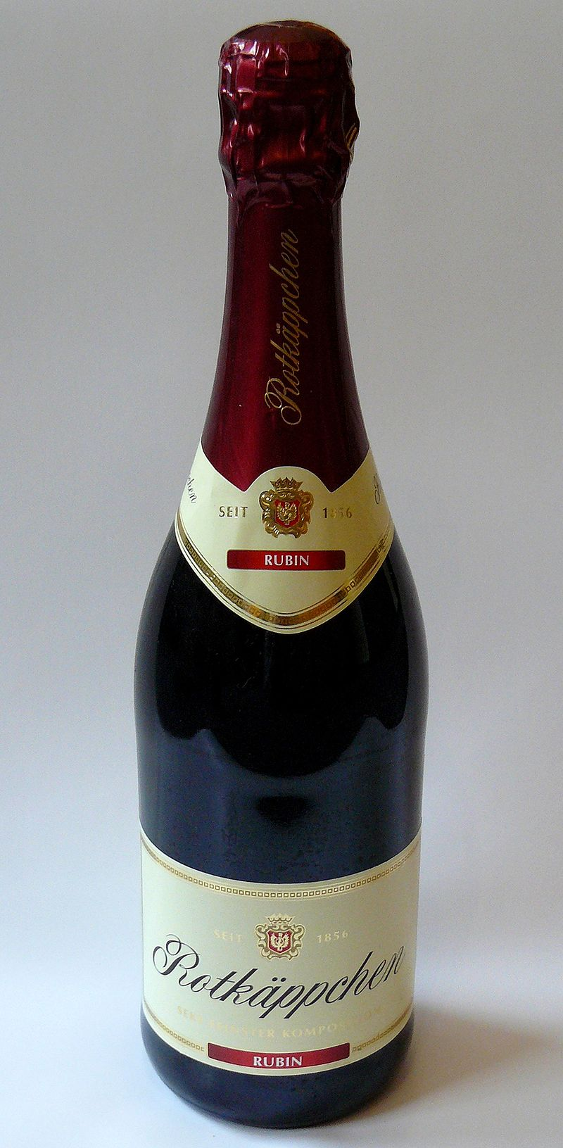
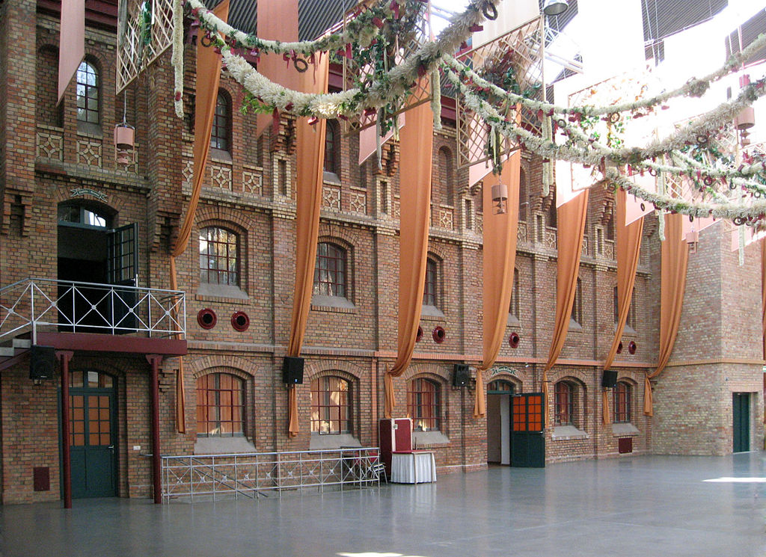
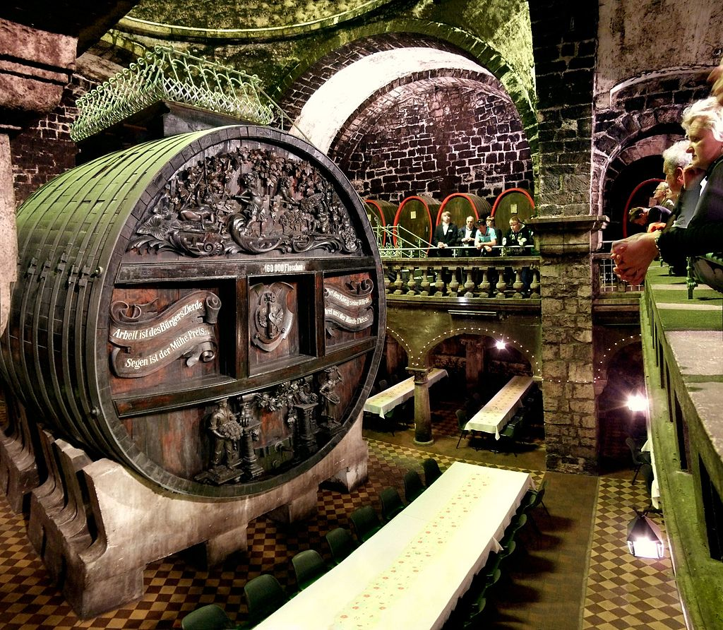
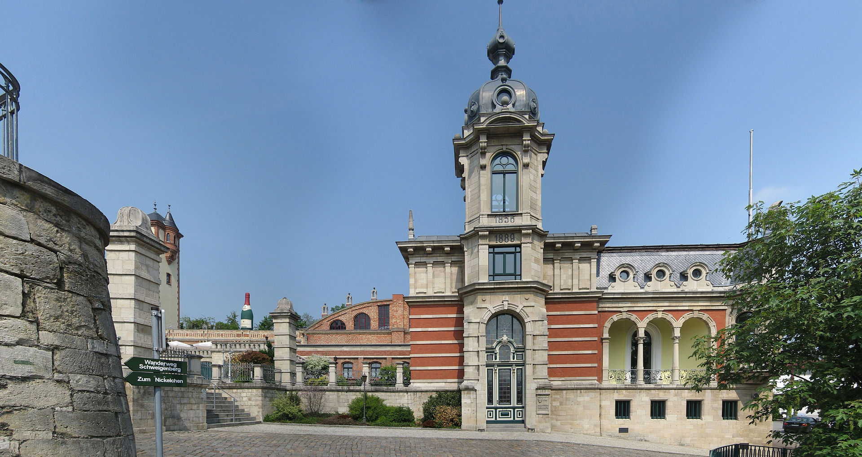
The economy of the city has been dominated since 1856 by the production of sparkling wine. Today Rotkäppchen-Mumm Sektkellereien GmbH is headquartered in Freyburg and is the market leader in sparkling wine sales in Germany with more than 100 million bottles sold each year (including 65 million bottles of Red Riding Hood). Although Rotkäppchen employs only about 100 people in Freyburg, the name makes it a major tourist attraction. The former production facilities, which include 120.000 liters capacity of one of the largest oak barrels in the world, are shown on guided tours and both the covered atrium of the old production facilities as well as the cabaret cellar represent the cultural centre of Freyburg.
“Red Riding Hood”
covered atrium
oak barrel

Slide 8
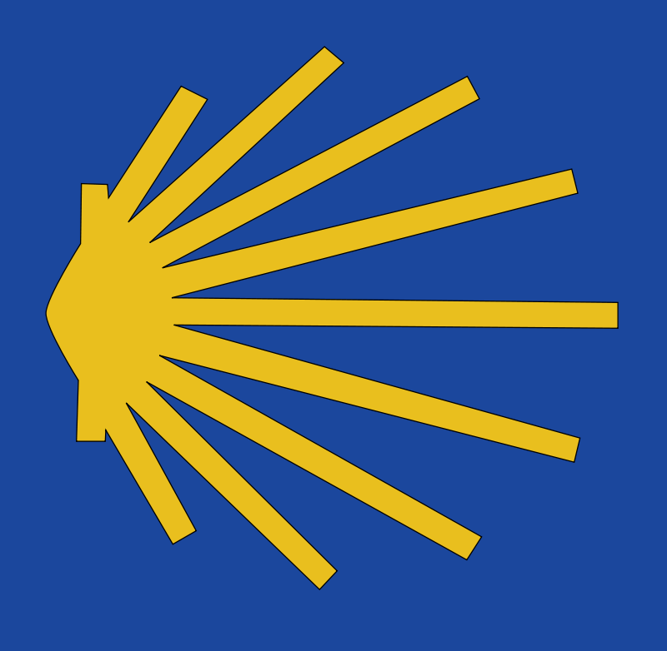
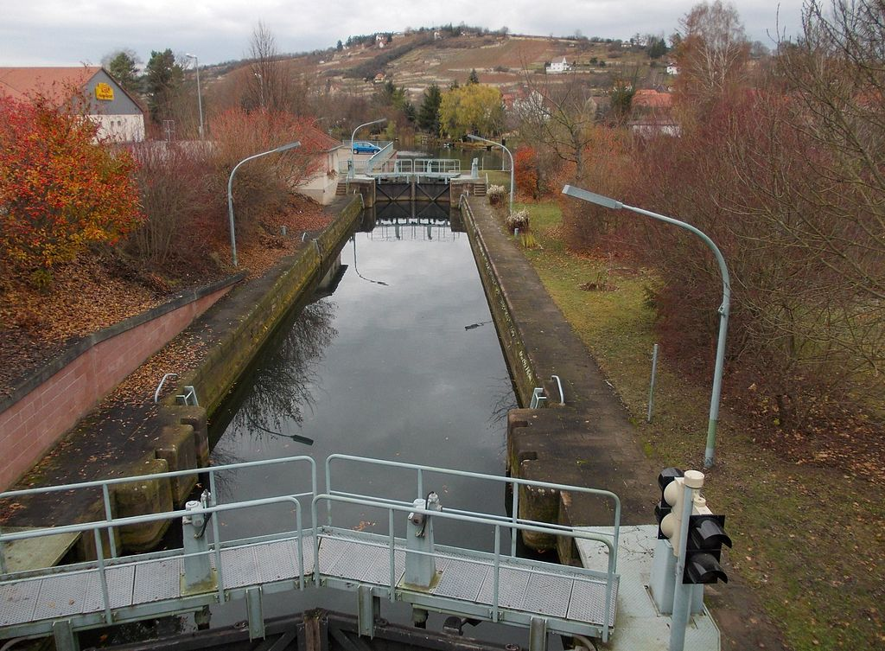
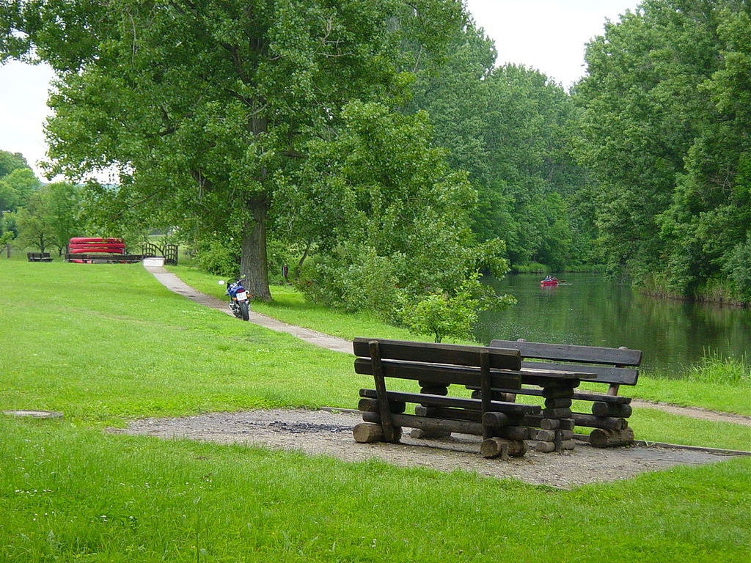
The Romanesque Route and the wine route Saale-Unstrut, both celebrating their 25th anniversary in 2018, the 176-kilometer Unstrut bike trail and the Ecumenical Pilgrimage from Görlitz to Vacha, lead through the town.
A lock allows water walkers to bypass the Unstrut weir in Freyburg.

Slide 9
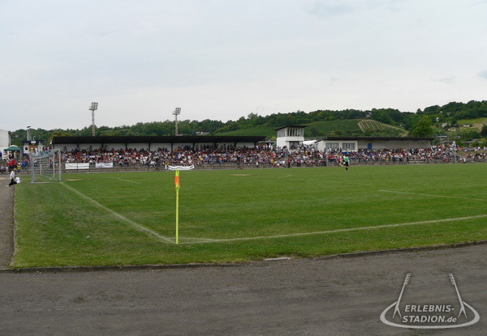
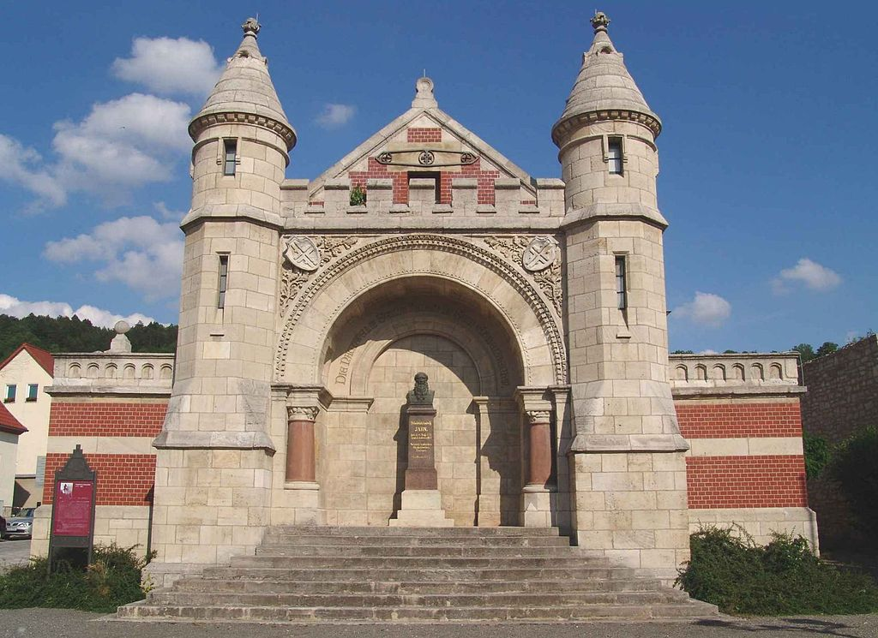
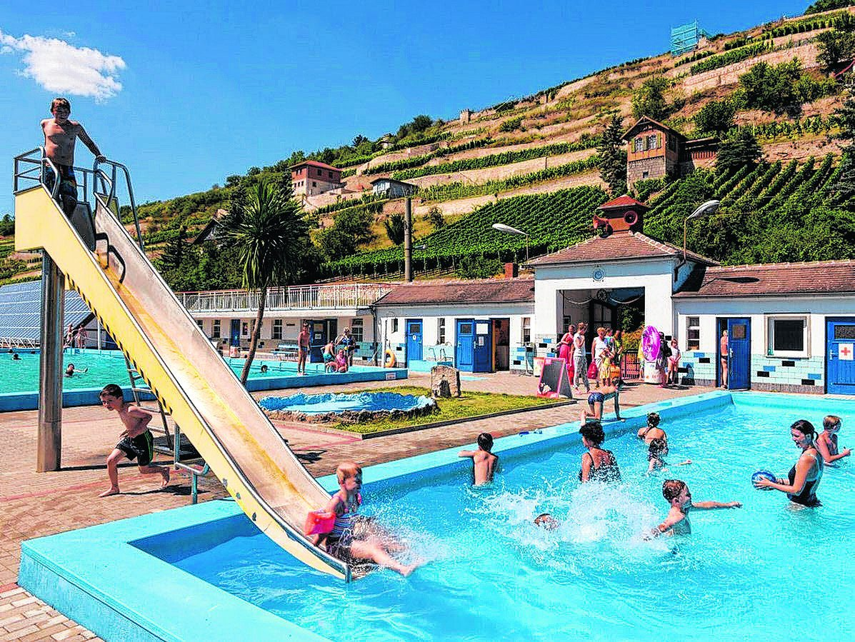
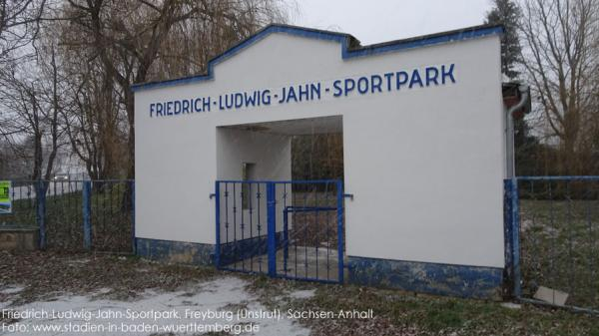
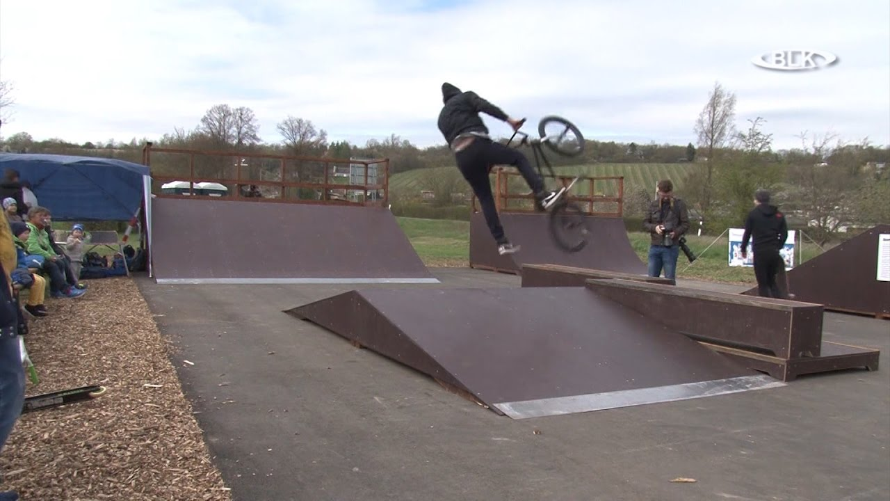
In Freyburg there are more than 30 clubs for sports, culture and tradition. With two gymnasiums and the Friedrich-Ludwig-Jahn-Sportpark (with bowling alley) as well as a swimming pool, which is supported by a club, the city offers a lot of opportunities for physical activity.
In 2017, a skate park was opened in the north of the town.

