Slide 1
serbia

Slide 2
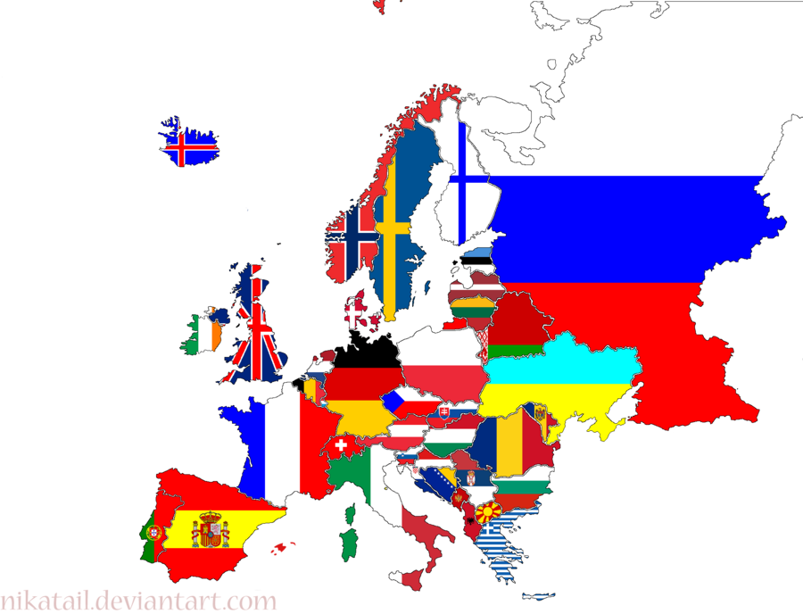
EUROPE

Slide 3
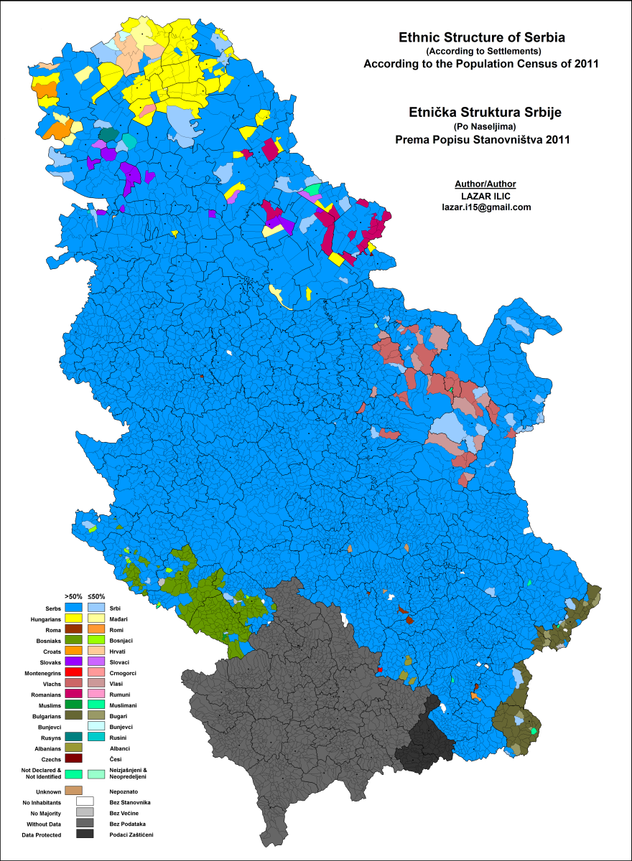
Name of state: Republic of Serbia Capital city: Belgrade - White City
Population in Serbia:
more than 7,000,000
Population in Belgrade:
more than 1,600,000

Slide 4
FRENCH AND SERBIAN FLAGS
Stripes on the French flag are vertical: Blue - White – Red On Serbian flag stripes are horizontal with a coat of arms to the left that includes a white double-headed eagle from the Nemanjić dynasty. The Nemanjić dynasty ruled from the late 12th to the mid-14th century.

Slide 5
Capital city: Belgrade - More than 1,600,000 people live here. Belgrade change its name several times. The Celts called it Sngidun, which the Romans later changed into Singidunum and we changed it into Belgrade/White City mostly because of its white architecture (buildings). The name Belgrade is mentioned for the first time in the 9th century but in 1284 Belgrade comes under Serbian rule for the first time. 1403 - Under Despot Stefan Lazarević Belgrade becomes the capital of mediaeval Serbia.

Slide 6
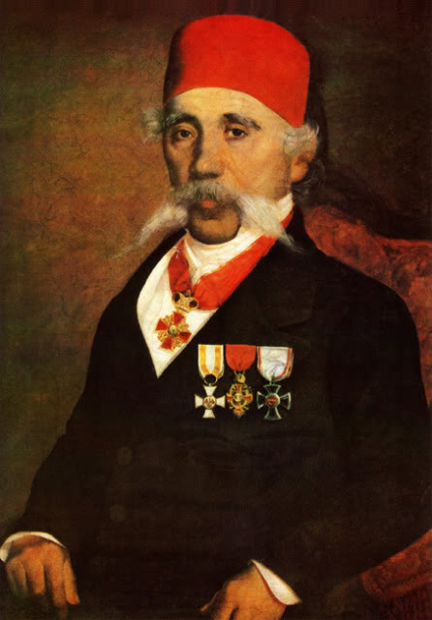
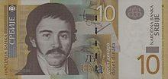
Serbian alphabet
10thcentury – The Cyrillic script was developed but it had many strange letters. Vuk Stefanović Karadžić was a Serbian linguist and he changed Cyrillic Alphabet and in 1818 he published the First edition of Serbian dictionary. Serbian Cyrillic Alphabet is our official alphabet.
Vuk Stefanović Karadžić

Slide 7
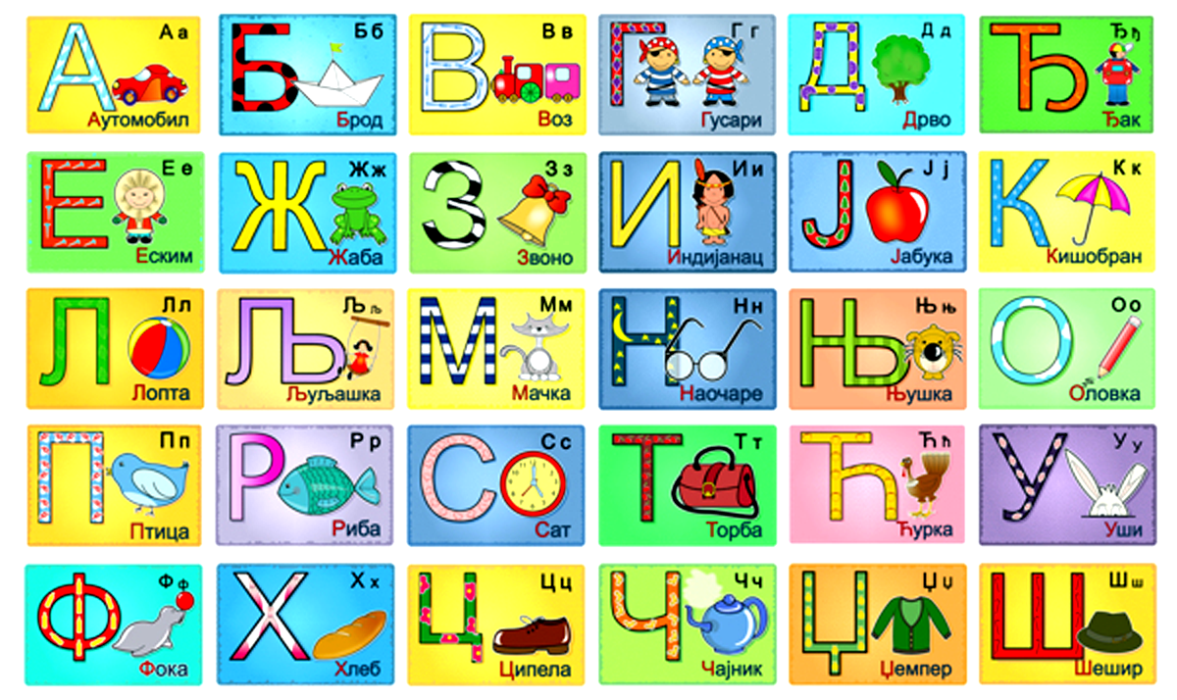
Serbian Cyrillic Alphabet

Slide 8
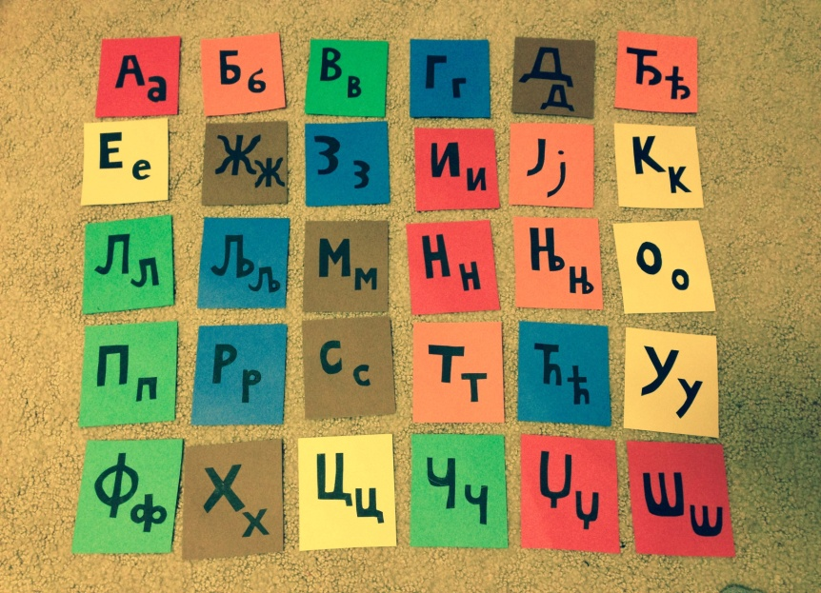
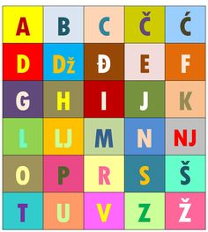
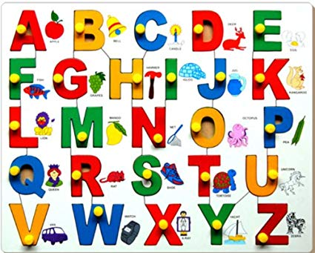
Serbian alphabet
Madame Martin Gospođa Martan Госпођа Мартан Ivana Pusica Ivana Pušica Ивана Пушица

Slide 9
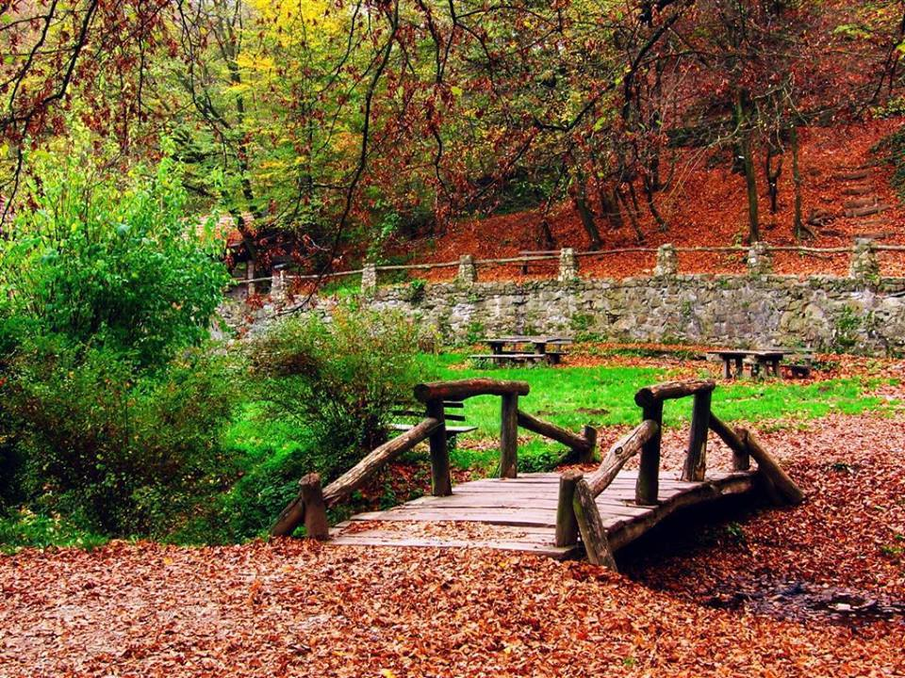
The Fruška Gora National Park
The Fruška Gora National Park – has many villages, meadows and lakes, dense forest inhabited by deer, boars and other wildlife. Fruska Gora is 60 km from Belgrade.

Slide 10
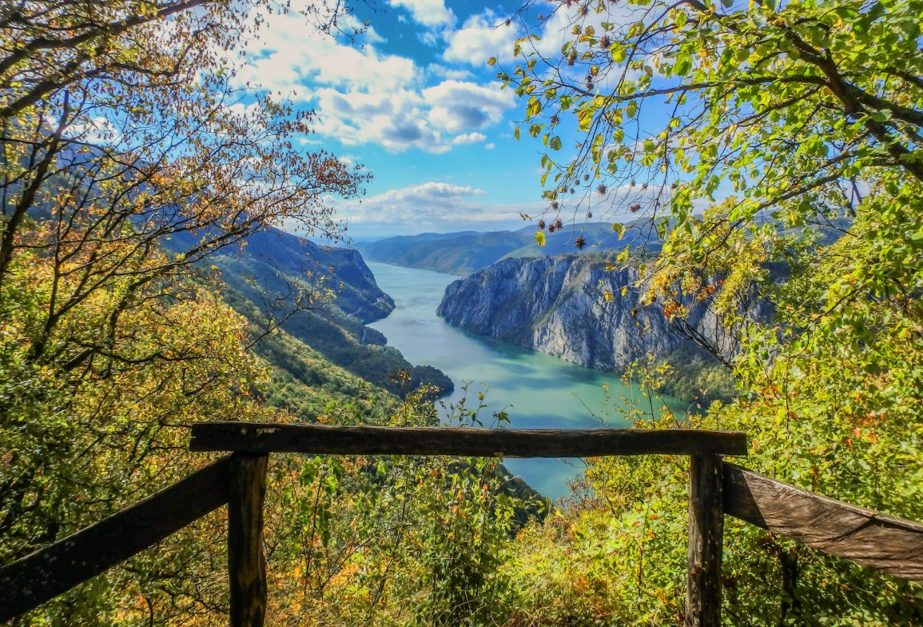
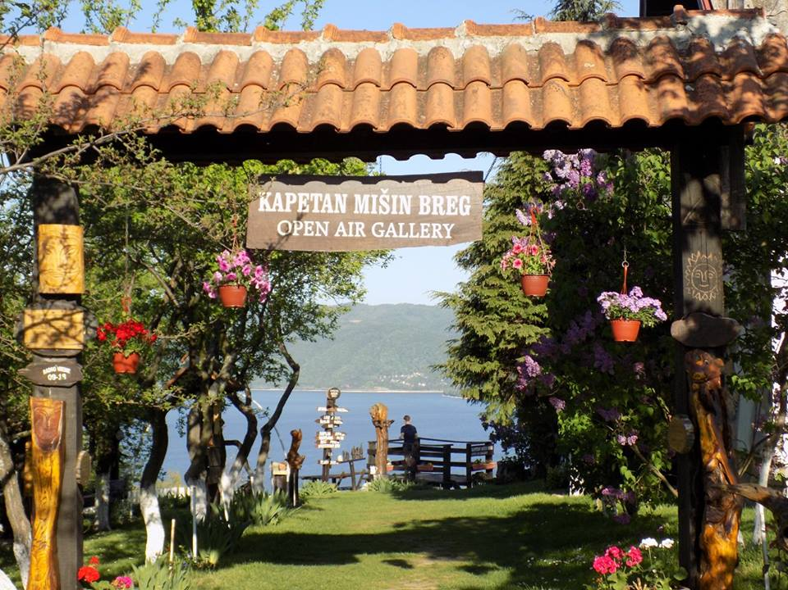
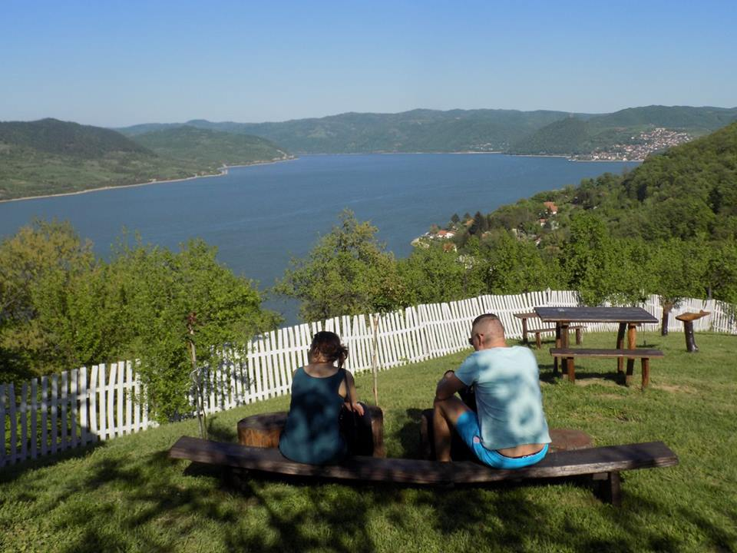
The Đerdap National Park
The Đerdap National Park is the biggest national park in Serbia. It also known as the Iron Gates of the Danube. Djerdap Gorge is the biggest in Europe. Many rivers and over thousand caves of extraordinary beauty are hidden on the right bank of the river, from the Golubac fortress to the ancient fort of Diana.

Slide 11
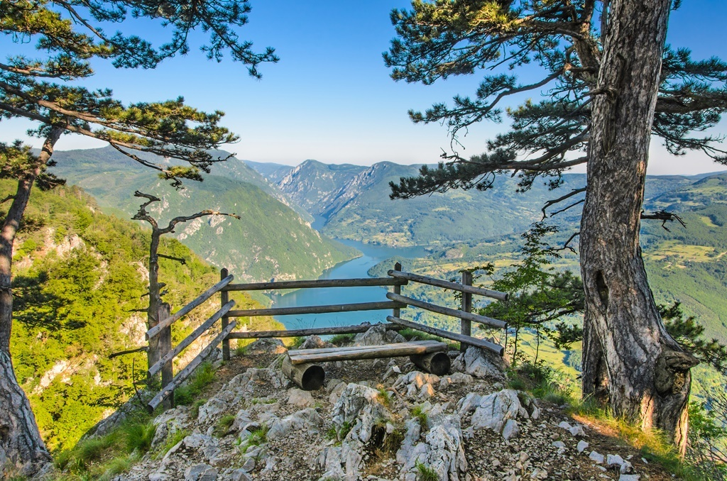
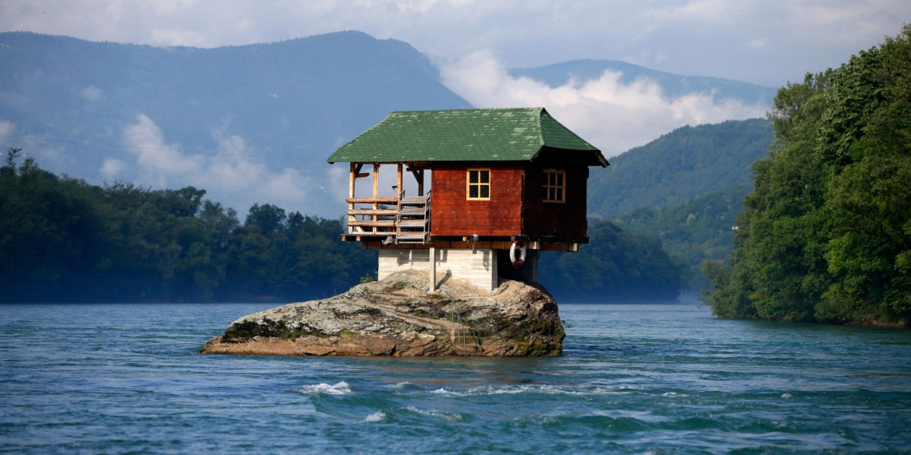
The Tara National Park
The Tara National Park is one of the most beautiful places in Serbia. There are many lakes, ethno villages, and beautiful Tara river.

Slide 12
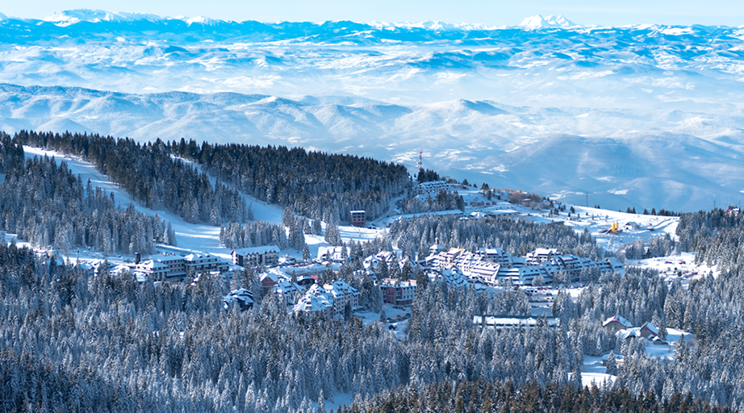
The Kopaonik National Park
Kopaonik is the most popular ski-resort in Serbia with more than 160 days of snow per year. It has over 60 kilometers of ski tracks. Pančićev Vrh is the highest peak here and it is 2017m high.
Kopaonik is called also “the Silver Mountain”

Slide 13
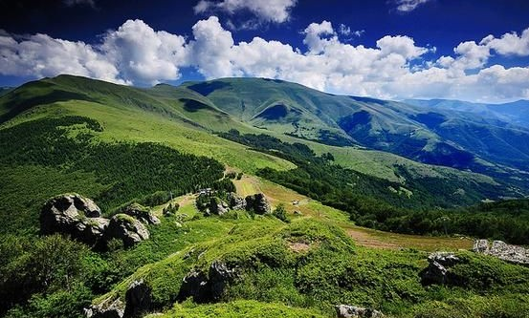
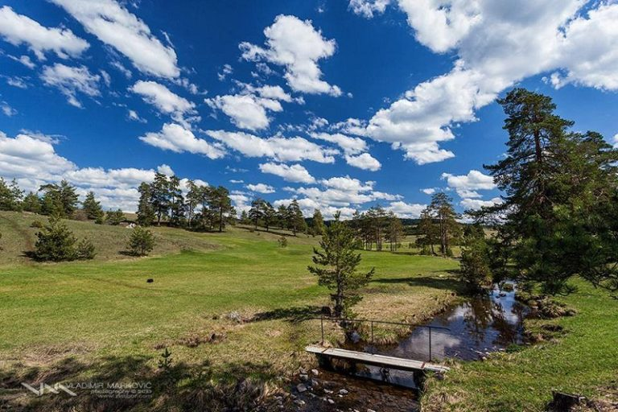
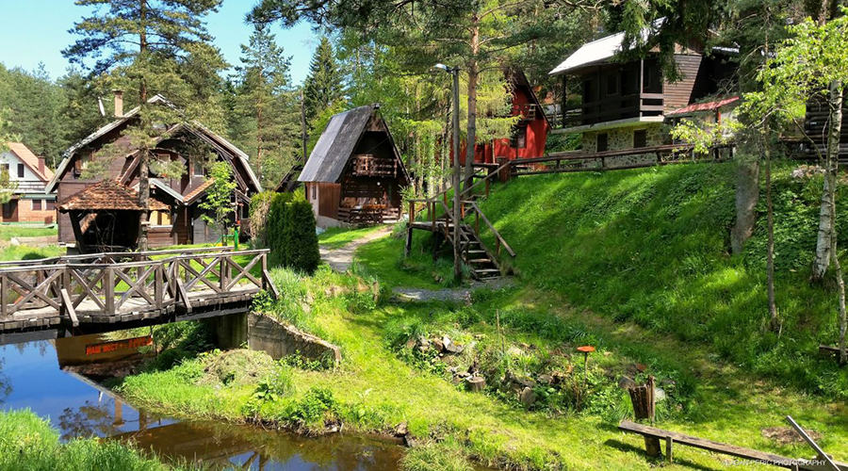
Other mountains in Serbia
Stara planina (the Balkan mountains), is 550 kilometers long and it connects Serbia and Bulgaria. The highest peaks are Dupljak (2032m) and “Babin zub” (1,758 m).
Divcibare ski resort is only 2h drive from Belgrade. It is part of Maljen Mountain. The highest peaks are Kraljev Sto, at 1,104m and Crni Vrh at 1,043 m.
Zlatibor is one of the most popular destinations for rural and sports activities. Ski center Tornik is 1496m high.

Slide 14
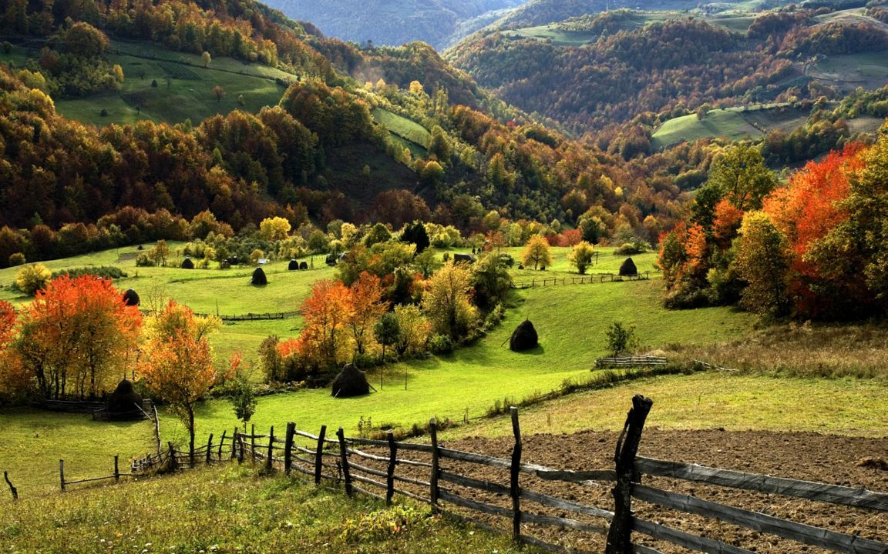
ZLATIBOR

Slide 15
Rivers
The Danube river goes through ten countries. There are seven large fortresses built on the banks of the Danube river.
The Sava is a river of extraordinary beauty and power. Just before the confluence with the Danube it forms a small lake, also known as “the Belgrade Sea”
The Morava is the longest Serbian river.
It is 493 km long.
Once it was an important battle site that divided the Eastern and the Western Roman Empire, later the Austro-Hungarian Empire and Serbia, and today the Drina is the border between Serbia and Bosnia and Herzegovina.
The Lim runs is through Montenegro, Albania, Serbia, and Bosnia and Herzegovina.
The Ibar, runs through Montenegro, Serbia and Kosovo. It is 272 km long.

Slide 16
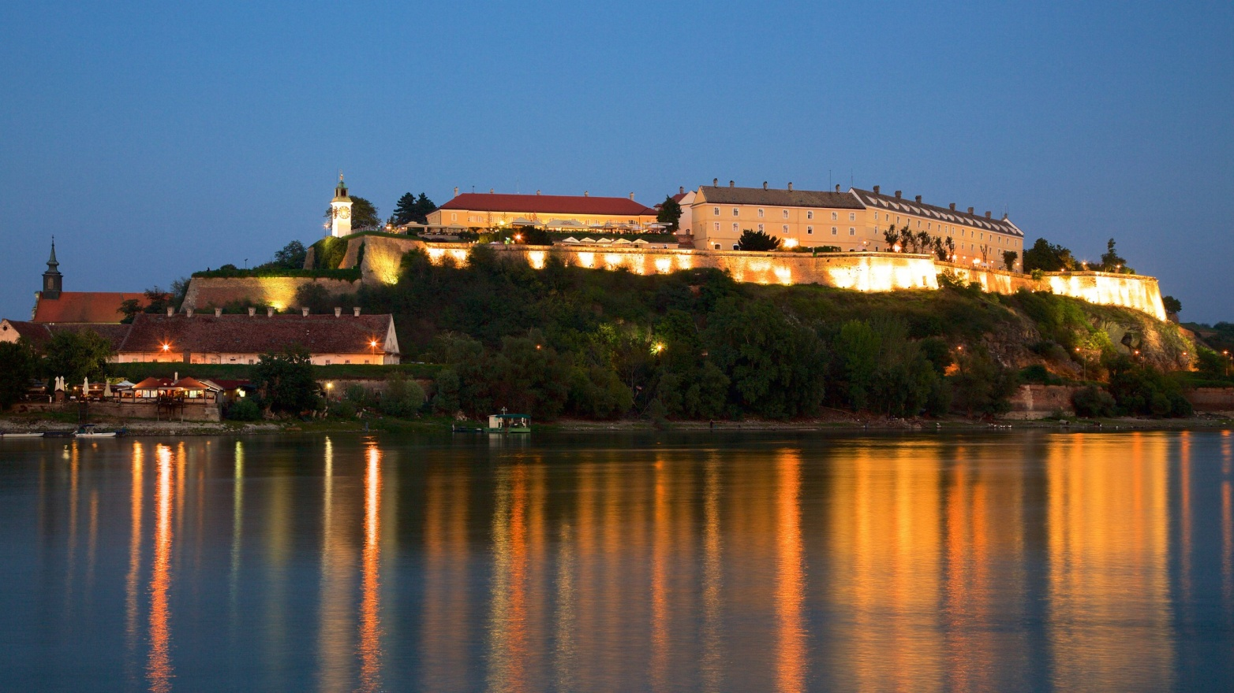
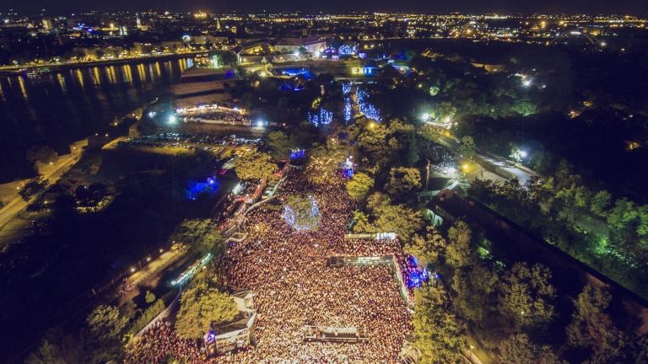
Petrovaradin fortress is very popular in July because of the EXIT festival which is held inside the fortress and it lasts for four days.

Slide 17
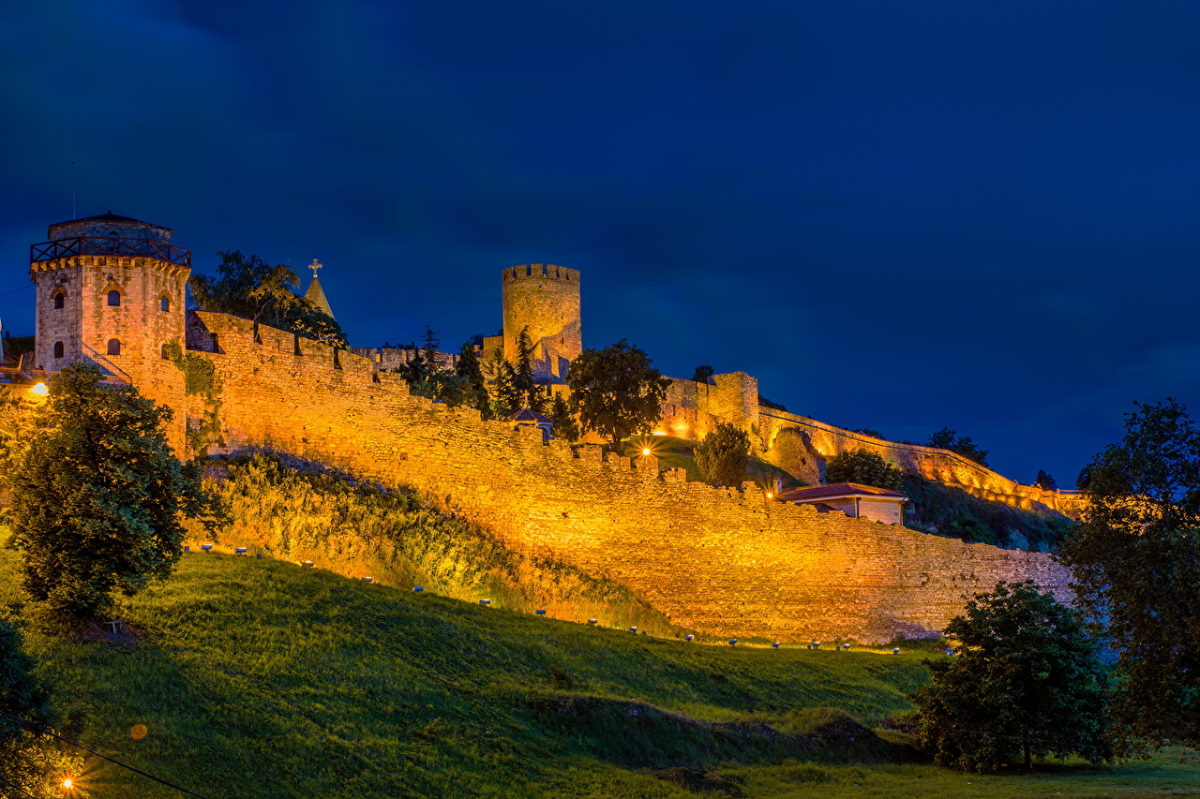

Slide 18
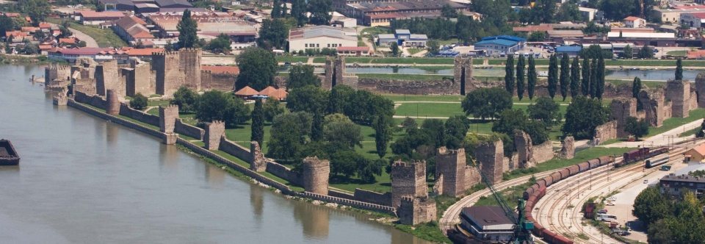

Slide 19
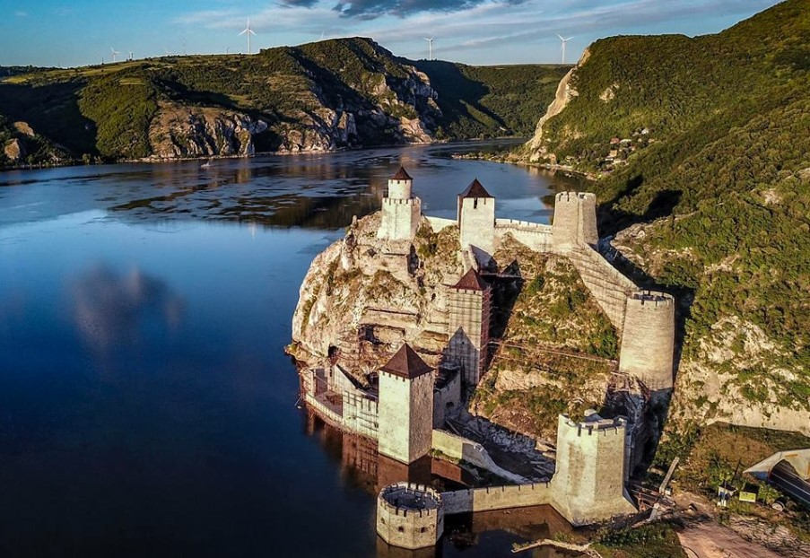

Slide 20
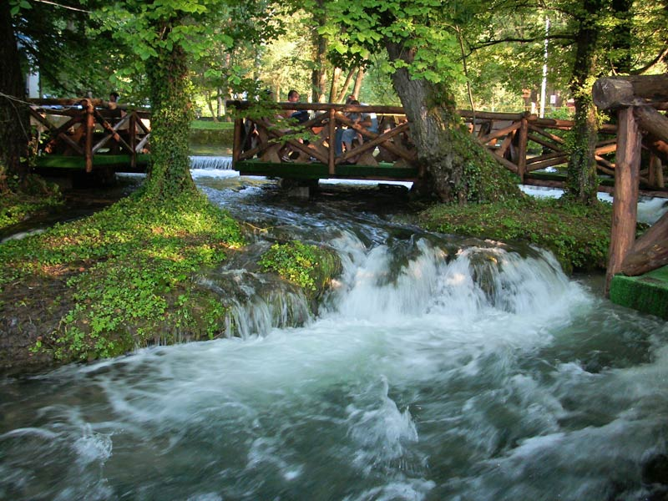
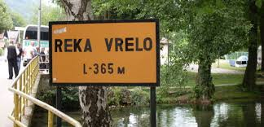
Lim, Drina, Ibar – are popular rafting places.
https://www.youtube.com/watch?v=0mFte3V6sFs
The Vrelo river (also known as A Year) is only 365 meters long and is probably one of the shortest rivers in the world.

Slide 21
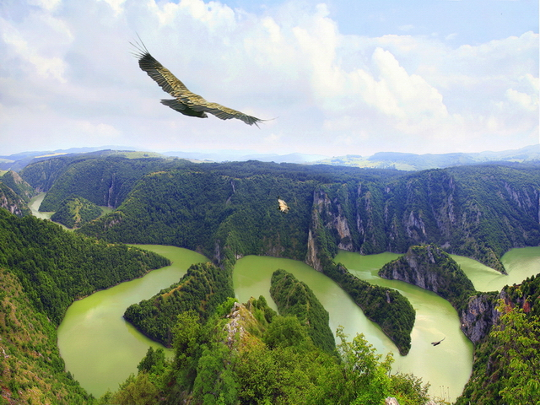
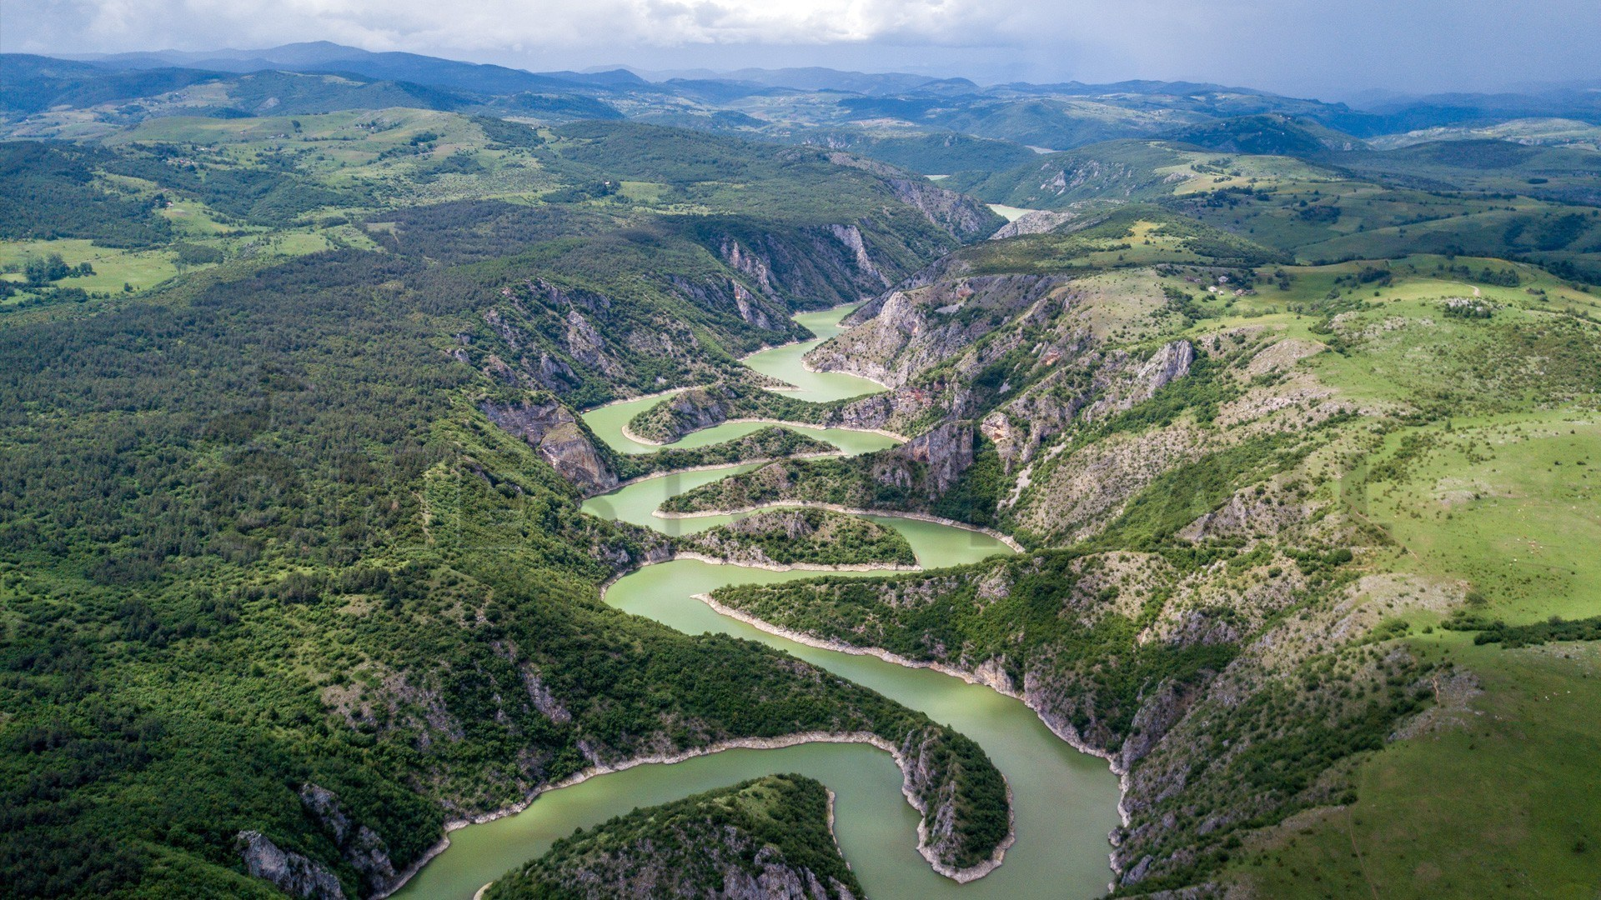
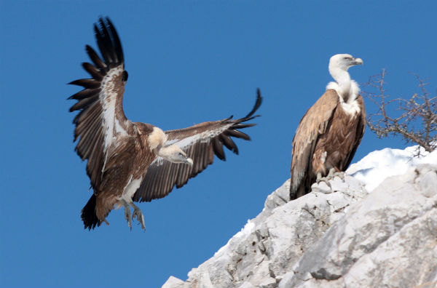
Lakes

Slide 22
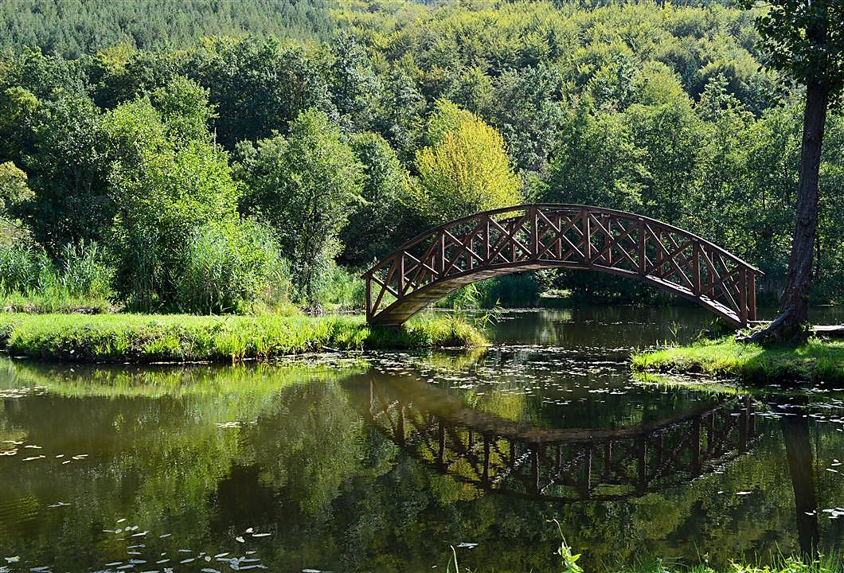
Semetes lake is popular because you can take a ride on its magical floating islands!
https://www.youtube.com/watch?v=dUgtK59OlmE

Slide 23
Religion and ethnic groups
Ethnic groups: Serb 83.3%, Hungarian 3.5%, Romani 2.1%, Bosniak 2%, and undeclared 3.4%
Religion: Orthodox 84.6%, Catholic 5%, Muslim 3.1%, Protestant 1%, atheist 1.1%, other 0.8% (includes Christians, Eastern religionist, Jewish), undeclared 4.5%

Slide 24
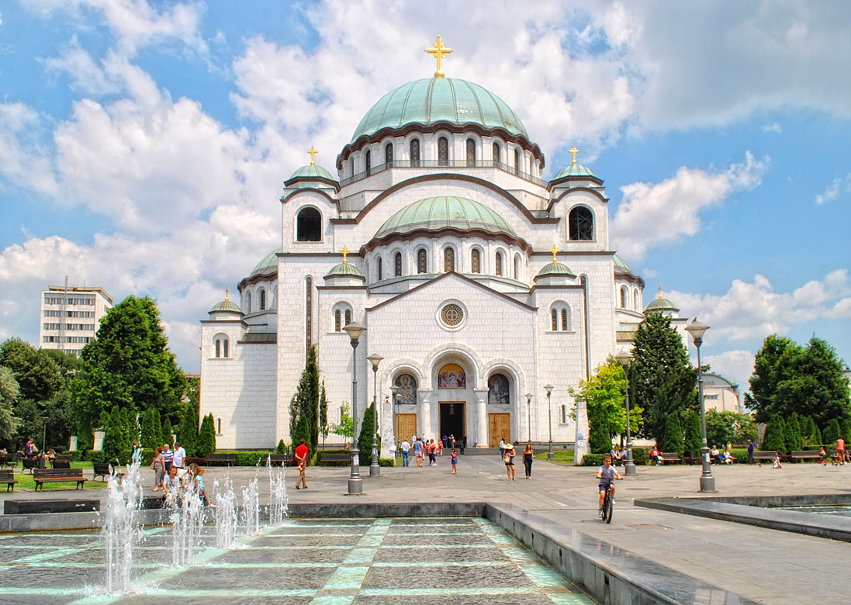
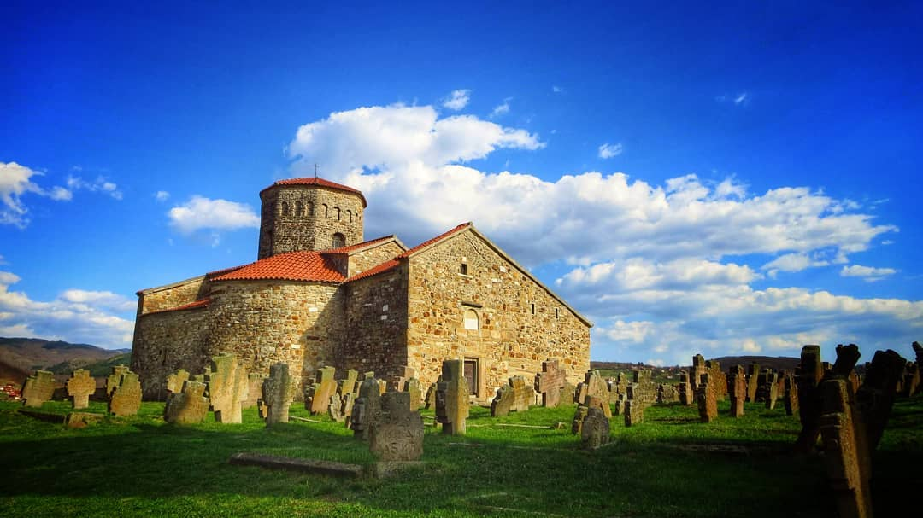
Temple of Saint Sava is the biggest orhtodox church in the Balkans.
Church of St Peter is the oldest orthodox church in Serbia. It is part of the Stari Ras complex, an UNESCO World Heritage Site. It was founded in the 4th century during Roman rule, and it is dedicated to Saints Peter and Paul. There are aroung 405 ortxodox manasteries and churches in serbia.

Slide 25
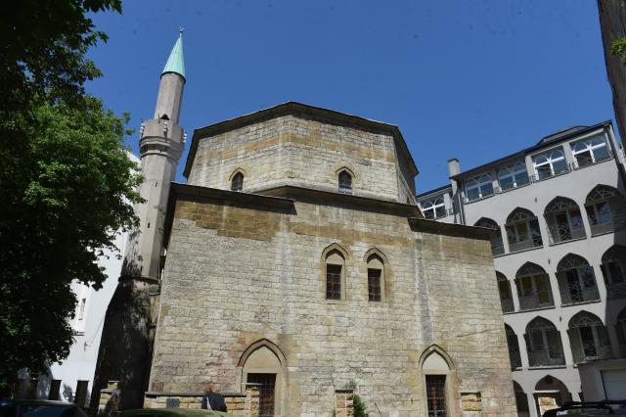
The Bajrakli Mosque in Belgrade built around 1575.

Slide 26
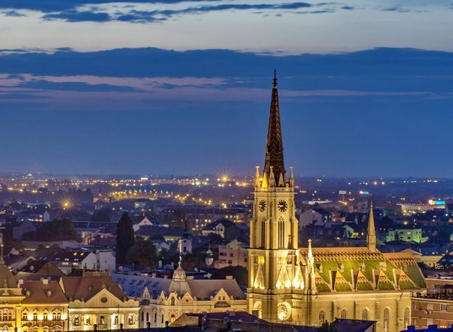
Roman Catholic Parish Church of “The Name of Mary”
It was being built from 1893 to 1895

Slide 27
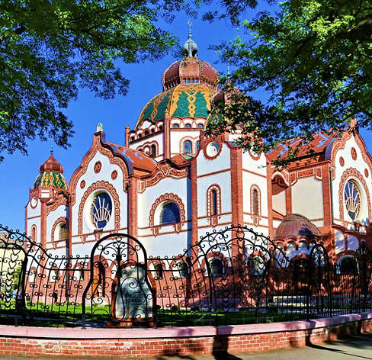
Subotica Synagogue is the second largest synagogue in Europe. It was built in 1901-1902.

Slide 28
The most famous serbians

Slide 29
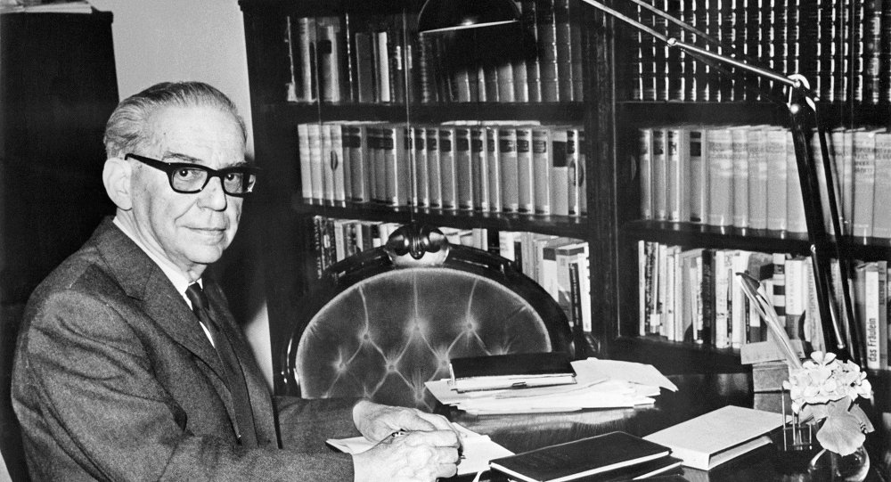
Ivo Andrić – novelist, poet and short story writer who won the Nobel Prize in Literature in 1961.

Slide 30
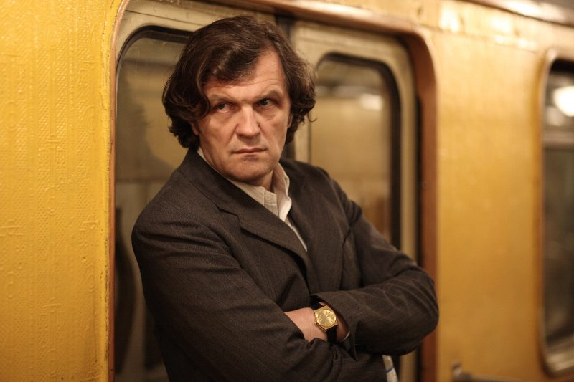
Emir Kusturica - director, musician and screenwriter

Slide 31
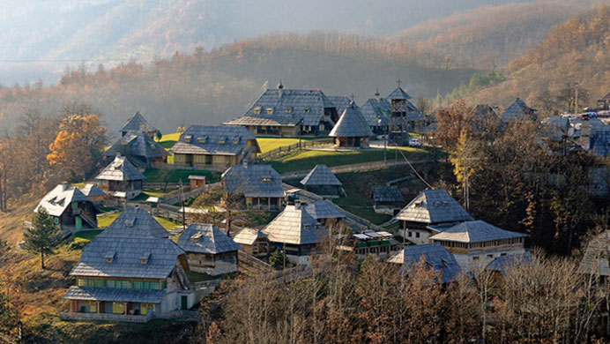
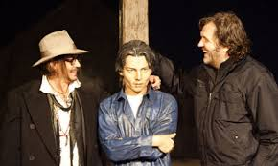
Drvengrad, on Mećavnik in Mokra Gora, is a place created by Emir Kusturica.
This ethno village, in the middle of nowhere, is a home of several festivals. The first one is ‘Kustendorf’, a film and music festival, for young filmmakers. Bolshoi’ Music Festival, for young performers of classical music.
Autumn Theatre Festival and the Writers’ Festival in May. This place was visited by the most eminent actors from the film world.

Slide 32
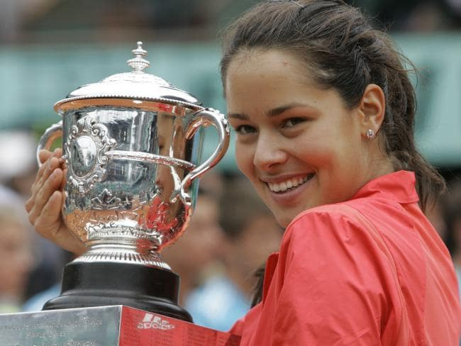
Ana Ivanovic: French Open champion in 2008 and world No. 1

Slide 33
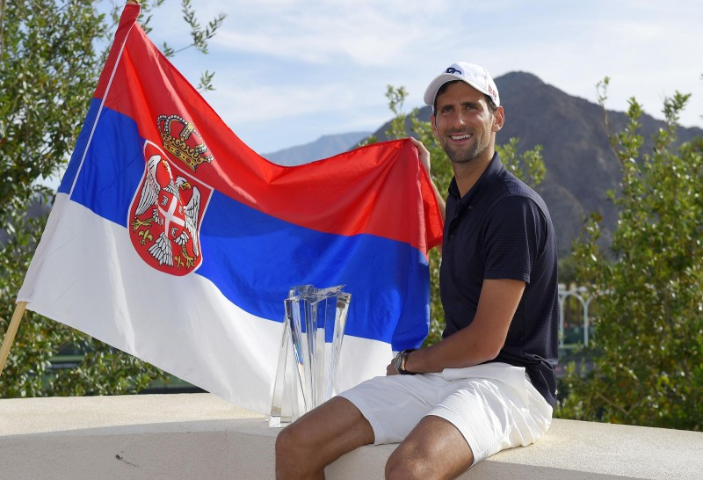
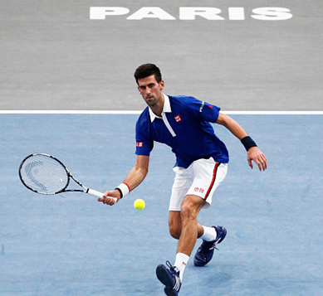
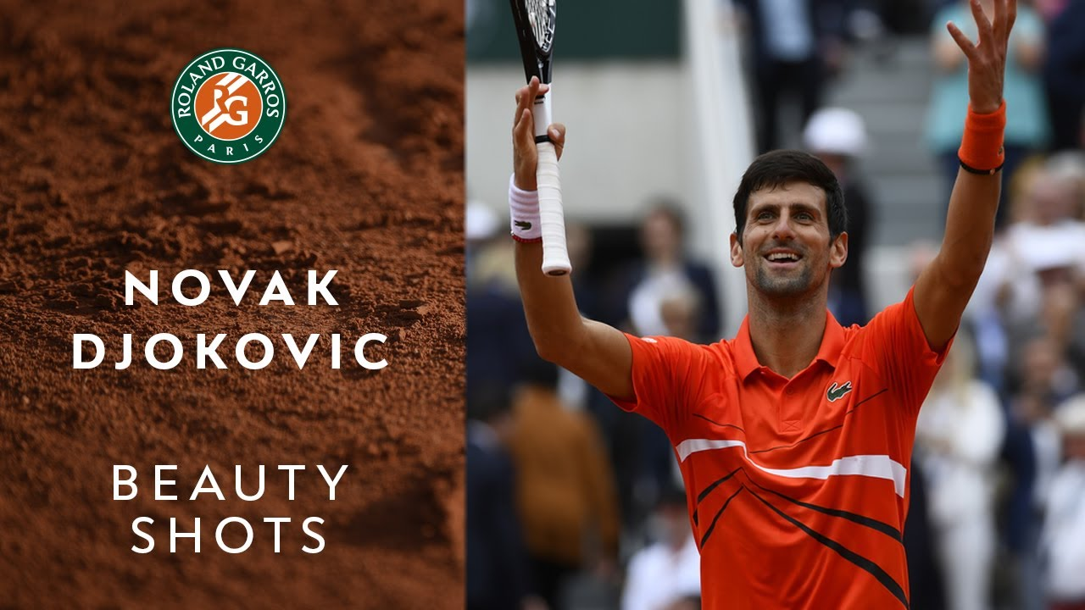
Novak Djokovic is a Serbian professional tennis player who is currently ranked world No. 1 in men's singles

Slide 34
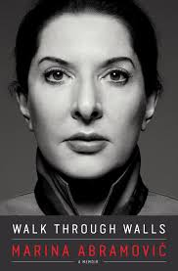
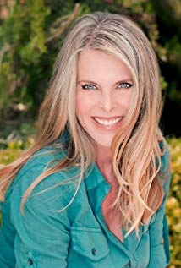
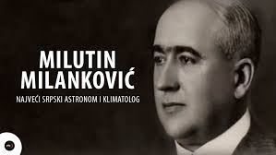
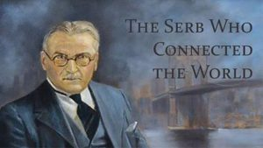
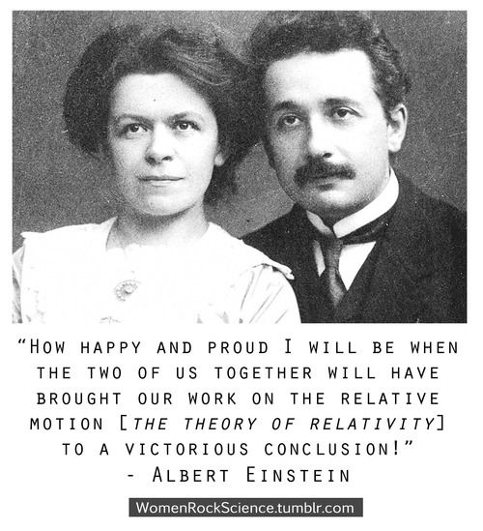
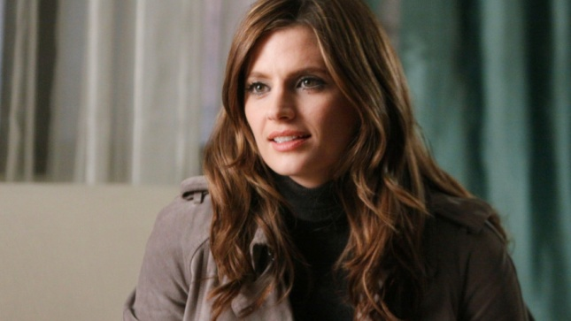
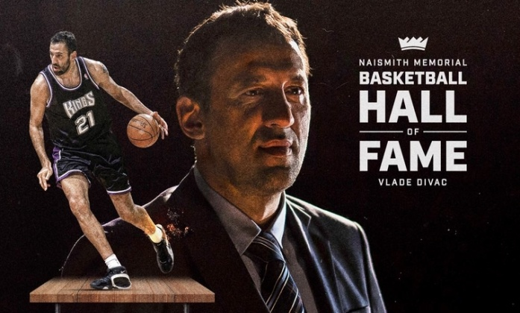
Suzana Drobnjaković, known by her stage name Sasha Alexander.
Catherine Oxenberg
Stana Katic
Mileva Marić-Einstein

Slide 35
Welcome to Serbia – Dobro došli !
National costume

